Slide 1
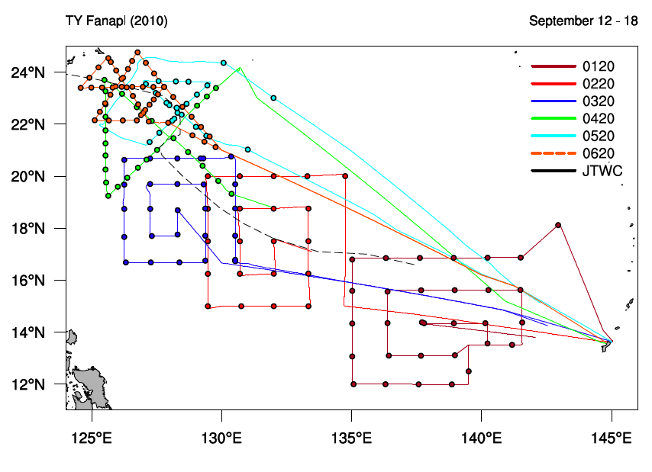
All things Tropical Cyclone
Formation
TY Fanapi
Sequence of flights that square
spirals patterns to obtain optimal
Coverage to identify factors
related to TC formation
Role of:
Separate convection centers
Separate vortices
Midlevel versus low-level
circulations
Use of aircraft data for specification
of low-level thermodynamic
conditions
Model and satellite-based studies
the formation of TY Fanapi

Slide 2
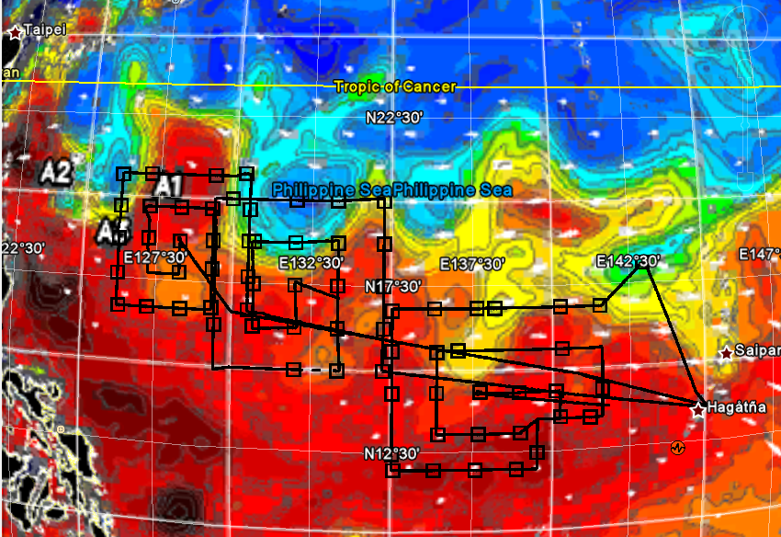
Pre-Fanapi AXBTs

Slide 3
Focus on Fanapi: vertical alignment after 3 days, developing from the surface upward.
Surface 14 Sept, 2010
Surface 13 Sept, 2010
Surface 12 Sept, 2010
5.FANAPI genesis over warm eddy
3.Sfc vortex develops over warm/cold eddies
1.Wave growth over deep D26
700 MB 13 Sept, 2010
700 MB 12 Sept, 2010
6.Vertical development established
4.Slow vertical development
2.Weak wave vertical consistency

Slide 4
Surface 14 Sept, 2010
Day 2: Slow surface spin-up (depression
stage) with half circulation over cold
eddy, half over warm eddy
Surface 13 Sept, 2010
14
Day 1: Open wave, enhanced
winds/surface flux in deep tropics
over high heat content ocean.
13
Surface 12 Sept, 2010
14
5.FANAPI genesis over warm eddy
13
Day 3: Typhoon stage: formation,
with slowing of storm speed over
warm eddy, W1.
13
12
3.Sfc vortex develops over warm/cold eddies
Surface processes key in Fanapi formation
Development is bottom-up
Result is formation process highly dependent
on ocean eddy pattern.
12
1.Wave growth over deep D26

Slide 5
TC Intensification
Relative roles of
Vertical wind shear
Upper-level environment and outflow
Ocean characteristics
TC intensity
Validation of satellite-based, automated TC intensity estimates
Comparison with manual TC intensity estimates
All things Tropical Cyclone

Slide 6
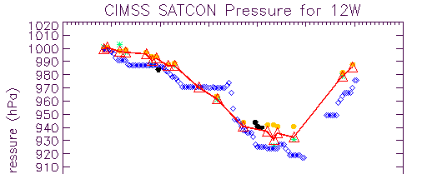
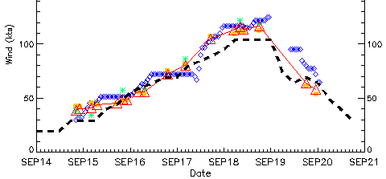
Fanapi Intensity Change
Aircraft
SATCON
ADT
Cold Eddies
Warm Eddy W1
Taiwan Landfall
Cold Wake Formation
Formation:
14 Sept, 1800 UTC
Intensification at moderate rate
to CAT3:
25 kt/day (RI: ≥ 31 kt/day)
30 mb/day
‘Cold Wake’ formation:
16 Sept, 1200 UTC – 18 Sept, 1800 UTC
Landfall:
19 Sept, 0000 UTC
CAT 4
CAT 3
CAT 2
CAT 1
C1
C2
Flights
Typhoon Fanapi formed a ‘cold wake’ after reaching CAT 1 intensity lasting until crossing the
Kuroshio prior to landfall
Little impact of cold eddies or ‘cold wake’on Fanapi intensification rate. Different from Jangmi08.
WHY?

