Slide 1
Luca Centurioni and Jan Morzel ITOP workshop Kaohsiung 26-29 March 2012

Slide 6
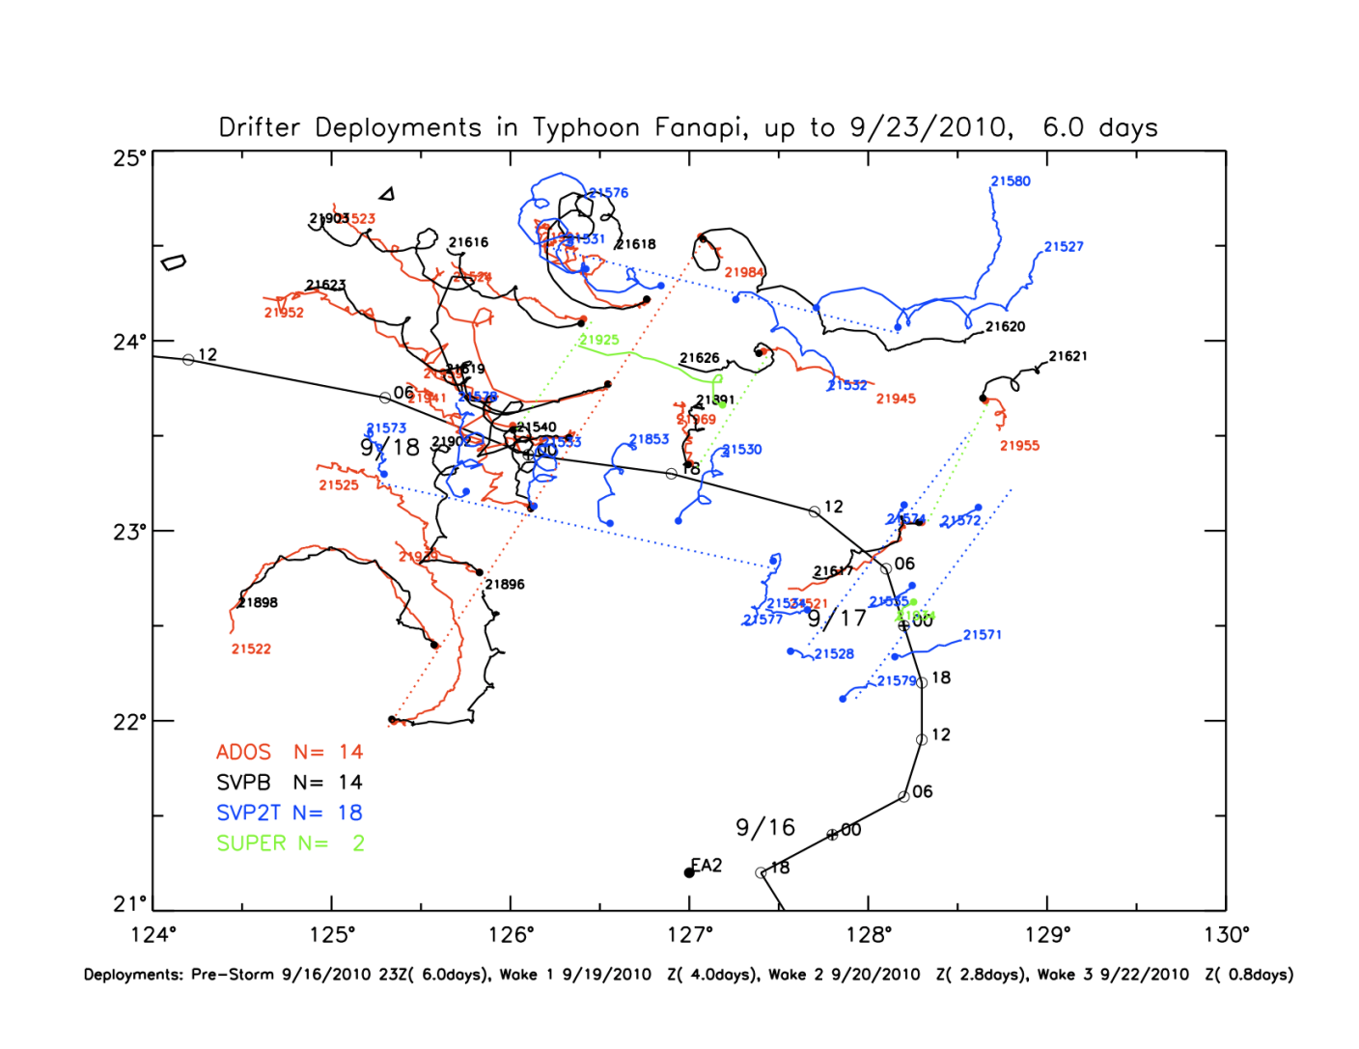

Slide 11
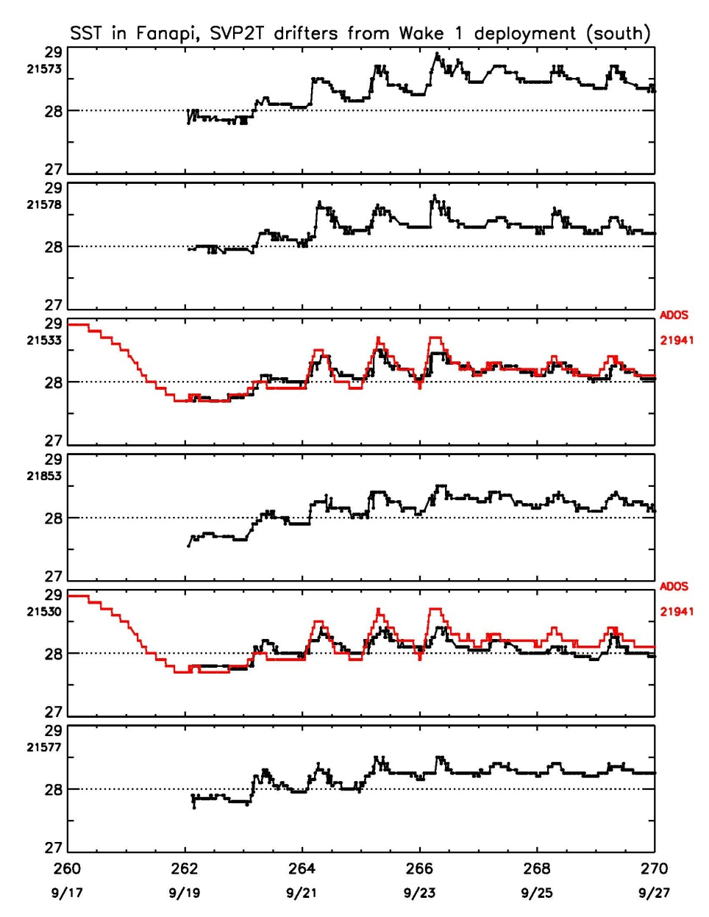
Spatial Coherence of the Wake (first 3-4 days)

