Slide 1
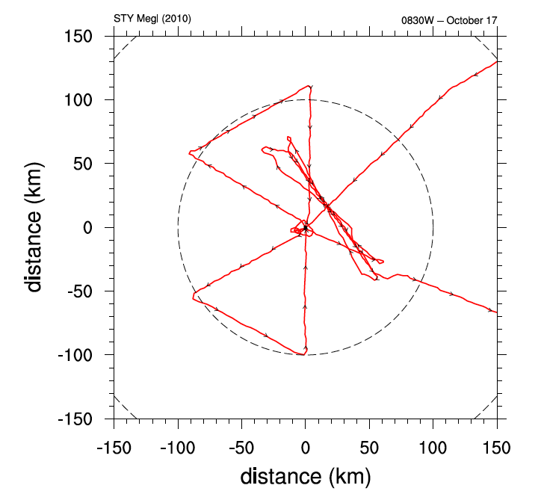
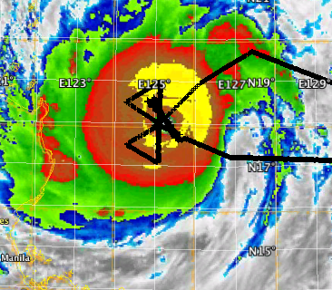
Working Group on Tropical Cyclone Structure: Initial Results Unique to ITOP
Observations of fine-scale, inner-core structures in a small, intense tropical cyclone
Unique sampling strategy that deployed dropwindsondes in pairs to examine relative flow characteristics
Unique combination of dropwindsonde-AXBT deployments
Unique use of SAR imagery
Unique use of nearby buoy measurements
WC-130J storm-relative flight track: Flight 0830 TY Megi 0651-1840 UTC 17 October
Enhanced IR MTSAT 1130 UTC 17 October

Slide 2
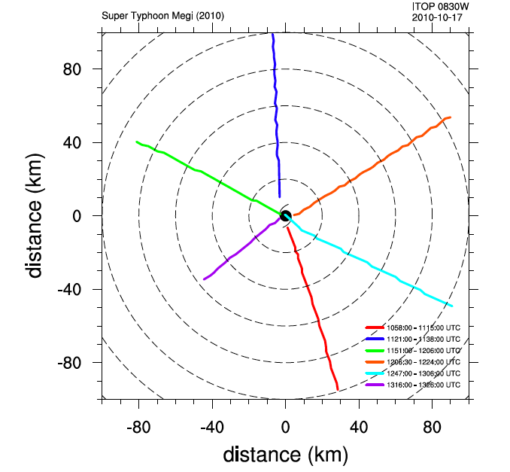
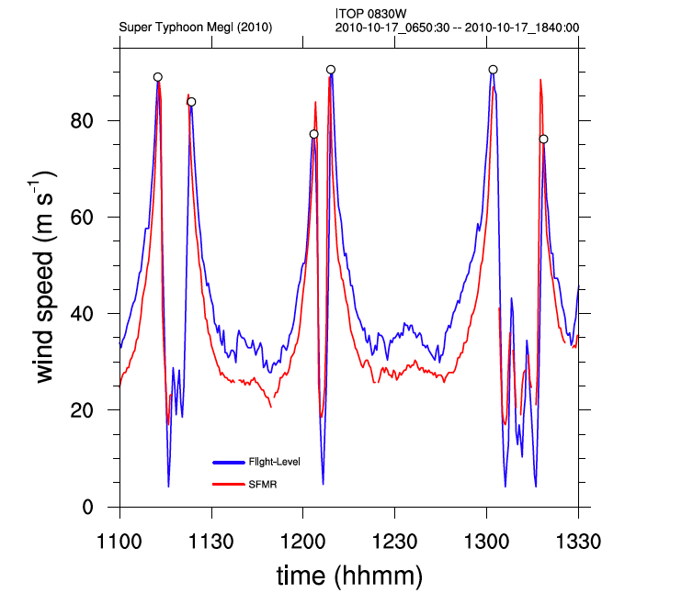
Implications for:
Inner-core processes related to changes in intensification
recycling of inner-eye air
super intensity
Examination of factors related to maximum potential intensity
Boundary layer characteristics and processes
TY Megi: Flight 0830: storm relative radial
flight legs
TY Megi: Flight 0830: flight-level an SFMR-based surface winds for three eye penetrations

Slide 3
New Features in Extreme Wind Boundary Layer
Inflow Layer
Mixed Layer
Wind Max
Constant Radial Wind
Constant Wind Speed
IN
OUT
Black- TC right semicircle Red- TC left semicircle
Simultaneous sonde pair launches reveal strong/weak shear couplets: mesoscale influence
Constant Wind Layer (30 m) violates ‘log’ law: air/water (spray) slurry may act as no-slip layer
Wind max (210 m) below top of mixed layer (250 m) in contrast to reverse at larger radii
Shallow inflow layer (600 m)

Slide 4
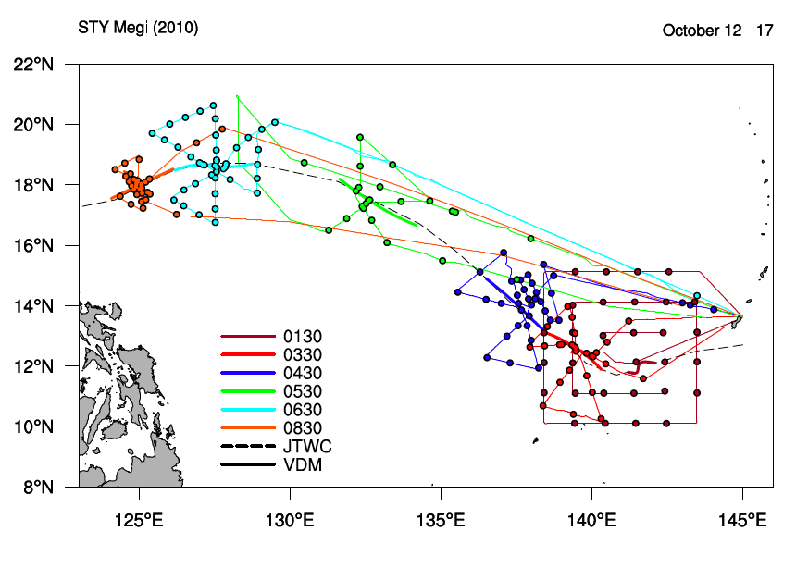
TY Megi: All WC-130J Flights

Slide 5
ITOP: Tropical Cyclone Structure
Examination of the bulk approach to surface flux estimates over a wide variety of atmosphere, ocean, and tropical cyclone conditions:
TY Megi
Very intense, small tropical cyclone
Philippine Sea with uniform, deep mixed layer and high SSTs
TY Fanapi
Average intensity and size
Track along southern periphery of the subtropical anticyclone and southern eddy zone
TY Malakas
Weaker intensity, large size
Track poleward through the southern eddy zone

Slide 6
ITOP: Tropical Cyclone Structure
Examination of the role of the cold wake in tropical cyclone structure and intensity change
Modification of the boundary layer stability profile
Enhanced inflow
Impact on inner-core convection
Validation and examination of surface winds defined via derivation from satellite-based SAR measurements
Identify fine-scale storm structures
Use to define analyzed wind fields and model initialization
TY Megi in the context of
Maximum potential intensity relative to
La Nina
Large-scale, low- and upper-level atmospheric conditions over the western North Pacific
Storm Size

