Slide 1



ITOP Remote Sensing Overview
Hans C. Graber
CSTARS – University of Miami
Contributors: C. Wackerman (GDAIS), M. Caruso (UM/CSTARS), J. Horstmann (NURC), R. Foster (UW/APL), R. Romeiser (UM/CSTARS), V. Cardone (Oceanweather), I-I Lin (NTU), L. Centurioni (Scripps)
2nd ITOP Workshop, Kaohsiung, Taiwan. 25 – 28 March 2012

Slide 2
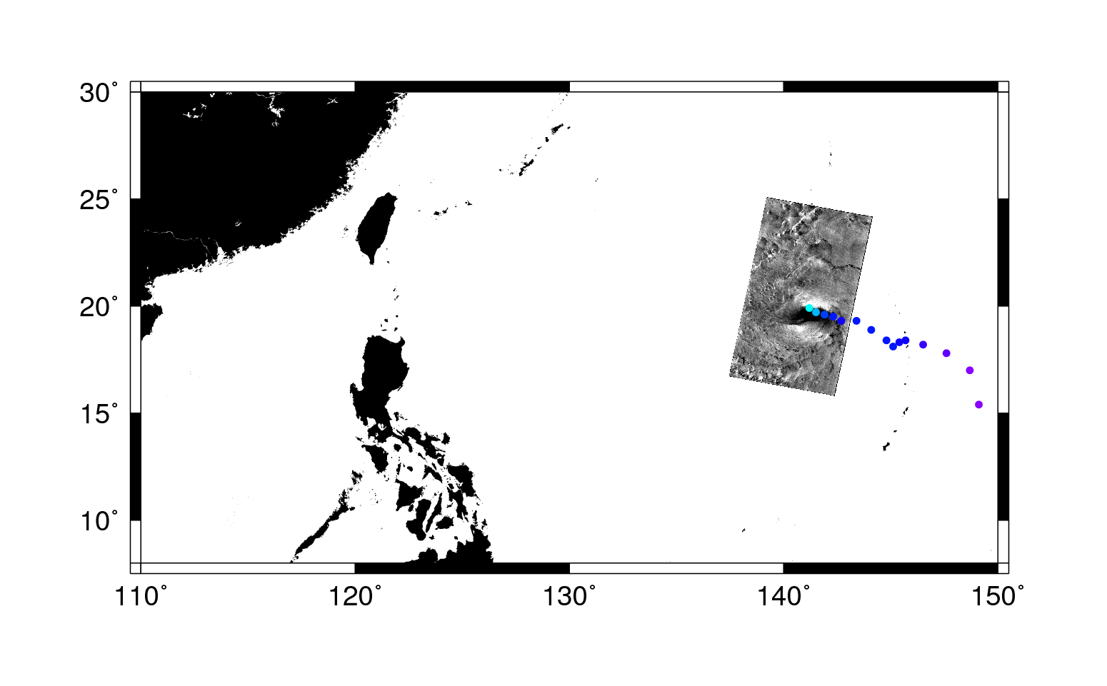
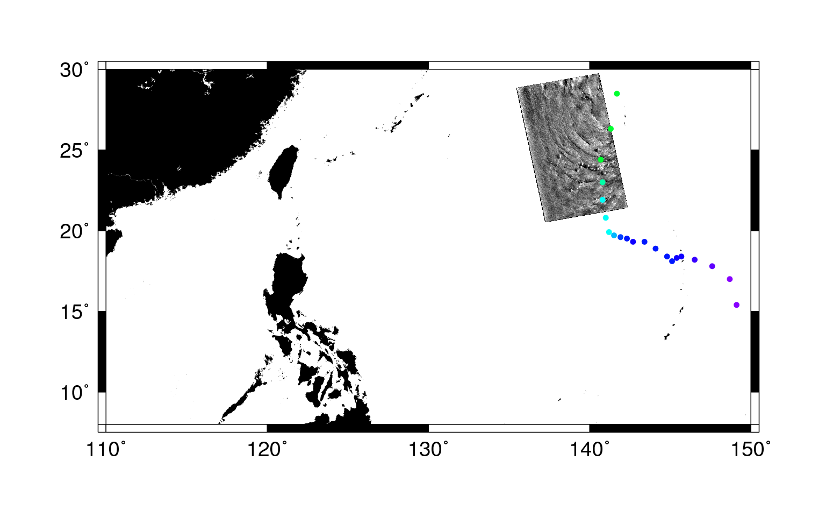

Typhoon Malakas Collections
Sep 24, 2010
08:49 GMT
Sep 22, 2010
20:29 GMT

Slide 3
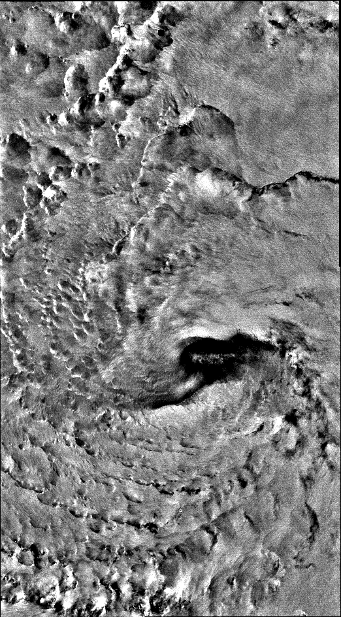
Typhoon Malakas
Raw SAR image
Radarsat-2
Sep 22, 2010, 20:29 UTC
HH/HV
Eye hit
Malakas 9/22/10

Slide 4
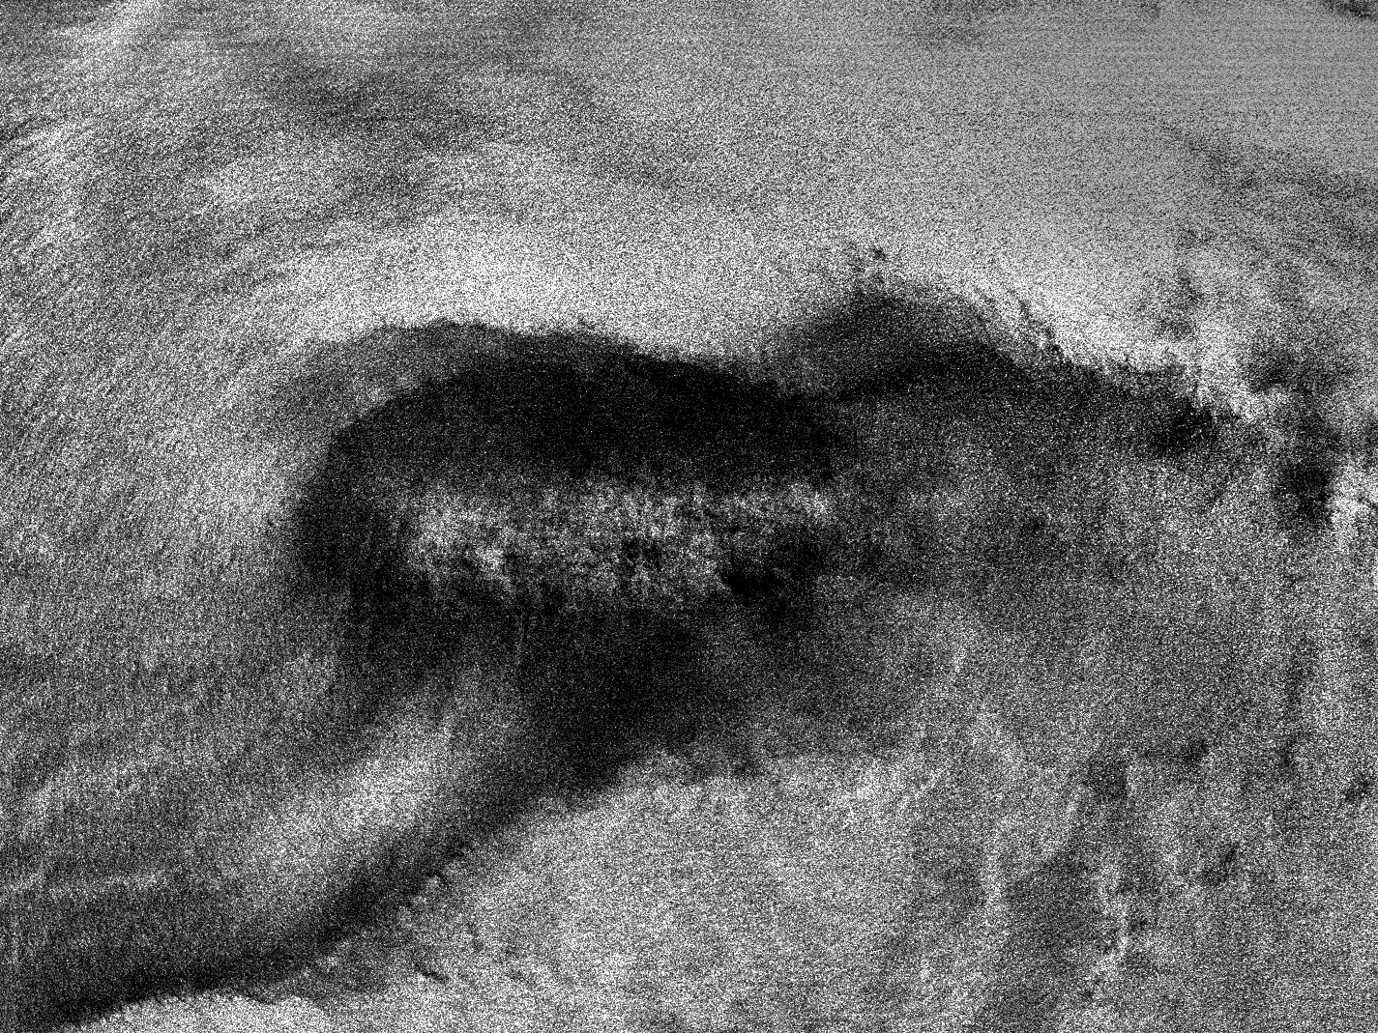
Eye of Typhoon Malakas
Major Axis: 205 km
Minor Axis: 80.6 km
Azimuth: 92.4°
160.35 km
213.75 km

Slide 5
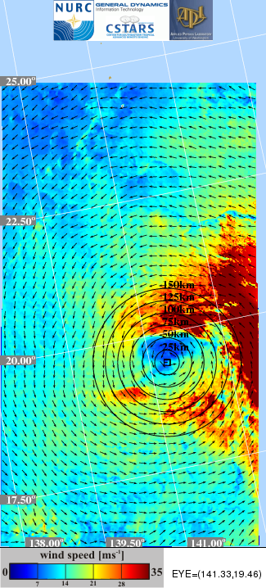
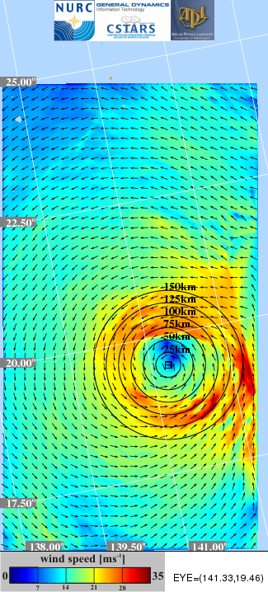
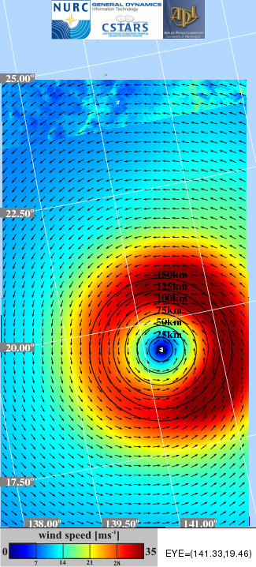
Typhoon Malakas Wind Vectors
Merged Winds
SLP Winds
H*Winds

Slide 6
Typhoon Malakas
Distance Between Aircraft and Splash (km)
Black = C130, Red = SAR-Derived,
Dots are dropsondes; color is distance (km) between aircraft and splash.
From SAR Winds

Slide 7
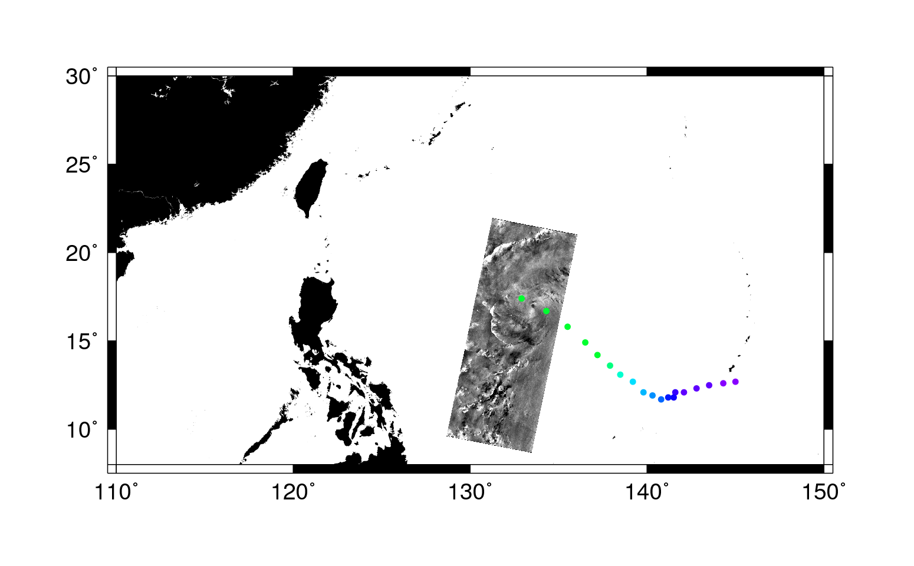
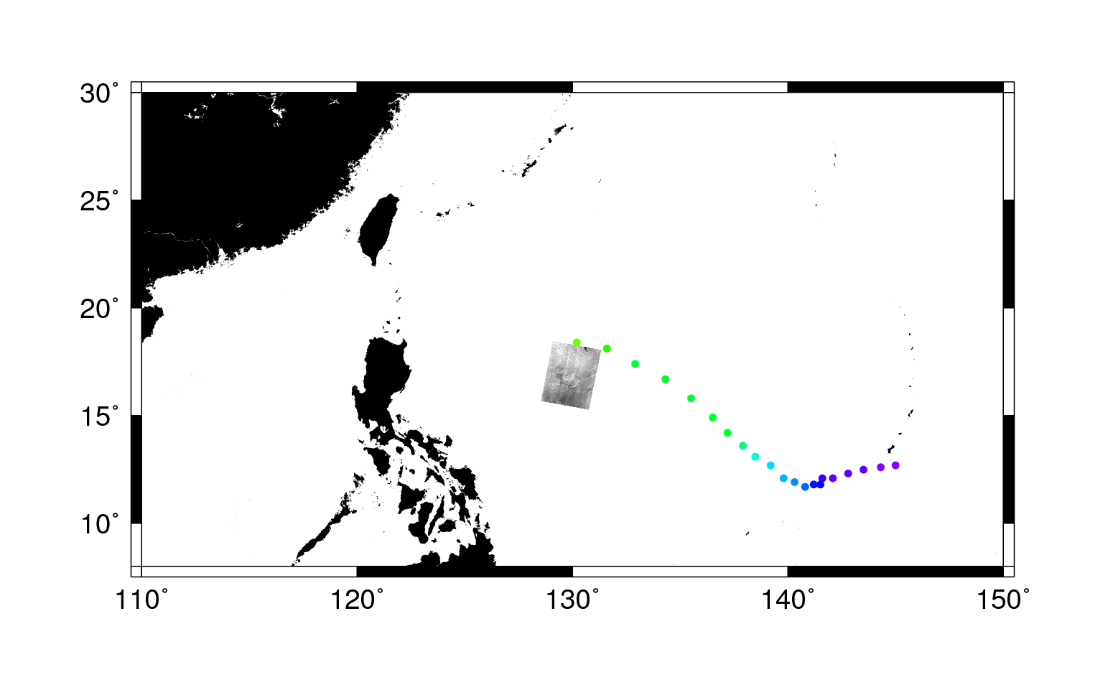
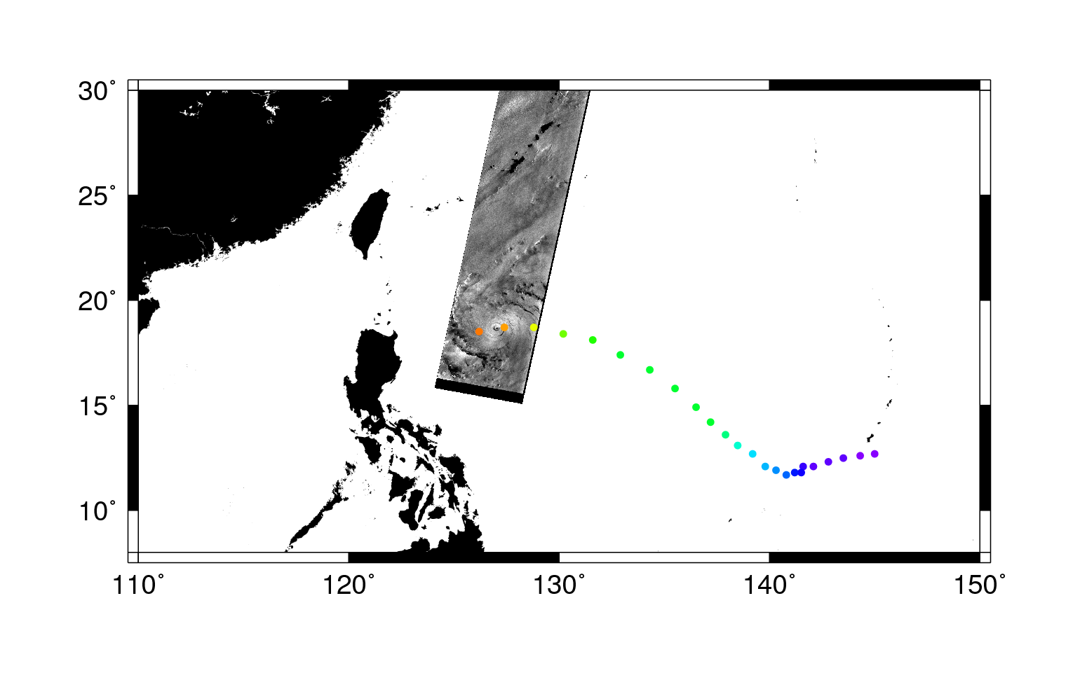
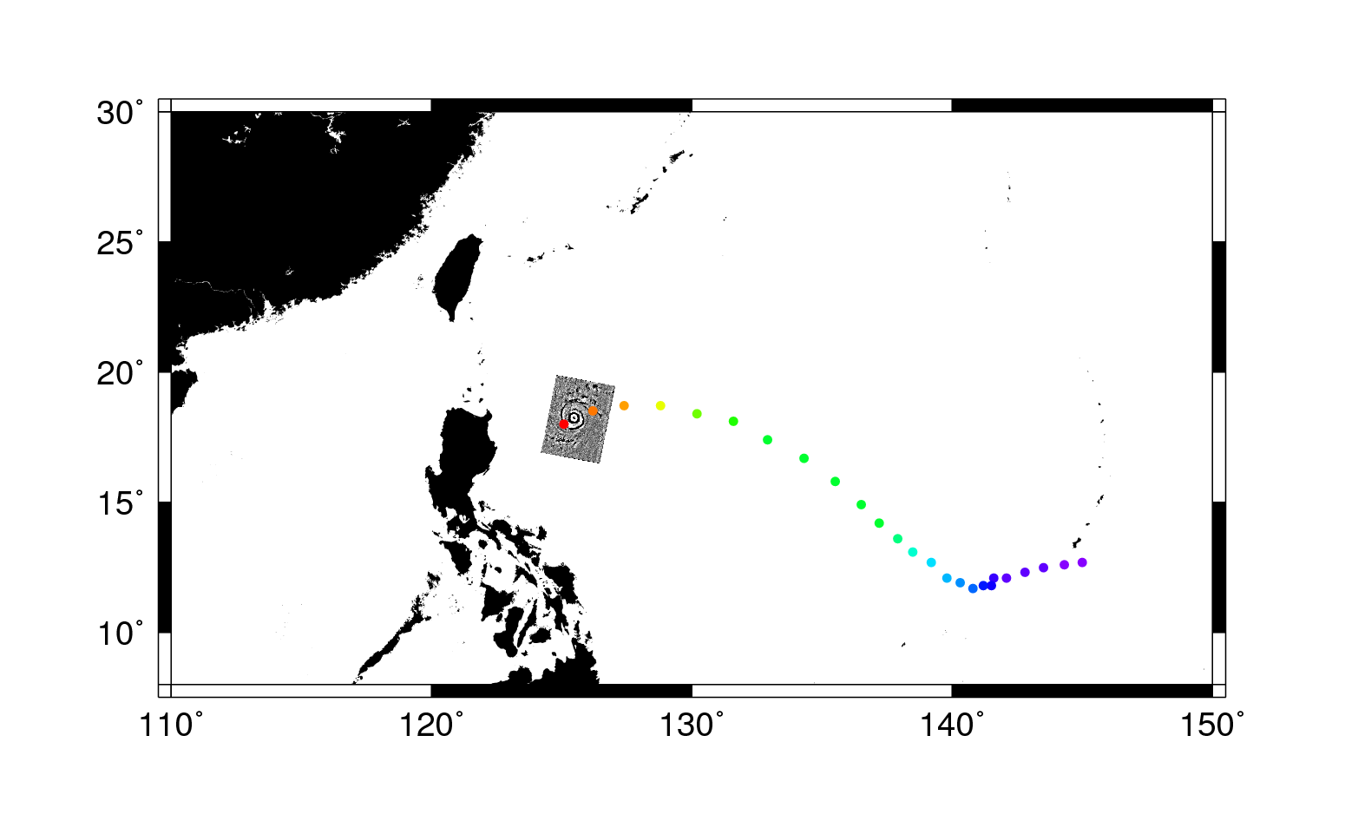
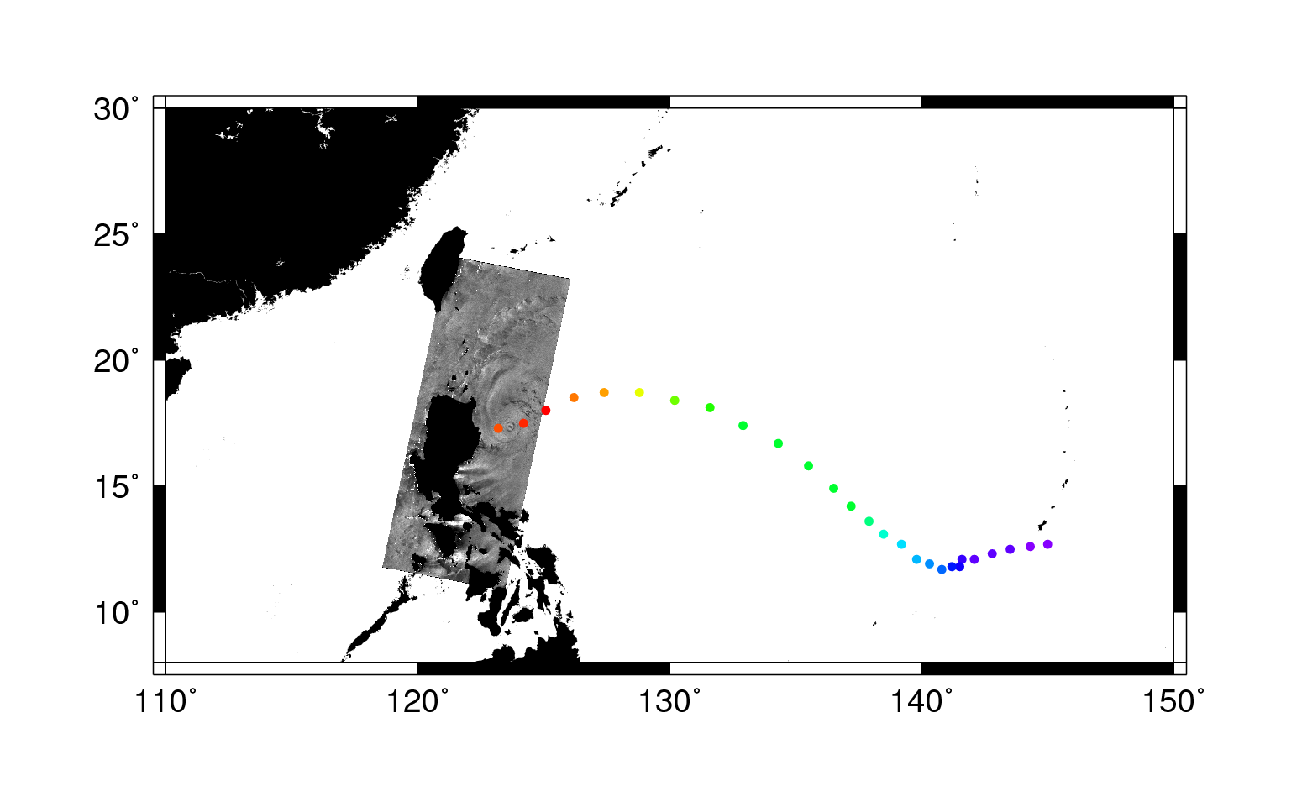
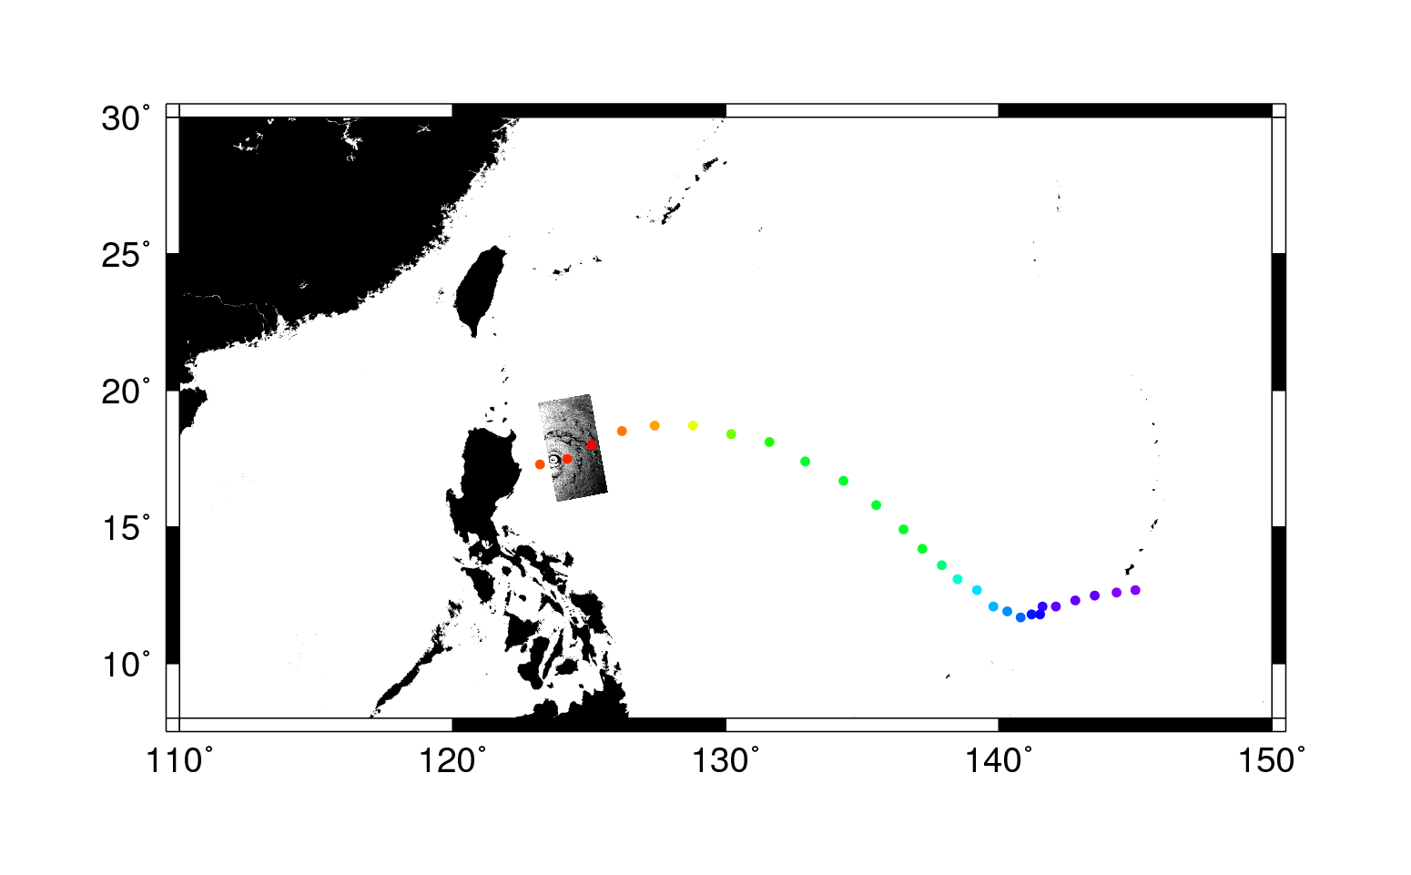
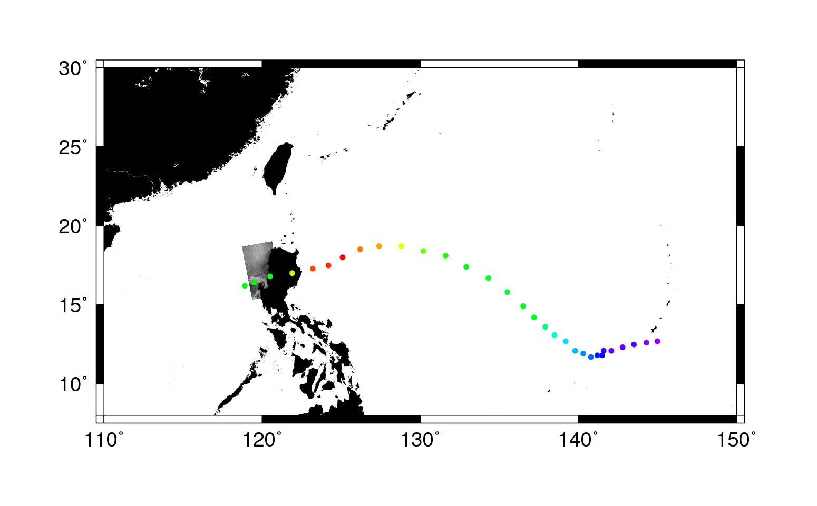


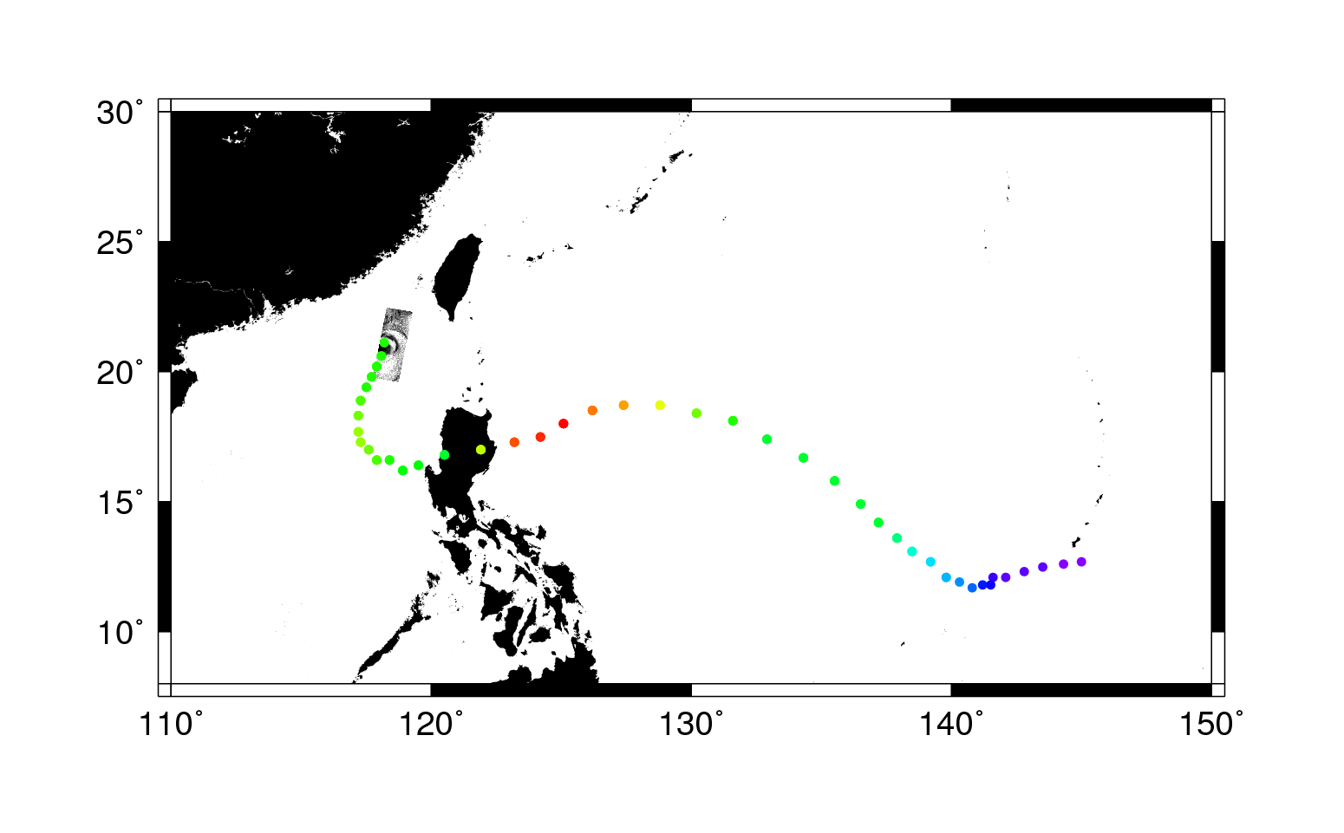



Typhoon Megi Collection Sequence
Radarsat-2 Oct 15 21:00
Cosmo/Skymed-3 Oct 16 09:17
Envisat Oct 17 01:27
Cosmo/Skymed-3 Oct 17 09:35
Radarsat-2 Oct 17 21:41
Cosmo/Skymed-3 Oct 17 21:53
Cosmo/Skymed-3 Oct 18 20:12
Cosmo/Skymed-1 Oct 19 09:41
Cosmo/Skymed-3 Oct 19 22:30
TerraSAR-X Oct 21 22:05
Radarsat-2 Oct 15 21:00
Cosmo/Skymed-3 Oct 16 09:17
Envisat Oct 17 01:27
Cosmo/Skymed-3 Oct 17 09:35
Radarsat-2 Oct 17 21:41
Cosmo/Skymed-3 Oct 17 21:53
Cosmo/Skymed-3 Oct 18 20:12
Cosmo/Skymed-1 Oct 19 09:41
Radarsat-2 Oct 15 21:00
Cosmo/Skymed-3 Oct 16 09:17
Envisat Oct 17 01:27
Cosmo/Skymed-3 Oct 17 09:35
Radarsat-2 Oct 17 21:41
Cosmo/Skymed-3 Oct 17 21:53
Cosmo/Skymed-3 Oct 18 20:12
Radarsat-2 Oct 15 21:00
Cosmo/Skymed-3 Oct 16 09:17
Envisat Oct 17 01:27
Cosmo/Skymed-3 Oct 17 09:35
Radarsat-2 Oct 17 21:41
Radarsat-2 Oct 15 21:00
Cosmo/Skymed-3 Oct 16 09:17
Envisat Oct 17 01:27
Radarsat-2 Oct 15 21:00
Radarsat-2 Oct 15 21:00
Cosmo/Skymed-3 Oct 16 09:17
Radarsat-2 Oct 15 21:00
Cosmo/Skymed-3 Oct 16 09:17
Envisat Oct 17 01:27
Cosmo/Skymed-3 Oct 17 09:35
Radarsat-2 Oct 15 21:00
Cosmo/Skymed-3 Oct 16 09:17
Envisat Oct 17 01:27
Cosmo/Skymed-3 Oct 17 09:35
Radarsat-2 Oct 17 21:41
Cosmo/Skymed-3 Oct 17 21:53
Radarsat-2 Oct 15 21:00
Cosmo/Skymed-3 Oct 16 09:17
Envisat Oct 17 01:27
Cosmo/Skymed-3 Oct 17 09:35
Radarsat-2 Oct 17 21:41
Cosmo/Skymed-3 Oct 17 21:53
Cosmo/Skymed-3 Oct 18 20:12
Cosmo/Skymed-1 Oct 19 09:41
Cosmo/Skymed-3 Oct 19 22:30

Slide 8
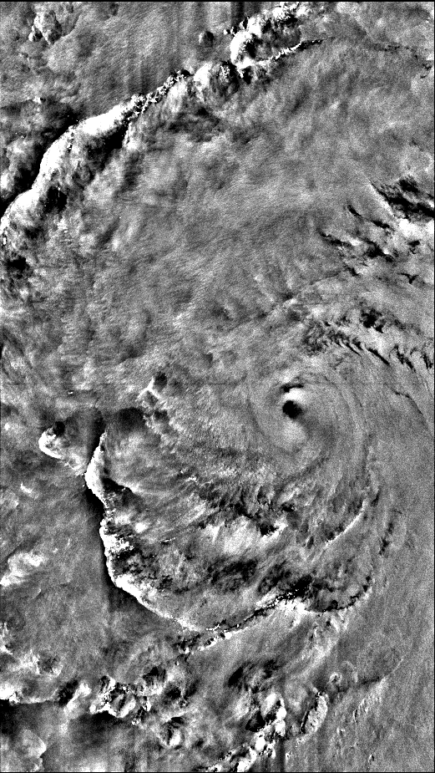
Typhoon Megi
Raw SAR image
Radarsat-2
Oct 15, 2010 21:00 UTC
VV
Eye hit
Megi 15 Oct 2010

Slide 9
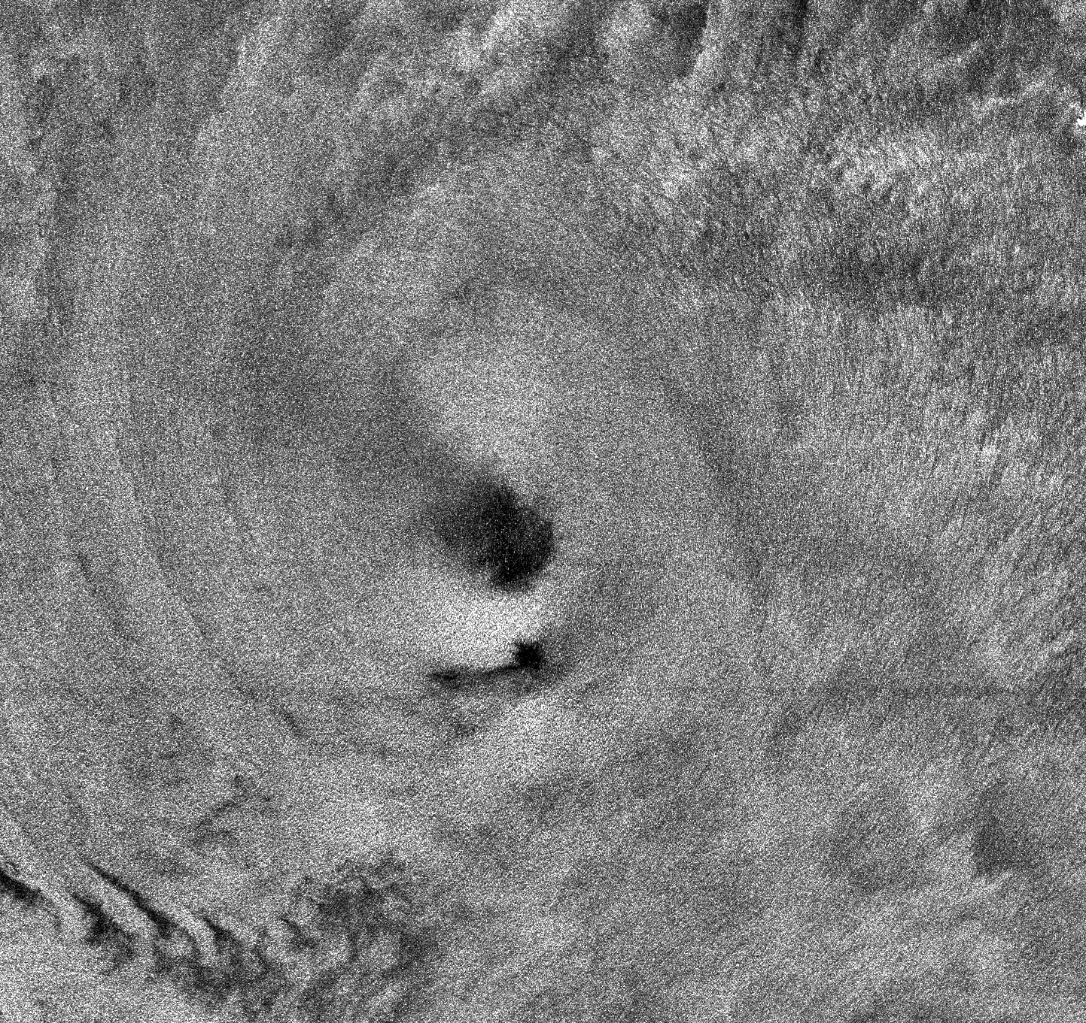
Eye of Typhoon Megi
216.45 km
Major Axis: 25.6 km
Minor Axis: 18.8 km
Azimuth: -34.1°
204.15 km

Slide 10
Typhoon Megi Wind Vectors
H*Winds

Slide 11
SAR Wind Comparisons
5km jitter
1.0/1.2
5km jitter
1.0/1.2
RMSE = 4.9 m/s
RMSE = 5.7 m/s
5km jitter
1.0/1.2
5km jitter
1.0/1.2
RMSE = 3.8 m/s
RMSE = 3.7 m/s
HH
VV

Slide 12
SAR Wind Comparisons along SFMR Tracks
5km jitter/1.2
5km jitter
1.2/1.2
RMSE = 5.7 m/s
RMSE = 4.9 m/s
5km jitter/1.2
5km jitter
1.2/1.2
RMSE = 3.7 m/s
RMSE = 3.8 m/s

Slide 13
Typhoon Megi
Distance Between Aircraft and Splash (km)
Black = C130, Red = SAR-Derived,
Dots are dropsondes; color is distance (km) between aircraft and splash.
From SAR Winds

Slide 14
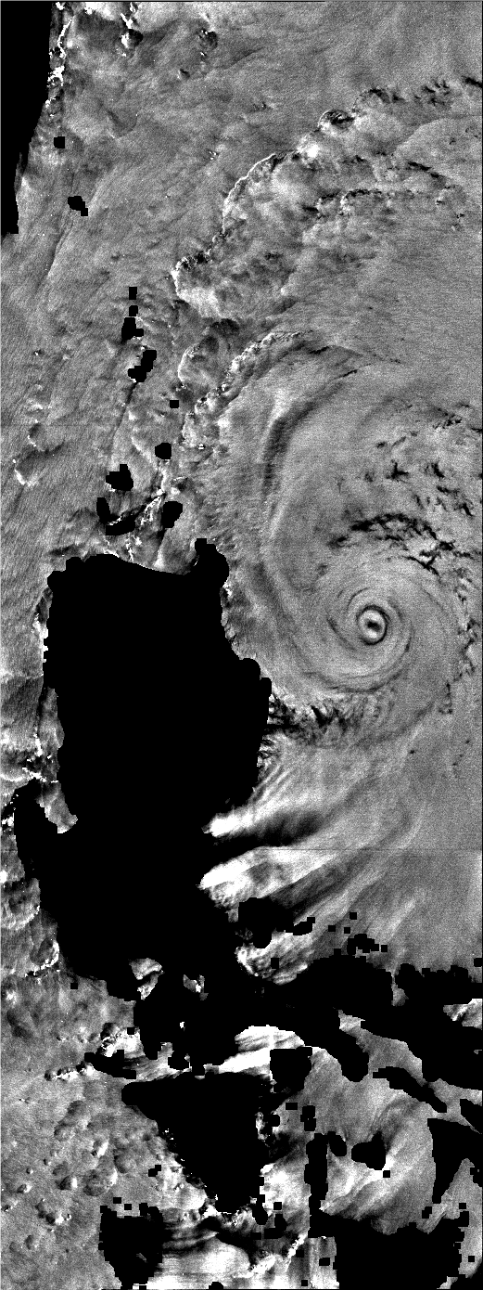
Typhoon Megi
Raw SAR image
Radarsat-2
Oct 17, 2010 21:41 UTC
VV
Eye hit
Megi 17 Oct 2010

Slide 15
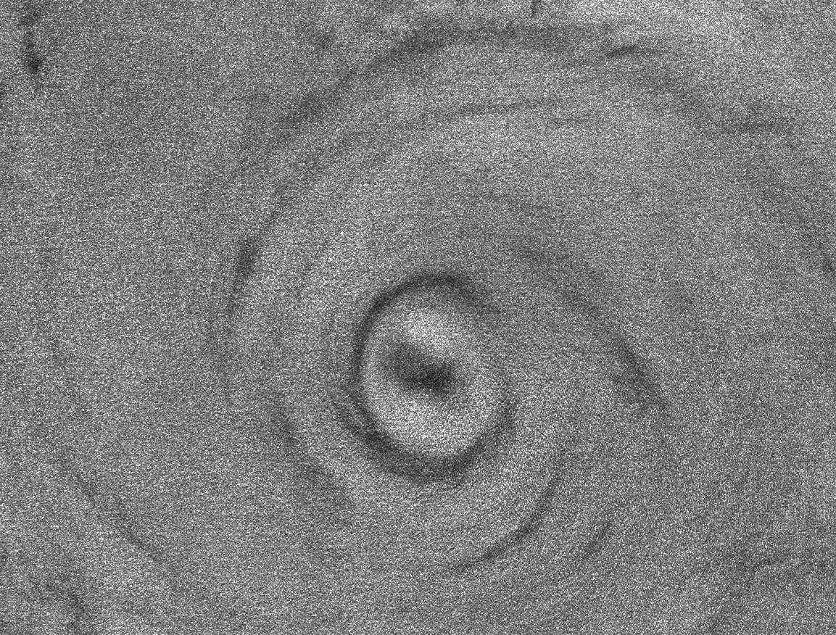
Eye of Typhoon Megi
172.96 km
Major Axis: 42.9/17.4 km
Minor Axis: 31.2/11.6 km
Azimuth: 6.8°/125.6°
131.40 km

Slide 16
Typhoon Megi Wind Vectors
H*Winds

Slide 17
Typhoon Megi
From SAR Winds

Slide 18
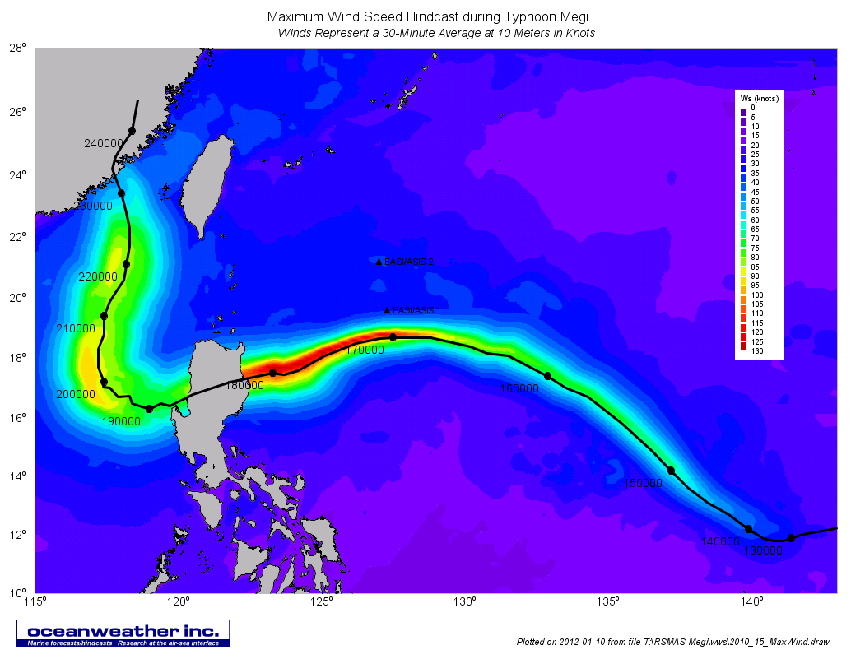

Slide 19
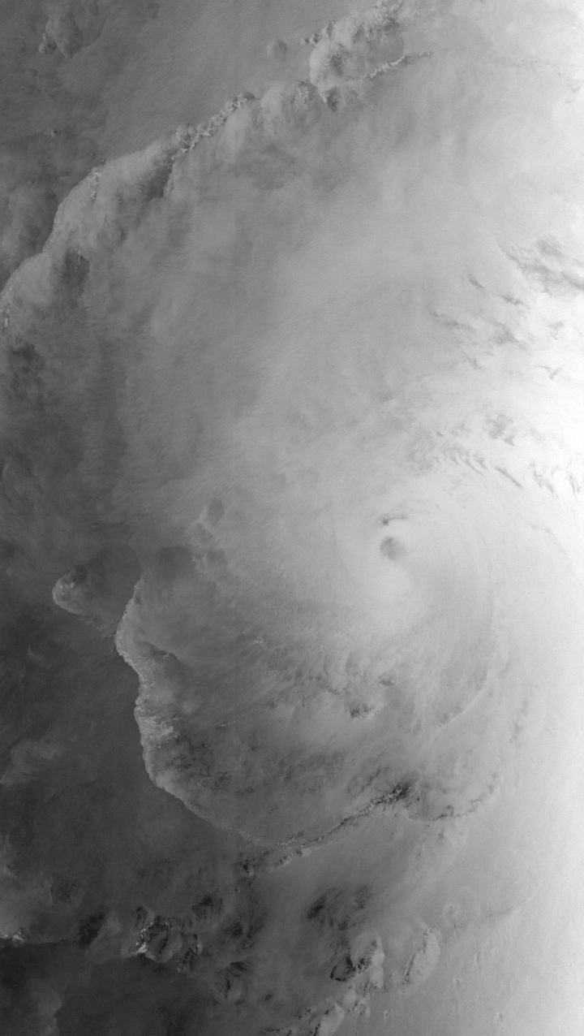
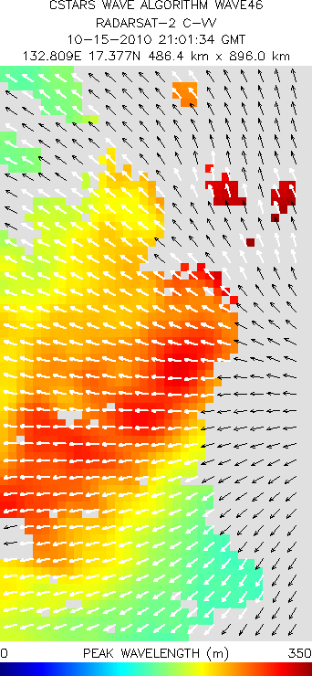
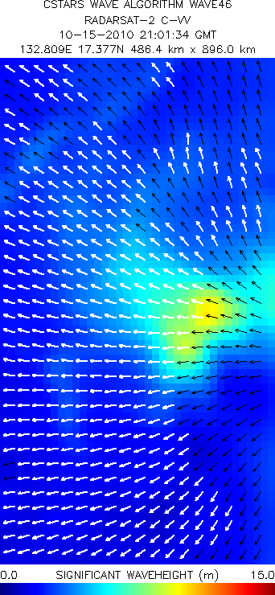
Typhoon Megi Waves
Megi, 15 Oct 2010 21:01 UTC

Slide 20
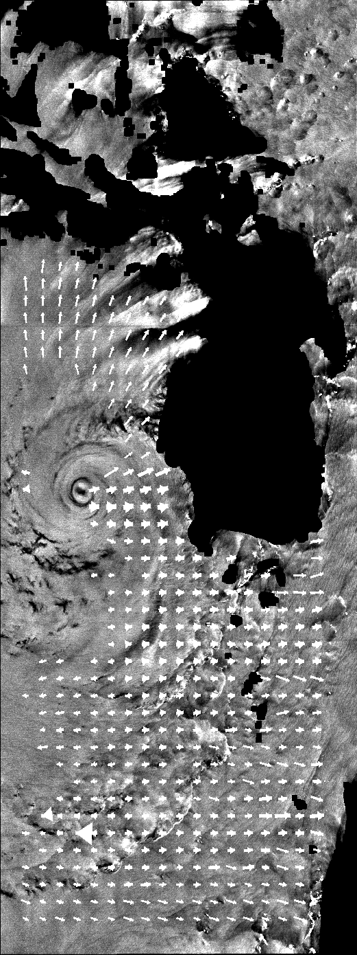
Megi 17 Model Fit Spectra
Typhoon Megi Waves
SAR = original SAR image spectrum
Model = using a model (modified JONSWAP spectrum for hurricanes) to extend SAR spectrum

Slide 21
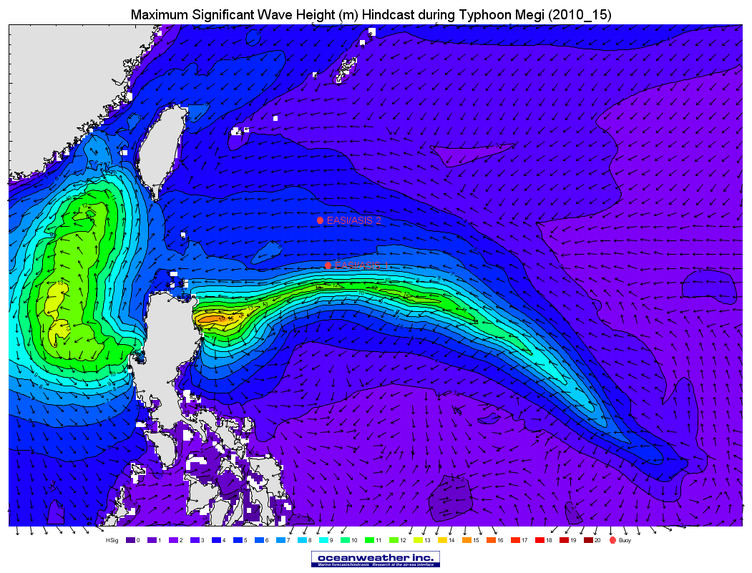

Slide 22
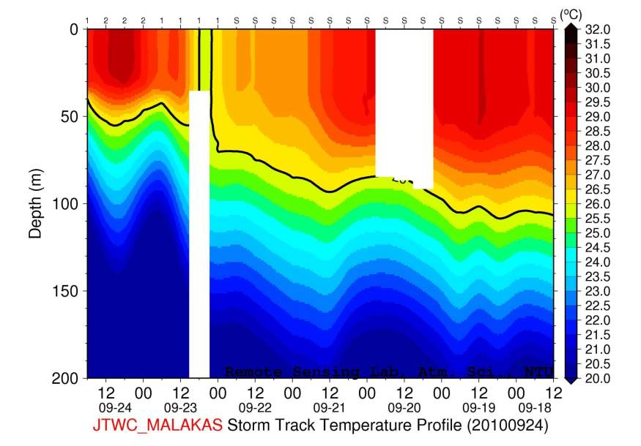
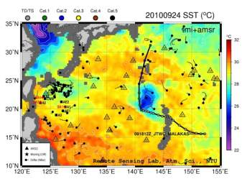
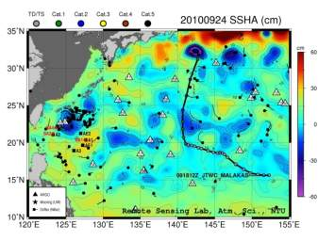
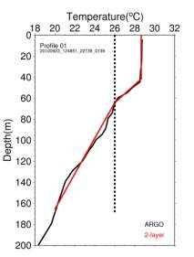
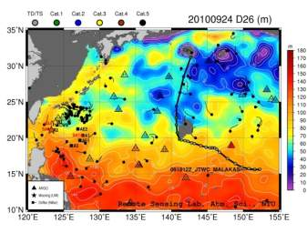
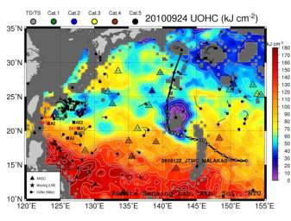
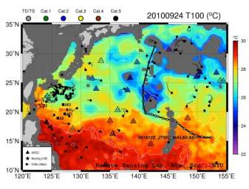
1. Daily satellite maps of SSHA, D26, T100, UOHC and Argo floats and satellite-derived profiles for IOP : contribute to flight planning, cruise’s cold wake synoptic info.
Satellite observations: SST and SSHA
2-layer-dervied products: D26, UOHC, and T100

Slide 23
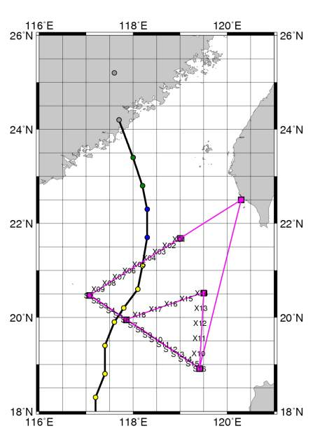
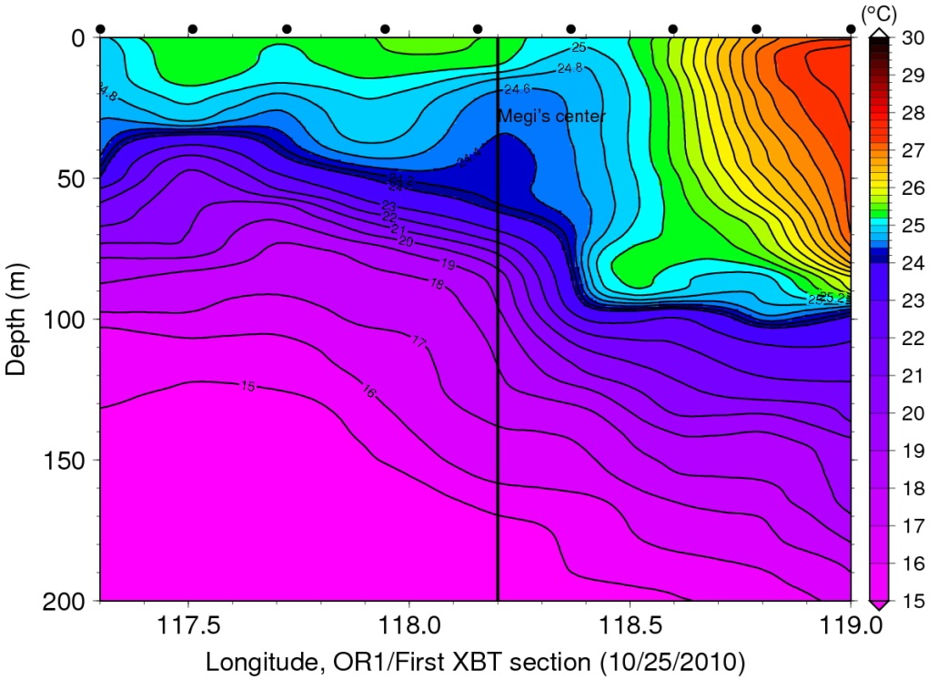
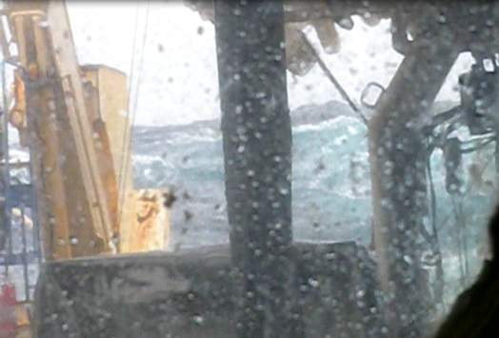
2. South China Sea cruise for Megi’s cold wake
x₀₉
x₀₁
Megi’s track
XBT transect
OR1’s planning path
Withdrew due to horrible sea state
On the deck of OR1 (from Tang’s group)

Slide 24
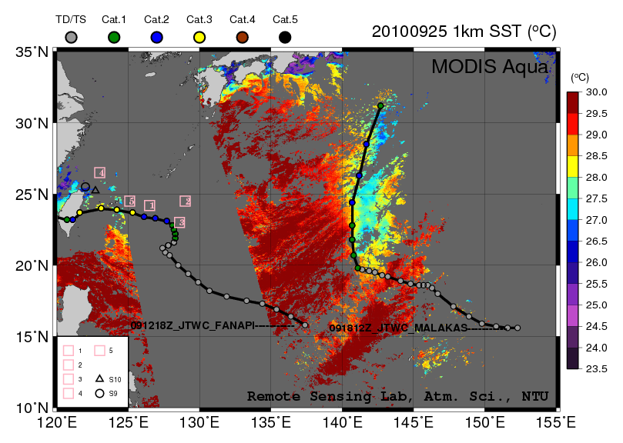
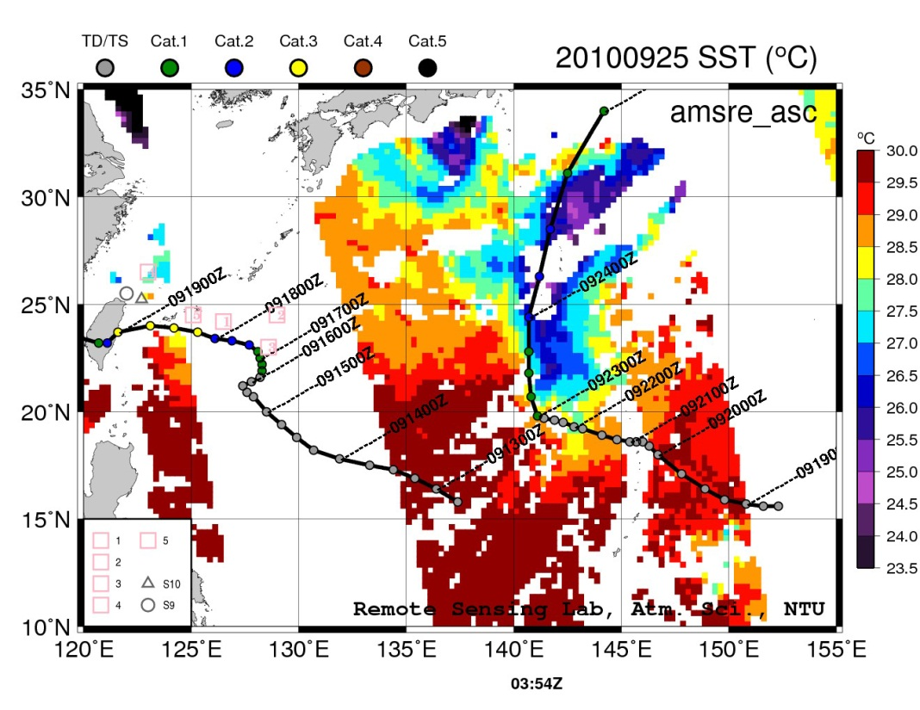
0535Z
3. Difference between microwave and IR SST over Malakas’ cold wake
Key point: large difference in IR SST (MODIS) and Microwave SST (AMSR-E)
of Malakas’ wake.
Left: MODIS SST acquired at 5Z 0925 shows much weaker cold wake as compared to the AMSR-E (right) cold wake acquire 1 hour earlier (4Z) on the same day. From the MODIS SST, the cold wake between 20-25N was around 27-27.5 ºC vs 26-26.5 ºC. For the area between 25-33N, the difference was even bigger. With MODIS SST of 26.5-27.5 ºC vs 24.5-26 ºC for AMSR-E.
* To be validated by ITOP in-situ measurements of Malakas

Slide 25
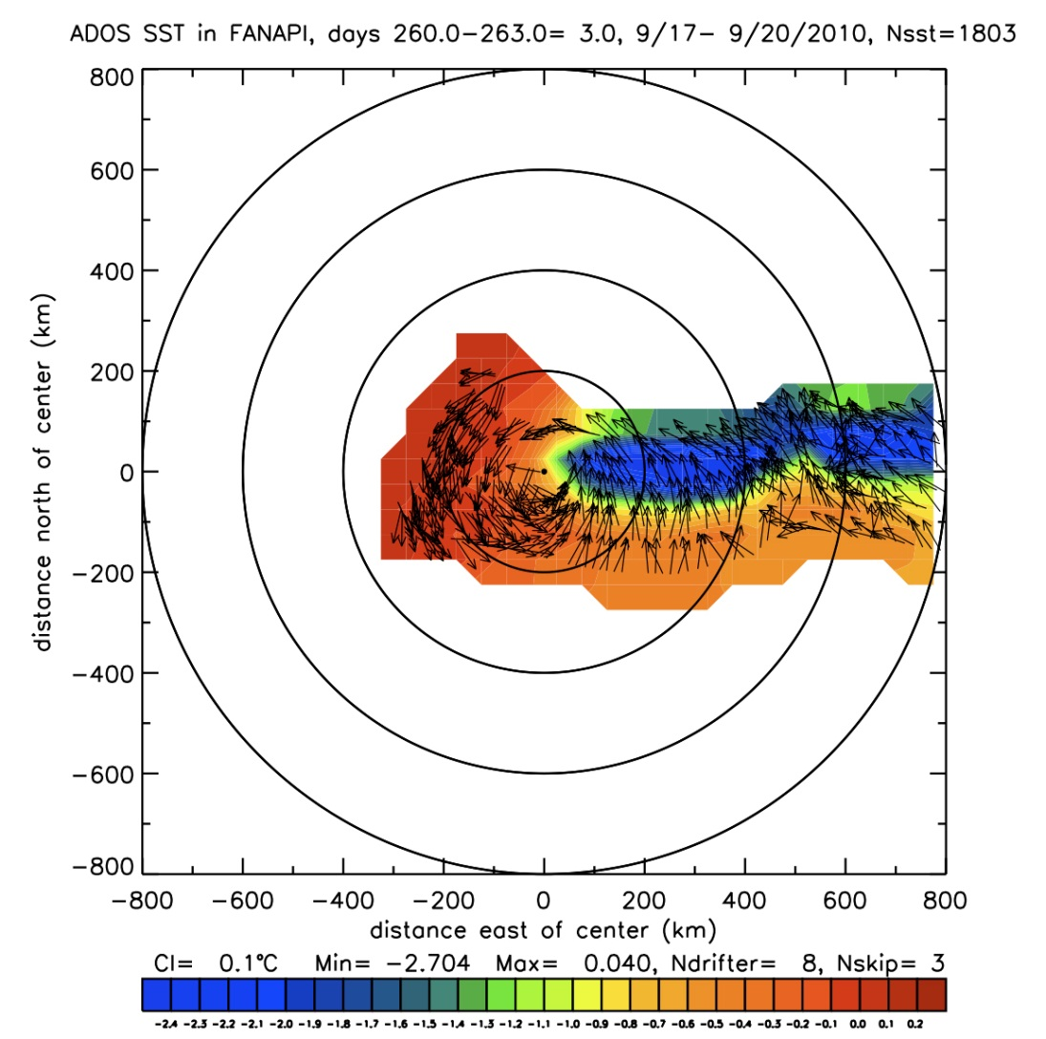
Cold Wake & Wind Observations from the ADOS Array
SST observations from 8 ADOS drifters deployed ahead of typhoon Fanapi on September 17, 2010.
SST changes during first 3 days after Fanapi passed over the ADOS drifters are shown.
The vectors represent wind directions. For clarity, only every third wind vector is plotted.
The data are plotted in storm co-ordinates, i.e. referred to the center of the storm.
The storm is advancing approximately from east to west.

Slide 26
Summary and Overview
Completed C-band SAR data analyses
Robust algorithm to produce realistic wind fields
More validation is needed for wave fields since only long waves (swell) can be derived from ScanSAR mode images
Sea level pressures from SAR winds compare well with Dropsonde and C-130 measurements
Progressing on X-band (Cosmo-SkyMed and TerraSAR-X) data
Cross-validation with nearly concurrent C-band results
Fusing Oceanweather wind and waves with SAR data
Comparison with EASI/ASIS data and SAR products

