Slide 1
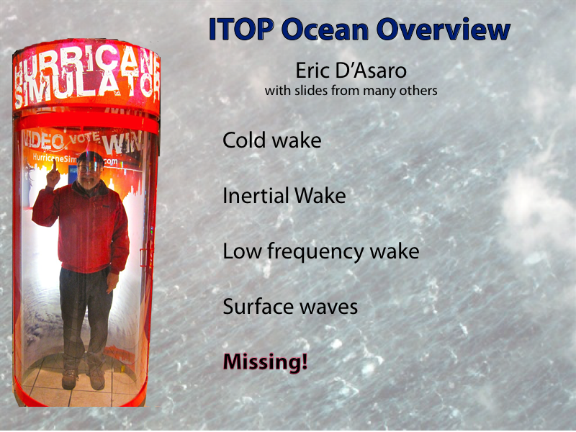

Slide 2
FANAPI Ocean Measurements
2 Moorings
72 AXBTs
7 EM-APEX
14 ADOS
4 Lagrangian Floats
26 SVP Drifters
3 SUPER drifters
3 weeks UCTD
9 Seagliders
uStructure – ship/glider
Notes:
Missing 2 Atlas moorings, the ASIS-EASI moorings, and the Lagrangian floats from this. Additional surface (and near surface) data from 26 SVP drifters, also not plotted.

Slide 3
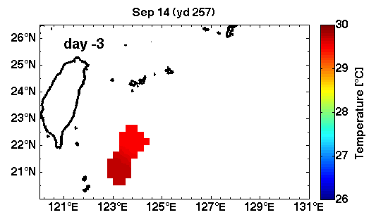
In Situ “SST” Movie (3 day mean)
Mrvaljevic
Notes:
Same as previous slide, but using 3 day window (Pete likes this one better).

Slide 4
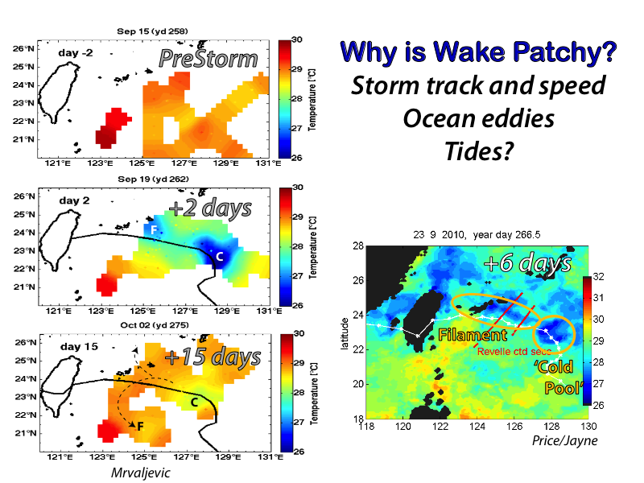

Slide 5
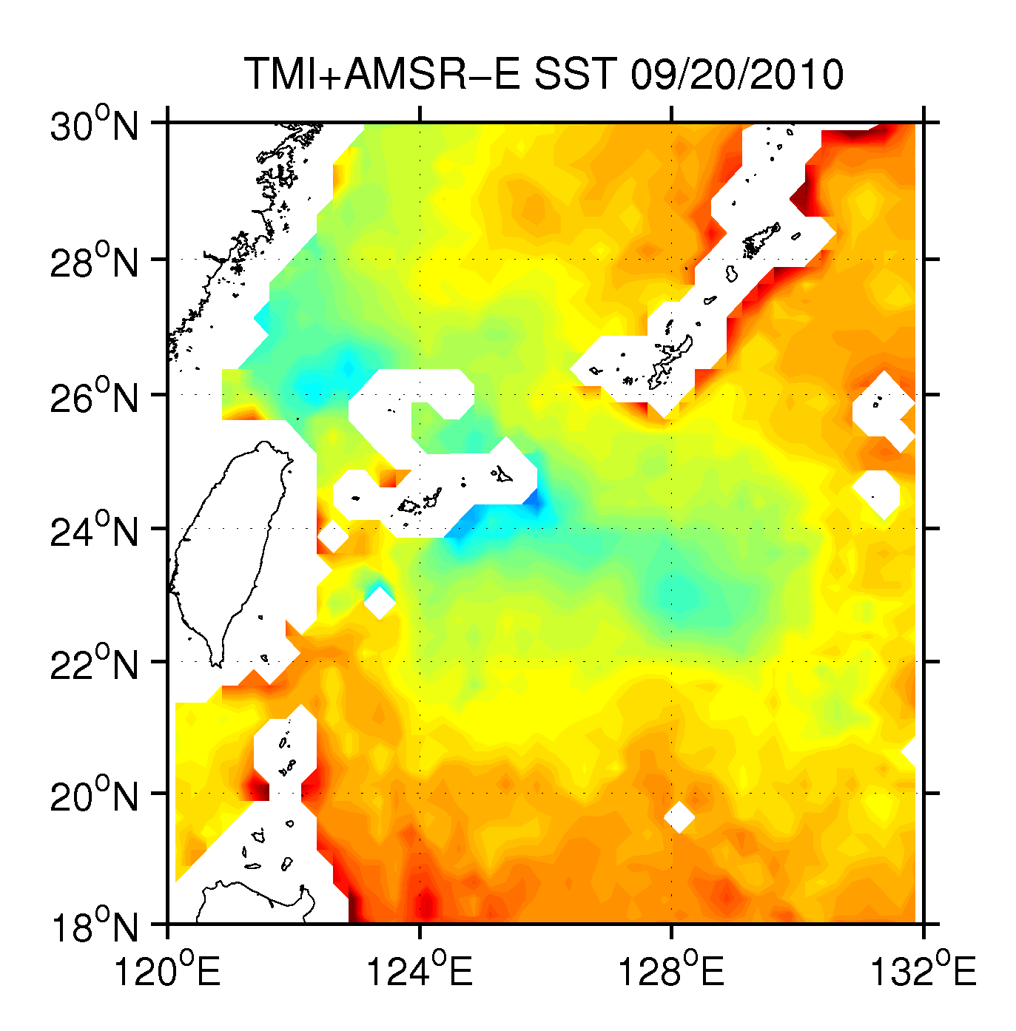
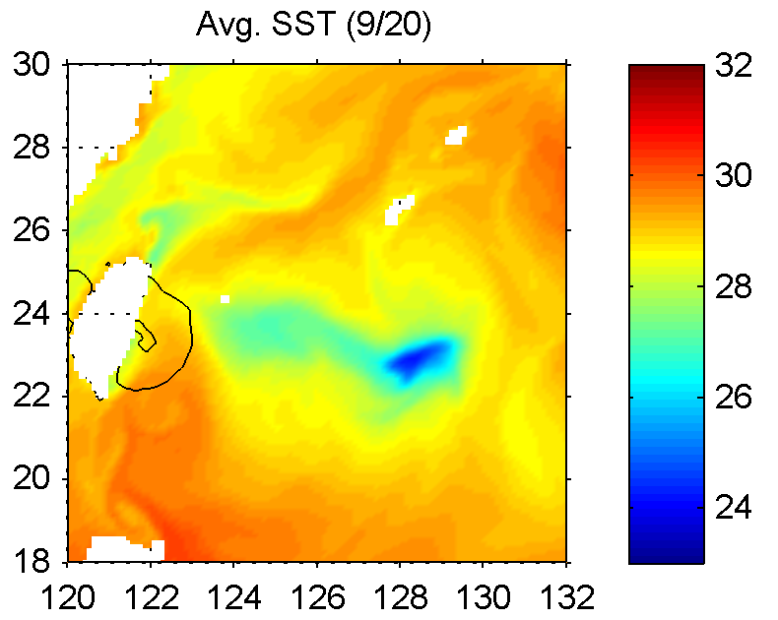
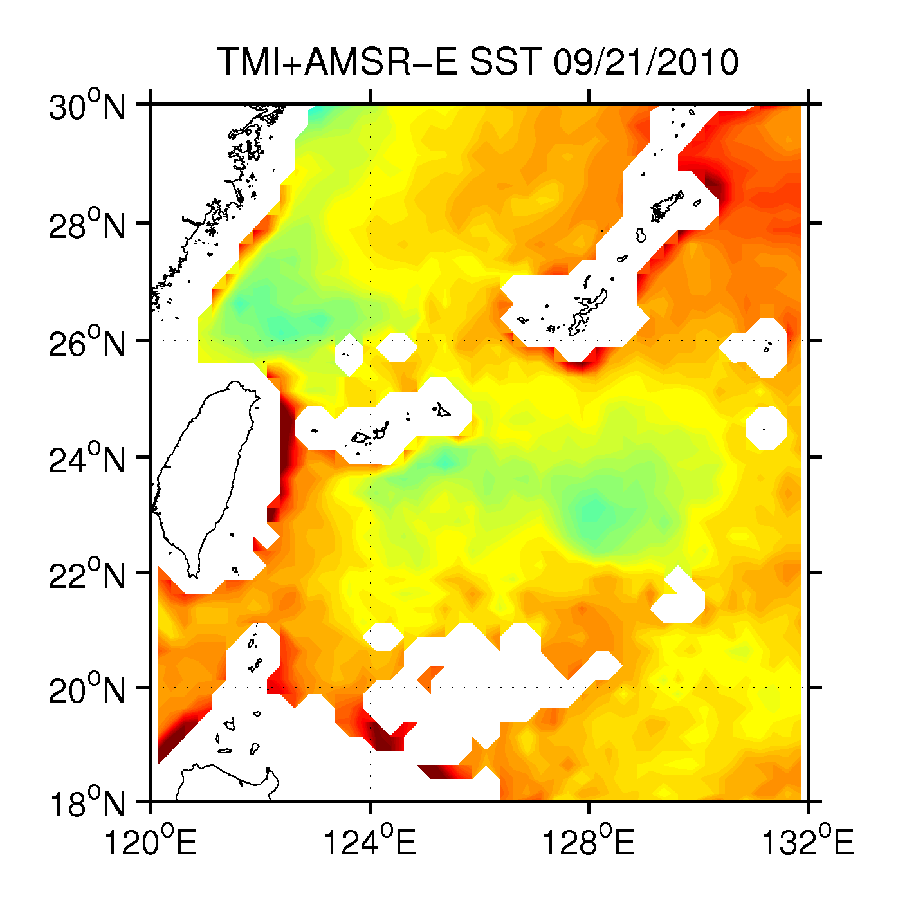
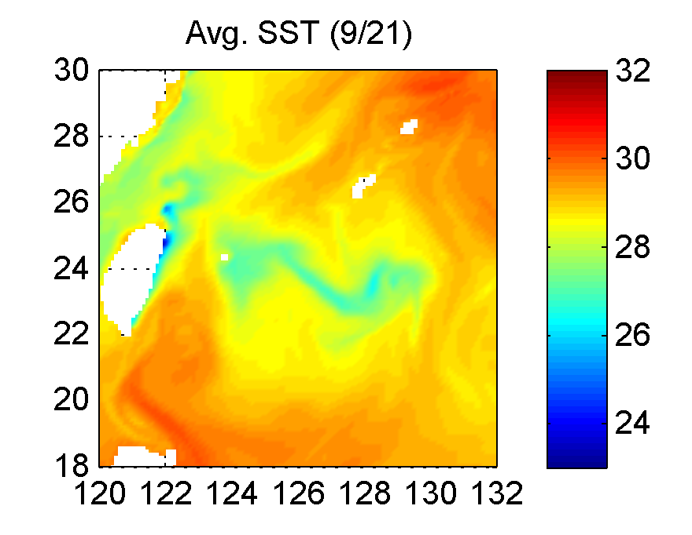
Comparison of Satellite and COAMPS SST
+3
+4
S. Wang
Sante Fe meeting
COAMPS’s cold wake area is similar to the satellite observation for 9/20-21
COAMPS maximum narrow cold anomaly recovered significantly after 3 days.

Slide 6
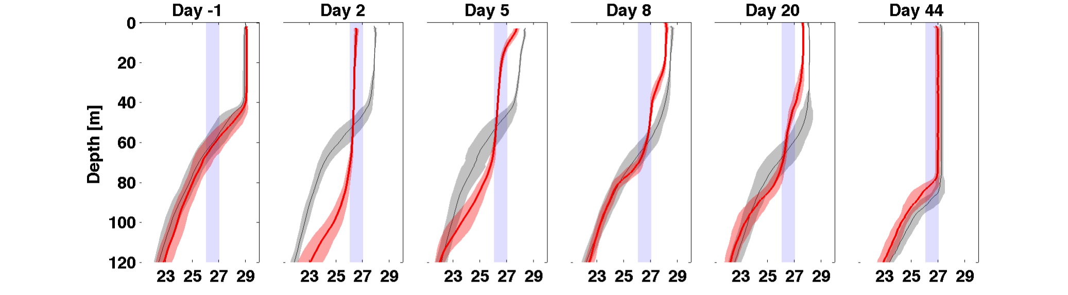
Subsurface Profile Evolution
Pre-Storm
Mix
Cap
Mix and cool
T. Chaba
Cap
X
Out
Wake
Mrvaljevic
What processes destroy the cold wake?
      Surface heating and mixing
      Lateral eddy straining
      Subsurface vertical mixing
Notes:
Day -1: Pre-storm: warm, shallow mixed layer.
Day 2: Fanapi forms deep, cold mixed layer.
Day 5: Sun comes out, warm cap forms.
Day 8: New mixed layer deepens.
Day 20: Cold wake signature remains below the surface for several weeks.
Day 44: Chaba forms new cold wake.

Slide 7
Wake thickness and Lifetime
24 days
Mrvaljevic
Can we quantify and model these processes ?
      Surface heating and mixing
      Lateral eddy straining
      Subsurface vertical mixing
Notes:
Upper: Observations of the thickness of the 26°C to 27°C layer vs. year day, 2010. Gray dots are thickness observations made by ITOP platforms. Compared to 2 backgrounds, Argo (red) and mooring SA2 (blue). Red dots are Argo thicknesses (2000-2010), red line is the running median. Blue dots are thicknesses measure at mooring SA2, line is running median.
Lower: Temporal distribution of the number of profiles by platform type. The colors correspond to those in Figure 1: magenta = EM-APEX; light blue = ADOS (includes 3 SUPER drifters); dark blue = UCTD; green = Seagliders.
ITOP observations find 26-27degC layers cease to be thicker than background 24 days after Fanapi passed, on yd 285. This is also when observations in the area were scarce, so the subsurface signature of the wake could have persisted even longer. But probably not longer than 40 days, but Chaba came through.
The subsurface signature of Fanapi’s cold wake stuck around for on the order of a month! That’s 3-4 times longer than lifetimes given using SST alone.

Slide 8
Capping of Wake by Solar Radiation
Price / Jayne
Price, Morzel and Niiler , 2008. Solar restratification time Γ ∼ C τ /λ(Qmax f)^{1/2} where C is known. Γ depends upon two properties of the heat flux, the noon maximum, Qmax, and the trend associated with the SST anomaly, λ. Post-Fanapi conditions Γ~ 1 week.

Slide 9


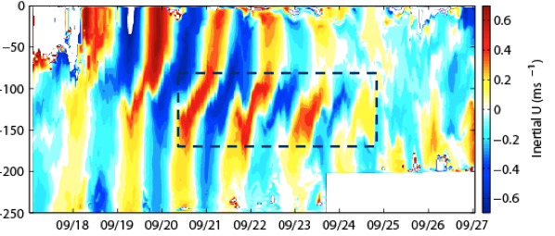
Near-Inertial Waves in Fanapi
EM-APEX Profiles
Strong shear crucial for mixing
Near-inertial energy remains in thermocline ~3 days after Fanapi
Shear ! Shear !
Subsurface Jet
Lien, Sanford, Hsu, Price
Does this
mix the wake
after formation?
Is this formed linearly?
Or due to eddies?
Notes:
Authors of these slides are Lien, Sanford, Andy Hsu, and Price. Focuses of our study will be on oceanic responses of the typhoon forced stage.
We will include observations from Fanapi, Megi, and Francis. PWP3D model simulation will be used to understand the dynamics.
Our primary focuses are Near Inertial Waves and Subinertial Jet induced by tropical cyclone. Especially, we would like to understand the near inertial wave properties and the effect of subinertial jet on oceanic responses to tropical cyclones.
We decompose EM-APEX float velocity observations into tidal, inertial and subinertial motions following isopycnal surfaces.
A subsurface subinertial jet fully develops about one day about the Fanapi pass. The subinertial ject may reflect or trap near inertial waves. It also advect cold wake. A subsurface cold wake was reported by Rosalinda.
We found the inertial energy stay in thermocline, instead of penetrate deeper. Possible mechanism is trapped by Fanapi enhanced vorticity field, and a left behind high-mode inertial wave energy.
We would like to focus on these processes in probably two papers. We will include cases of Megi and Francis.

Slide 10
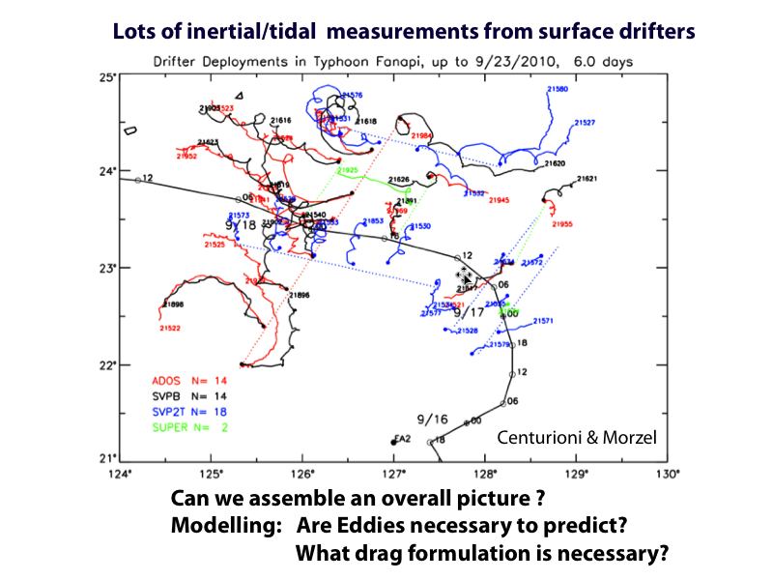

Slide 11
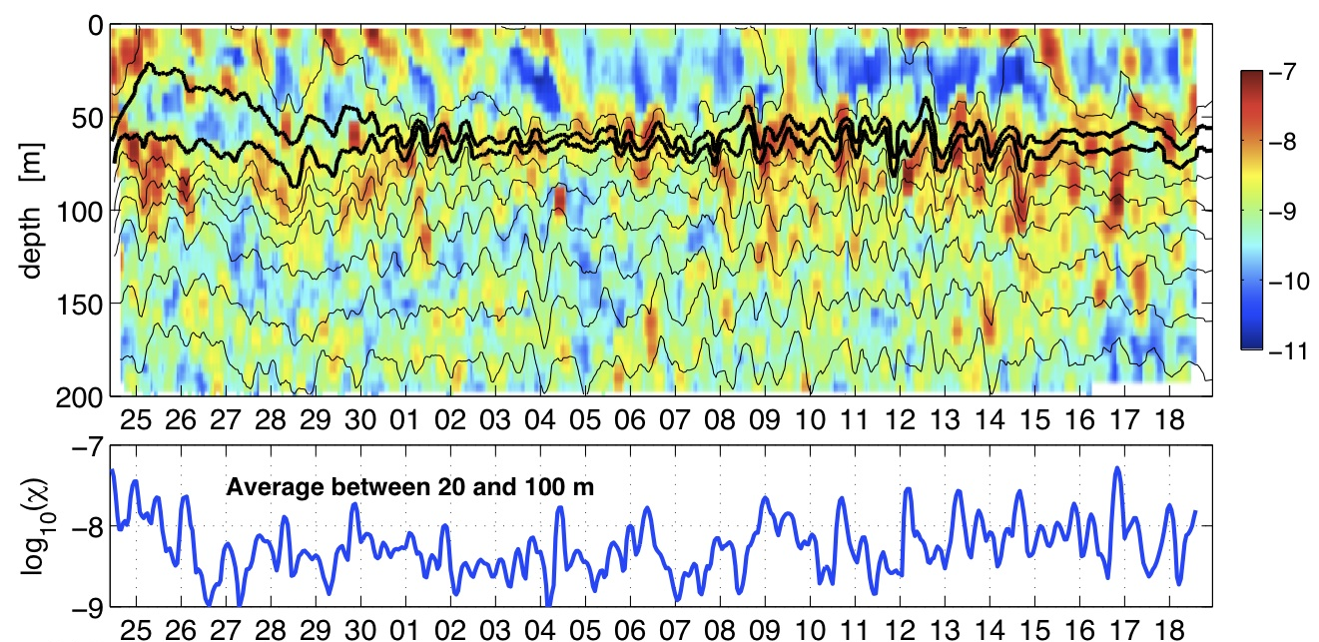
Glider Time series of χ near typhoon wake
Diurnal heating
log₁₀(χ)
Sub-surface cold wake (26-27°C)
Elevated dissipation
September-October 2010
Rainville/Lee
Is this consistent with the observed mixing rate of the subsurface wake?
Do models predict these mixing rates? Does it matter?

Slide 12
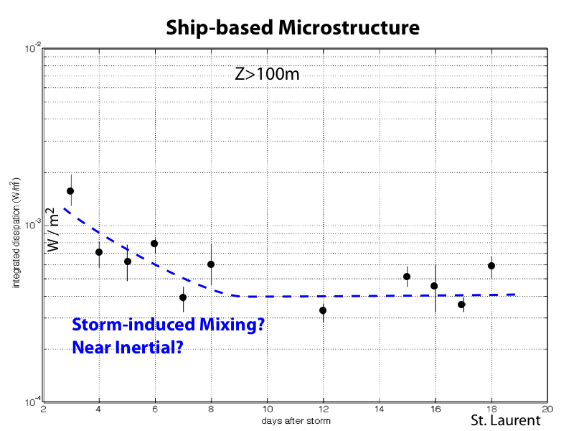

Slide 13
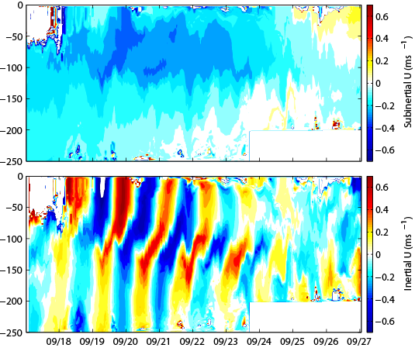
The Fanapi Subinertial Jet
Subsurface jet develops in 1 day after Fanapi in EM-APEX data
Geostrophic – due to net upwelling under the (slow) storm
Decomposition on isopycnal coordinate
Importance of Subinertial Jet
Advecting cold wake
Reflecting and/or trapping near inertial waves?
Does it make an ‘eddy’?
Subinertial Jet
Lien, Sanford
Hsu, Price
Notes:
Authors of these slides are Lien, Sanford, Andy Hsu, and Price. Focuses of our study will be on oceanic responses of the typhoon forced stage.
We will include observations from Fanapi, Megi, and Francis. PWP3D model simulation will be used to understand the dynamics.
Our primary focuses are Near Inertial Waves and Subinertial Jet induced by tropical cyclone. Especially, we would like to understand the near inertial wave properties and the effect of subinertial jet on oceanic responses to tropical cyclones.
We decompose EM-APEX float velocity observations into tidal, inertial and subinertial motions following isopycnal surfaces.
A subsurface subinertial jet fully develops about one day about the Fanapi pass. The subinertial ject may reflect or trap near inertial waves. It also advect cold wake. A subsurface cold wake was reported by Rosalinda.
We found the inertial energy stay in thermocline, instead of penetrate deeper. Possible mechanism is trapped by Fanapi enhanced vorticity field, and a left behind high-mode inertial wave energy.
We would like to focus on these processes in probably two papers. We will include cases of Megi and Francis.

Slide 14
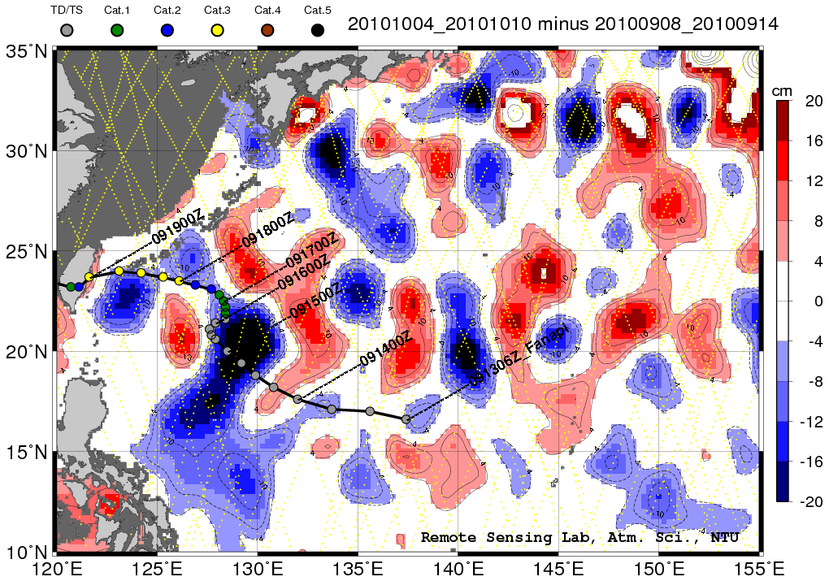
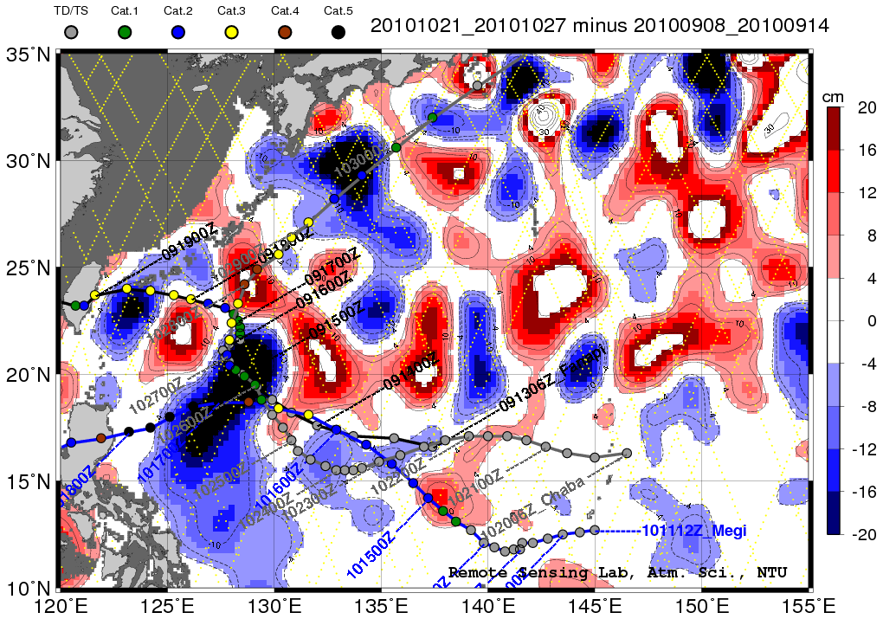
Fanapi’s SSH wake
II Lin
Post – Pre Storm ~ 1 Month
Fanapi made an eddy!?
Large SSH signal at slow part of storm track
Predicted by wind-stress curl
Can we model this?
Is SSH / T100 relationship different?
Expect a stronger eddy for 2009 T. Lupit )
~ 7 weeks
Key point:
Along-track delta SSHA can effectively detect subsurface cold wake even when SST is recovering. The subsurface cold wake lasted fore more than 1 month because it was subsequently enhanced by Megi and Chaba, and finally the seasonal signal comes in.
It appears that this cold wake never recover back.

Slide 15
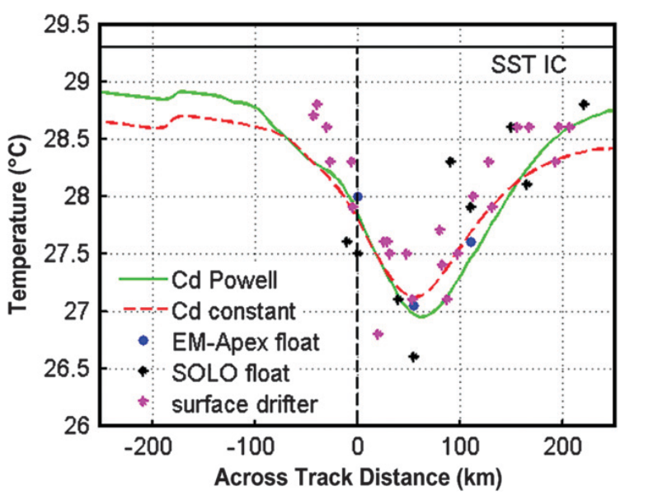
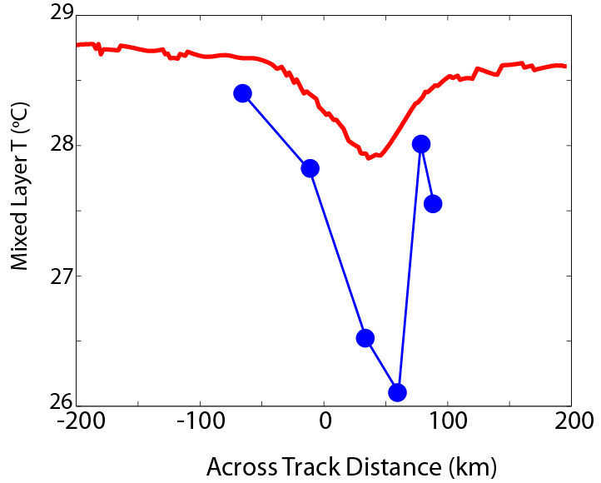
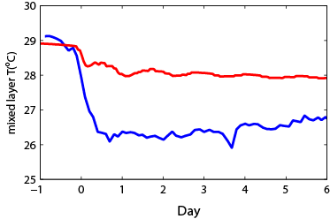
Unpredicted Cooling in Fanapi?
PWP3D predicts observed -2ºC cooling in Francis (Sanford et al. 2011)
Lien, Sanford, Hsu, Price
PWP3D fails to predict the surface cooling by Fanapi
WHY?
Inaccurate initial condition?
Poor storm wind stress?
Missing surface buoyancy flux?
Float advection?
Background Eddy and evolution?
Model Error? (PWP is not perfect)
Francis
PWP3D
Fanapi
EM-APEX
PWP3D : δT ~1ºC
EM-APEX : δT ~2.5ºC
Fanapi
Notes:
Prediction of surface cooling: PWP3D predicts very well the surface cooling of -2C observed by floats and drifters.
PWP3D fails to predict Fanapi cooling of 2.5C, a discrepancy of 1.5C. Possible reasons for the discrepancy include
Inaccurate initial condition, (2) missing surface heat and buoyancy, (3) float advection, (4) background eddy.

Slide 16
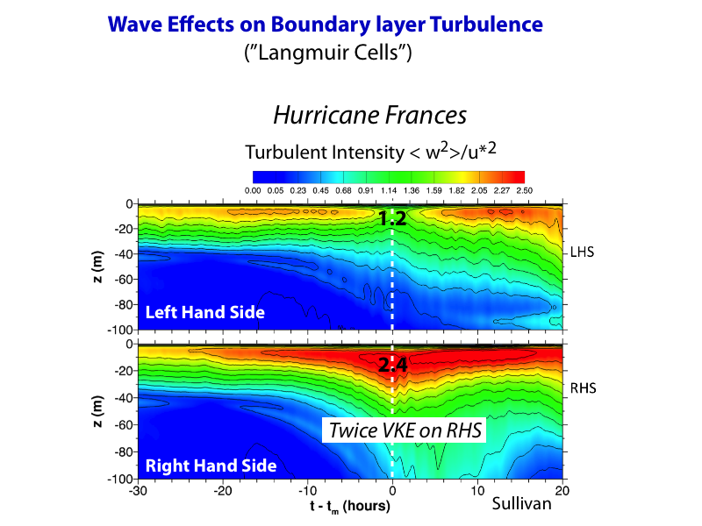
Notes:
Here we’ve made a contour plot of w^2 over the entire OBL. We notice immediately that w^2 is enhanced over a thick layer on the RHS of the storm. This is due to the great alignment between stokes drift and
surface winds. Again this indicates the formation of vigorous Langmuir cells on the RHS, the variance is nearly a factor of 2.5 times the local value of u_*^2.
Interesting things happen on the LHS. Note that the dip we saw previously happens over a large fraction of the upper OBL at the time of maximum winds. This is due to wind-wave misalignment
and also the fact that the vertical momentum fluxes are ``counter-gradient” to the vertical gradient of Stokes drift! In other words the production of w variance by Stokes drift in the w variance budget
Is quenched on the LHS of the storm track at the time of maximum winds. This is also clearly visible in flow visualization. On the RHS the cells are potent and long, more than 100 meters. On the
left hand side the Langmuir cells are short and do not penetrate into the OBL.

Slide 17
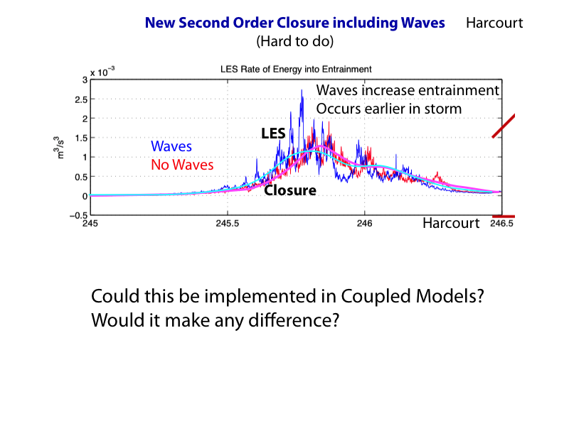

Slide 18
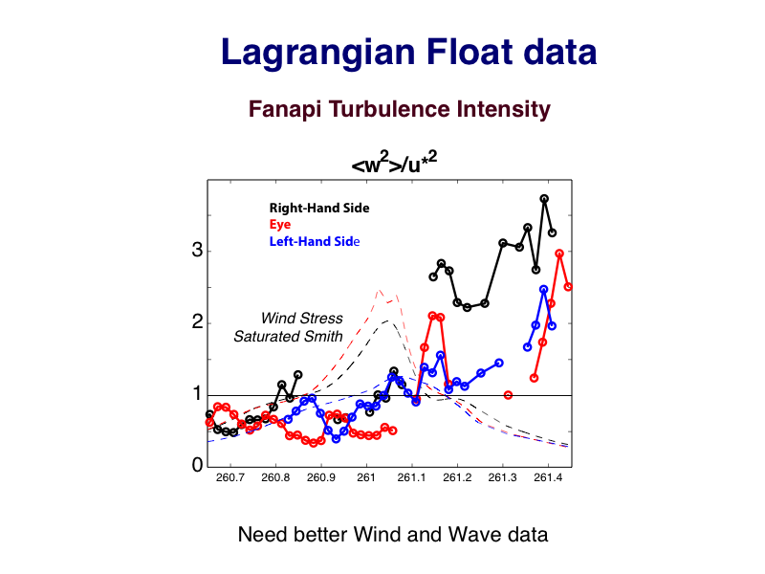

Slide 19
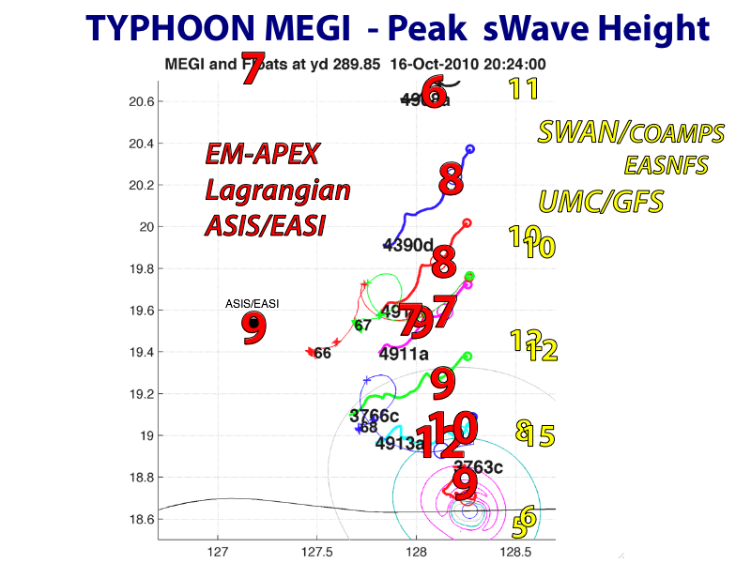

Slide 20
