Slide 1

Impact of Typhoon on Ocean in Pacific (ITOP)
Modeling Group Report
Shuyi S. Chen, Chiaying Lee, and Brandon Kerns (RSMAS/UM)
Sue Chen and Shouping Wang (NRL-MRY)
D. S. Ko (NRL-SSC) and S.-Y. Chao (U. of Maryland)
Luca Centurioni (SIO/UCSD) and Jan Morzel
(ITOP PI Workshop, Kaohsiung, Taiwan, 26-28 March 2012)

Slide 2
Contents
Operational and research model forecasts and analysis products (e.g., NOGAPS, GFS, ECMWF, EASNFS, COAMSP-TC, UMCM, Coupled WRF, etc.)
Coupled observational data sets/analyses for model evaluation and verification
Research results - better understanding of physical and dynamic processes in the atmosphere, ocean, and air-sea coupling
Formation and recovery of cold wake in Fanapi
Stable boundary layer in Fanapi and its impact on storm structure and intensity
Air-sea fluxes and energetic in TCs

Slide 3
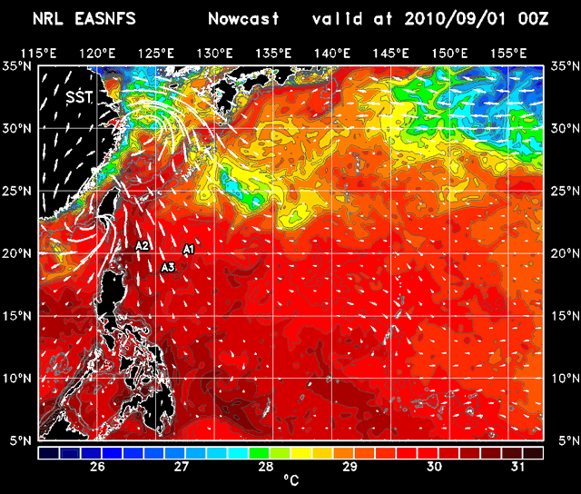
ITOP
D. S. Ko (Naval Research Laboratory) S.-Y. Chao (University of Maryland)
East Asian Seas Nowcast/Forecast System (EASNFS)
Daily 120-hr Forecast from 2010/08/01 to 2010/11/30 to support IOP
http://www7320.nrlssc.navy.mil/NLIWI_WWW/ITOP.html
Pun, I.F., I.-I. Lin, P.G. Black, and D.S. Ko, 2012: Regression-derived satellite-based upper ocean thermal structure
for the western North Pacific typhoon research, Prog. Oceanog., submitted.

Slide 4
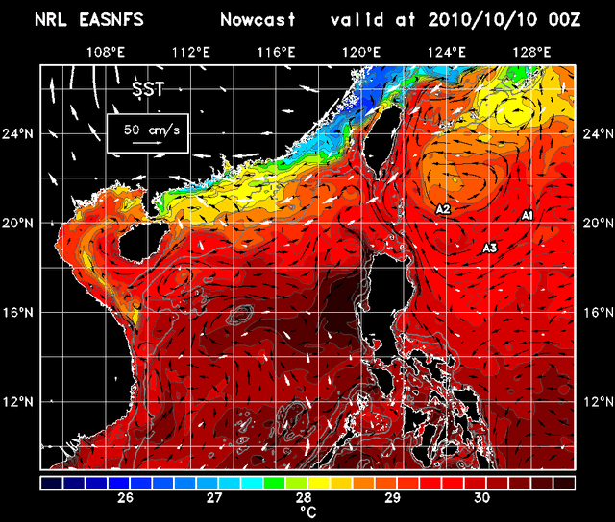
ITOP
D. S. Ko (Naval Research Laboratory) S.-Y. Chao (University of Maryland)
East Asian Seas Nowcast/Forecast System (EASNFS)
Daily 120-hr Forecast to support Megi SCS Survey

Slide 5
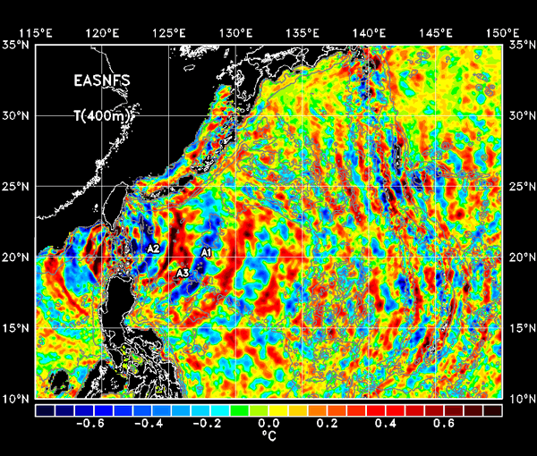
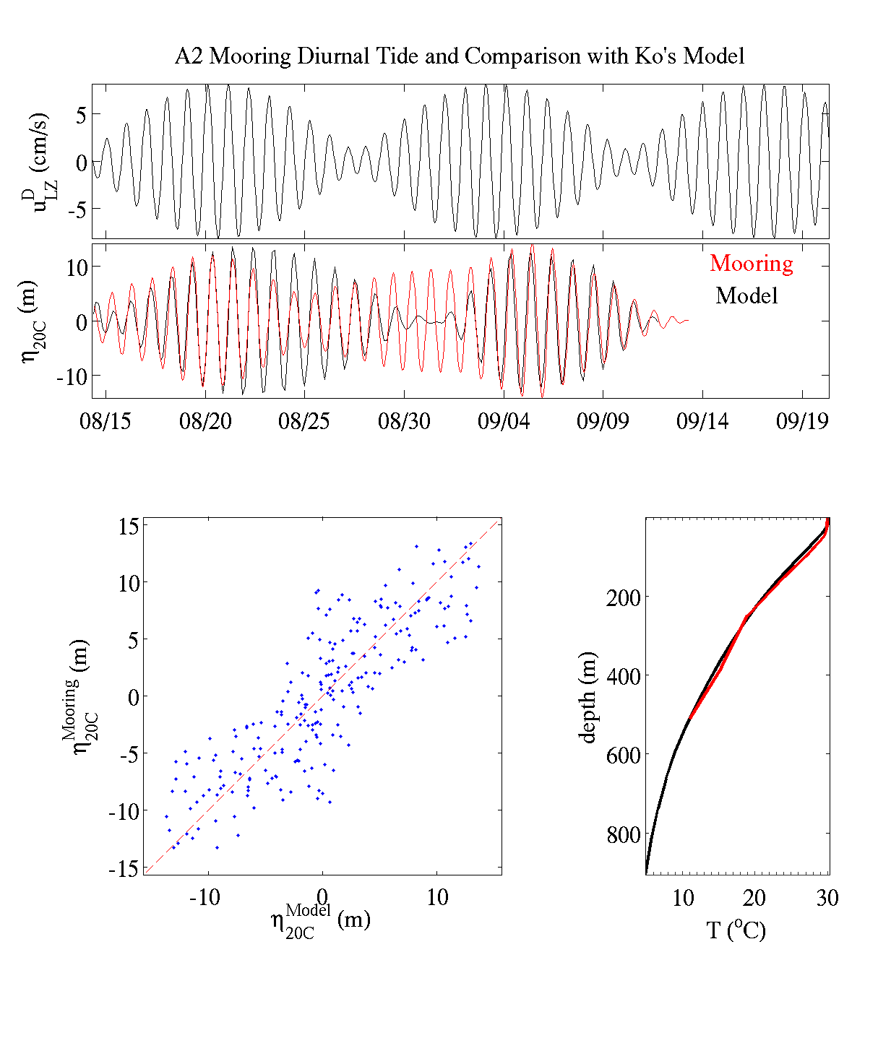
ITOP
D. S. Ko (Naval Research Laboratory) S.-Y. Chao (University of Maryland)
East Asian Seas Nowcast/Forecast System (EASNFS)
Internal Tides Prediction to support IOP
Ko, D.S., S.-Y. Chao, T.Y. Tang, and Y.-T. Chang, Typhoon Impacts on the Western Pacific: Internal Tides and Real-Time Prediction, Asia Oceania Geosciences Society 8th Annual Meeting, Taipei, Taiwan, 8-12 August 2011.

Slide 6
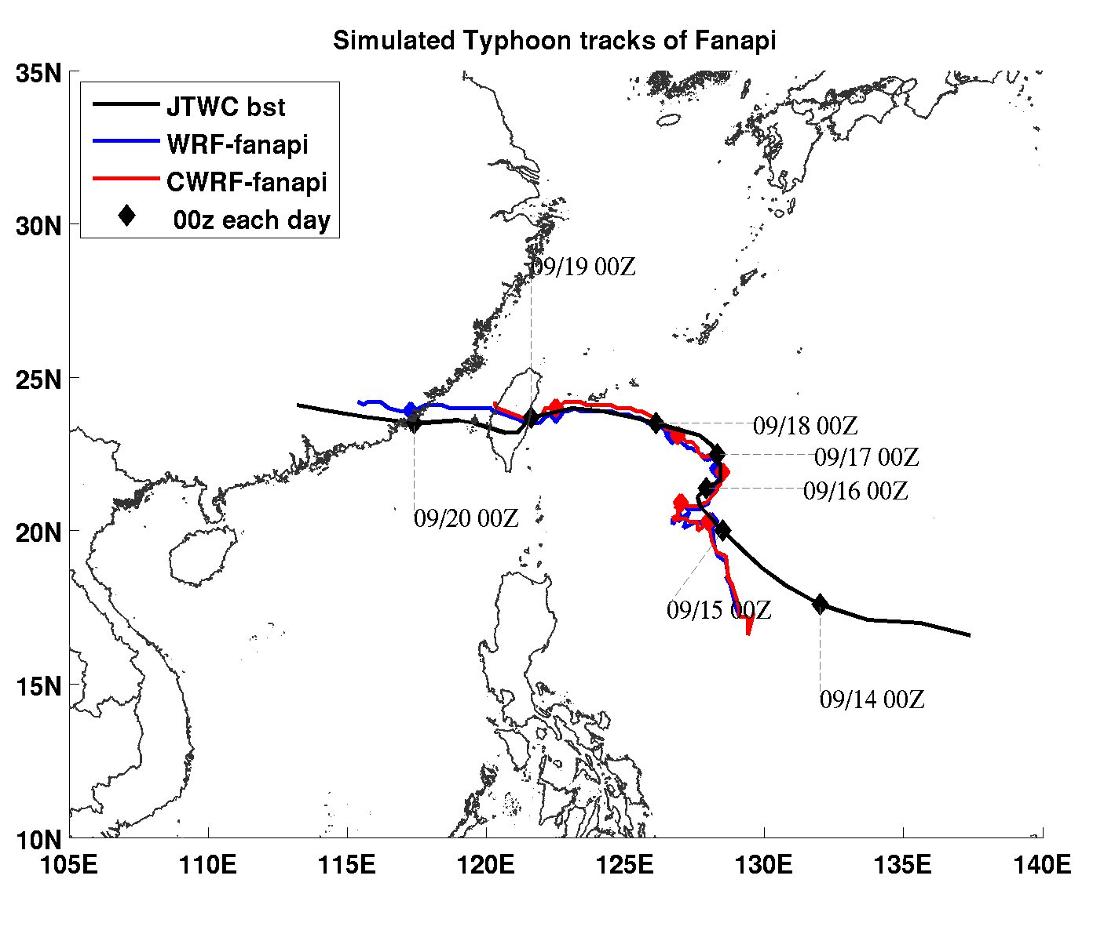
Multi-Model, High-Resolution, Coupled Modeling System at University of Miami:
UM Coupled Atmos-Wave-Ocean Model (UMCM)
Coupled WRF-ocean (CWRF)
WAVEWATCH III
HYCOM
3DPWP ocean model – initialized with satellite SST + Obs profiles, and NCOM or HYCOM data assimilation
Mini ensemble UMCM, MM5 CWRF, & WRF forecasts using GFS, GFDL, NOGAPS, CMC, JMA, and ECMWF forecast fields as initial and lateral boundary conditions
Real-time support for ITOP 2010
Virtual experiments for research
Understanding TCs and improve perditions
12 km
4 km
Most challenging Issues:
coupled model initialization, data assimilations, and evaluation/verifications.
1.3 km

Slide 7
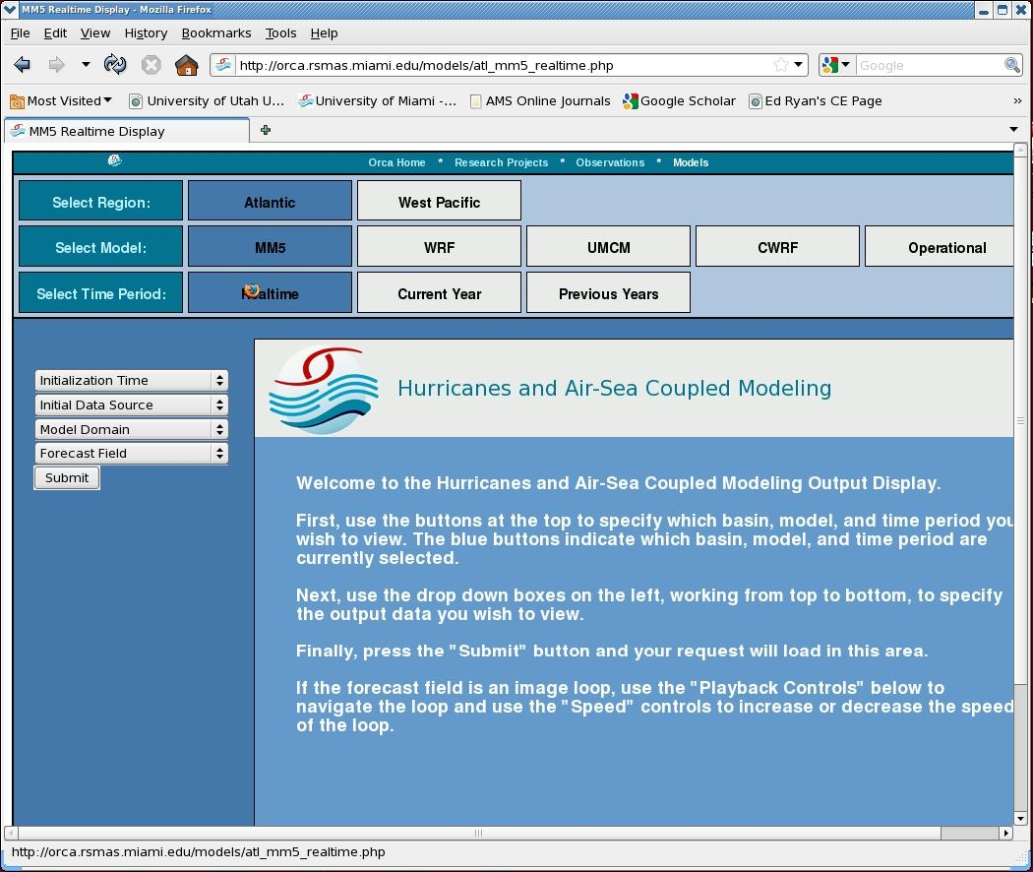
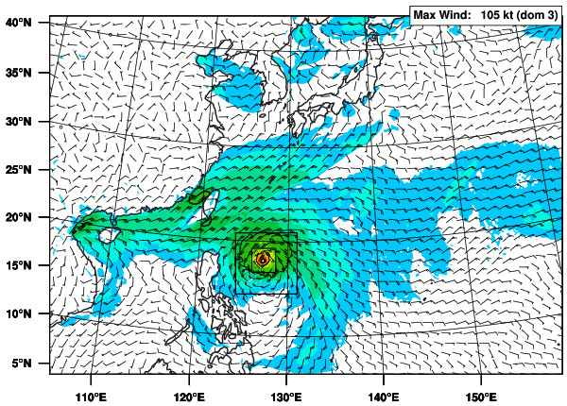
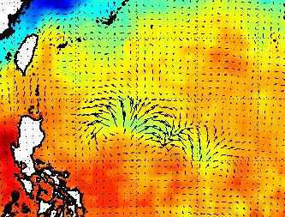
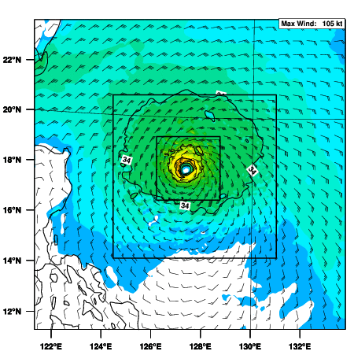
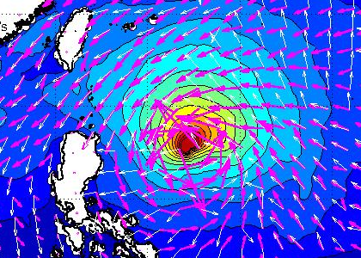
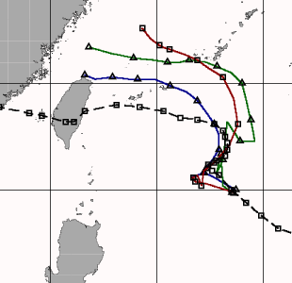
Atmosphere
Ocean
Waves
Notes:
Example of plots available in real-time as the model is running. available on website

Slide 8
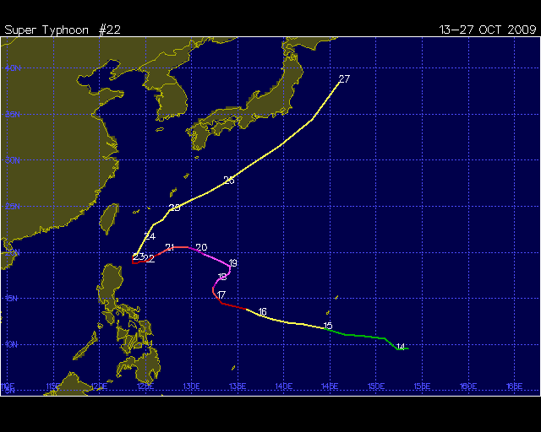
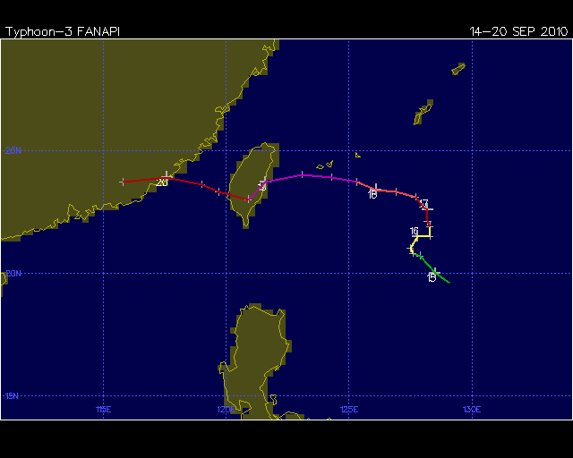
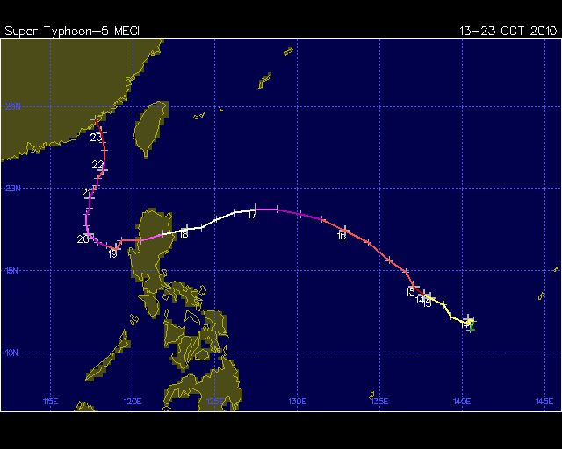
Verification: ITOP Cases
Storm | Dates | Number of Forecasts*
Lupit (2009) | 15-18 Oct. 2009 | 4
Fanapi (2010) | 15-18 Sept. 2010 | 4
Megi (2010) | 13-18 Oct. 2010 | 6
 | TOTAL: | 14
*Once per day
while storm is
in area of
interest.
S-curve
S-curve
A record-breaking Cat-5
super typhoon
These were CHALENGING cases!
(Kerns et al. 2012)
Notes:
Focus of ITOP dry run and field phase.

Slide 9
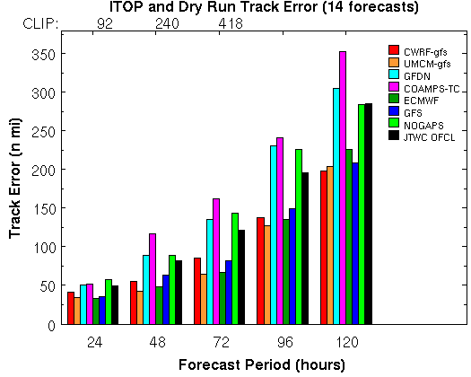
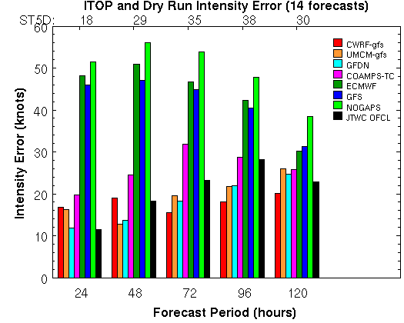
Track Intensity
High-resolution (1.3 km) coupled models (UMCM and CWRF) improve intensity forecast significantly
GFDN and COAMPS-TC have smaller intensity error, but larger track error compared to that of global models
Notes:
High resolution coupled models are red and brown. JTWC official forecast in black.

Slide 10
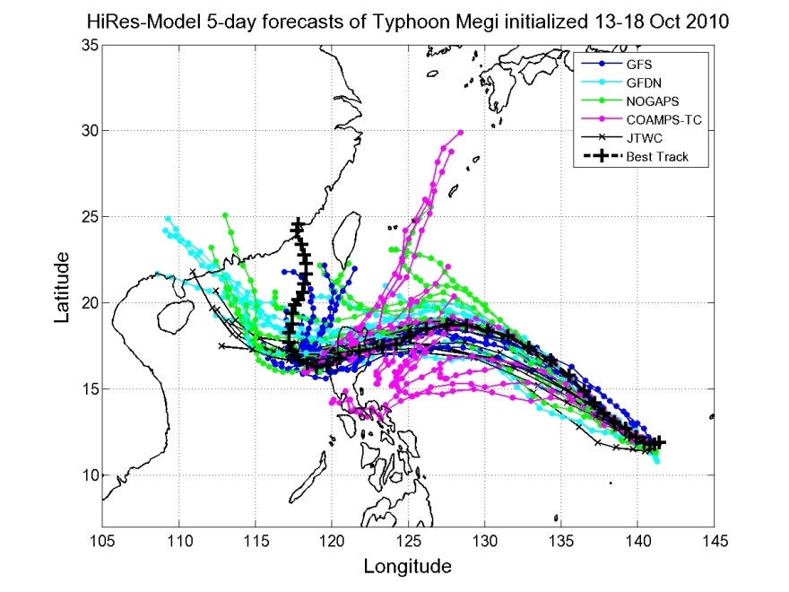
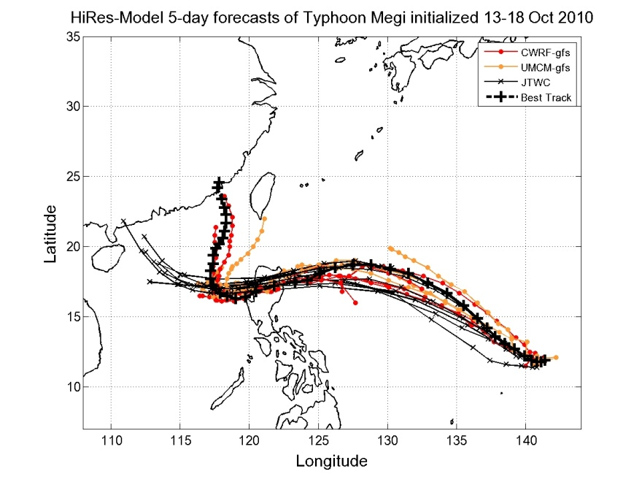
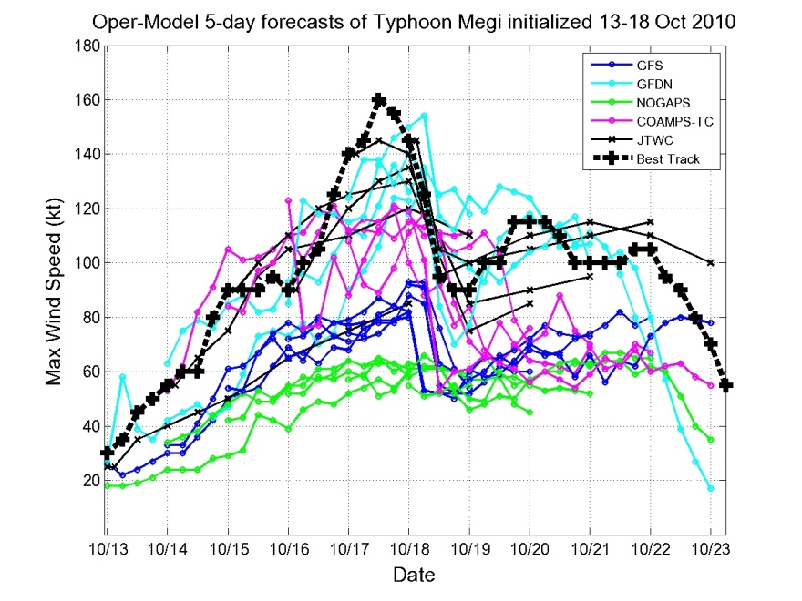
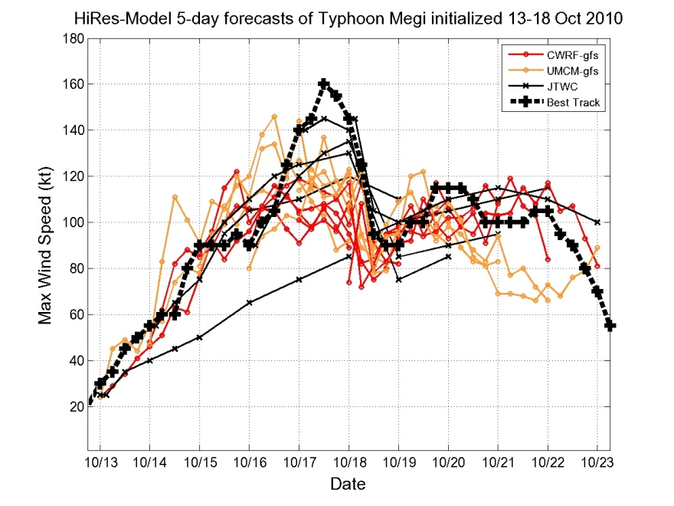
Track and Intensity
OPERATIONAL High-res UMCM & CWRF
GFDN big track error
Megi
Megi
INTENSITY TRACK
Megi
GFDN great intensity forecast
Megi
Notes:
Here is an example where the intensity error can be small, but the track error large at the same time. You’re looking at …

Slide 11
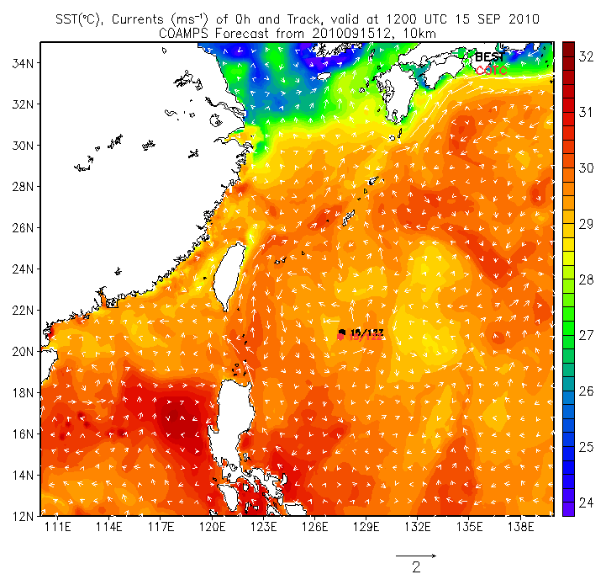
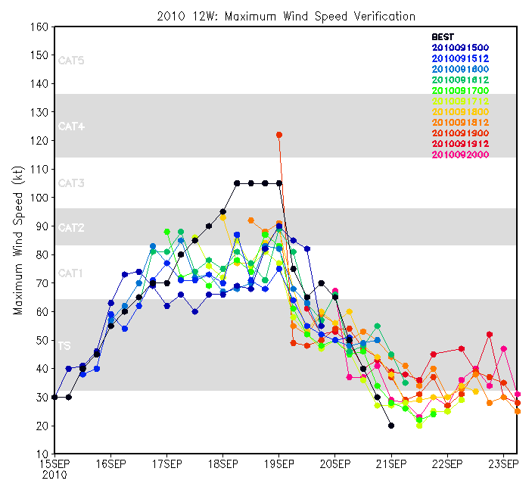
Prediction of Typhoons and Their Impact on the Upper Ocean (ITOP)
Real-Time Coupled Forecasts for 2010 Typhoon Fanapi (12W)
SST, Currents and Track of COAMPS Forecasts
Maximum Wind Speed Verification
160
140
120
100
80
60
40
20
34
32
30
28
26
24
22
20
18
16
14
12
Best
COAMPS
Maximum Wind Speed (Kt)
111 114 117 120 123 126 129 132 135 138
15SEP 16 17 18 19 20 21 22 23
The predicted track was very close to the best track
The predicted intensity followed the trend, but was weaker
Cold wake was produced after Sept. 16, 2010.
(Shouping Wang)
Notes:
Fanapi is category 3 Typhoon, struck Taiwan and Mainland China . It formed Sept 14, 2011.

Slide 12
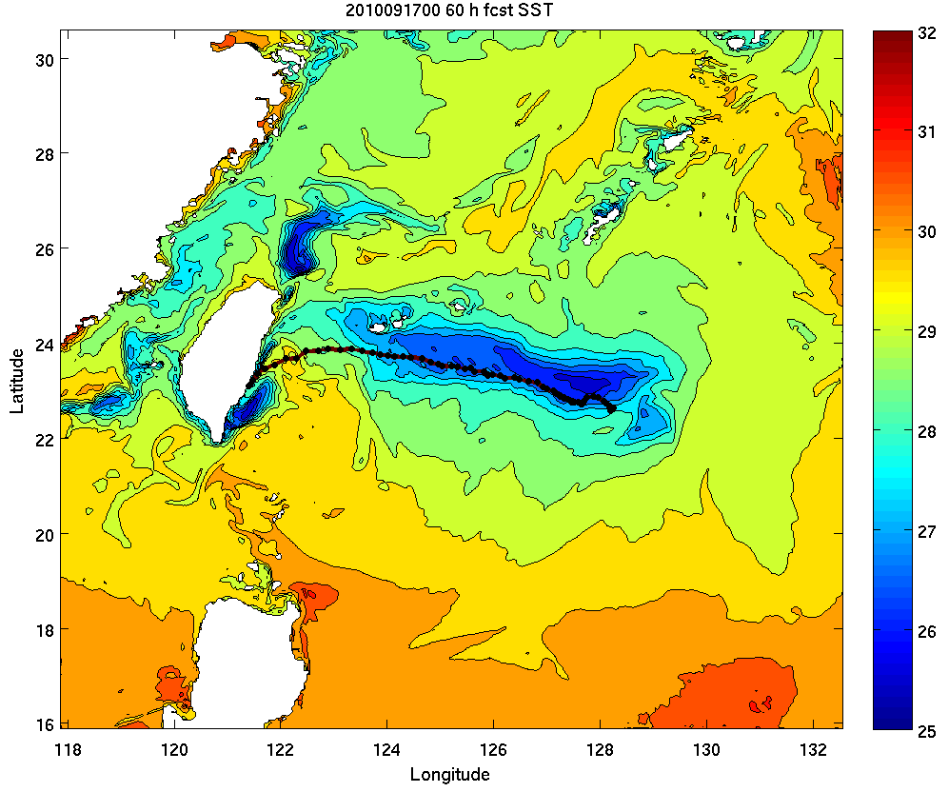
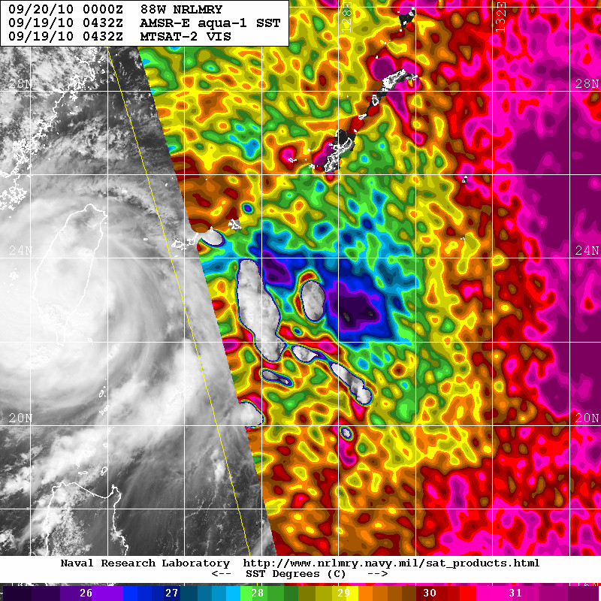
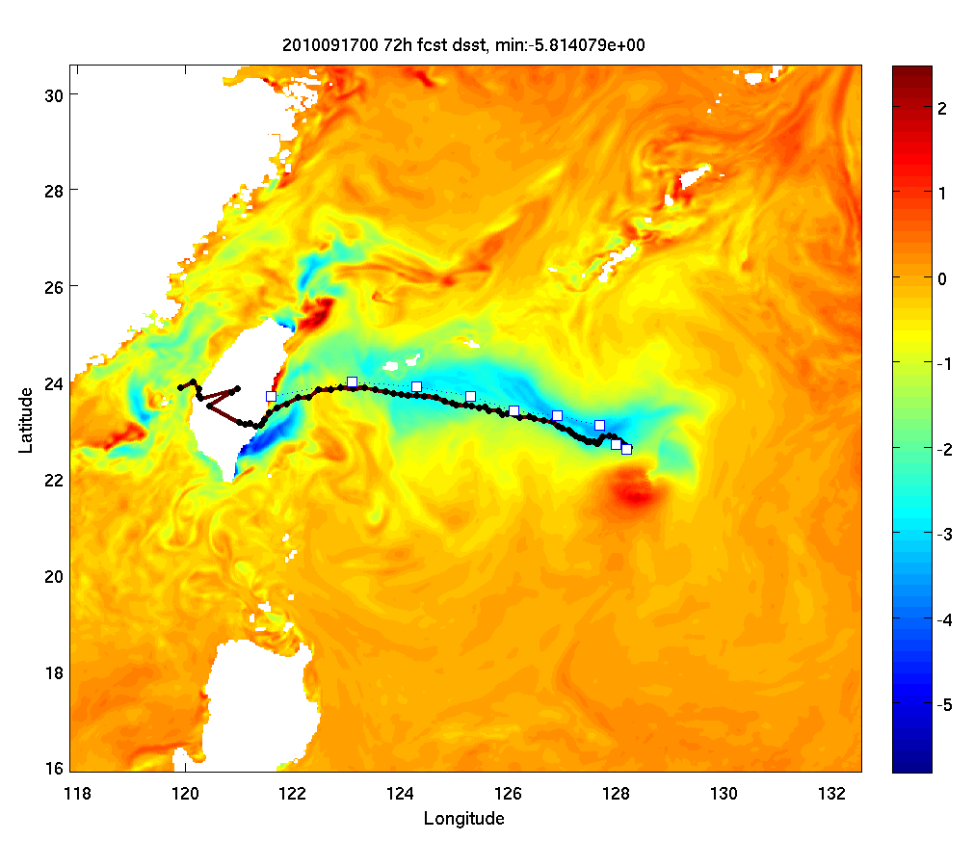
Air-ocean-wave coupled COAMPS 2010091700 60h forecast SST of typhoon Fanapi
NRL SST 0432Z 09/19/10 AMSR-E Acqua-1
Atmosphere: 27, 9, and 3 km
Ocean: 9 and 3 km
Wave: 1/6 degree
Model spin-up from 2010090800
12 h update cycle
3-4 °C cold wake
COAMPS predicts two wake centers similar to AMSR-E SST
72 h SST anomaly
(Sue Chen)
Notes:
This slide shows the 2010091700 COAMPS 60h forecast SST. It is a warm start COAMP simulation. The model predicted two wake centers similar to the NRL AMSR-E SST analysis on 0432 UTC 19 Sep, 2010 with a magnitude of 3-4C cooling.

Slide 13
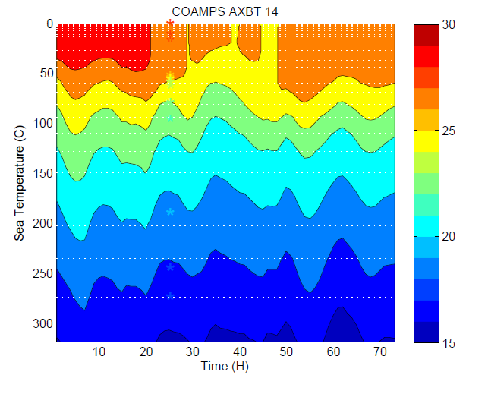
Passage of COAMPS Fanapi eye
What cause these two continuous cooling after the passage of Fanapi eye?
AXBT
(Sue Chen)
Notes:
This slide shows the comparisons of COAMPS forecast with one AXBT near the Fanapi eye. COAMPS has a cold bias due to track error (model is 5 hr too slow).

Slide 14
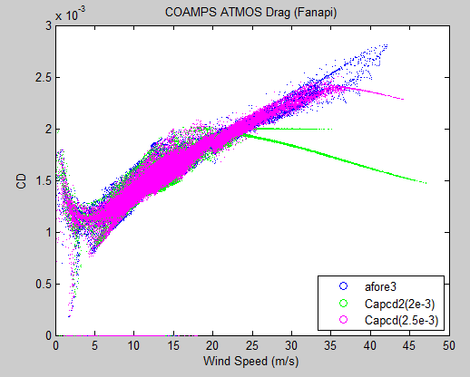
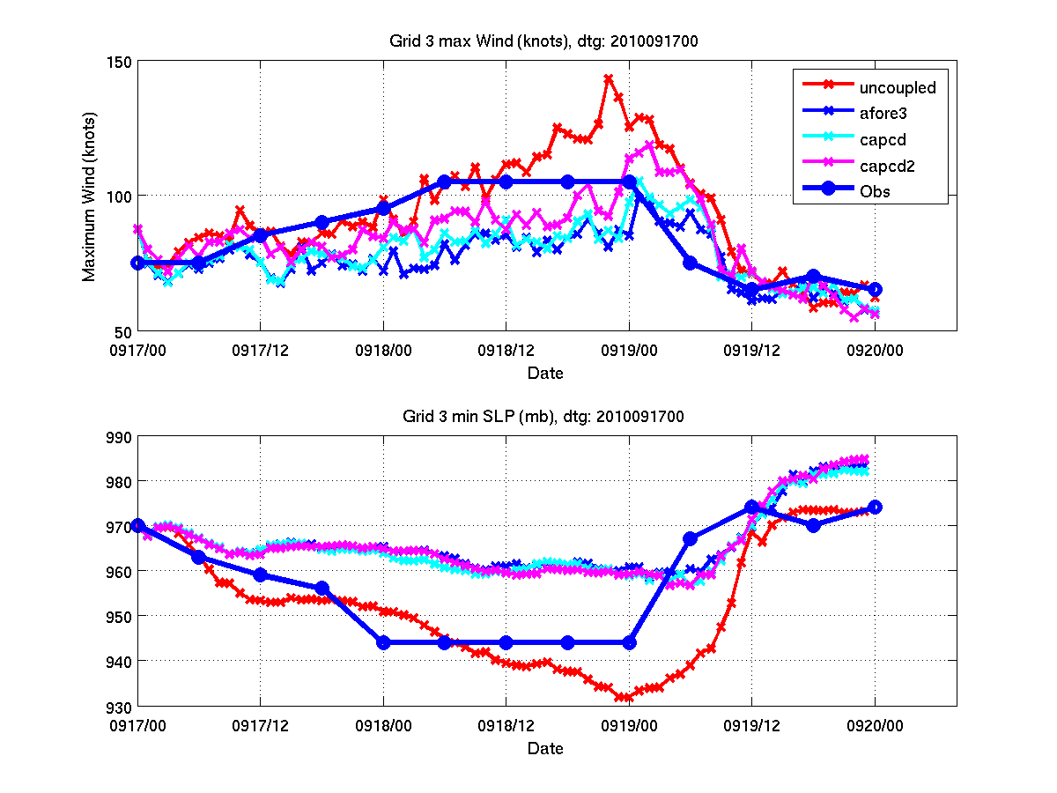
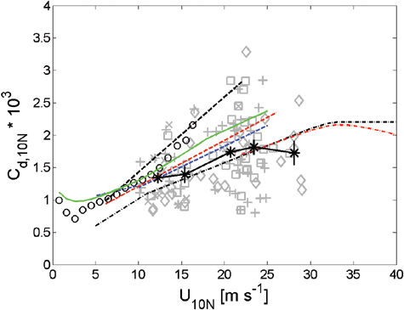
COAMPS momentum Drag Coefficient
Max wind speed
Cap Cd
Cap Cd 2
Minimum SLP
CBLAST Drag Coefficient
Lower the momentum drag coefficient increases the wind speed but has a small change in enthalpy flux due to compensating effect of increased cold wake cooling
Recalibration of the atmosphere physic suite within coupled COAMPS-TC is on going
(Sue Chen)
Notes:
This slide shows the intensity comparisons of four COAMPS sensitivity runs. The uncoupled run has the best intensity forecast. While all three coupled runs have a negative intensity bias. The maximum wind speed comparisons show level off the drag coefficient at a low value 2.0e-3 (capcd2) than the uncoupled run (cd=2.5e-3) improves the coupled COAMPS intensity forecast compare to the control run (drag increase with wind speed, afore3). Not much change in the minimum sea level pressure forecast. The lower drag coefficient is within the CBLAST range. We are still working on the atmospheric physics to improve the intensity forecast of coupled COAMPS-TC.

Slide 15
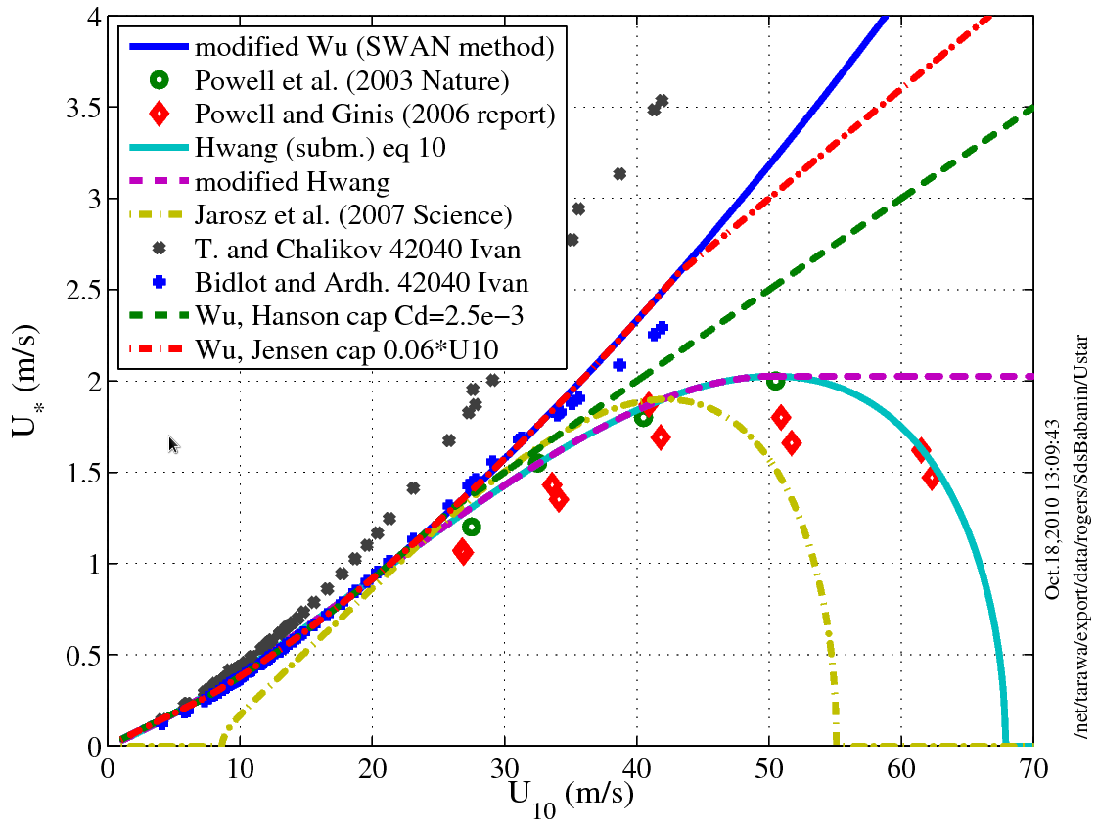
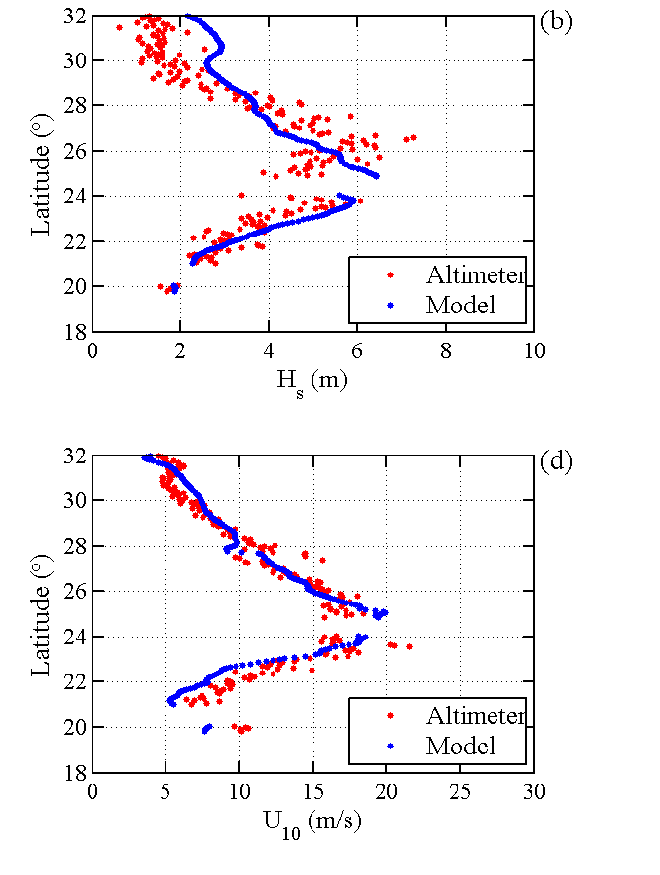
Coupled COAMPS-TC Fanapi Wave Forecast
Wu
Altimeter SWH
COAMPS-TC
Altimeter wind speed
The combined effects of a new wave input , dissipation parameterization in SWAN (Rogers et al. 2011, Babanin et al. 2010) , and reduced drag coefficient (Hwang 2011) improve the SWH forecast
COAMPS SWH and wind speed (5 to 20 m/s range) compare well with the altimeter observation after removing the track bias
(Sue Chen)
Notes:
Similar to the atmospheric model, fully coupled COAMPS-TC sensitivity tests also showed the momentum drag in the wave model SWAN need to be reduced in order to obtain a better significant wave height forecast.

Slide 16
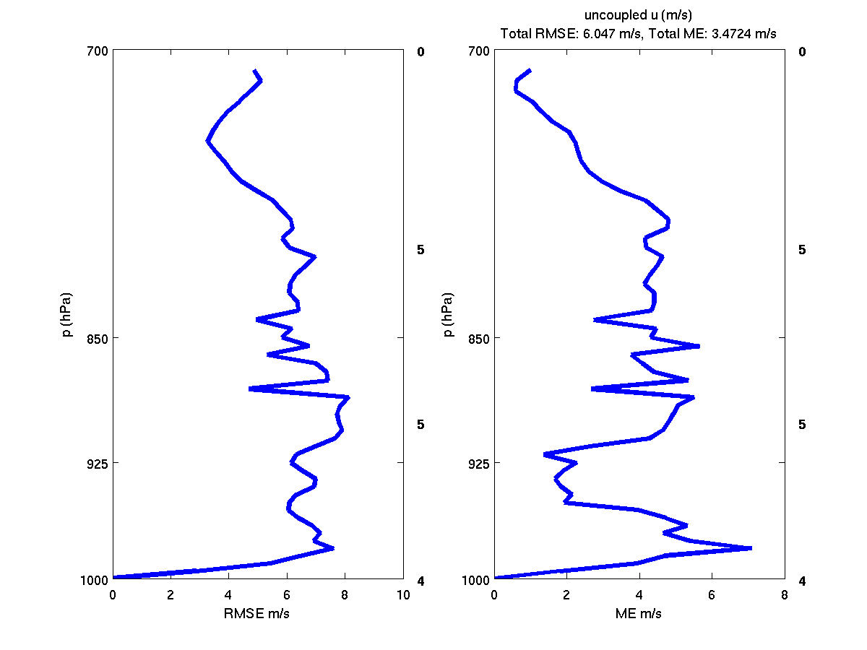
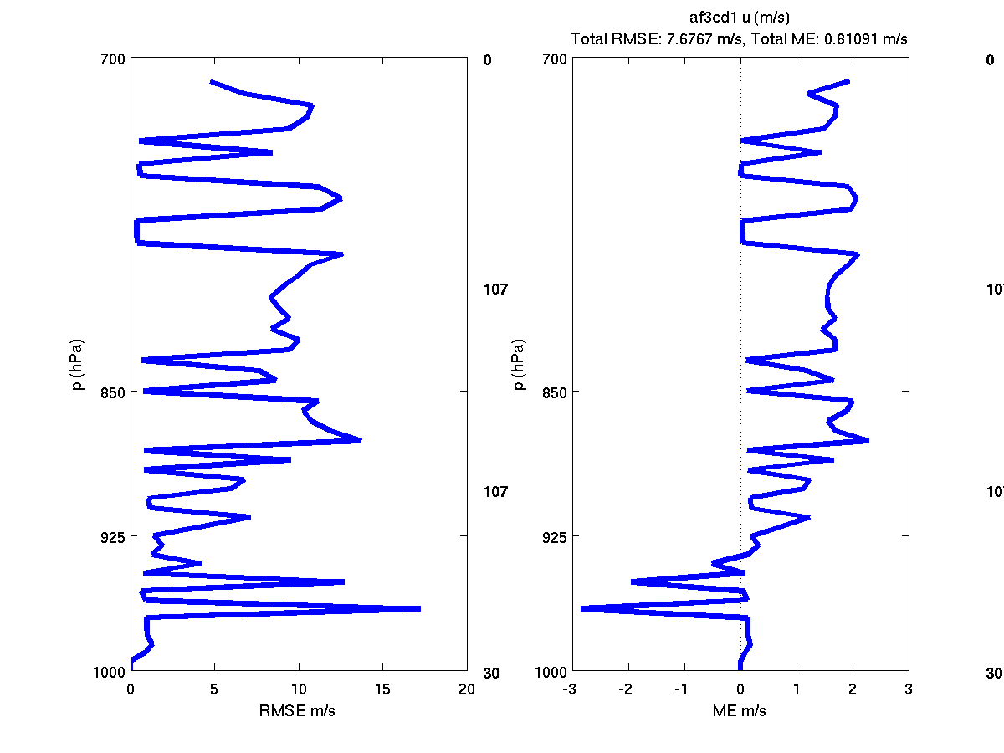
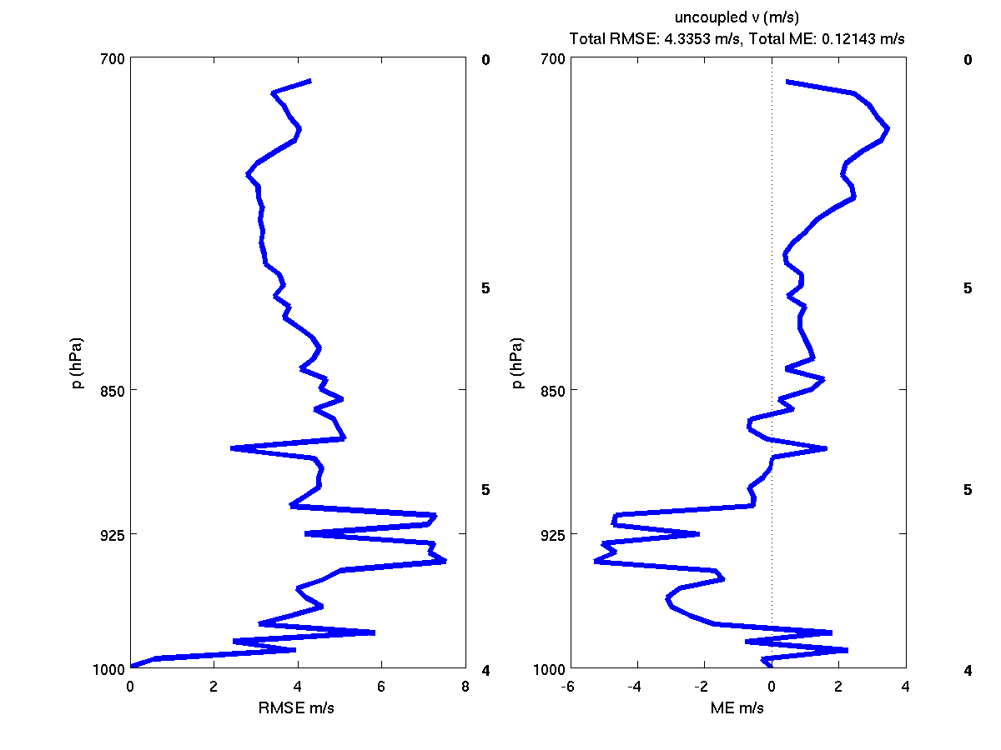
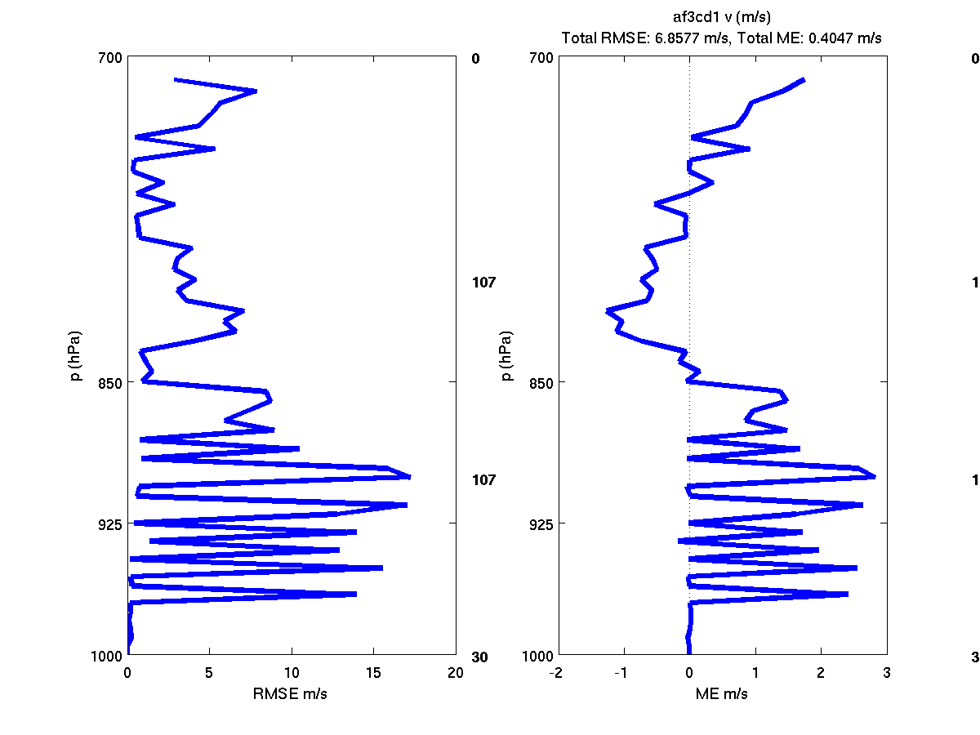
Coupled COAMPS-TC Wind Validation
Uncoupled
Coupled
Both the uncoupled and coupled COAMPS simulations have a small < 8m/s wind RMS error
Air-ocean-wave coupling improves the lower boundary wind prediction
Coupled run has a larger wind RMS error above the lower boundary layer
U:
ME:3.5
RMS:6.9
U:
ME:0.8
RMS:7.7
V:
ME:0.1
RMS:4.4
V:
ME:0.4
RMS:6.9
(Sue Chen)
Notes:
These plots show the COAMPS 28-32h storm relative u and v wind forecast RMSE and ME errors compared to the Fanapi dropsonde observations (28 soundings) taken between 2312UTC 17 Sep to 0223UTC 18 Sep. COAMPS forecast track was about 5 hr too slow compare to the best track. The along and cross track bias were removed from the wind statistics by shifting the time and locations of the model soundings relative to the observed eye locations.

Slide 17
Summary
High-resolution coupled atmosphere-ocean-wave model forecasts were made in real-time in support of the ITOP field campaign.
Track and intensity errors of the high-res coupled models for the 3 typhoons compare favorably with the operational models.
ITOP provides a unique, coupled data set for evaluation and verification of the high-res coupled model forecasts of TC structure, air-sea fluxes, and upper ocean properties.
Negative intensity and significant wave height biases in coupled COAMPS-TC are reduced using a lower momentum drag coefficient in the atmospheric and wave models
Simulations with ocean and wave coupling have a smaller low-level wind error compare to the uncoupled run

Slide 18
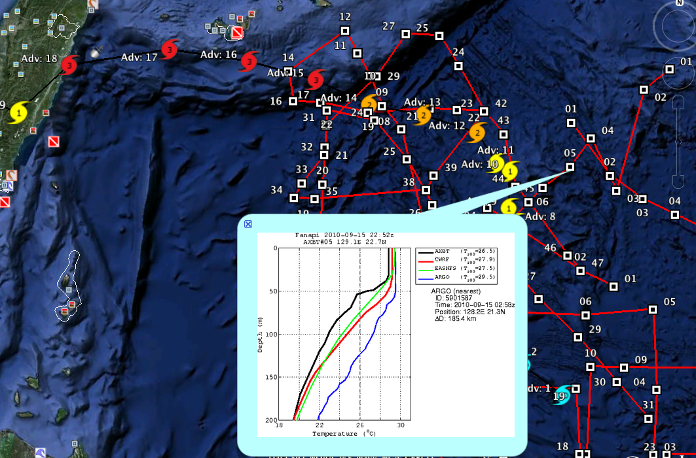
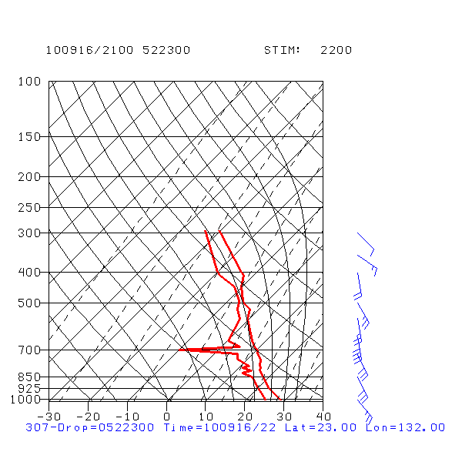
Comparison of AXBTs/ARGOs/EASHF/UM coupled models
Fanapi (14-20 Sept)

Slide 19
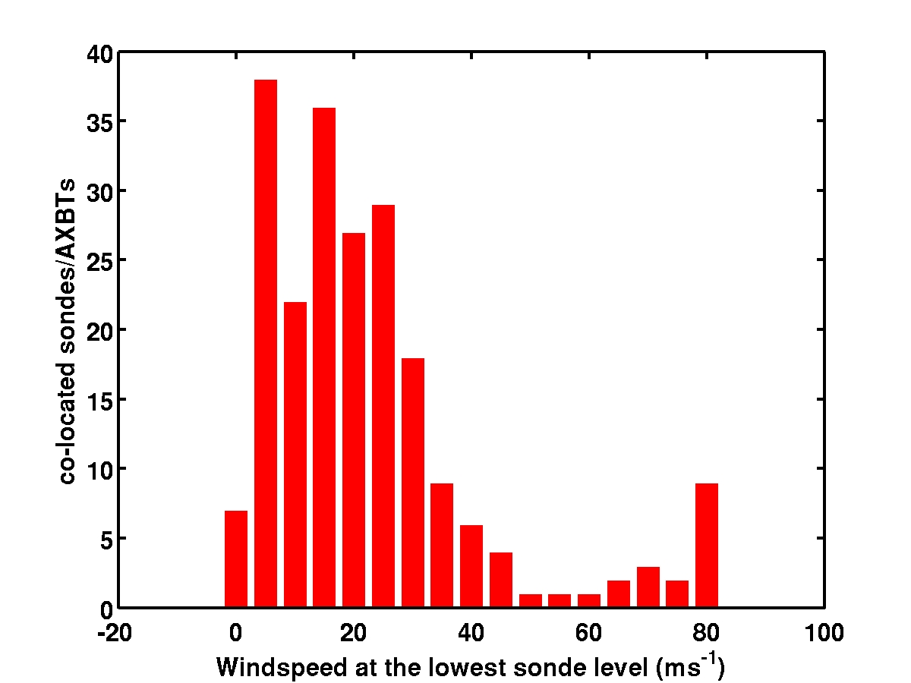
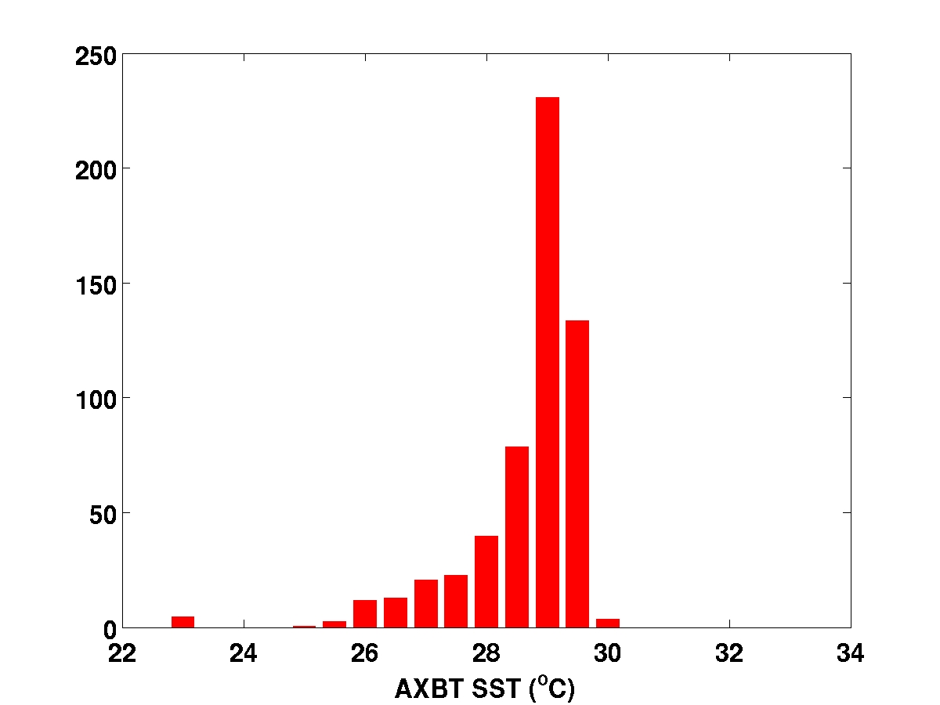
ITOP: Co-located Dropsondes and AXBTs

Slide 20
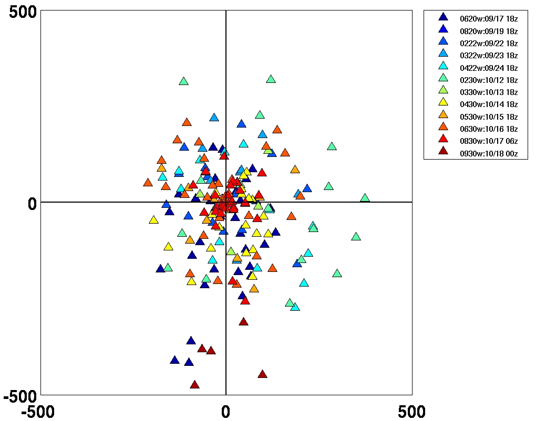
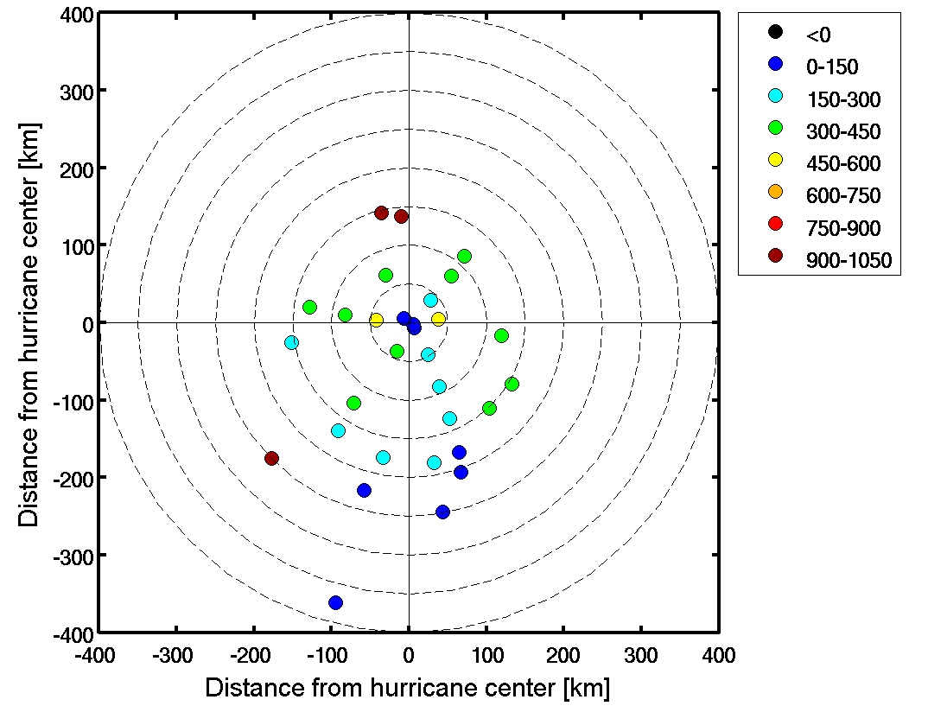
Co-located Dropsondes and AXBTs in Storm-Relative Coordinate
Fanapi
Malakas
Megi
Enthalpy (Sensible + Latent Heat) Flux
Fanapi
(Chen et al. 2012)

Slide 21
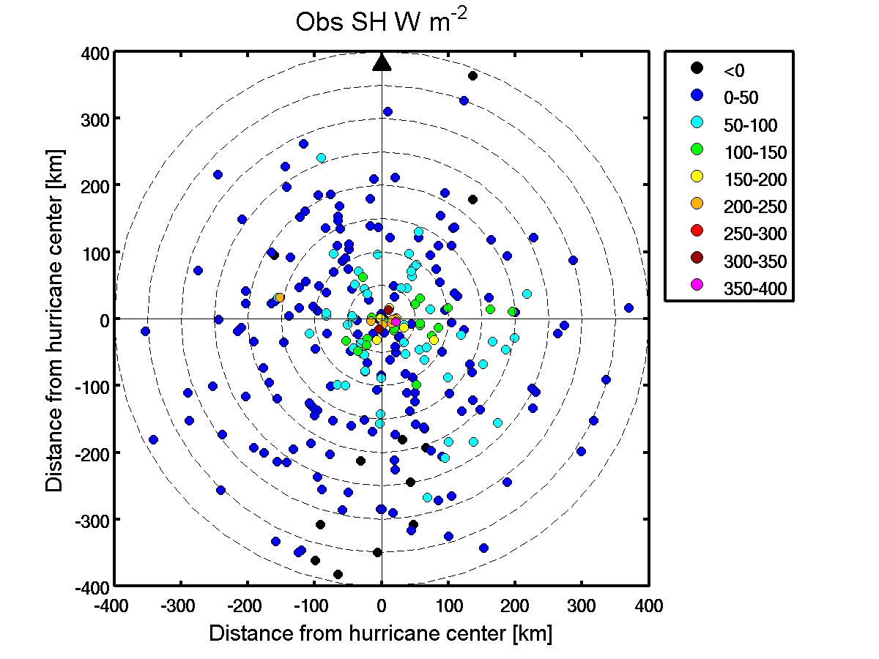
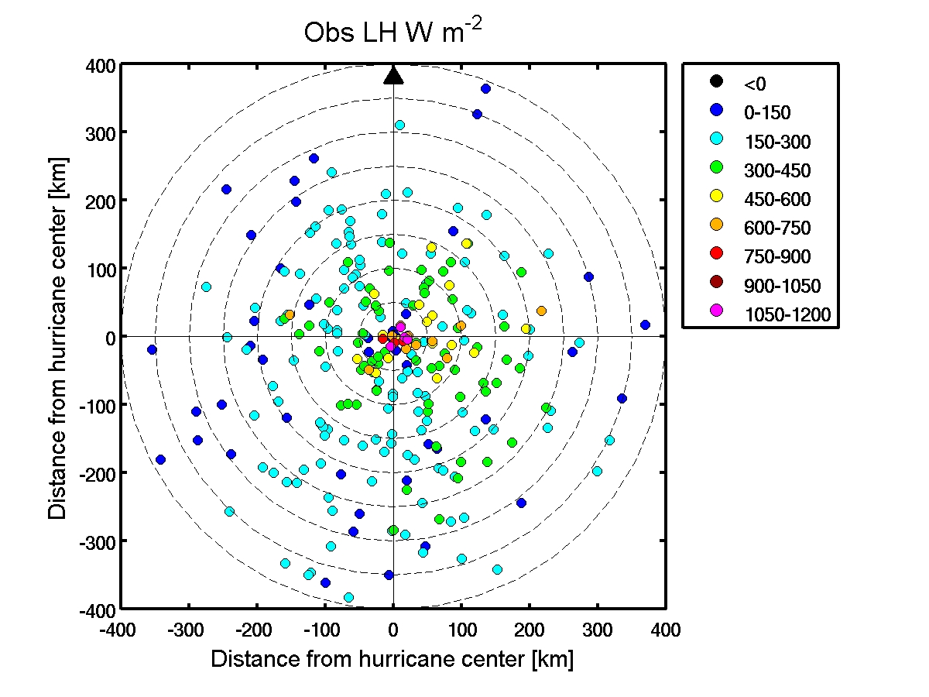
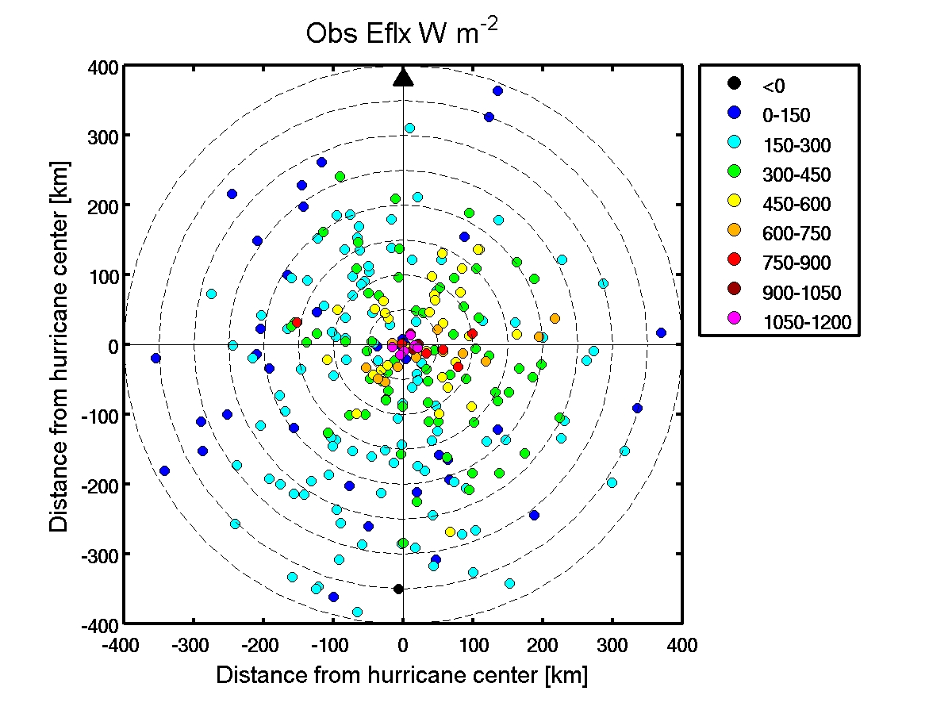
(Chen et al. 2012)
Notes:
Storm-relative SH, LH, and Enthalpy fluxes from Fanapi, Malakas, and Megi

Slide 22
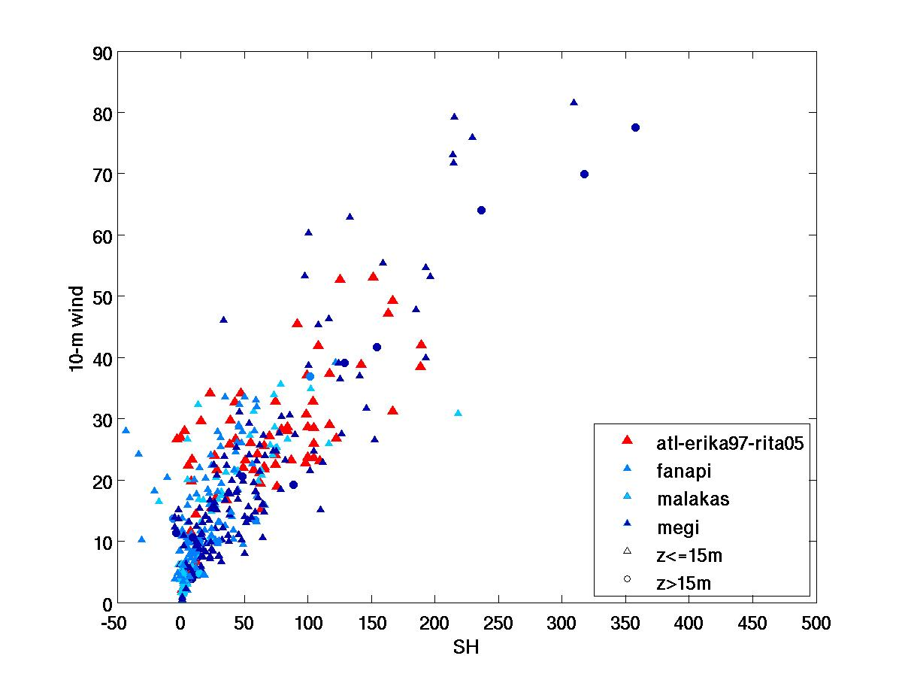
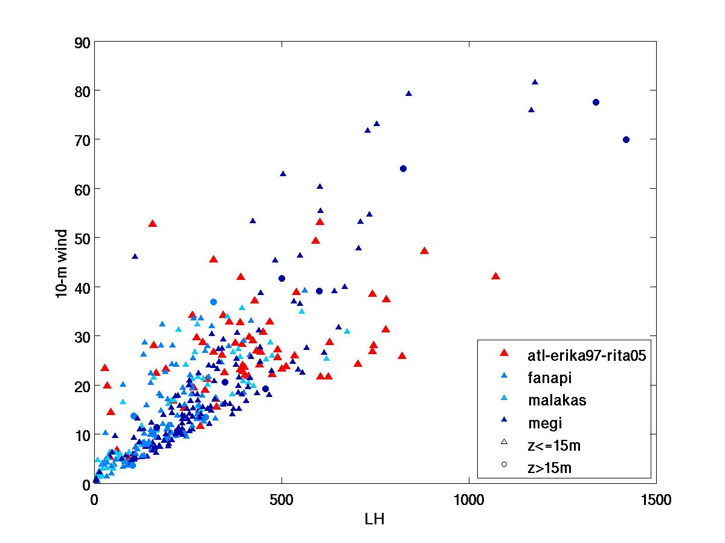
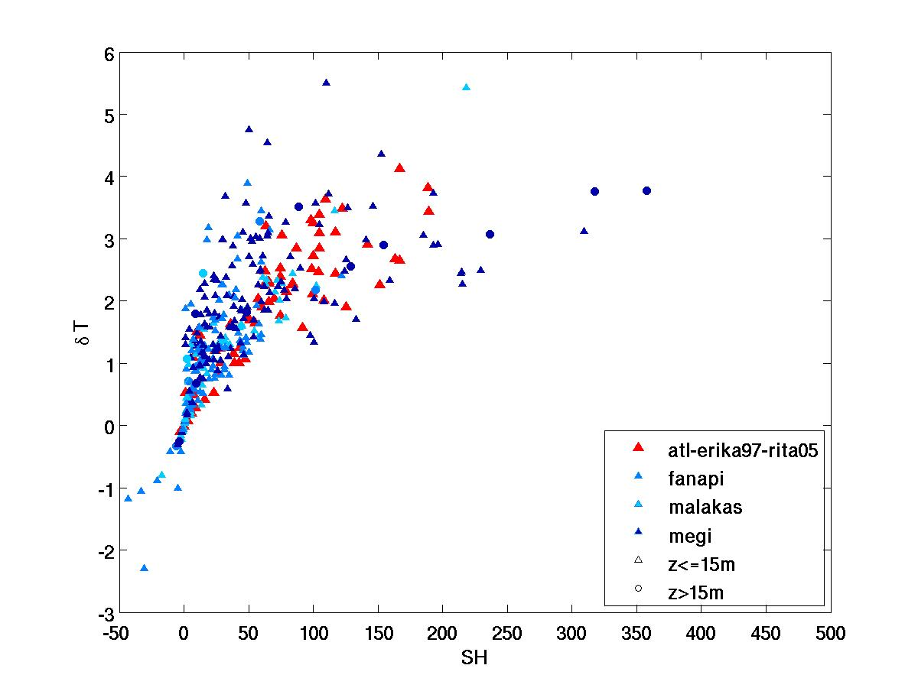
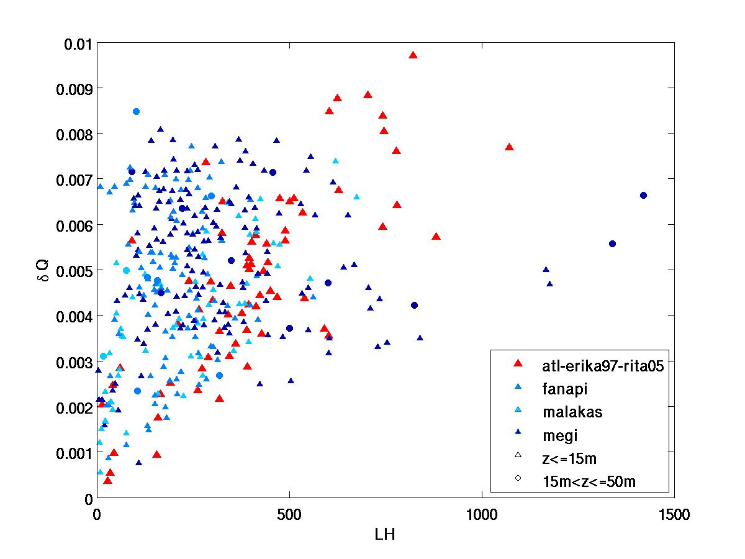
(Chen et al. 2012)

Slide 23
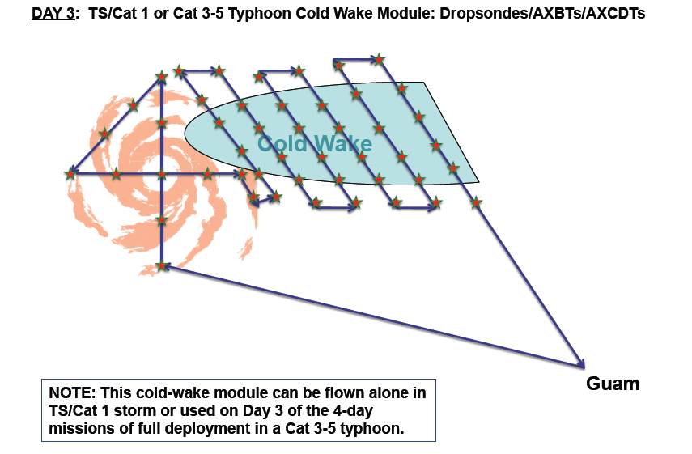

Slide 24
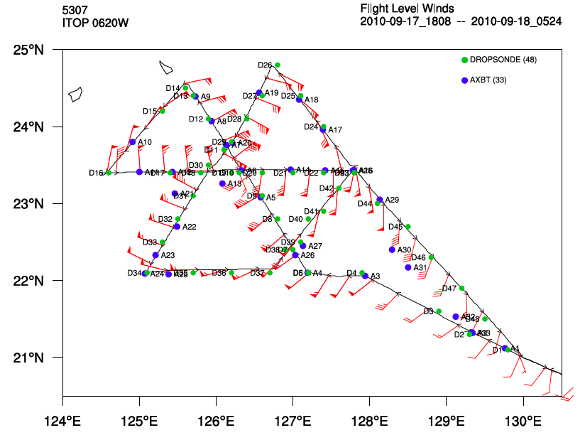

Slide 25




Observed and Modeled Structure and Intensity of Fanapi
JTWC
JTWC
Notes:
Obs 9/16 21z-9/17 03z, WRF 9/17 22z
Obs 9/17 21z-9/18 03z, WRF 9/18 06z

Slide 26

Figure: ADOS wind speed observations of typhoon Fanapi. The sea level winds are adjusted to 10m neutral stability winds and compared with corresponding dropsonde data. The dropsonde wind speed observations from levels closest to 10m are adjusted to 10m, as well. ADOS wind observations ahead of Fanapi are marked with blue dots, and with black dots in the lee of the storm.
(Luca Centurioni and Jan Morzel)
Notes:
Eight air deployment boxes each containing one Autonomous Drifting Ocean Station (ADOS) drifter [Black et al., 2007; Centurioni, 2010] and one Surface Velocity Program with Barometer (SVPB) Lagrangian drifter [Niiler, 2001] were air-deployed from the back ramp of a C-130J on 9/17/2010 along a line running across the forecasted track of Fanapi. The deployment line was approximately 340 Km long, spanning from 21.97N, 125.31E to 24.53N, 127.09E. The ADOS, which is not a Lagrangian drifter, measures SST, surface wind speed and direction, air pressure and subsurface temperature every 15 m to a depth of 150. SVPB drifters are designed to follow ocean currents at a depth of 15 m and measure SST and air pressure.
The wind data were obtained from a Gill 2-axis WindSonic anemometer (0-60 ms⁻¹ range, accurate within 2% at 12 ms⁻¹, nominal). The anemometer is located on the highest point of the ADOS hull. The ADOS internal algorithm discards the wind data when the drifter is partially underwater, as flagged by the barometer data. The wind vane of the ADOS aligns with the wind direction, which is therefore measured with an internal compass. The accuracy of the wind direction has been determined from previous tropical cyclone deployments and comparisons with collocated QSCAT to be winds is ±10°. A scaling factor needs to be applied to the measured wind data to compensate for biases introduced, for example, by sampling the wind in the lee of surface ocean waves and to adjust the observation taken 0.5 m over the ocean surface to 10 m neutral-stability wind. The scaling factor of 1.84 was obtained from sea tests off California when the measured wind from drifters fitted with WindSonic anemometers was compared with measurements from a nearby NOAA buoy and QSCAT winds. Such scaling factor was applied to the observations presented here. The eye of Fanapi passed over the ADOS line on September 18, 1:00 Z and the maximum observed wind was 38.5 ms⁻¹ (Fig. x). A sharp nearly exponential rise in wind speed was observed towards the center of Fanapi and considerable variability (of the order of 3-5 ms⁻¹) was observed at any given distance from the center and it could either be due to real wind variability or could be an artifact of the observing technique. The measured winds increased by some 5 ms⁻¹ from the front to the back of the storm either due to the strengthening of the typhoon or to storm relative differences between the front and the rear quadrants. The ADOS wind data are in excellent agreement with the dropsonde wind measurements.

Slide 27






Is cold wake good or bad for TC intensification?
(How does Air-Sea Coupling Affect TC Intensity? – Lee and Chen 2012)
t = 0
t = 120 min.
Coupled
Iso-surface of tracer from cold wake region
t = 120 min.
Uncoupled
t = 0
301 302 303
Notes:
Air-sea interaction in hurricane research has been studied in the past 20 years through either coupled models and observations. But non of them actually describe how air-sea interaction change the storm structure.
Last year, by using our own coupled model, we found an very interesting feature, which is shown here.
2) So what I did is put a tracer in both coupled and uncoupled model at boundary layer, and then - there is more vertical transport in uncoupled run at outside of eyewall, and less vertical transport, therefore more tracer able to enter eyewall,
- the same features occurs one hour later: little convection outside of the eyewall, and therefore more tracer is able to stay in HBL and then get into the eyewall, but in uncoupled simulation, the tracer is brought out to free atmosphere rainband area.

Slide 28


Stable Boundary Layer: surface is cooler than the air (Stull 1988)
Static stability
> 0 - stable
= 0 – neutral
< 0 - unstable
z
Stable
Unstable
Typhoon Fanapi
Neutral
θ_{v}
Obs
CWRF
Notes:
From stull, the definition of SBL is when the surface is cooler than the air, The the air-temperature will always adjust toward surface temperature, and therefore there will be a reverse temperature profile as the figure shows here.
This is where the stable boundary layer is.
So one way to form the stable boundary is to cooling the surface for a certain amount of time. Over land, radiation cooling at night could be one cause.
So how about under hurricane circumstance. Hurricane usually form over the warm water as the figure shows here, which his a pre-storm sea-sruface temperature, and here is the storm location.
Over ocean, under this warm environment, the only way for ocean surface to cool down in hurricane is through the air-sea interaction which bring up the colder water underneath and cool the surface.
However, maybe because the lack of observations, and coupled model… we never really understand if there is a stable boundary layer, and what is its impact on storm??

Slide 29



Typhoon Fanapi
B
WARM
Mission | 0620w
Dropsonde | 49
AXBT | 33
COLD
WARM
A
Air Temperature
Cold air flows over warm ocean, upward sensible heat flux
Air-sea interface
Warm air flows over cold ocean, downward sensible heat flux
Ocean Temperature
A
B
Notes:
Direction of Energy reverses in these two regions

Slide 30


Typhoon Fanapi - CWRF
B
WARM
COLD
WARM
A
Air Temperature
Cold air flows over warm ocean, upward sensible heat flux
Air-sea interface
Warm air flows over cold ocean, downward sensible heat flux
Ocean Temperature
A
B
Notes:
Direction of Energy reverses in these two regions

Slide 31


Thermodynamic forcing – ABL and air-sea fluxes
θ_{e} along the trajectories released from the cold wake region
CWRF
WRF
Unstable, into rainbands
Stable, near sfc inflow
Initial release of trajectories

Slide 32

Enhanced inflow over the cold wake:

Slide 33

Schematic of tracer from cold wake region
Cold wake/stable BL suppress deep convection locally and downwind (in outer rainband region).
Stable BL over the cold wake keeps air in BL longer and enhances sfc flux/increases θ_{e} of the inflow into the eyewall.
SST gradient at the edge of cold wake results in larger inflow angle and stronger inflow.
WRF
CWRF

Slide 34


Formation and Recovery of a Cold Wake from Fanapi
COAMPS SST (9/18/2010)
Satellite SST (9/18/2010)
Predicted cold affected area is smaller than satellite obs.
Predicted maximum ΔT (-3.0°C) is larger than that from AXBT.
Mixed layer depth ranges between 20 – 40 m.
COAMPS thermocline is weaker than the AXBT.
-2 °C
-2 °C
COAMPS (9/17-18)
3
Fanapi AXBT (9/17-18)
4
2
2
1
4
3
1
(Shouping Wang)

Slide 35


Formation and Recovery of a Cold Wake from Fanapi
09/22/2010
An area is chosen for averaging from both the model and satellite SST.
The predicted SST is 1.5°C colder.
Two different warming periods are identified in the satellite SST
How does cold wake recover to its environment?
1
Rapid Warming
1
Slow Warming
Cooling
Satellite average
(Shouping Wang)

Slide 36

Formation and Recovery of a Cold Wake from Fanapi
CW warming is caused by solar insolation.
Env. loses heat faster due to higher SST.
The warming rate should be a function of the ocean surface layer depth and net heat input.
More heat budget analyses are being conducted.
Stress
SST
Heat gain: Insolation
Heat loss: Sensible+Latent+LW
(Shouping Wang)

Slide 37
Collaborative Research Efforts and Publications
Summary of model forecasts and verification during ITOP field campaign August-October 2010 (Kerns&Chen 2012, Sue Chen, Ko and Chao, others)?
Overview of ITOP research modeling results?
Coupled air-sea observations and high-resolution model simulations of Typhoon Fanapi, Malakes and Megi (storm structure, storm-induced cold wake, etc.)
Air-sea fluxes in TCs: model and obs (Chen et al. 2012)
Typhoon Fanapi – cold wake/stable boundary layer and its impact on TC structure and intensity (Chen, Lee, Kerns)
Cold wake recovery (S. Wang, Sue Chen)

Slide 38
Impacts of ITOP beyond TC community?
Unprecedented COUPLED air-sea observations
High-resolution coupled models and better data assimilation techniques
Perfect for a high-resolution coupled REANALYSIS products for understanding and model development in the future.

