Slide 1
Wave Estimates From ScanSAR Data:
Old Problems, New Solutions
Roland Romeiser
University of Miami, RSMAS-AMP & CSTARS rromeiser@rsmas.miami.edu
and the ITOP SAR Team
C. Wackerman (GD-AIS), M. Caruso & H. Graber (CSTARS), J. Horstmann (NURC), D. Walker (SRI), R. Foster (UW-APL)
ROMEISER ET AL. WAVES FROM SCANSAR ITOP SANTA FE 2011
ROMEISER ET AL. WAVES FROM SCANSAR ITOP SANTA FE 2011

Slide 2
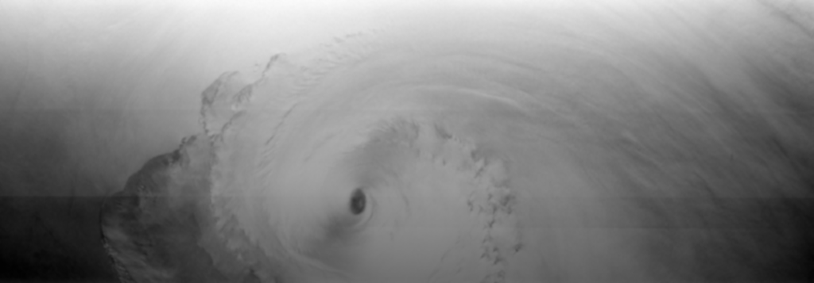
ScanSAR vs. Stripmap SAR
100 km
450 km
●
●
●
● Much better coverage, scanning over multiple adjacent sub-swaths
● Reduced spatial resolution (100 m vs. 25 m at C band)
● Sub-swath switching may cause specific ScanSAR imaging artifacts

Slide 3
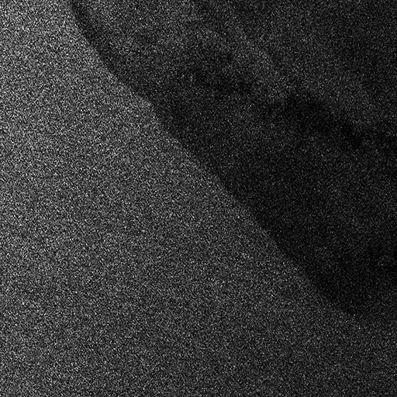
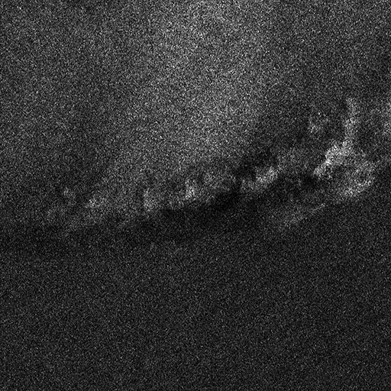
ScanSAR Imaging Artifact: Scalloping
Two subsections of 1024 × 1024 pixels = 51.2 km × 51.2 km
●
●
●
●
● Wave-like periodic intensity modulation artifact
● Found in many ScanSAR images of ocean scenes from various satellites and SAR processors
● Big problem for wave and wind retrievals
● Post-processing filter developed in ITOP
RADARSAT-1 ScanSAR image of hurricane Helene (2006), 450 km × 1240 km

Slide 4
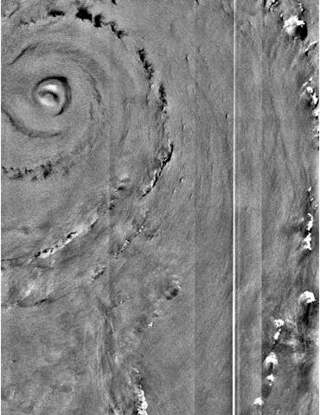
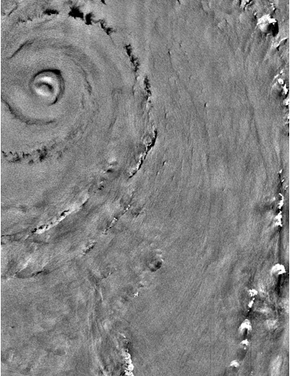
ScanSAR Imaging Artifact: Beam Seams
●
●
● Some ScanSAR images exhibit visible beam seams and / or bright "nadir ambiguity" line
● GD-AIS developed specific filter to remove such artifacts
ScanSAR image of hurricane Katrina (2005)

Slide 5
SAR Imaging of Ocean Waves
●
●
●
●
➔
● Tilt modulation of incidence angle
● Hydrodynamic modulation of small-scale roughness
● Nonlinear SAR imaging artifacts ("velocity bunching")
● Modulation strengths vary with wavelength and direction, as well as with wind vector, local incidence angle, etc.
➔ Conversion of image spectrum to ocean wave spectrum is challenging task, even more under typhoon conditions

Slide 6
MTF-Based Wave Retrieval Algorithm
SAR Image Intensity Array
●
●
●
●
Fourier Transform
● Neglects nonlinearities of imaging mechanism
● Neglects wavelengths below spatial resolution
● Neglects specific high sea state effects
● Requires detectable wave signatures to work
Image Spectra
Modulation Transfer Function
Ocean Wave Spectra
Analysis
Peak Wavelengths, Directions, SWHs
●
●
● Idea: Empirical algorithm could account for neglected effects, lead to improvements without complex theoretical modeling
● Wind algorithms have always used empirical functions

Slide 7
New Empirical Wave Retrieval Algorithm
SAR Image Intensity Array
Fourier Transform & Filters
Image Spectra
Peak Analysis Routine
Averaging
Image Peak Wavelengths
Image Peak Directions
Image Mean Intensities
Empirical Relation
Empirical Relation
Ocean Peak Wavelengths
Ocean Peak Directions
Ocean SWHs
●
●
➔
● Developed using RADARSAT-1 hurricane images and WAM spectra
● SWH depends most strongly on mean intensity & peak direction
➔ Extrapolated peak directions permit SWH estimates everywhere; no wave signatures required!

Slide 8
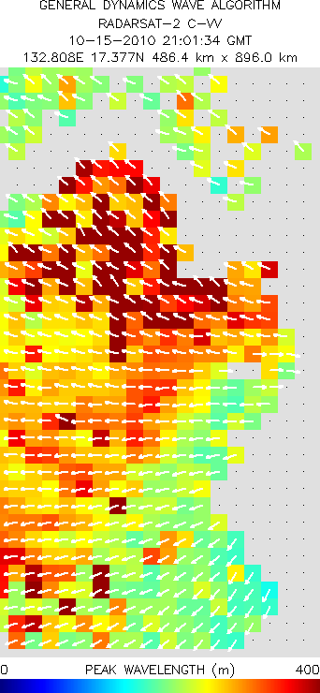
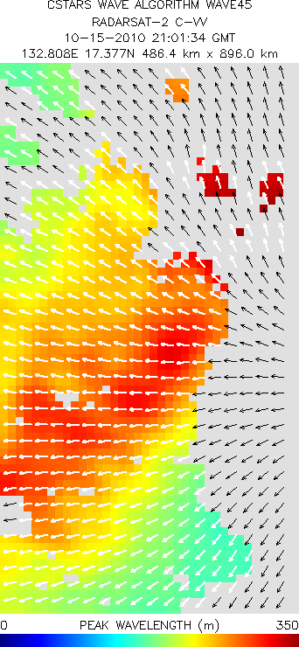
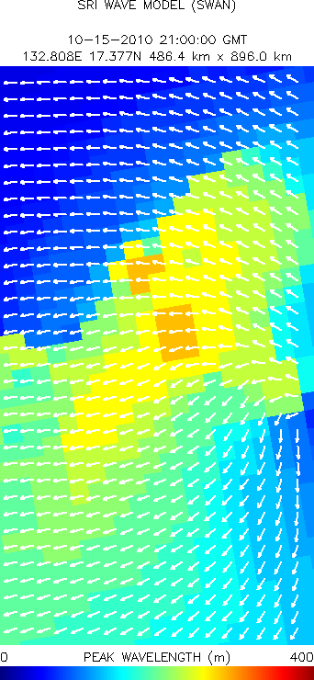
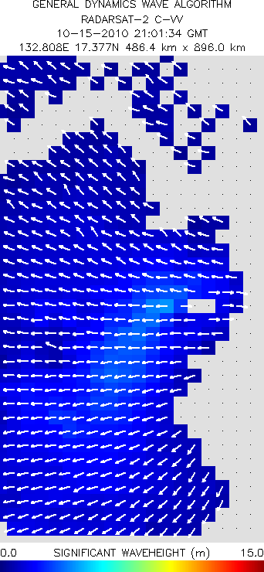
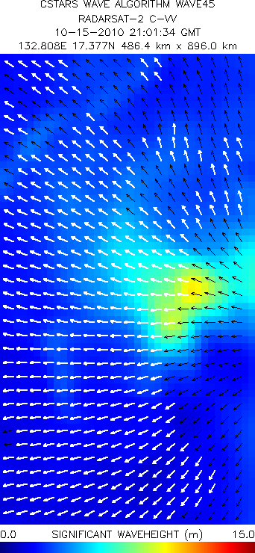
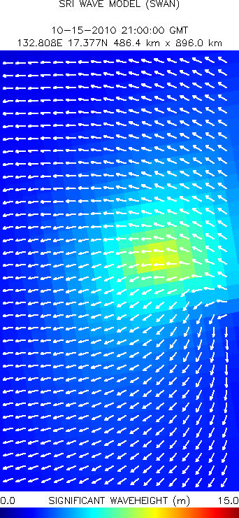
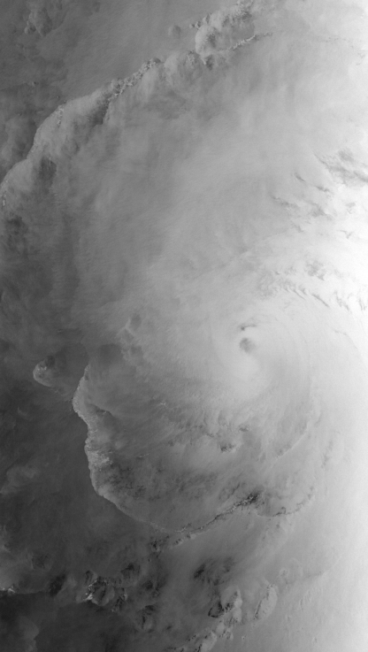
Example Result: Megi 2010-10-15 21:01 GMT
RADARSAT-2 Image
●
●
● Peak wavelength & direction: Similar results; differences partly due to different filtering & peak detection methods
● SWH: Better coverage with new method; large values around center of storm consistent with SWAN

Slide 9
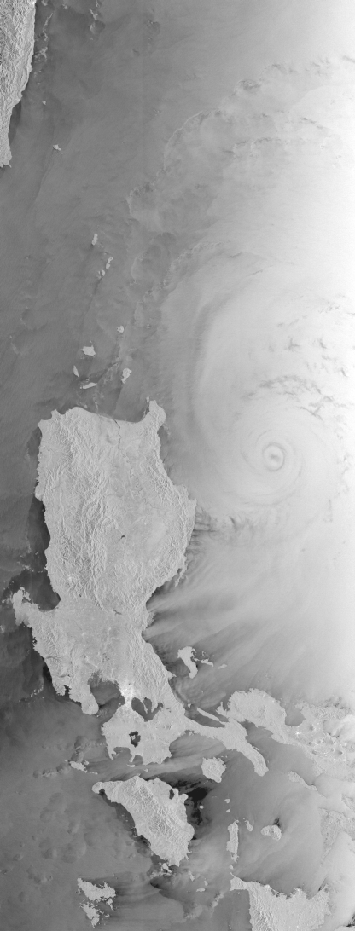
Example Result: Megi 2010-10-17 21:44 GMT
RADARSAT-2 Image

Slide 10
Summary & Outlook
●
●
●
●
●
●
●
● New scalloping and beam seam filters enable routine use of ScanSAR imagery for wave and wind retrievals
● MTF-based wave retrieval works (see Wackerman), but limited spatial coverage, seems to underestimate SWH
● New empirical wave retrieval algorithm estimates wave parameters from properties of image and image spectrum
● Similar to wind retrieval with empirical model function
● Can account for effects of sub-resolution-scale waves and nonlinearities implicitly
● Can estimate SWH where no wave signatures exist
● Upcoming: Detailed comparisons, further refinement, combination of the two wave algorithms, combination of wave and wind algorithms

Slide 11
END OF PRESENTATION
rromeiser@rsmas.miami.edu

