Slide 1
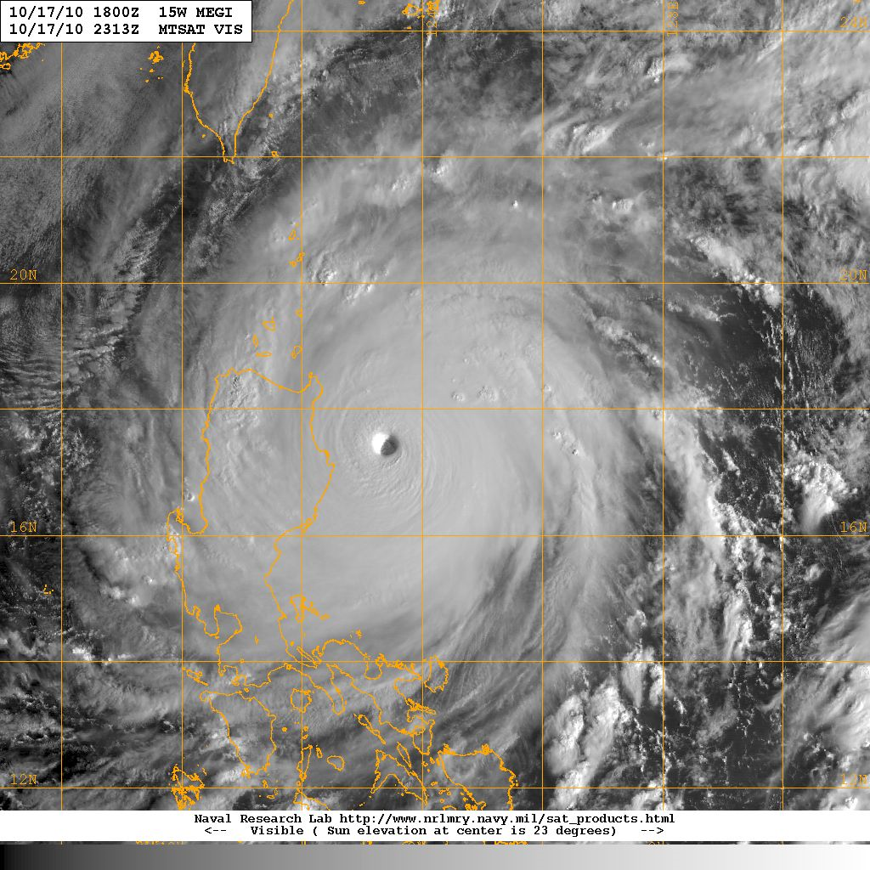
ITOP -2010 Data Management Support at NCAR/EOL
Scot Loehrer, Jim Moore and Steve Williams
NCAR/EOL
ITOP Santa Fe Meeting 17-20 May

Slide 2
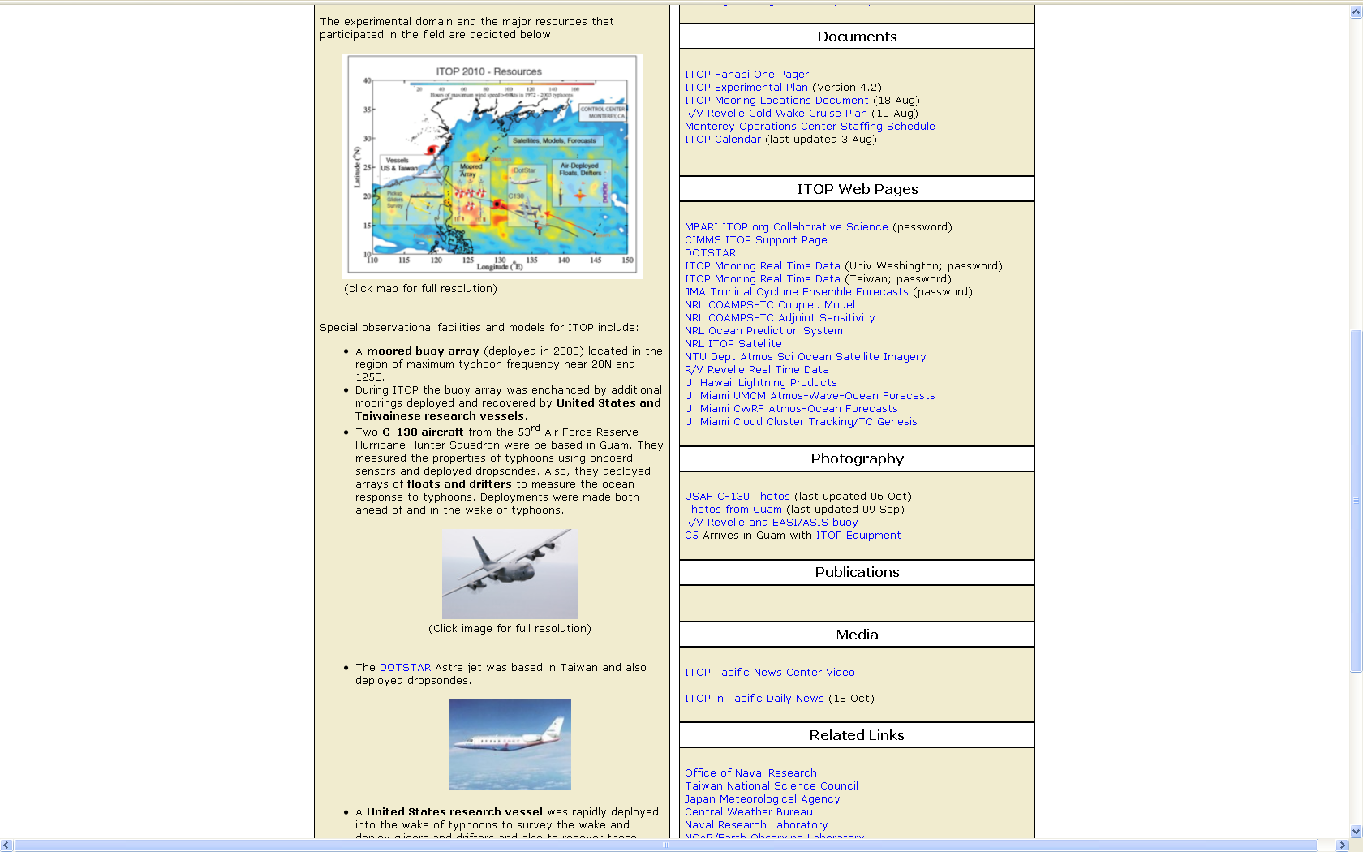
ITOP-2010 Project Web Site
at NCAR/EOL
http://www.eol.ucar.edu/projects/itop
ITOP Wiki
ITOP Distributed Data Archive
Dataset Submission Instructions
ITOP Field Catalog
ITOP Meetings
ITOP Documents
ITOP Web Sites
ITOP Photography
ITOP Publications

Slide 3
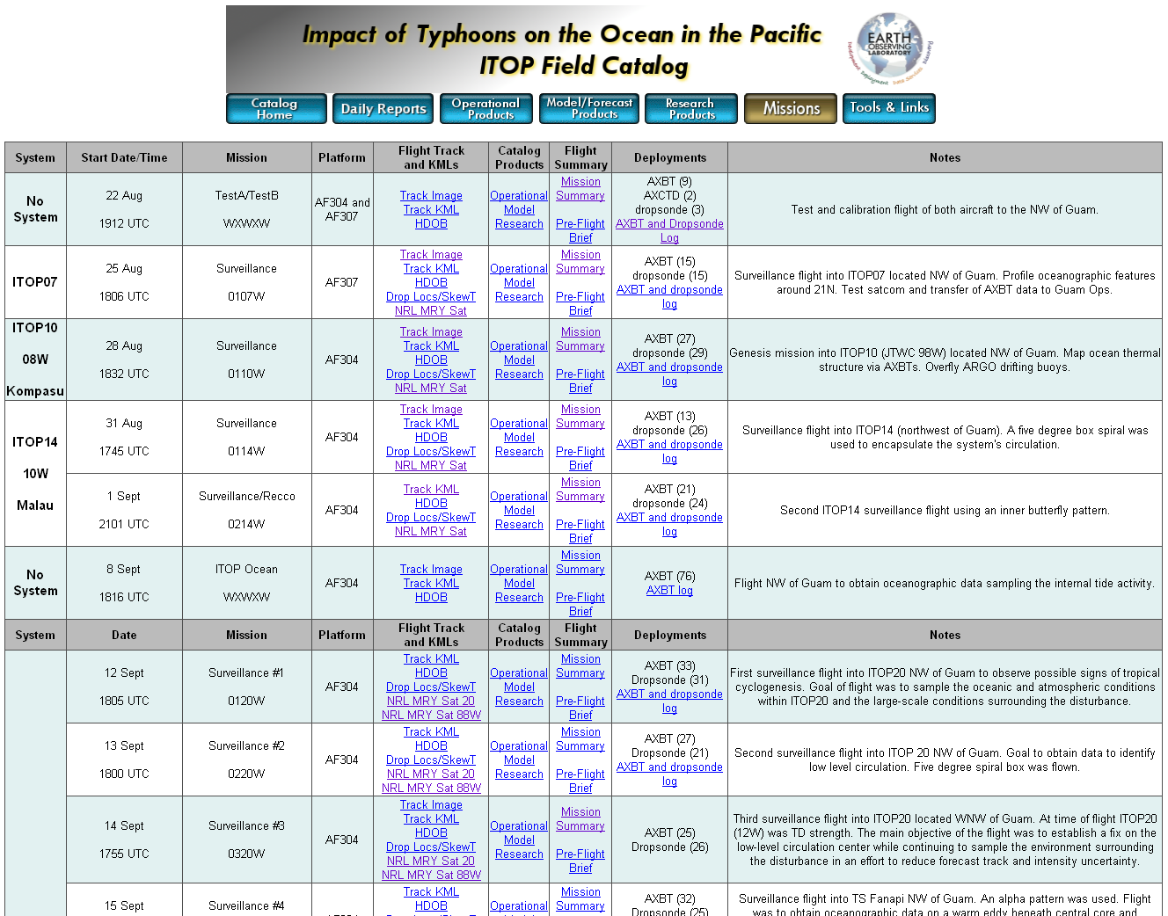
ITOP-2010 Field Catalog
Contains products from 1 July to 31 October 2010
All products are also now available from the Data Archive.
Daily Reports
Operational Products
Model Products
Research Products
Mission Summary Table
We are missing aircraft mission summaries for the following flights:
0520W, 0522W, 0330W, 0530W and 0830W
http://catalog.eol.ucar.edu/itop_2010

Slide 4
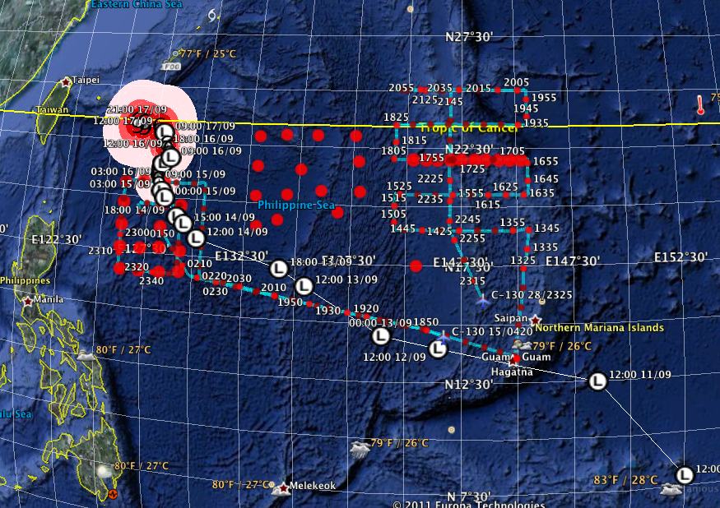
ITOP GE Products
Multiple GE kml overlays from Mission Summary table in ITOP Catalog

Slide 5
ITOP-2010 Field Catalog Statistics
Reports/Summaries (Forecasts, Mission Summaries, Instrument Status, etc)
1,973 documents and images (0.55Gb)
Research Imagery (Aircraft and Ocean)
3,939 images (0.43Gb)
Operational Imagery (Satellite, Radar, Upper Air, Lightning, Ocean, etc)
227,980 images (78.83Gb)
Model Imagery (Operational and Research Models)
489,044 images (31.24Gb)
TOTALS:
722,936 images (111.06Gb)
http://catalog.eol.ucar.edu/itop_2010

Slide 6
ITOP Data Policy Summary
The basis for the ITOP data policy is T-PARC and the World Meteorological Organization (WMO) Res. 40
In general, users will have free and open access to all the ITOP data, subject to procedures to be put into place at the various ITOP Data Archive Centers (IDACs).
Prompt submission of ITOP data to an IDAC to facilitate free and open access and exchange
Standard meteorological data such as synoptic observations, dropsonde observations, special rawinsonde observations, and satellite imagery shall be submitted to the appropriate IDAC within six months following the end of the field campaign on 1 November 2010.
All data shall be promptly shared with other ITOP investigators upon request.
During the initial data analysis period (one year following the end of the field phase; 1 November 2011), if data are provided to a third party (journal articles, presentations, research proposals, other investigators) the investigator who collected the data must be notified first.
All data will be considered public domain not more than one year following the end of the ITOP field phase. (There will be exceptions where extensive data processing is required)
Any use of the data will include acknowledgment (i.e., citation). Co-authorship during the one year analysis phase will be at the discretion of the investigator(s) who collected the data.
Acknowledgements of ITOP data and resources should identify: (1) ITOP; (2) the data providers (3) the relevant funding agencies; and (4) the role of the relevant ITOP Data Archive Center.

Slide 7
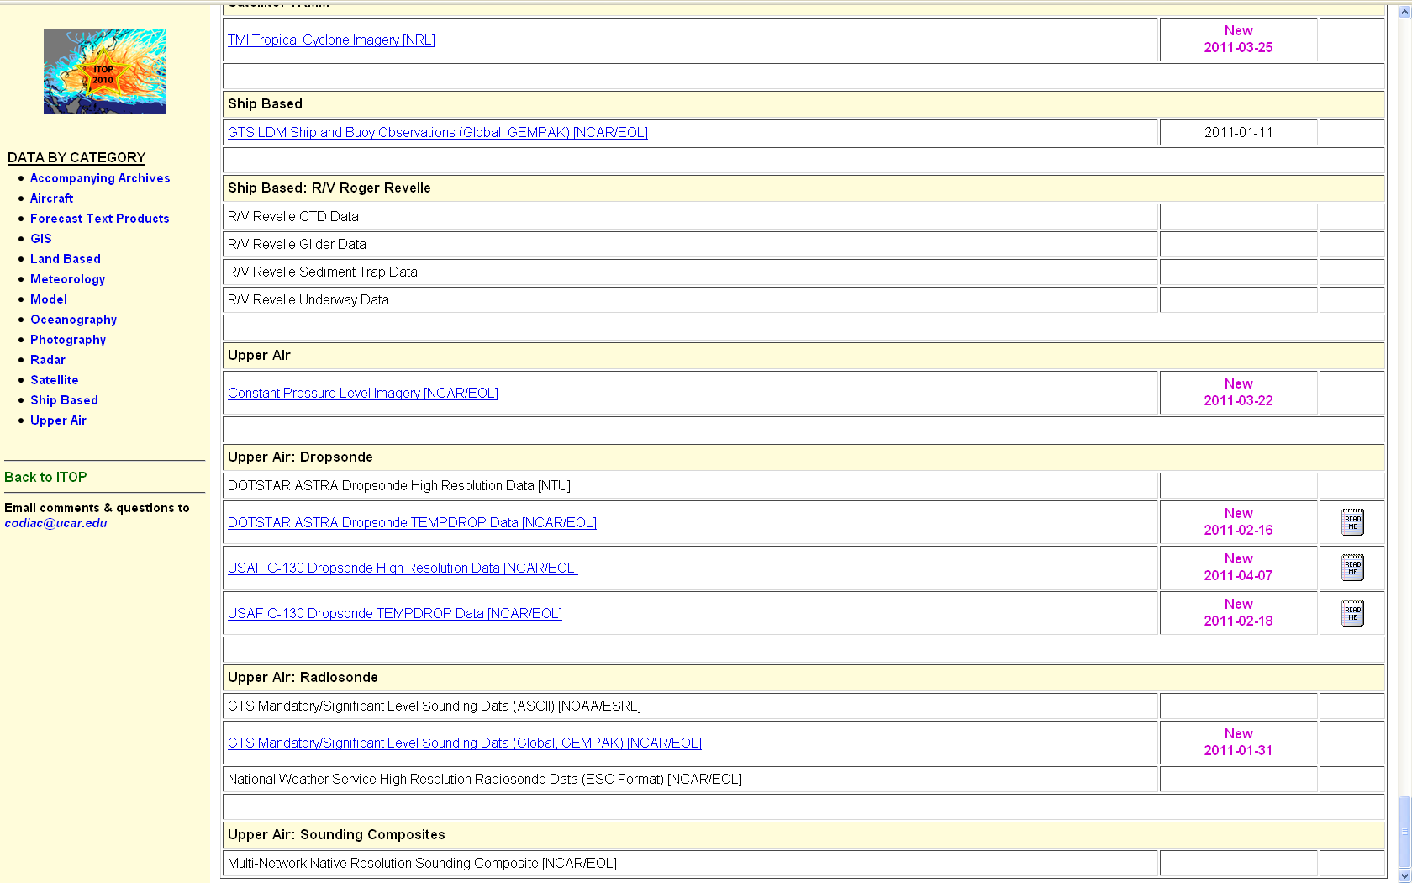
ITOP-2010 Distributed Data Archive
http://data.eol.ucar.edu/master_list/?project=ITOP
Links to ITOP.org
Links to other archives
Links to EOL archives
Links to documentation

Slide 8
ITOP-2010 Operational Data Set Inventory
http://data.eol.ucar.edu/master_list/?project=ITOP
GTS Surface METAR Observations (Global; GEMPAK and ASCII formats)
GTS Surface SYNOP Observations (Global; GEMPAK format)
GTS Voluntary Observing Ship and Buoy Observations (Global in GEMPAK format, ITOP Region in ASCII)
GTS Mandatory/Significant Level Radiosonde Observations (Global in GEMPAK format; Western Pacific Ocean region in ASCII)
High Resolution (6-second) Radiosonde data from NWS sites (Chuuk, Guam, Koror, Majuro, Ponape, and Yap) for August through October 2010. No data for Majuro for September or Yap for October.
Guam WSR-88D Level III Radar Data (NCDC)
Satellite Data requirements (geostationary and polar)?

Slide 9
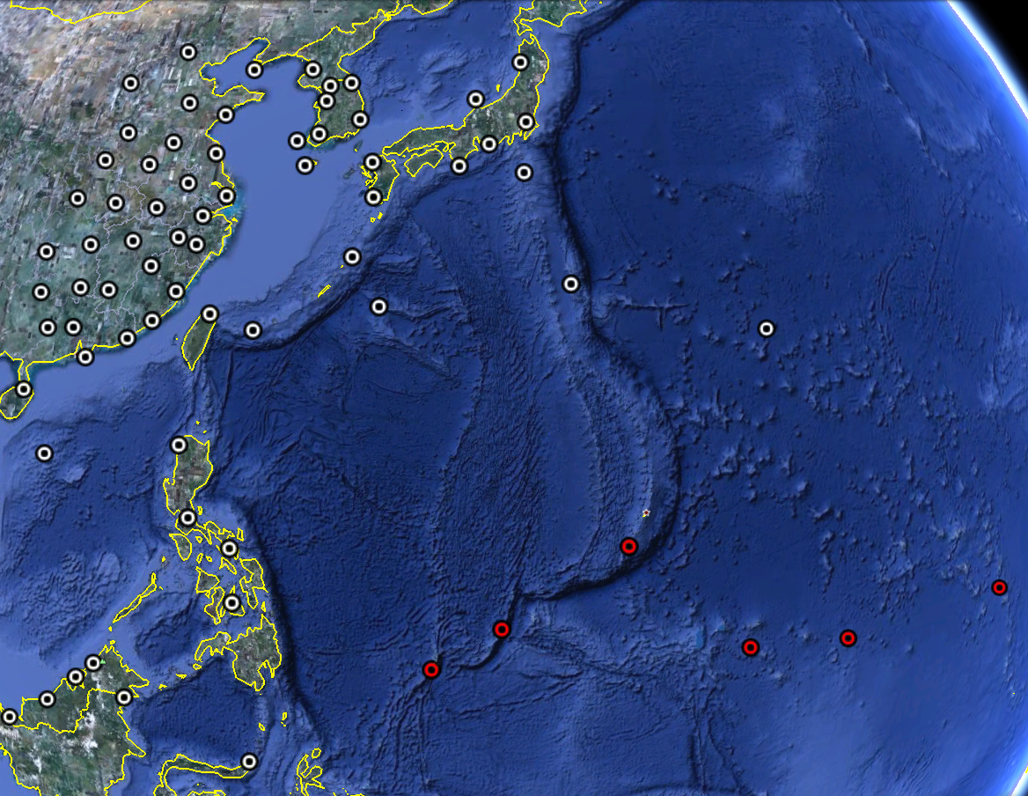
GTS (white) and High-Res (red) Radiosonde Locations

Slide 10
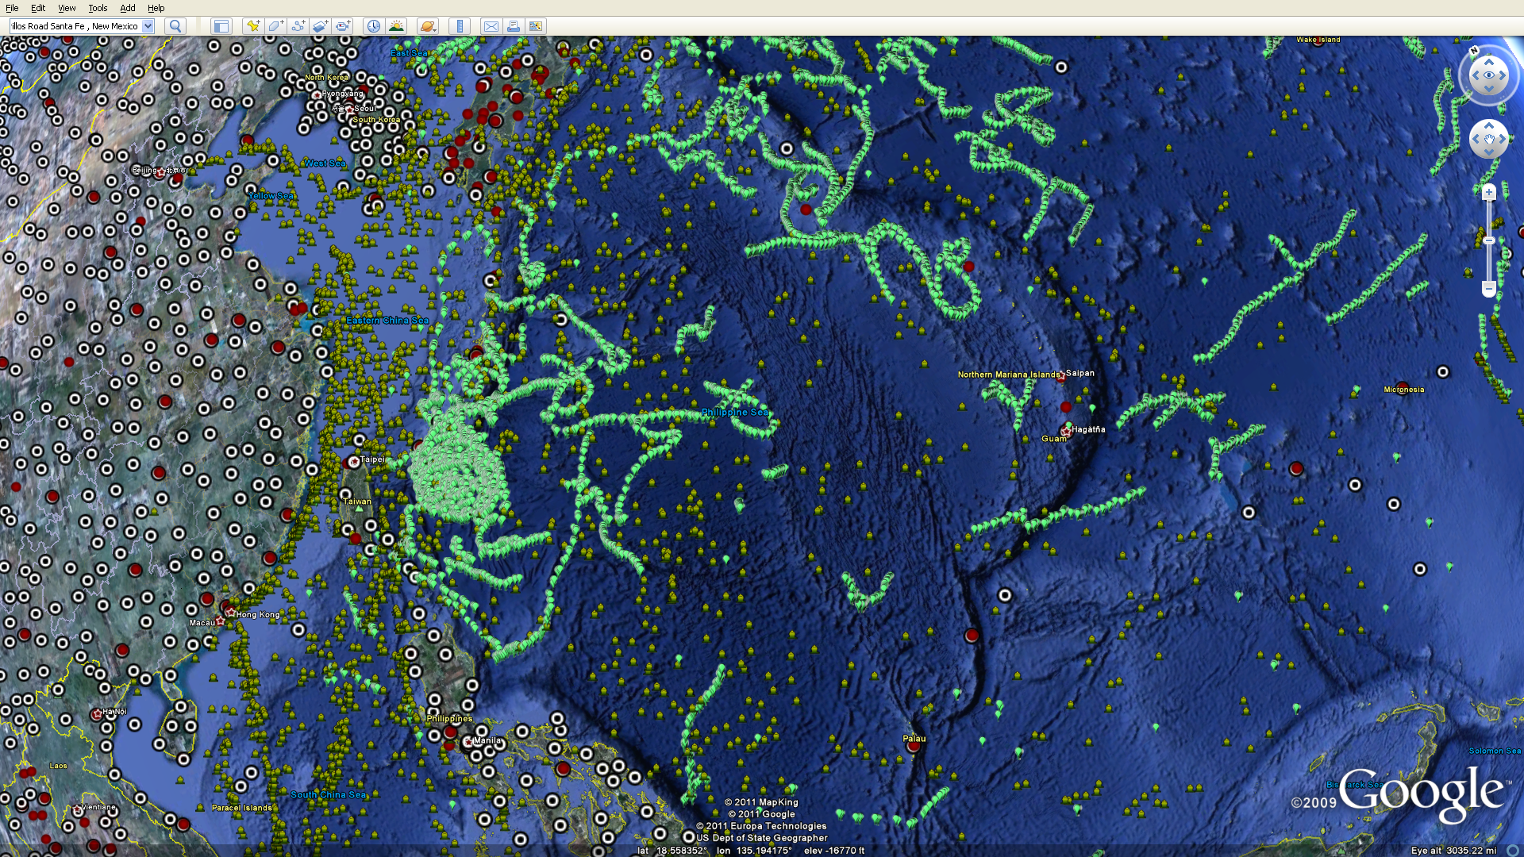
GTS METAR/SYNOP and Ship/Drifter Locations
Buoy/Drifter
Voluntary Observing Ships
VOS and Buoy/Drifter locations from October 2010.
SYNOP
METAR

Slide 11
ITOP-2010 Research Data Sets
http://data.eol.ucar.edu/master_list/?project=ITOP
USAF C-130 Dropsonde Data (quality controlled and high resolution)
USAF C-130 Flight Level, SFMR, and Radar Video data (not currently available)
DOTSTAR ASTRA Dropsonde Data (not currently available)
DOTSTAR ASTRA Flight Level Data (not currently available)
Synthetic Aperture Radar Data (not currently available)
Oceanography data sets will be available as links to ITOP.org web site.

Slide 12
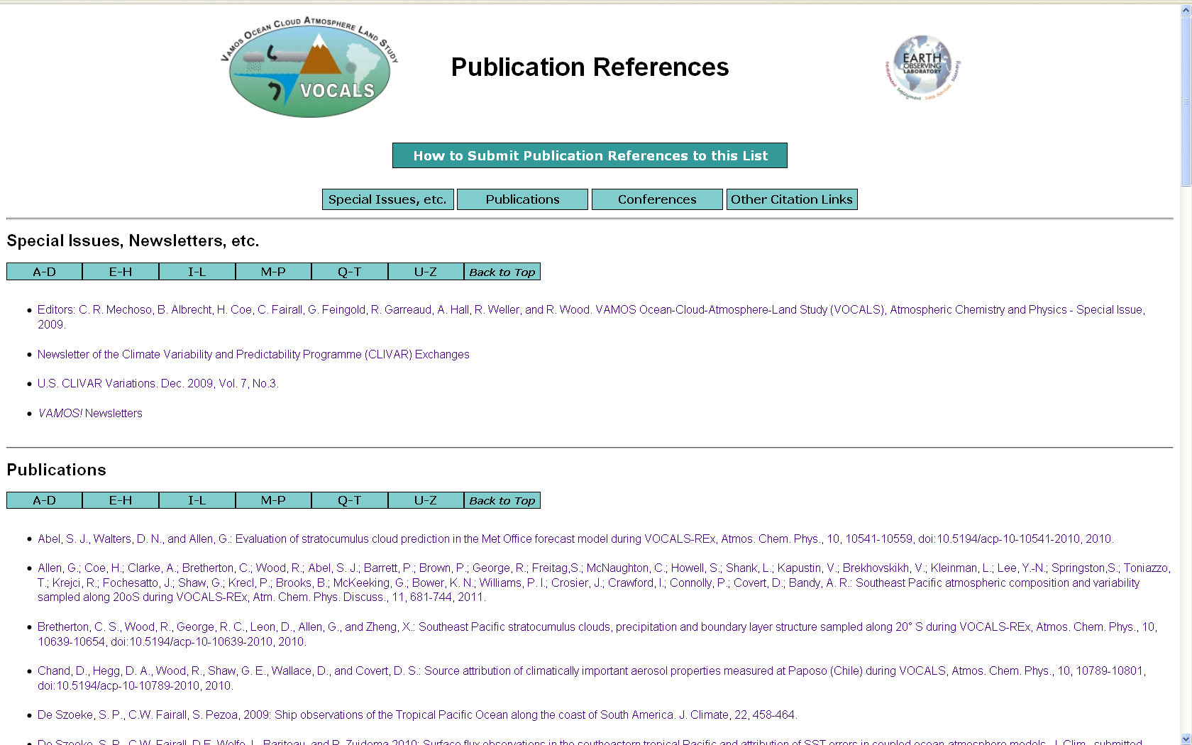
ITOP-2010 Publications
Central access point for all publications derived from the project.
Could include links to peer-reviewed papers, special issues, conference proceedings, reports, theses, etc.
Requires input from investigators.

Slide 13
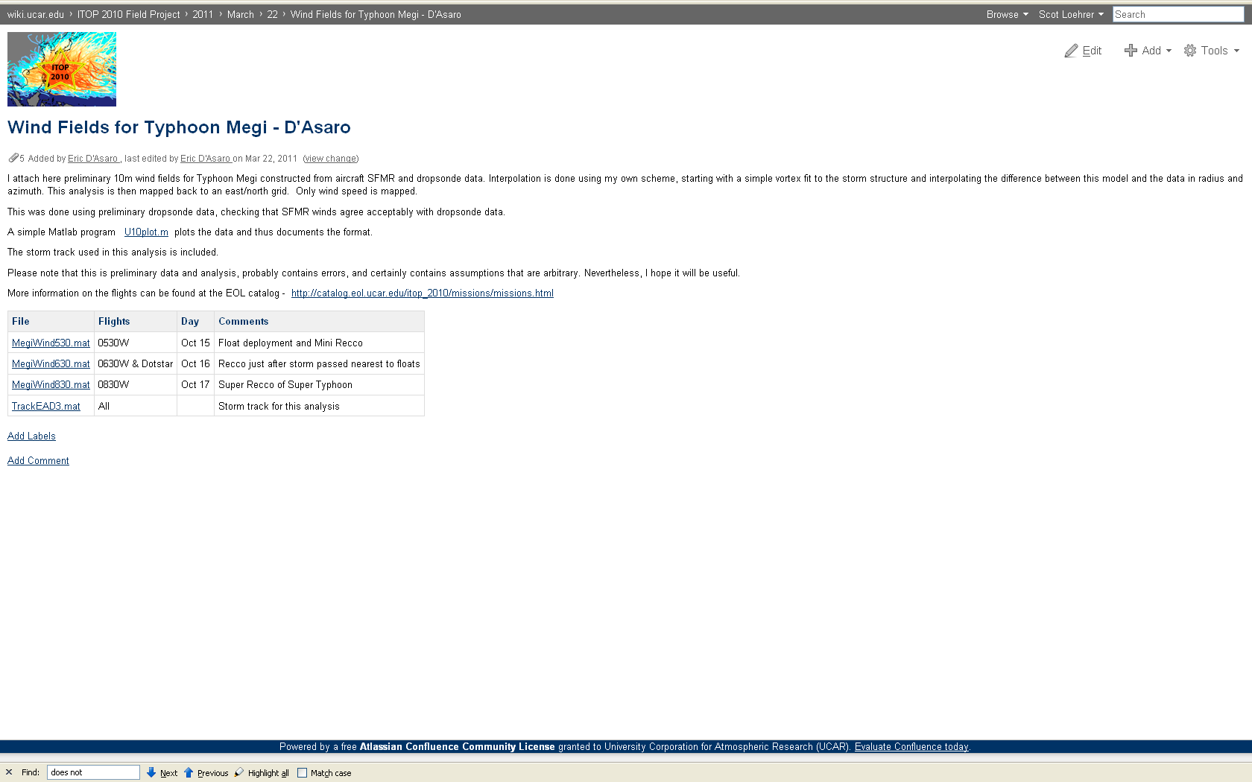
ITOP-2010 Wiki
https://wiki.ucar.edu/display/itop2010/Home

Slide 14
Summary
Field Catalog remains available and all products also available from the archive.
A Master List of all ITOP data sets has been developed and operational data sets are being populated.
The USAF C-130 QC’ed dropsonde data are available (next talk).
What satellite data (both geostationary and polar) need to be part of the archive?
Are there other operational data sets that should be archived?
Submit your data or links!

Slide 15
Data Set/Link Submission
Complete information on submitting your data and documentation or links to your data in another archive are available on the ITOP web site.
For those submitting data and documentation to the EOL archive we have set up an anonymous ftp location for submittal.
ftp data.eol.ucar.edu
login: anonymous
password: your email
cd pub/incoming/itop
When you have submitted your data and documentation send an email to Scot Loehrer (loehrer@ucar.edu) with the information including your data set title and any password restriction requirements. Or if the data set is too large for ftp submission send an email so we can work out the appropriate transfer method.
If your data are available from another long-term archive please send the link to your data set so it can be included in the Master List.

