Slide 1
Two-Scale SAR Wave Retrievals
C. Wackerman, R. Romeiser, M. Caruso, R. Foster, H. Graber, J. Horstmann
ITOP Meeting, 17-20 May 2011, Santa Fe NM

Slide 2
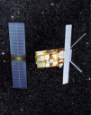
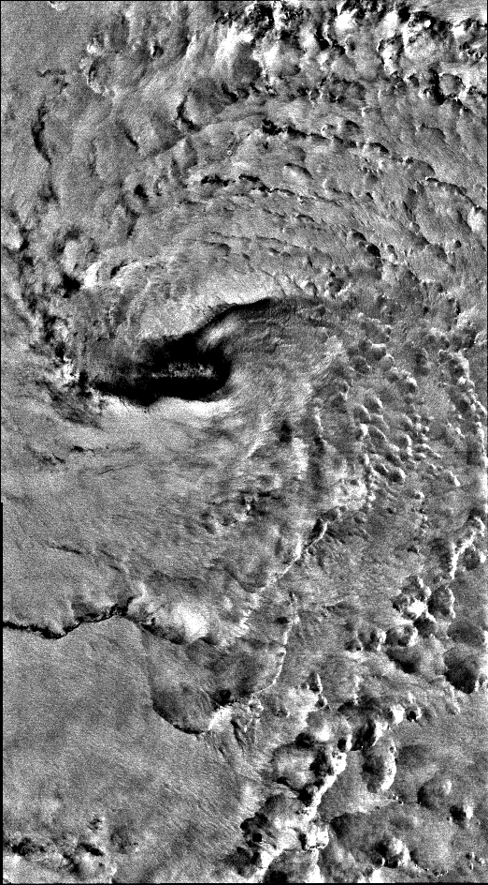
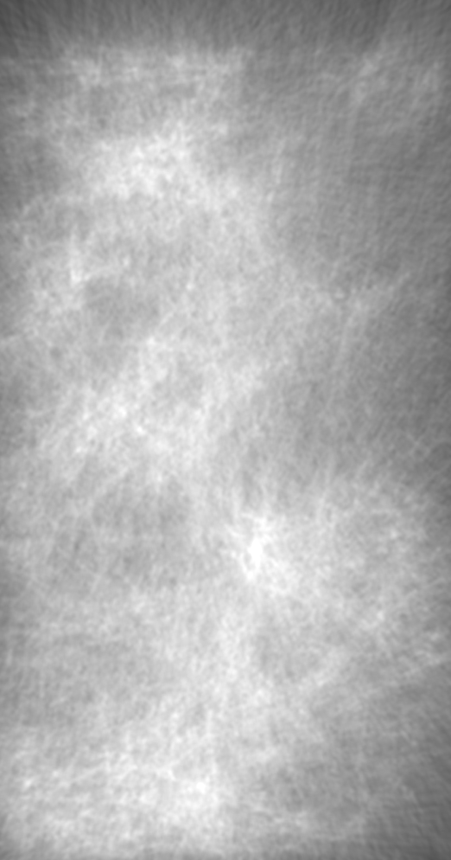
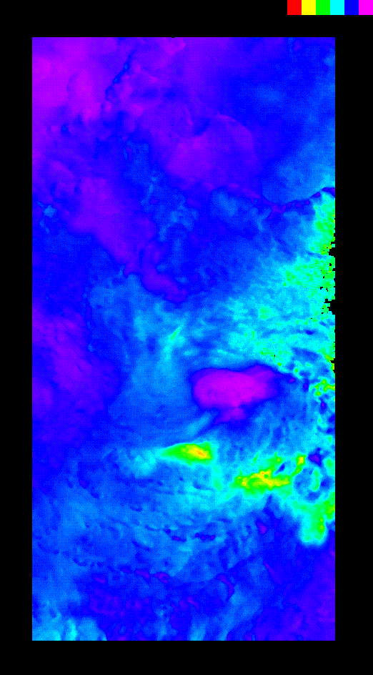
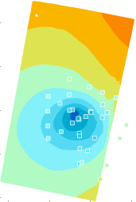
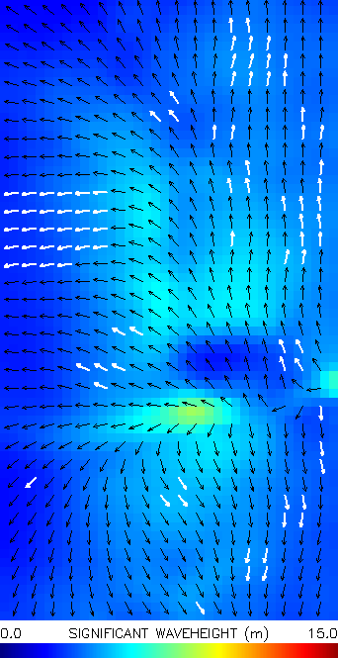
SAR Typhoon Processing System (SARTyPS)
Real-time SAR environmental product generation system being built at CSTARS to support field deployment
CSTARS SAR BackBone Processing System
Environmental Products
SAR Data
Eye location, size
Winds & Pressure Fields
Waves
CSTARS
Back
Bone
SAR Ancillary Files
Land
Mask
Wind Vectors ASCII File
Wave MeasuresASCII File
Previous Tracks
Eye Product
Eye Location,
Properties
UW-APL
Pressure Analysis
GD Eye Finder
NURC Eye Finder
Internet Access
GD Winds
Wind Product
Best Wind Directions
RCS-GMF
Wind Speed
NURC
WiSAR
GD Waves
Wave Product
Wave Spectral Map
CSTARS
Waves
Wind &Wave Products
SRI
SWAN/SAR
Assimilation
Best-Fit
Wave Spectra
& Winds

Slide 3
Overview of SAR Wave Retrieval
Utilization of SAR to estimate wave spectra for moderate wave states is well established
  multiple approaches have been published
The SAR ITOP program is determining whether these approaches can generate useful information under typhoon conditions
RMSE = .10 m

Slide 4
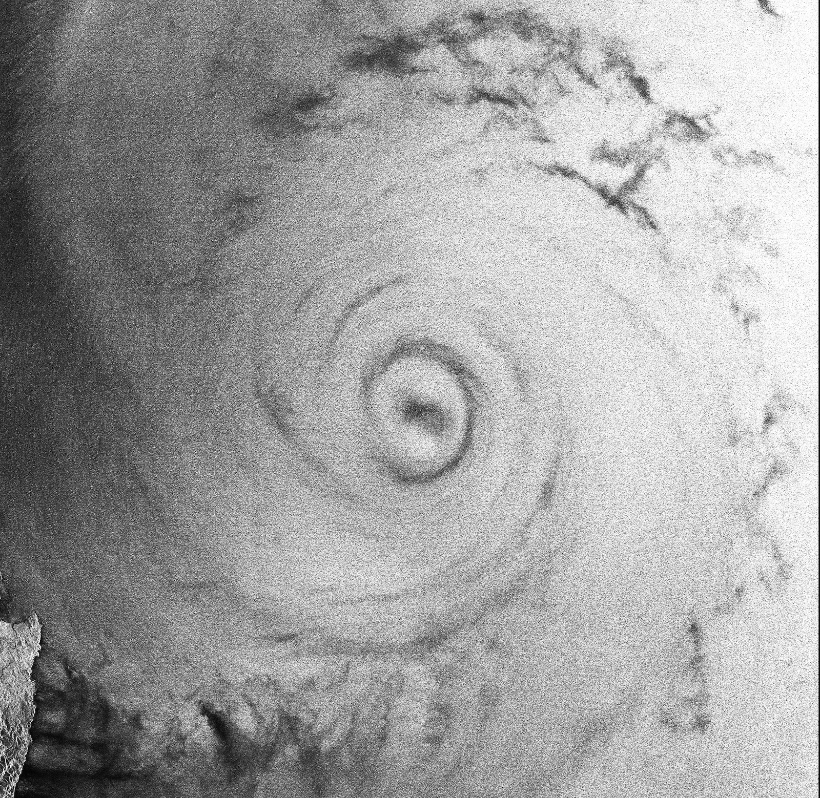

Slide 5
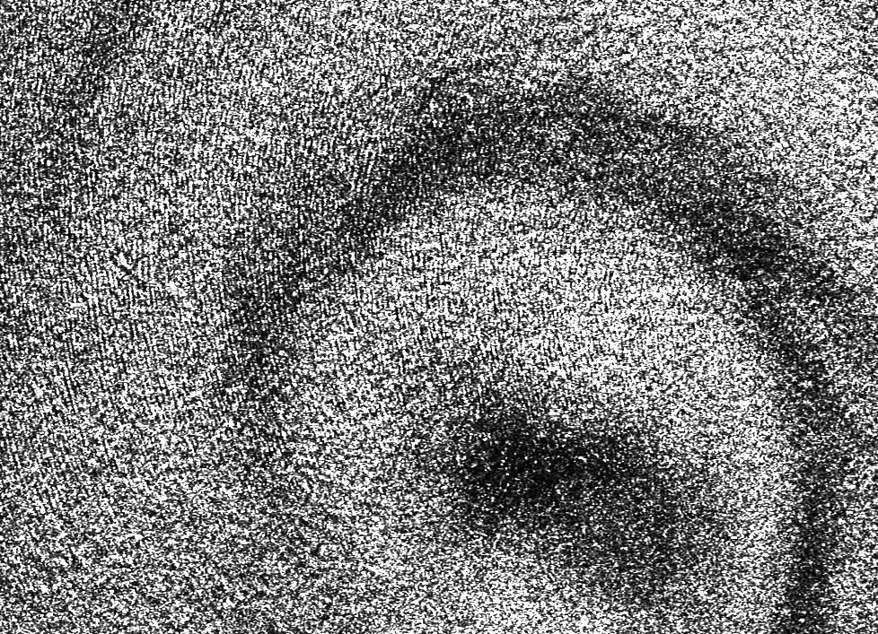

Slide 6
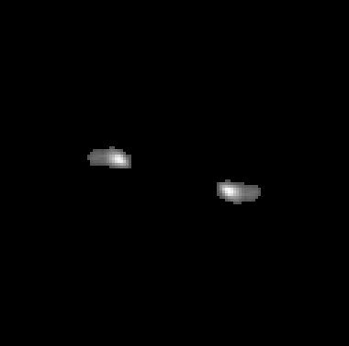

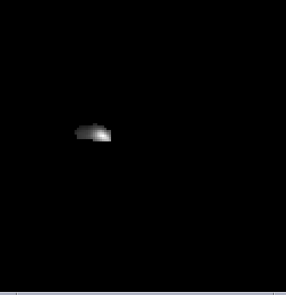
Overview of SAR Wave Retrieval (cont.)
First step is to remove SAR imaging effect to generate a clean spectrun of image modulations
Final step is to divide the image spectrum by the two-scale MTF to generate wave height spectrum
Noise-Removed FFT
MTF Magnitude
Wave Height Spectrum

Slide 7
Overview of SAR Wave Retrieval (cont.)
Krosa
For SAR images collected over typhoons there are additional issues:
SAR images are coarse resolution (100m), so only the very long waves can be imaged
(< 200m)
Due to SAR imaging effects, only the wave components near the SAR range direction are imaged
=> Only portions of the SAR image will contain wave modulations, and we can only estimate the long-wave component of the wave spectra
Finally, the only ground truth to date has been model results – any ground truth from ITOP would be great!

Slide 8
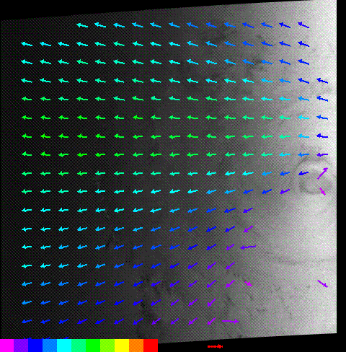
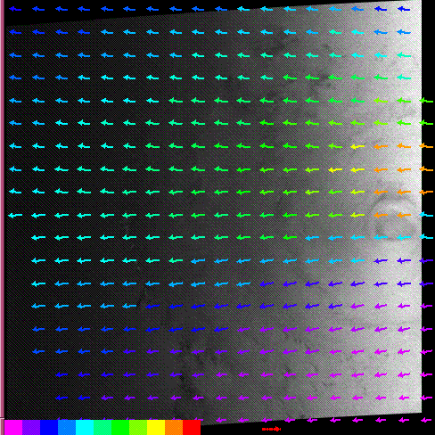
SAR
WAM
RMSE =0.66 m
Ignoring points to the right
Helene19

Slide 9
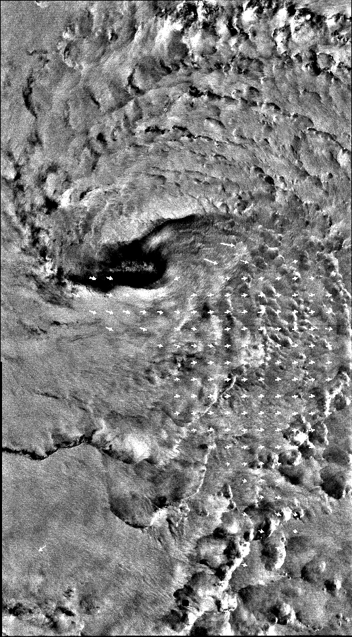
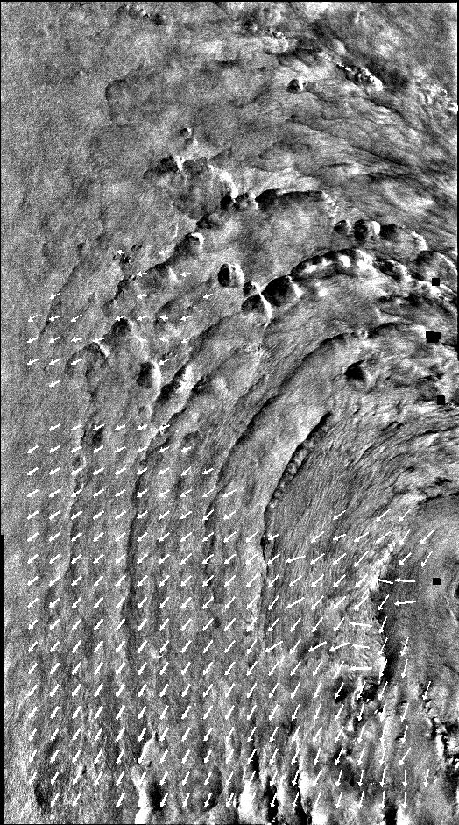
Malakas 9/22/2010
Malakas 9/24/2010
Blue arrows are storm track

Slide 10
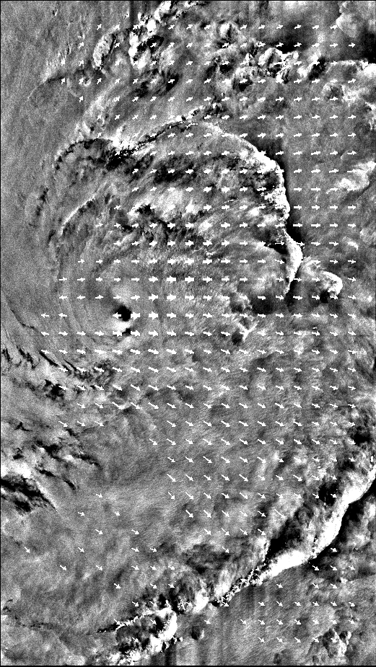
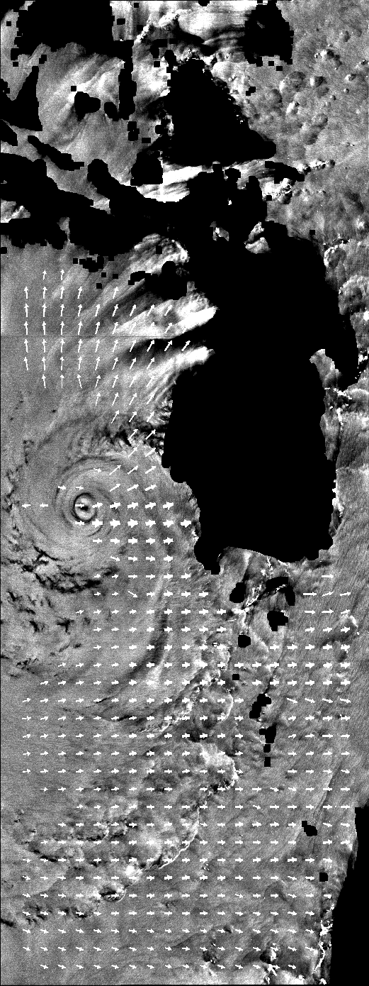
Megi 10/17/2010
Megi 10/15/2010

Slide 11
SAR Wave Retrieval
Used BT Peak Winds as a surrogate for storm strength to determine if wave heights track with storm intensity

Slide 13
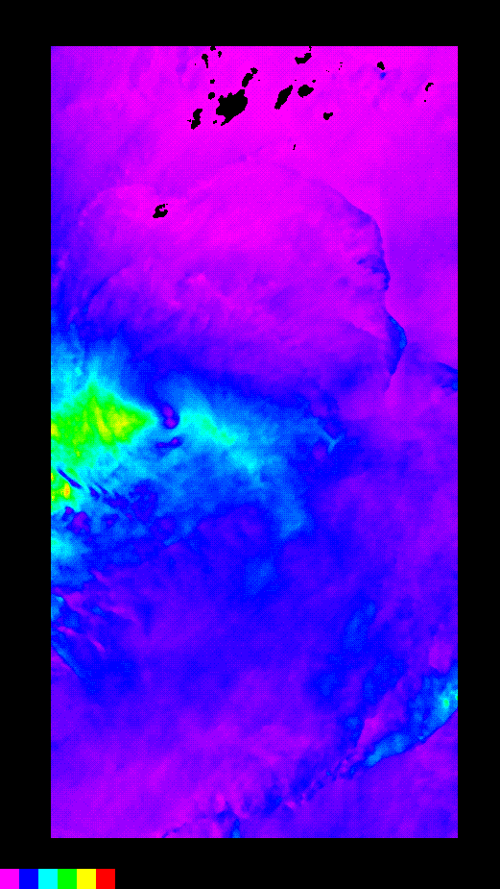
Incorporating a Wind Wave Model Into the Spectrum
SAR Wind Speed
0.2 m
4 m
14 m
Pierson-Moskowitz H_{sig} for wind waves
0.7 m
3 m
6 m
JONSWAP H_{sig} for limited fetch

Slide 14
SAR Wave Retrieval
Ongoing Analysis:
Would be great to connect with any available wave height ground truth
Need to develop an approach to retrieve the components of the wave
spectra the SAR does not observe, and the spatial regions that the SAR
sees no wave modulations
  need to compare to long-scale waves in the model results
  we are investigating adding spectral models that use the local wind speed to the observed long-scale waves
  Roland Romeiser will present next an approach that does an
  empirical fit to model results

Slide 15
Back-up

Slide 16
