Slide 1


ITOP-2010 USAF C-130 Dropsonde Data Quality Control
Scot Loehrer, Kate Young, and June Wang
ITOP Santa Fe Meeting 17-20 May 2011

Slide 2
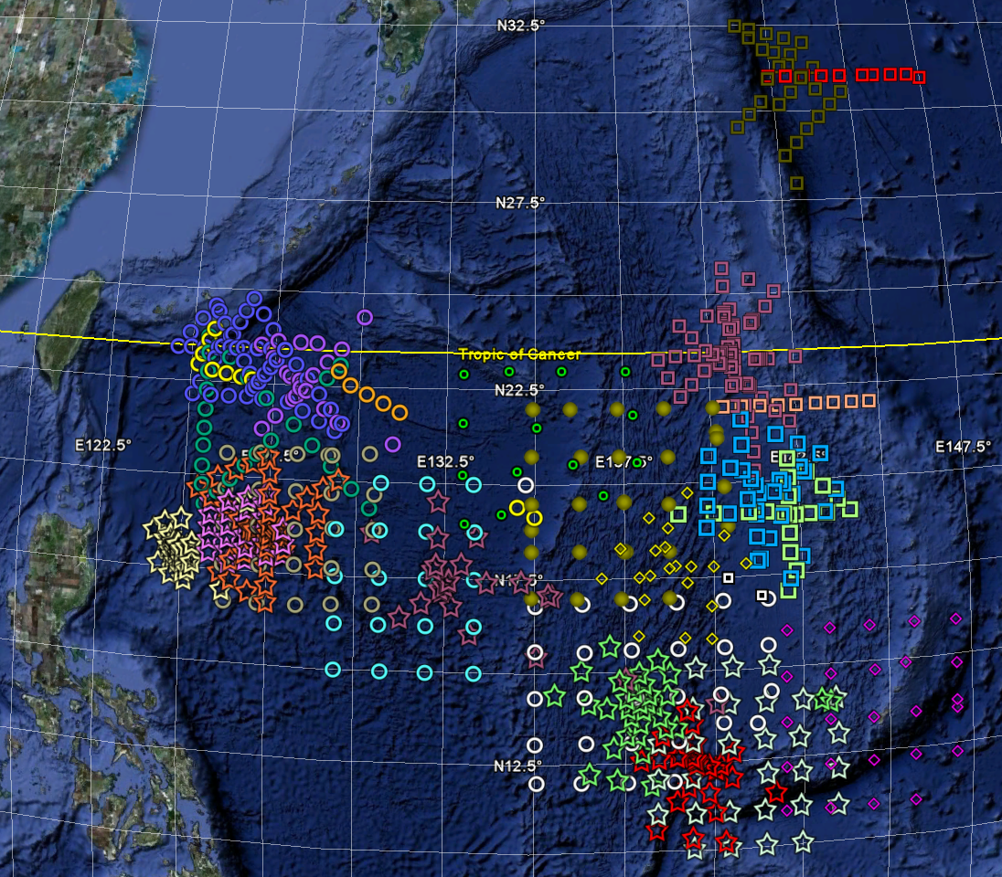
USAF C-130 Dropsonde Overview
683 dropsondes in final data set
26 flights
1 test flight (2 aircraft)
25 research flights
2 aircraft
AF304 (12 flights; 338 drops)
AF307 (13 flights; 345 drops)
6 tropical systems
ITOP07
ITOP10 (Kompasu)
ITOP14 (Malau)
ITOP20 (Fanapi)
ITOP22 (Malakas)
ITOP30 (Megi)
Malakas
Fanapi
Megi

Slide 3
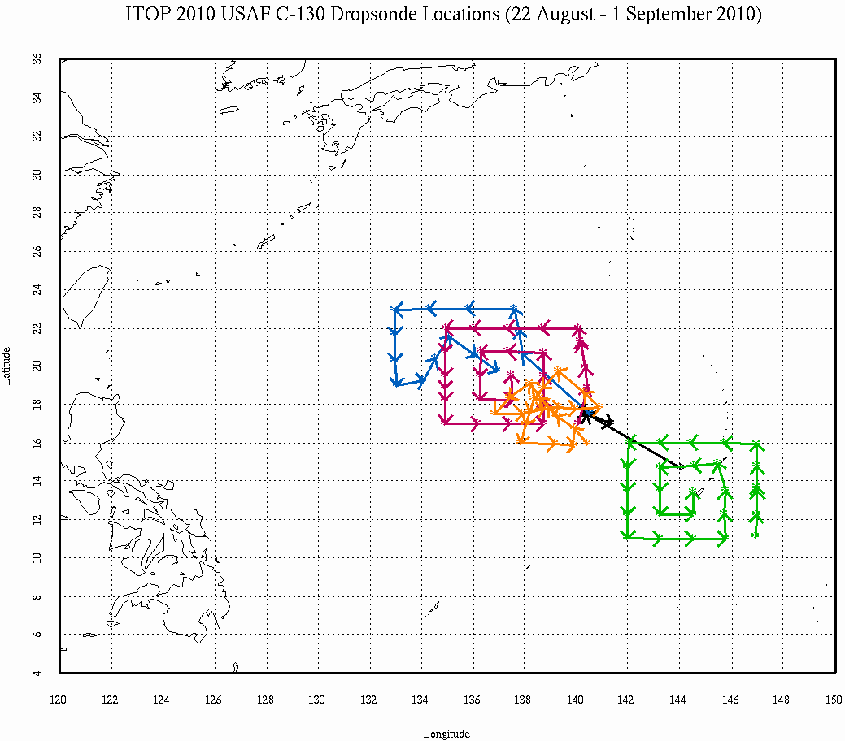
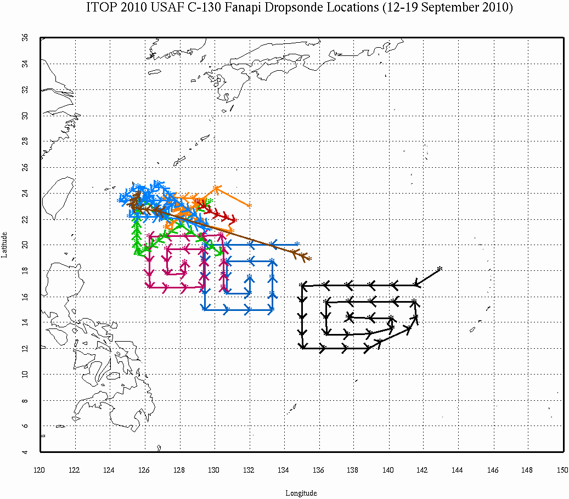
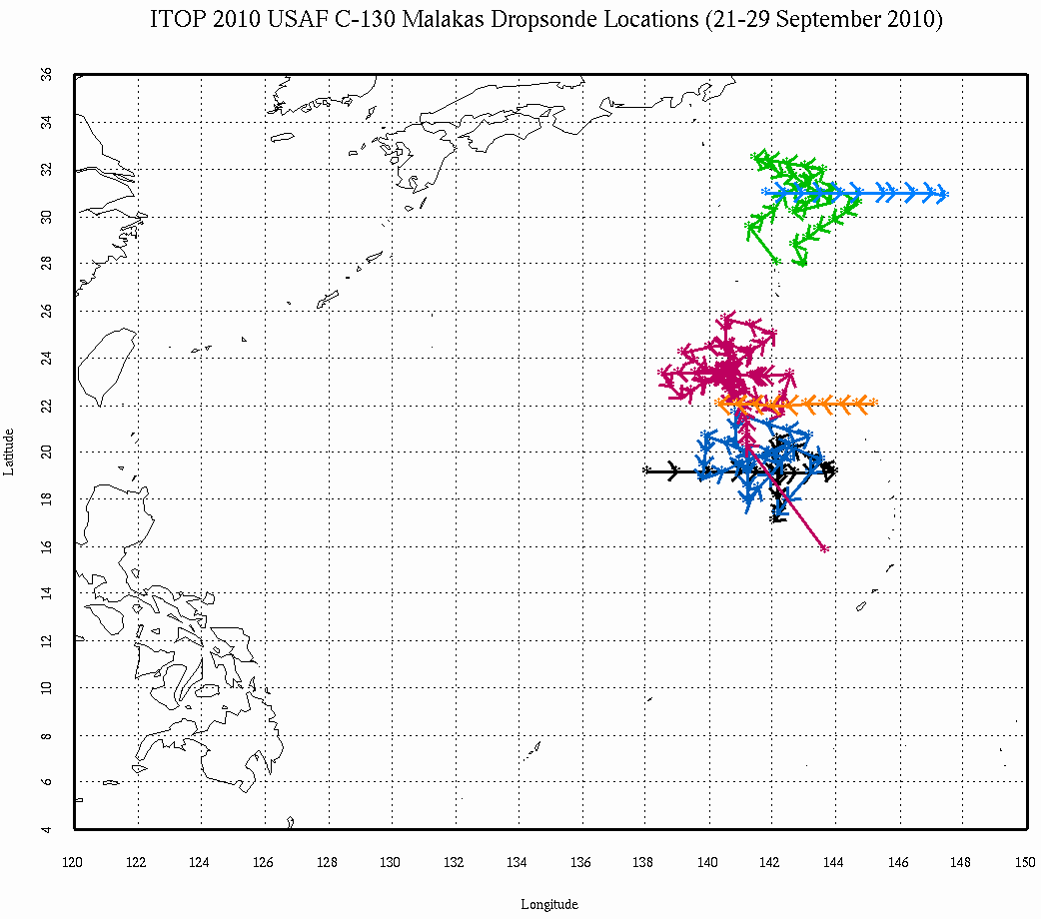
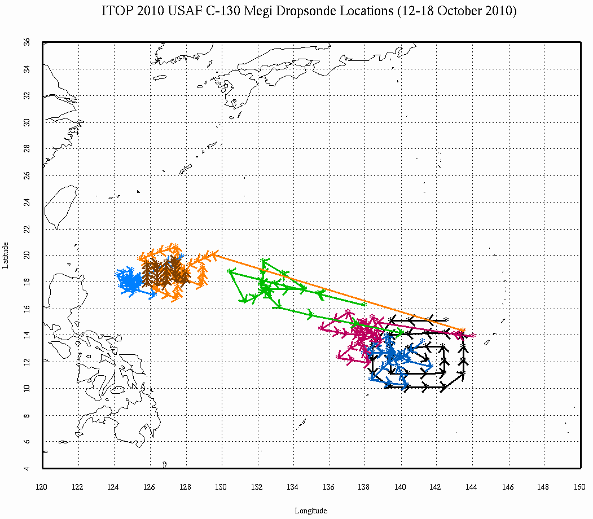
USAF C-130 Dropsonde Overview (cont)
Fanapi
8 flights
194 drops
ITOP07 (15)
TESTA (6)
ITOP10 (29)
ITOP14 (48)
Megi
7 flights
221 drops
Malakas
6 flights
170 drops

Slide 4
Quality Control of Dropsonde data
In-Field Data Inspection
Uncovered PTU oscillation problem
Launch Detect Errors (early/late/failed)
Fast Falls
Not to surface
Sensor Failure
Special Problems:
  PTU oscillation noise
  Pressure offsets
Raw Profile Examination
Batch ASPEN
Time series of PTU and Wind
Provides analysis tools (skew-t diagrams, xy-plots)
Removes suspect data points
Derives geopotential height
Performs smoothing
Batch mode processing for large data sets
Histograms of PTU and Wind
Derive Vertical Winds
Examination of the consistency of soundings
Ability to study temporal-spatial variability of data
Check and correct any problematic soundings
Visually Examine QC Sounding
Allows examination of the distribution and range of each
parameter and its reasonableness
Check and correct any problematic soundings
Release Data with detailed documentation of findings
Notes:
Creating histograms allows us to examine the distribution and range of each parameter and it’s reasonableness
-ability to check and correct problematic soundings
-study characteristics of each parameter
Time series plots allow us to examine consistency of soundings during each flight
- check and correct any problematic soundings
- ability to study temporal-spatial variability of data for all flights.

Slide 5
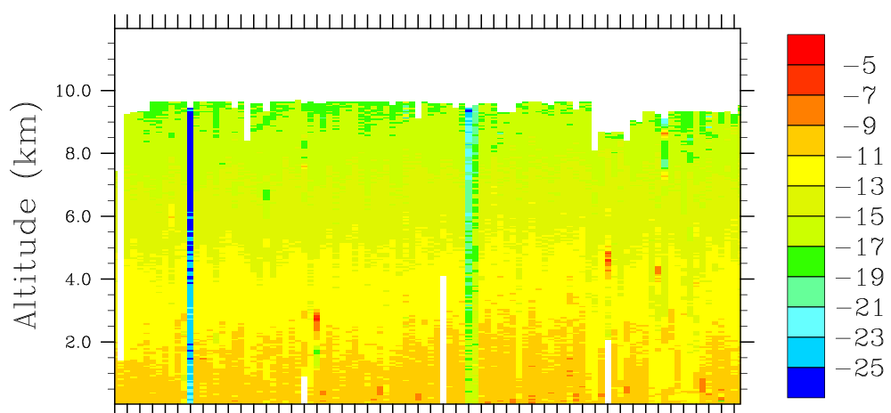
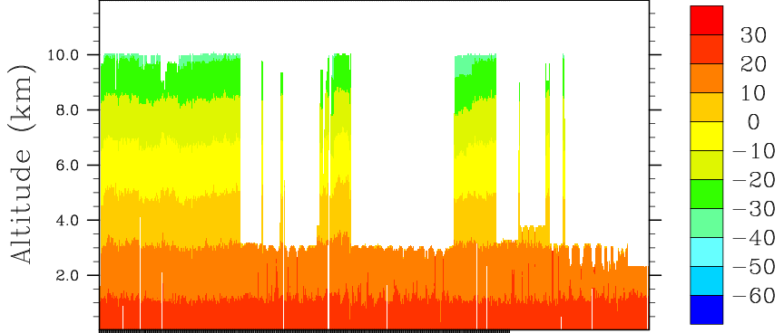
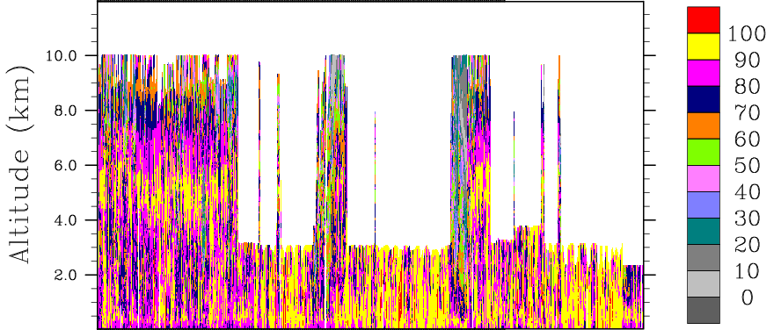
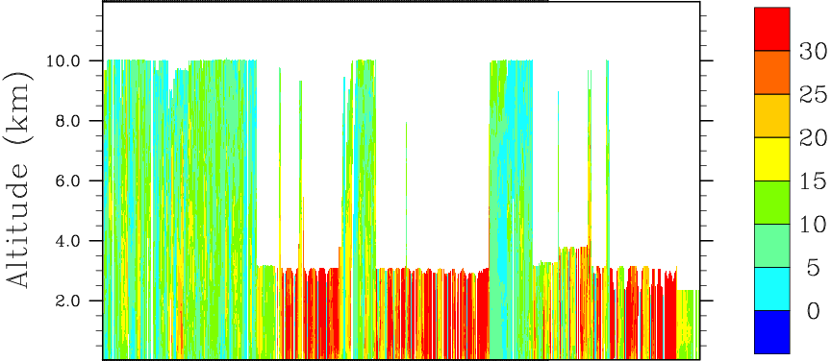
USAF C-130 Dropsonde Time Series
DZ/DT (first 100 drops)
Temperature
Fast Falls
Relative Humidity
Wind Speed

Slide 6
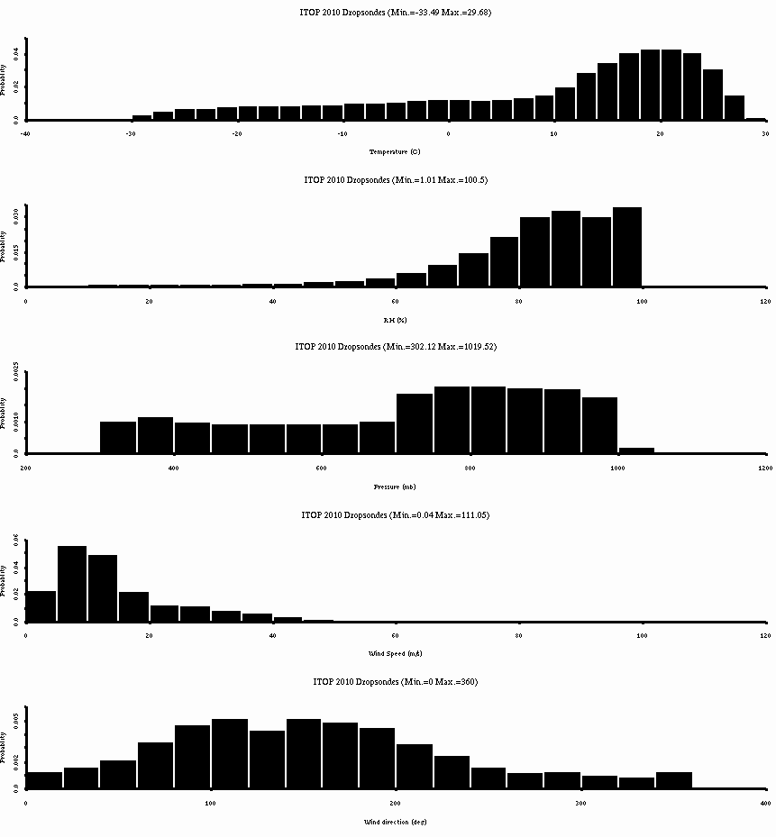
USAF C-130 Dropsonde Histograms
Temperature
RH
Pressure
Wind Speed
Wind Dir

Slide 7
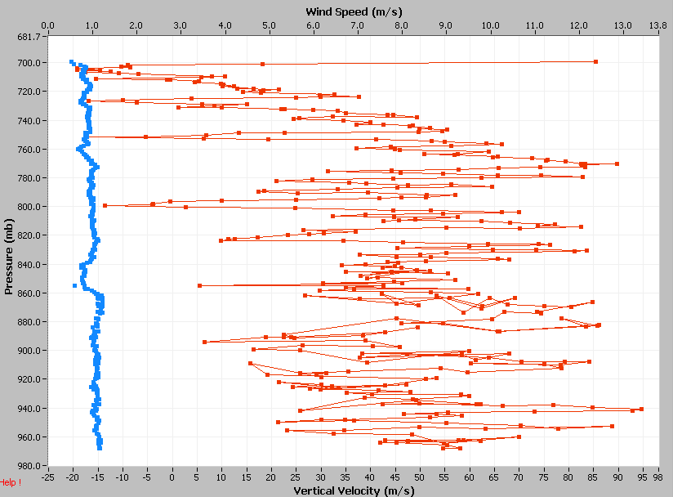
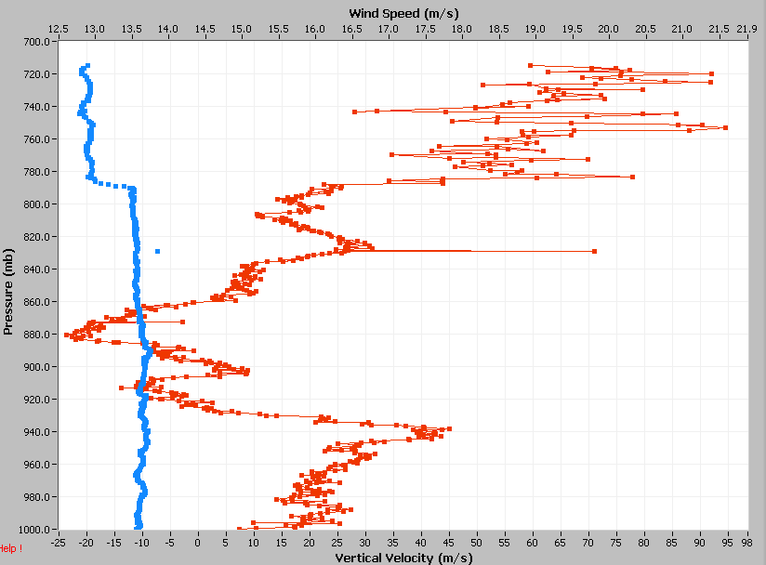
Fast Falls and Partial Fast Falls
Issue
Dropsondes with fall rates 1.5 to 2 times the usual rate for entire drop or for a period after release. During ITOP-2010 there were 25 fast fall drops and 20 partial fast fall drops.
Fast Fall
Cause
The parachute failed to deploy or deployed late (partial fast fall) .
This often results in a tumbling action in the dropsonde. The wind speed and direction are unreliable.
Actual dz/dt
Typical
dz/dt
Wind Speed
Corrections
For these soundings the wind speed, wind direction and vertical wind parameters were set to missing during the period of fast fall.
Partial
Fast Fall

Slide 8
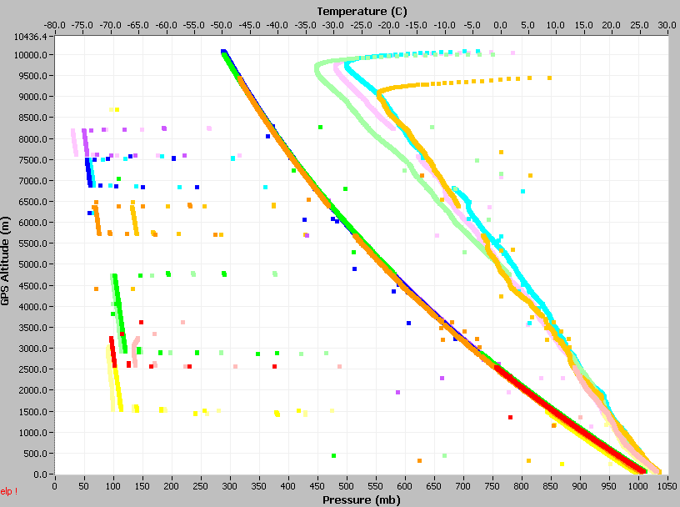
PTU Offsets
Issue
Six soundings had large, temporary offsets in pressure, temperature and humidity.
Cause
A PTU firmware problem that has since been corrected.
Corrections
The PTU data during these periods were set to missing.

Slide 9
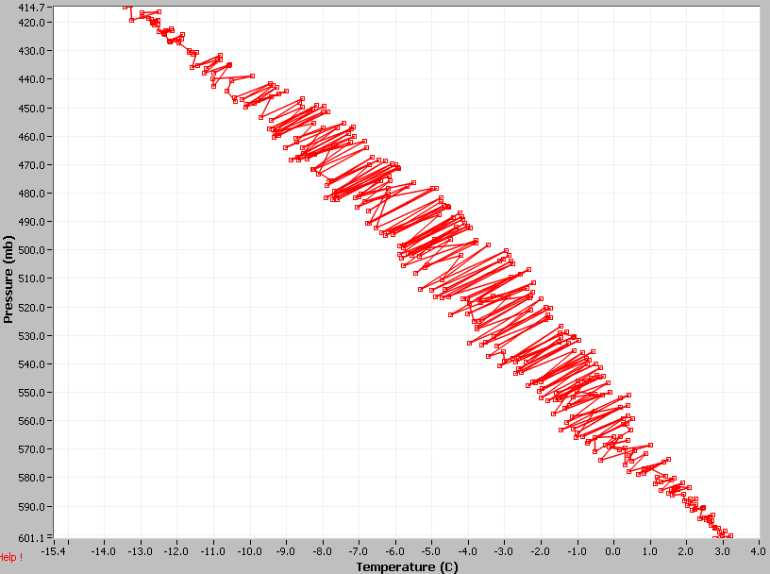
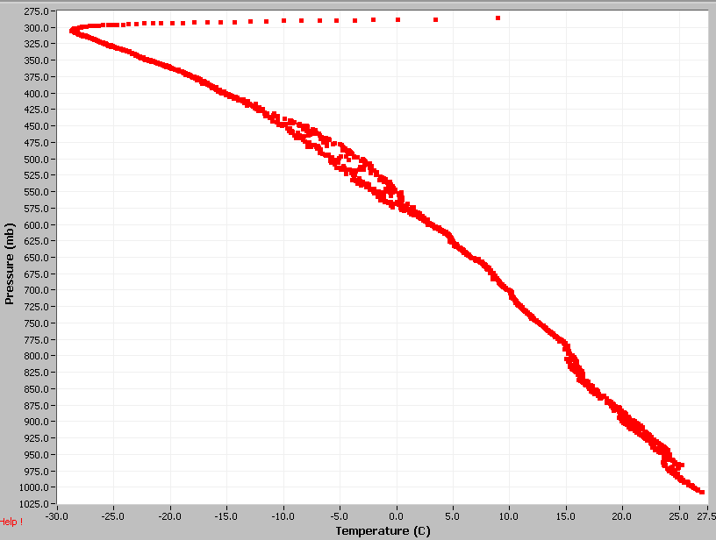
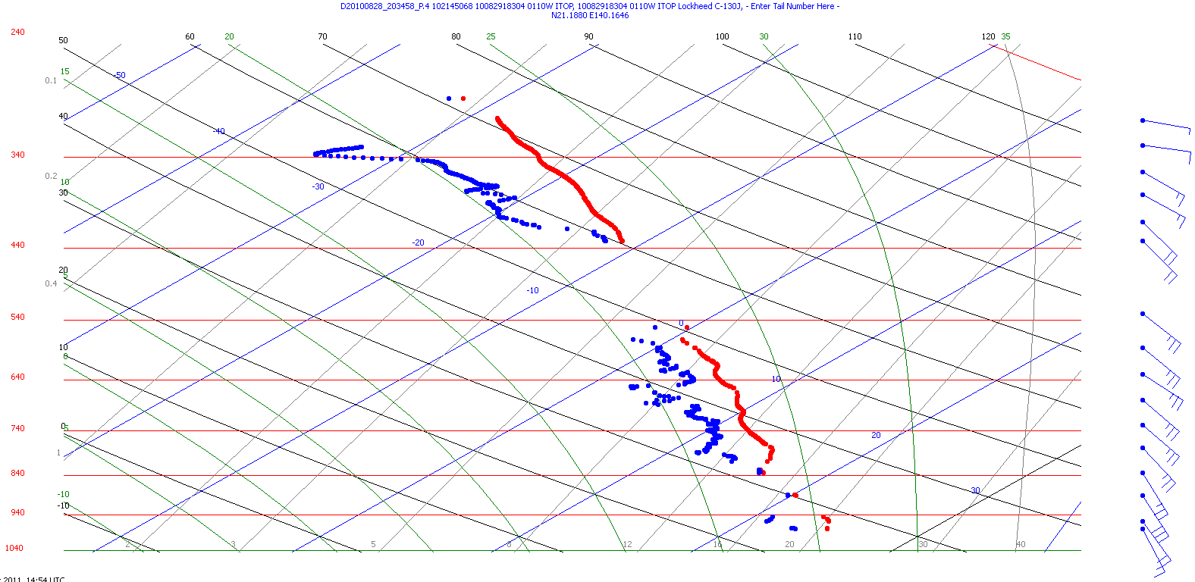
PTU Oscillations
Issue
27 dropsondes had varying degrees of noise or oscillations in the pressure, temperature and/or RH data.
Cause
This occurred for AVAPS II version A2/A3 and mainly for sondes manufactured after the tenth week of 2010. After investigation by NCAR and Vaisala the cause was found to be RF energy from the dropsonde transmitter antenna inducing noise in the PTU module which was caused by a manufacturing change in the PTU module and tolerance of electronic components in the dropsonde. The problem has been fixed as of AVAPS II version A5.
Corrections
These files were processed through ASPEN with more restrictive QC parameters than are typically used. This removed virtually all evidence of the oscillations (smaller scale residual effects can still be seen in the calculated dz/dt. As a result, these soundings can be data sparse.

Slide 10
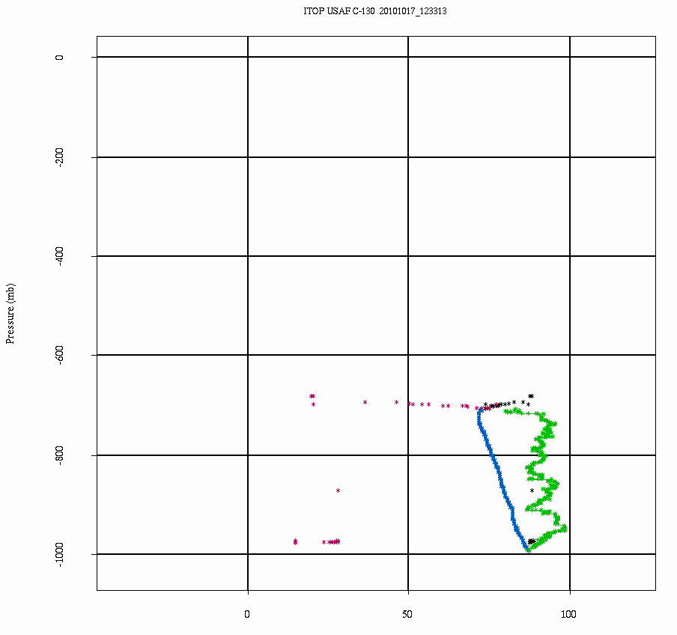
Launch Detect Problems
Early Launch Detect (4)
In these cases some data is flagged as “in-flight” while drop is still in the chute.
No Launch Detect (18)
In these cases all data was flagged as “pre-launch”.
Late Launch Detect (89)
A total of 440 drops had late launch detect where some data is flagged as “pre-launch” after sonde release. The majority of these were minor (1-5 seconds). A total of 89 of these had more than a 5 second delay.
Corrections
In all cases the launch times were corrected, flight level data updated, data properly flagged and filenames updated.
Late Launch Detect

Slide 11
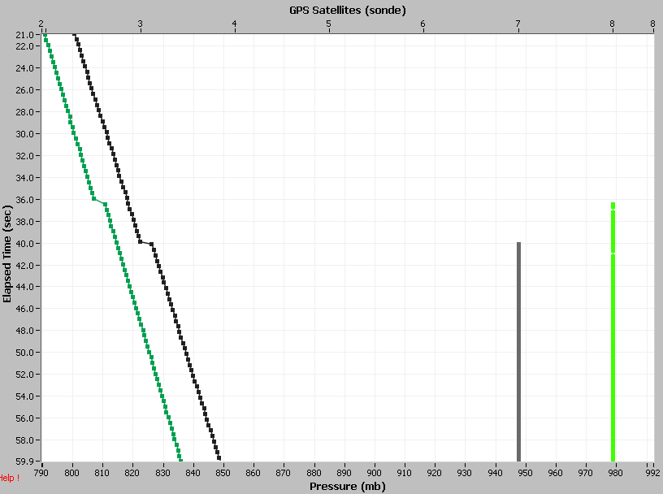
“Pressure Jump”/PC Clock Drift
Issue
In 129 soundings (all from the final seven AF304 flights) there was a large negative spike in dz/dt caused by an abrupt “pressure offset”.
Cause
Time tag differences between the AVAPS PC clock and GPS time from the dropsondes. This occurred if the dropsonde did not have GPS satellite lock prior to launch and the PC clock significantly drifted.
Corrections
During these periods (usually about 5 seconds) the calculated descent rates and vertical winds were set to missing.
GPS satellites
Pressure

Slide 12
Other Issues
Loss of signal prior to launch – A total of 24 dropsondes experienced a loss of signal prior to launch that resulted in varying degrees of data loss (typically ~30mb). Without a signal at the time of launch, accurate launch times could not be determined.
Data not to surface - A total of 14 dropsondes experienced a loss of signal and failed to transmit data to the surface or had PTU oscillation problems at the surface. For these soundings the geopotential altitude was calculated from flight level downward.
No GPS – One sounding never had a GPS signal. File contains no winds or location information.
Soundings removed from archive – A total of 15 dropsonde files were removed from the final archive for one of the following reasons: the dropsonde was started up but never launched, the file contained no data, or the file contained very little data of poor quality.

Slide 13
Note on the Altitude Parameters
The GPS Altitude is not referenced to mean sea level, rather the GPS compares the height to a reference ellipsoid that approximates the real shape of the Earth. So the height may be above or below the actual sea level depending on location. This is why the ITOP drosponde surface GPS altitudes are not zero.
Sea Level
GPS Height
Reference Ellipsoid
When the sonde reaches the surface the Geopotential Altitude is referenced to the sea level and is derived from the surface upwards using the PTU data.
If the sonde did not transmit to the surface or had PTU oscillation problems leading to the removal of surface data, the geopotential altitude was derived from flight level downwards and thus should be used with caution.

Slide 14
Summary
698 dropsondes were deployed, 683 are included in the final archive.
These data include filtered and unfiltered vertical wind velocity (at the request of the PI). It is calculated from the pressure-calculated and theoretical dropsonde fall rates. The filtered vertical wind is the calculated vertical wind subjected to a 20 second low pass filter.
27 soundings (4%) were affected by the PTU oscillation error and had more stringent QC parameters applied in ASPEN. Thus these soundings often are more data sparse.
6 soundings (0.9%) experienced large, temporary offsets in the pressure, temperature and humidity . The PTU data were removed during these offsets.
14 soundings (2%) either failed to transmit to the surface or had PTU oscillation problems at the surface. In these cases the geopotential heights were calculated from flight level down.
25 soundings (3.7%) were “fast fall” soundings, and 20 (2.9%) were “partial fast-fall”. The wind and vertical wind parameters were set to missing during the fast fall period.

Slide 15
Summary (cont)
4 soundings experienced failure of one or more sensors, resulting in data loss.
Launch detect errors:
  4 (0.5%) early launch detects
  8 (2.6%) failed launch detects
  440 (64.4%); only the 89 (13.0%) that were > 5 seconds late were corrected
24 soundings (3.5%) experienced a loss of signal prior to launch that resulted in varying degrees of data loss. Without a signal at the time of launch, accurate launch times could not be determined.
129 (18.8%) of the quality controlled sounding files exhibited a large negative spike(s) in calculated descent rate (dz/dt) found to be caused by a small, yet abrupt, positive offset in pressure. Due to time tag differences between the AVAPS PC clock and GPS time from the dropsondes. Calculated dz/dt and vertical winds set to missing during these periods (typically ~5 sec).
Data are available from the EOL archive.

