Slide 1

Local Gradient SAR Wind Directions and H*wind SAR Winds
Local Gradient SAR Wind Directions and H*wind SAR Winds
The SAR-Team#
#J. Horstmann, C. Wackerman, M. Caruso, R. Romeiser, R. Foster and H. Graber

Slide 2
Local Gradient SAR Wind Directions and H*wind SAR Winds
Local Gradient SAR Wind Directions and H*wind SAR Winds
Outline:
SAR wind direction retrieval
SAR wind field error estimator
Assimilation of SAR winds into H*wind
SAR Wind field retrieval utilizing X-band

Slide 3
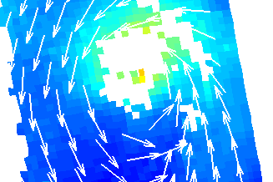
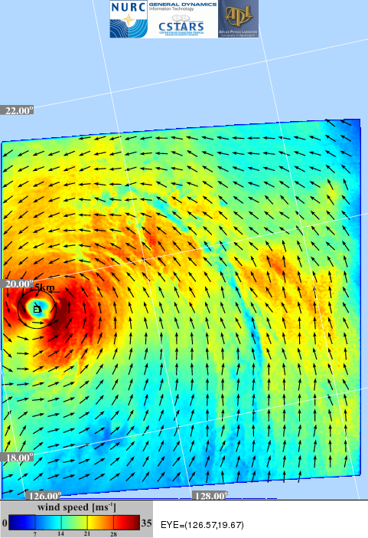
Why SAR for Tropical Cyclones
QuikSCAT
SAR

Slide 4
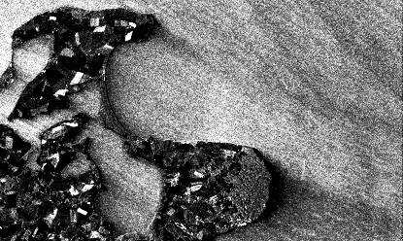
SAR Wind Field Retrieval
Wind Directions via
Local Gradient Method
Wind Speed via
Geophysical Model
Sobel
Φ
Binomial filter
2 dim. B² Filter
2 dim. B⁴ Filter
Φ
θ
σ_{o}
Optimized Sobel-Filter
GMF
u₁₀
Notes:
WiSAR was already available and had to be adjusted for the different needs withi

Slide 5
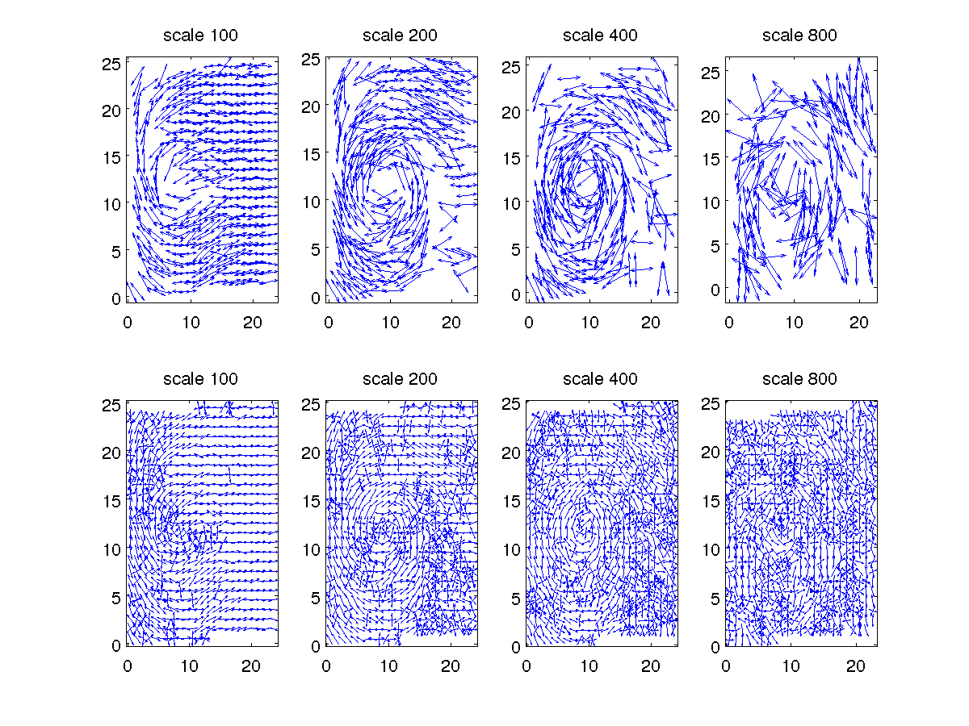
SAR Retrieved Directions Resulting
from the LG-Method
Notes:
Finding the cyclone eye to remove ambiguities in wind direction

Slide 6
SAR Retrieved Directions Resulting
from the LG-Method
Grids with only one wind direction

Slide 7
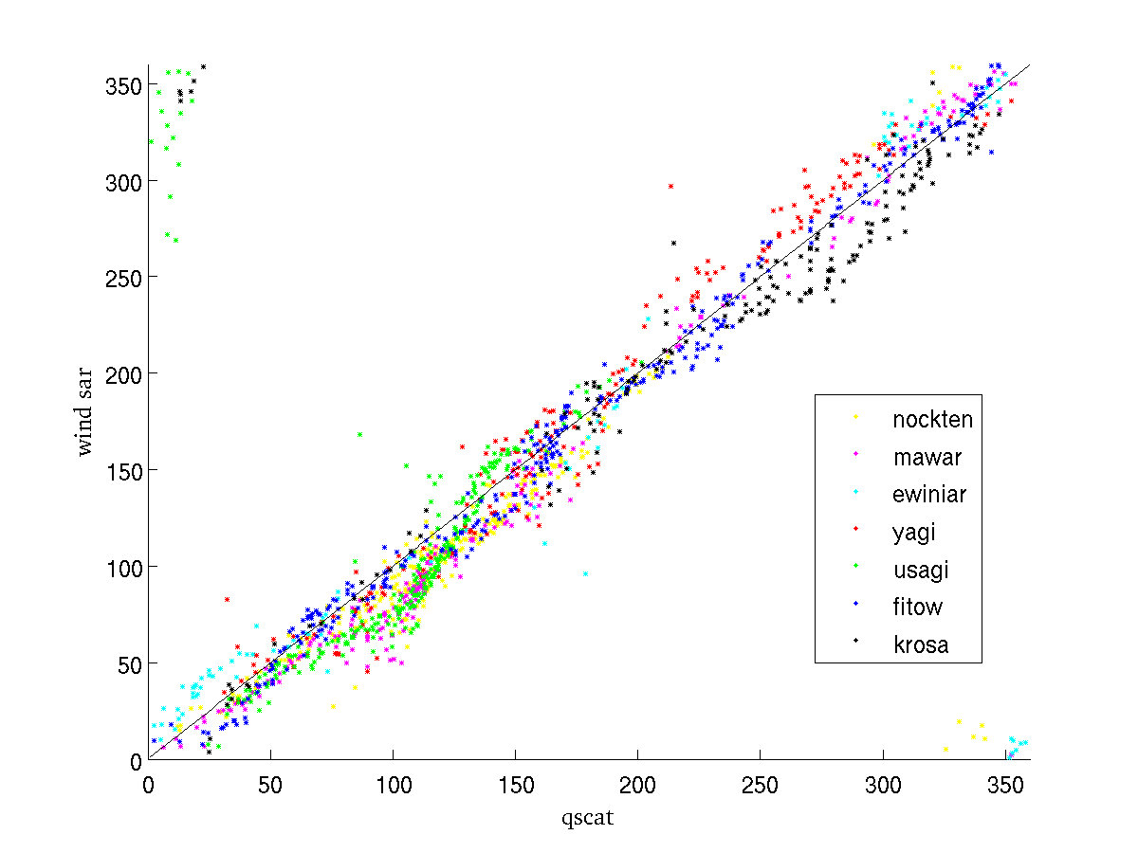
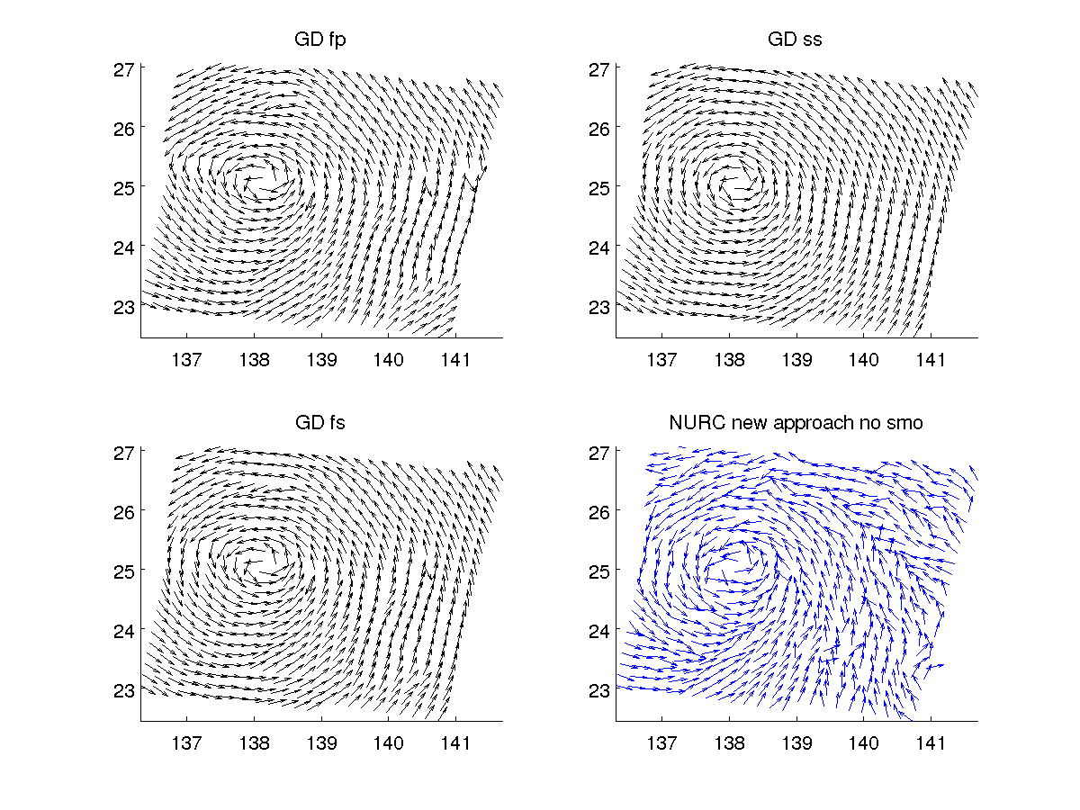
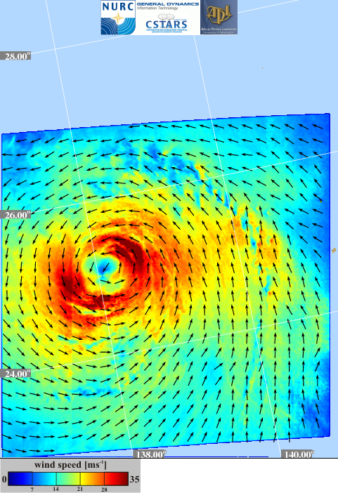
Wind Direction Ambiguity Removal
cor = 0.96
rms = 17.6°
bias = 6.4°
Radarsat-1
22. Aug. 2007

Slide 8

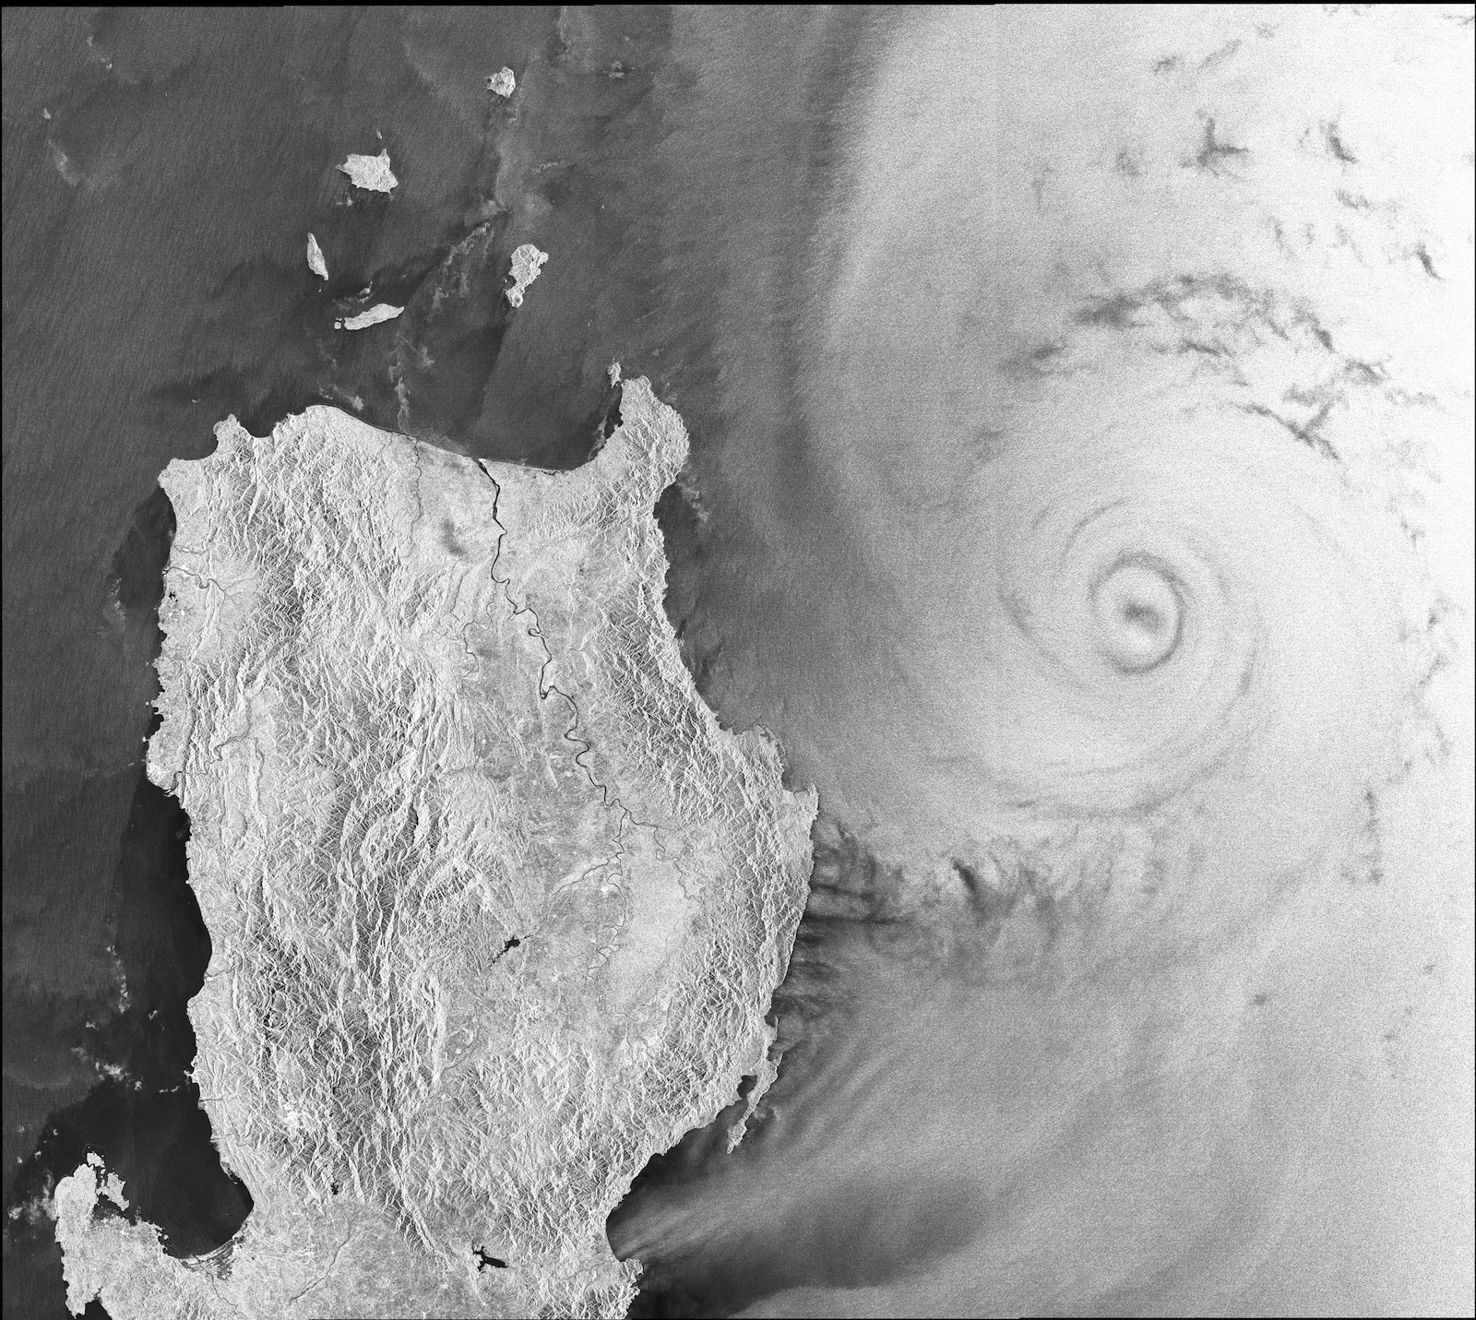
Typhoon
Megi
UNCLASSIFIED

Slide 9
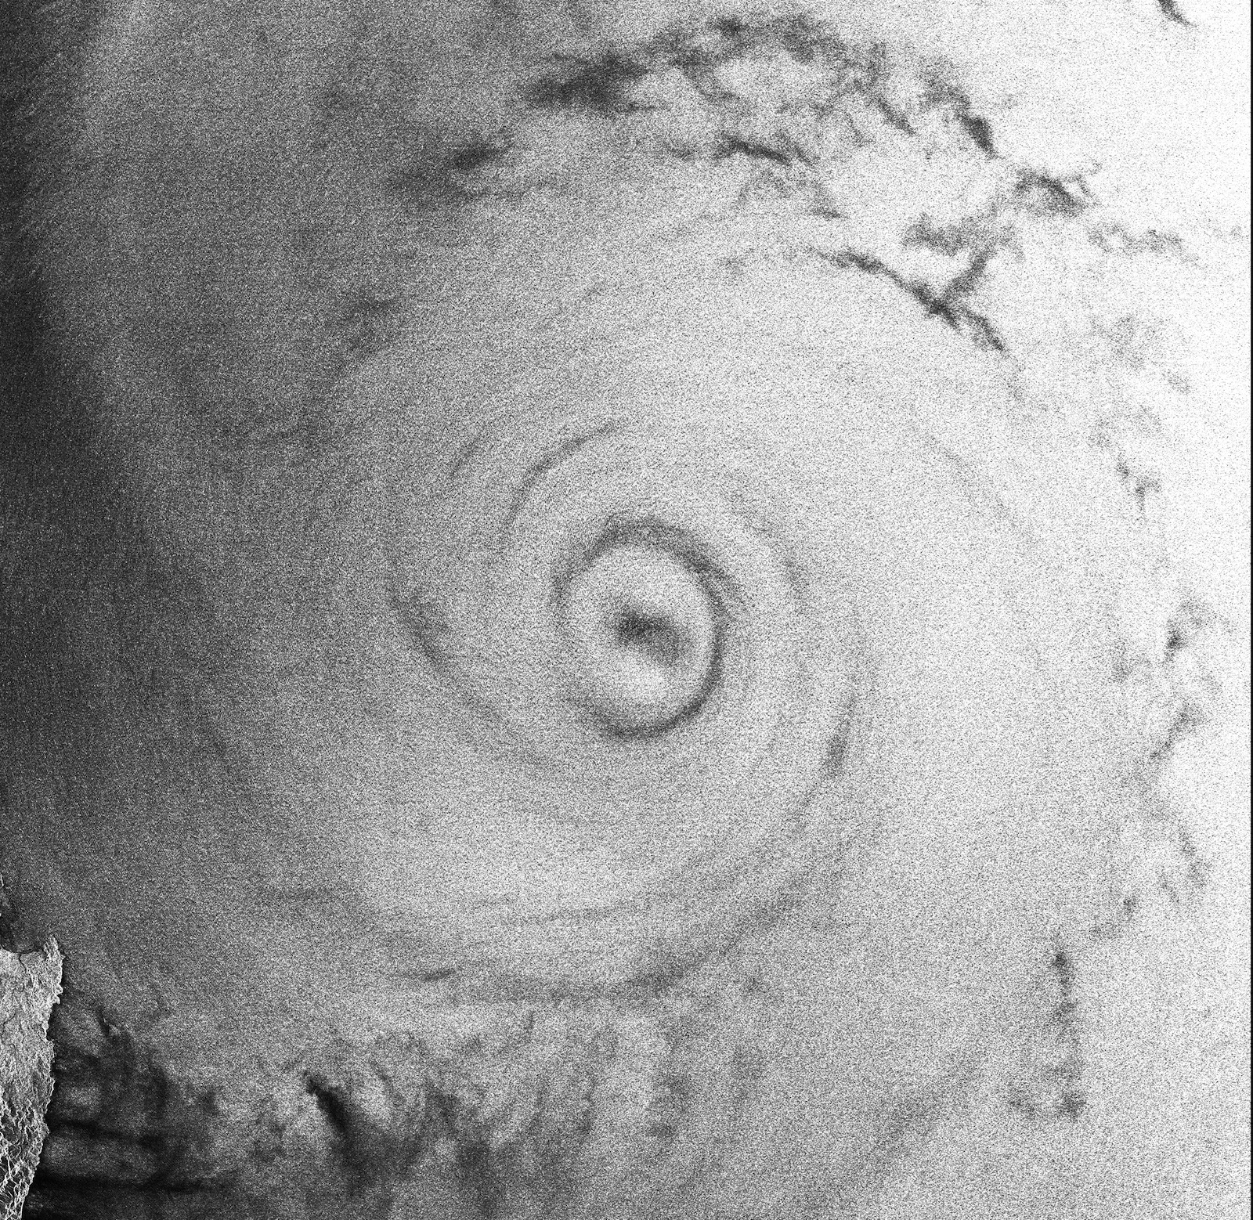

Typhoon
Megi
UNCLASSIFIED

Slide 10
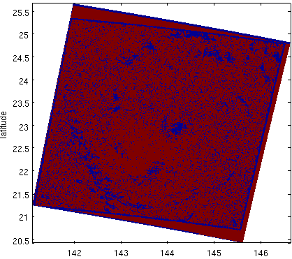
SAR Wind Speed Flags
Non wind
phenomenon
flag
Latitude
Longitude
Notes:
Out of definition mask means that NRCS values in the SAR image are larger than defined within the Cmod5 GMF
Red means SAR measured NRCS – 0.5 dB is out of definition
Yellow means SAR measured NRCS is out of definition
Light blue means SAR measured NRCS + 0.5 dB is out of definition
Areas in dark blue are assumed to be non wind induced
Uncertainty mask assuming an SAR NRCS error of 0.5 dB

Slide 11
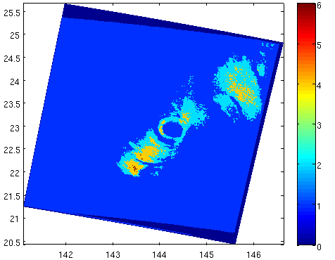
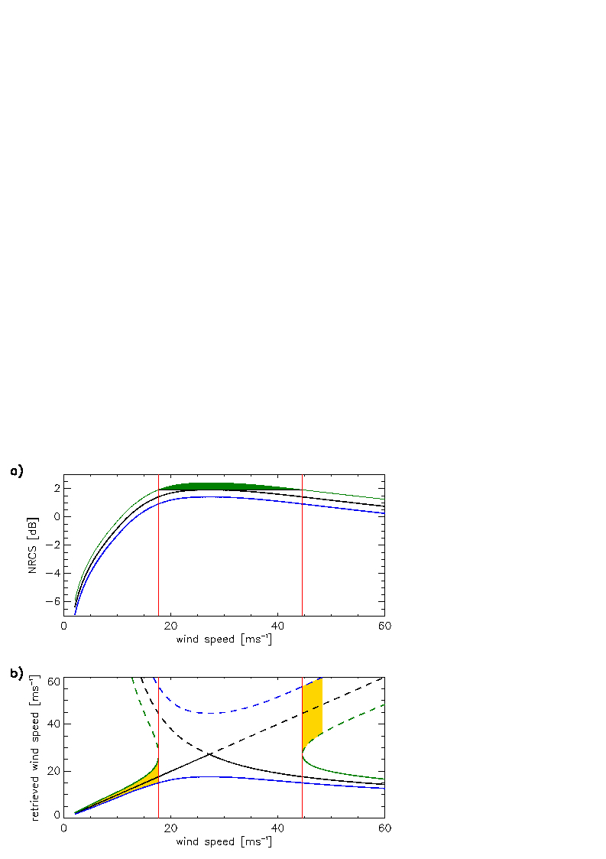
SAR Wind Speed Flags
Out of
definition
flag
Latitude
F
NRCS [dB]
out of definition no error defined
θ=20°, downwind
wind speed [m/s]
Longitude
Notes:
Out of definition mask means that NRCS values in the SAR image are larger than defined within the Cmod5 GMF
Red means SAR measured NRCS – 0.5 dB is out of definition
Yellow means SAR measured NRCS is out of definition
Light blue means SAR measured NRCS + 0.5 dB is out of definition
Areas in dark blue are assumed to be non wind induced
Uncertainty mask assuming an SAR NRCS error of 0.5 dB

Slide 12
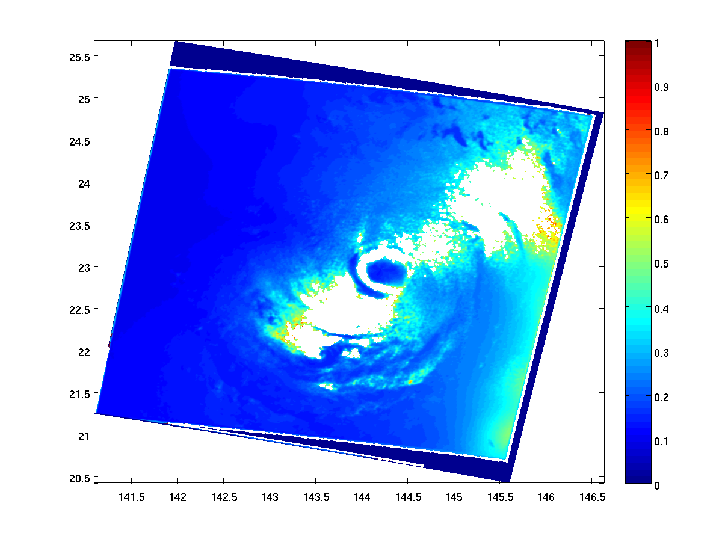
SAR Wind Speed Flags
Uncertainty
flag
Latitude
Longitude
Notes:
Out of definition mask means that NRCS values in the SAR image are larger than defined within the Cmod5 GMF
Red means SAR measured NRCS – 0.5 dB is out of definition
Yellow means SAR measured NRCS is out of definition
Light blue means SAR measured NRCS + 0.5 dB is out of definition
Areas in dark blue are assumed to be non wind induced
Uncertainty mask assuming an SAR NRCS error of 0.5 dB

Slide 13
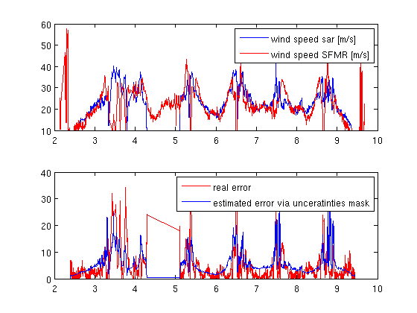
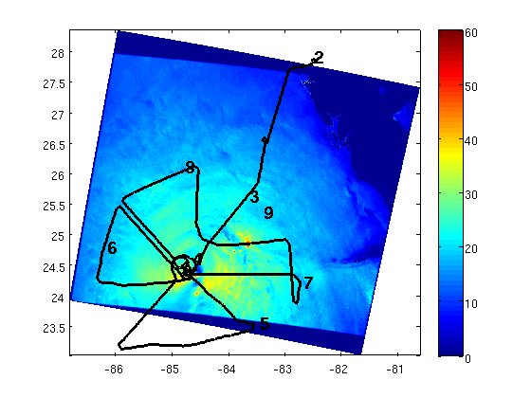
Comparison of SAR and SFMR Wind Speeds
SAR wind speeds with superimposed adjusted
SFMR flight track
Comparison of wind speeds
Wind speed [m/s]
Time delay [h]
Comparison of wind speed errors
Wind speed [m/s]
Time delay [h]
Notes:
To test the error estimator SAR-retrieved wind fields were compared to air borne measurements from the Stepped Frequency Microwave Radiometer (SFMR). Fig. X (left hand side) shows the wind field of Hurricane Katrina on the 27. August 2005 at 11:28 GMT as retrieved from a Radarsat-1 SAR image. Superimposed to the SAR wind field is the flight pattern of the aircraft performing the SFMR measurements. The flight paths were corrected for the movement of the storm with time. The corrections were performed by keeping the distance of the aircraft to the cyclone eye at the time of SAR acquisition equal to the distance of the cyclone eye to each SFMR measurement time. The numbers present the time delay in hours with respect to SAR acquisition. Comparison of the SAR and SFMR retrieved wind speeds are given in the upper plot on the right hand side and the comparison of the difference between SAR and SFMR wind speed measurements to the estimated SAR wind speed uncertainty is shown in the lower plot on the right hand side. Preliminary results show that the developed SAR wind speed error estimator gives a good approximation of the certainty of the SAR-retrieved wind speed.

Slide 14
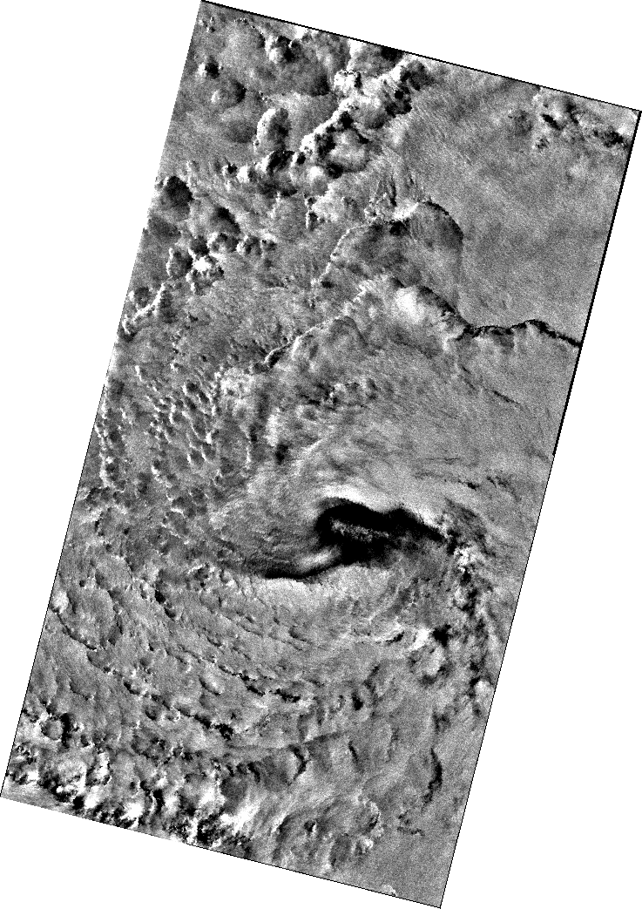
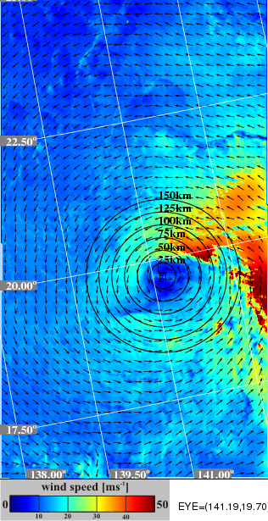
Assimilating SAR Winds into H*wind
NURC Wind Field
Radarsat-2 SAR image
Typhoon Malakas

Slide 15
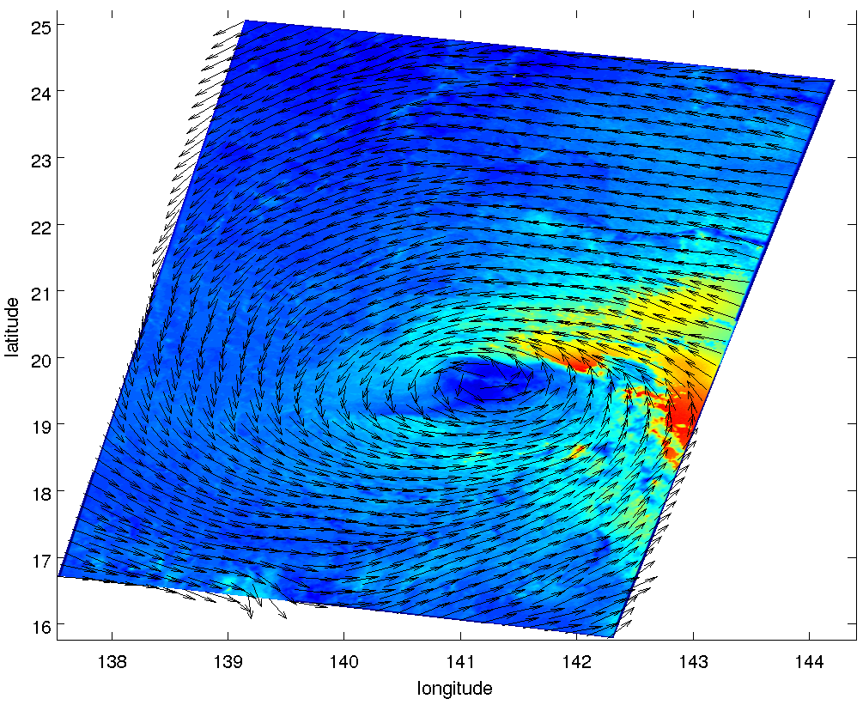
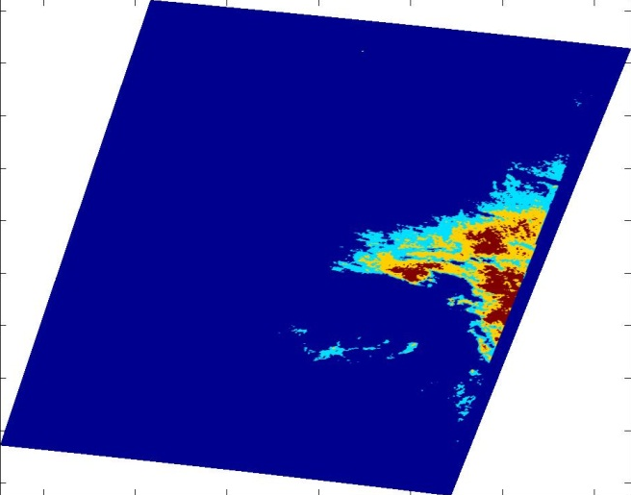
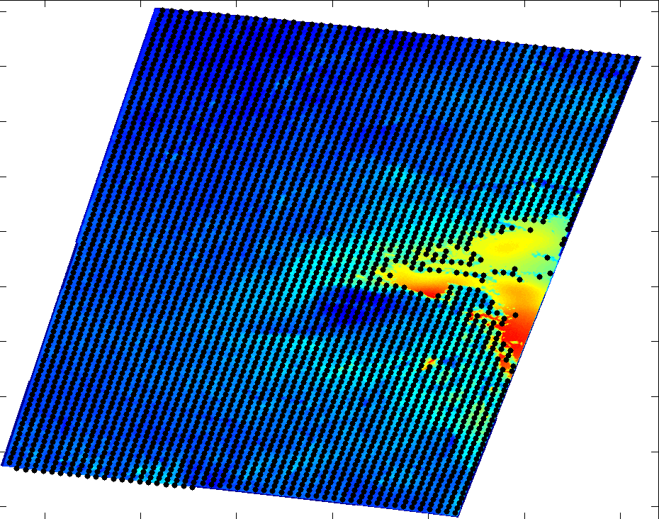
Assimilating SAR Winds into H*wind

Slide 16
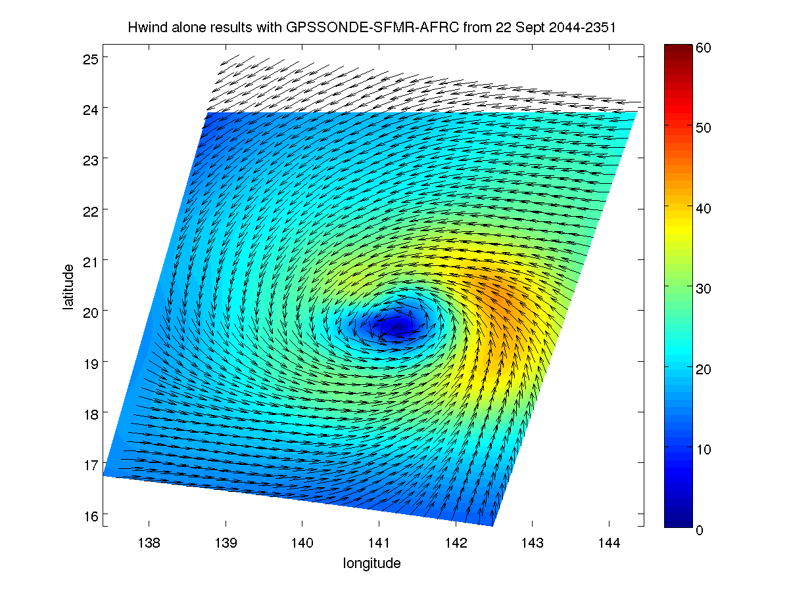
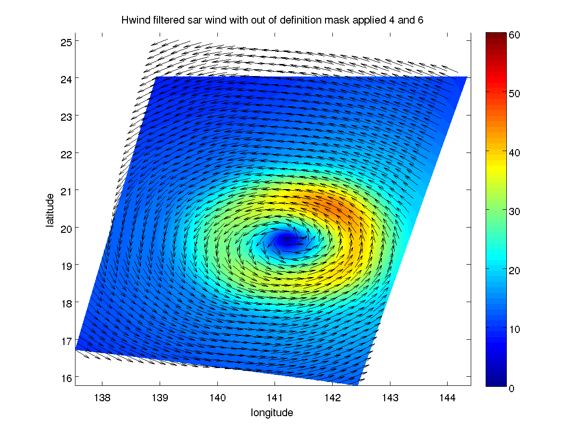
Assimilating SAR Winds into H*wind
H*wind with in situ
and SFMR
H*wind with SAR wind field solely
We would love to look at SAMURAI !!!

Slide 17
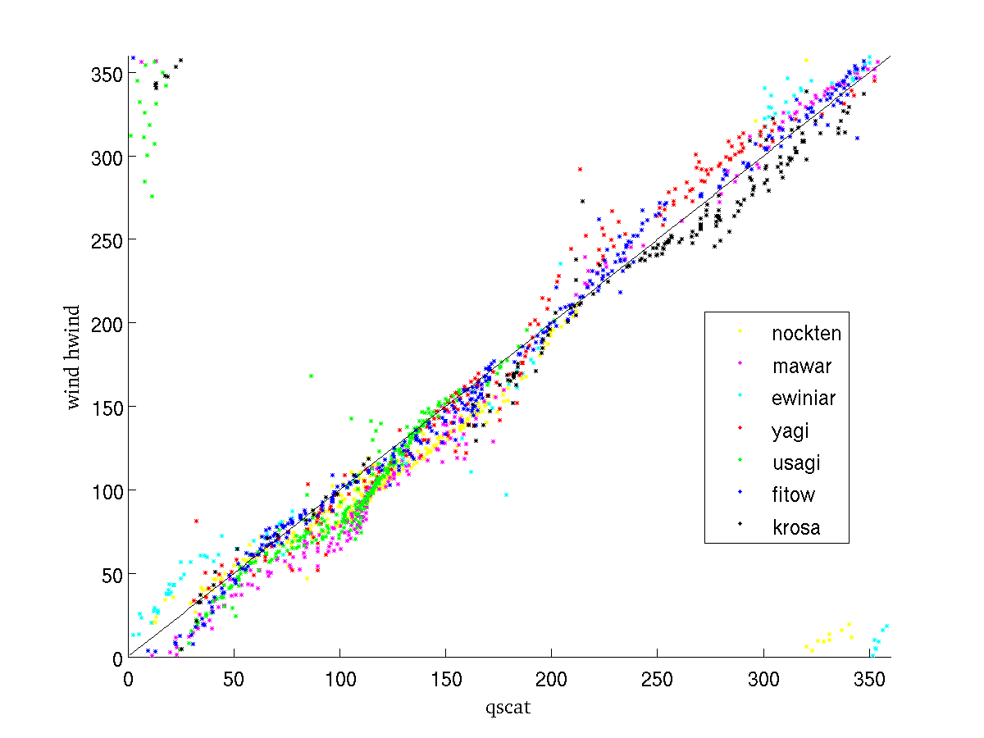
Comparison of SAR to Quikscat winds
SAR wind directions
NURC-GD merged
H*wind wind directions
assimilation of SAR wind field (solely)
cor = 0.96
rms = 17.6°
bias = 6.4°
cor = 0.97
rms = 16.6°
bias = 5.7°

Slide 18
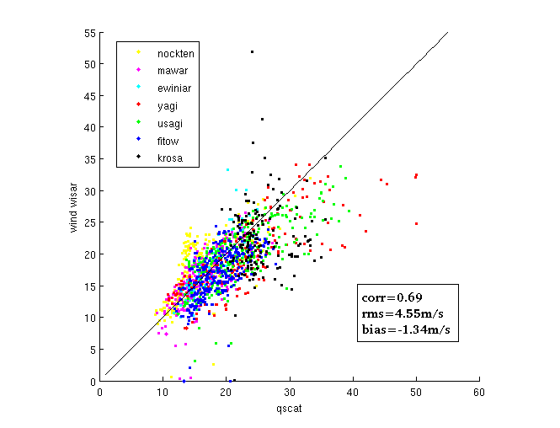
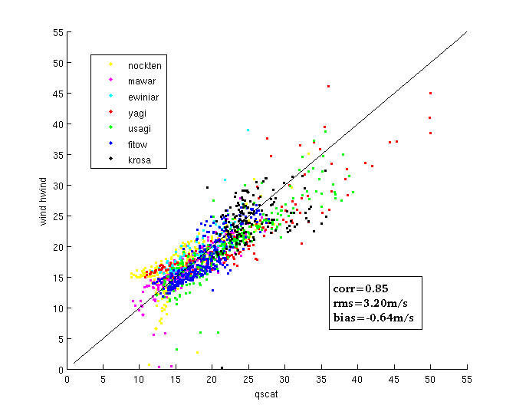
Comparison of SAR to Quikscat winds
SAR wind speeds
NURC-GD merged
H*wind wind speeds
assimilation of SAR wind field (solely)
Notes:
Comparison of 7 SAR retrieved wind speed products to QuikSCAT data.
Left hand side: Wind directions result from the merged NURC and GD wind directions and were used with the Cmod5 GMF and a polratio of 0.8 to generate the wind speeds
Right hand side: HWIND wind speeds resulting from assimilation of SAR generated wind field from left hand side including the SAR retrieved certainty. NOTE: only SAR data were assimilated!!!

Slide 19
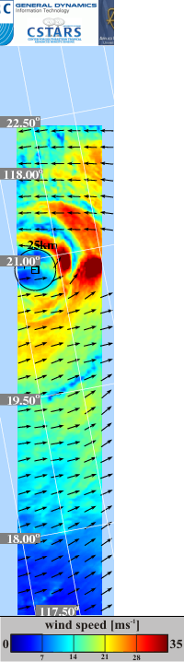
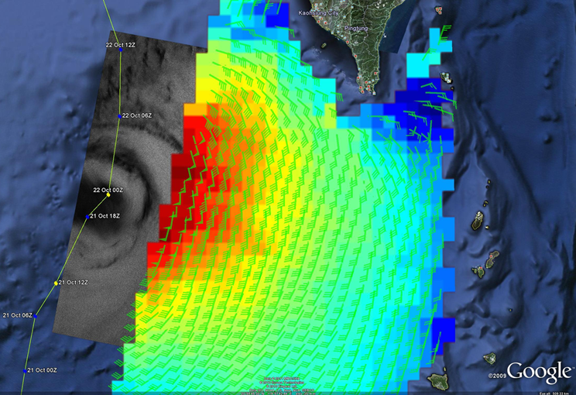
Qualitative Comparison of Winds from TerraSAR-X to ASCAT (Preliminary)

Slide 20
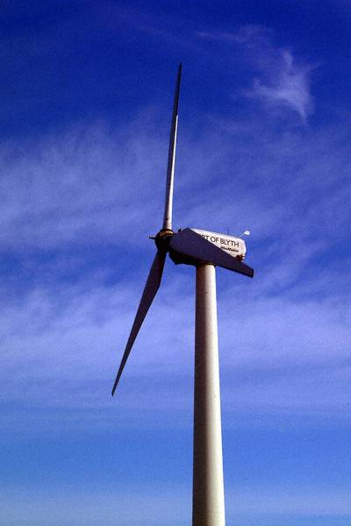

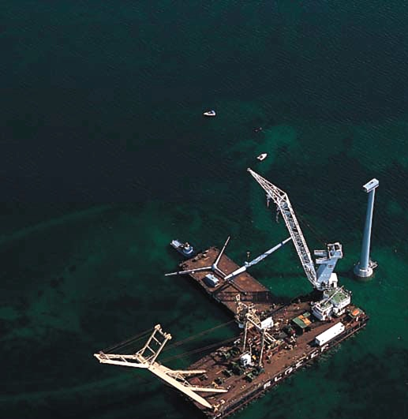
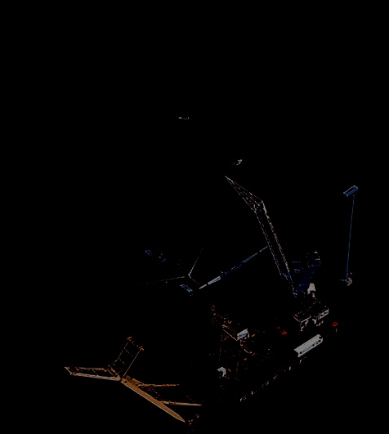

Summary &
Outlook
SAR wind directions are retrieved from the orientation of linear features (rms of 18°, lack of inflow)
Filters have been developed to flag:
  non wind induced areas
  areas with uncertain wind speeds
Assimilation of SAR winds in H*wind reduce wind speed errors
Preliminary results from X-band model look promising
Validation of X-band model for high winds
Inclusion of Doppler shift information for wind direction retrieval
Research Center

Slide 21
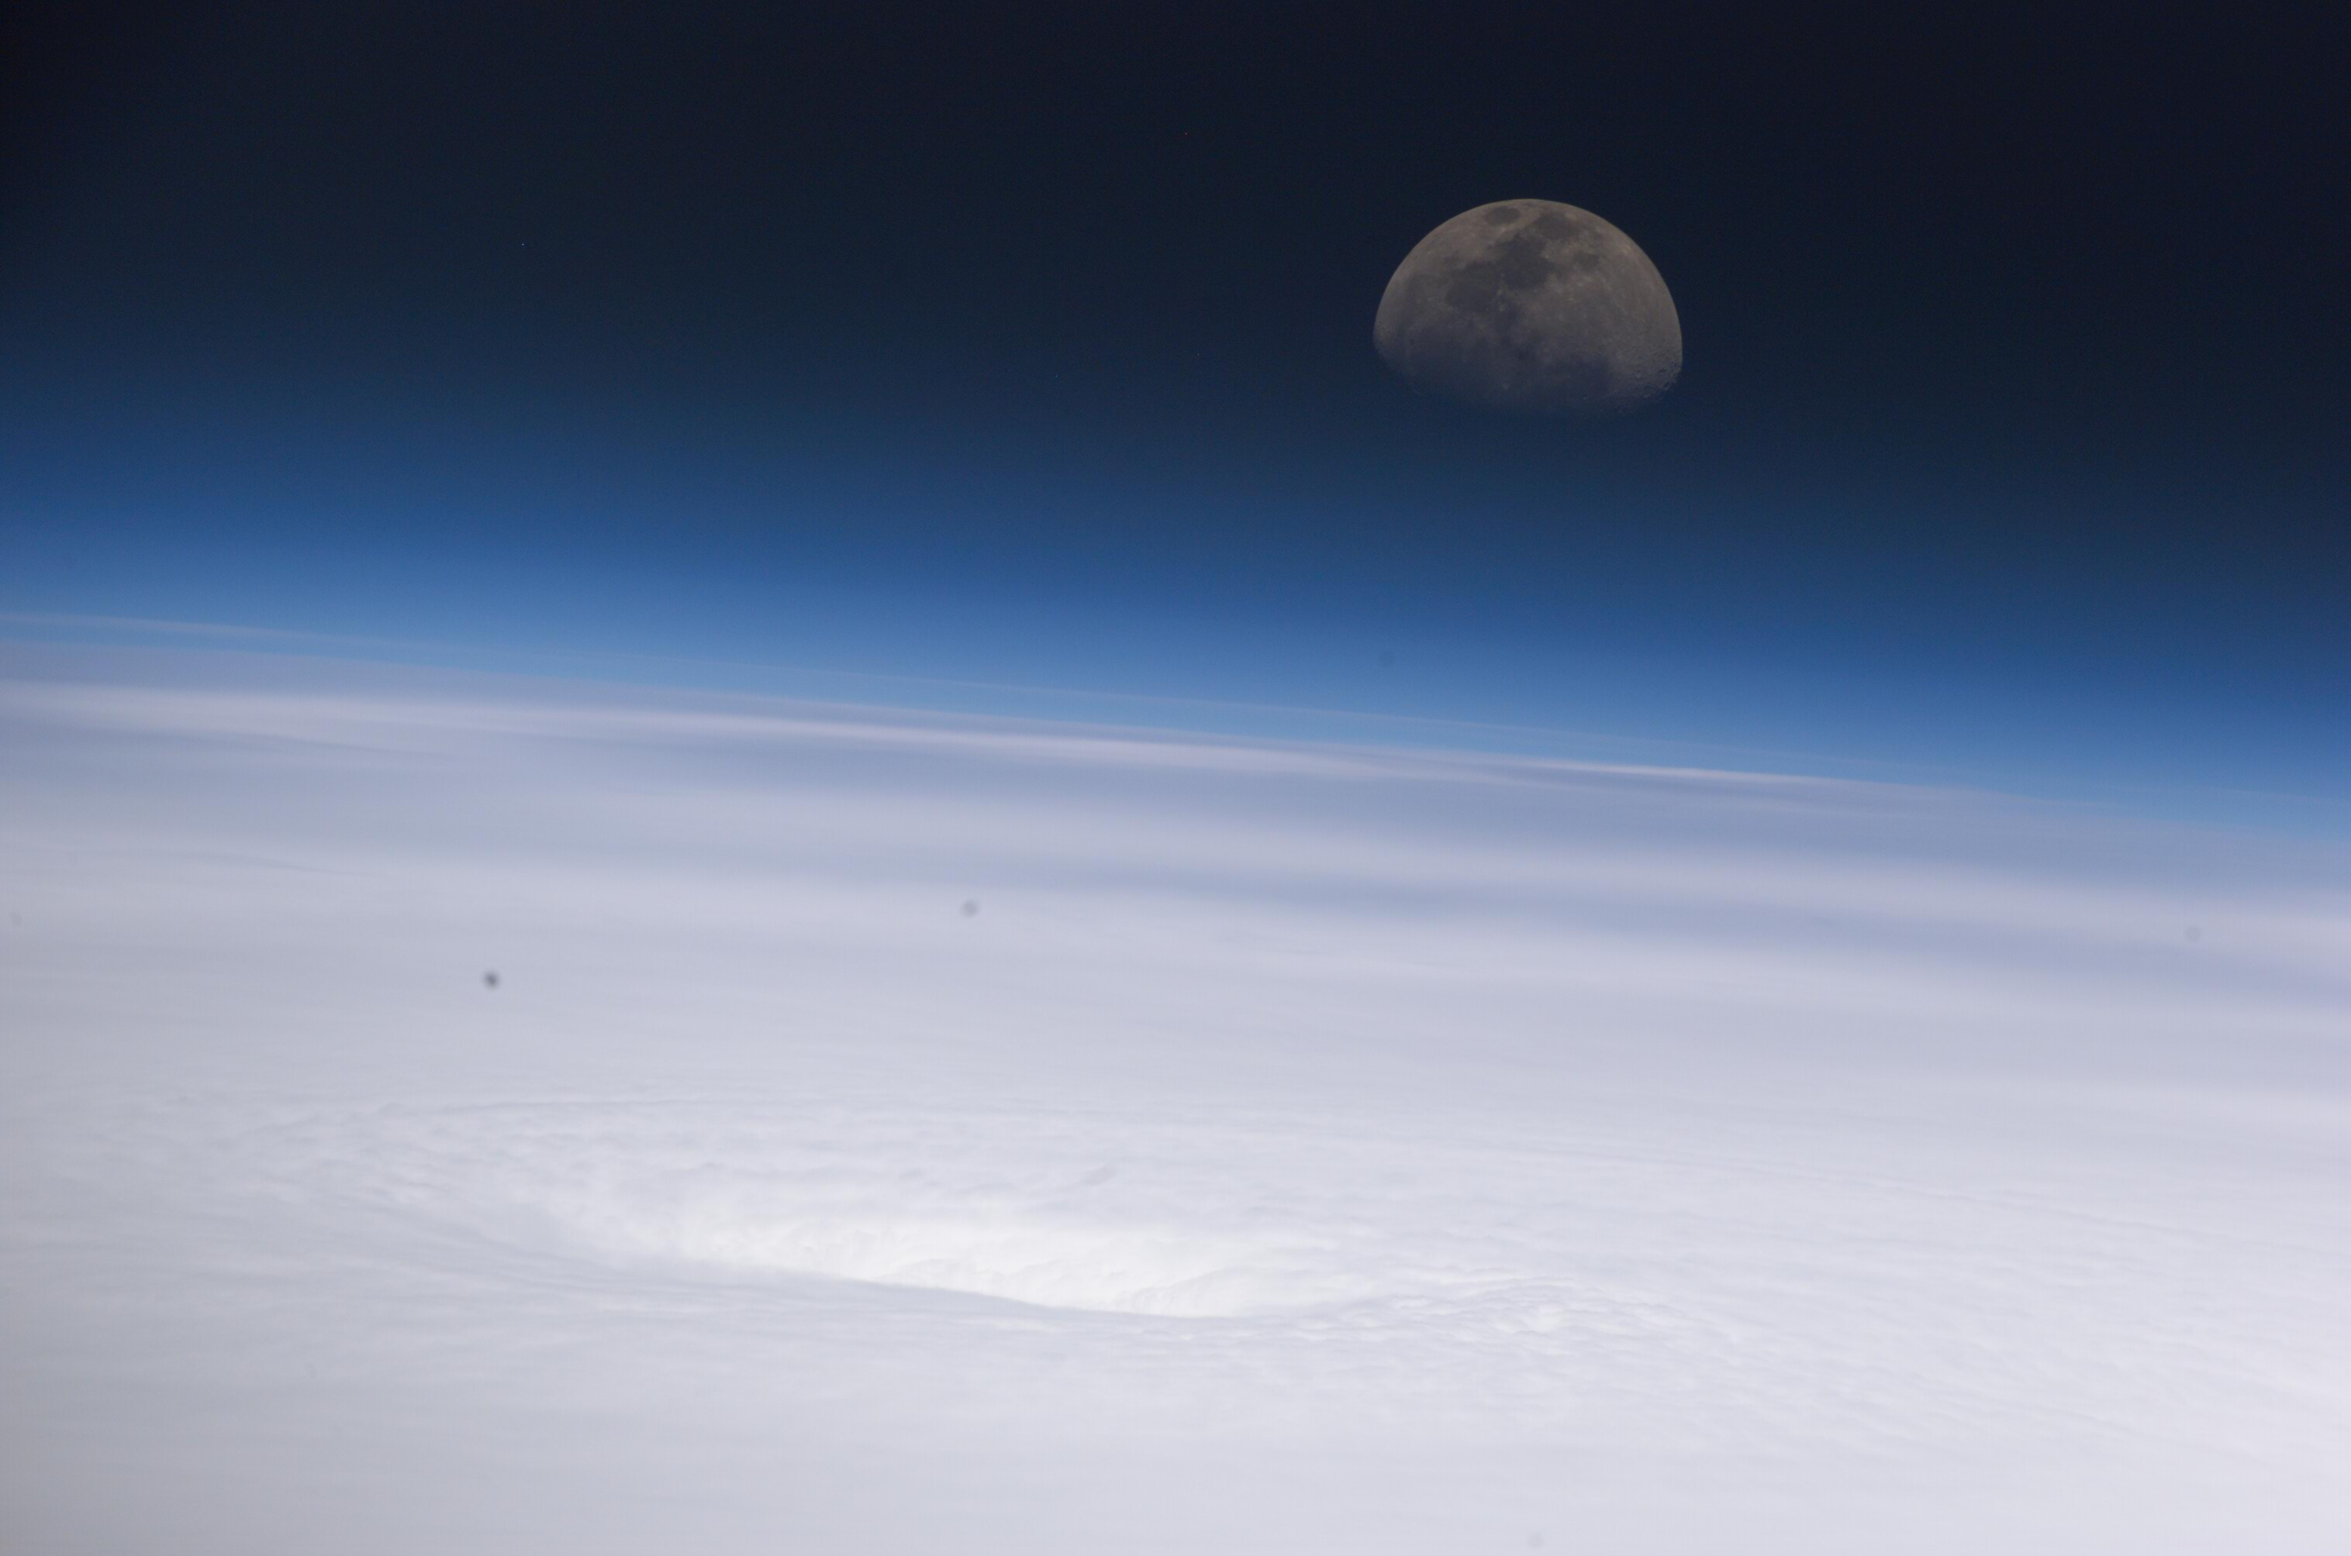
Thank you to ONR for supporting this work

Slide 22
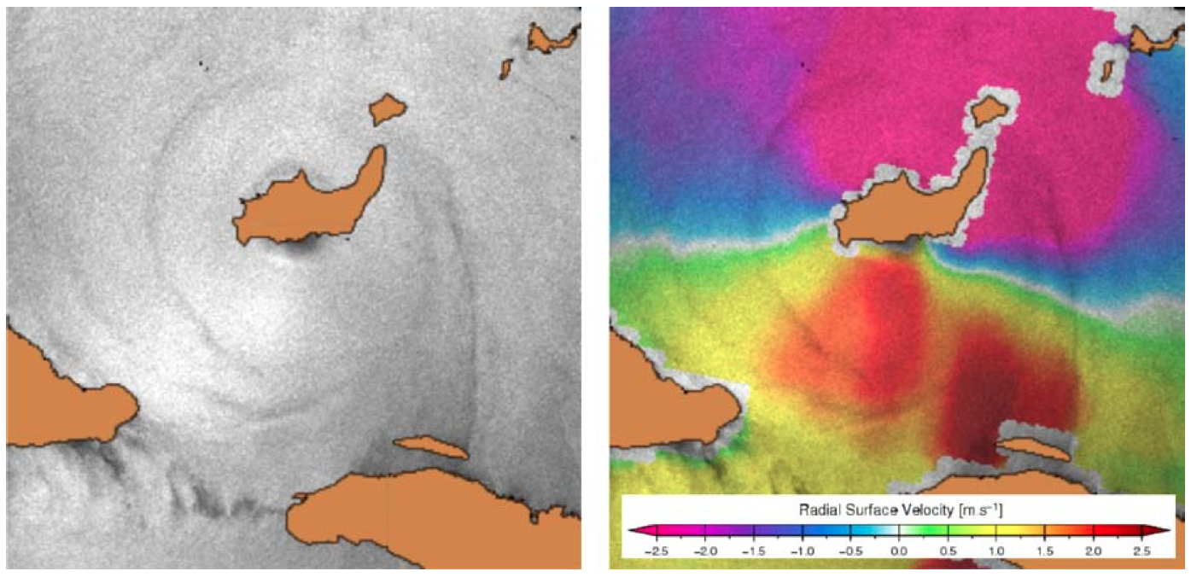
Doppler Shift Information for SAR Wind Retrieval

Slide 23
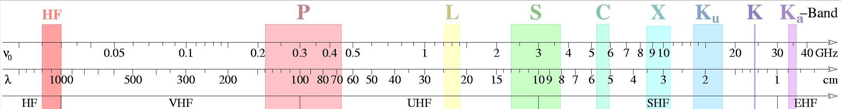
Development of an Empirical GMF
for X- and L-band
TerraSAR-X
PalSAR
ASAR
ASCAT
QuikSCAT
extrapolation
interpolation
extrapolation using a theoretical model

Slide 24
Doppler Shift for Wind Retrieval
f_{Ds} = f_{Dc} - f_{Dp}
f_{Dc} is the measured Doppler centroid,
f_{Dp} is the predicted Doppler shift
Only the radial component of the surface displacement contributes to the Doppler shift
azimuth
v_{radial}
v_{range}
surface
scatter
available with
ENVISAT ASAR
SENTINEL-1
v_{scatter}
Notes:
f_{Dc} is the measured Doppler centroid, defined as the radar return frequency shift at the antenna beam center
f_{Dp} is the predicted Doppler shift arising from the relative velocity of the satellite and rotating Earth

Slide 25
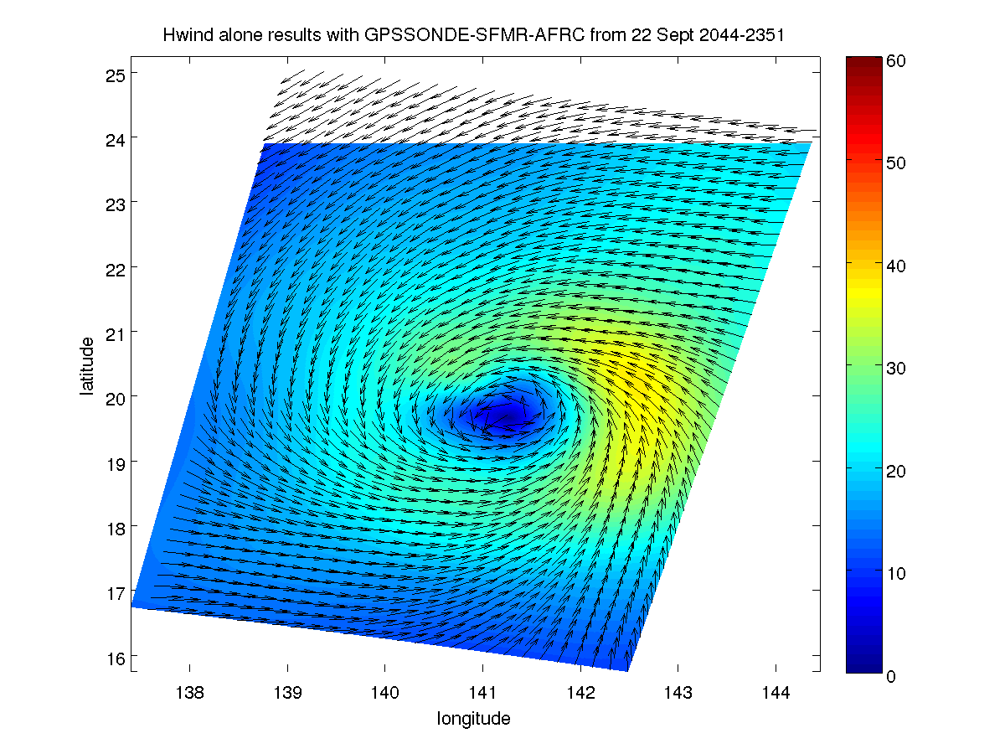
Typhoon Malakas, Assimilation into HWIND
HWIND with in situ
and SFMR 1 min
HWIND with in situ
and SFMR 10 min.
HWIND with SAR wind field 10 min.

Slide 26
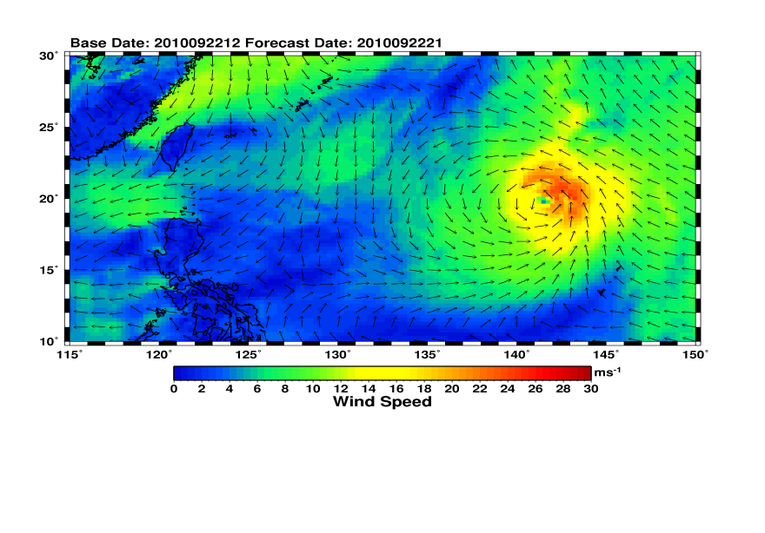
Typhoon Malakas, Comparison to Numerical Model Results
HWIND with in situ
and SFMR 10 min.
HWIND with SAR wind field 10 min.
ECMWF winds

Slide 27
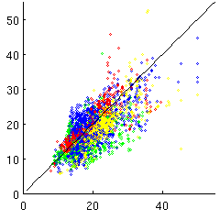
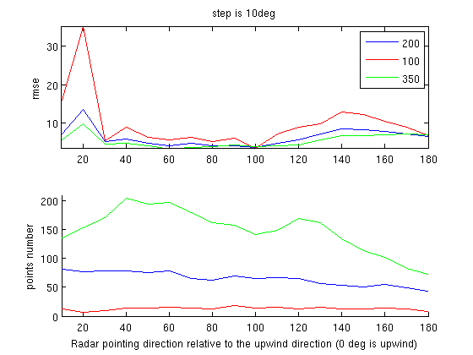
Comparison of SAR to QuikSCAT winds
cor 0.68
rms 5.16 m/s
bias 1.76 m/s
NURC wind speed [m/s]
QuikSCAT wind speed [m/s]
Wind speed [m/s]
pts radi<100km
pts radi<200km
pts radi<350km
Radar look direction with respect to wind direction [deg]
Notes:
Comparison of SAR retrieved wind speeds versus QuikSCAT (Cmod5 polratio of 0.8).
Comparison was performed with respect to tropical eye propagation, by splitting the storm into 4 quadrants.
No significant dependency on quadrant was identified.
In the lower plot we investigated the error in wind speed with respect to look direction and distance to eye
(radar look direction with respect to wind direction 0 deg is upwind)
Within SARTyPS we have now implemented a merged wind direction resulting from GD and NURC wind directions. This approach gives as similar errors as the individual approches of GD and NURC but less significant outliers. We sitill have to think about how to deal with the lack of inflow.

Slide 28
SAR Retrieved Feature Directions
Resulting from the LG-Method
Notes:
Finding the cyclone eye to remove ambiguities in wind direction

Slide 29
Wind Direction Ambiguity Removal
Select grids with only one wind direction

Slide 30
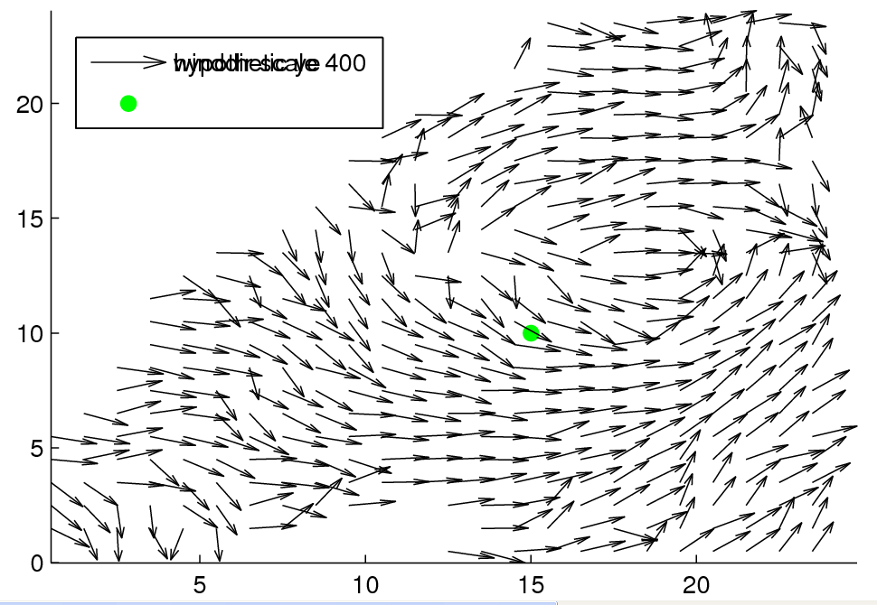
Wind Direction Ambiguity Removal
Select nearest neighbor for the other wind directions

Slide 31
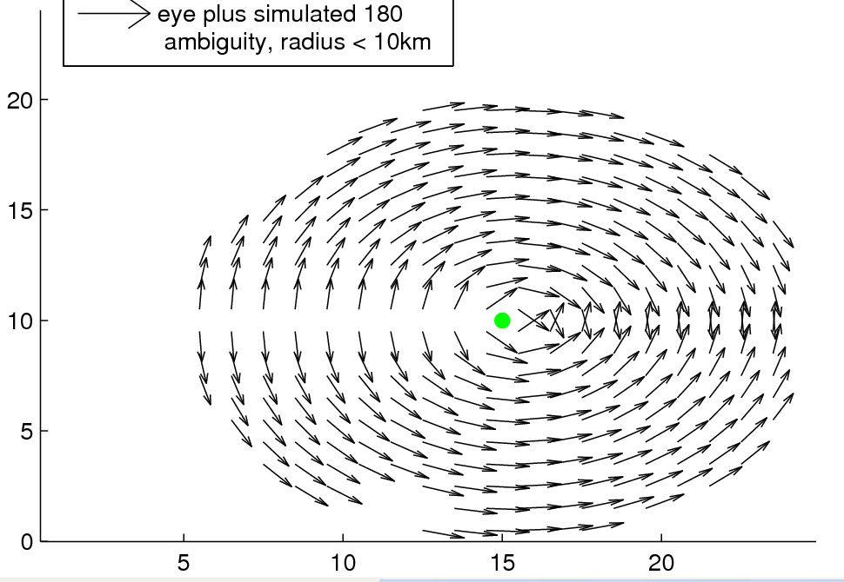
Wind Direction Ambiguity Removal
Polar wind directions around hypothetic eye with 180 deg ambiguity
Limit radius around the eye

Slide 32
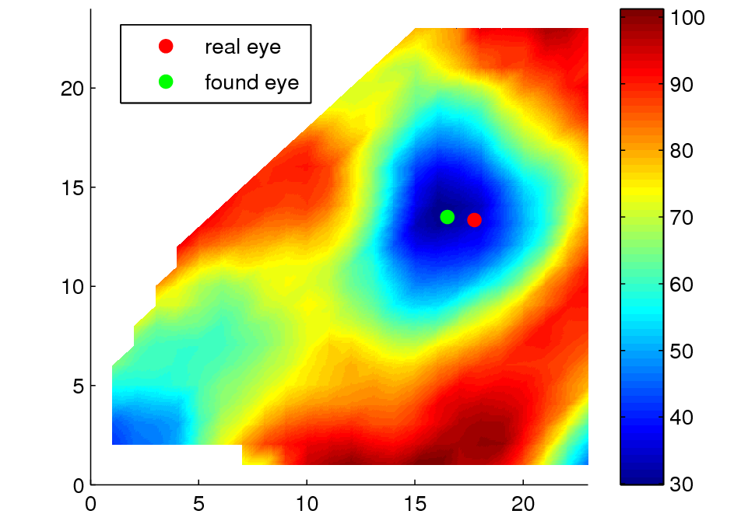
Wind Direction Ambiguity Removal
Retrieve 60% quantile of simulated polar wind at 400 m grid wind
Notes:
We believe that after step 5 Chris Blobfinder (last step in GDs eyefinder routine) brings us to a more accurate eye position than resulting from our methodology applied solely. Question is, which of the methodologies developed by GD and NURC will work best. Test set will be the data set of the Canadian Space Agency (156 storms).

Slide 33
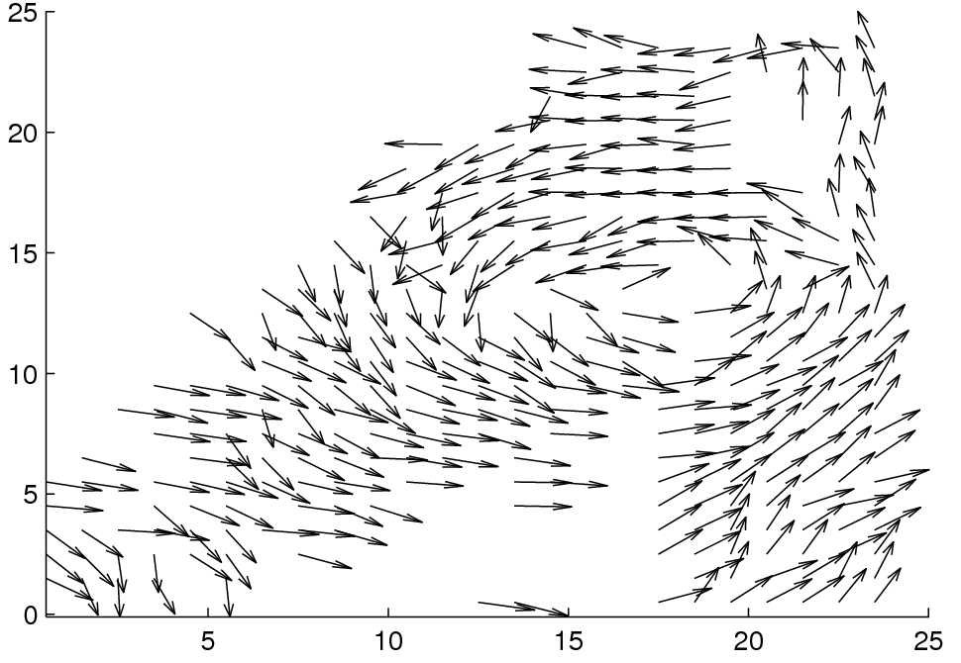
Wind Direction Ambiguity Removal
Use eye location and polar wind to remove 180 deg ambiguity and wind directions with difference above 60 deg

Slide 34
Wind Direction Ambiguity Removal
Select nearest neighbor of all scales to previously selected wind directions
Smooth wind directions
Radarsat-1
22. Aug. 2007

