Slide 1
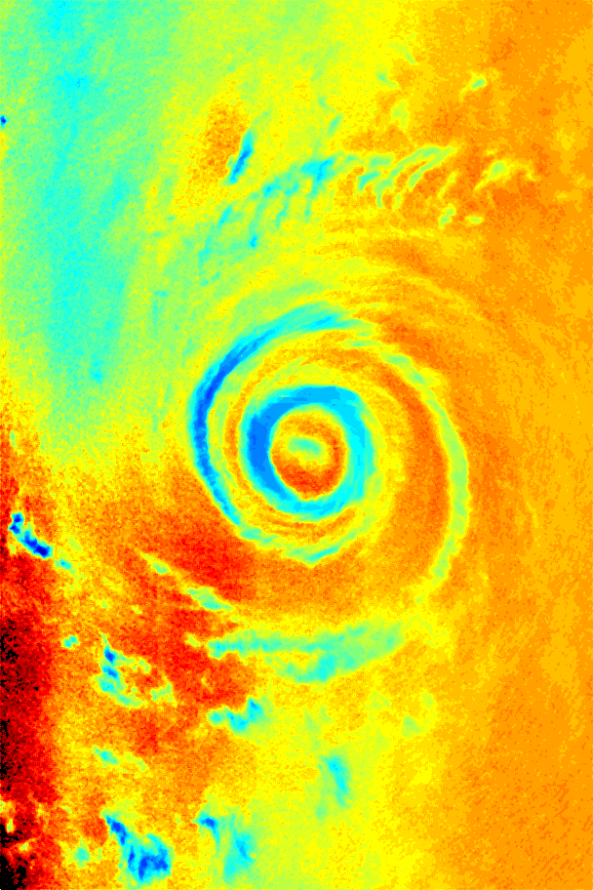
Status of SAR Wind Processing System
Status of SAR Wind
Processing System
ITOP SAR Team
ONR funded within Code 32
DRI on West Pacific Typhoons

Slide 2
Outline
SAR Wind processing system
SAR coverage of 2010 Typhoon season
  Background collections
  Targeted collections
Typhoon Fanapi
Typhoon Malakas
Typhoon Megi

Slide 3
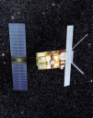
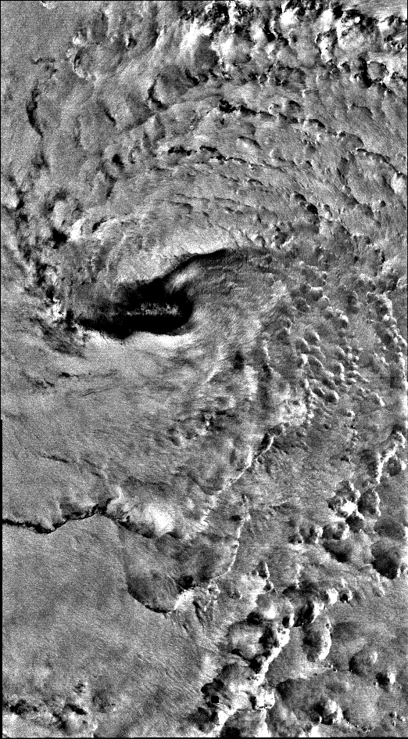

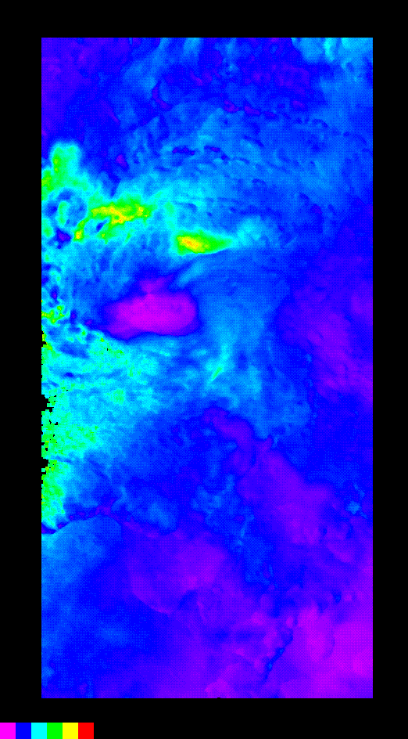
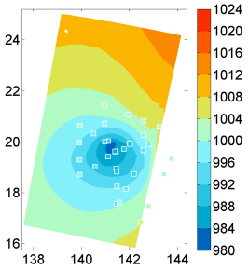
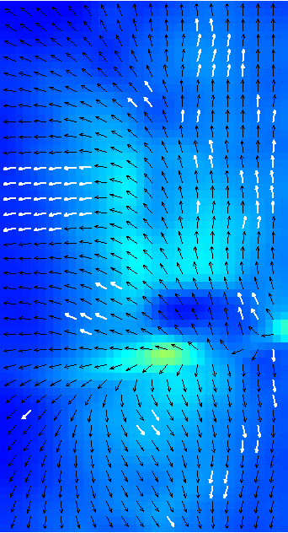
SAR Wind Processing System
CSTARS SAR BackBone Processing System
Real-time SAR environmental product generation system being built at CSTARS to support field deployment
Environmental Products
SAR Data
Eye location, size
Winds & Pressure Fields
Waves
CSTARS
Back
Bone
SAR Ancillary Files
Land
Mask
Wind Vectors ASCII File
Wave MeasuresASCII File
Previous Tracks
Eye Product
Eye Location,
Properties
UW-APL
Pressure Analysis
GD Eye Finder
NURC Eye Finder
Internet Access
GD Winds
Wind Product
Best Wind Directions
RCS-GMF
Wind Speed
NURC
WiSAR
GD Waves
Wave Product
Wave Spectral Map
CSTARS
Waves
Wind &Wave Products
SRI
SWAN/SAR
Assimilation
Best-Fit
Wave Spectra
& Winds

Slide 4
SAR Acquisitions
A total of 168 SAR images were acquired at CSTARS during the 2010 ITOP field program. The majority of these images were acquired as low priority requests and were not targeted at a specific typhoon. Images were acquired from four different instruments:
  Cosmo/Skymed – 19 passes
  Envisat – 22 passes
  Radarsat-2 - 101 passes
  TerraSAR-X – 26 passes
The combination of background and targeted imaging resulted in 11 eye hits and 4 near misses.

Slide 5
Background Missions
TerraSAR-X, Radarsat-2 and Envisat data were acquired as background collections.
  Low priority collections over typhoon region
  Collections were acquired if duty cycle permitted and there were no conflicts with other requests.
TerrarSAR-X
  97 Requests, 26 acquired
Radarsat-2
  101 Requests, 96 acquired
Envisat
  35 Requests; 22 acquired

Slide 6
Targeted Acquisitions
Radarsat-2
  7 Requests; 5 acquired
Cosmo/Skymed
  37 Requests; 19 acquired
TerraSAR-X
  0 Requests; Satellite was not available after Sep 20, 2010 due to calibration activities with Tandem‑X

Slide 7
Typhoon Summary – Fanapi/Malakas
Fanapi
Date | Satellite | Mode | Notes
Sep 12, 2010 20:23 GMT | Radarsat-2 | VV | Near miss
Sep 13, 2010 09:08GMT | Radarsat-2 | HH/HV | Near miss
Sep 17, 2010 21:14 GMT | Radarsat-2 | HH/HV | Near miss
Malakas
Date | Satellite | Mode | Notes
Sep 22, 2010 20:29 GMT | Radarsat-2 | HH/HV | Eye hit
Sep 24, 2010 08:49 GMT | Radarsat-2 | HH/HV | Near miss

Slide 8
Typhoon Summary – Megi
Date | Satellite | Mode | Eye Center | Eye Characteristics Major/Minor/Rotation
Oct 14, 2010 20:58 GMT | Cosmo/Skymed-3 | VV | Miss
Oct 14, 2010 21:17 GMT | Cosmo/Skymed-2 | VV | Miss
Oct 15, 2010 21:00 GMT | Radarsat-2 | VV | 17° 00’ 28” N 133° 30’ 44” E | 25.6 km/18.8 km/-34.1°
Oct 16, 2010 09:17 GMT | Cosmo/Skymed-3 | VV | 18° 09’ 21” N 130° 41’ 10” E | 37.4 km/30.2 km/130°
Oct 17, 2010 01:27 GMT | Envisat | VV | 18° 39’ 47” N 127° 04’ 52” E | 20.8 km/12.7 km/97.5°
Oct 17, 2010 09:35 GMT | Cosmo/Skymed-3 | VV | 18° 13’ 55” N 125° 29’ 49” E | 45.3 km/44.6 km/49.2° 19.7 km/11.1 km/111.0°
Oct 17, 2010 21:41 GMT | Radarsat-2 | VV | 17° 21’ 07” N 123° 40’ 34” E | 42.9 km/31.2 km/6.8° 17.4 km/11.6 km/125.6°
Oct 17, 2010 21:53 GMT | Cosmo/Skymed-3 | VV | 17° 28’ 23” N 123° 43’ 08” E | 46.2 km/38.0 km/91.8° 21.6 km/10.9 km/102.9°
Oct 18, 2010 22:12 GMT | Cosmo/Skymed-3 | VV | 16° 14’ 13” N 119° 30’ 54” E | 7.8 km/6.2 km/80.9
Oct 19, 2010 09:41 GMT | Cosmo/Skymed-1 | VV | 16° 54’ 10” N 118° 29’ 17 E | 16.4 km/14.2 km/37.2°
Oct 19, 2010 22:30 GMT | Cosmo/Skymed-3 | VV | 17° 08’ 06” N 117° 20’ 10” E | 28.9 km/22.8 km/-1.6°
Oct 21, 2010 22:05 GMT | TerraSAR-X | VV | 20° 54’ 50” N 118° 09’ 36” E | 57.6 km/43.2 km/104.7°

Slide 9
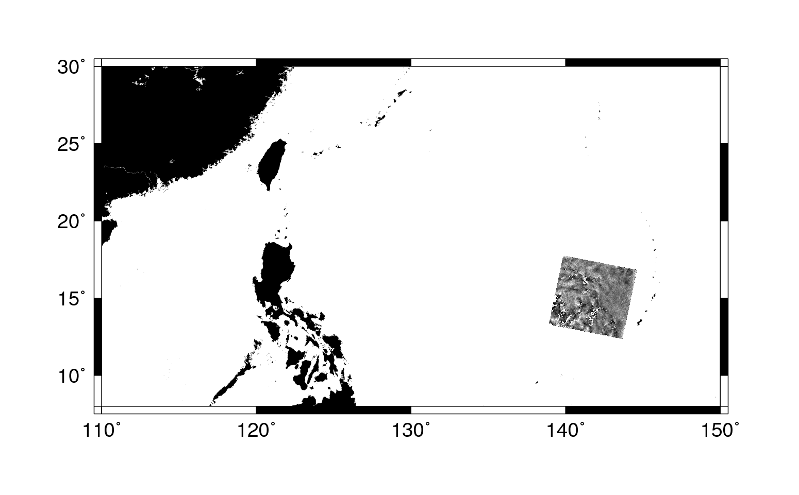
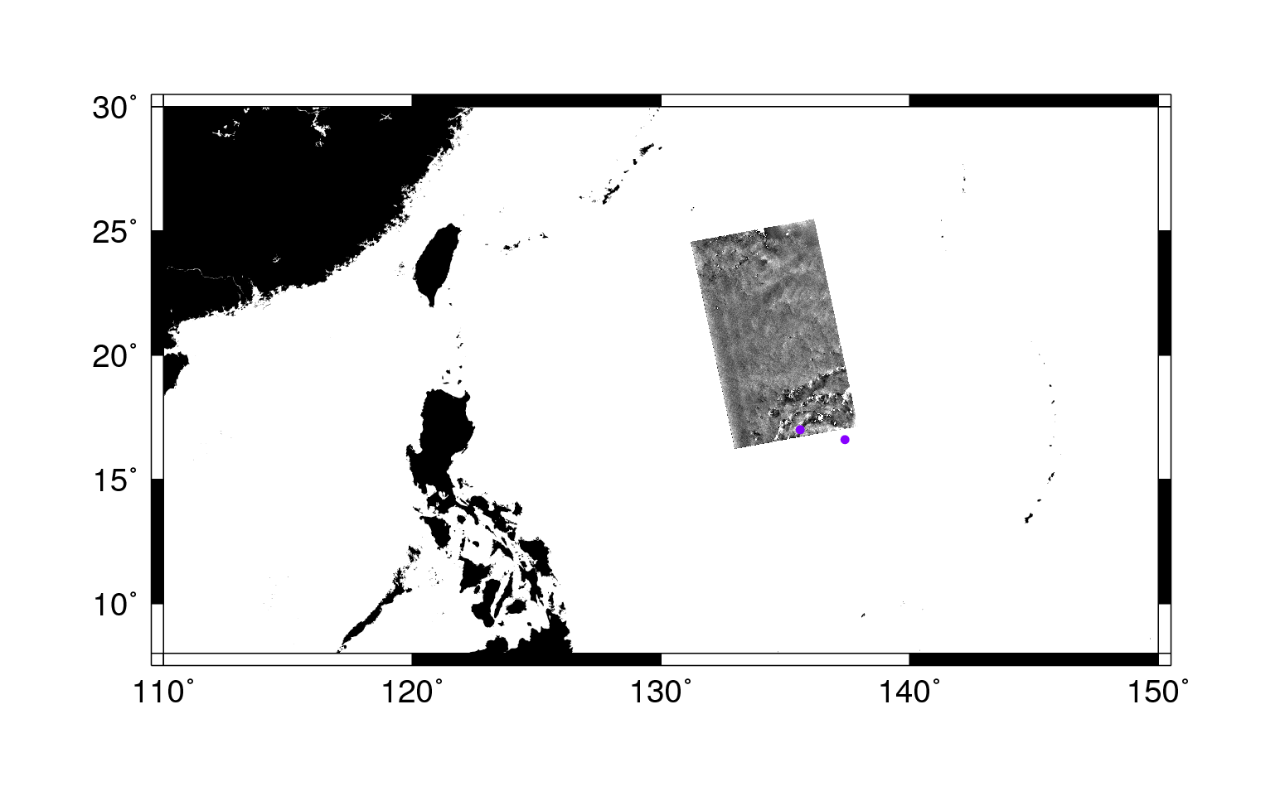
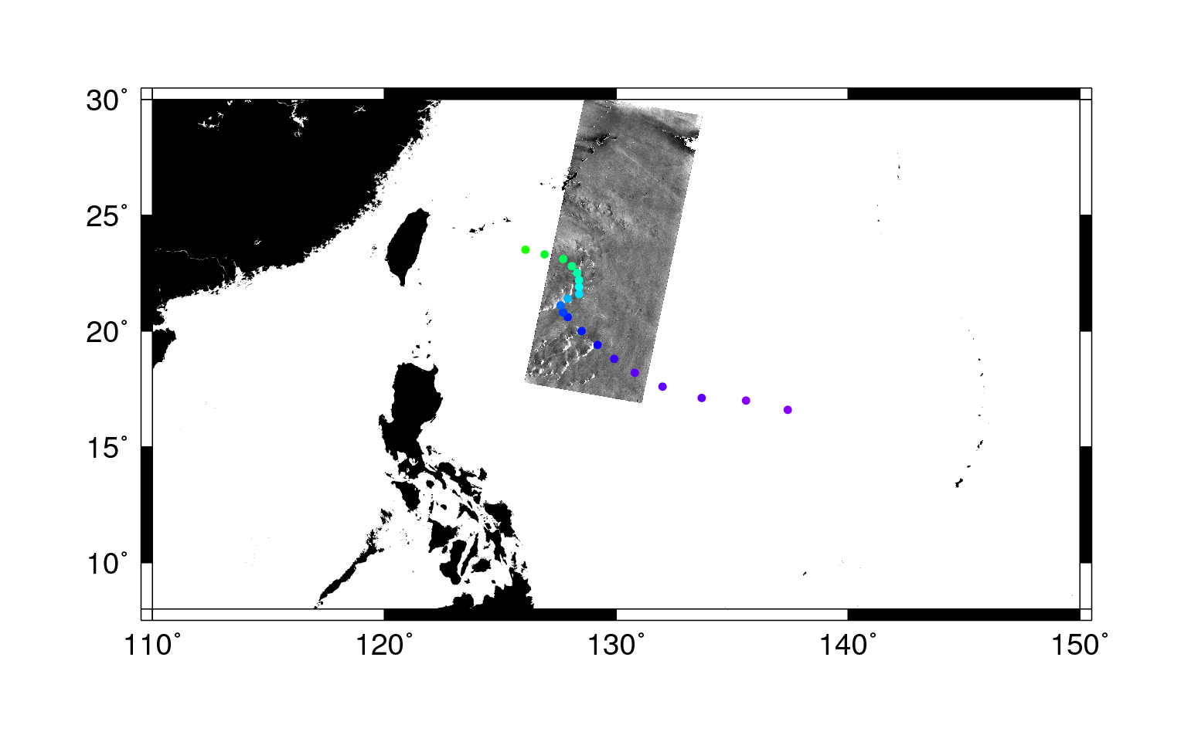

Typhoon Fanapi Overview
Radarsat-2
Sep 17, 2010
21:14 GMT
Radarsat-2
Sep 13, 2010, 09:08 GMT
Radarsat-2
Sep 12, 2010, 20:23 GMT

Slide 10
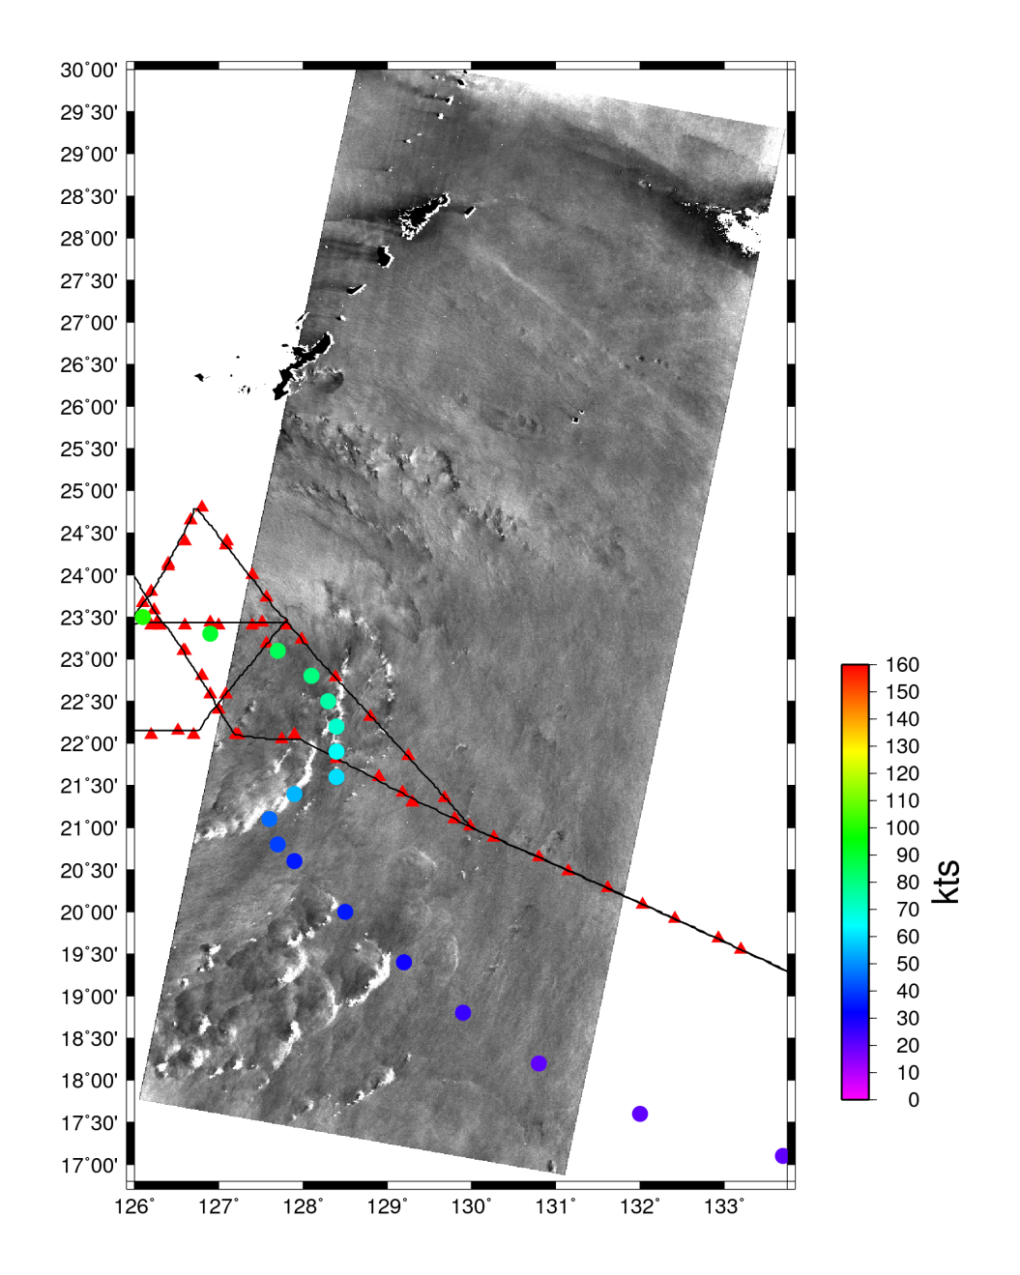
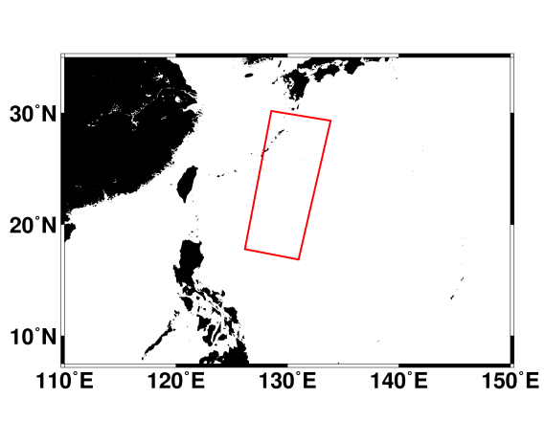
Typhoon Fanapi Sep 17, 2010 21:14 GMT
Radarsat-2
Polarization: HH,HV
Beam: SCWA
Resolution: 100m
USAF C130
Sep 17, 21:30 – Sep 18, 03:00
Cross

Slide 11
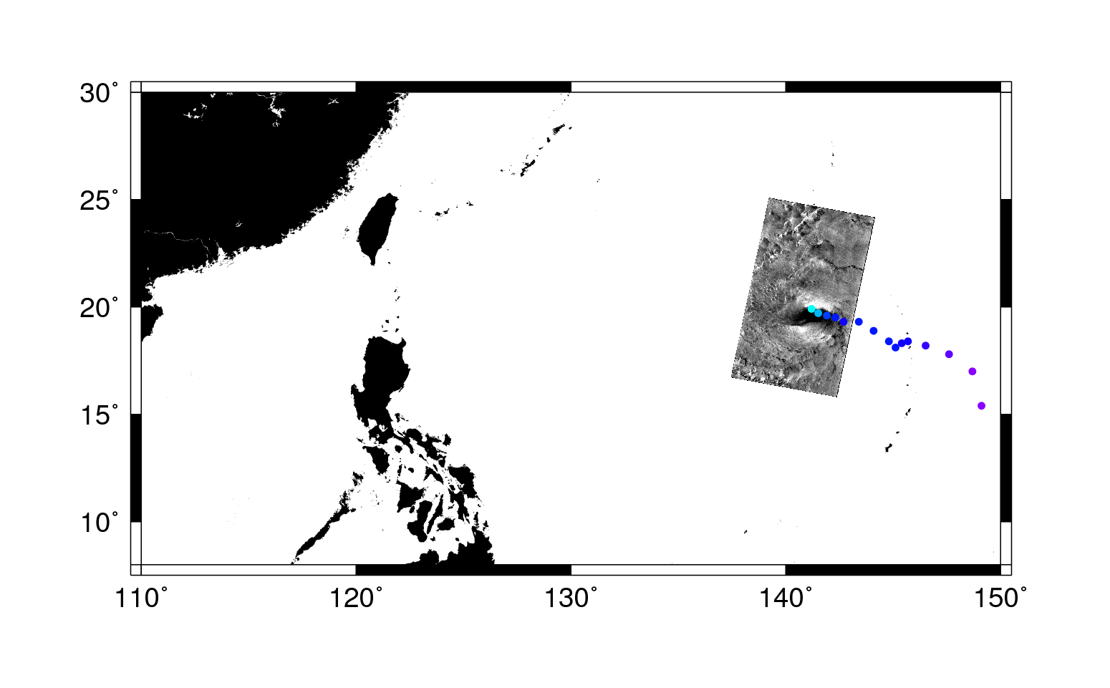
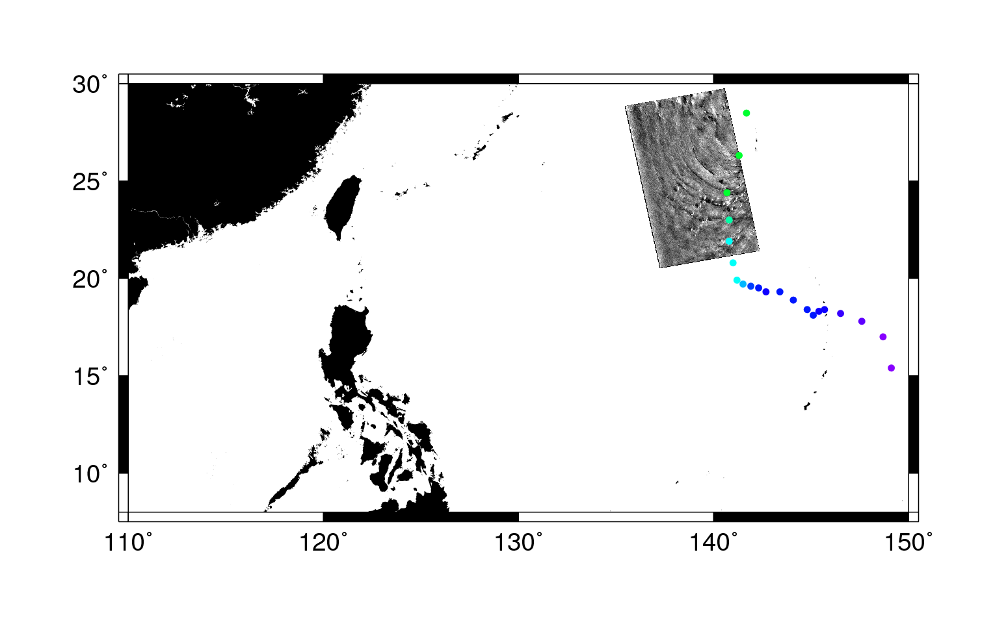
Typhoon Malakas Overview
Sep 24, 2010
08:49 GMT
Sep 22, 2010
20:29 GMT

Slide 12
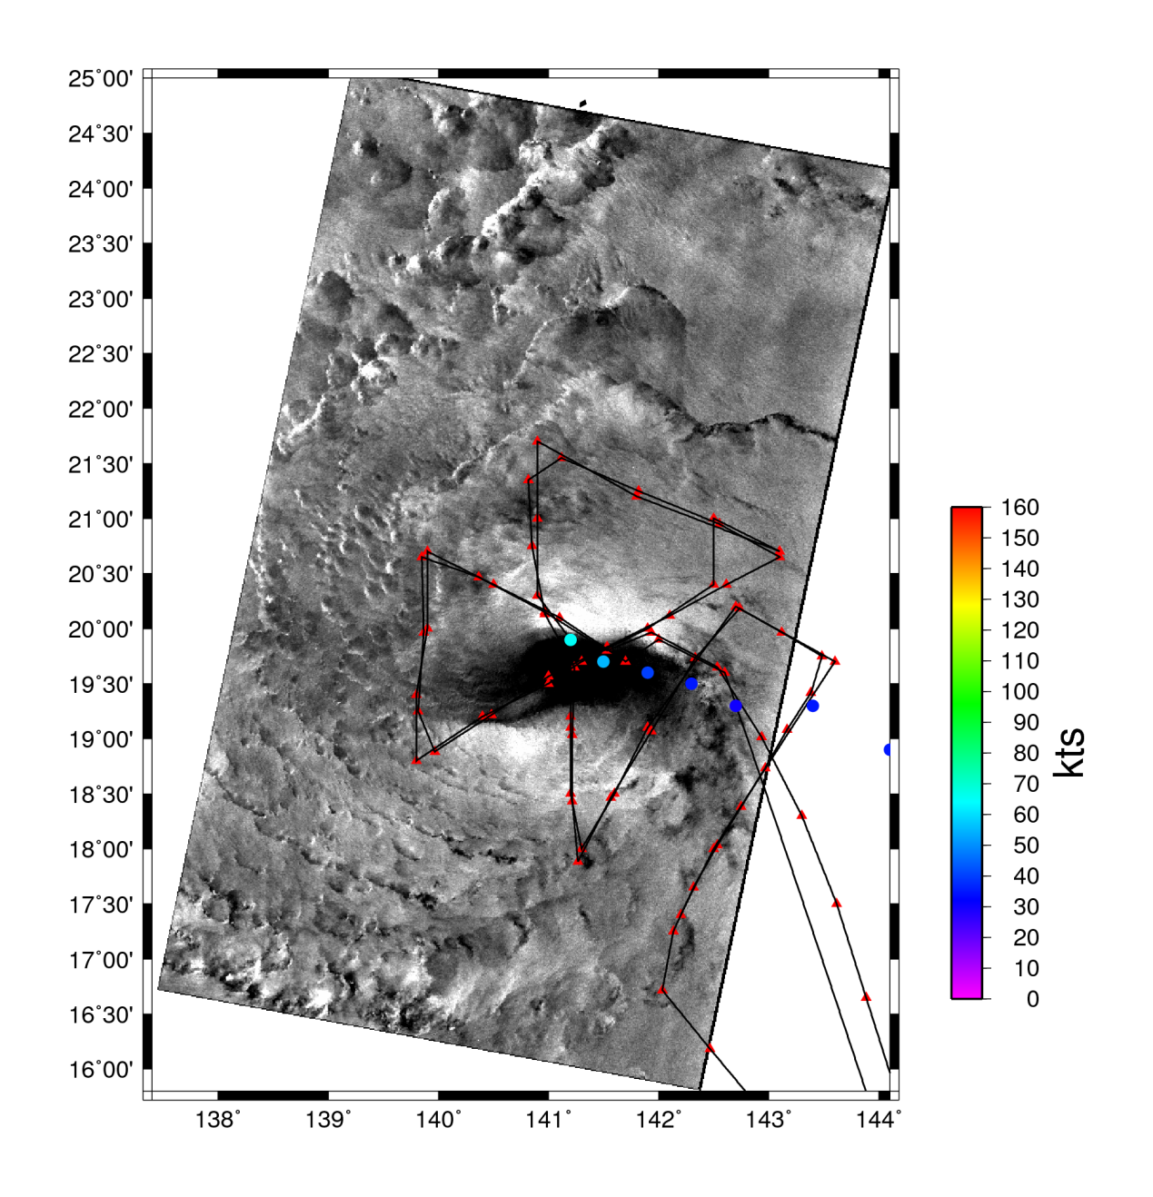
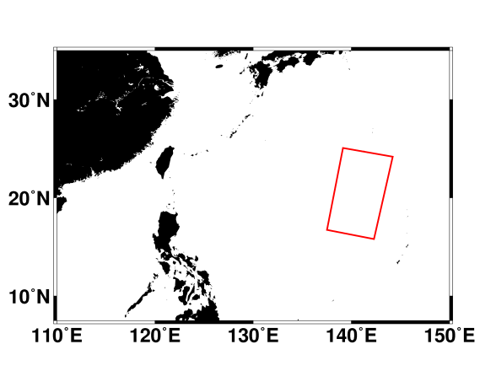
Typhoon Malakas Sep 22, 2010 20:29
Radarsat-2
Polarization: HH,HV
Beam: SCWA
Resolution: 100m
USAF C130
Sep 22, 20:00 – Sep 23, 02:00
Cross
Center at:
19° 32’ 35” N
141° 22’ 8” E
Major Axis: 205 km
Minor Axis: 80.6 km
Azimuth: 92.4°

Slide 13
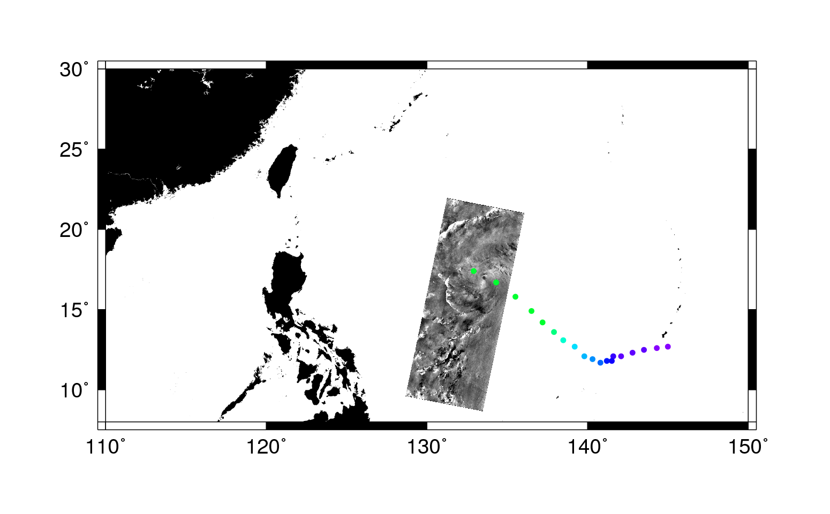
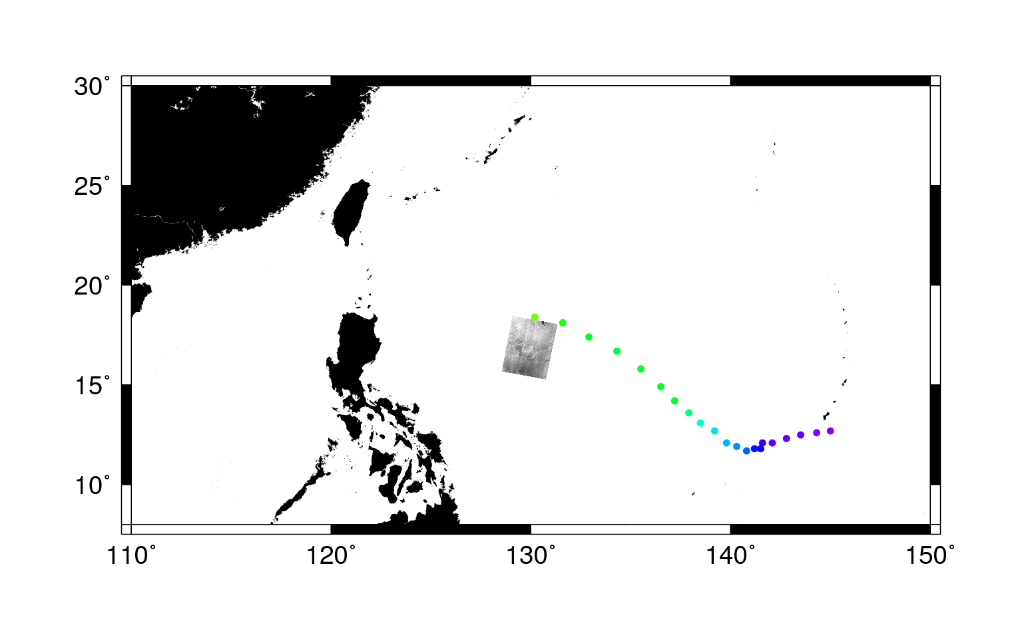
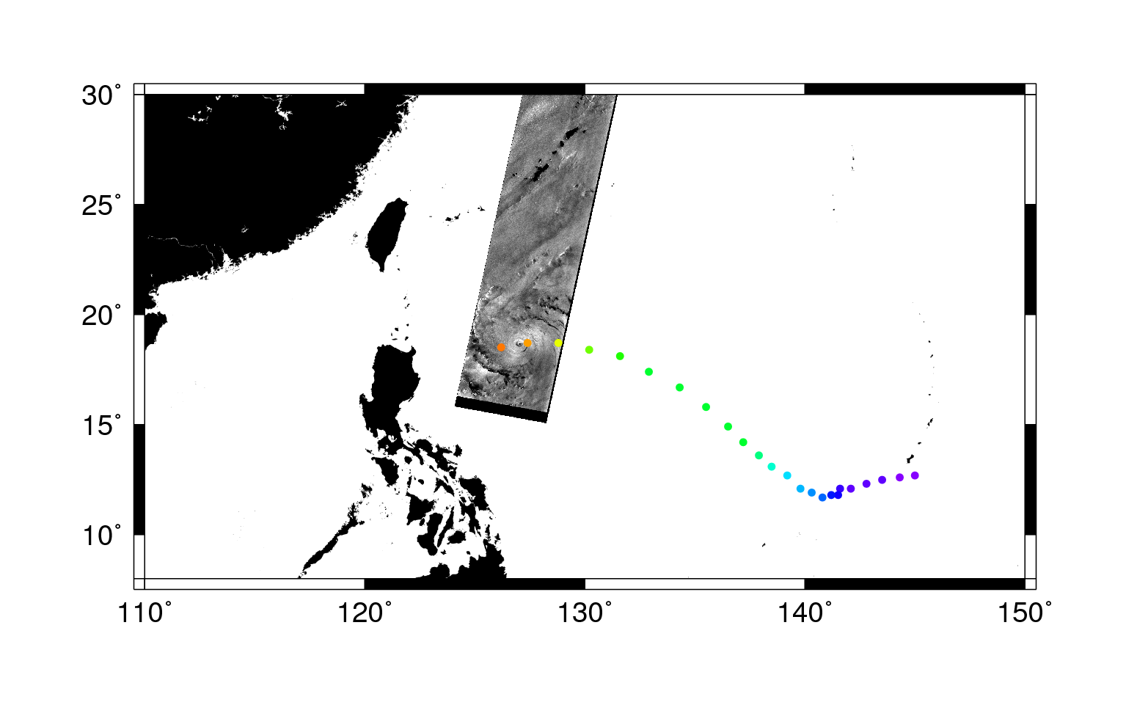
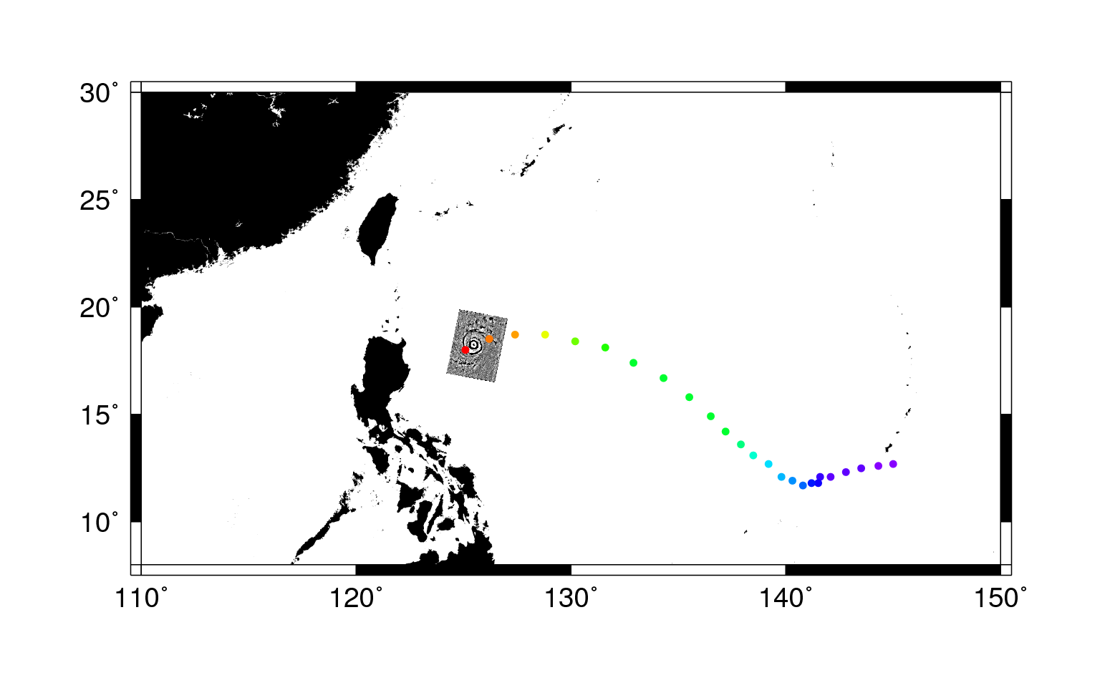
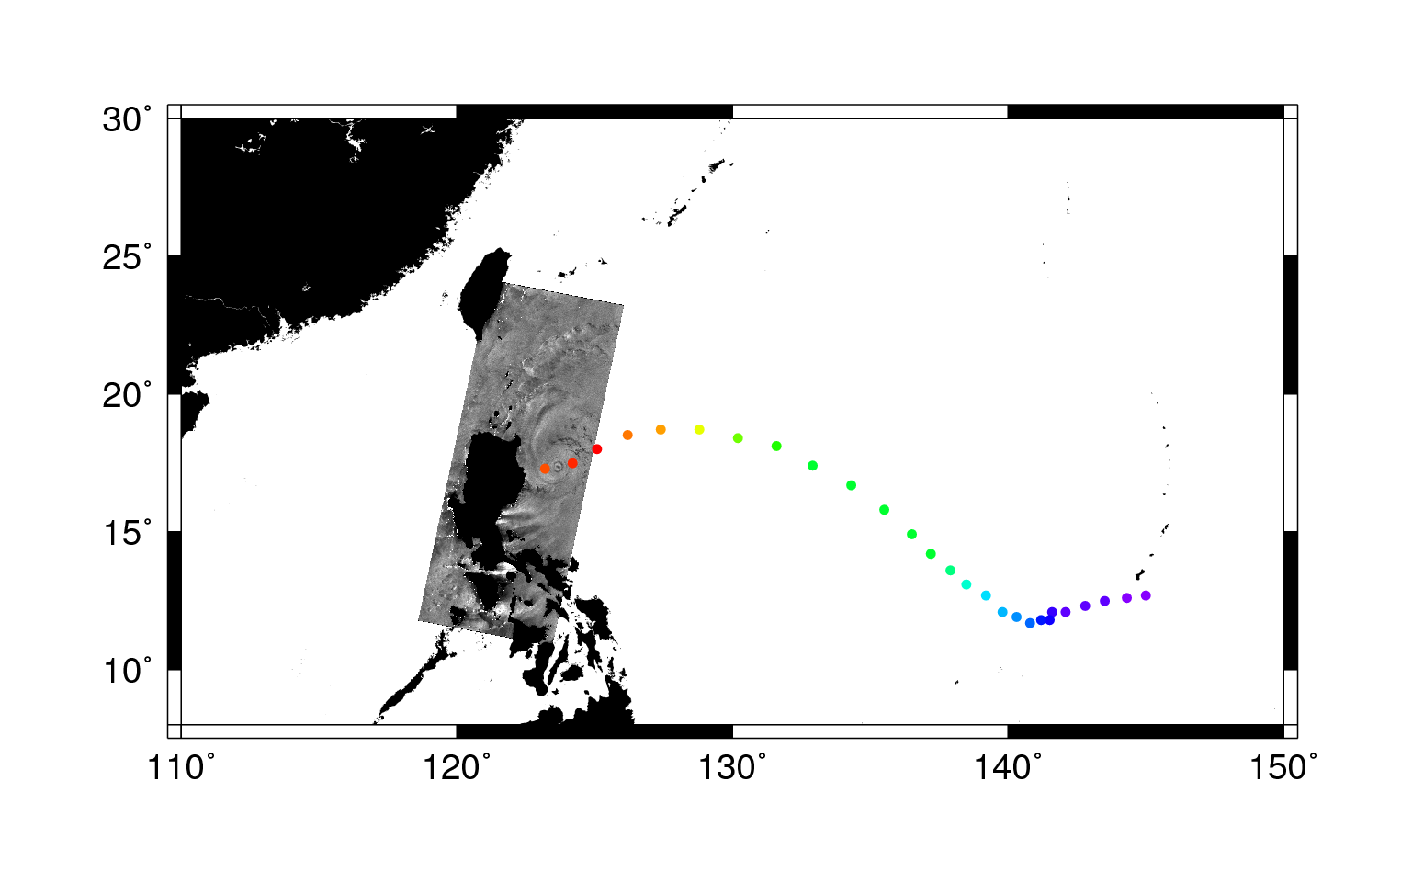
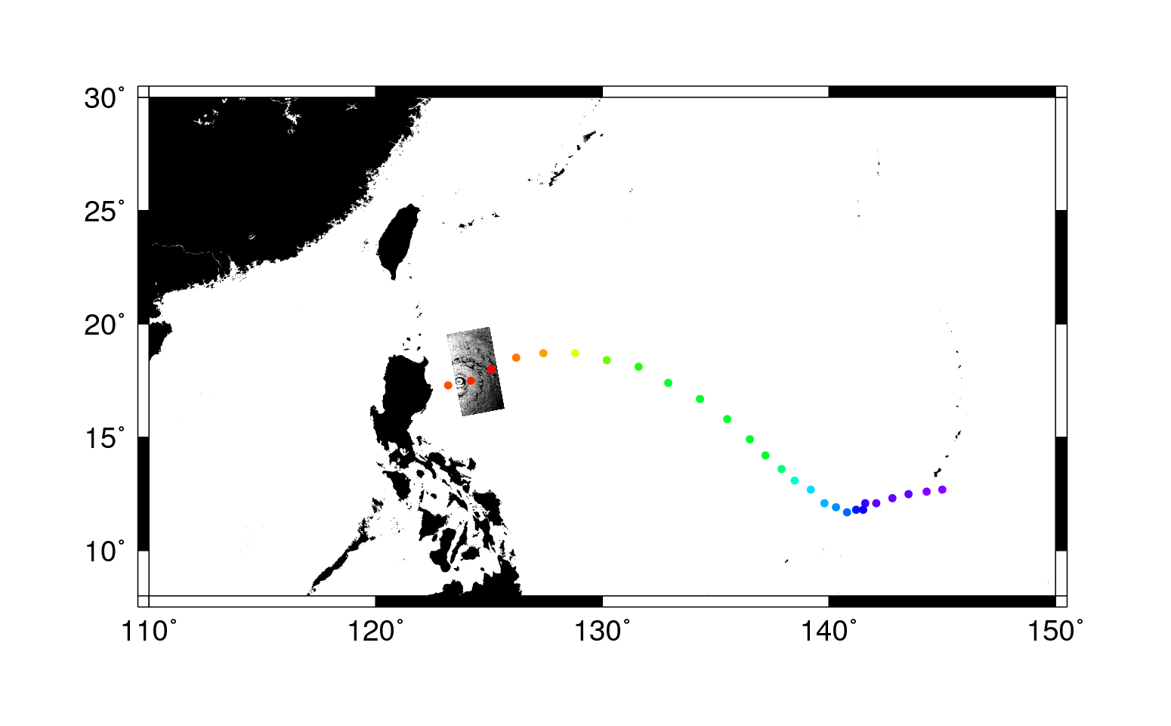
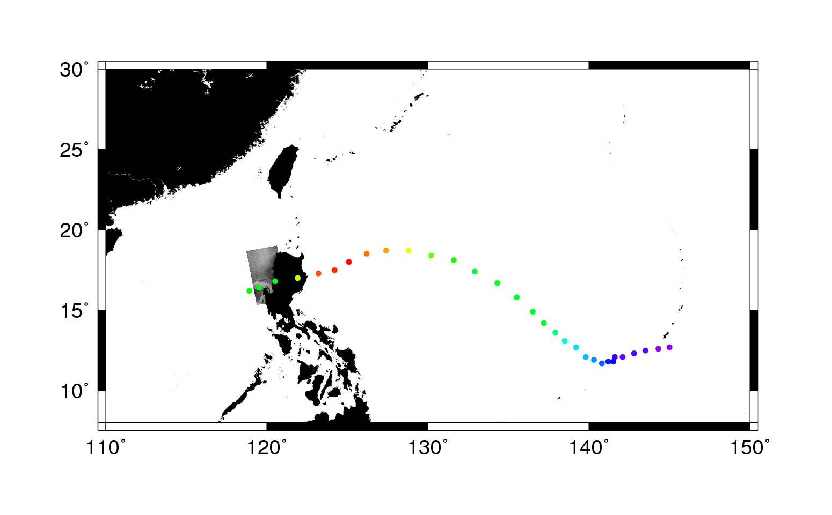


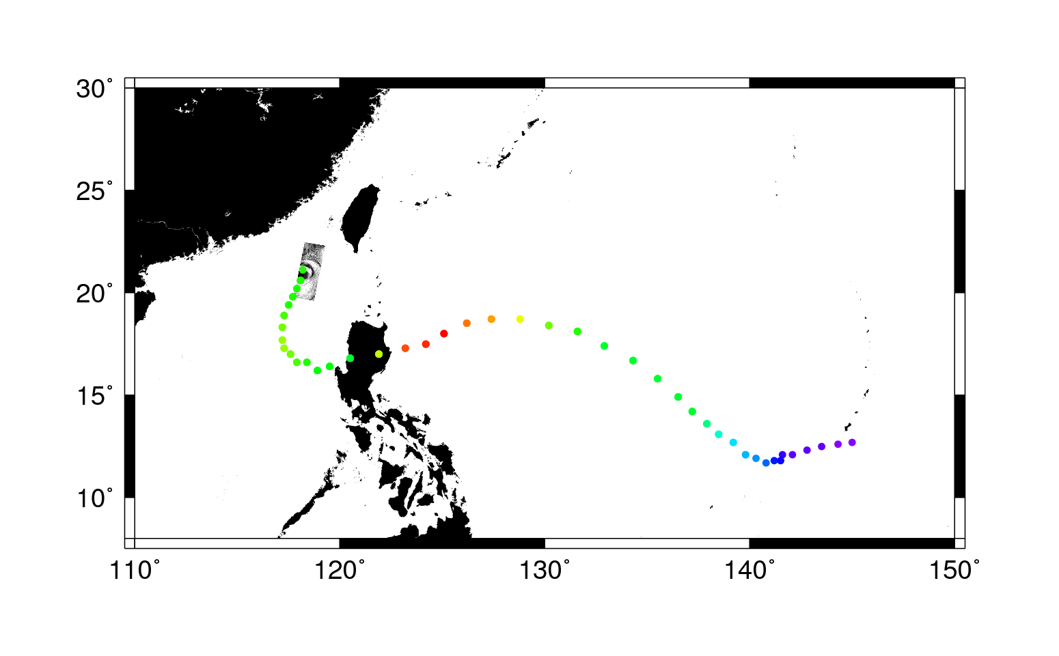



Typhoon Megi Collection Sequence
Radarsat-2 Oct 15 21:00
Cosmo/Skymed-3 Oct 16 09:17
Envisat Oct 17 01:27
Cosmo/Skymed-3 Oct 17 09:35
Radarsat-2 Oct 17 21:41
Cosmo/Skymed-3 Oct 17 21:53
Cosmo/Skymed-3 Oct 18 20:12
Cosmo/Skymed-1 Oct 19 09:41
Cosmo/Skymed-3 Oct 19 22:30
TerraSAR-X Oct 21 22:05
Radarsat-2 Oct 15 21:00
Cosmo/Skymed-3 Oct 16 09:17
Envisat Oct 17 01:27
Cosmo/Skymed-3 Oct 17 09:35
Radarsat-2 Oct 17 21:41
Cosmo/Skymed-3 Oct 17 21:53
Cosmo/Skymed-3 Oct 18 20:12
Cosmo/Skymed-1 Oct 19 09:41
Radarsat-2 Oct 15 21:00
Cosmo/Skymed-3 Oct 16 09:17
Envisat Oct 17 01:27
Cosmo/Skymed-3 Oct 17 09:35
Radarsat-2 Oct 17 21:41
Cosmo/Skymed-3 Oct 17 21:53
Cosmo/Skymed-3 Oct 18 20:12
Radarsat-2 Oct 15 21:00
Cosmo/Skymed-3 Oct 16 09:17
Envisat Oct 17 01:27
Cosmo/Skymed-3 Oct 17 09:35
Radarsat-2 Oct 17 21:41
Radarsat-2 Oct 15 21:00
Cosmo/Skymed-3 Oct 16 09:17
Envisat Oct 17 01:27
Radarsat-2 Oct 15 21:00
Radarsat-2 Oct 15 21:00
Cosmo/Skymed-3 Oct 16 09:17
Radarsat-2 Oct 15 21:00
Cosmo/Skymed-3 Oct 16 09:17
Envisat Oct 17 01:27
Cosmo/Skymed-3 Oct 17 09:35
Radarsat-2 Oct 15 21:00
Cosmo/Skymed-3 Oct 16 09:17
Envisat Oct 17 01:27
Cosmo/Skymed-3 Oct 17 09:35
Radarsat-2 Oct 17 21:41
Cosmo/Skymed-3 Oct 17 21:53
Radarsat-2 Oct 15 21:00
Cosmo/Skymed-3 Oct 16 09:17
Envisat Oct 17 01:27
Cosmo/Skymed-3 Oct 17 09:35
Radarsat-2 Oct 17 21:41
Cosmo/Skymed-3 Oct 17 21:53
Cosmo/Skymed-3 Oct 18 20:12
Cosmo/Skymed-1 Oct 19 09:41
Cosmo/Skymed-3 Oct 19 22:30

Slide 14
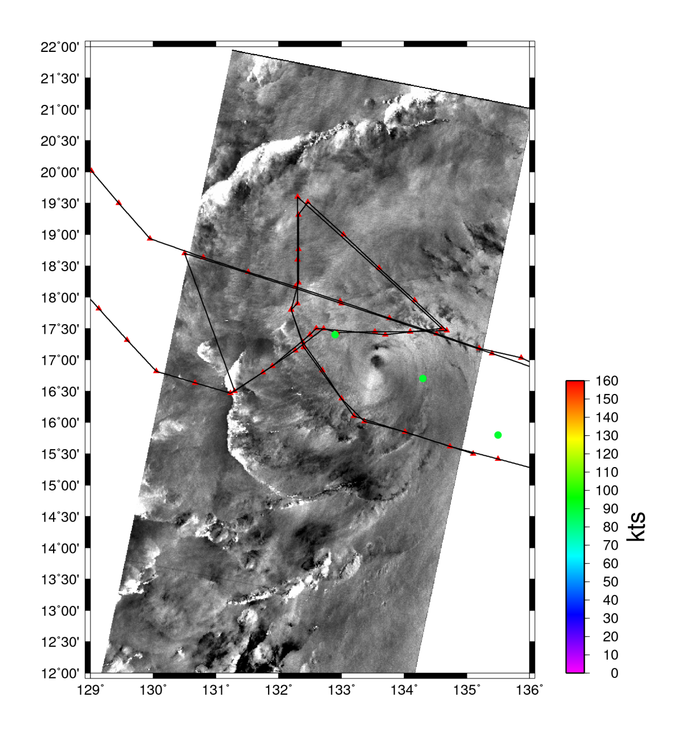
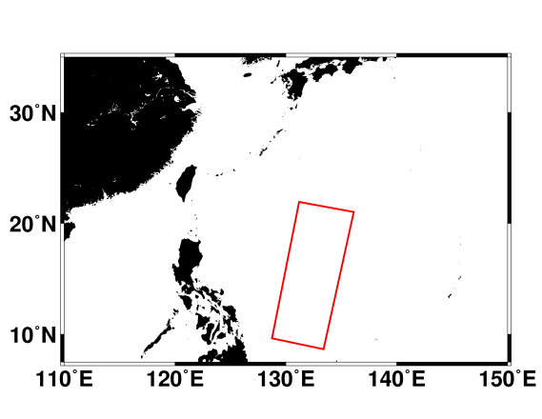
Typhoon Megi Oct 15, 2010 20:06 GMT
Radarsat-2
Polarization: HH,HV
Beam: SCWA
Resolution: 100m
USAF C130
Oct 15, 21:15 Outbound
Oct 15, 02:00
Cross
Center at:
17° 00’ 28” N
133° 30’ 44” E
Major Axis: 25.6 km
Minor Axis: 18.8 km
Azimuth: -34.1°
Notes:
Ellipse Center: (133.572 , 16.972)
Major Axis 25.6 km
Minor Axis 18.8 km
Major Axis Azimuth: -34.1 deg
Ellipse Area: 378.8 km^2
Eye Area: 262.5 km^2

Slide 15
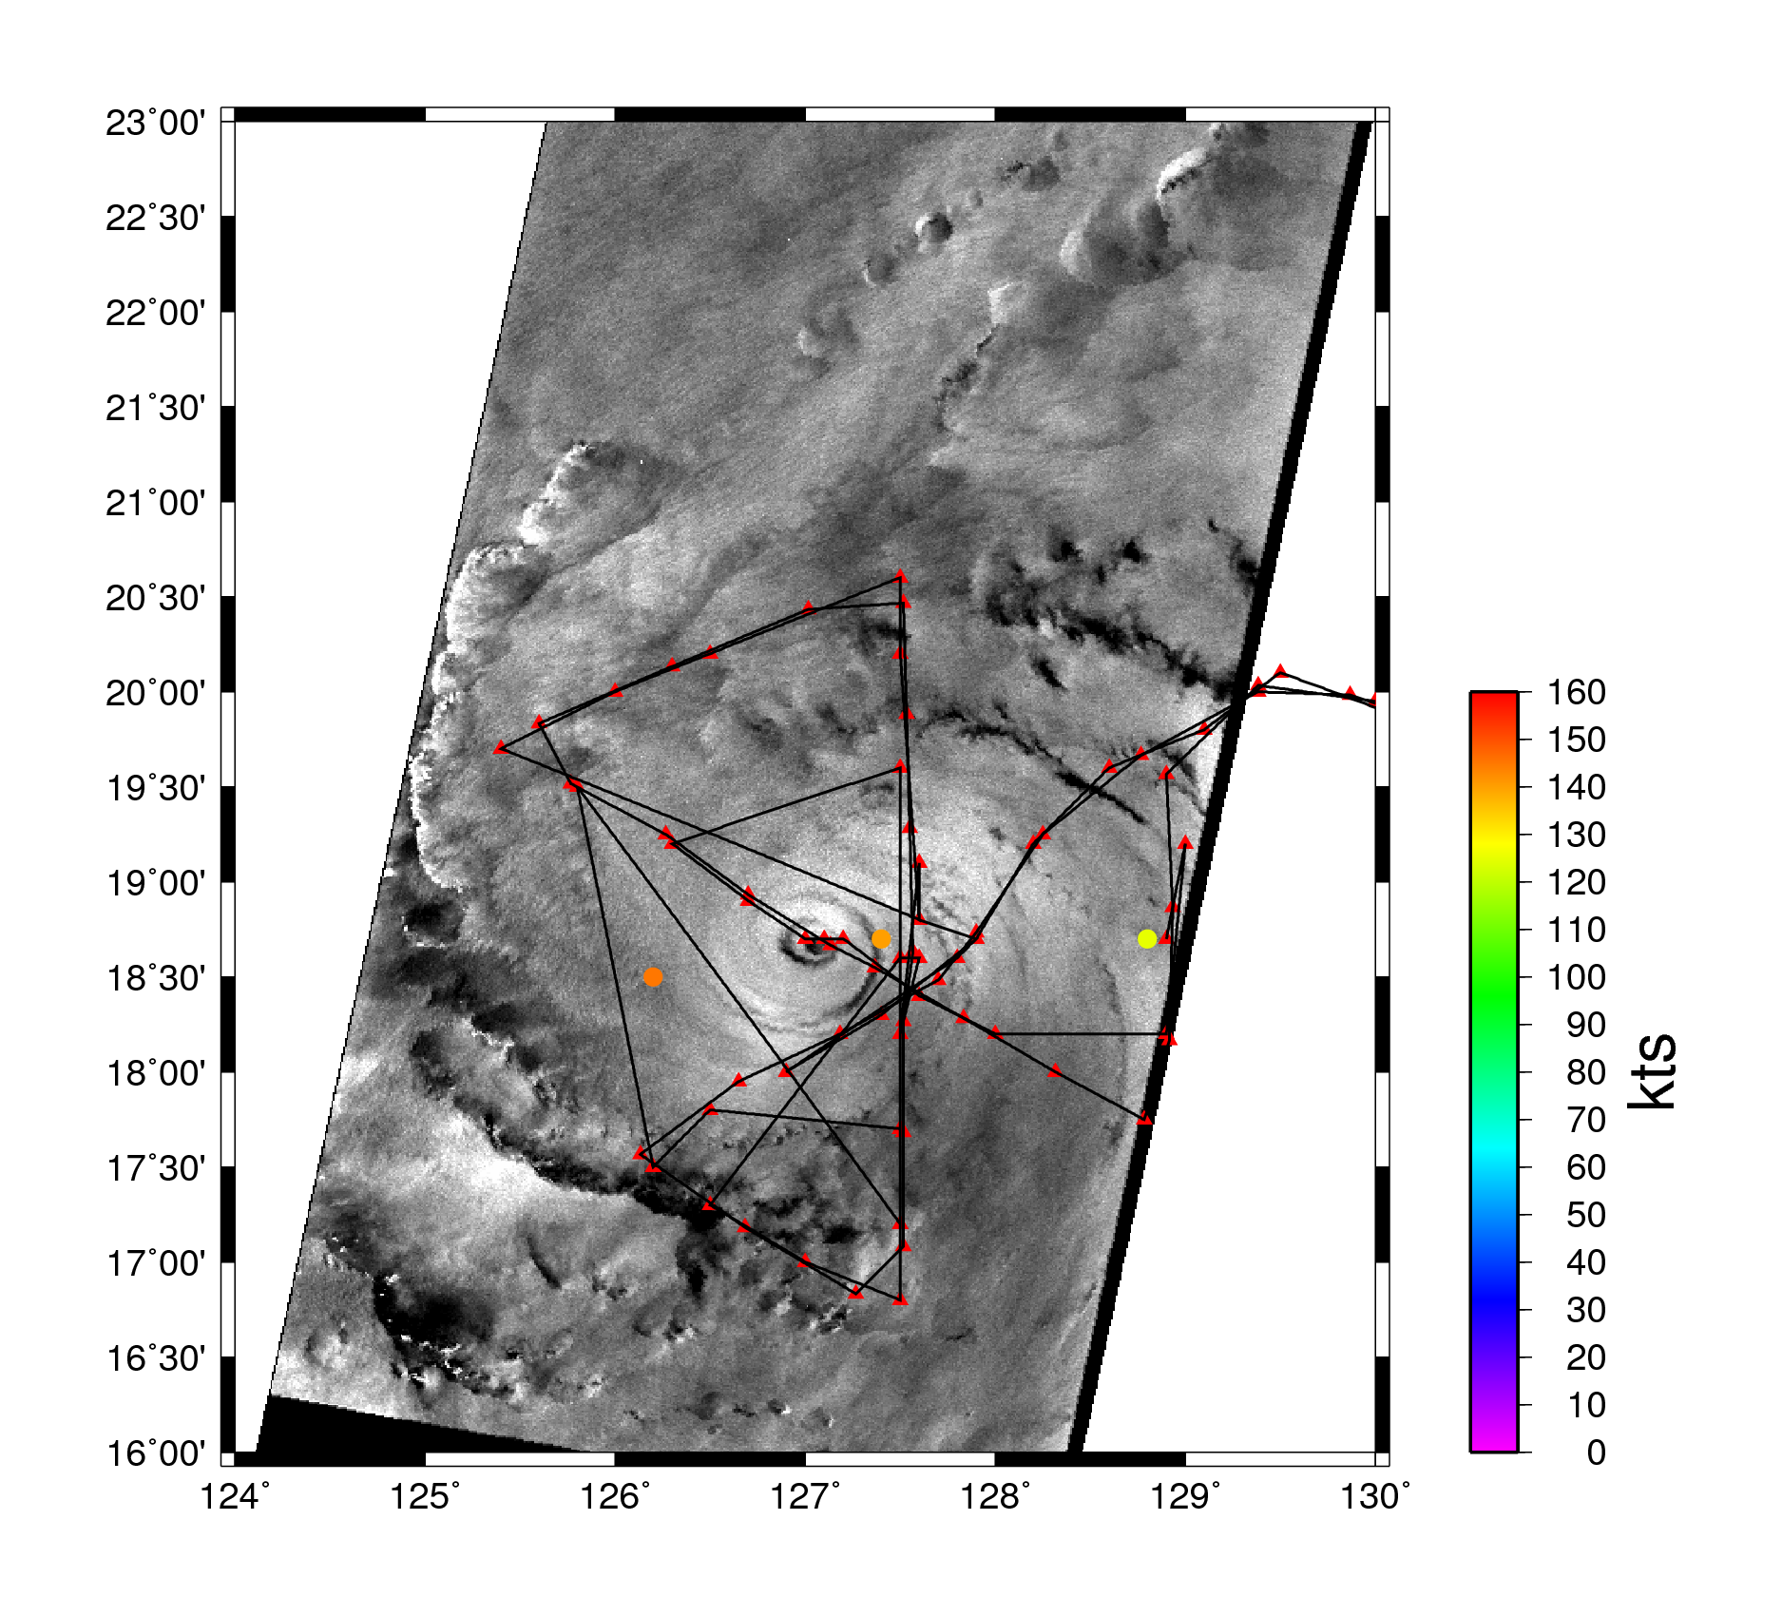
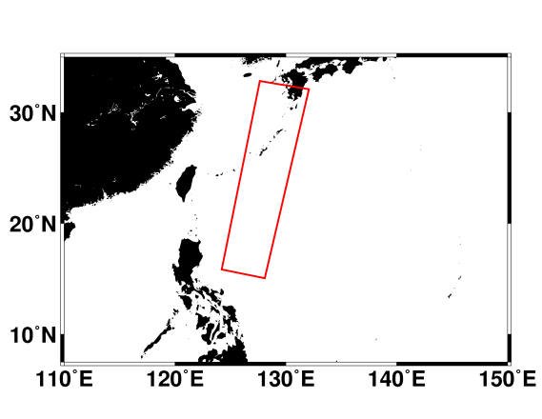
Typhoon Megi Oct 17, 2010 01:27 GMT
Envisat ASAR
Polarization: VV
Beam: WSM
Resolution: 150 m
USAF C130
Oct 17, 00:00
Cross
Center at:
18° 39’ 47” N
127° 04’ 52” E
Major Axis: 20.8 km
Minor Axis: 12.7 km
Azimuth: 97.5°

Slide 16
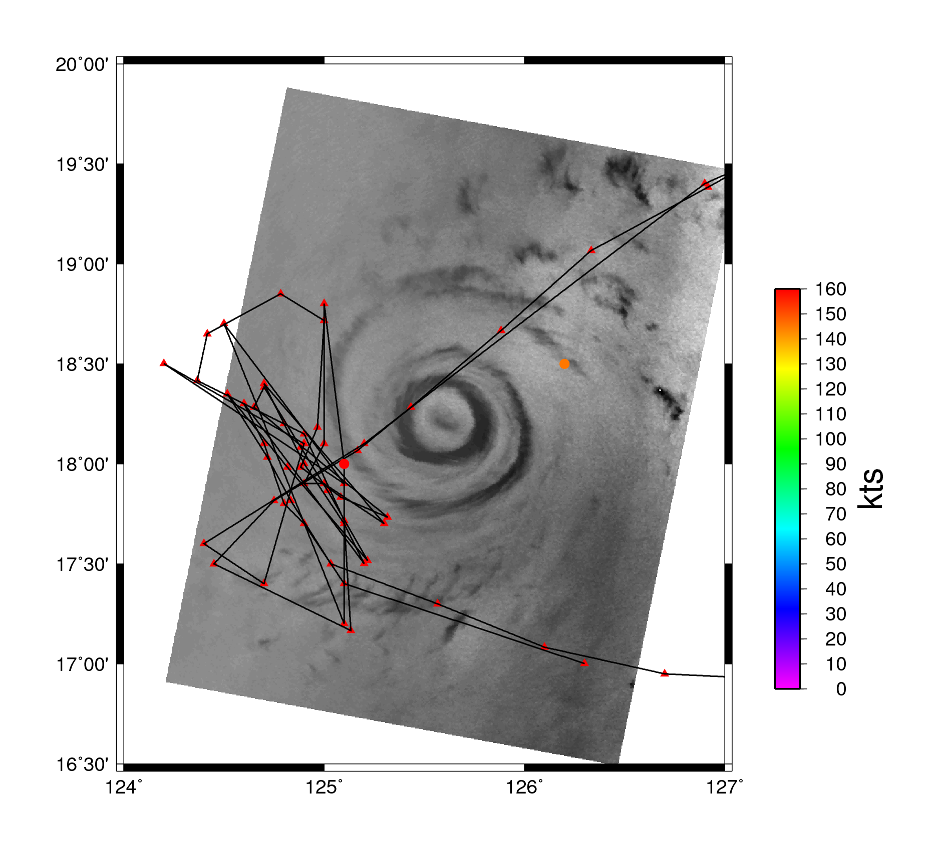
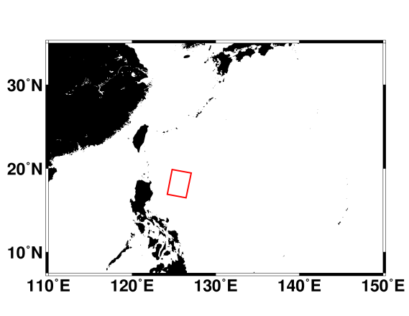
Typhoon Megi Oct 17, 2010 09:35 GMT
Cosmo/Skymed3
Polarization VV
Beam: HR
Resolution: 100 m
USAF C130
Oct 17, 13:00
Cross
Center at:
18° 13’ 55” N
125° 29’ 49” E
Major Axis: 45.3/19.7 km
Minor Axis: 44.6/11.1 km
Azimuth: 49.2°/111.0°

Slide 17
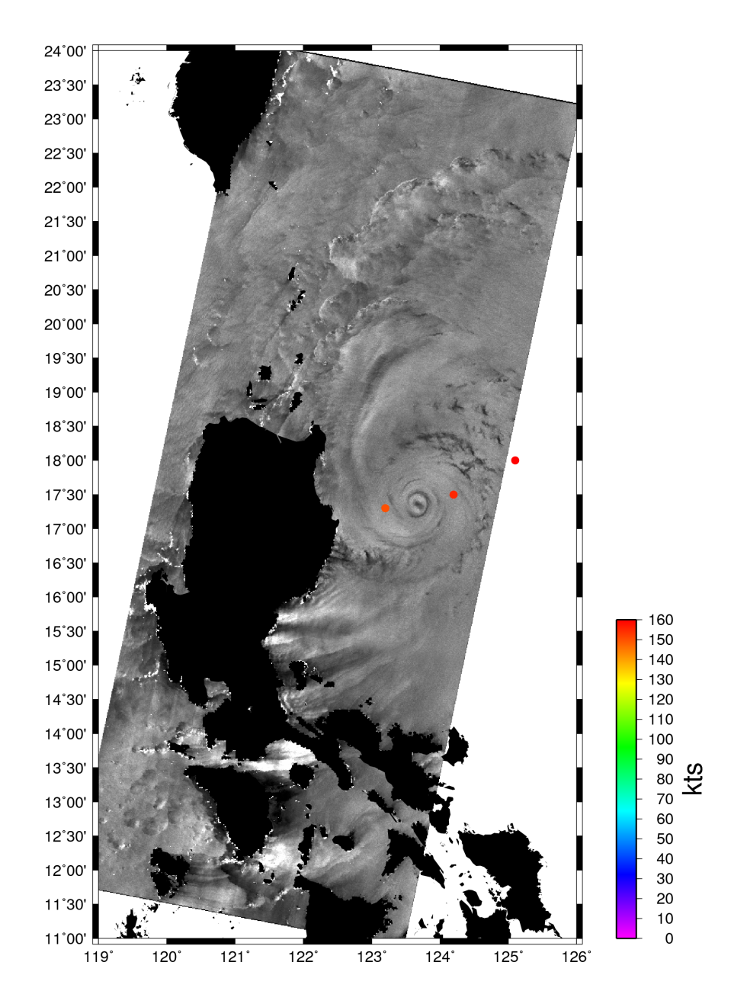
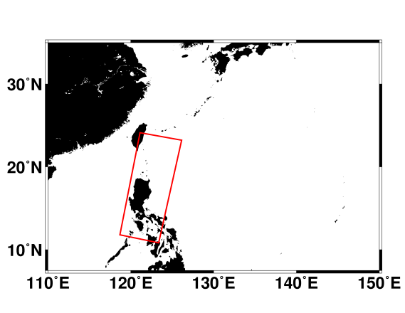
Typhoon Megi Oct 17, 2010 21:41 GMT
Radarsat-2
Polarization: HH,HV
Beam: SCWA
Resolution: 100m
Center at:
17° 21’ 07” N
123° 40’ 34” E
Major Axis: 42.9/17.4 km
Minor Axis: 31.2/11.6 km
Azimuth: 6.8°/125.6°

Slide 18
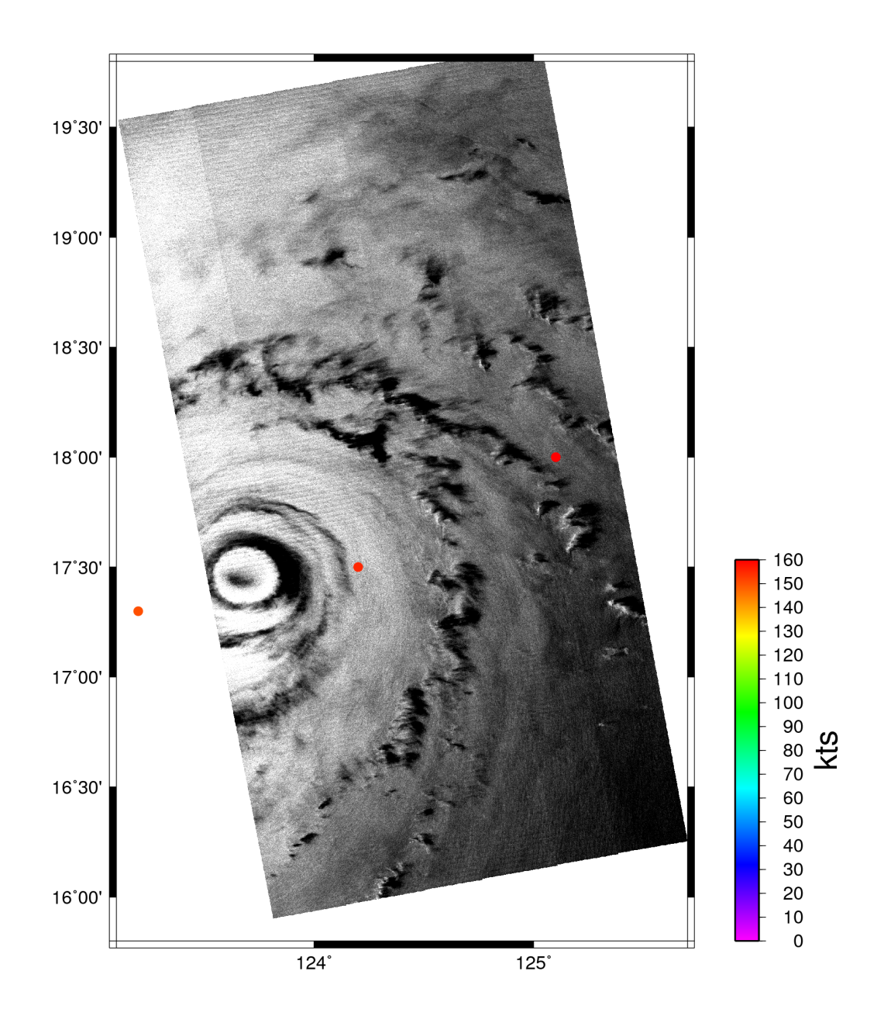
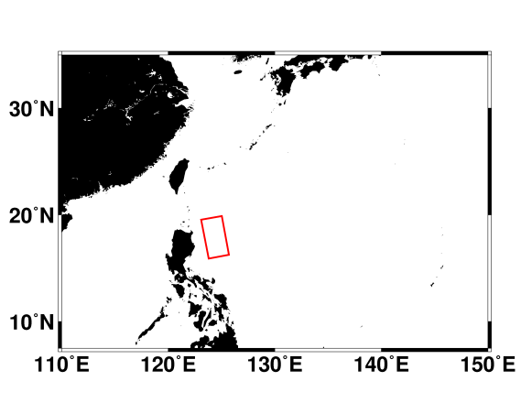
Typhoon Megi Oct 17, 2010 21:53 GMT
Cosmo/Skymed3
Polarization VV
Beam: HR
Resolution: 100 m
Center at:
17° 28’ 23” N
123° 43’ 08” E
Major Axis: 46.2/21.6 km
Minor Axis: 38.0/10.9 km
Azimuth: 91.8°/102.9°

Slide 19
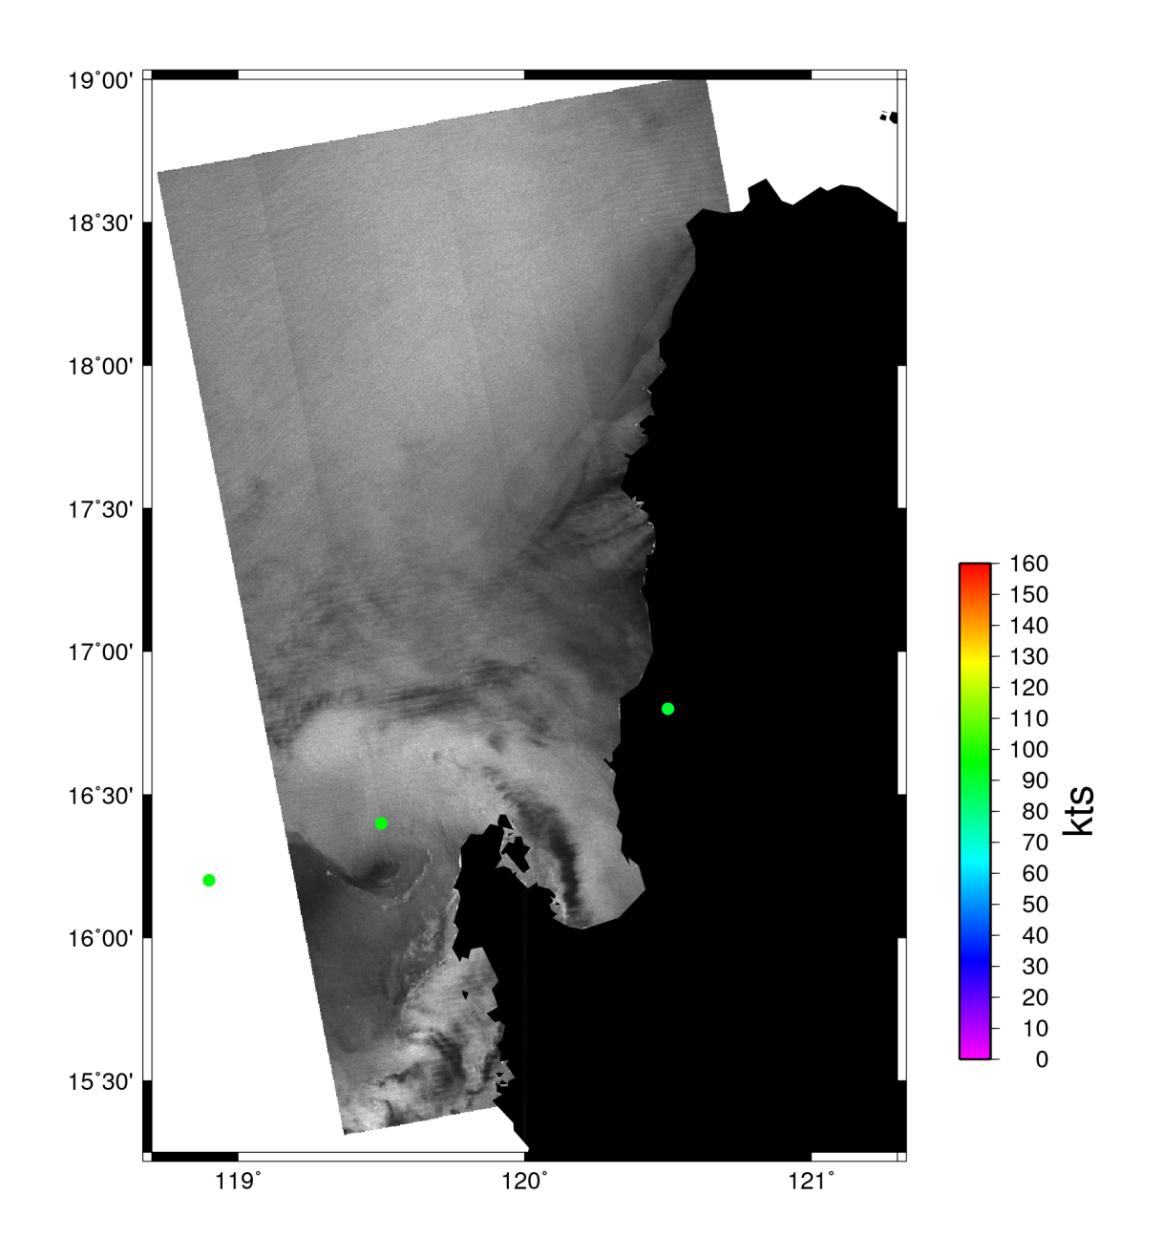
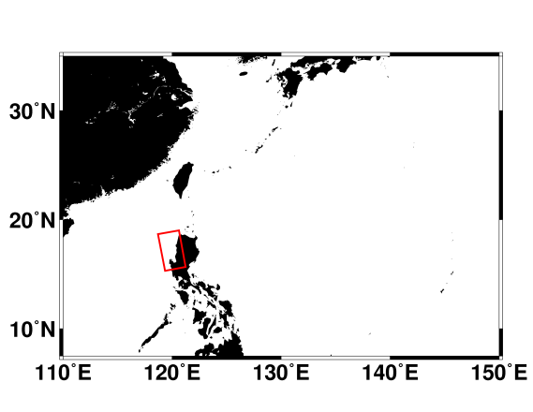
Typhoon Megi Oct 18, 2010 22:12 GMT
Cosmo/Skymed3
Polarization VV
Beam: HR
Resolution: 100 m
Center at:
16° 14’ 13” N
119° 30’ 54” E
Major Axis: 7.8 km
Minor Axis: 6.2 km
Azimuth: 80.9°

Slide 20
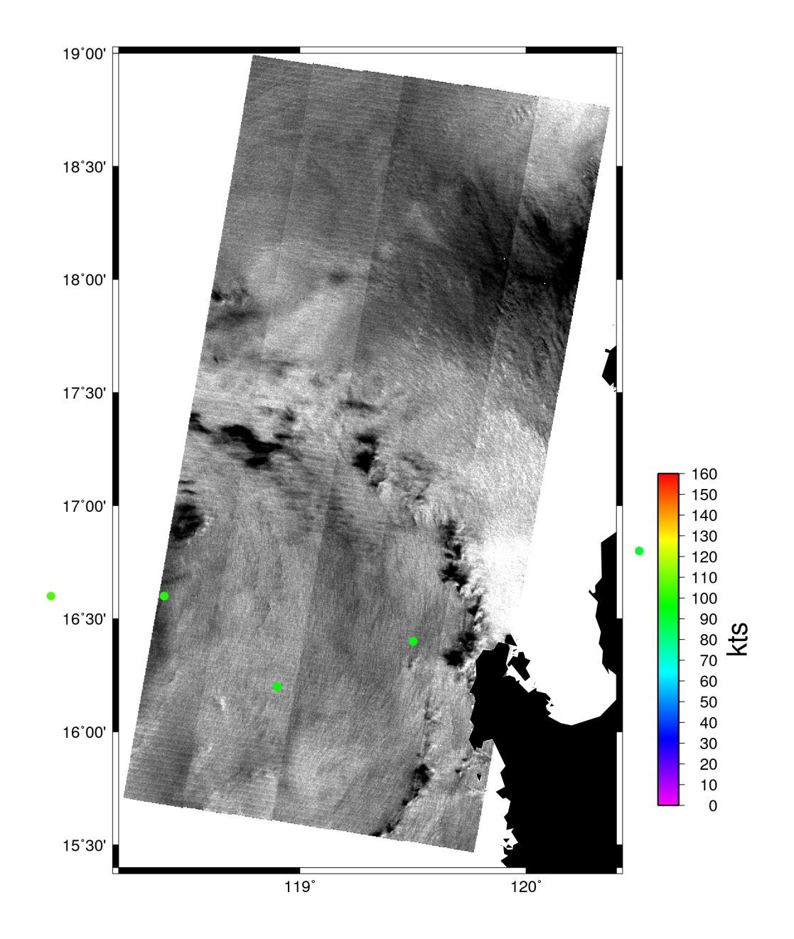

Typhoon Megi Oct 19, 2010 09:42 GMT
Cosmo/Skymed1
Polarization VV
Beam: HR
Resolution: 100 m
Center at:
16° 54’ 10 N
118° 29’ 17” E
Major Axis: 16.4 km
Minor Axis: 14.2 km
Azimuth: 37.2°

Slide 21
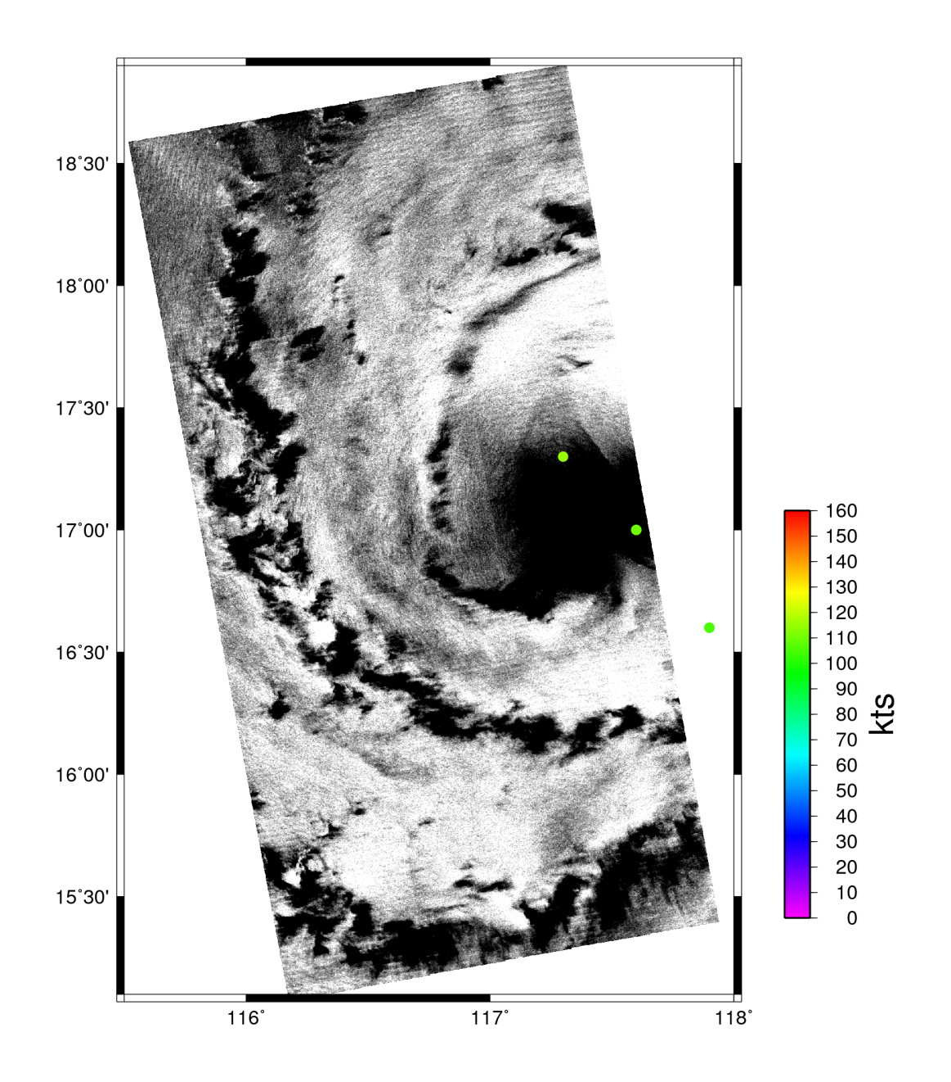
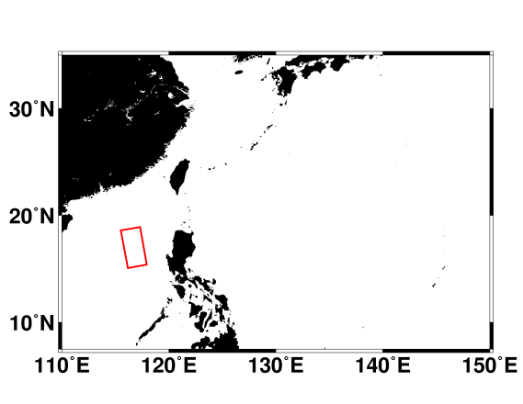
Typhoon Megi Oct 19, 2010 22:30 GMT
Cosmo/Skymed3
Polarization VV
Beam: HR
Resolution: 100 m
Center at:
17° 08’ 06” N
117° 20’ 10” E
Major Axis: 28.9 km
Minor Axis: 22.8 km
Azimuth: -1.6°

Slide 22
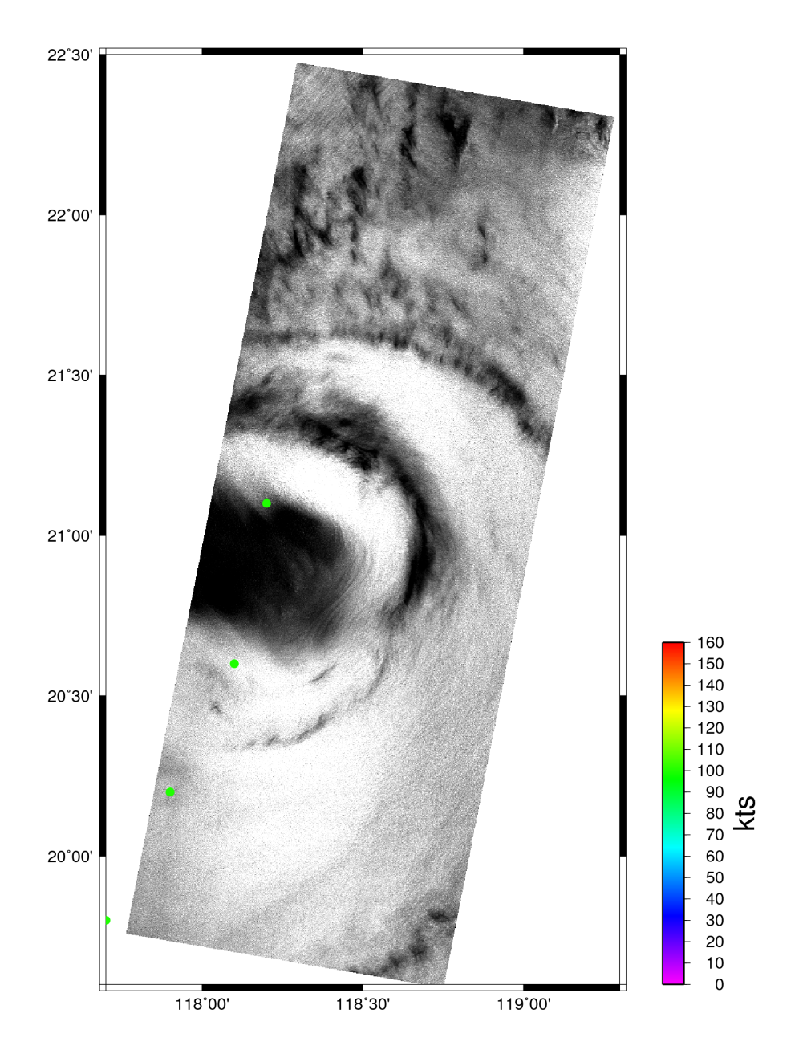
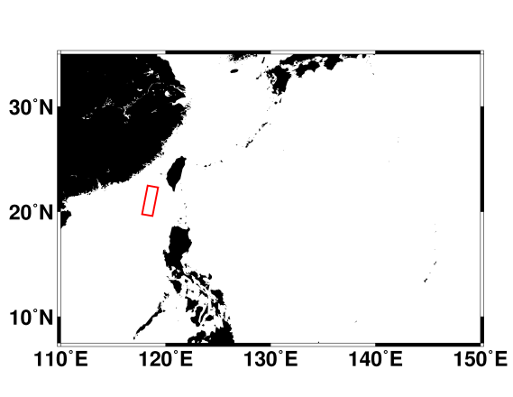
Typhoon Megi Oct 21, 2010 22:05 GMT
TerraSAR-X
Polarization VV
Beam: scanSAR
Resolution: 18 m
Center at:
20° 54’ 50” N
118° 09’ 36” E
Major Axis: 57.6 km
Minor Axis: 43.2 km
Azimuth: 104.7°

Slide 23
Summary
168 SAR C- and X-band during ITOP 2010 Typhoon season
5 passes nearly coincident with aircraft observations
10 eye hits captured typhoon Megi between Oct 15 and Oct 21

