Slide 1
Air-Ocean-Wave Coupling of Typhoon Fanapi (ITOP 2010) Rick Allard¹ Travis A. Smith¹ Sue Chen² Jim Dykes¹ David Wang¹
Naval Research Laboratory
¹Stennis Space Center, MS
²Monterey, CA

Slide 2
Typhoon Fanapi (2010)
In conjunction with NRL-MRY, Typhoon Fanapi (September 2010) was simulated to compare to observational data collected during the Western Pacific ITOP effort.
The simulation of Typhoon Fanapi was spun up for five days prior to the 17 SEP 2010 72 hour forecast. Six-way air/sea/wave coupling in the ESMF framework was utilized.
During ITOP 2010, NRL-MRY ran COAMPS-TC (coupled with ocean) in real-time. NRL Monterey is studying the ocean mixed layer response as it directly impacts the TC intensity forecast
The forecast for Typhoon Fanapi shown in this presentation is simulated using the latest version of COAMPS-TC.

Slide 3
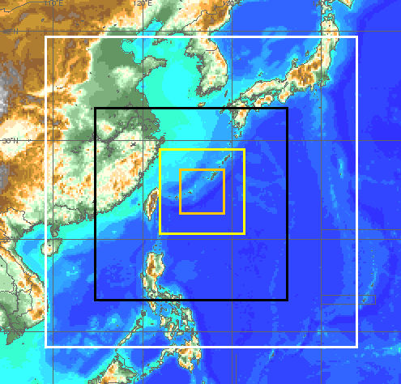
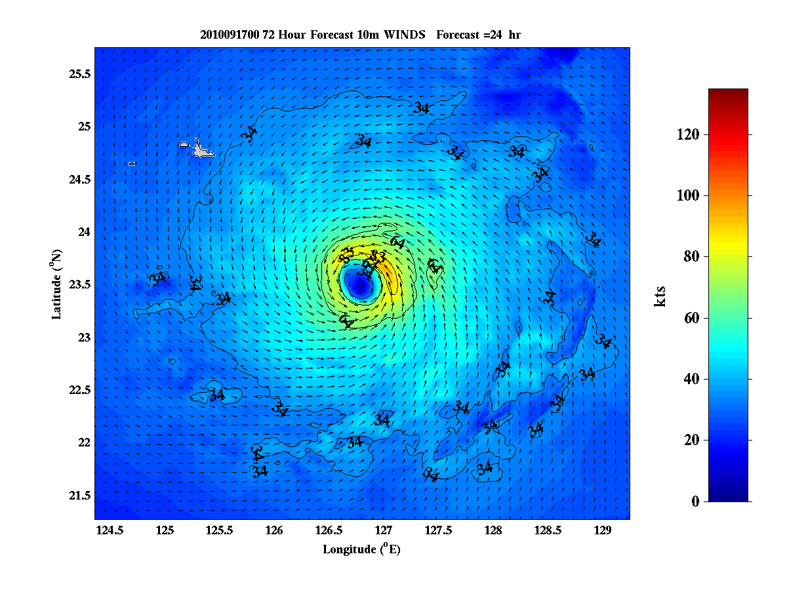
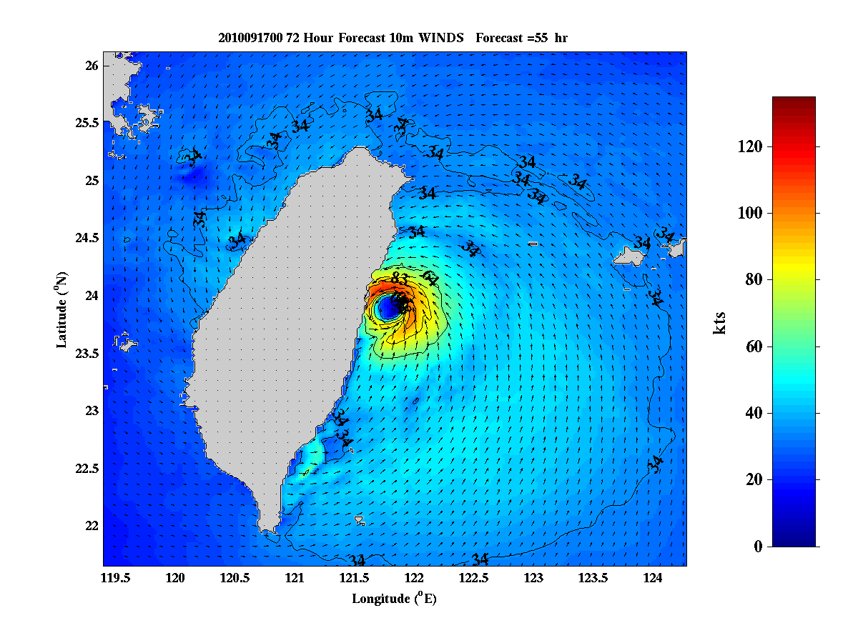
Modeling Overview
Typhoon Fanapi (SEP 14-20)
Vertical Resolution:
- 60 atmospheric levels
- 50 ocean levels
Horizontal Resolution:
Atmos: 18, 6, 2 km (child moving)
Ocean: 8 km (black)
Wave: 8 km (black)
Boundary Conditions:
Atmos: 1º NOGAPS
Ocean: Global NCOM (⅛ deg)
Wave: WaveWatch III
Data Assimilation:
Atmos: NAVDAS (3DVAR)
Ocean: NCODA (MVOI)
12 hour update cycle
Coupling Interval:
6 minutes
2 km
COAMPS
6 km COAMPS
8 km NCOM,
SWAN
18 km COAMPS
Winds tau=24
Winds tau=55

Slide 4
COAMPS5 Air-Ocean-Wave Coupling
WAVE
ATMOS (TC)
OCEAN
ocean feedback module
atmos feedback module
internal nested grids
internal nested grids
fluxes computed in surface subroutine using ocean & wave feedback
atmos & wave feedback used in ocean update & mixing subroutines
atmos exchange grid
ocean exchange grid
ESMF interface
ESMF interface
ESMF interface
sea surface temperature
10-meter wind
sea level pressure, surface wind stress, surface heat flux, surface moisture flux, shortwave radiation
Charnock
Water elevation, surface current
Stokes drift current, wave radiation stress gradient, bottom orbital wave current
ESMF COUPLER (regrid between any two components)

Slide 5
Model versus “Best Track”
Observed (RED) and COAMPS-TC (GREEN) tracks of Typhoon Fanapi.

Slide 6
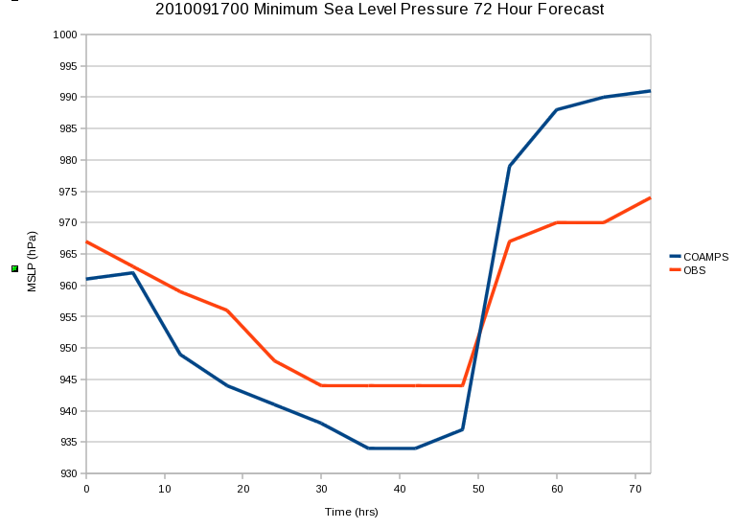
Wind, SLP Comparisons
Max Wind Speed (Knt)
Min SLP (hPa)
10 20 30 40 50 60 70
10 20 30 40 50 60 70
Forecast Tau
Forecast Tau
COAMPS (BLUE), OBS (RED)

Slide 7
Altimeter Observations
Altimeter Passes: Wind Speed
(JASON-2)
Altimeter Passes: Sig. Wave Height
(JASON-2)

Slide 8
Fanapi Altimeter Wave/Wind Comparisons (model adjusted +6 hours)
SWAN
COAMPS
Notes:
36 directions and 33 frequencies new Babanin et al. wave input and dissipation parameterization modified Hwang drag formulation (drag formulation more in line with observations, but capped around friction velocity = 2 for winds greater than 50 m/s).

Slide 9
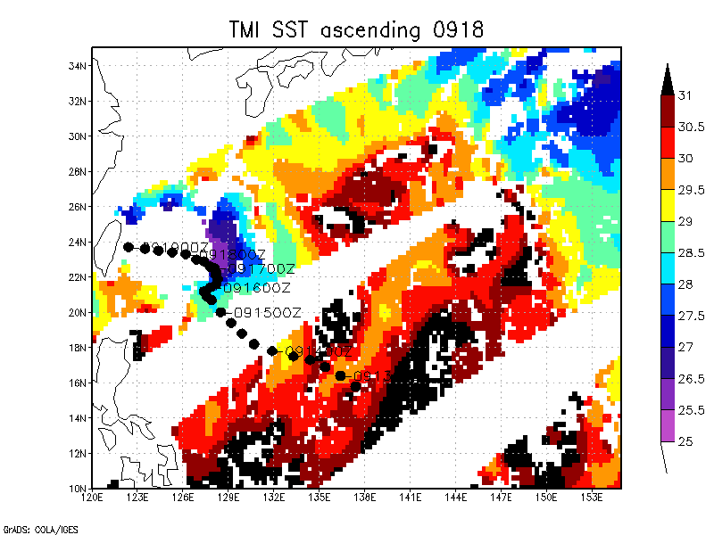
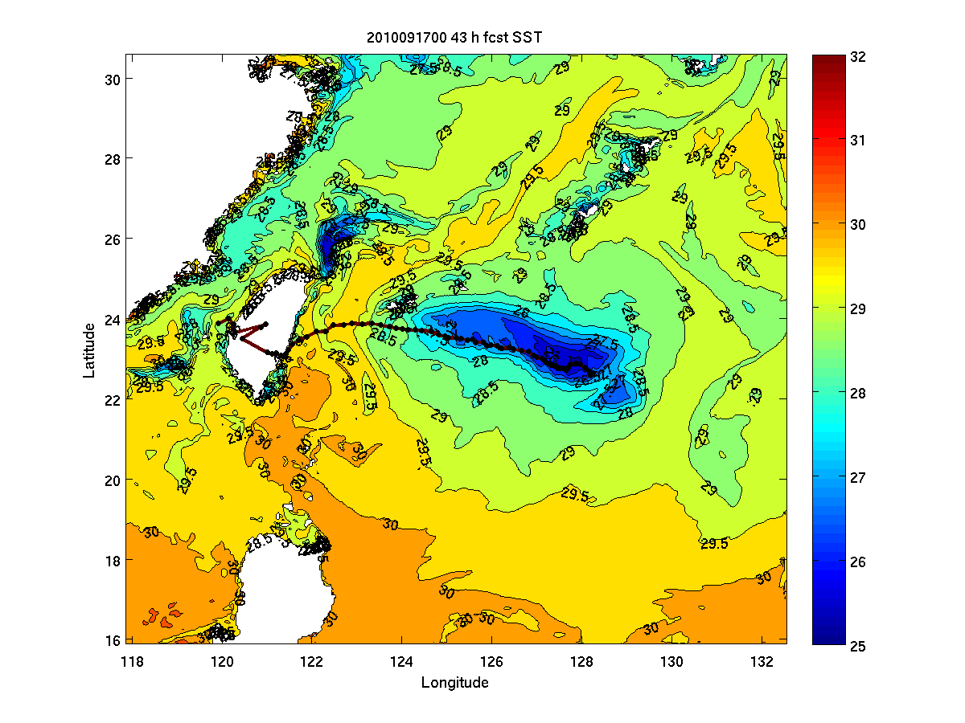
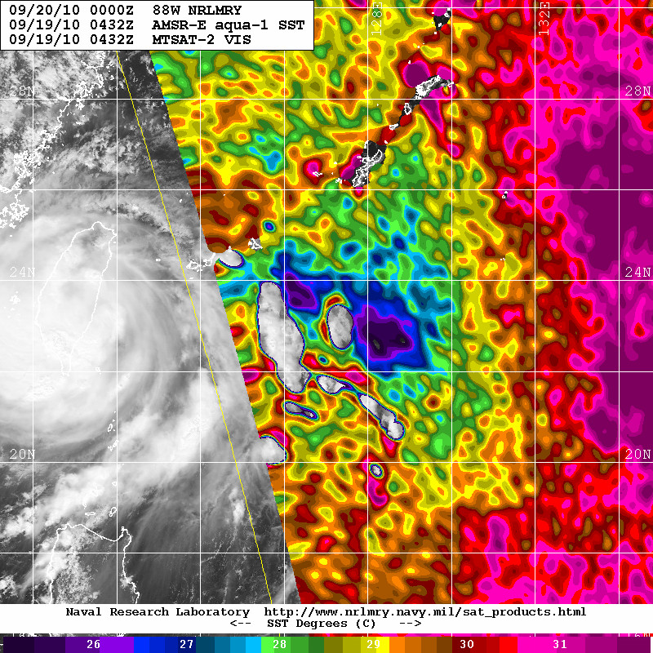
Model vs Observed Cold Wake
Cold wake from COAMPS-TC
high-resolution ocean nest (3 km) run.
Courtesy of Sue Chen at NRL-MRY.

Slide 10
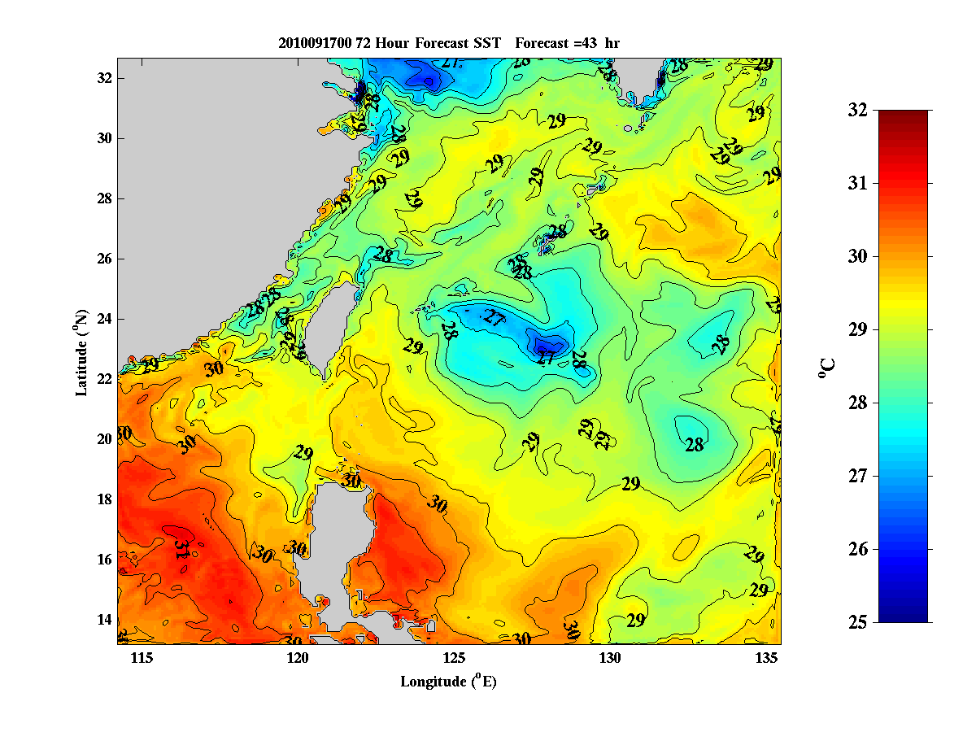
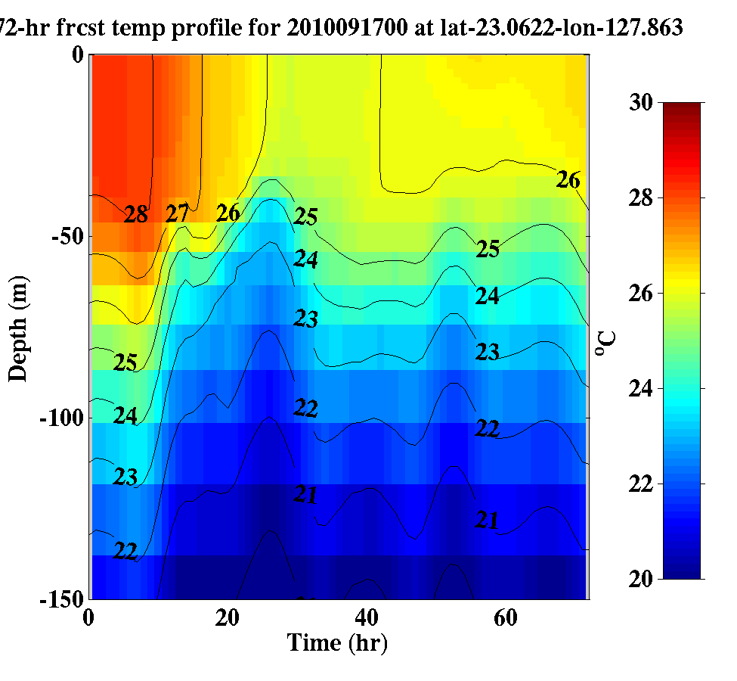
Cold Wake (cont.)
Cold wake from 8 km ocean nest
Run at tau=43.
Vertical cross section of
temperature at

Slide 11
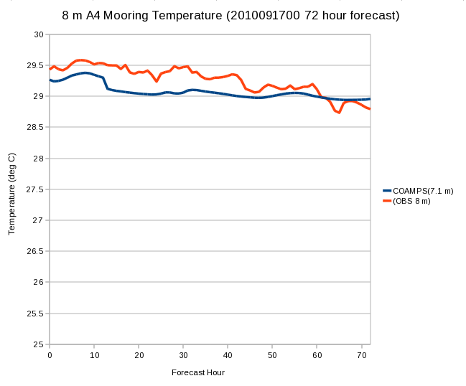
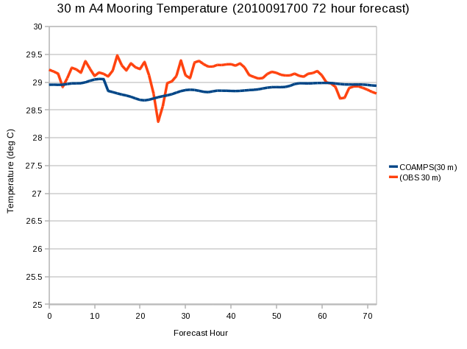
Preliminary Comparisons at A4 Mooring

Slide 12
Summary/Future Plans
A lag of several hours in the forecast when compared to observations may have had an impact on the storm’s intensity. The observed eyewall replacement cycle of Typhoon Fanapi before landfall may also lead to error in the forecast.
The magnitude of the observed cold wake agreed well with satellite estimations. Between 2-3 ºC of cooling was observed and modeled.
Satellite altimeter data agreed very well with COAMPS model wind and significant wave height fields when time adjusted to make a direct comparison.
Plans to perform higher-resolution (ocean and wave) coupled runs with 3DVAR data assimilation; compare results against available in situ observations (including waves); perform extended simulations into Oct 2010.

