Slide 1
Cold Wake in Coupled COAMPS-TC Forecasts of Typhoon Fanapi
Shouping Wang, Hao Jin, Peter Black, Sue Chen, James Doyle, Larry O’Neill
Naval Research Laboratory at Monterey

Slide 2
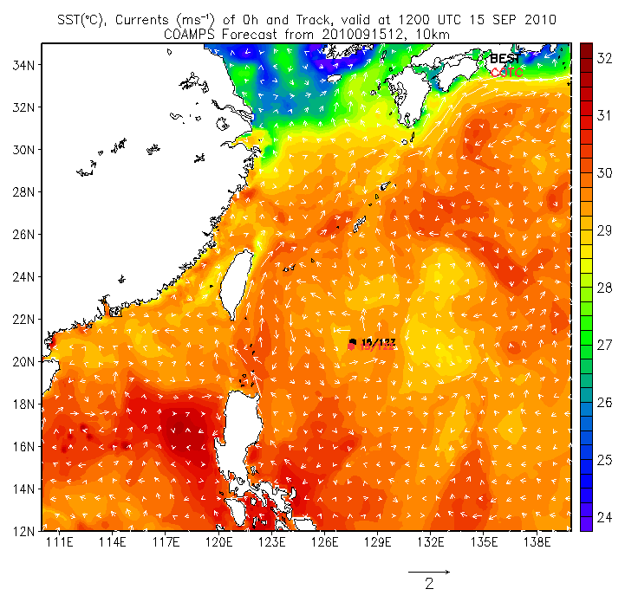
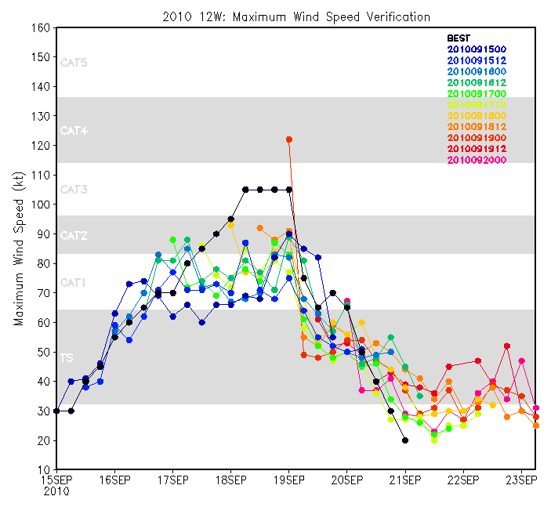
Cold Wake Characteristics in COAMPS’s Fanapi
Coupled Forecasts for Typhoon Fanapi (12W)
SST, Currents and Track of COAMPS Forecasts
Maximum Wind Speed Verification
160
140
120
100
80
60
40
20
34
32
30
28
26
24
22
20
18
16
14
12
Best
COAMPS
Maximum Wind Speed (Kt)
111 114 117 120 123 126 129 132 135 138
15SEP 16 17 18 19 20 21 22 23
The predicted track was very close to the best track
The predicted intensity followed the trend, but was weaker
Cold wake was produced after Sept. 17, 2010.
Notes:
Fanapi is category 3 Typhoon, struck Taiwan and Mainland China . It formed Sept 14, 2011.

Slide 3
Comparison of Satellite and COAMPS SST
stress
COAMPS maximum cold anomaly is -4 °C compared to -2.5 °C from satellites
The satellite cold wake area is more extensive than COAMPS
COAMPS initial intense cold pool (128.5E, 22.2N) is probably due to the slow movement of predicted Fanapi

Slide 4
Comparison of Satellite and COAMPS SST
COAMPS’s cold wake area is similar to the satellite observation for 9/20-21
COAMPS maximum narrow cold anomaly recovered significantly after 3 days.

Slide 5
Comparison between COAMPS and AXBT ocean temperature profiles
Predicted ΔT (-2.0°C) is very close to that from AXBT.
Mixed layer depth ranges between 20 – 40 m.
COAMPS thermocline is significantly weaker than the AXBT.
-2 °C
-2 °C
COAMPS (9/17-18)
3
Fanapi AXBT (9/17-18)
4
2
2
1
4
3
1
0000-0200 Sept 18 UTC
0000-0200 Sept 18 UTC

Slide 6
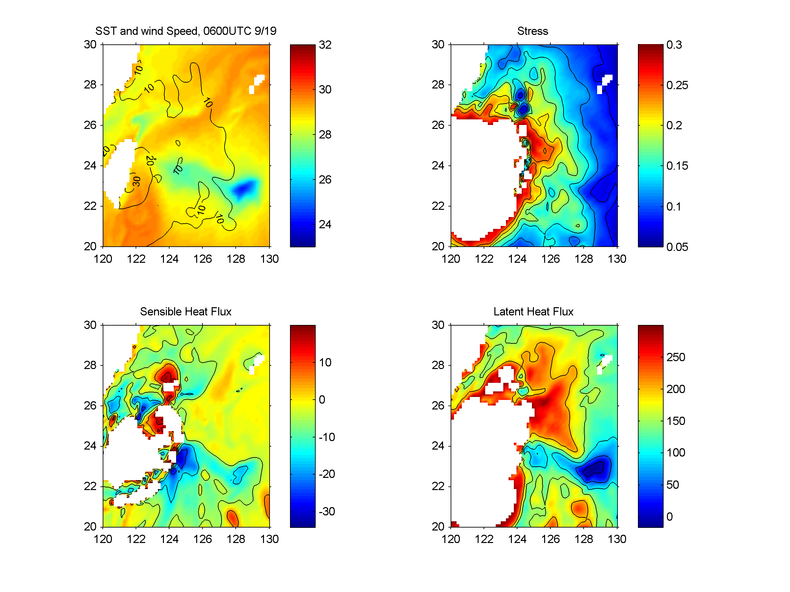
Predicted atmospheric responses to the cold wake
SST, Wind Speed (0600UTC 9/19)
Stress
Sensible Heat Flux
Latent Heat Flux
Both surface wind speed and stress tend to have minima over cold wake due to the strong surface stability.
Sensible and latent heat fluxes have minimum values over the cold wake.

Slide 7
PBL structure over cold wake
COAMPS, 09/19/2010
COAMPS Avg. SST
Potential Temp.
(128.3°E 23°N)
Cold wake
(9/18 -19)
Pre Storm (9/16)
SAT, 09/22/2010
Satellite SST
Dropsondes
1
Cold wake
9/18
Modeled PBL was more well-mixed before cold wake was formed.
PBL is stabilized and the depth is shallow over cold wake.
Satellite SST decrease was sharper.

Slide 8
PBL structure and cold wake
COAMPS Wind speed
COAMPS
TKE
Cold wake
9/18
Pre-Storm
9/19
Dropsondes
9/18
Cold wake
Wind speed have stronger shear at lower levels over cold wake.
COAMPS TKE is significantly reduced.
PBL height decreases.
Wind speed is reduced.

Slide 9
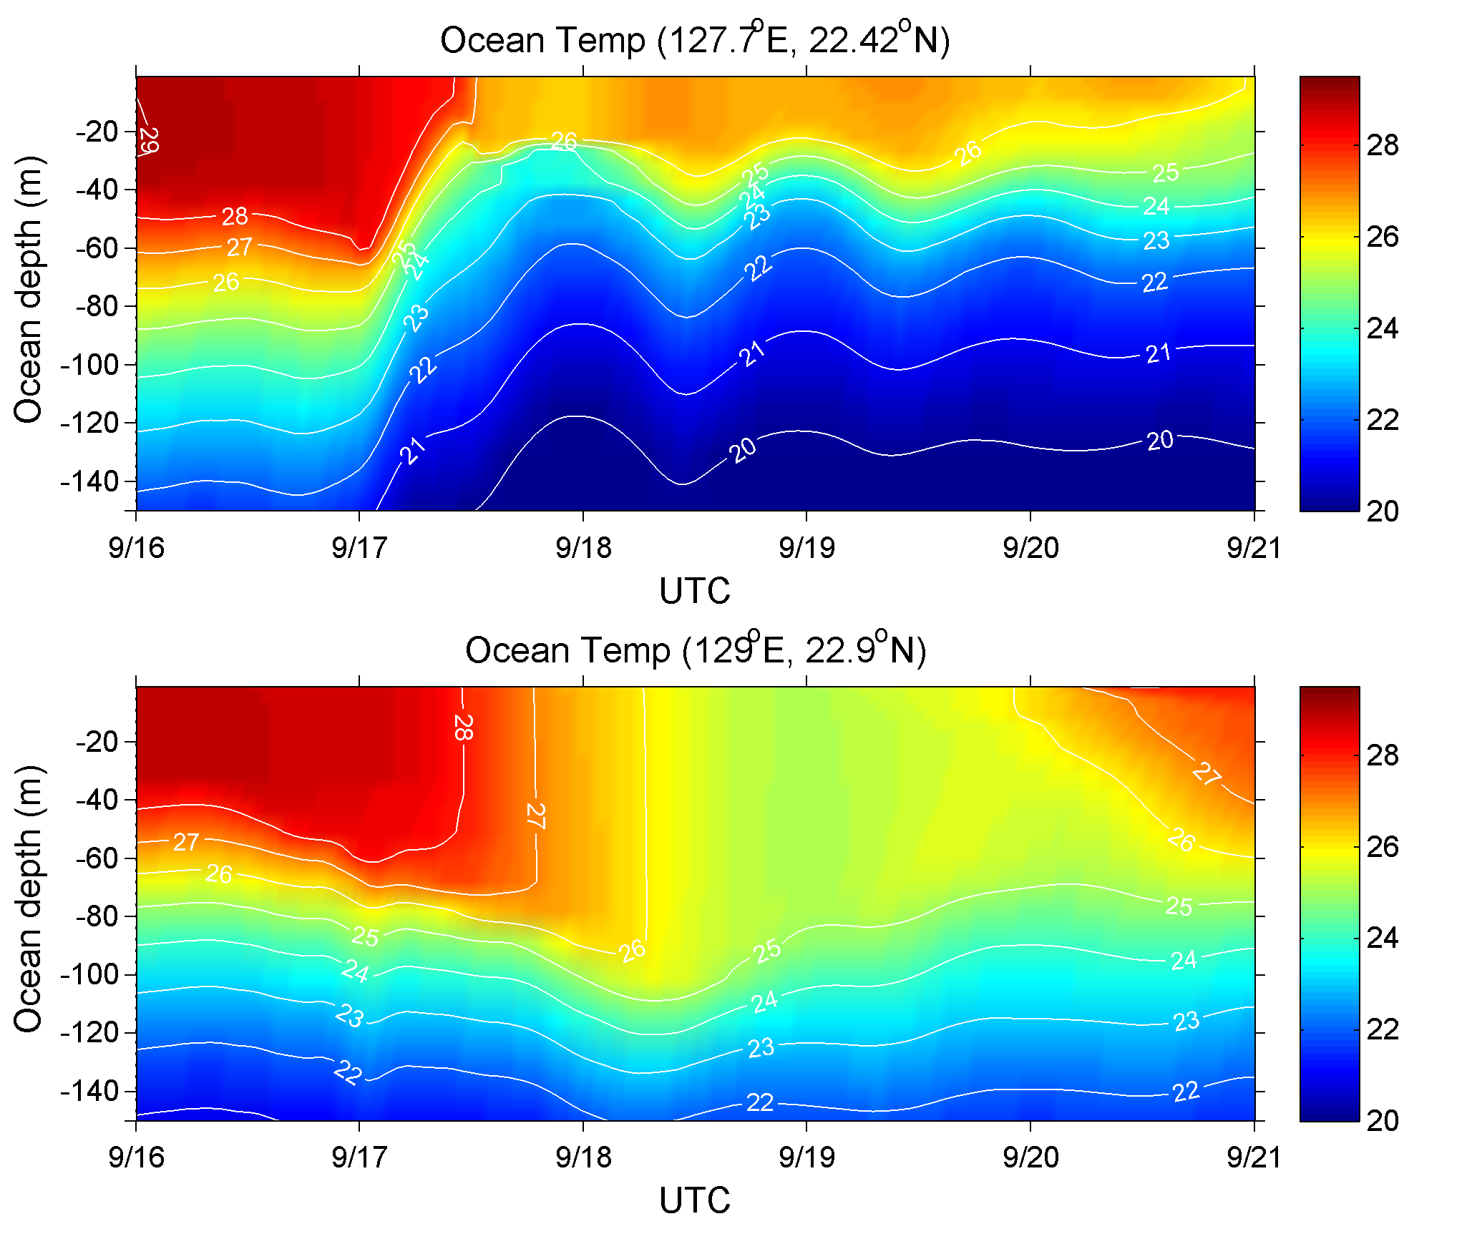
COAMPS Ocean Mixed Layer Evolution
X
Different behaviors of ocean mixed layers
X: Inertial pumping has amplitude 20 m, strongly modulating mixed layer.
O: Little up-down-welling. Mixed layer depth increases due to the entrainment.
O

Slide 10
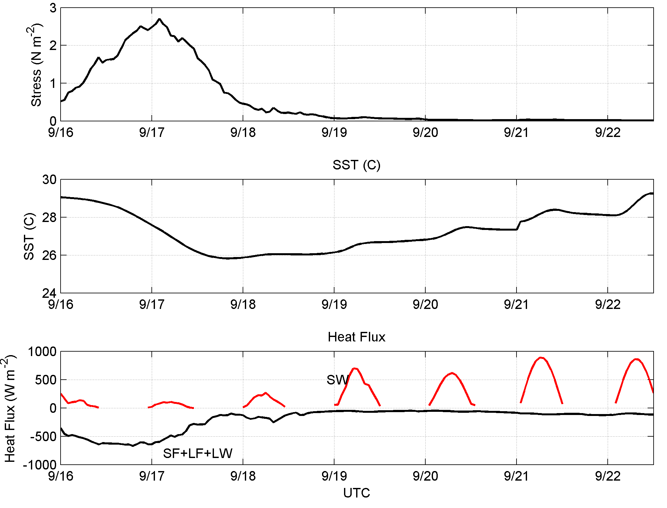
Evolution of Cold Wake from COAMPS
Surface Stress
0.01 – 0.03 Nm⁻²
SST
Heat Flux
Recovery (9/20-23) is highly correlated with solar heating, the warming rate of SST is ∼ 0.5 - 1 °C day⁻¹

Slide 11
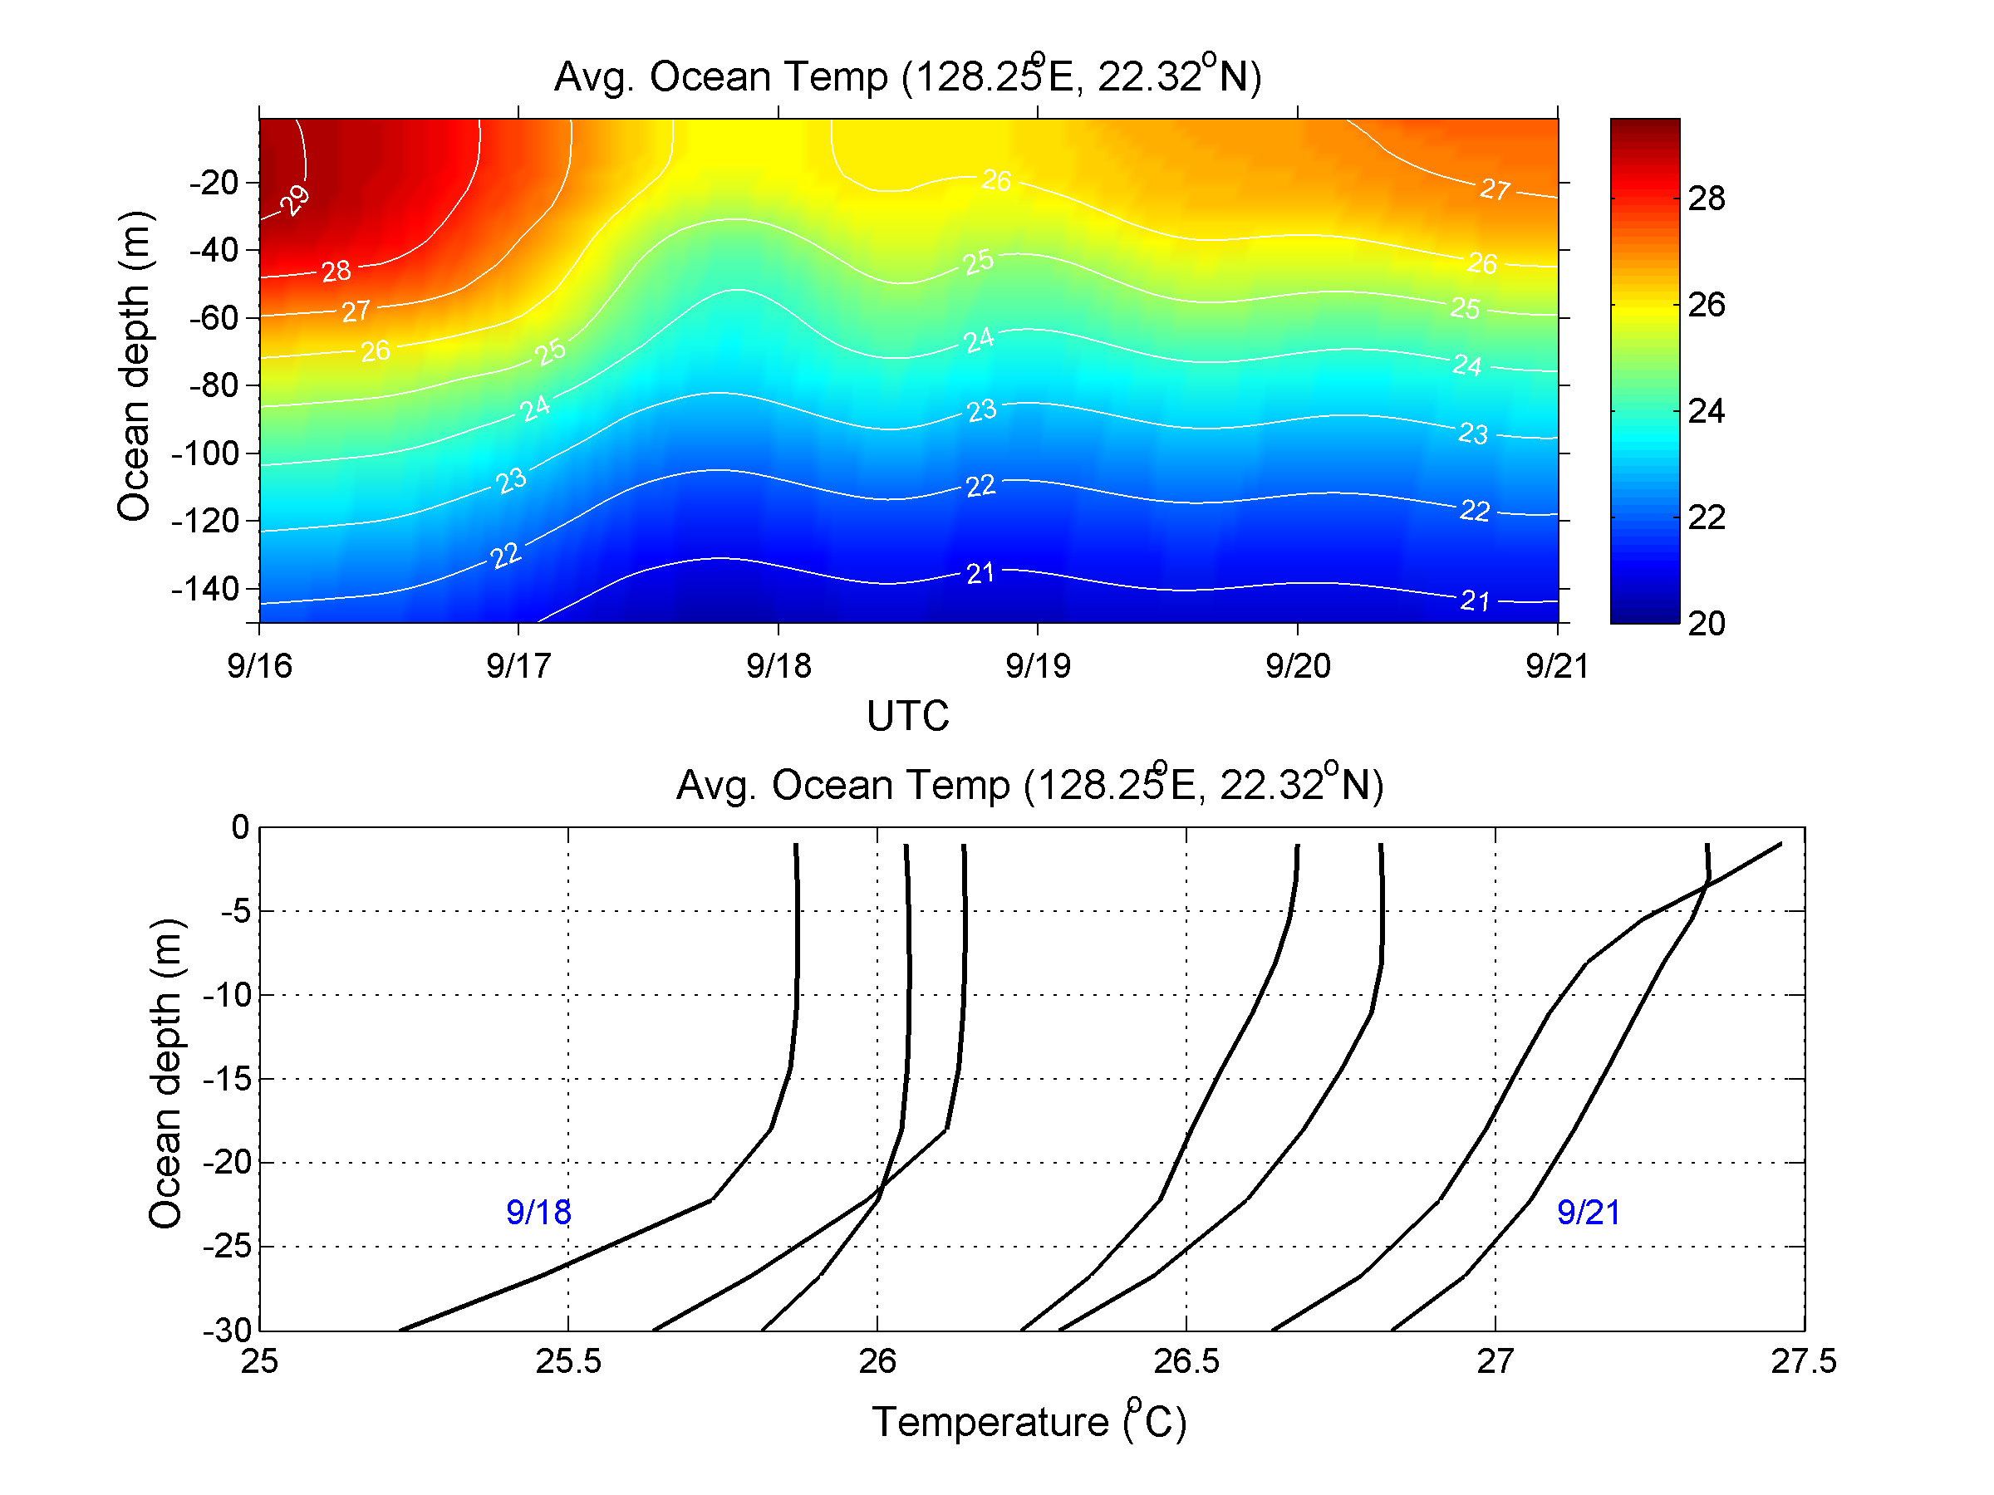
Evolution of Cold Wake from COAMPS
night cooling
daytime
warming
daytime
warming
night
9/18
9/21
Solar heating seem to dominate.
Warming penetrates to 50 m
Significant diurnal variation of surface (mixed) layer
Horizontal advection?

Slide 12
Evolution of Cold Wake from Satellite Data
09/22/2010
An areas is chosen for averaging.
Two different warming periods are identified.
There seem to be two different dominant processes for these two periods: advection and solar heating + mixing?
1
Rapid Warming
1
Cooling
Slow Warming
Satellite averages

Slide 13
Summary
Coupled COAMPS-TC predicted cold wake is similar to the observations:
Overall area extension and strength (∼ -2.5 °C)
Atmospheric boundary layer structure over cold wake
Ocean mixed layer depth
Other COAMPS cold wake features:
Wind speed and stress are also reduced due to the strong stability at the surface;
Inertial up- and down-welling highly regulate mixed-layer depth, contributing to the temperature evolution;
Solar heating appeared to dominate the recovery process, warming rate of SST ∼ 0.5 – 1 °C day⁻¹ ;
Initial cold pool is intense (50km radius and -4 °C anomaly)
Satellite observations appeared to show two-phase recovery
Rapid warming: ∼ 0.5 °C day⁻¹ for 3 days
Slow warming: ∼ 0.1 °C day⁻¹ for 13 days

Slide 14
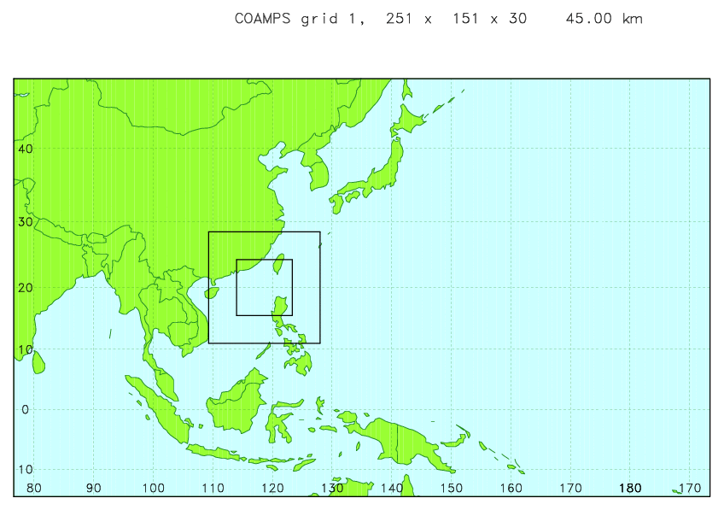
Cold Wake Characteristics in COAMPS’s Fanapi
Coupled COAMPS Forecast for ITOP (Aug. − Oct. 2010)
Δx=45 km
COAMPS
Improved dissipative heating
Drag coeff.: level off for > 35 m s⁻¹
Improved cloud microphysics (ice)
BC: GFS
NCOM
MY turbulence parameterization
3DVAR analysis
BC: Global NCOM
15 km
5 km
10 km
All runs are based on Typhoon warning issued by JTWC.
Model output were automatically transferred to ITOP archives (MBARI, EOL).
Notes:
Vortex relocation and synthetic TC data

