Slide 1
Effect of Stable Boundary Layer over the Cold Wake on TC Structure in Typhoon Fanapi
Chiaying Lee & Shuyi S. Chen
RSMAS/Univ. of Miami

Slide 2
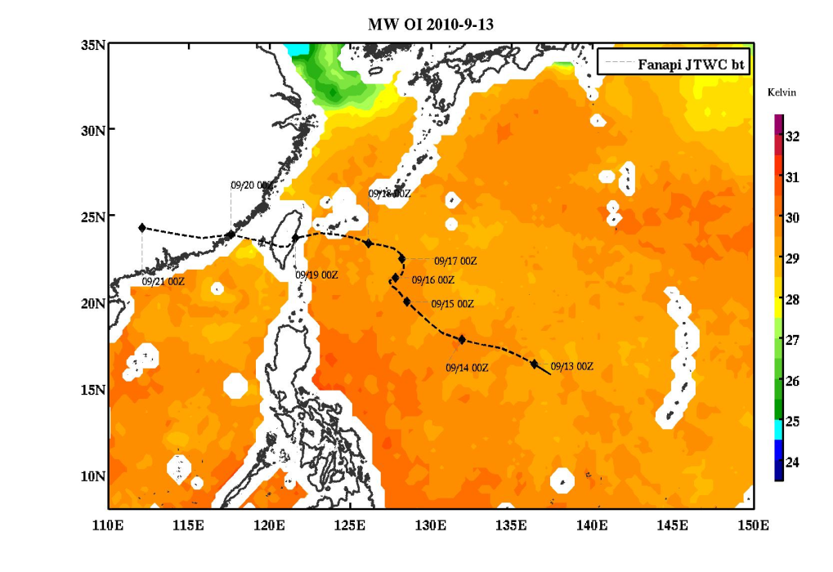
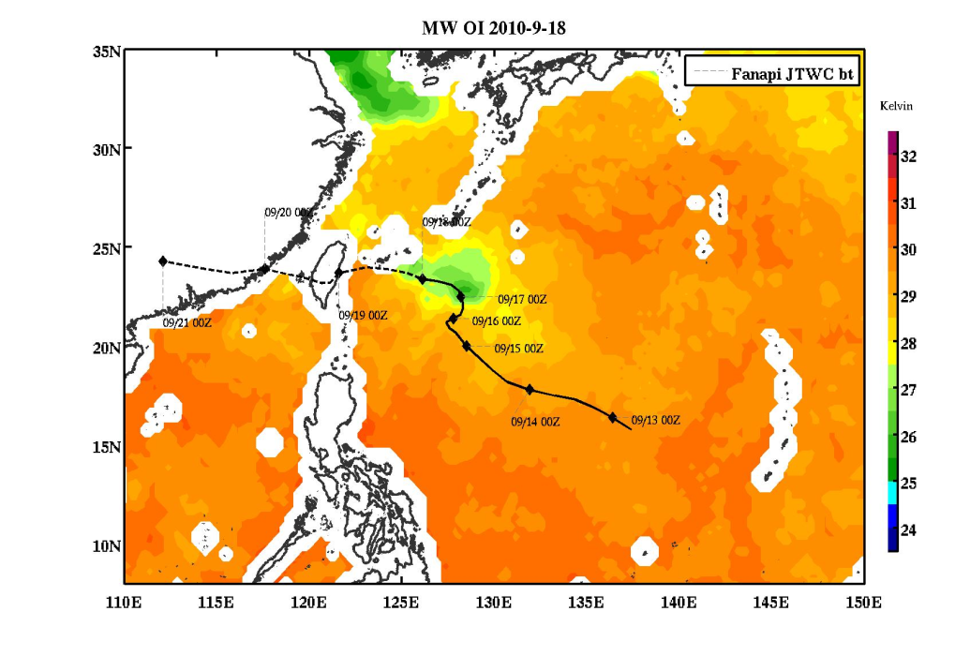
Stable Boundary Layer
Stull (1988): the surface is cooler than the air.
Static stability
z
> 0 - stable
= 0 – neutral
< 0 - unstable
Stable
Unstable
Neutral
θ_{v}
Stable Boundary Layer in Hurricanes?
Pre-storm SST
Post-storm SST

Slide 3
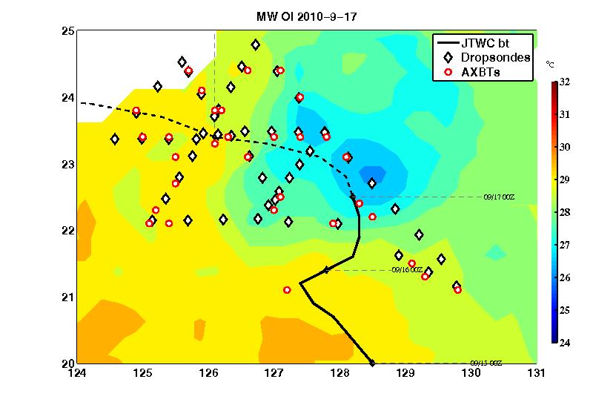
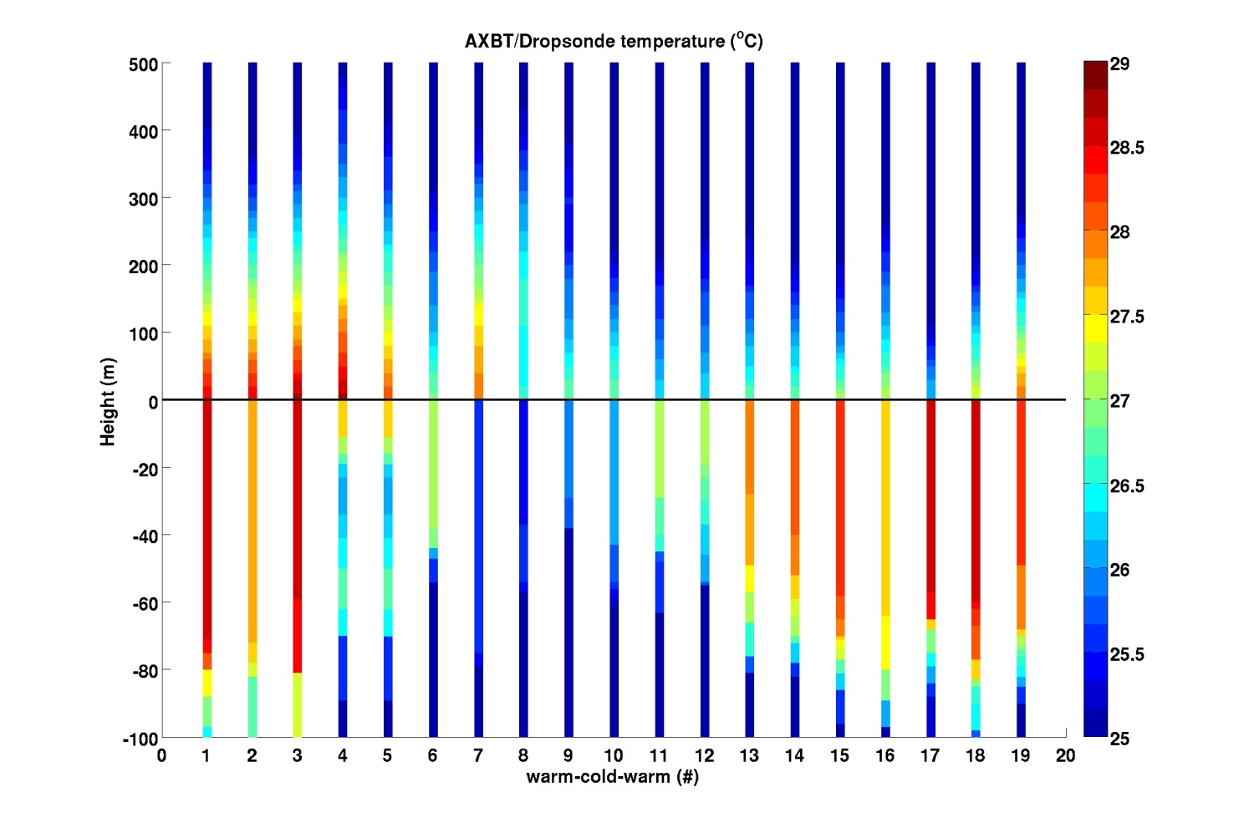
ITOP - Fanapi
B
WARM
Mission | 0620w
Dropsonde | 49
AXBT | 33
COLD
WARM
A
Air Temperature
Energy transfer is reversed
Cold air flows over warm ocean, SH goes upward.
Air-sea interface
Warm air flows over cold ocean, SH goes downward.
Ocean Temperature
A
B
Notes:
Direction of Energy reverses in these two regions

Slide 4
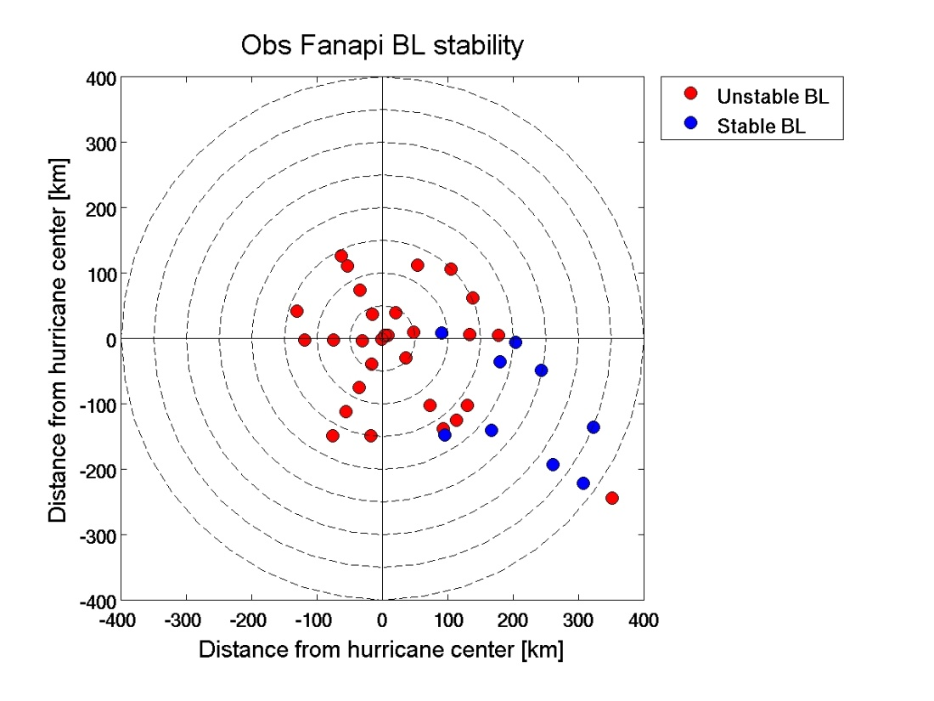
Notes:
Still need model to tell the whole story

Slide 5
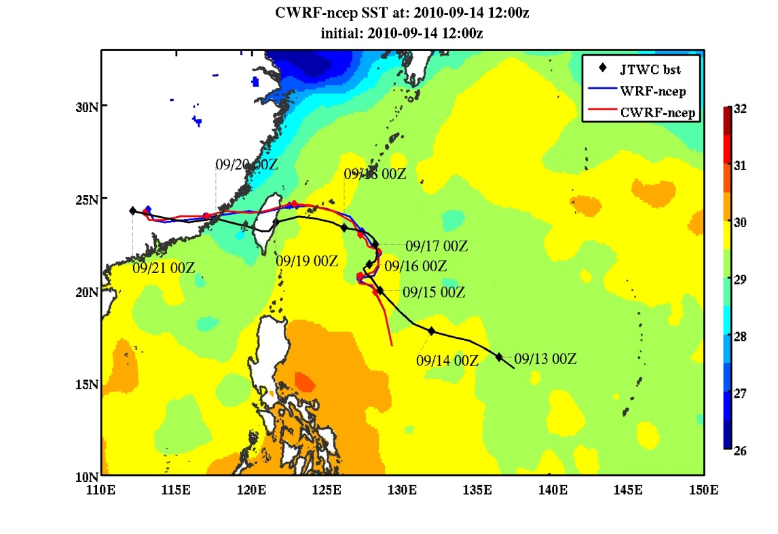
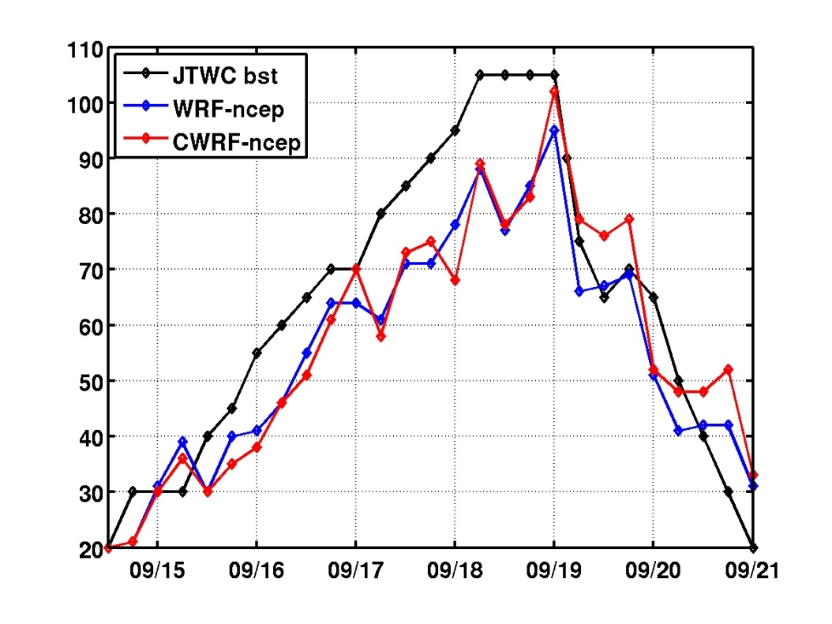
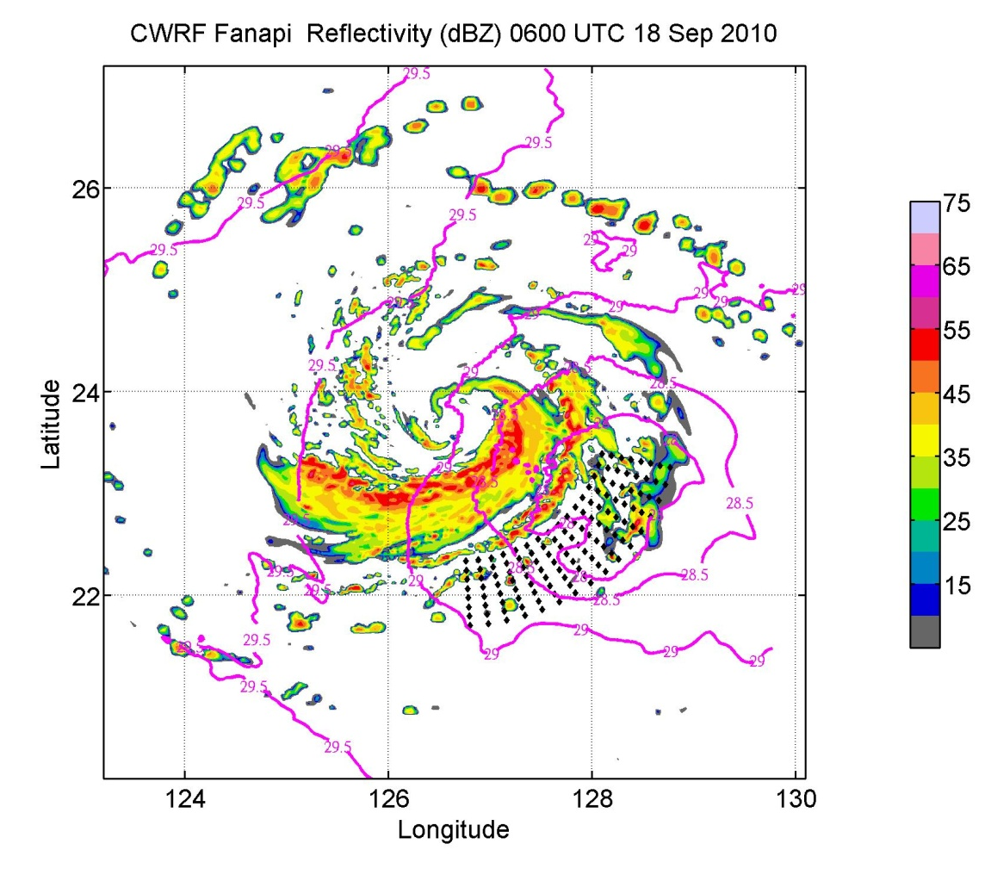
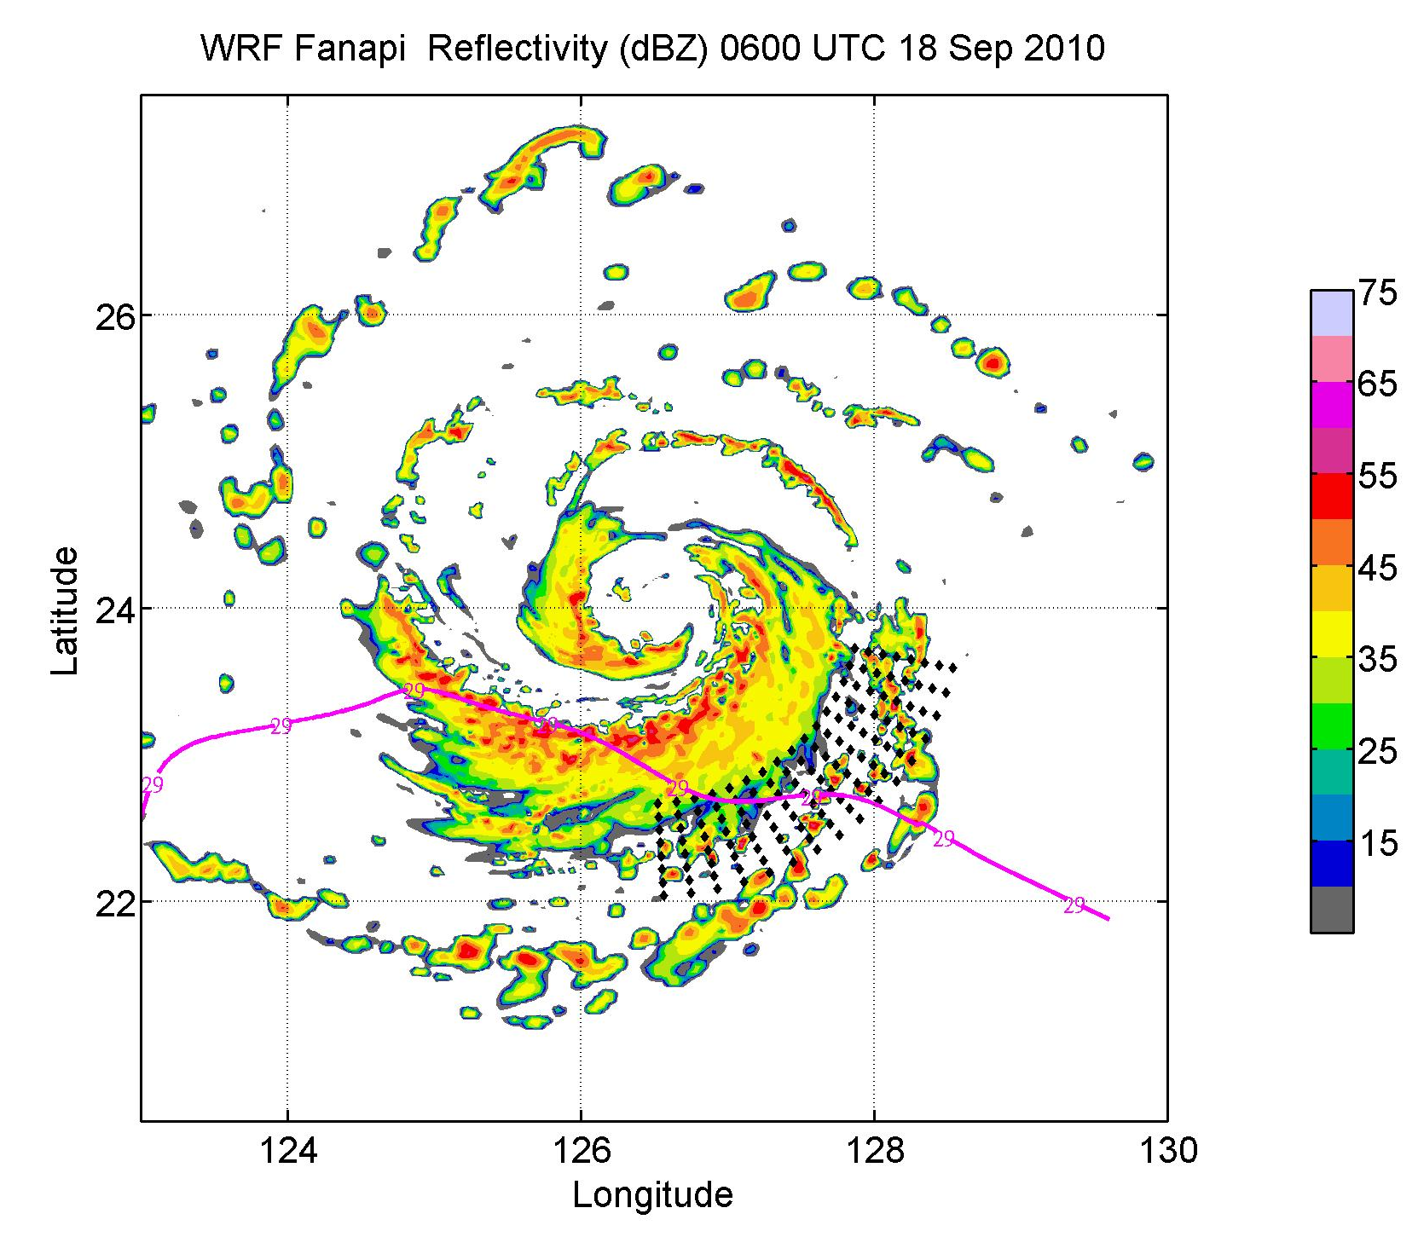
Results – CWRF simulations for Fanapi (2010)
Obs
Small eyewall !!
CWRF
WRF
29.5
No small eyewall
29.5
Primary rainband
Notes:
Using CWRF, Brandon has mentioned it.
Results is surprising! There is almost no impact of ocean coupling on storm intensity?
CWRF generate cooling~ 2 oC
Structure is different.
No small eyewall

Slide 6
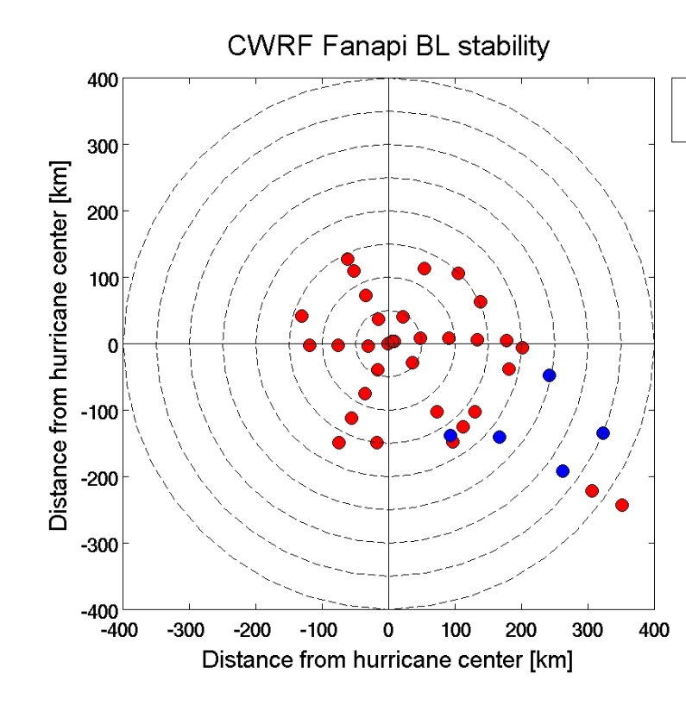
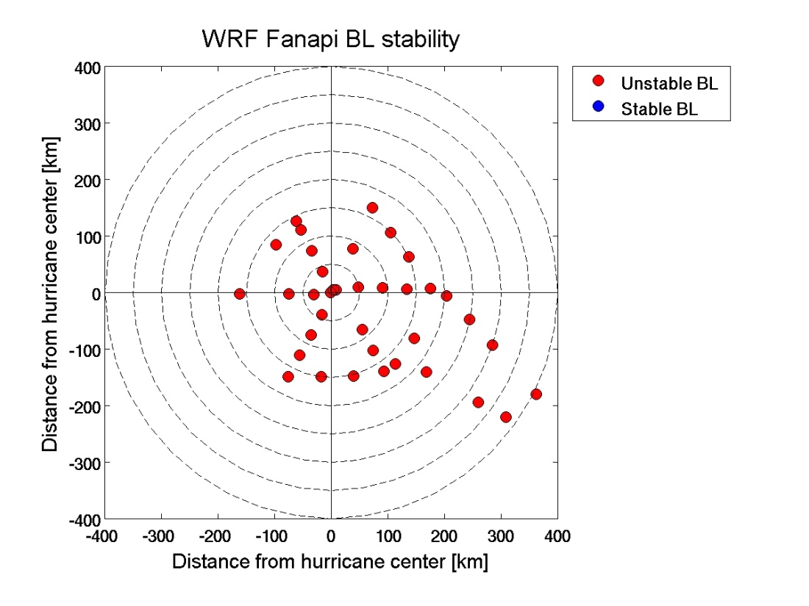
Only Coupled model (CWRF) can capture “stable boundary layer”
CWRF
WRF

Slide 7
Two ways to track the property of fluid:
Trajectory: an undiluted air parcel advected by wind
Tracer: air mass that is subjected to advection, turbulent mixing and molecular diffusion
Sink term
Molecular diffusion
Turbulent mixing
Notes:
Two method to examine the property of fluid
Trajectory is an undiluted air parcel advected by wind only
No such thing in Hurrincanes
In contrast to trajectory, tracer is an air mass which includes advection, turbulent mixing and molecular diffusion. The extra sink term here indicate the leaking of tracer at the lateral boundary in WRF.

Slide 8
Results – Tracer and trajectory initialization
CWRF
WRF
29.5
29.5
CWRF –cold wake regions, ~150 km from the center of the storm
WRF – same storm-relative locations as in CWRF
~250 trajectories released in each region
Tracer and trajectories released from ~80 m level
Both are tracked for 12 hours. The total amount of tracer is conserved within this period.
Notes:
Trajectory / tracer starts from cold wake, but it was warm air origionally
Cooling down then getting energy again

Slide 9
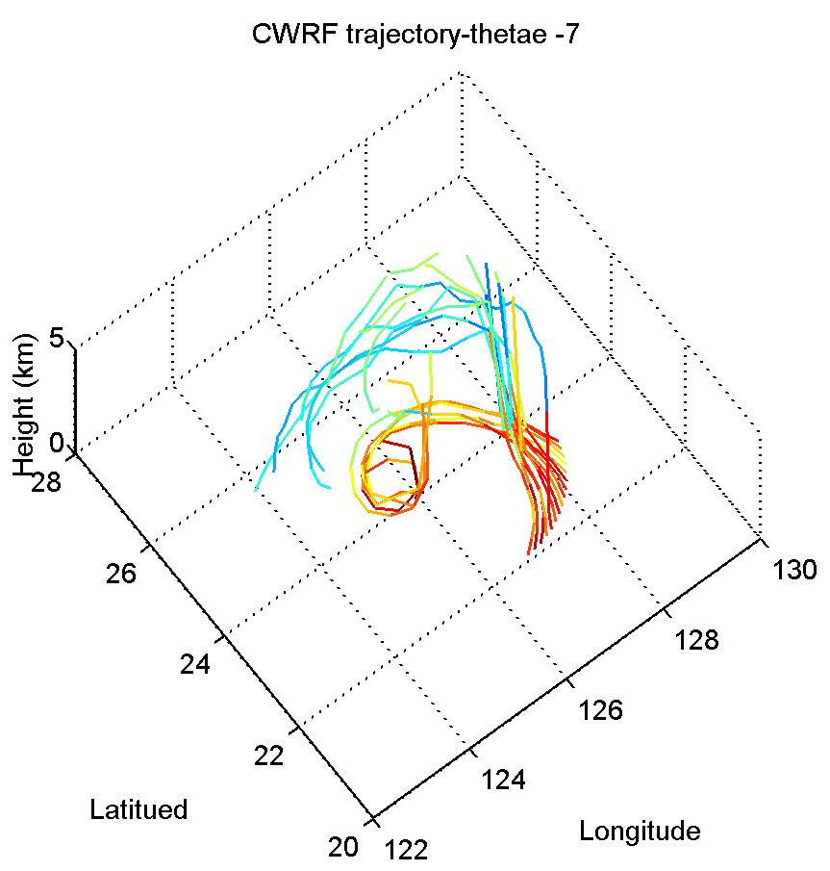
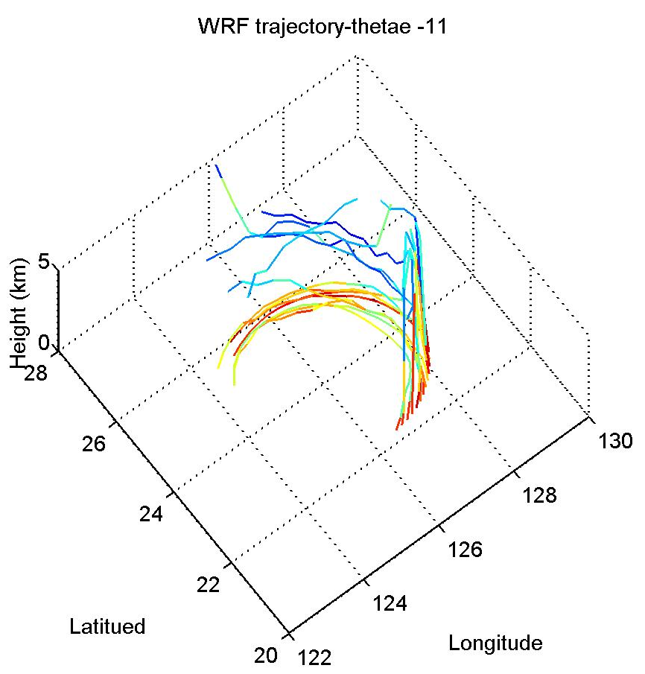
θ_{e} along the trajectories from the cold wake region
CWRF
WRF
Immediately enters the rainband
Cools down
Never enters into the eyewall
Gains energy and brings it into eyewall
Warm at beginning

Slide 10
Schematic of tracer from cold wake region
WRF
CWRF

Slide 11
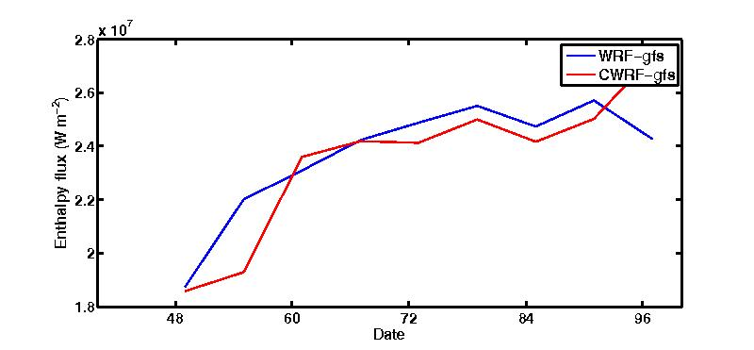
conclusions
ITOP observations confirm the stable boundary layer in TCs.
CWRF is able to capture such a stable BL over the cold wake.
New mechanism: stable BL over the cold wake keeps air in BL longer and increases θ_{e} of the inflow into the eyewall, which Indicates that coupled model is more efficient in bringing high energy air into the center of TCs than uncoupled model.
Surface fluxes are important to storm intensity, however, we need right/efficient storm structure to bring it into the eyewall.
Efficiency!!
Notes:
The domain averaged surface fluxes is not a deterministic effect, it is not proportional to intensity.
However the high energy that enters eyewall is important and that is determined by storm structure.
But storm sctructure is important, High energy air enters the eyewall is critical to storm intensity.

Slide 12
Acknowledgement
ITOP team.
NCAR scientists for their guidance on coupling CWRF, and developing tracer/trajectory calculation in WRF:
Dr. Jimy Dudhia,
Dr. Wei Wang,
Dave Gill, and John Michalakis
This work is supported by the ONR ITOP grant N000140810576

