Slide 1


High Resolution Fully Coupled Forecasts of Typhoons during ITOP
Brandon Kerns
Shuyi Chen
Chiaying Lee
Falko Judt

Slide 2
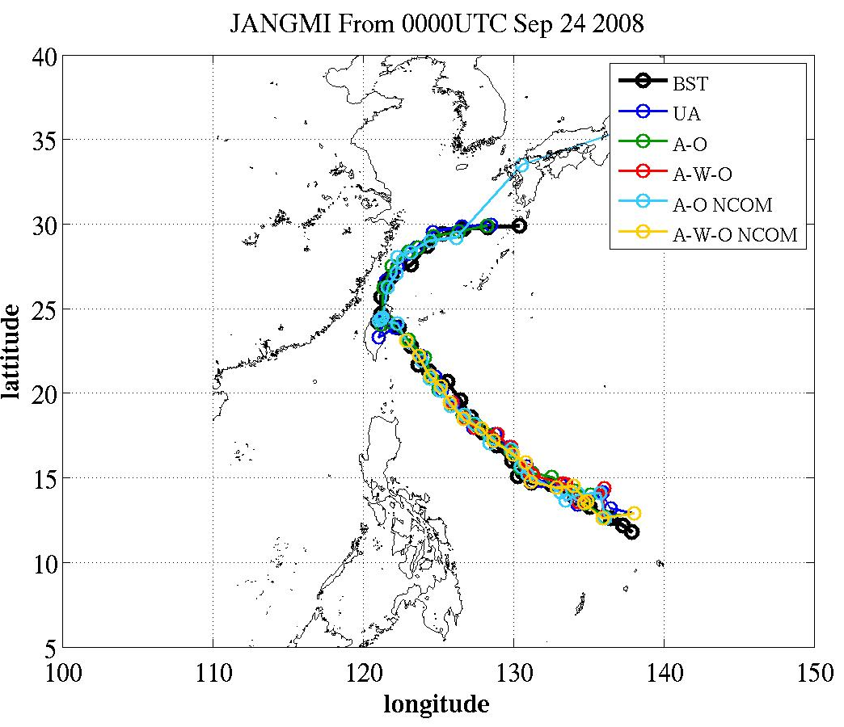
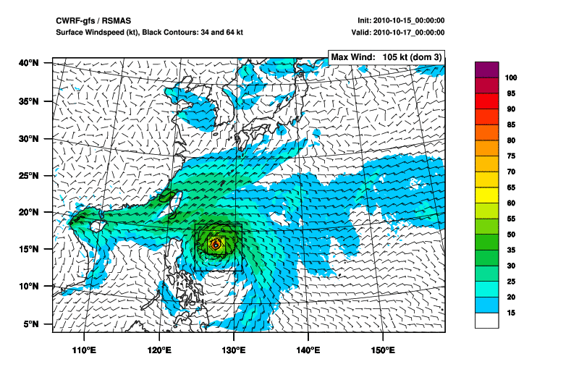
Real Time Coupled Modeling Setup
 | Atmosphere | Ocean | Waves | Initlal/Boundary Conditions
UMCM | MM5 | 3DPWP* | WW3 | GFS, NOGAPS, JMA, ECMWF
CWRF | WRF-ARW | 3DPWP*
12 km
12 km
0Z Forecast Cycle for UMCM-gfs
~ 06 Z | Model and plotting begin.
~ 14 Z | Model and plotting finished.
~ 21 Z | ITOP Forecast Brief.
4 km
4 km
1.3 km
1.3 km
*Price et al. (1986)
Notes:
Multi model, multi model, multi model. Real-time, real-time, real-time. These forecasts were used for mission planning during ITOP.

Slide 3
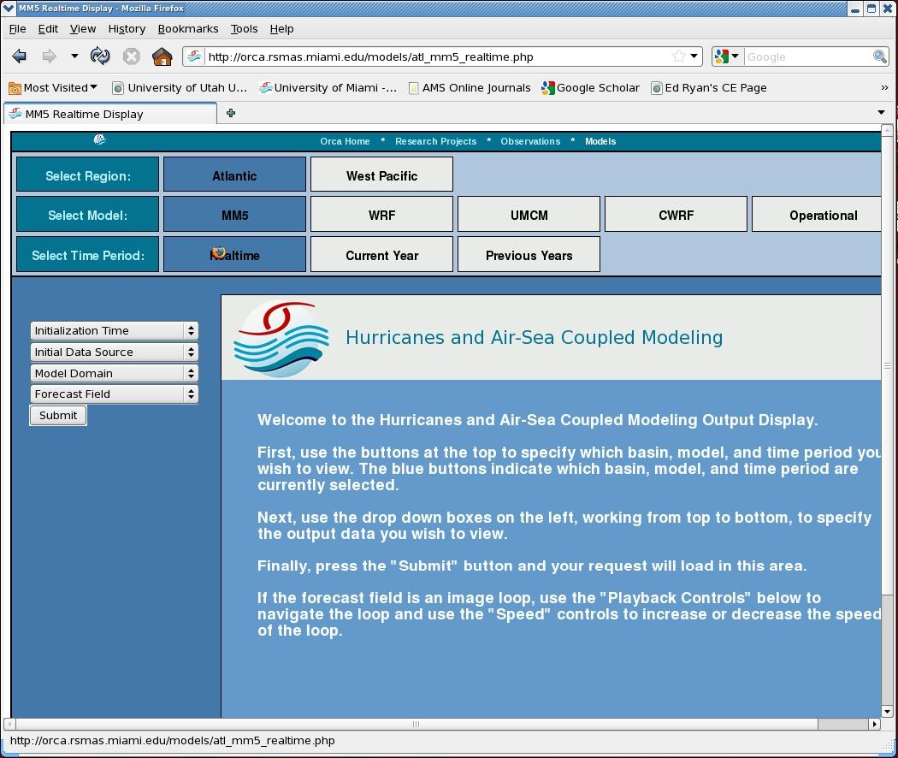
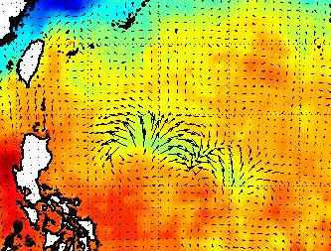
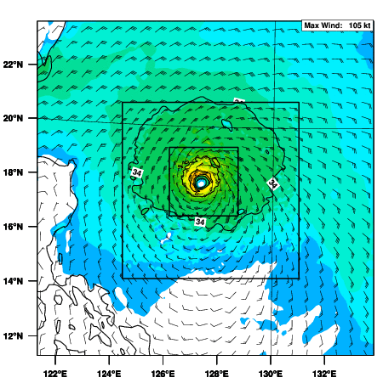
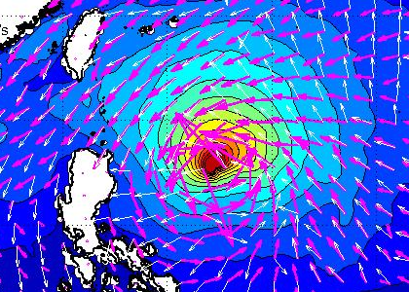
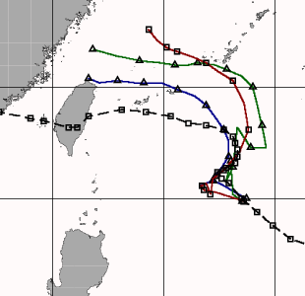
Atmosphere
Ocean
Waves
Notes:
Example of plots available in real-time as the model is running. available on website

Slide 4
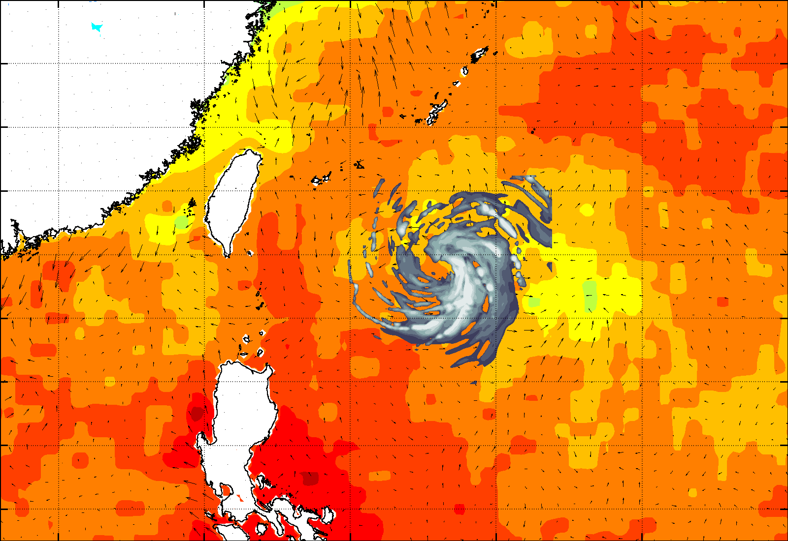
UMCM-gfs SST and Reflectivity

Slide 5
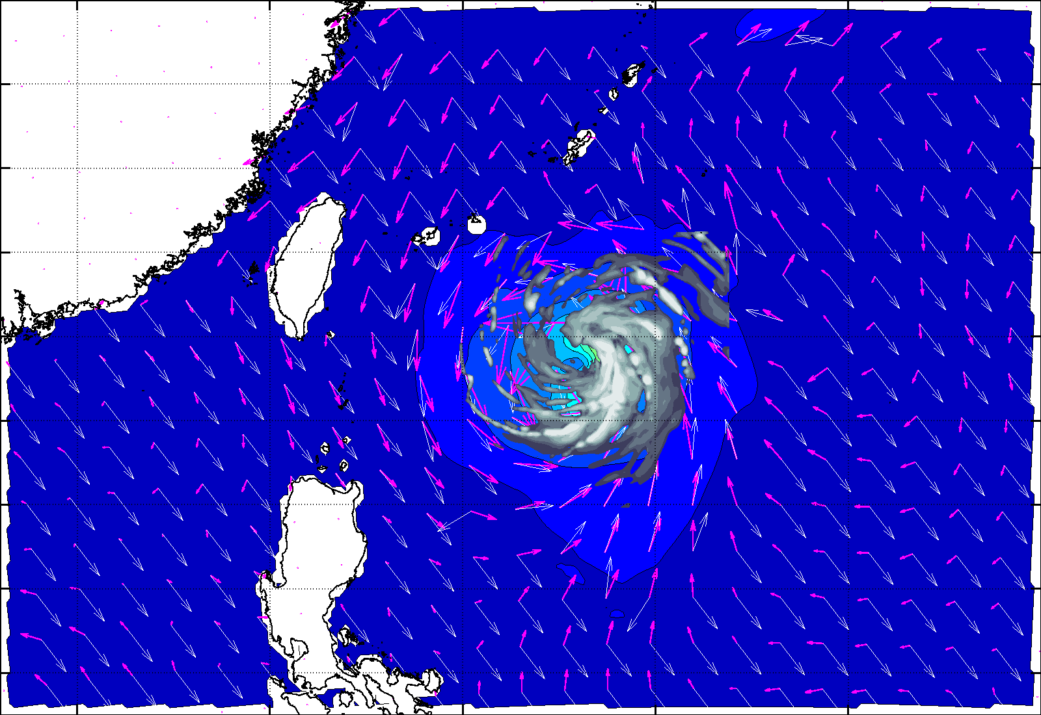
UMCM-gfs SWH and Reflectivity
Notes:
Refer to 1.) waves ahead of storm with no wind, 2._ waves different direction back side, possible Languimir turbulence matters.

Slide 6
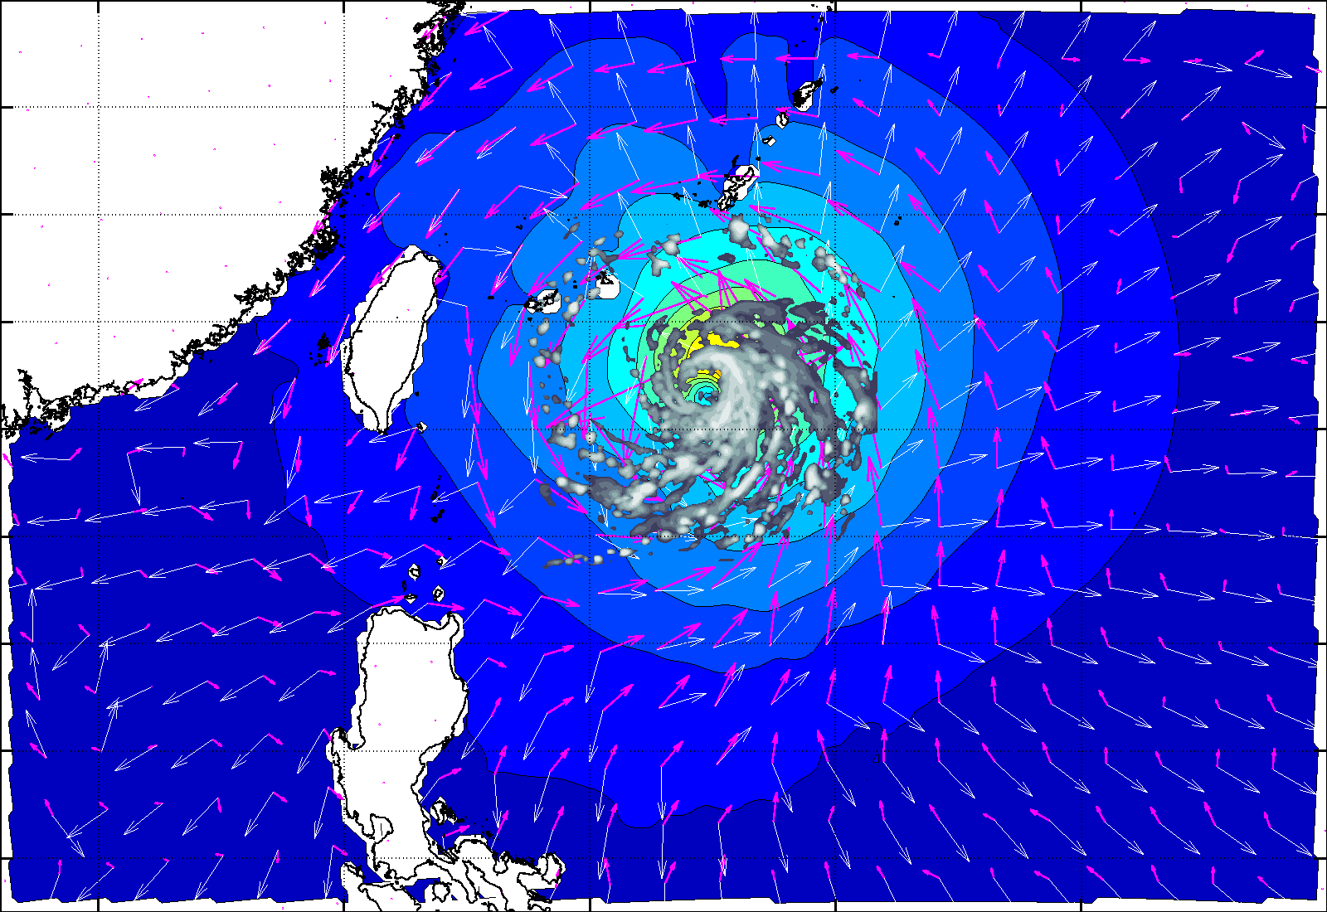
Wave direction different from wind direction
Notes:
Refer to 1.) waves ahead of storm with no wind, 2._ waves different direction back side, possible Languimir turbulence matters.

Slide 7
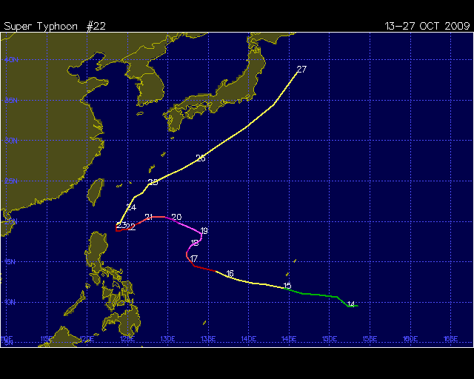
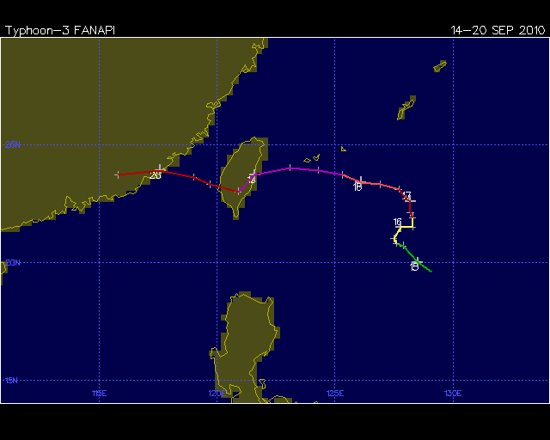
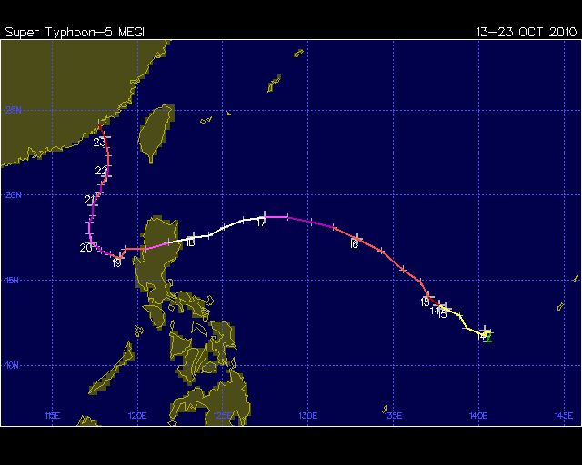
Verification Cases
Storm | Dates | Number of Forecasts*
Lupit (2009) | 15-18 Oct. 2009 | 4
Fanapi (2010) | 15-18 Sept. 2010 | 4
Megi (2010) | 13-18 Oct. 2010 | 6
 | TOTAL: | 14
*Once per day
while storm is
in area of
interest.
S-curve
S-curve
A record-breaking Cat-5
super typhoon
These were challenging storms.
Track plots from UNISYS.
Notes:
Focus of ITOP dry run and field phase.

Slide 8
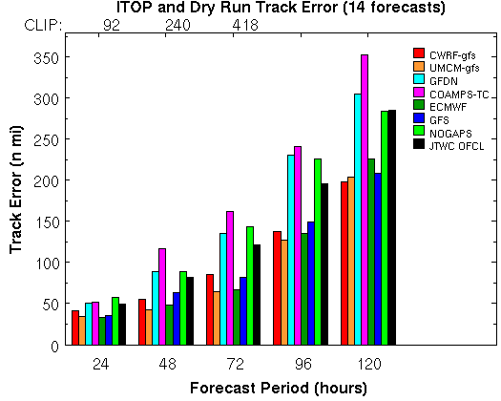
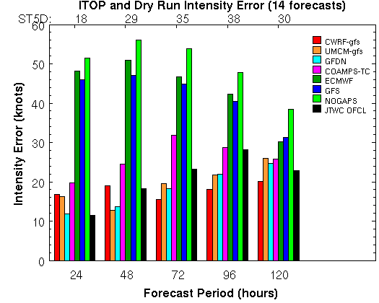
Track and Intensity
High resolution coupled models (red, brown)
perform very favorably compared with operational
guidance, for the 14 forecasts considered.
Notes:
High resolution coupled models are red and brown. JTWC official forecast in black. Operational models ltoo weak storm, too weak forcing on operational ocean model.

Slide 9
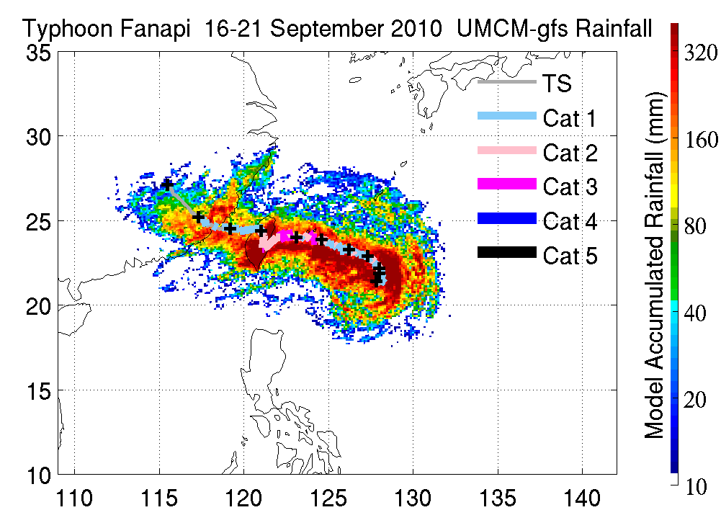
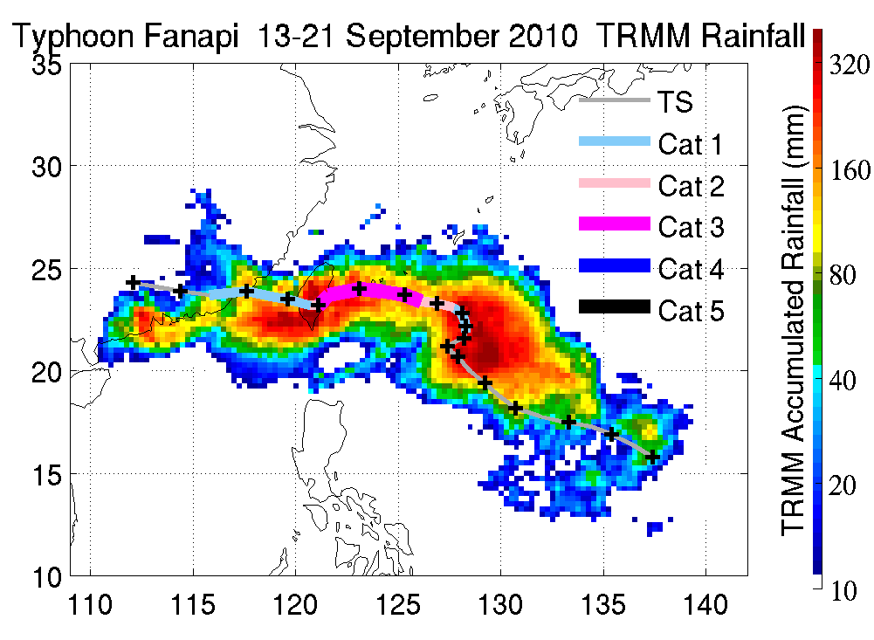
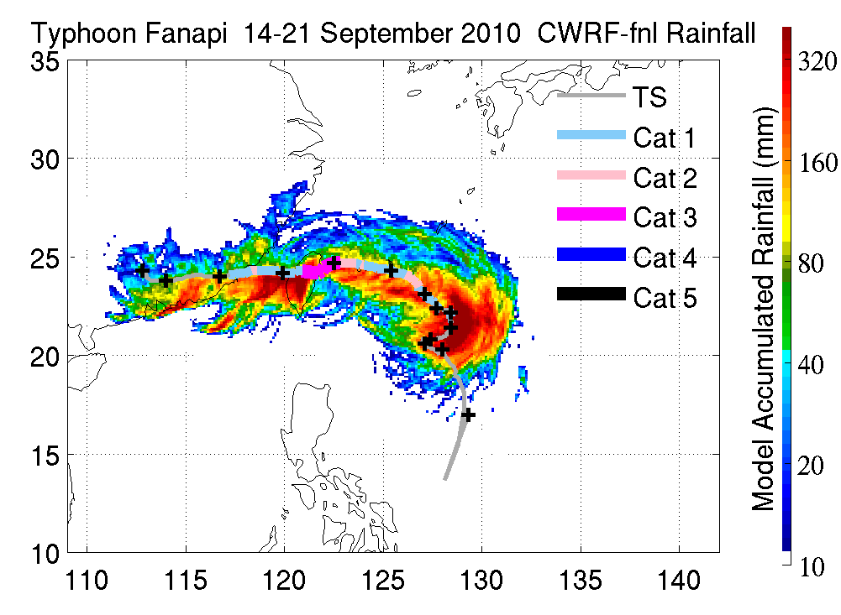
Verification of rain
After turn,
rainfall asymmetry
Left of track …
Notes:
This effects salinity.

Slide 10
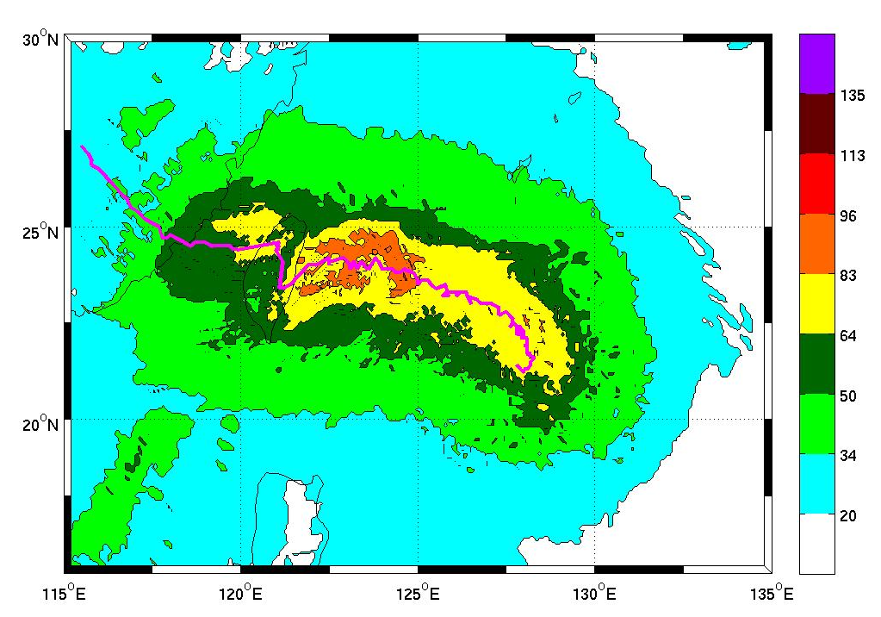
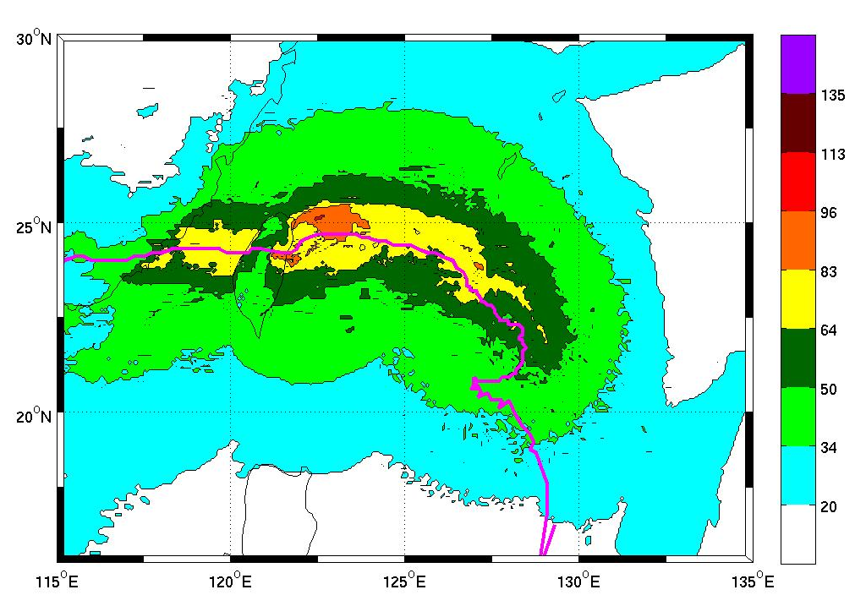
Verification of surface wind
135
113
96
83
UMCM-gfs
Forecast
0Z 9/16- 0Z 9/21
64
50
34
20
20
… But, wind asymmetry
Is to the right.
135
113
CWRF-fnl
Simulation
12Z 9/14 – 0Z 9/24
96
83
64
50
34
20
20
Notes:
No corresponding observations, only instatnaneous flight

Slide 11
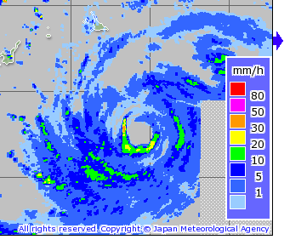
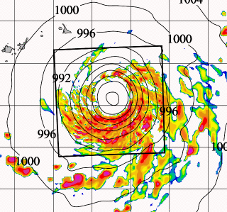
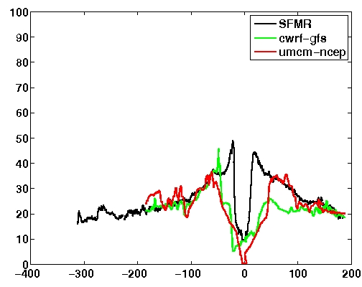
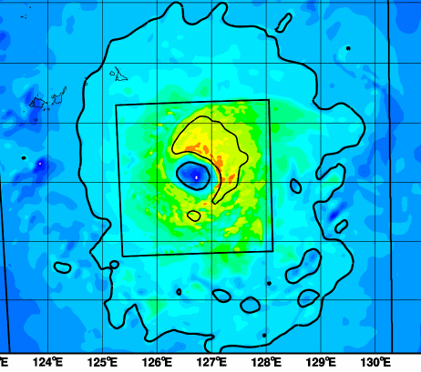
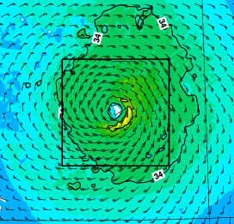
Verification of surface winds II: SFMR
OBS
UMCM
NW
SE
SFMR
CWRF
UMCM
UMCM
NW
SE
NW
SE
CWRF
NW
SE

Slide 12
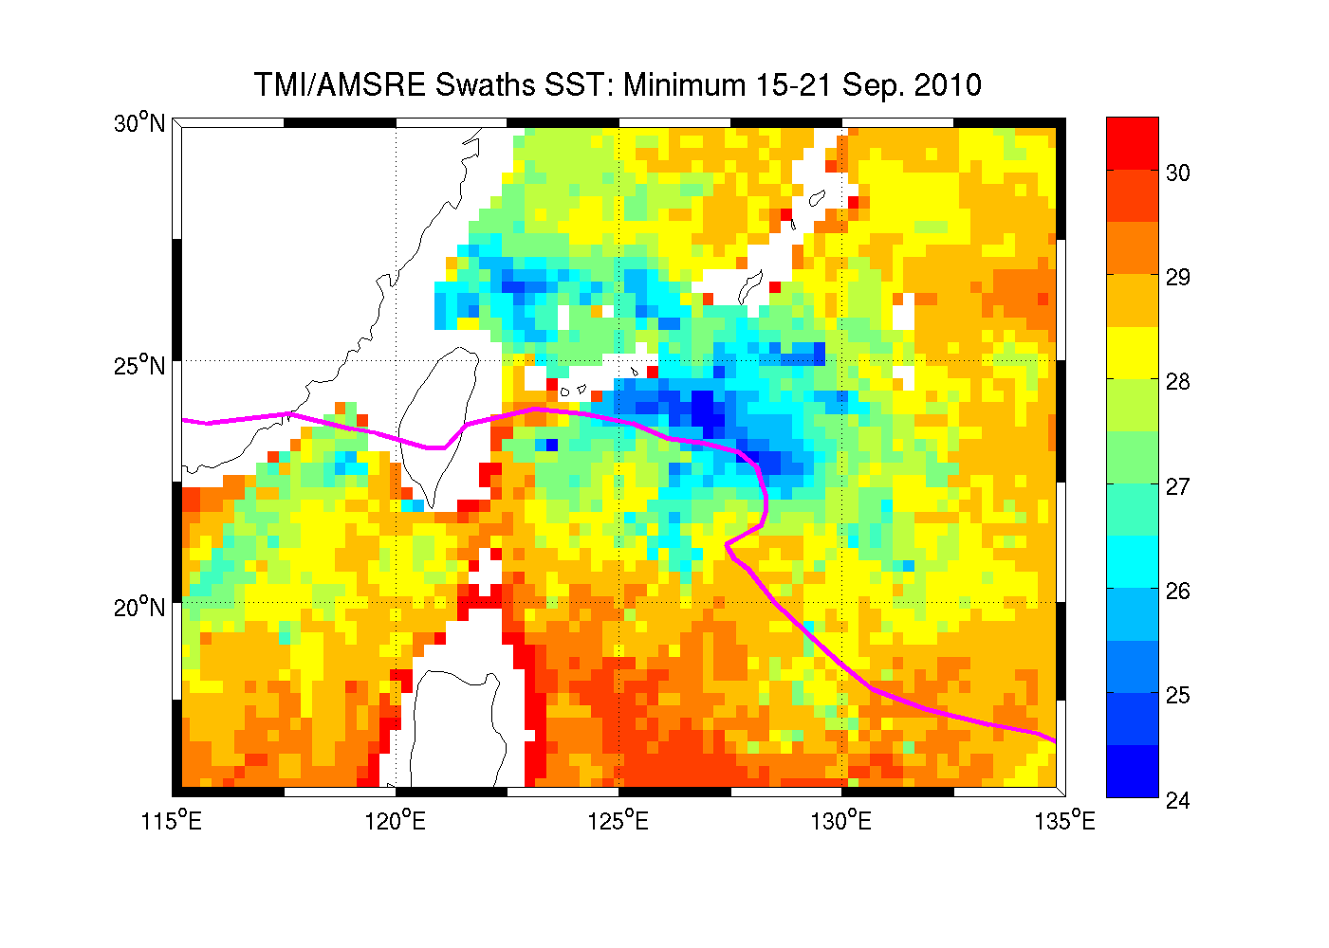
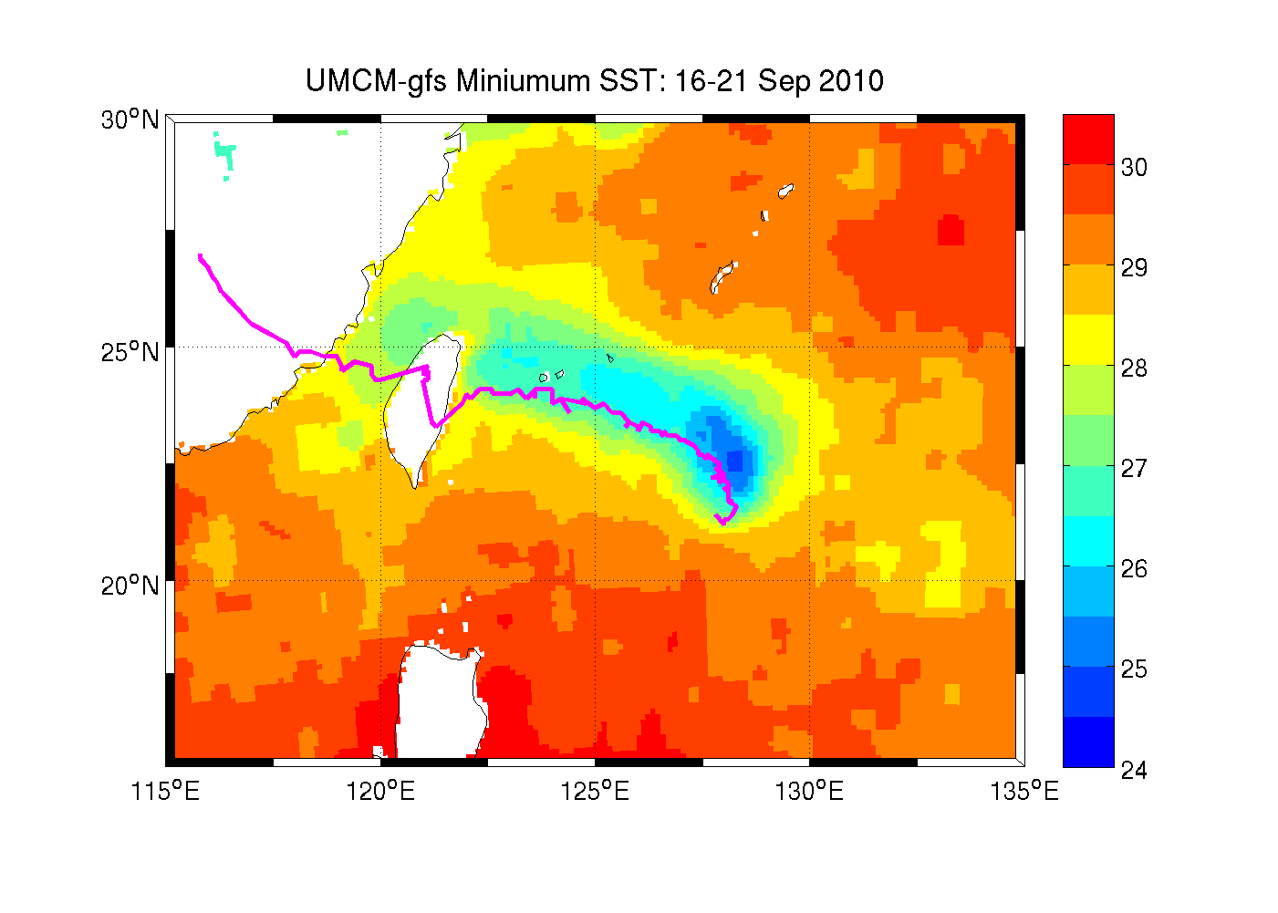
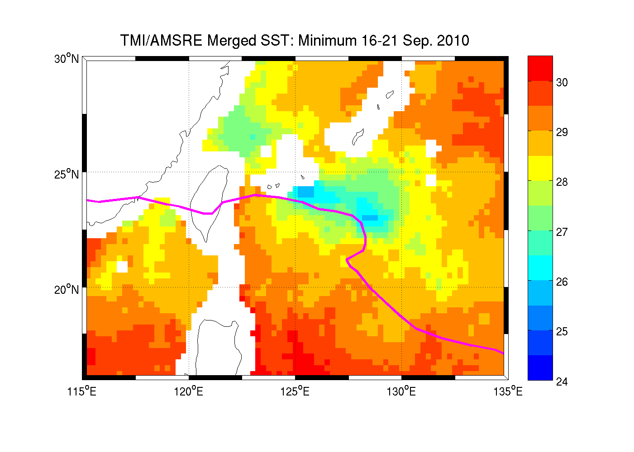
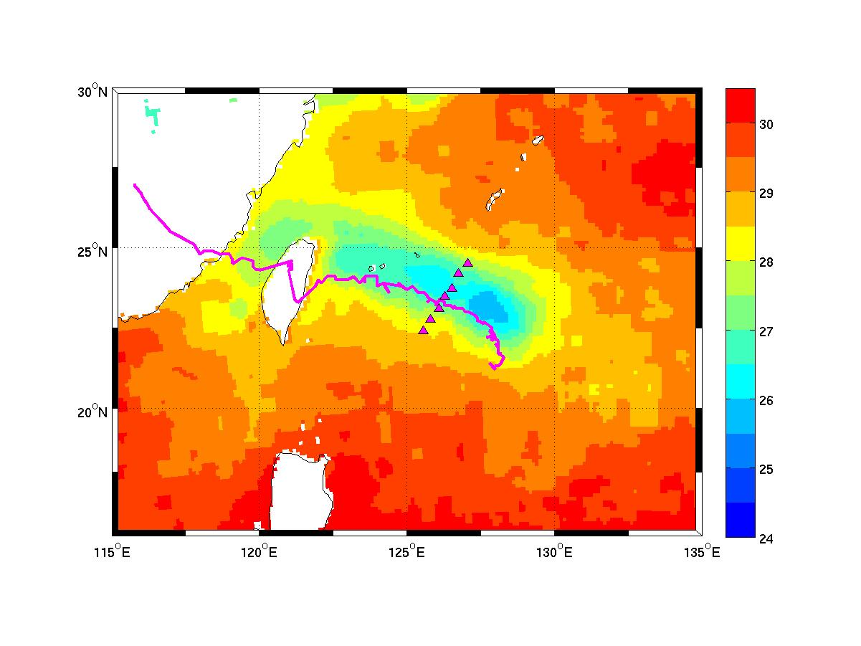
Verification of cold wake
OBS: INDIVIDUAL SWATHS
MODEL
Put minimum SST plot here.
OBS: DAILY COMPOSITE
MODEL
Notes:
*** Need to update UMCM and CWRF ones.
*** need re-done scatter plot.

Slide 13
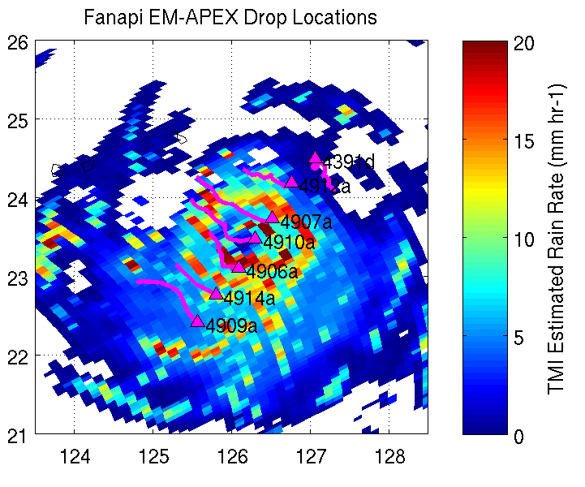
Verification of Cold Wake: Vertical Structure

Slide 14
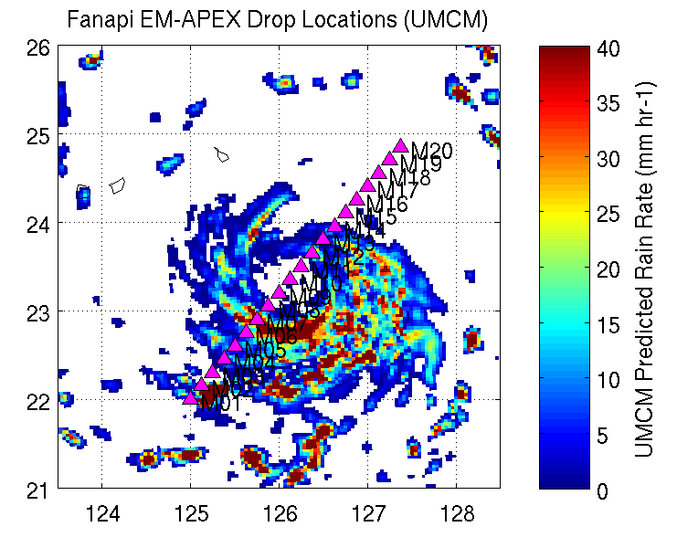
Verification of Cold Wake: Vertical Structure

Slide 15
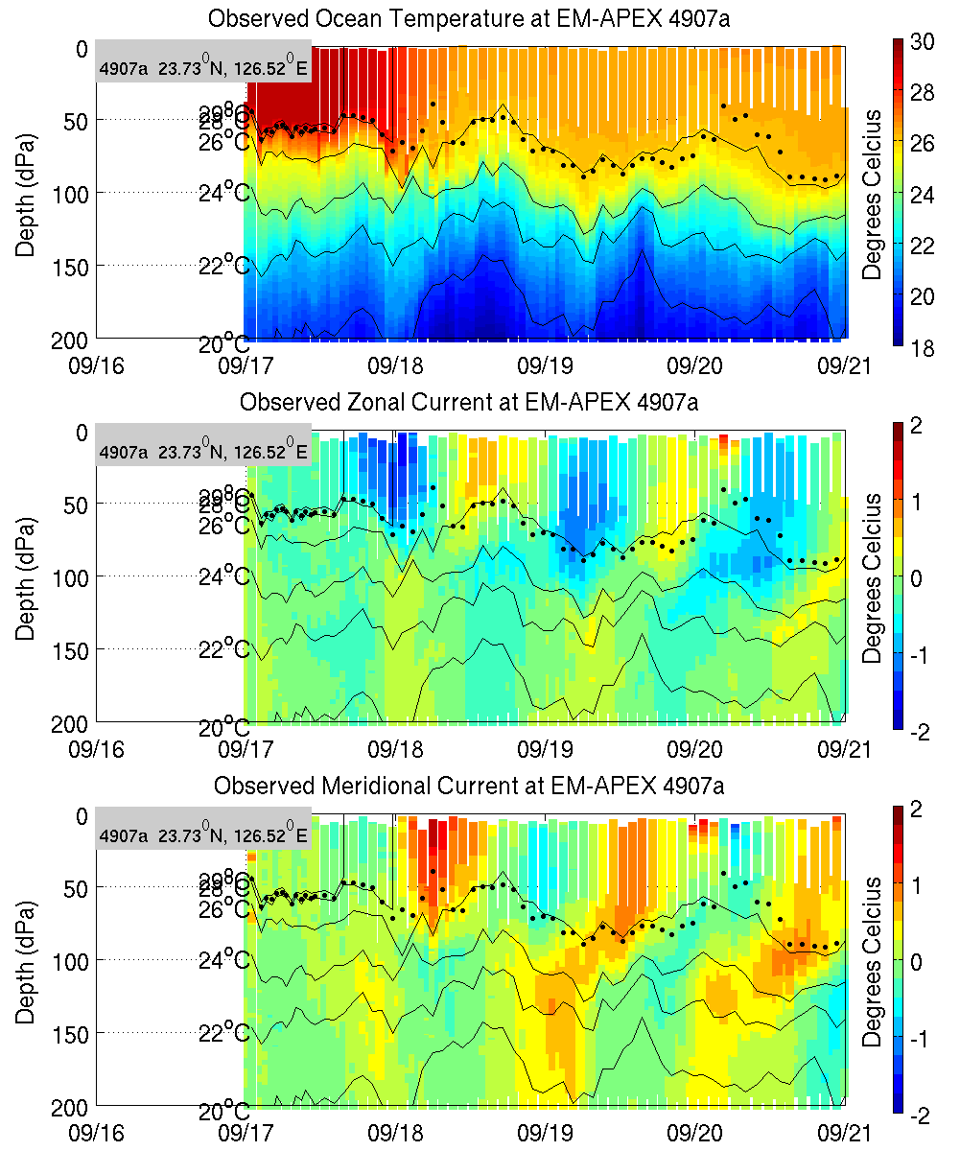
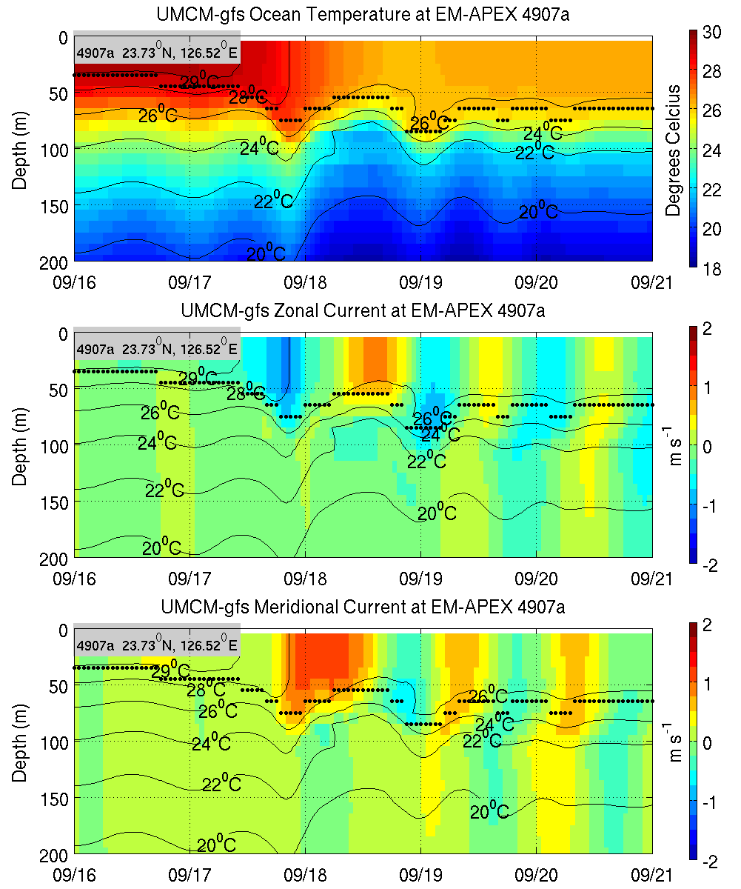
Right of storm
OBS
UMCM Model
T
T
U
U
V
V

Slide 16
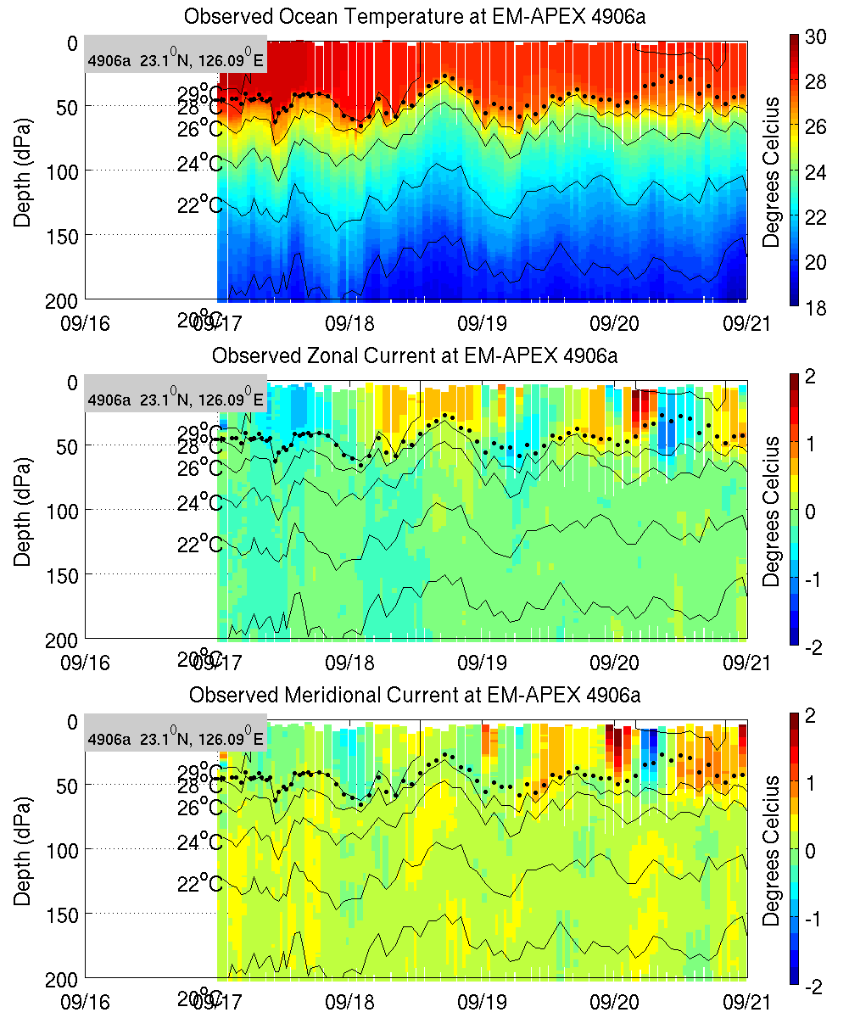
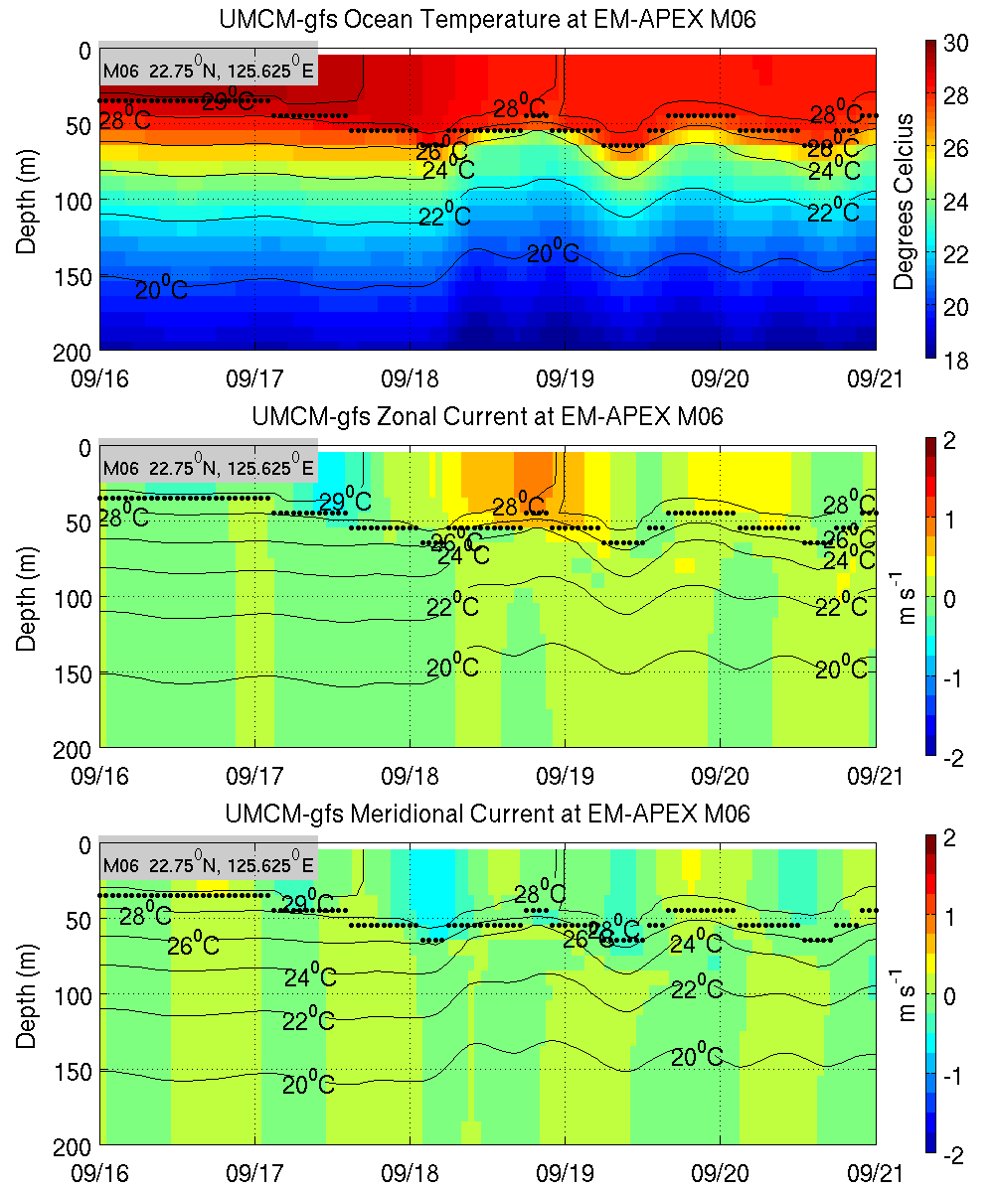
Left of storm
OBS
UMCM Model
T
T
U
U
V
V

Slide 17
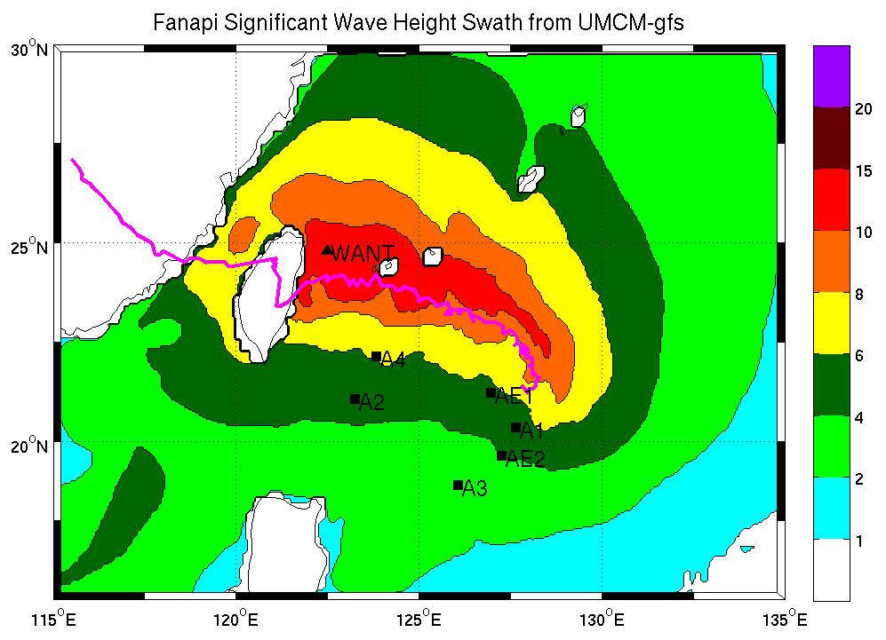
Anticipation of Wave Model Verification
Notes:
Need to change colors as Shuyi suggested.

Slide 18
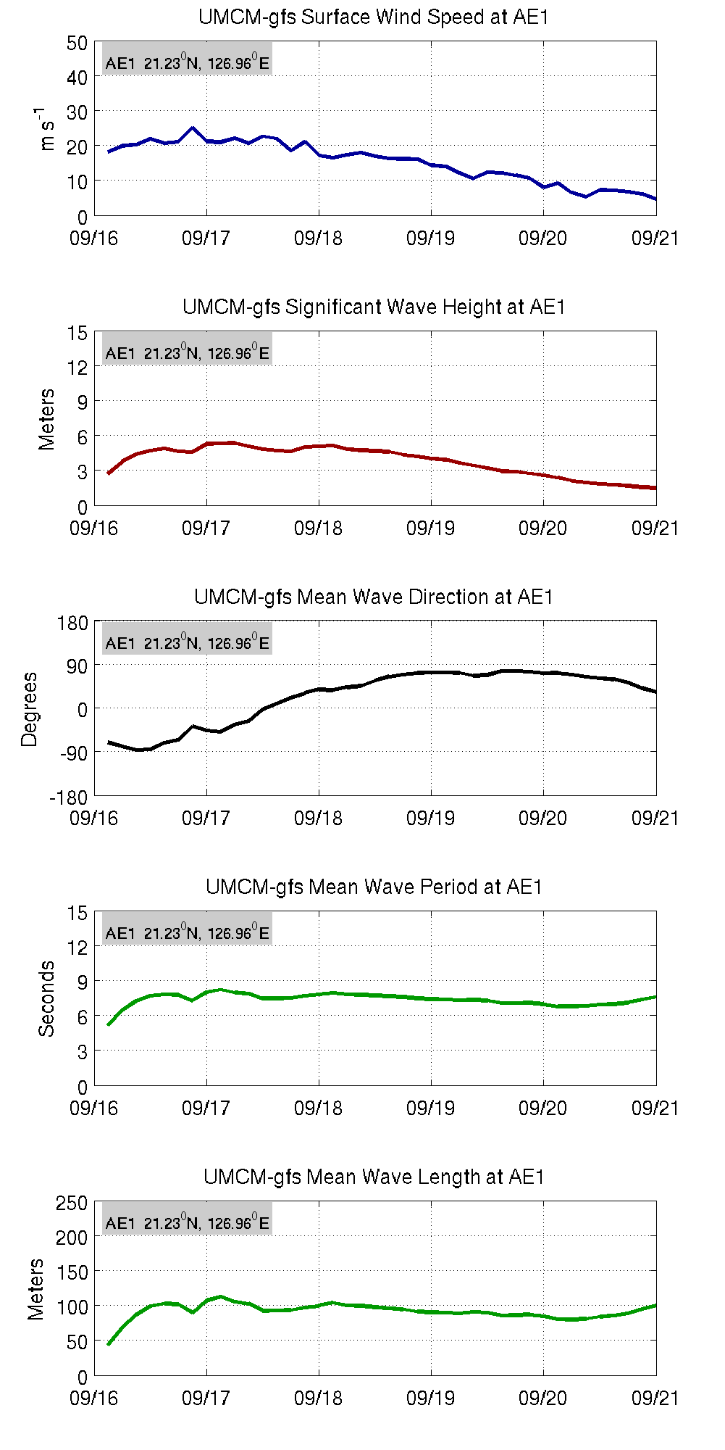
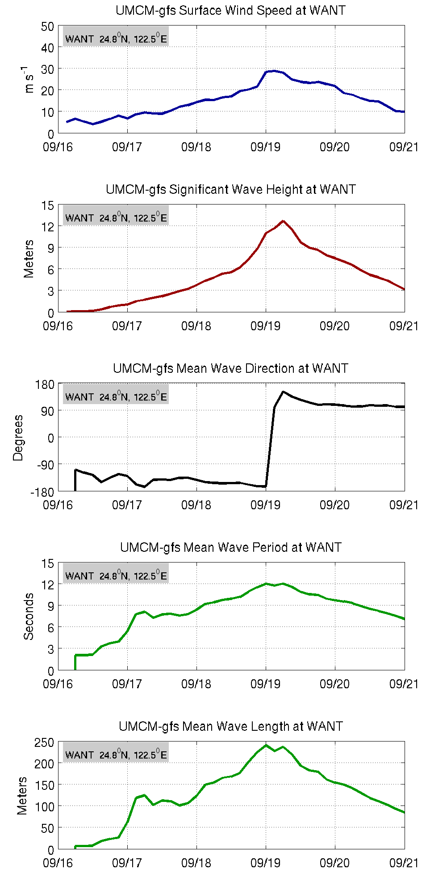
Anticipated Wave Model Verification
ASIS
“WANT”
Wind
Wind
WW3 at
ASIS mooring
AE1
WW3 at
imaginary
Location
“WANT”
Sig. Wave Hgt.
Sig. Wave Hgt.
Mean Direction
Mean Direction
Mean Period
Mean Period
Mean wave length
Mean wave length

Slide 19
Verification Conclusions
Coupled model greatly improve typhoon intensity forecasts compared with operational global models. This affects ocean forcing!
UMCM and CWRF capture the asymmetry of wind and rain, but the eyewall is too large.
Vertical structure of the cold wake right and left of the storm compared well with EM-APEX observations.
Wave fields will be verified against observations once available.
Notes:
Perhaps discard or keep as “extra”

Slide 20
Data and Analysis Plan
High resolution coupled model forecast fields for analysis and ocean model forcing (late June at EOL/ITOP.org)
Unified Reanalysis of coupled Atmosphere/Ocean/Wave fields
  Simulation stage (with HYCOM): Using global atmospheric/HYCOM analysis fields as boundary conditions (Within 1 year)
  Data assimilation using high resolution coupled models incorporating all available ITOP observations (1-??? Years) IDEAL OUTCOME FROM ITOP
Need: convenient way to access “all” data for a given platform for a given day.

