Slide 1
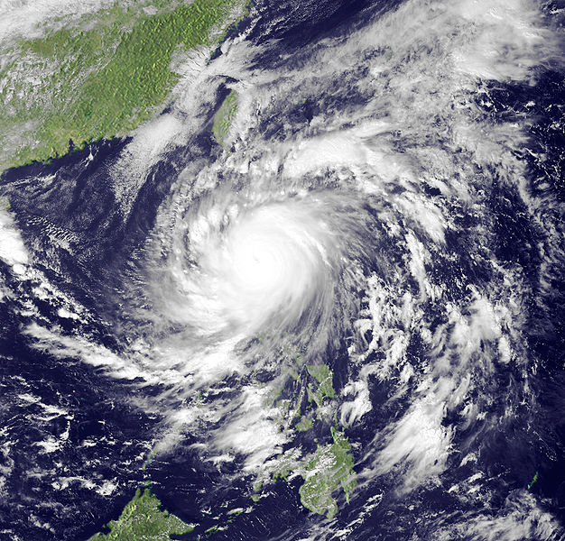
aspects of the ocean response
to typhoon Megi --- very small, but very intense
Jim Price, WHOI
for ITOP
Santa Fe, May 2011
Megi, 18 Oct 2010, by NASA SeaWIFS

Slide 2
aspects of the ocean response
to typhoon Megi --- very small, but very intense
1) Review SST maps to estimate the cooling response to Megi.
2) Eric’s first analysis of Megi’s winds, and
3) an ocean model simulation made from these winds,
4) suggests a few of the ways that the Megi case may be new and different.
5) A to-do list.
Megi, 18 Oct 2010, by NASA SeaWIFS

Slide 3
RSS MW + IR OI, L4 GHSST; daily at 9 km
Fanapi’s track

Slide 6
here comes Megi!!

Slide 14
apparent onset of seasonal cooling

Slide 23
an average over three days pre-Megi

Slide 24
an average over three days post-Megi

Slide 25
SST change, post-Megi minus pre-Megi

Slide 26
SST cooling sampled across the wake of Megi

Slide 27
SST cooling sampled across the wake of Megi
Fanapi?

Slide 28
preliminary
Eric DA’s first-cut
wind speed analysis

Slide 29
preliminary
wind speed radial profile
a very small radius to
maximum winds, R = 13 km

Slide 30
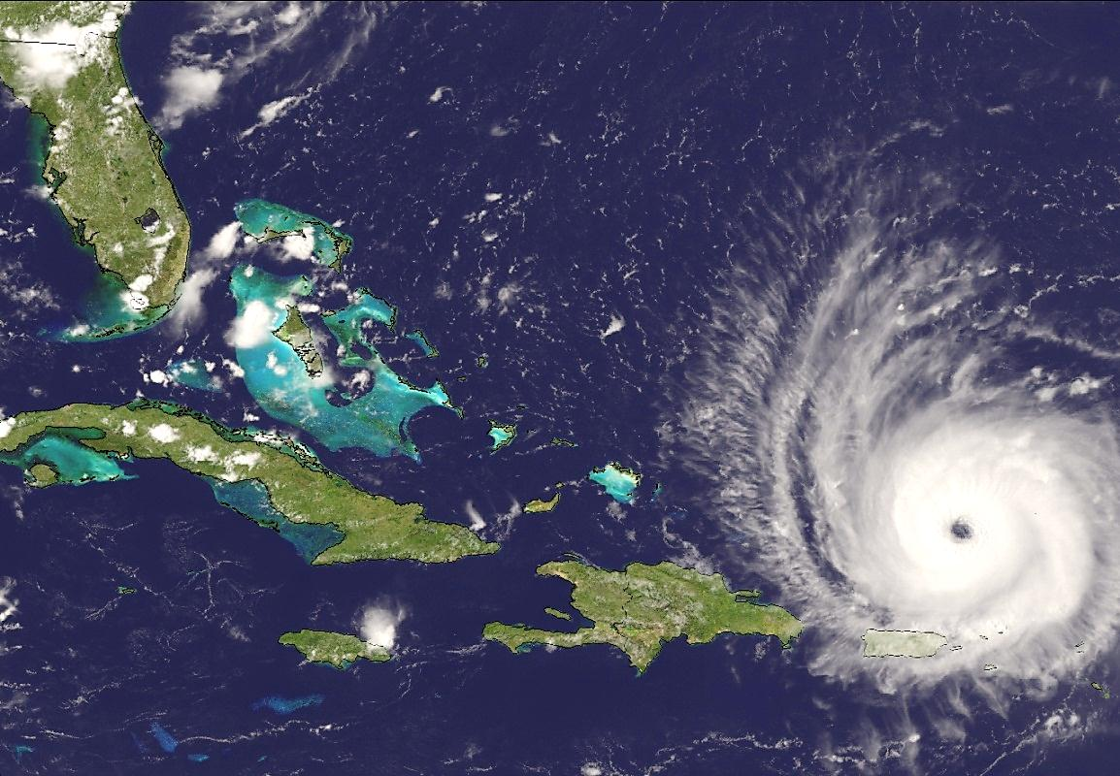
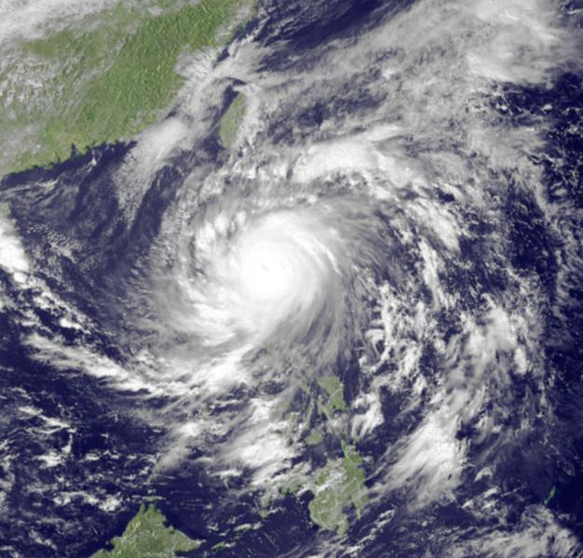
preliminary
a comparison of Frances (2004) and Megi (2010)
Frances Megi
trans speed, U, m/s 6 7
typhoon radius, R, km 35 13
stress, ταυ, Pa 6 10
ml thickness, h, m 70 50
rotation, 2πι / f, days 1.3 1.6
Frances Megi
non-d storm speed
S = U/2 R f 1.4 6
ml Burger number
B = g'h/4 R f 0.6 8
2
2
Megi, 17 Oct 2010
Frances, 1 Sep 2004
these images are from NASA SeaWIFS

Slide 31
preliminary

Slide 32
preliminary
Megi’s wind changed direction considerably faster
than the ocean current rotated inertially

Slide 33
preliminary
SST(t, x) from 3DPWP model of Megi
max cooling = 0.8 C 1.1+-0.2 C
max at x = 30 km vs. 50 +- 20 km
half width = 160 km 240 +- 30 km
This wake is slightly weaker and narrower than is the observed wake.

Slide 34
preliminary
SST(t, x) from 3DPWP model of Megi
slice through the solution at x = 0, 30 and 90 km.

Slide 35
preliminary

Slide 36
preliminary
T(t; z) and S(t; z) along the track
modest cooling, here about 0.7 C
large upwelling/inertial pumping, ~ 50 m
mixing within the stratified transition layer

Slide 37
preliminary
T(t; z) and S(t; z) along the track
shear-driven
diapycnal mixing
modest cooling, about 0.7 C
large upwelling/inertial pumping, ~ 40 m
mixing within the stratified transition layer

Slide 38
preliminary

Slide 39
preliminary

Slide 40
preliminary

Slide 41
preliminary
significant phase shift within the first half-cycle(!)

Slide 42
preliminary

Slide 43
preliminary

Slide 44
aspects of the ocean response
to typhoon Megi --- very small, but very intense
A (preliminary) ta-da list:
1) Megi caused fairly modest SST cooling, ~1C,
despite that wind speeds were very high.
i) Megi was very small and fast-moving, S ~ 6,
ii) the ocean Ti(z) also played a part; large
T100 implies small cooling.
2) Coupling between the surface layer and
thermocline was unusually strong, B ~ 8. This
leads to:
i) large thermocline currents within the first day,
ii) large phase change in the vertical and large
blue shift, and,
iii) shear-driven mixing within the interface layer.
Megi, 18 Oct 2010, by NASA SeaWIFS

Slide 45
aspects of the ocean response
to typhoon Megi --- very small, but very intense
A (preliminary) to-do list:
Send the Matlab SST image script and data
to the ITOP server; model, too.
Encourage a reliable wind stress field
for Megi.
Analyze the inertial-internal wave wake made
by Megi.
4) Internal tides ..... add to the model?
Can we understand the patterns in SST fields
at times other then typhoon passages?
Megi, 18 Oct 2010, by NASA SeaWIFS
end

Slide 47
preliminary
a comparison of Frances (2004) and Megi (2010)
Frances Megi
trans speed, U, m/s 6 7
typhoon radius, R, km 35 13
stress, ταυ, Pa 6 10
ml thickness, h, m 70 50
rotation, 2π / f, days 1.3 1.6
Frances Megi
non-d storm speed
S = U/2 R f 1.4 6
ml Burger number
B = g'h/4 R f 0.6 8
2
2
Megi, 17 Oct 2010
Frances, 1 Sep 2004
these images are from NASA SeaWIFS

