Slide 1
Moored Measurement Results
Ya-Ting Chang¹, Ming-Huei Chang², Ren-Chieh Lien³, Barry Ma³ , Yih Yang⁴ , Yi-Fen Pai¹ and Tswen-Yung David Tang¹
¹ Institute of Oceanography, National Taiwan University
² Department of Marine Environmental Informatics, National Taiwan Ocean University
³ Applied Physical Lab., University of Washington
⁴ Taiwan Ocean Research Institute, National Applied Research Lab.

Slide 2
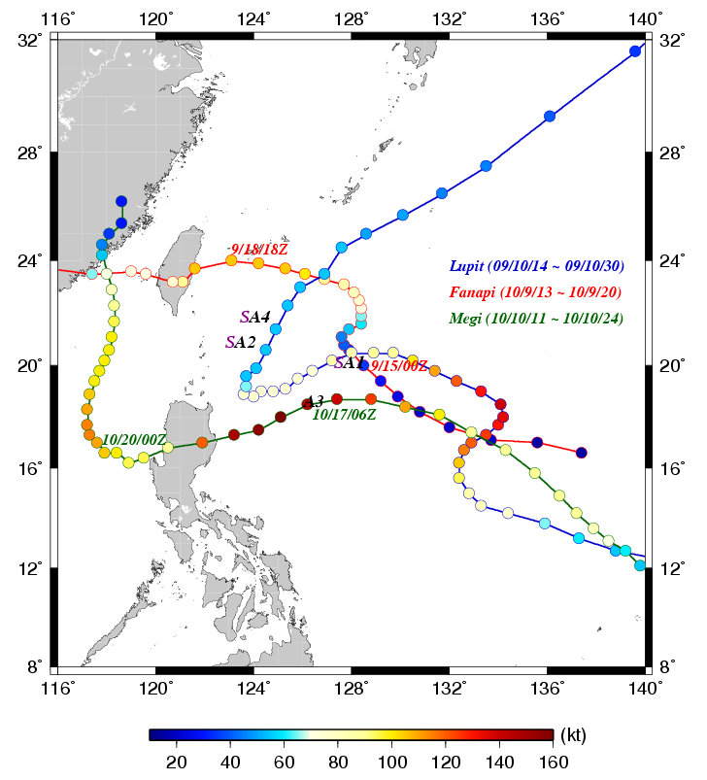
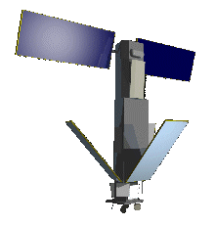
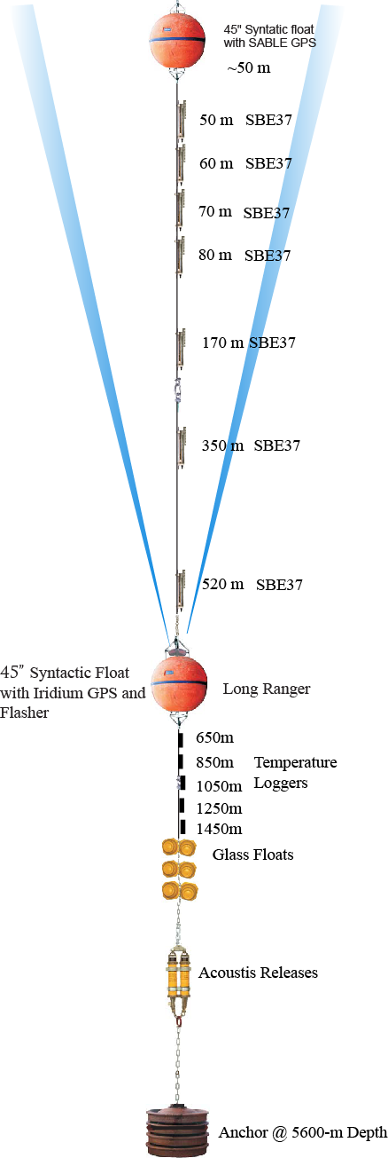
A3
Meteorological sensors (5 mins):
  Wind speed and direction (both propeller and ultrasonic sensors)
  Air temperature and relative humidity.
  Air pressure
  Solar irradiances
  Transmitted every 6 hours.
Under water sensors (mostly 2 mins):
  Temperature at 1, 4, 8, 12, 20, 30, 40, 50, 65, 100, 150, 250, 360 and 500, 600, 800, 1000 and 1400m.
  Salinity at 4, 12, 50 and 80m.
  Pressure at 500m.
  Transmitted every 2-4 hours.
  Wave Sensor(A4)
Subsurface current (mostly 1min):
  Only available from March to November 2010.

Slide 3
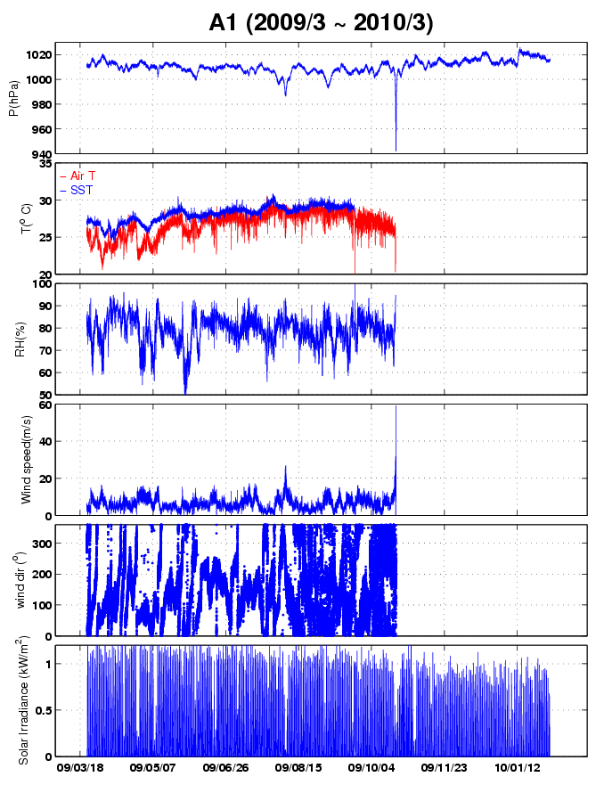
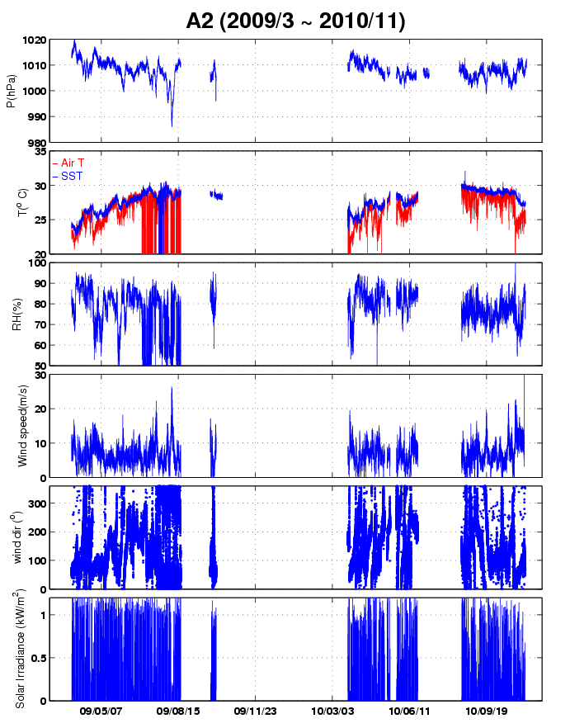
Meteorological Data
Lupit

Slide 4
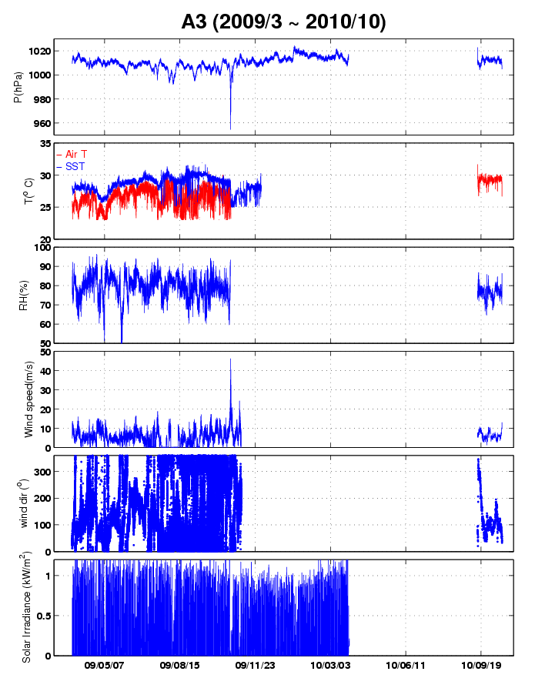
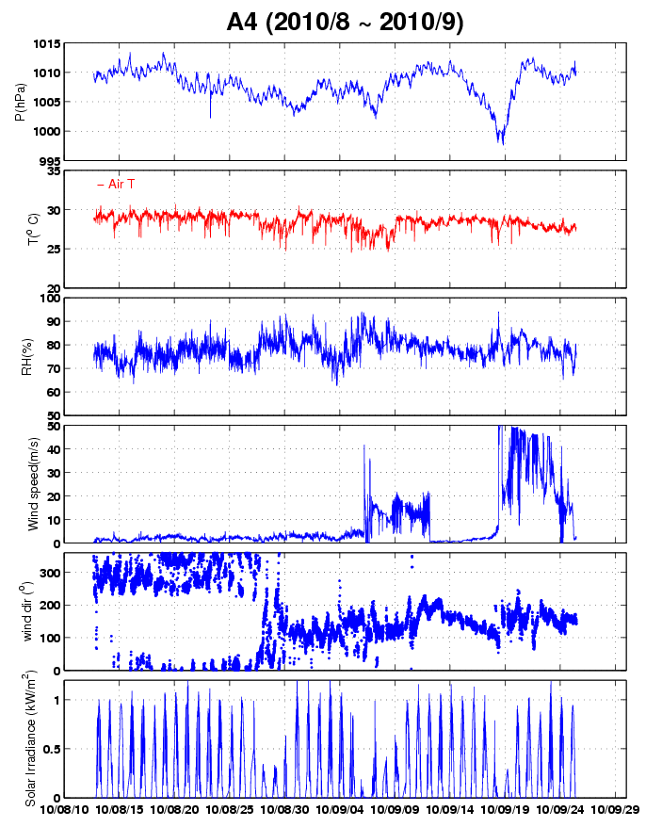
Kompasu
Malou
Fanapi
Morakot
Lupit

Slide 5
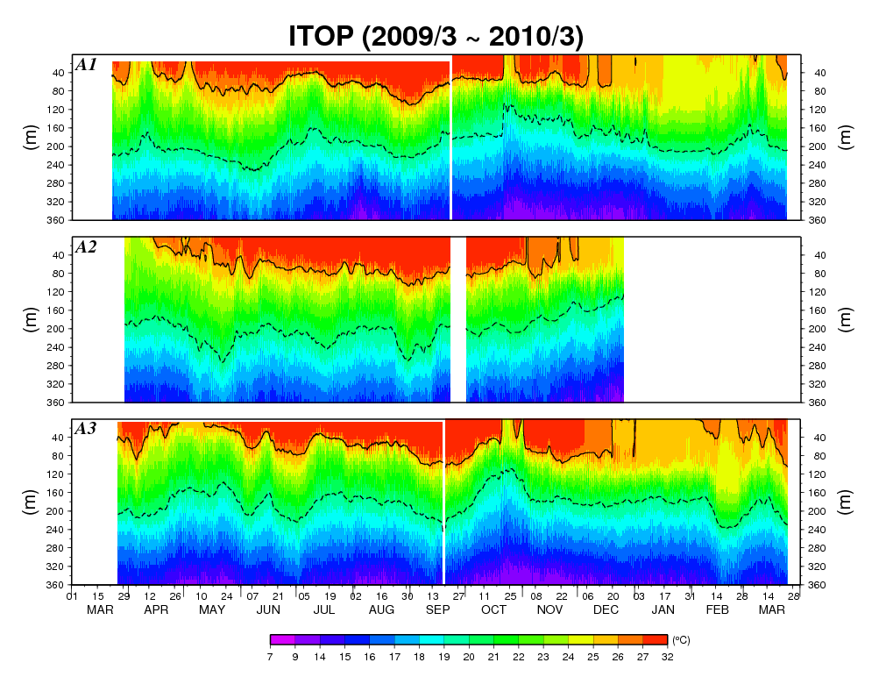
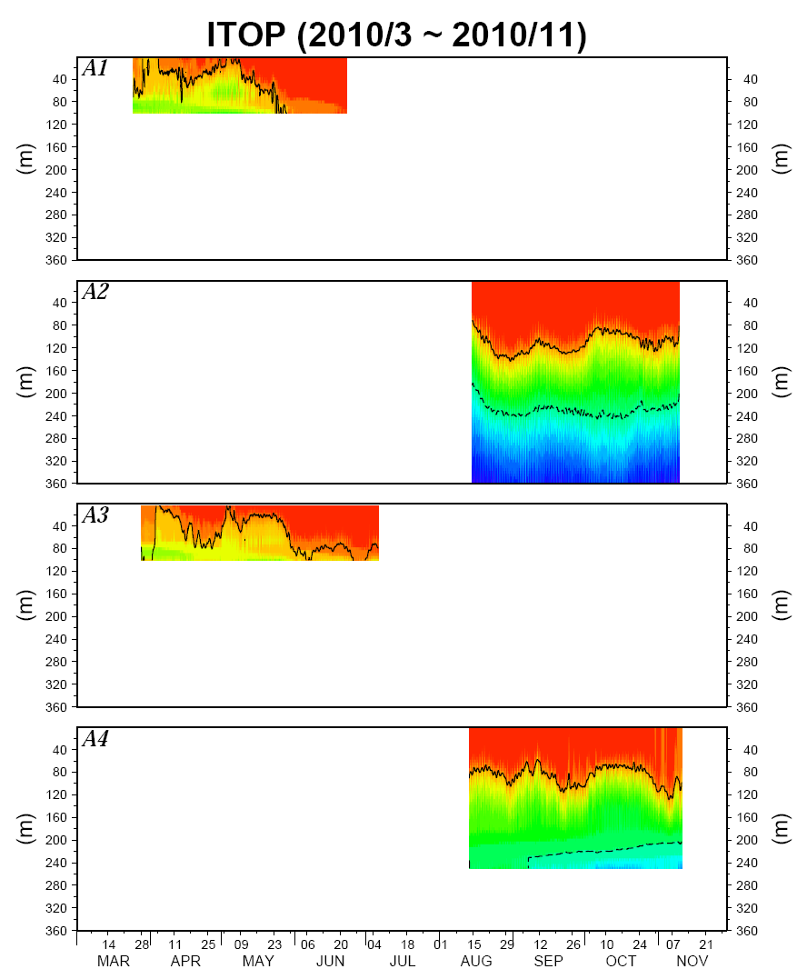
Summary of temperature profile
Primarily charged by TORI
Primarily charged by NTU

Slide 6
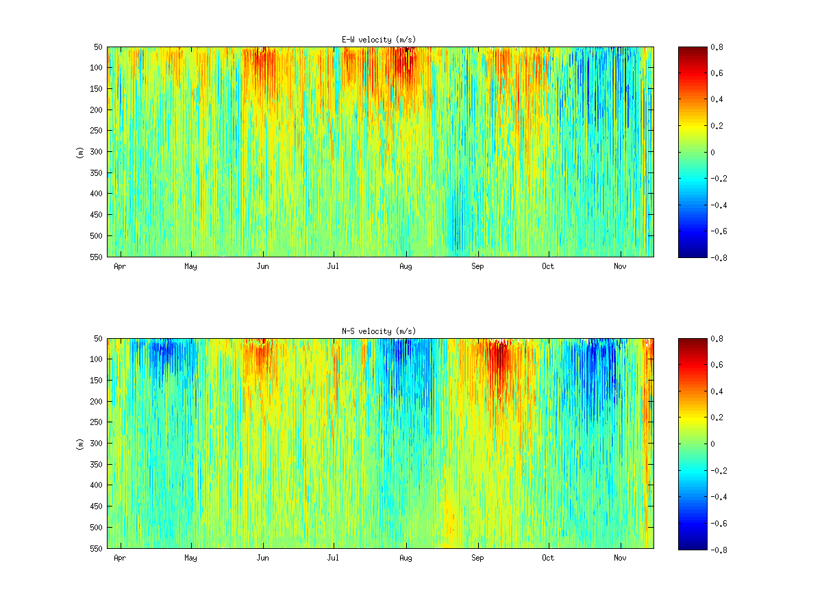
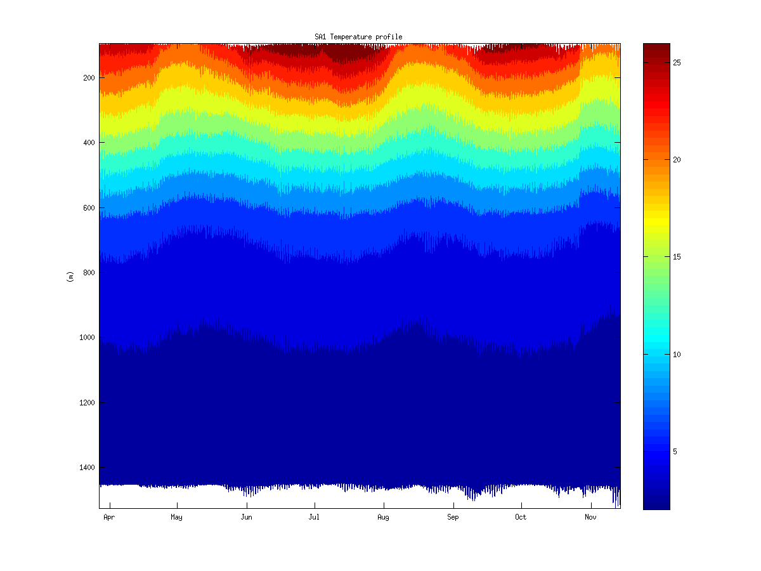
SA1 temperature & velocity profile
(UW)
E-W Velocity (m/s)
Temperature
N-S Velocity (m/s)

Slide 7
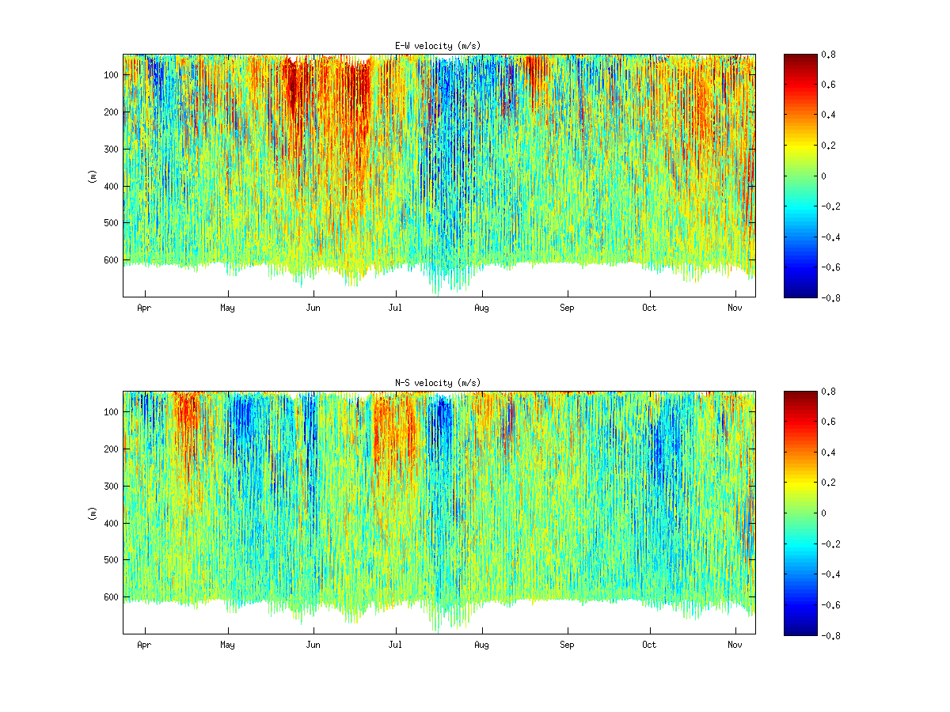
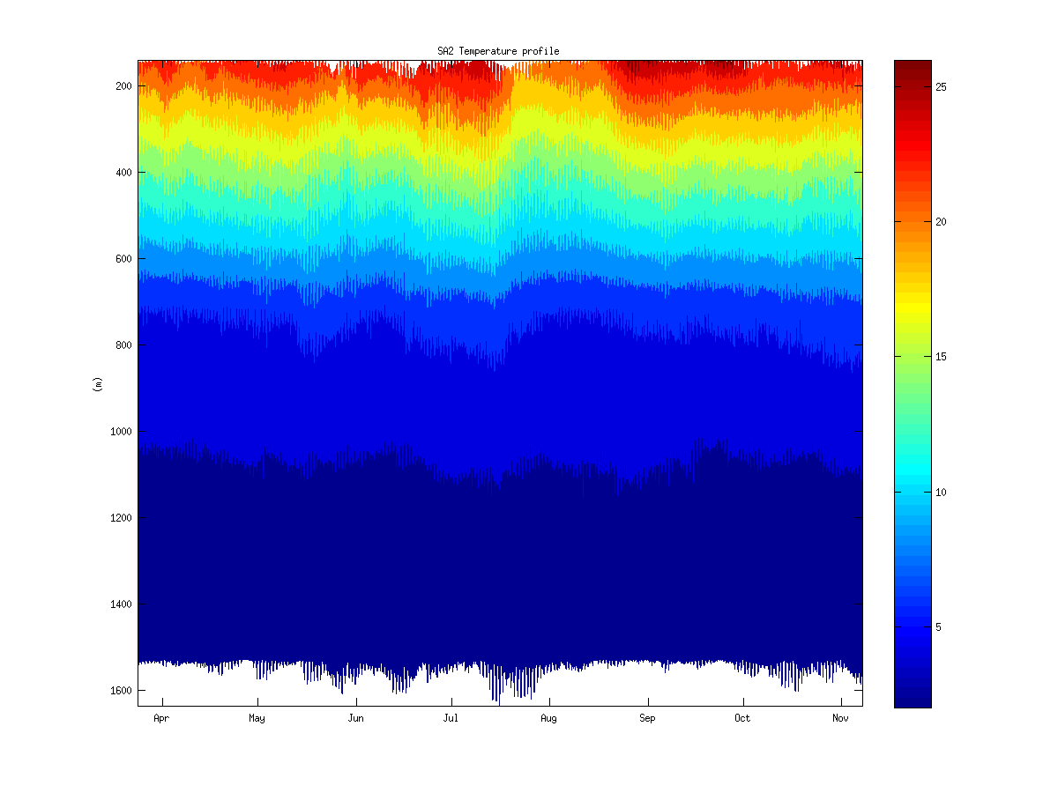
SA2 temperature & velocity profile
(UW)
E-W Velocity (m/s)
Temperature
N-S Velocity (m/s)

Slide 8
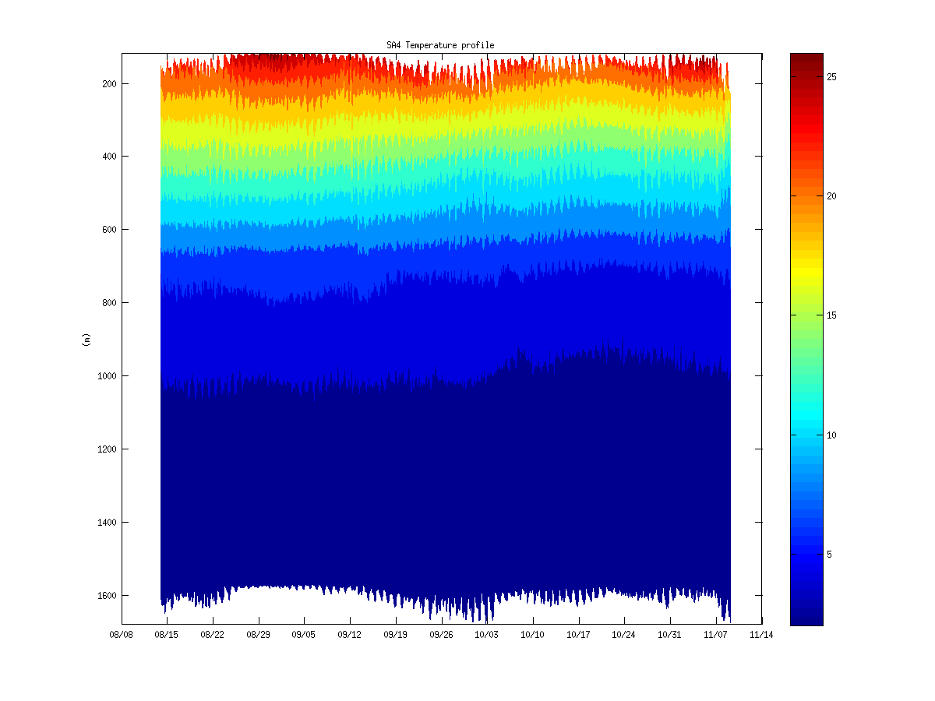
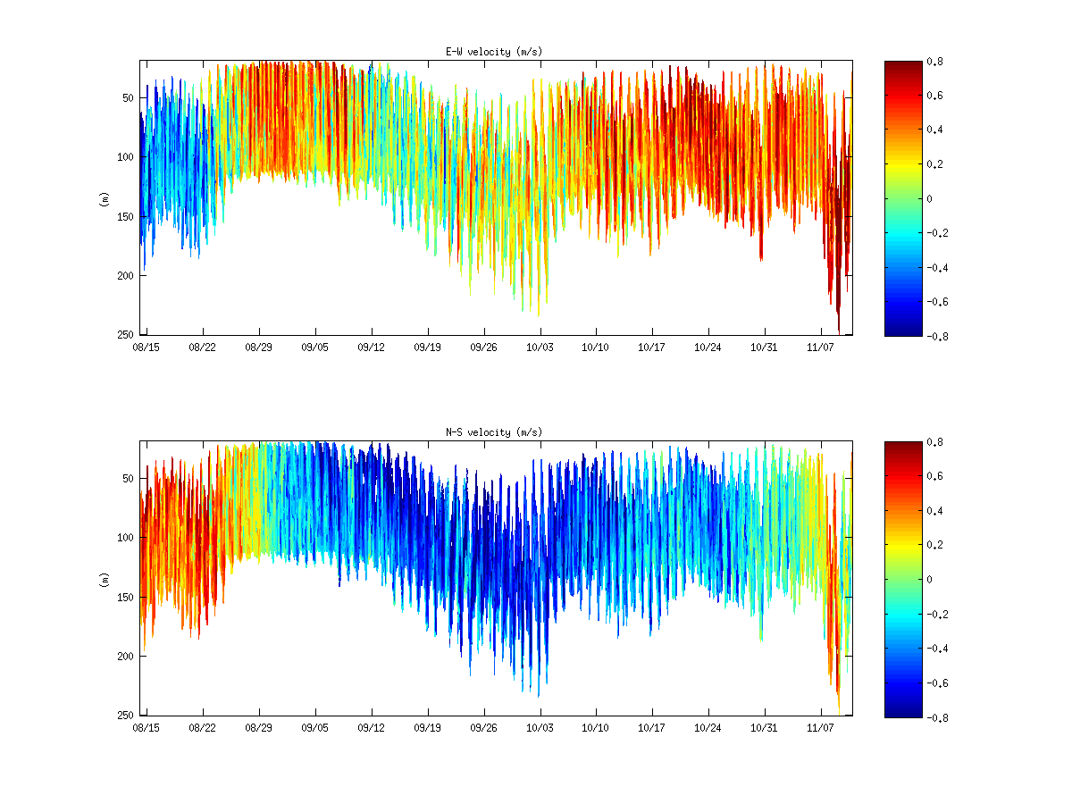
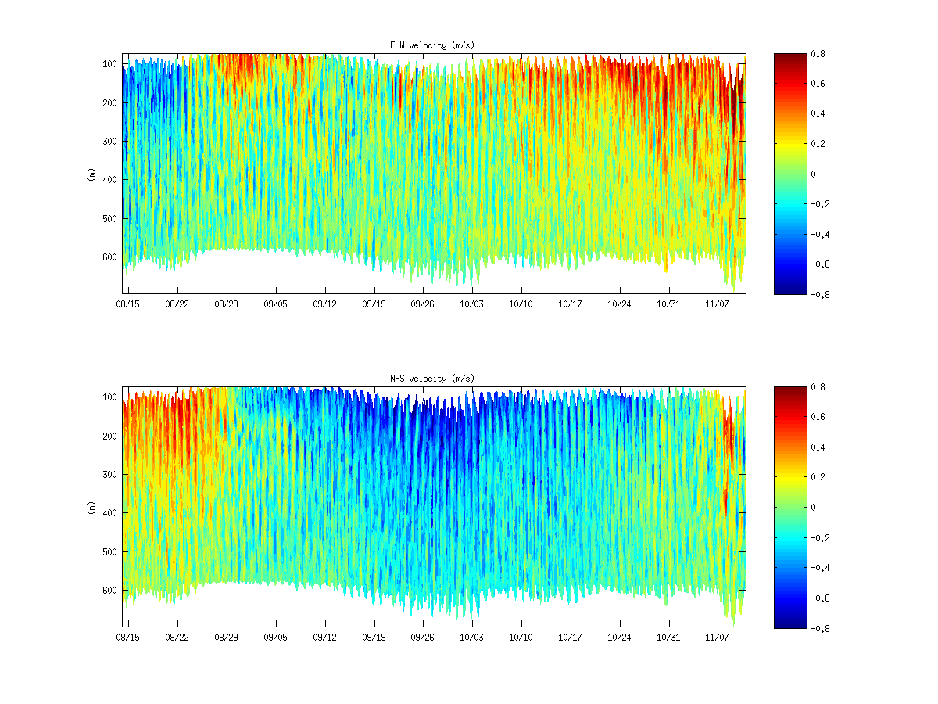
SA4 temperature & velocity profile
(UW)
E-W Velocity (m/s)
E-W Velocity (m/s)
N-S Velocity (m/s)
N-S Velocity (m/s)

Slide 9
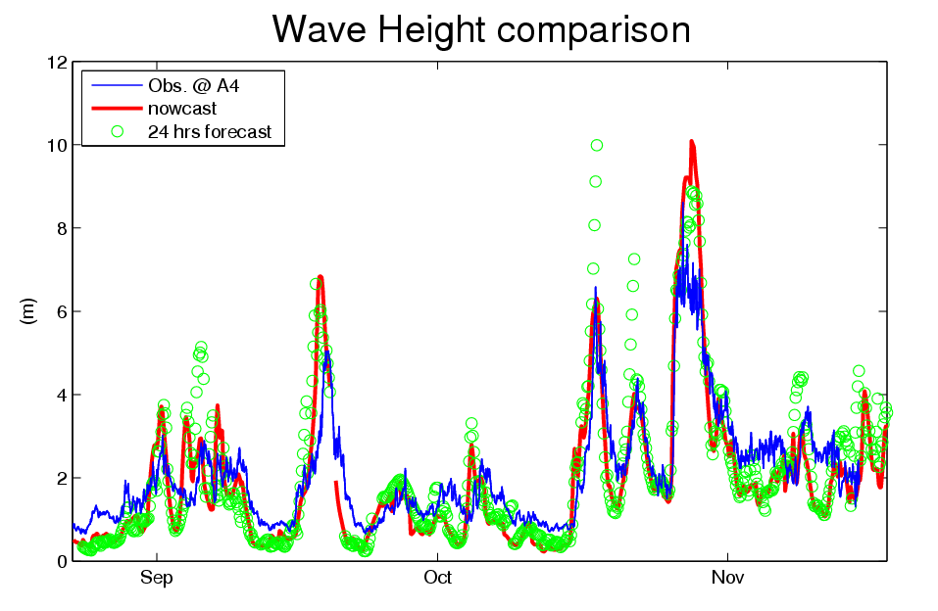
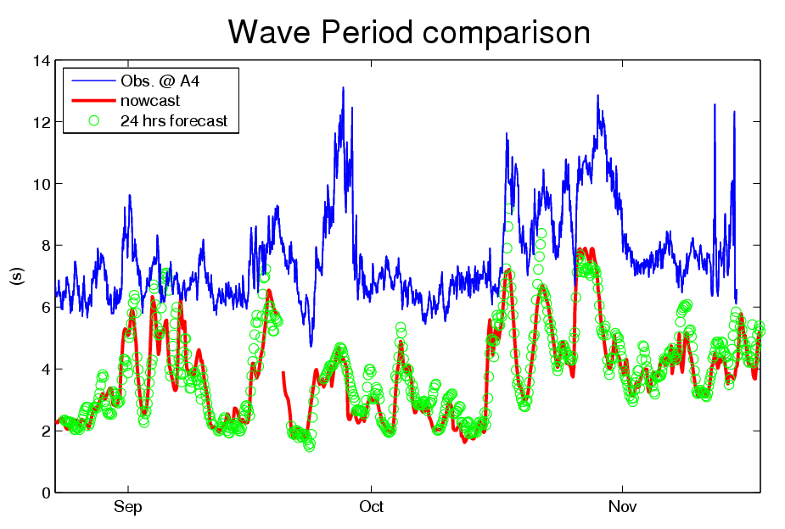
Wave measurement & results from SWAN
(with COAMPS and EASNFS inputs)
Megi
Fanapi
Good agreement in wave height from nowcast and 24-hrs forecast.
Underestimate in wave period.

Slide 10
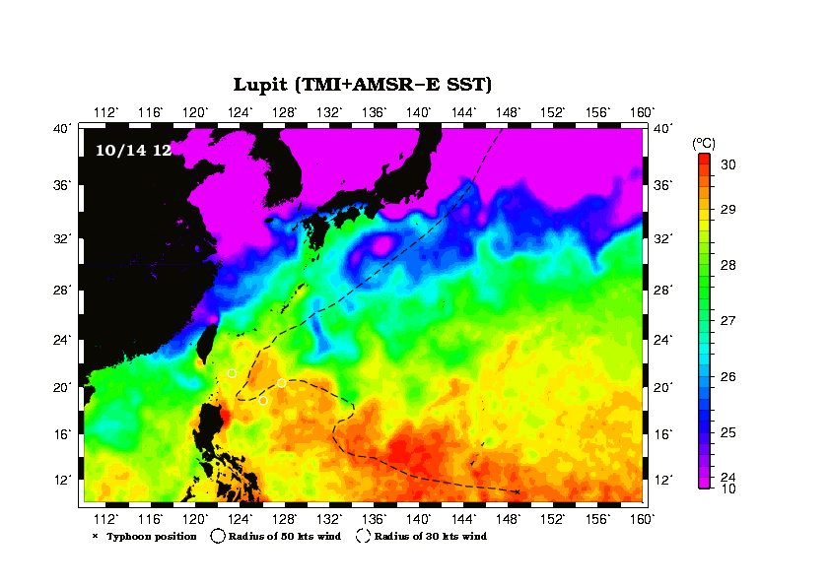
Case study – Lupit (2009)

Slide 11
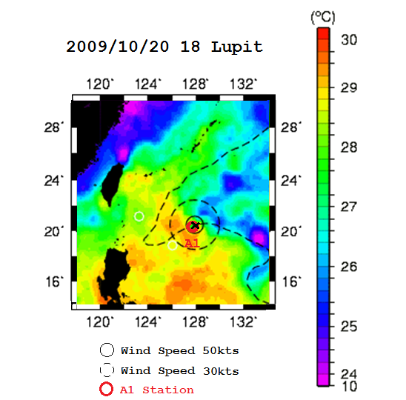
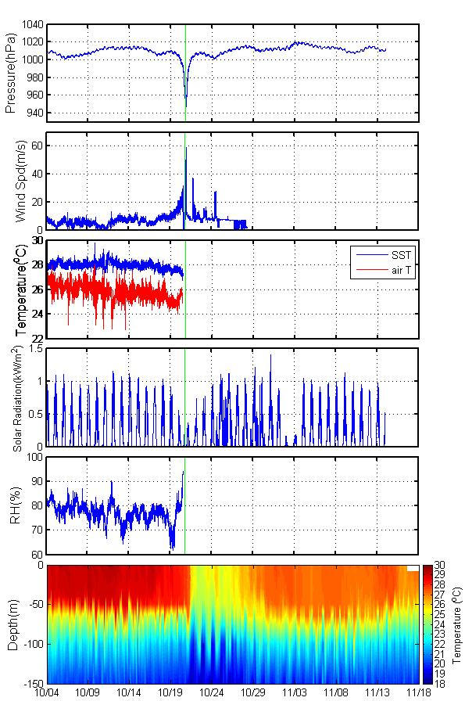
A1: under the eye
~942hPa at 10/20 19hr
~59m/s
SST decrease ~1ºC
Solar heating decline
Max Wind Speed: 59 m/s
Min Air Pressure: 942 hPa
SST dropped about 1ºC when typhoon passed by
SST dropped 5ºC in total after typhoon
Cooling lasted for 10 days
~95%
Strong upwelling
and inertial response
Cooling about 5ºC from 29º to 24º

Slide 12
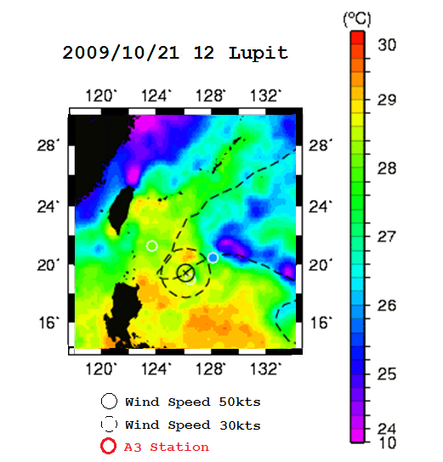
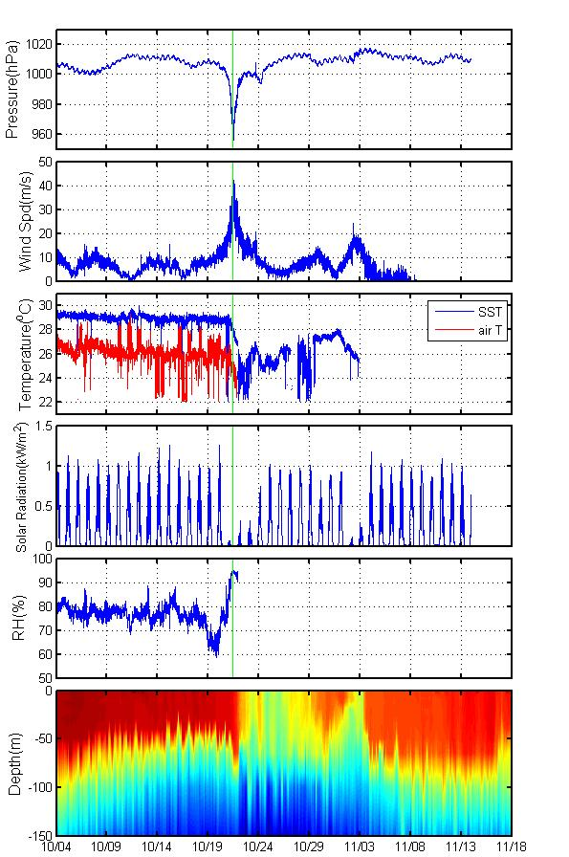

A3: left of eye
~955 hPa at 10/21 11hr
~46m/s
SST decrease ~4ºC
Solar heating decline
Max Wind Speed: 46.14 m/s
Min Air Pressure: 955 hPa
SST dropped about 6ºC in total
Cooling lasted 9 days
~95%
Strong upwelling
and inertial response
Cooling about 6 ° C from 29 to 23

Slide 13
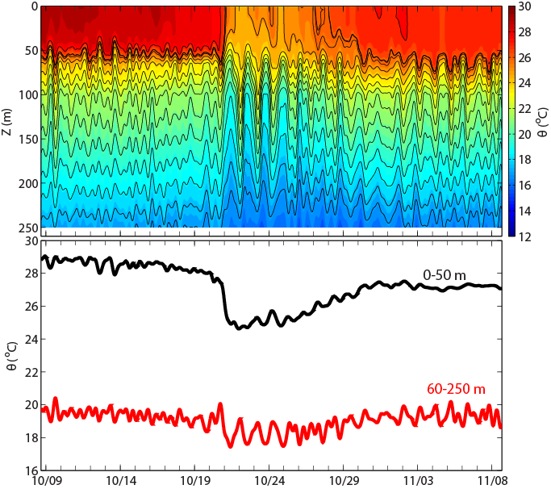
Upper and Deep Ocean Response and Recovery
Response
Deep Ocean:
Cooled by Upwelling with Inertial Waves Response
Recovery
Upper Ocean: ~ 10 days
Deep Ocean:
Upwelling ~ 10 days
Inertial Waves > 10 days and propagating
~ 10 days
Upwelling and inertial waves

Slide 14
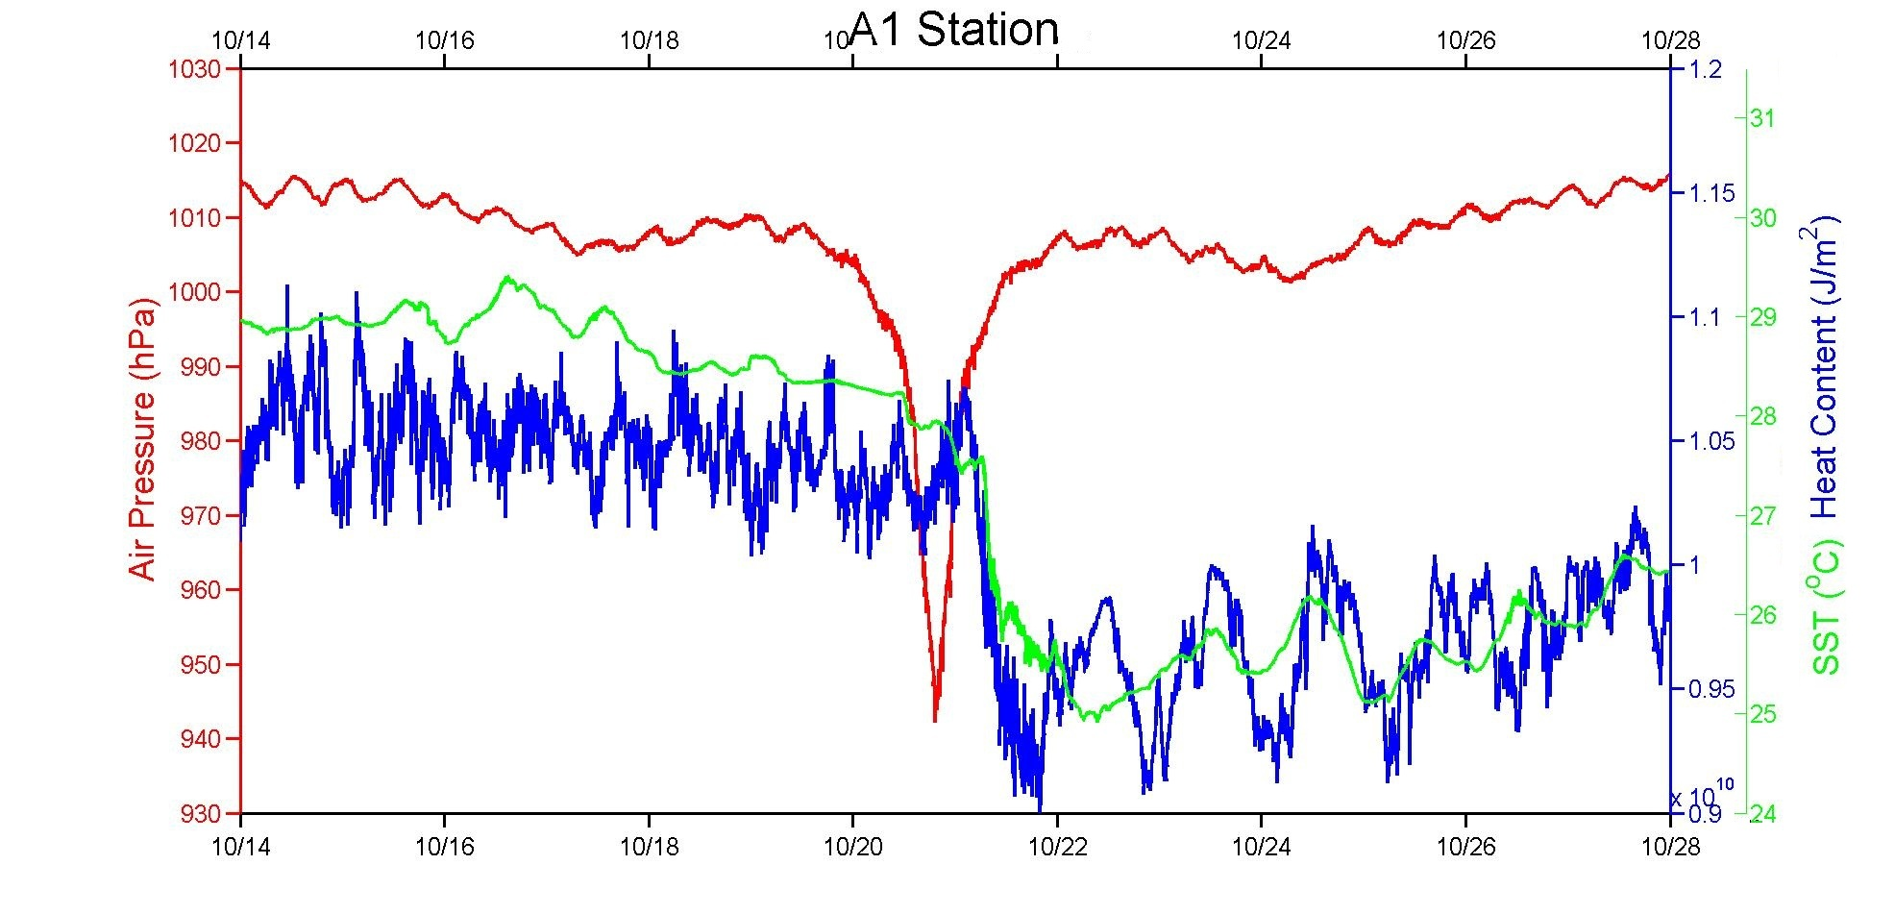
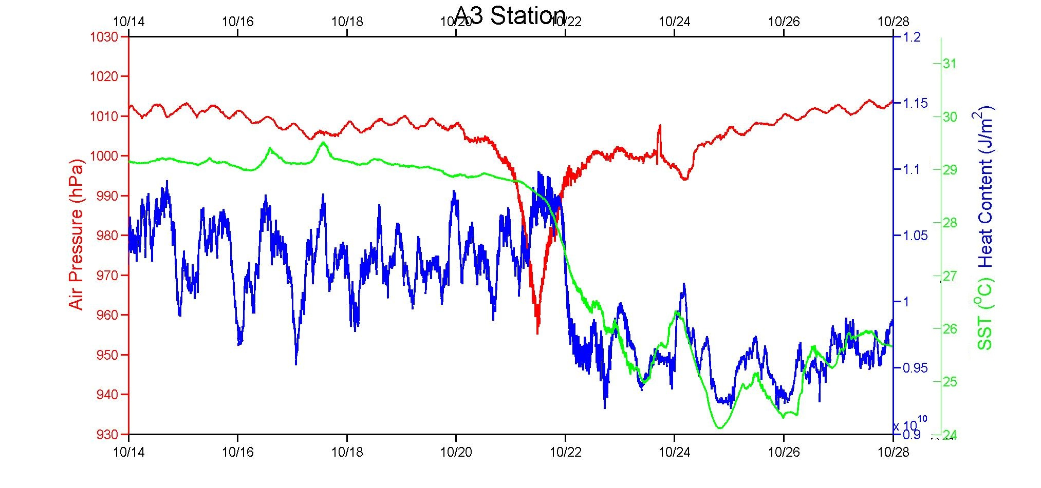
Heat Content
(1~100m)
34.4hr
(1~100m)
36.9hr

Slide 15
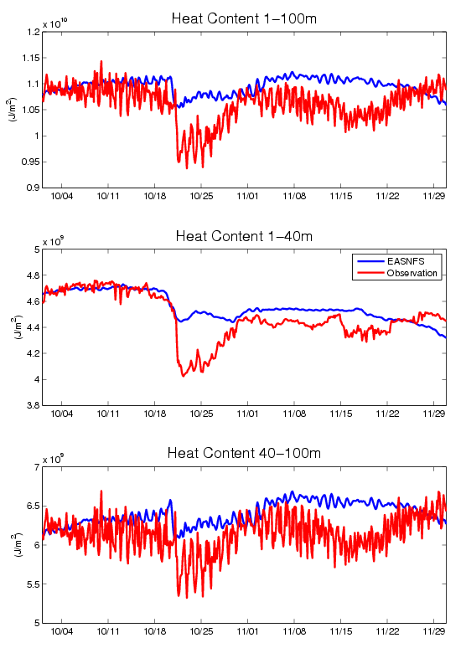
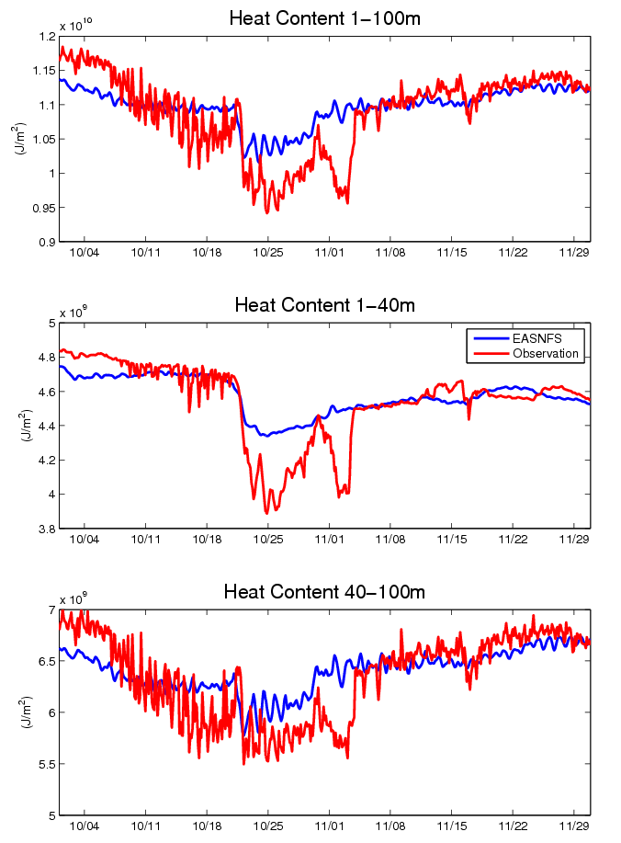
A1
A3

Slide 16
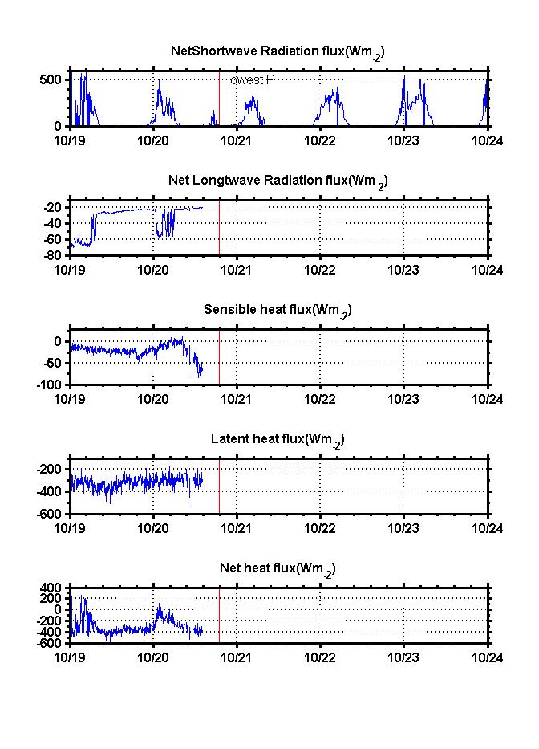
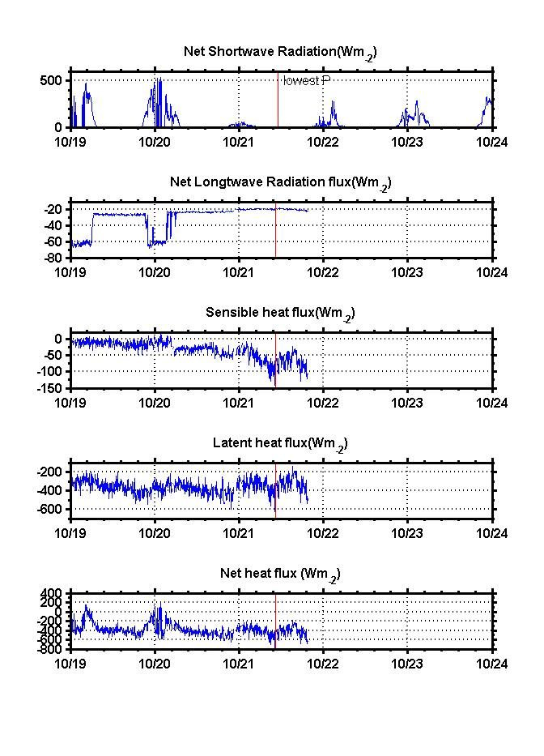
A1
Lowest Air Pressure
A3
Lowest Air Pressure
Net Shortwave Radiation (Wm-2 ) : decreases to 0 Wm-2
Net Shortwave Radiation (Wm-2 ) : almost decreases to 0 Wm⁻²
Net Longwave Radiation (Wm-2 )
Net Longwave Radiation (Wm-2 ) : near zero
Sensible Heat Flux (Wm-2 )
Sensible Heat Flux (Wm-2 )
Latent Heat Flux (Wm-2 )
Latent Heat Flux (Wm-2 ) : releases into the atmosphere
Net Heat Flux (Wm-2 ) : Net heat flux <0, ocean offer heat to atmosphere, cooling the ocean.
Net Heat Flux (Wm-2 )

Slide 17
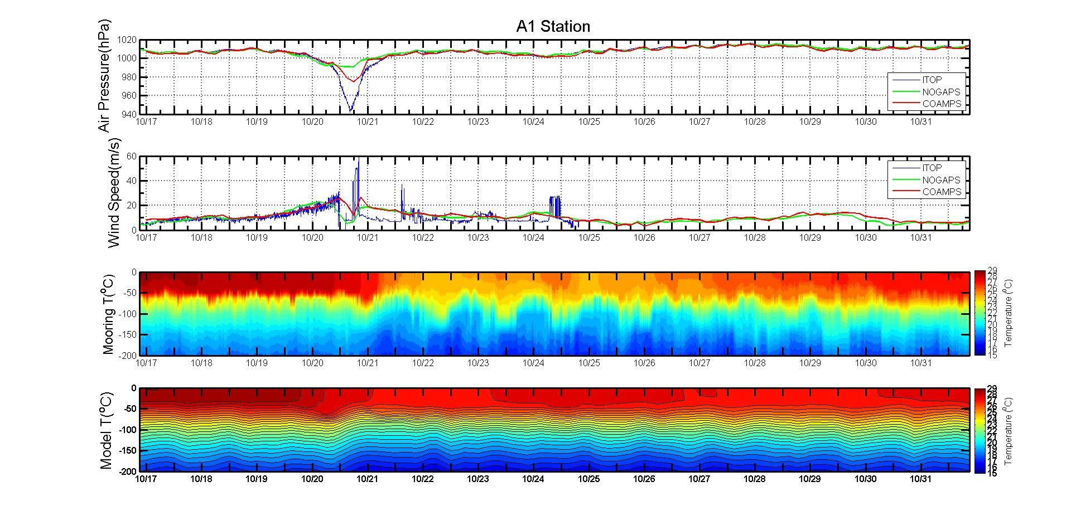
Comparison between field data and model: A1
Naval Research Laboratory, Dong-Shan Ko

Slide 18
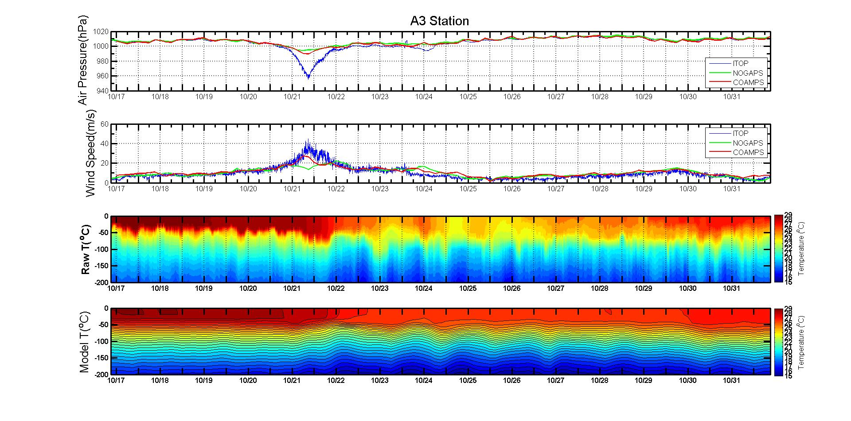
Comparison between field data and model: A3
Naval Research Laboratory, Dong-Shan Ko

Slide 19
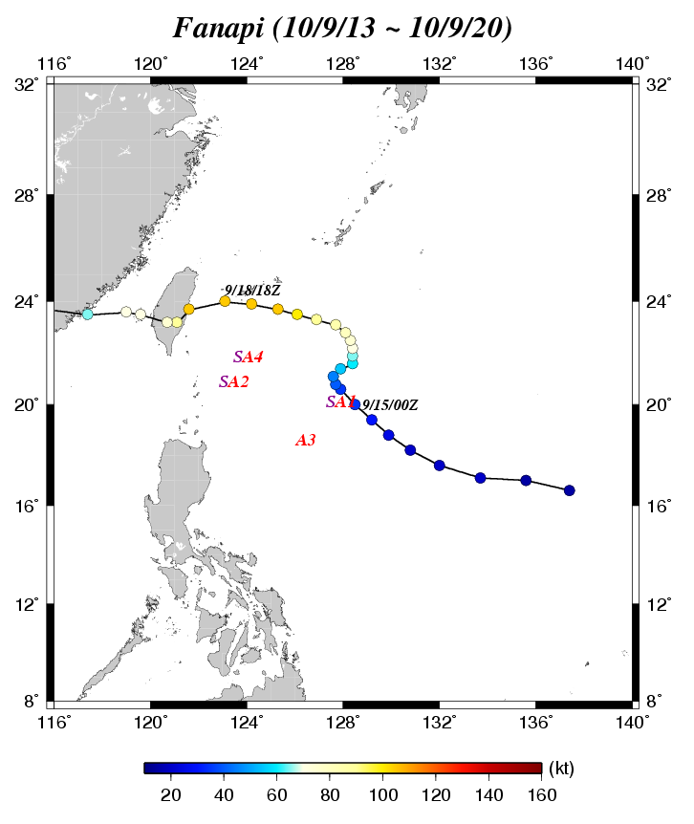

Slide 20
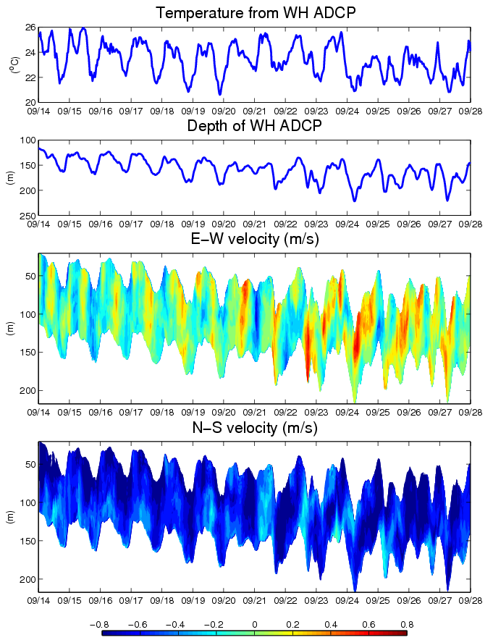
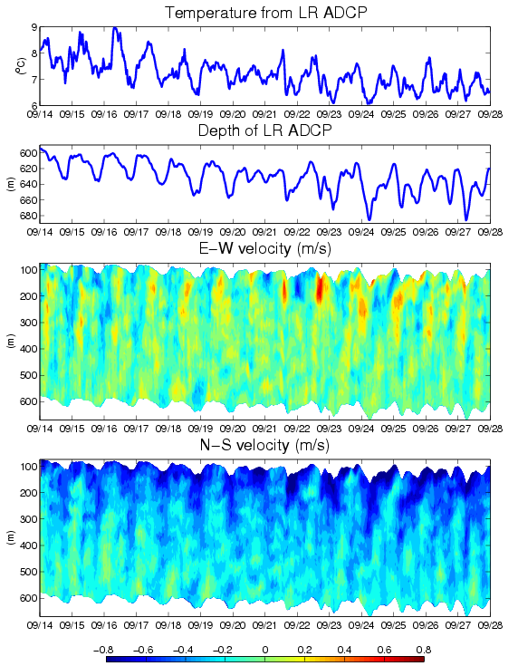
SA4

Slide 21

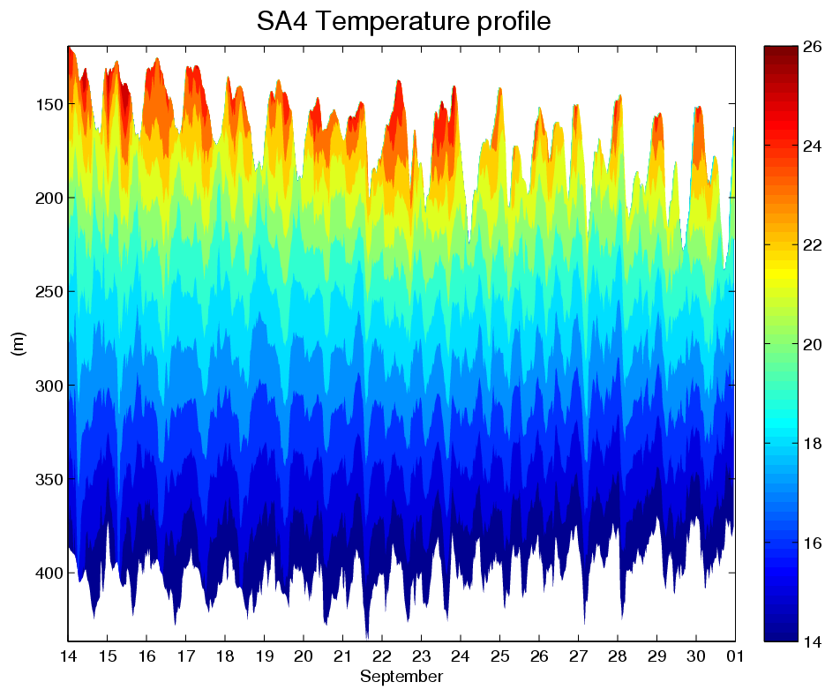

Slide 22
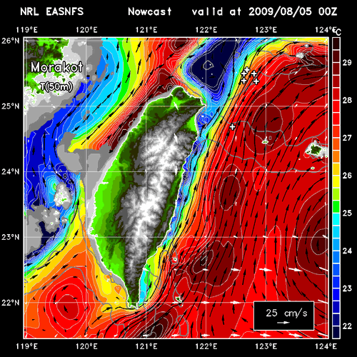
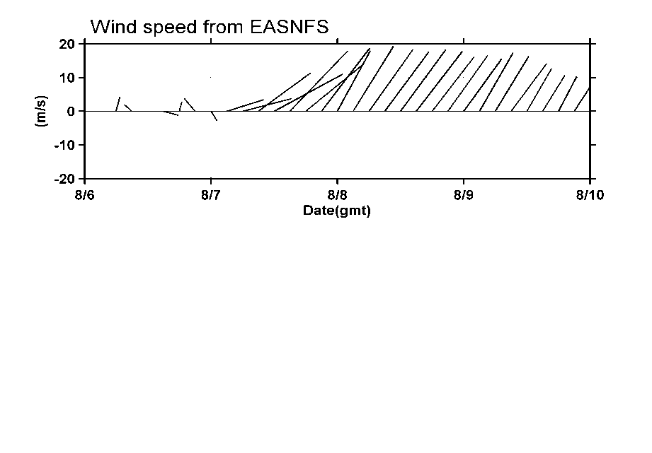
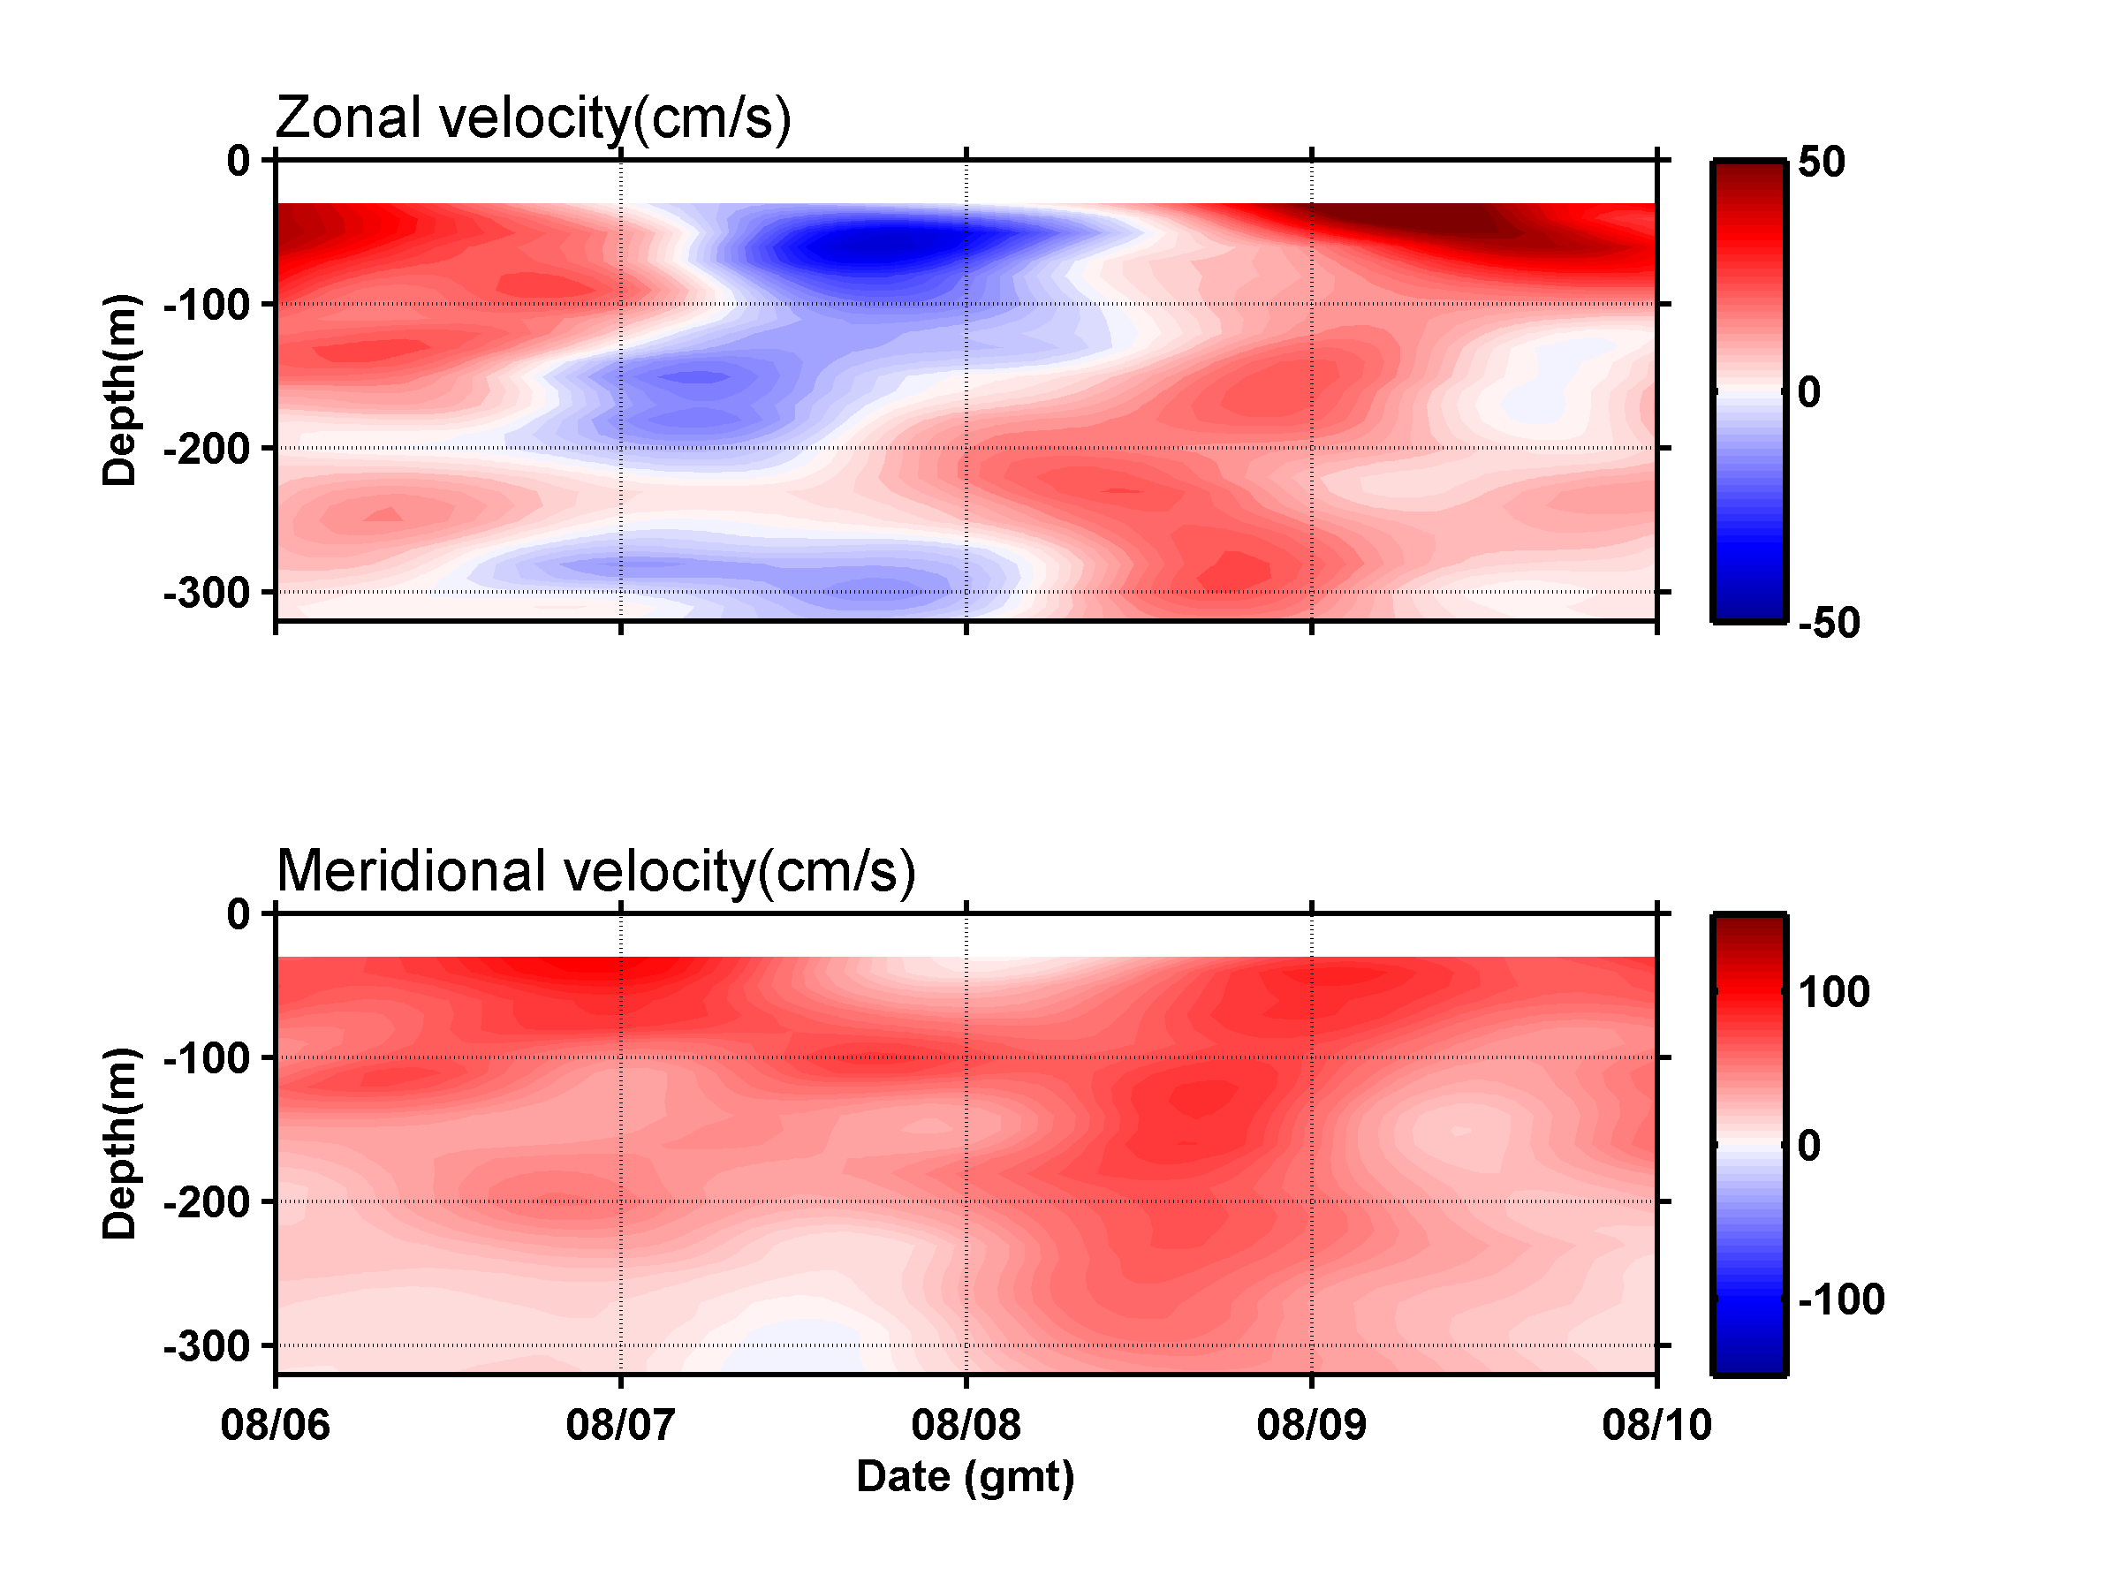
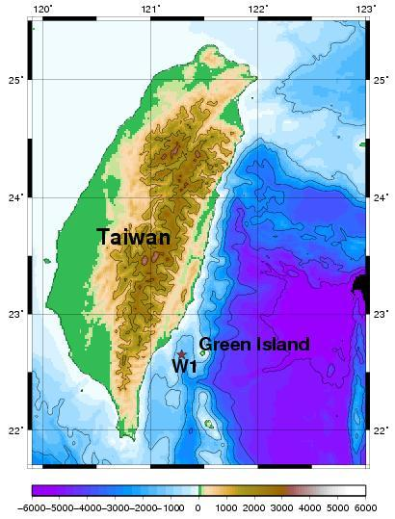
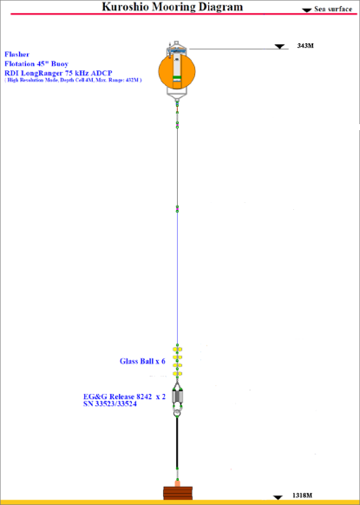
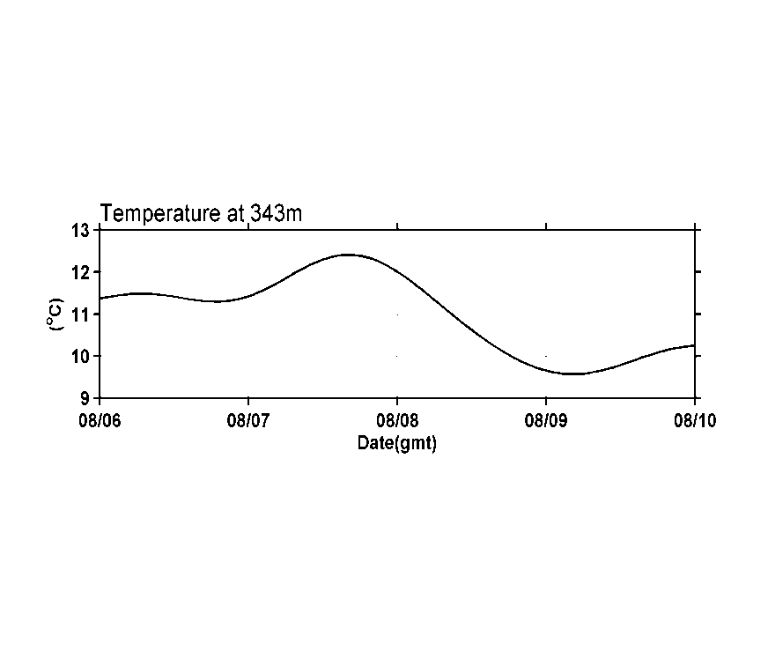
Head-wind Kuroshio from Morakot
The observed head-wind current could relate with the cold-eddy SE of Taiwan.
Wind speed from COAMPS
(1) A head- wind current(westward current) was observed.
(2) Northward current disappeared in
upper 50m, then re-appeared and
extended downward.
(3) Temperature at 343m increased at
first , then decreased.
N
(1)
E
(2)
(3)
Provided by Dong-Shan Ko and Ying-Han Liao

Slide 23
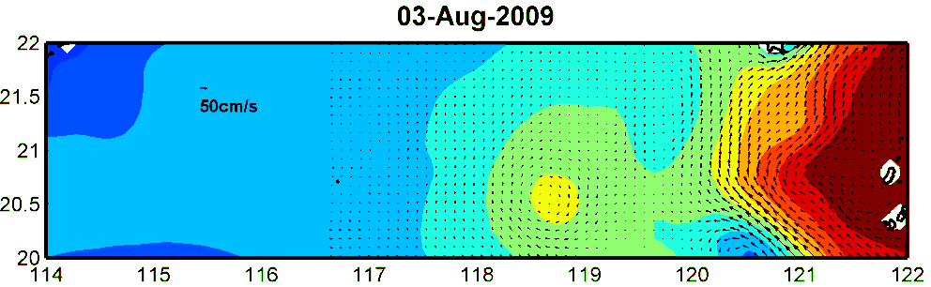
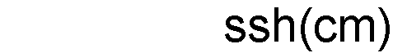
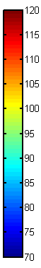
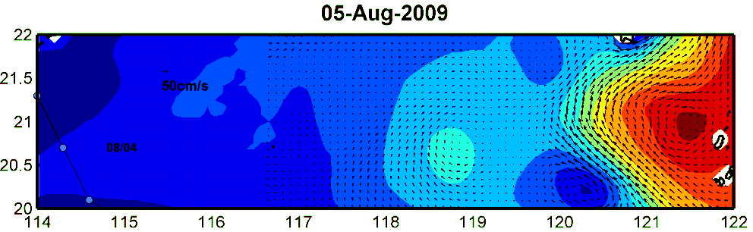
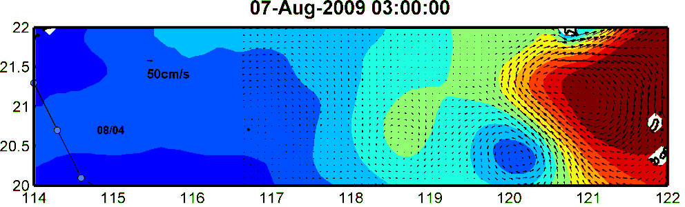
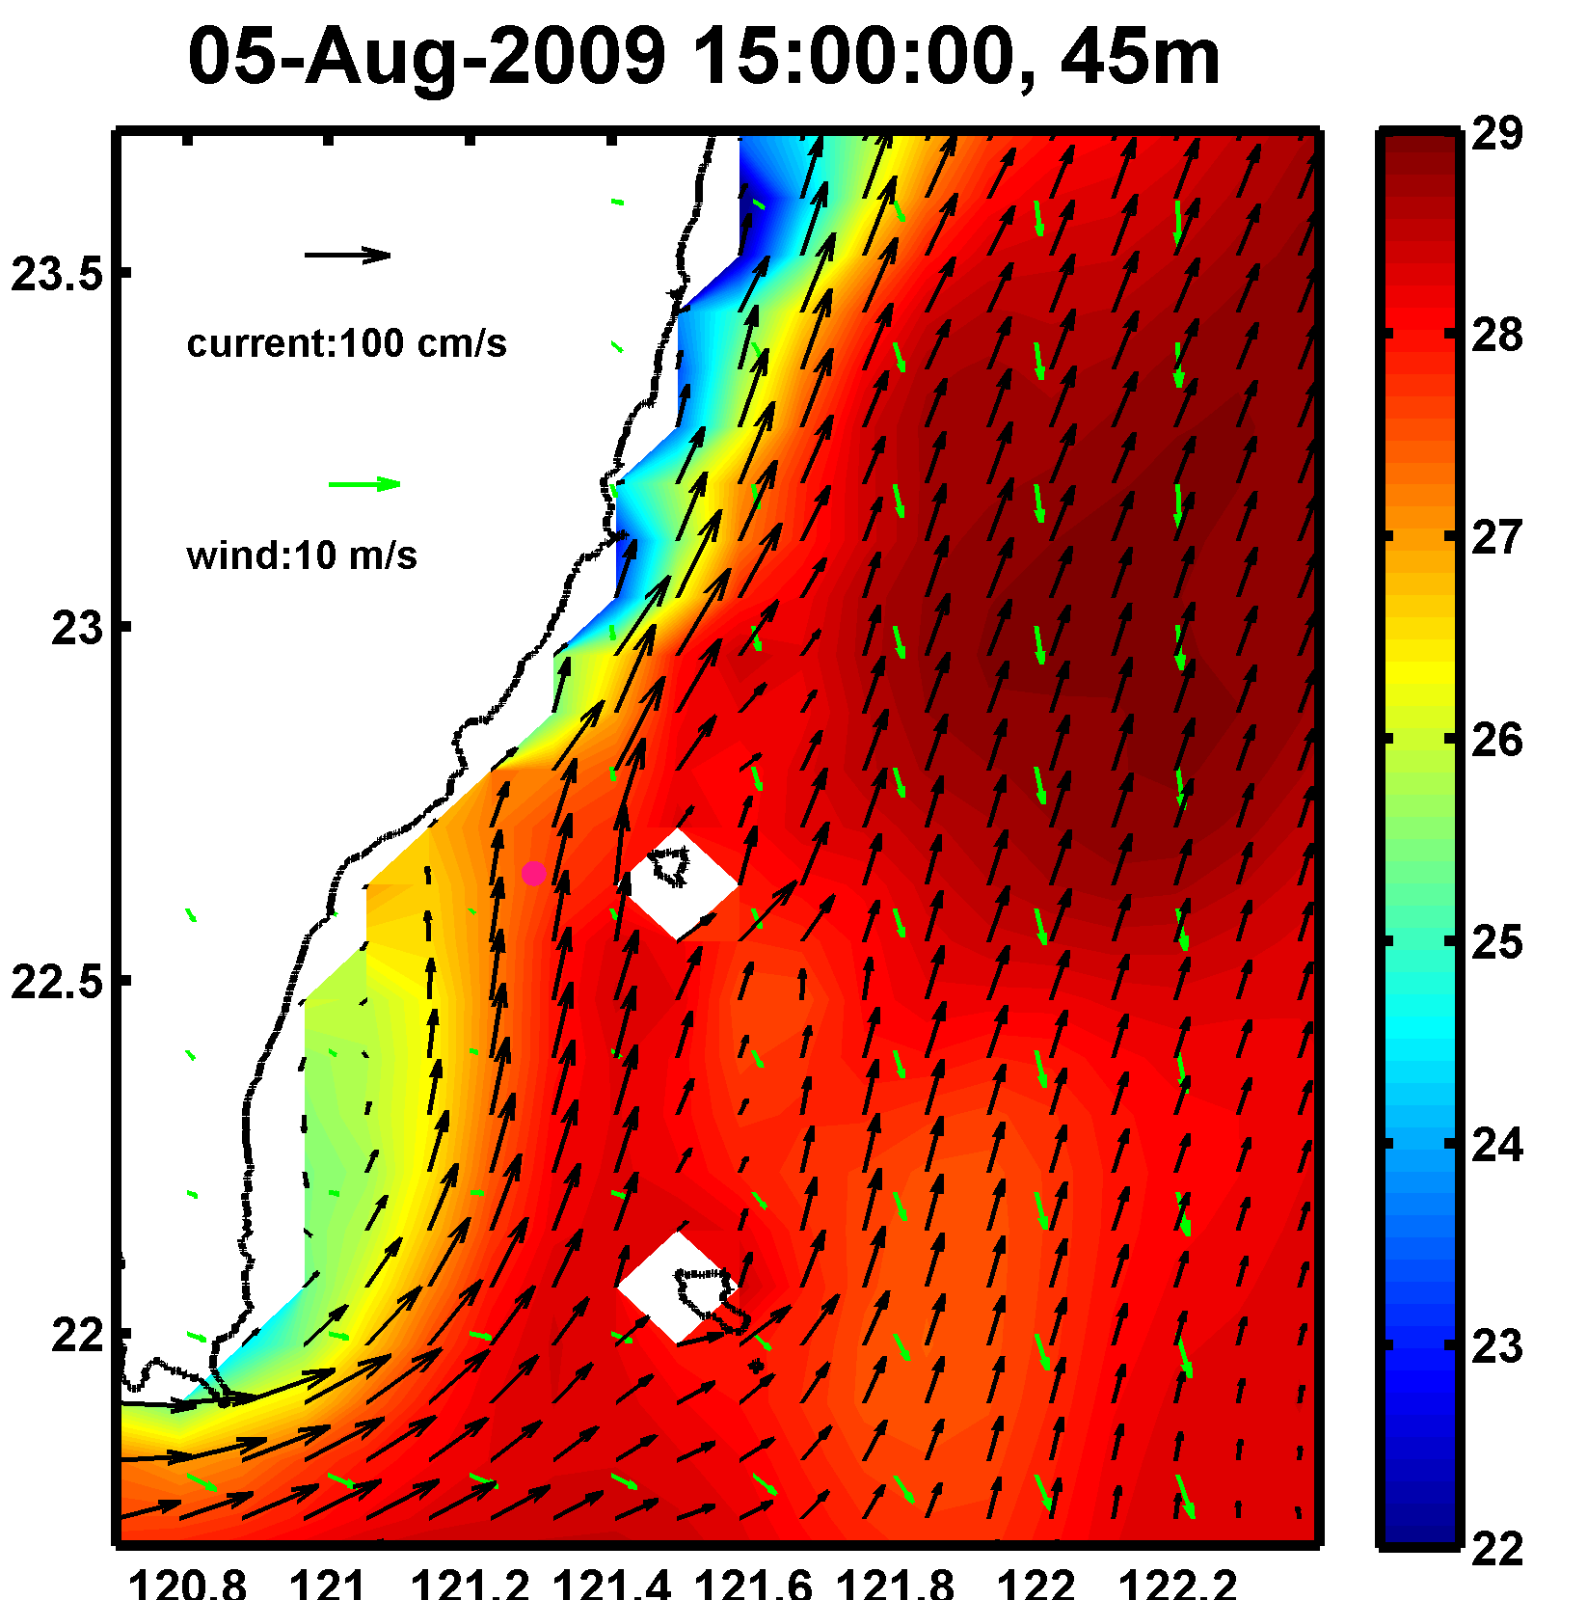
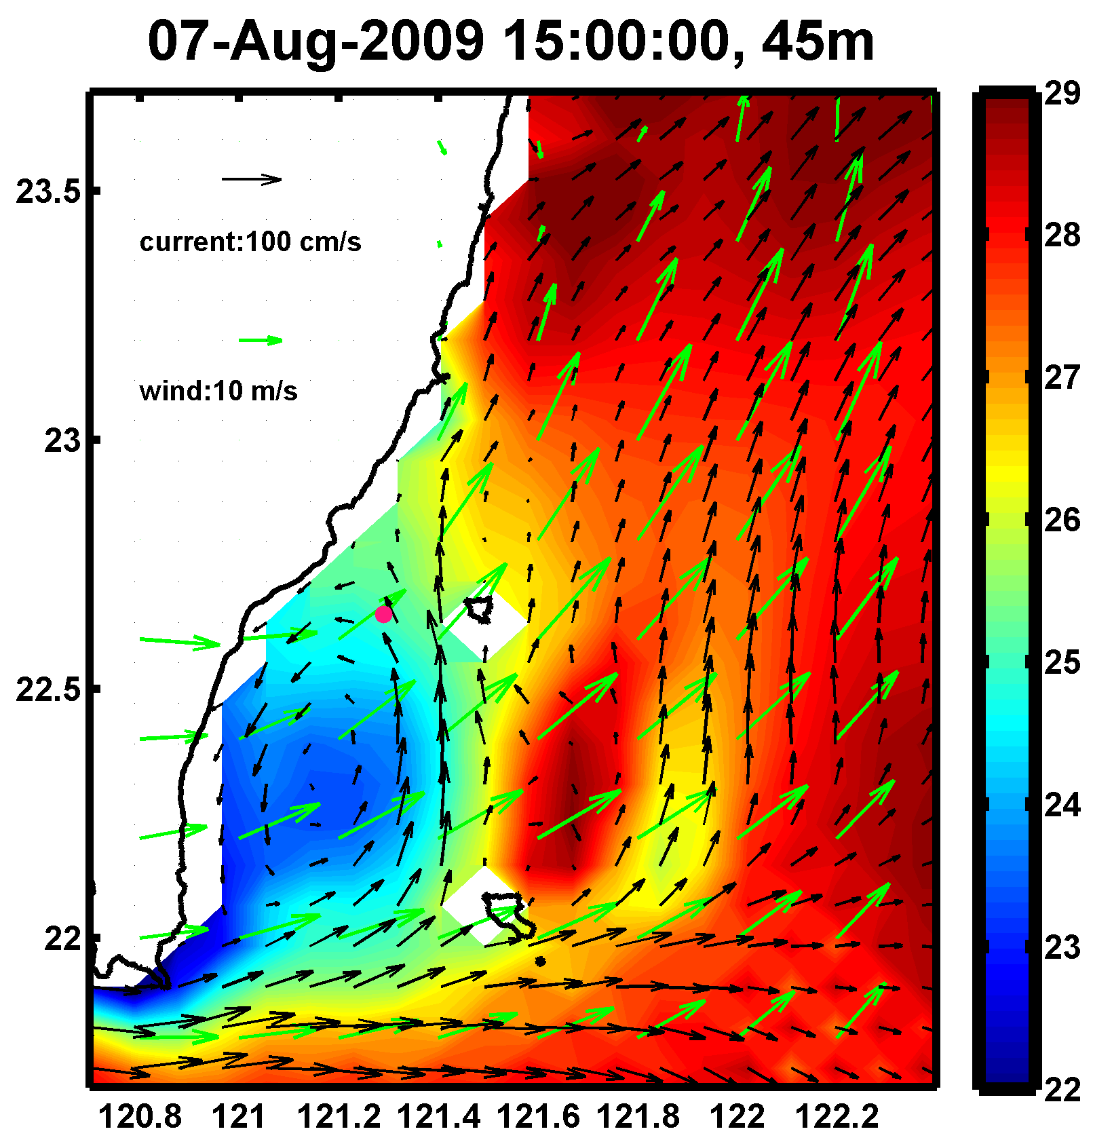
Head-wind current(cold eddy)
Ekman transport induced by Goni
lowered the sea surface height and
enhansed the anti-cyclonic meander
of Kuroshio, producing the strong
outflow (eastward current) south of Taiwan.
Kuroshio SE of Taiwan moved
eastward , meanwhile ,cold eddy
appeared.
Strong westerly wind caused by
Morakot south of Taiwan strengthened eastward current
Eastward current interacted with
two islands ,cold eddy expanded.
Provided by Dong-Shan Ko and Ying-Han Liao

Slide 24
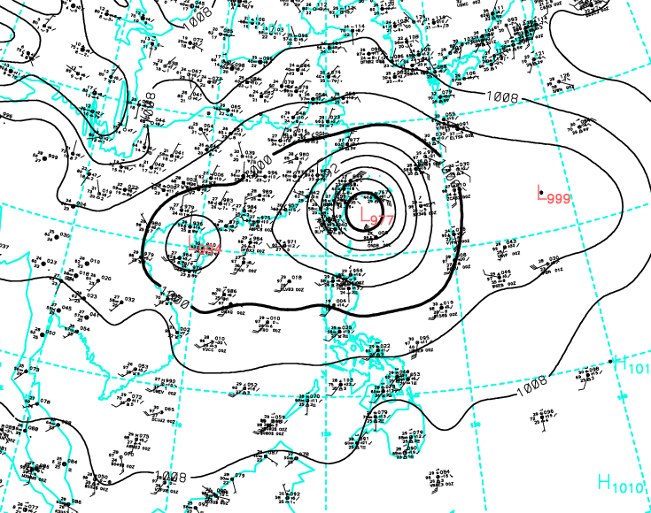















Similar track with Goni
Similar track with Morakot
Typhoon | Landing on Taiwan | Cold-core eddy SE of Taiwan
Morakot (typhoon) | 2009/8/7 | 2009/8/5
Haitung (super typhoon) | 2005/7/18 | 2005/7/18
Tailim (super typhoon) | 2005/8/31 | 2005/9/1
Fungwong (typhoon) | 2008/7/28 | 2008/7/28
Archives from EASNFS shows the similar tracks with typhoon Morakot and tropical depression Goni may induce cold eddy SE of Taiwan.
(Table)An eddy appeared 2 days earlier, than other cases, before Morakot landed on Taiwan.
Cold eddy was formed by the influence of Goni, then strengthened by Morakot.

Slide 25
SUMMARY
We do observe the evolution of oceanic response to the strong typhoon. We learn something meanwhile we know we have more to learn. Cooperation opportunity and suggestion to data analysis are welcome.
Although we don’t have perfect data during ITOP IOP in 2010, we still measure some good typhoon events in 2009, ex, LUPIT. In 2010, we successfully measure the wave field during Typhoon event.
The data description and downloading is available at http://kirin.apl.washington.edu/~itop/mooring_data_summary.html (Thank RC and Barry to build up this site). Please contact Ya-Ting if you need wave data.

