Slide 1
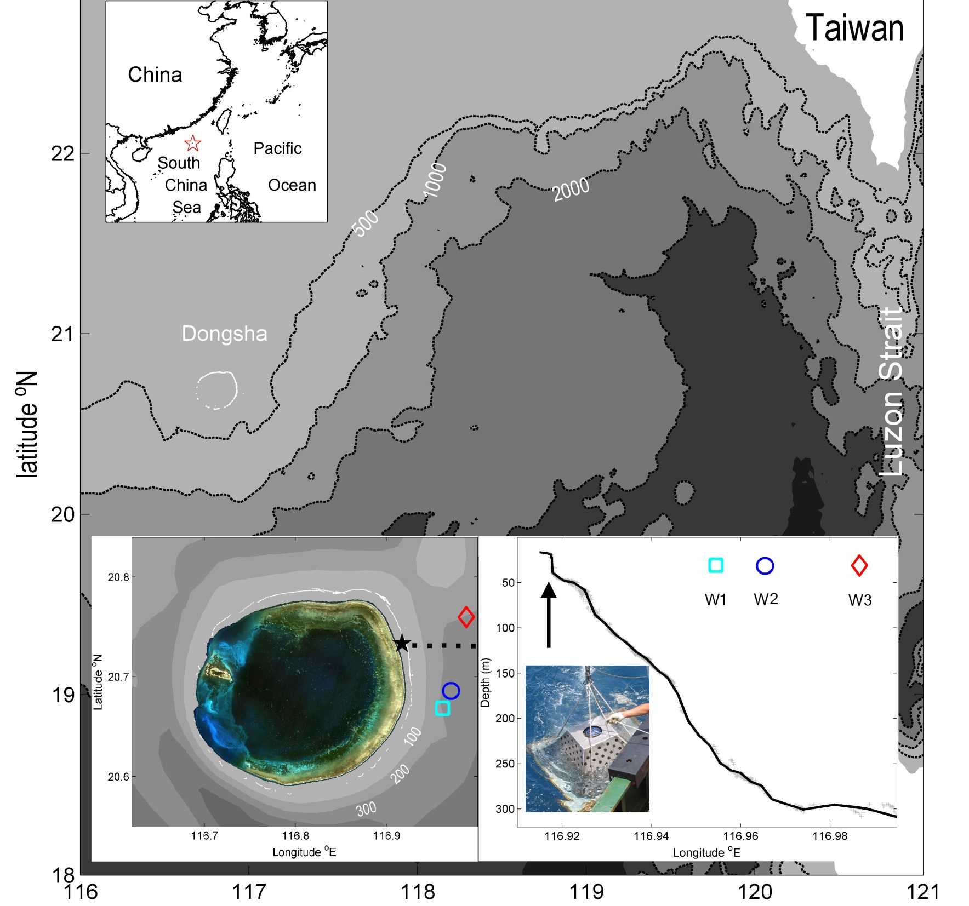
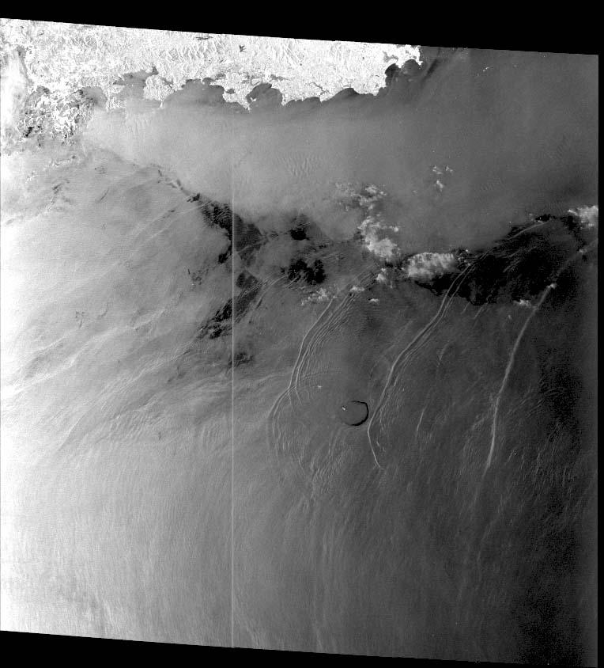
Variations of internal wave surging
east of Dongsha Atoll SCS
YuHuai Wang, IHuan Lee, Louis St. Laurent, Dong-Ping Wang
SantaFe meeting 2011/5/17

Slide 2
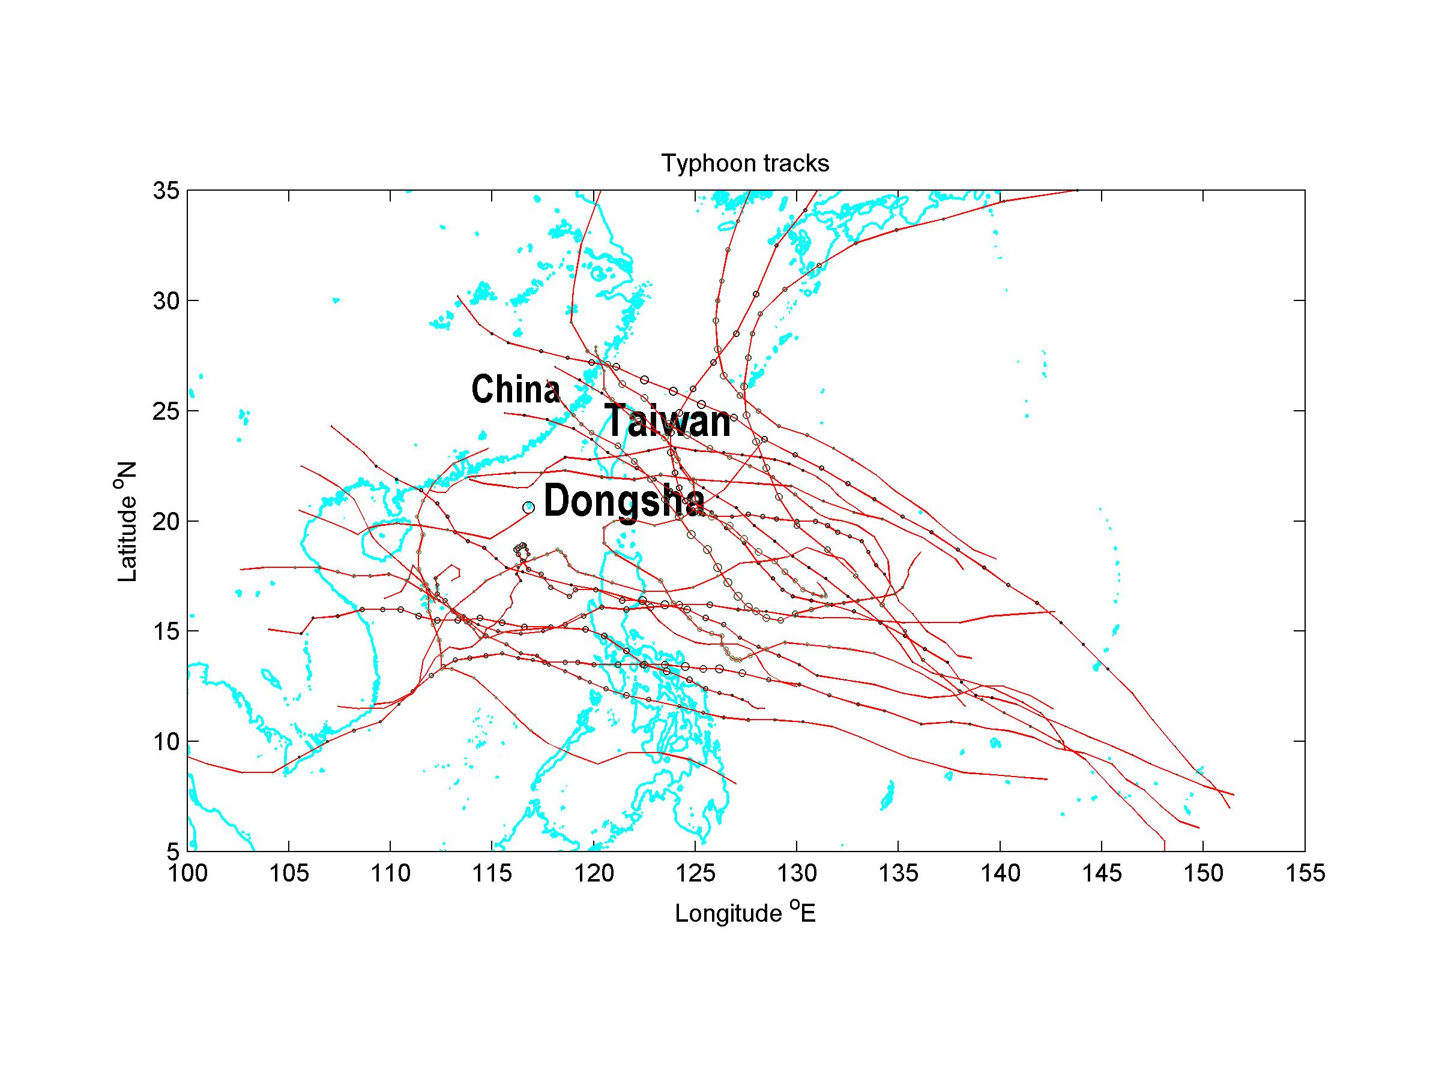
Typhoons 2006.7 ~ 2008.5

Slide 3
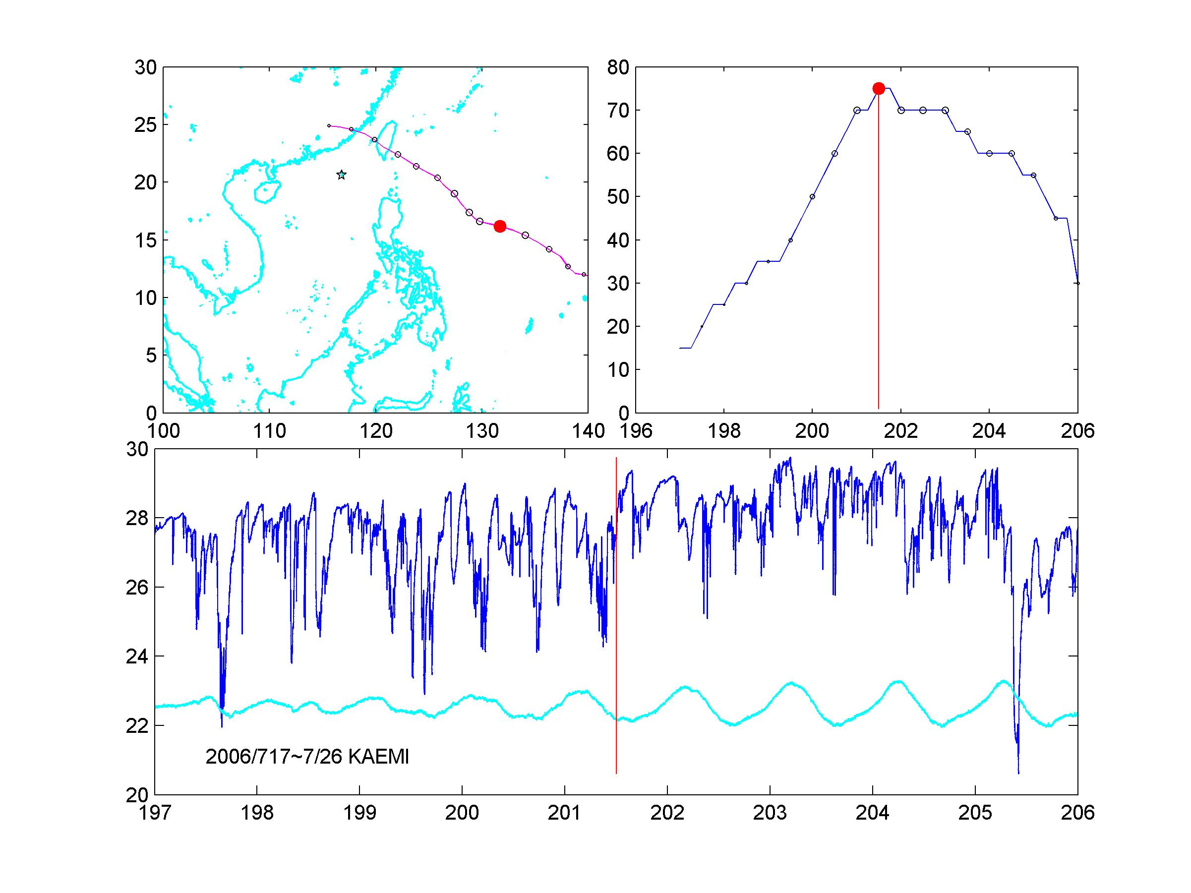

Slide 4
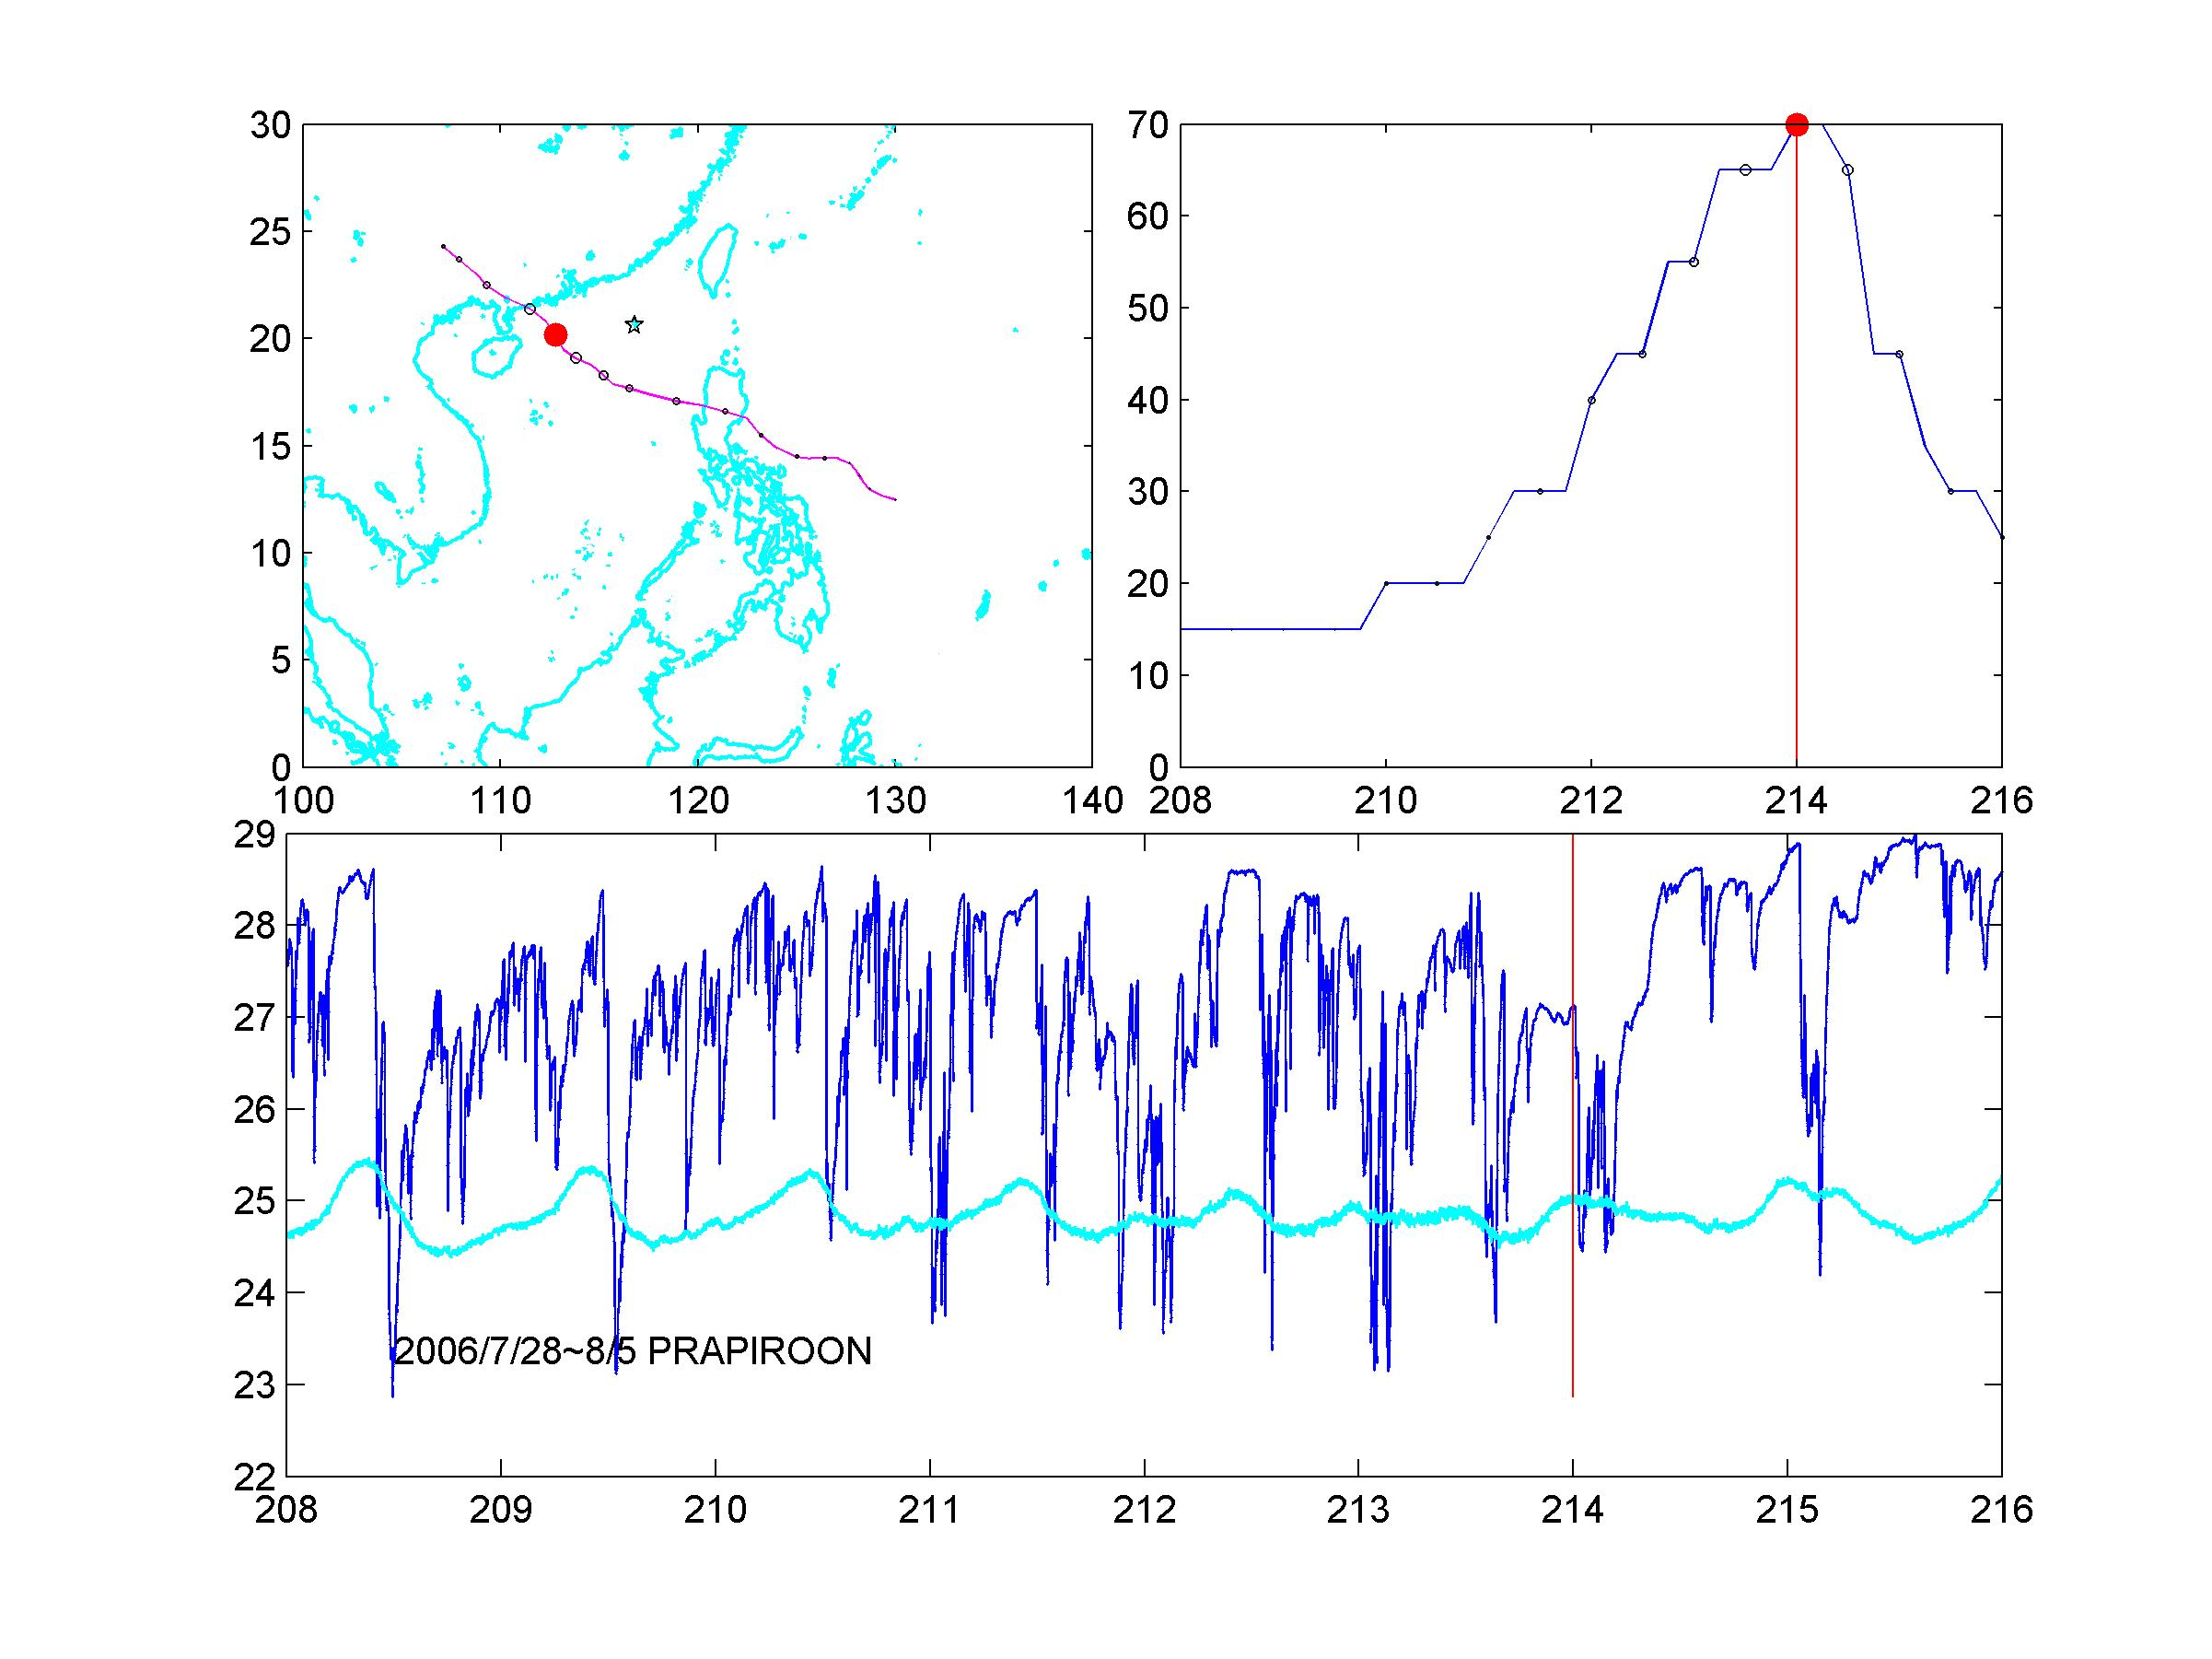

Slide 5
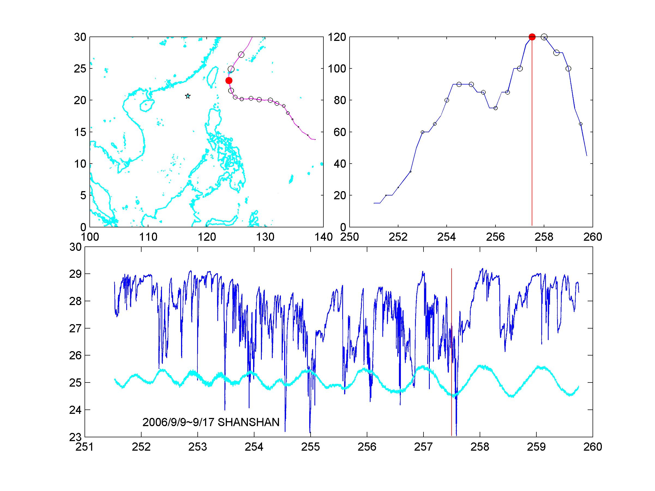

Slide 6
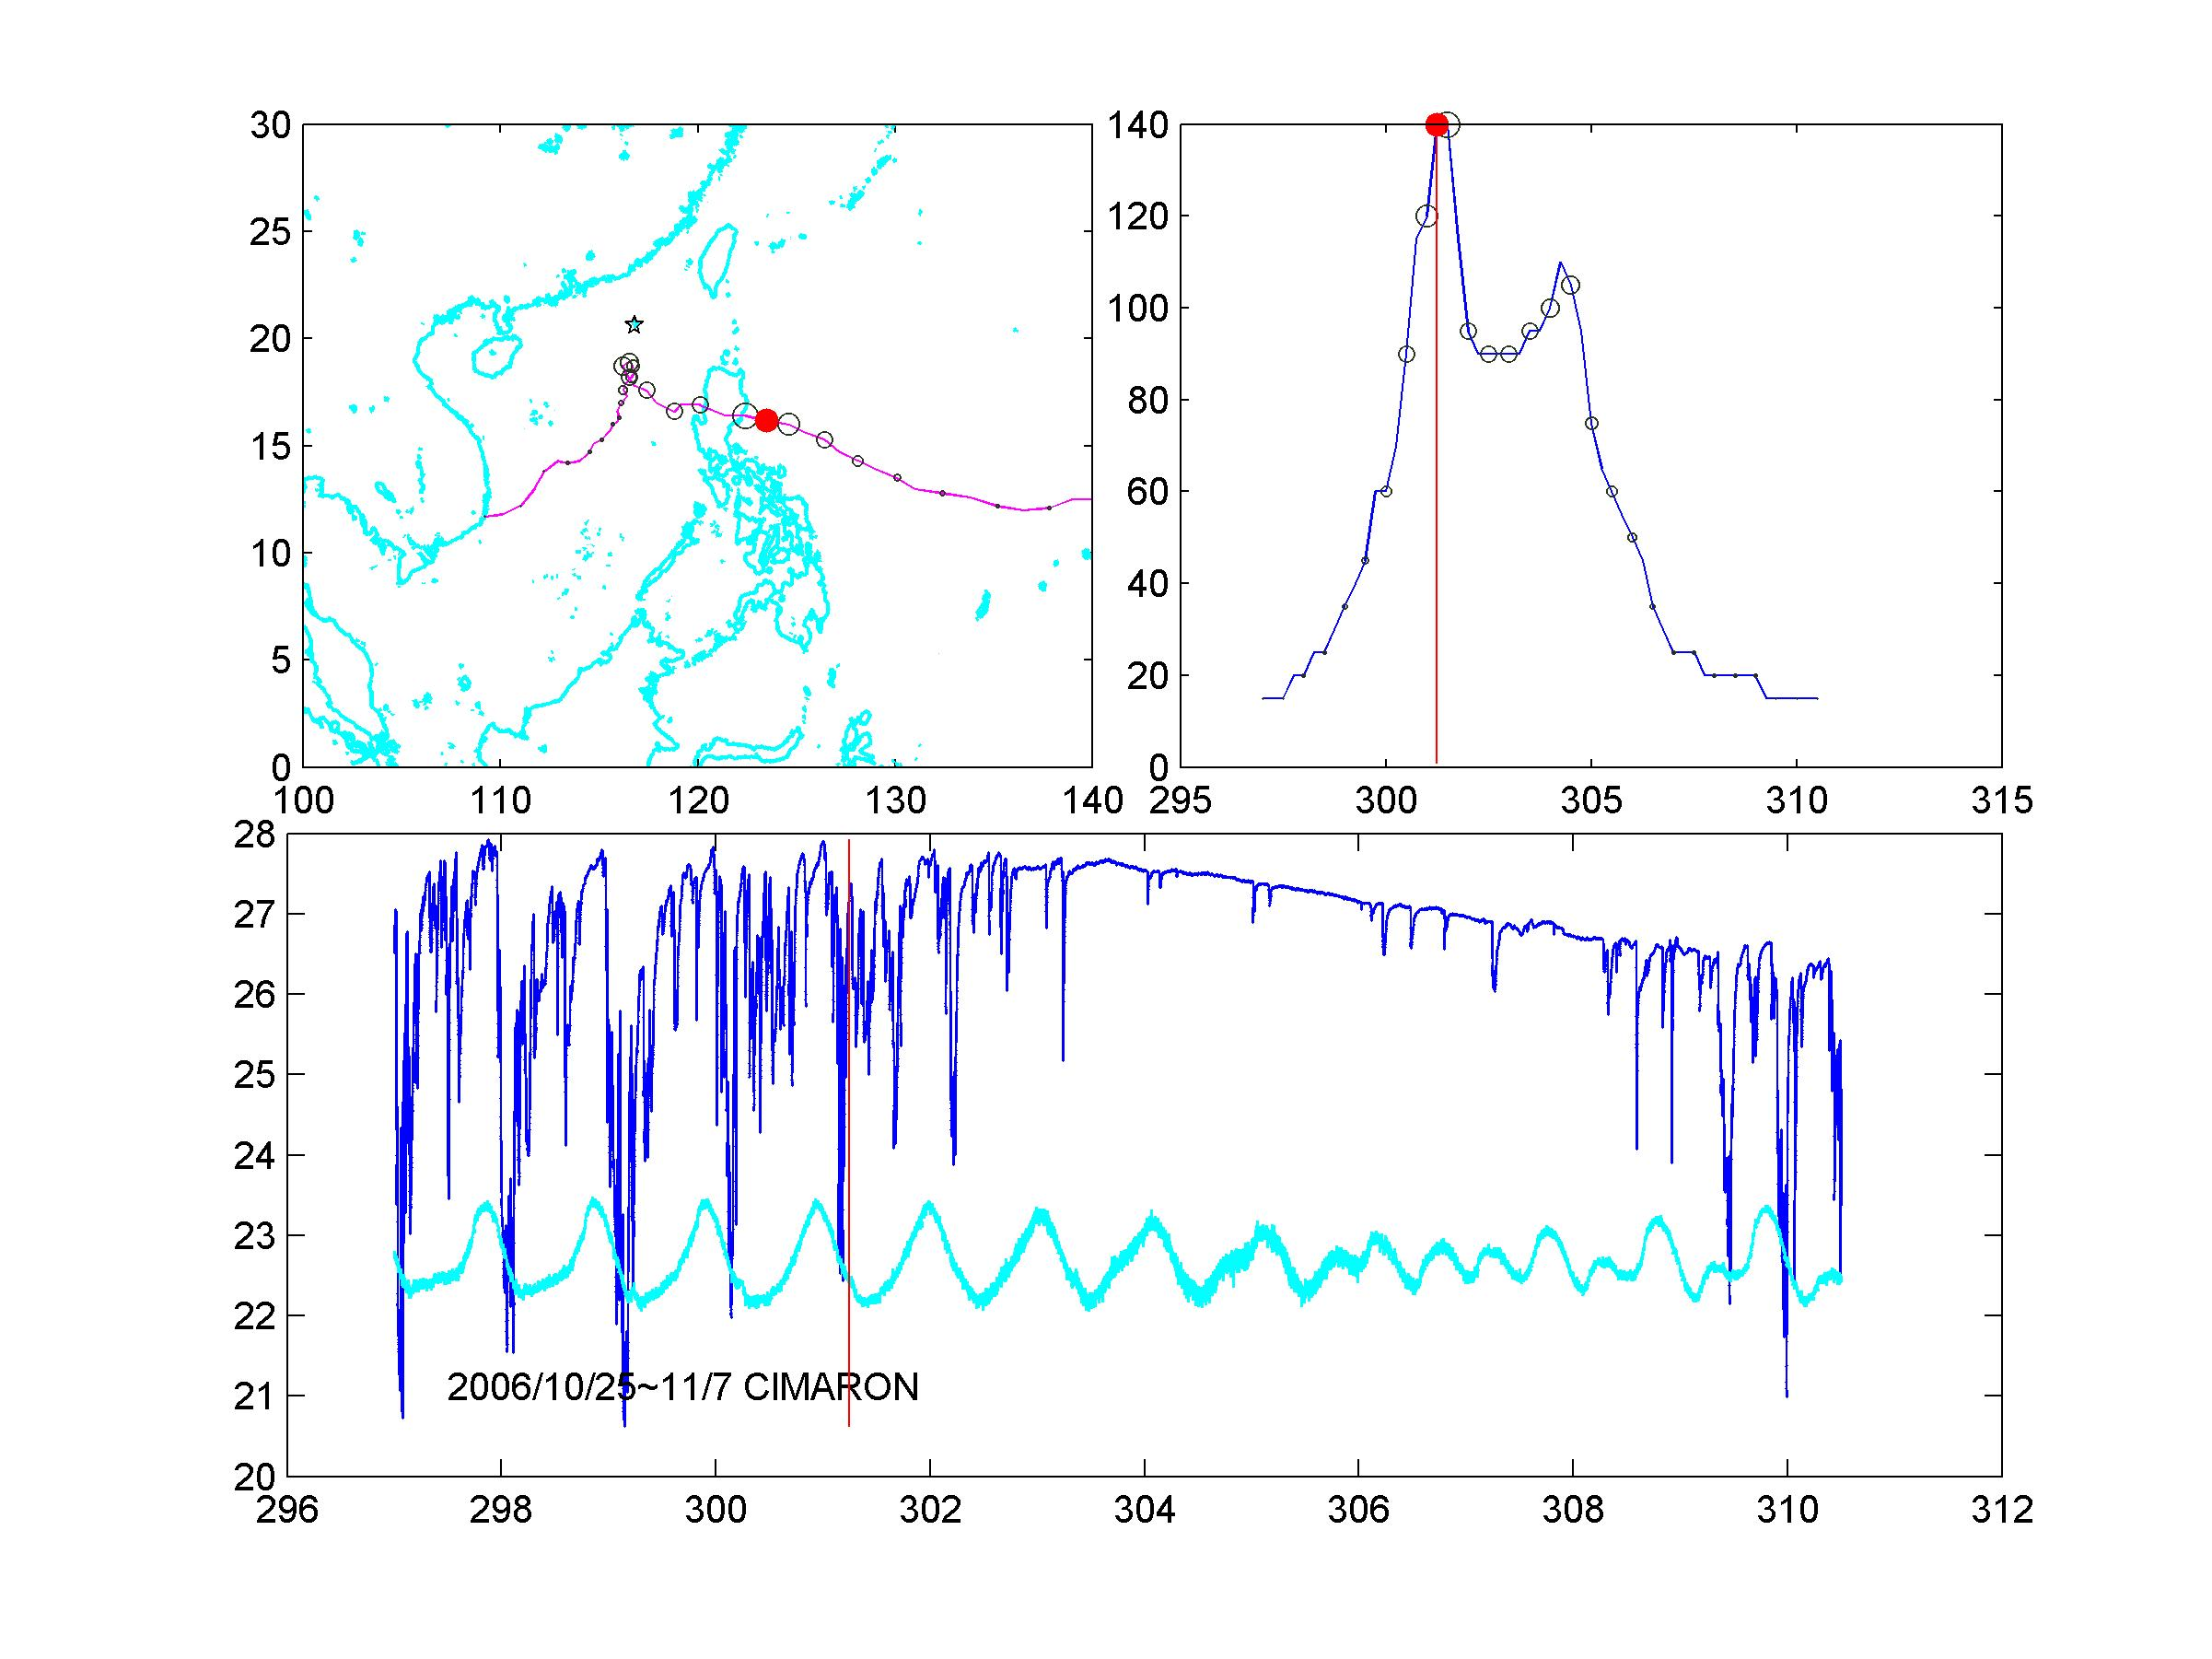

Slide 7
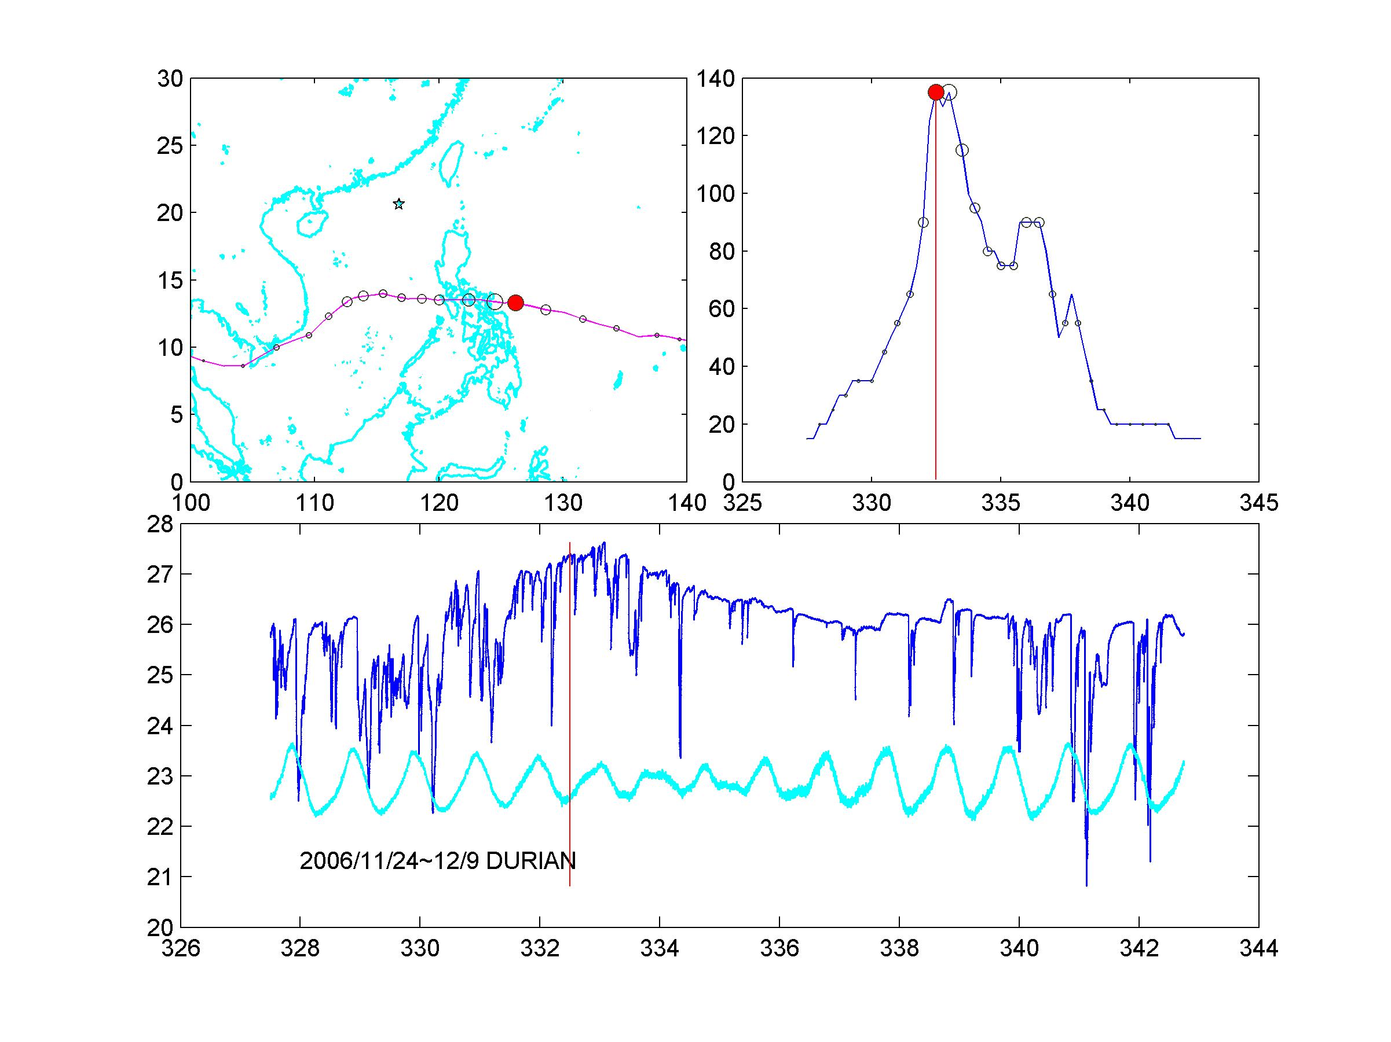

Slide 8
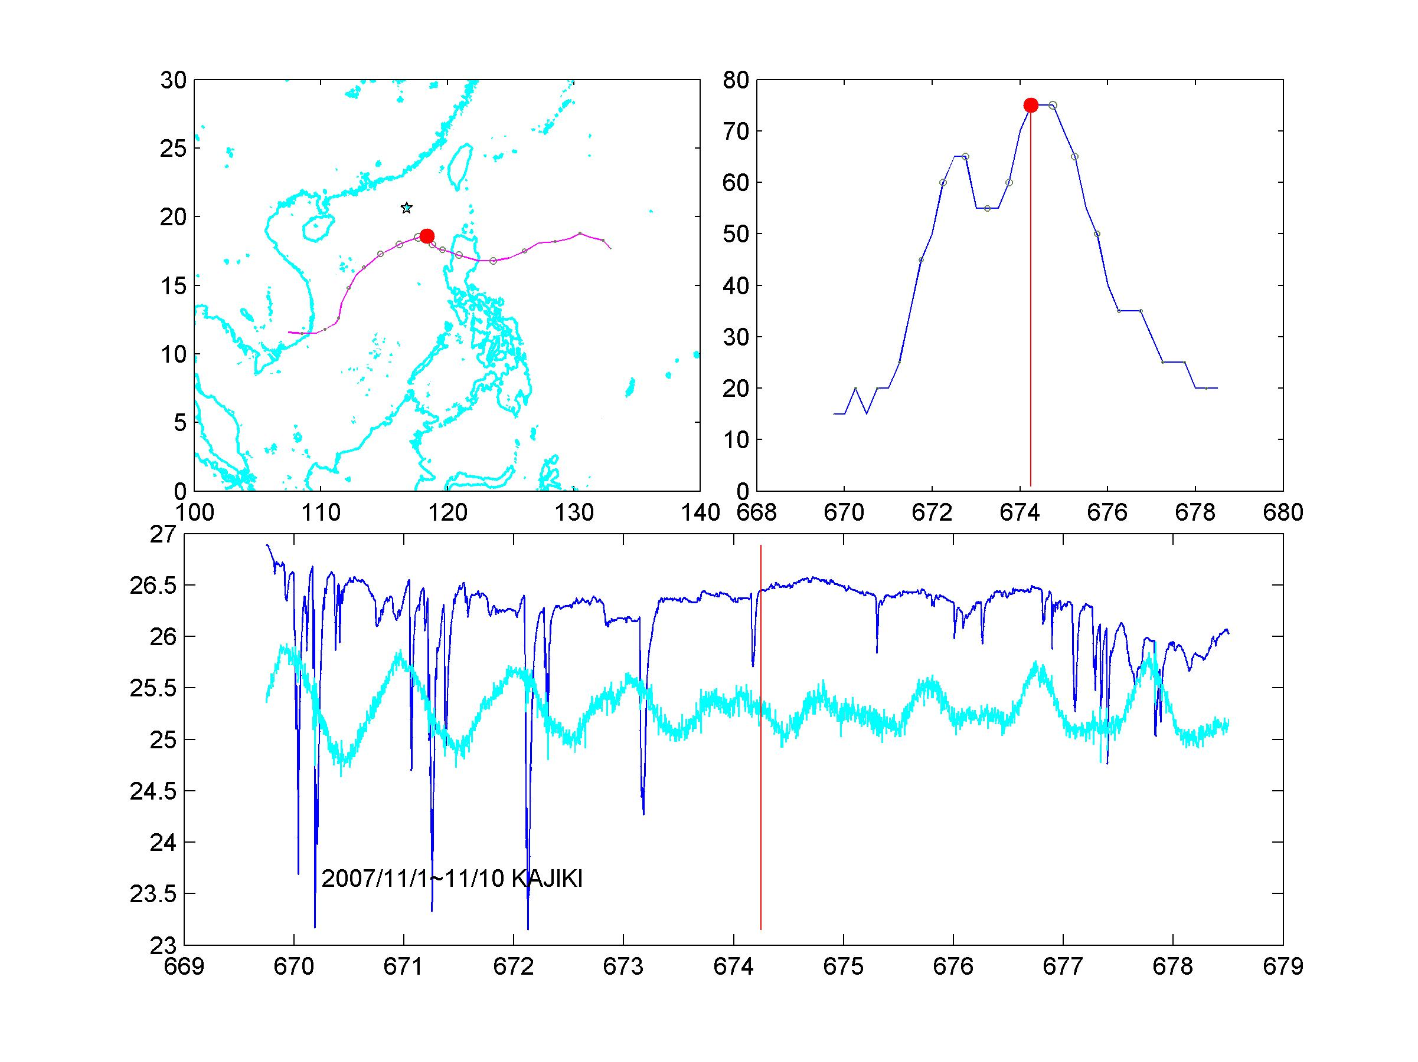

Slide 10
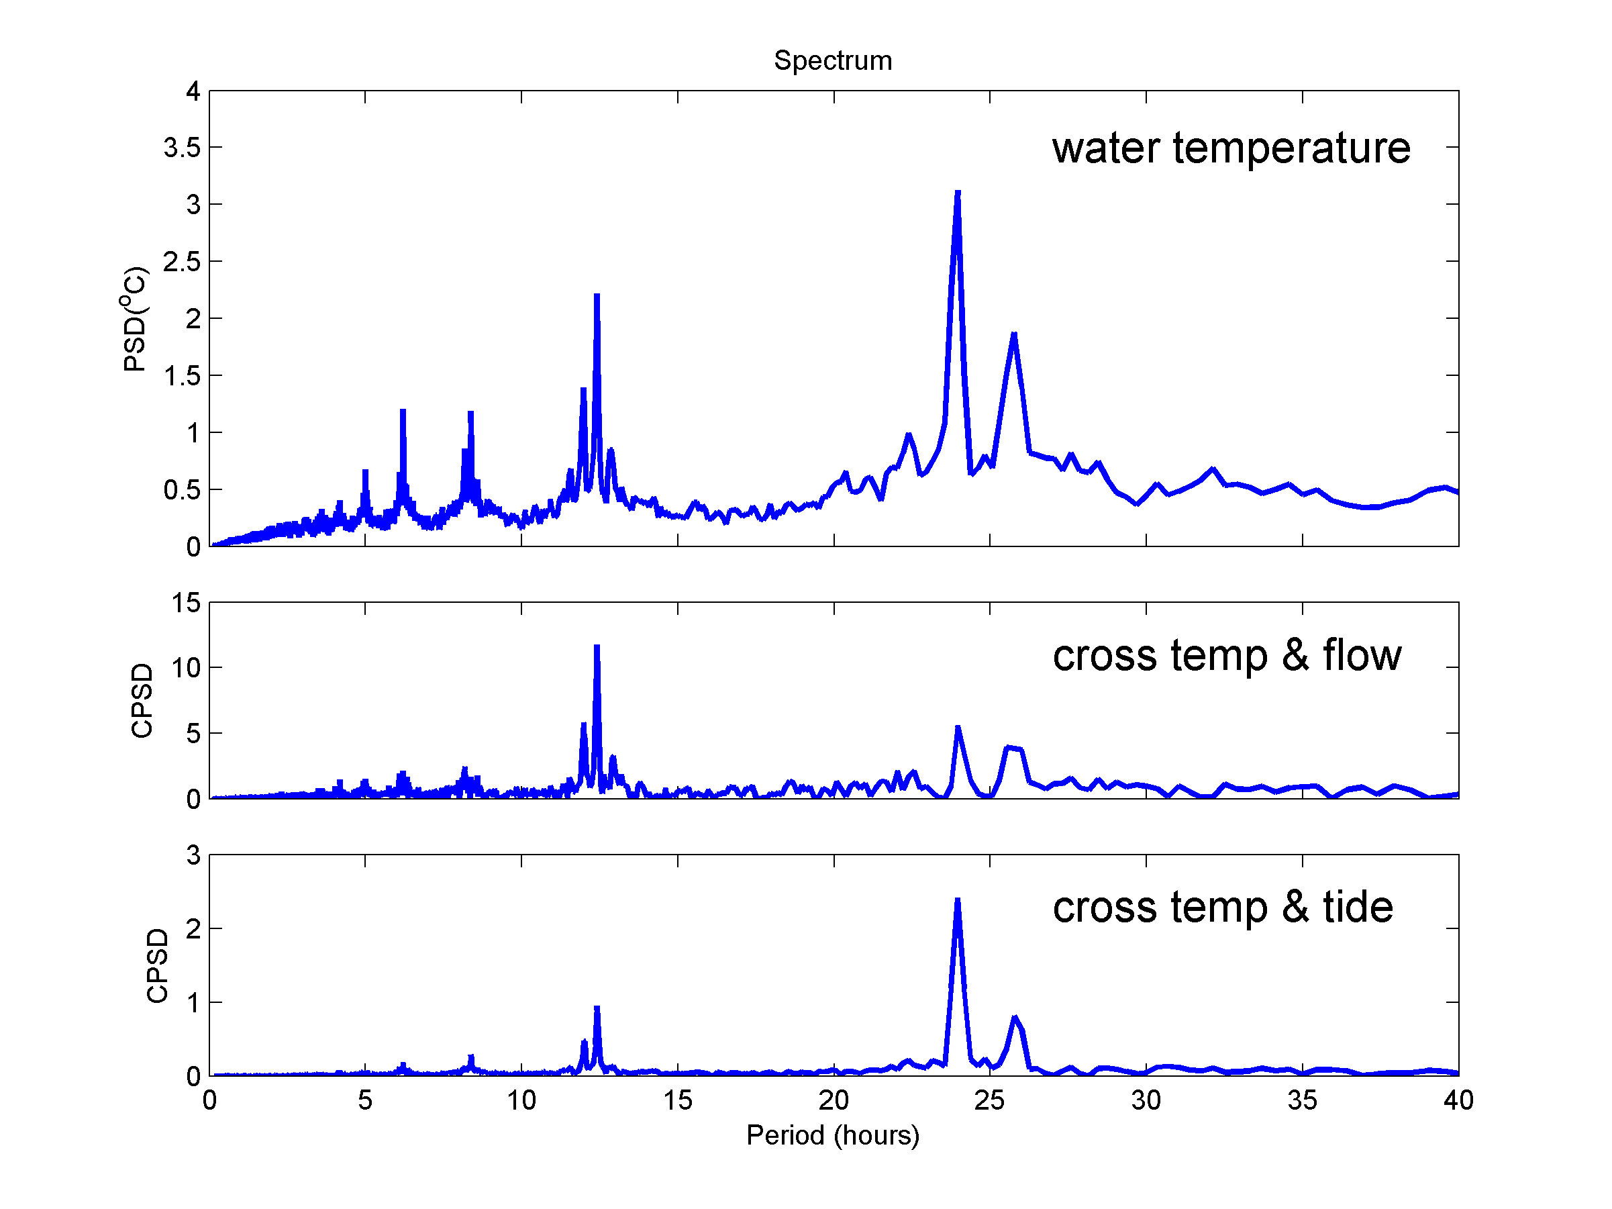
Spectrum of Water Temperature
diurnal
Semi-diurnal
Cross spectrum T~flow
Cross spectrum T~tide

Slide 11
Tide – 3Day moving harmonic K1

Slide 12
Winter
Temperature moving harmonic M2 K1 - winter

Slide 13
Summer
Temperature moving harmonic M2 K1 - summer

Slide 15
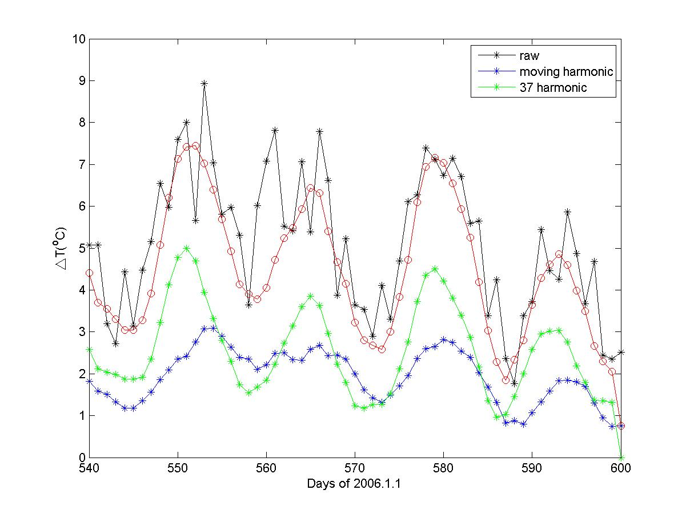

Slide 16
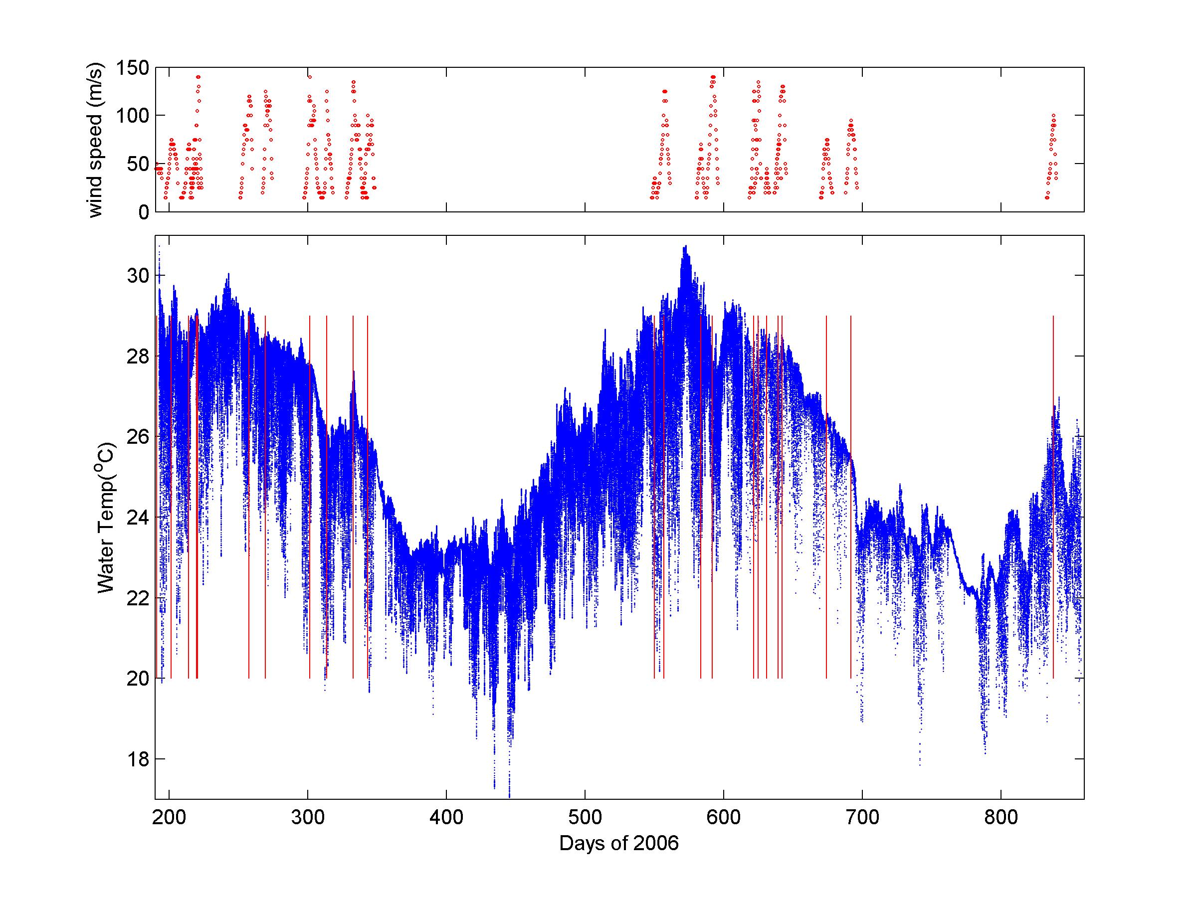

Slide 19
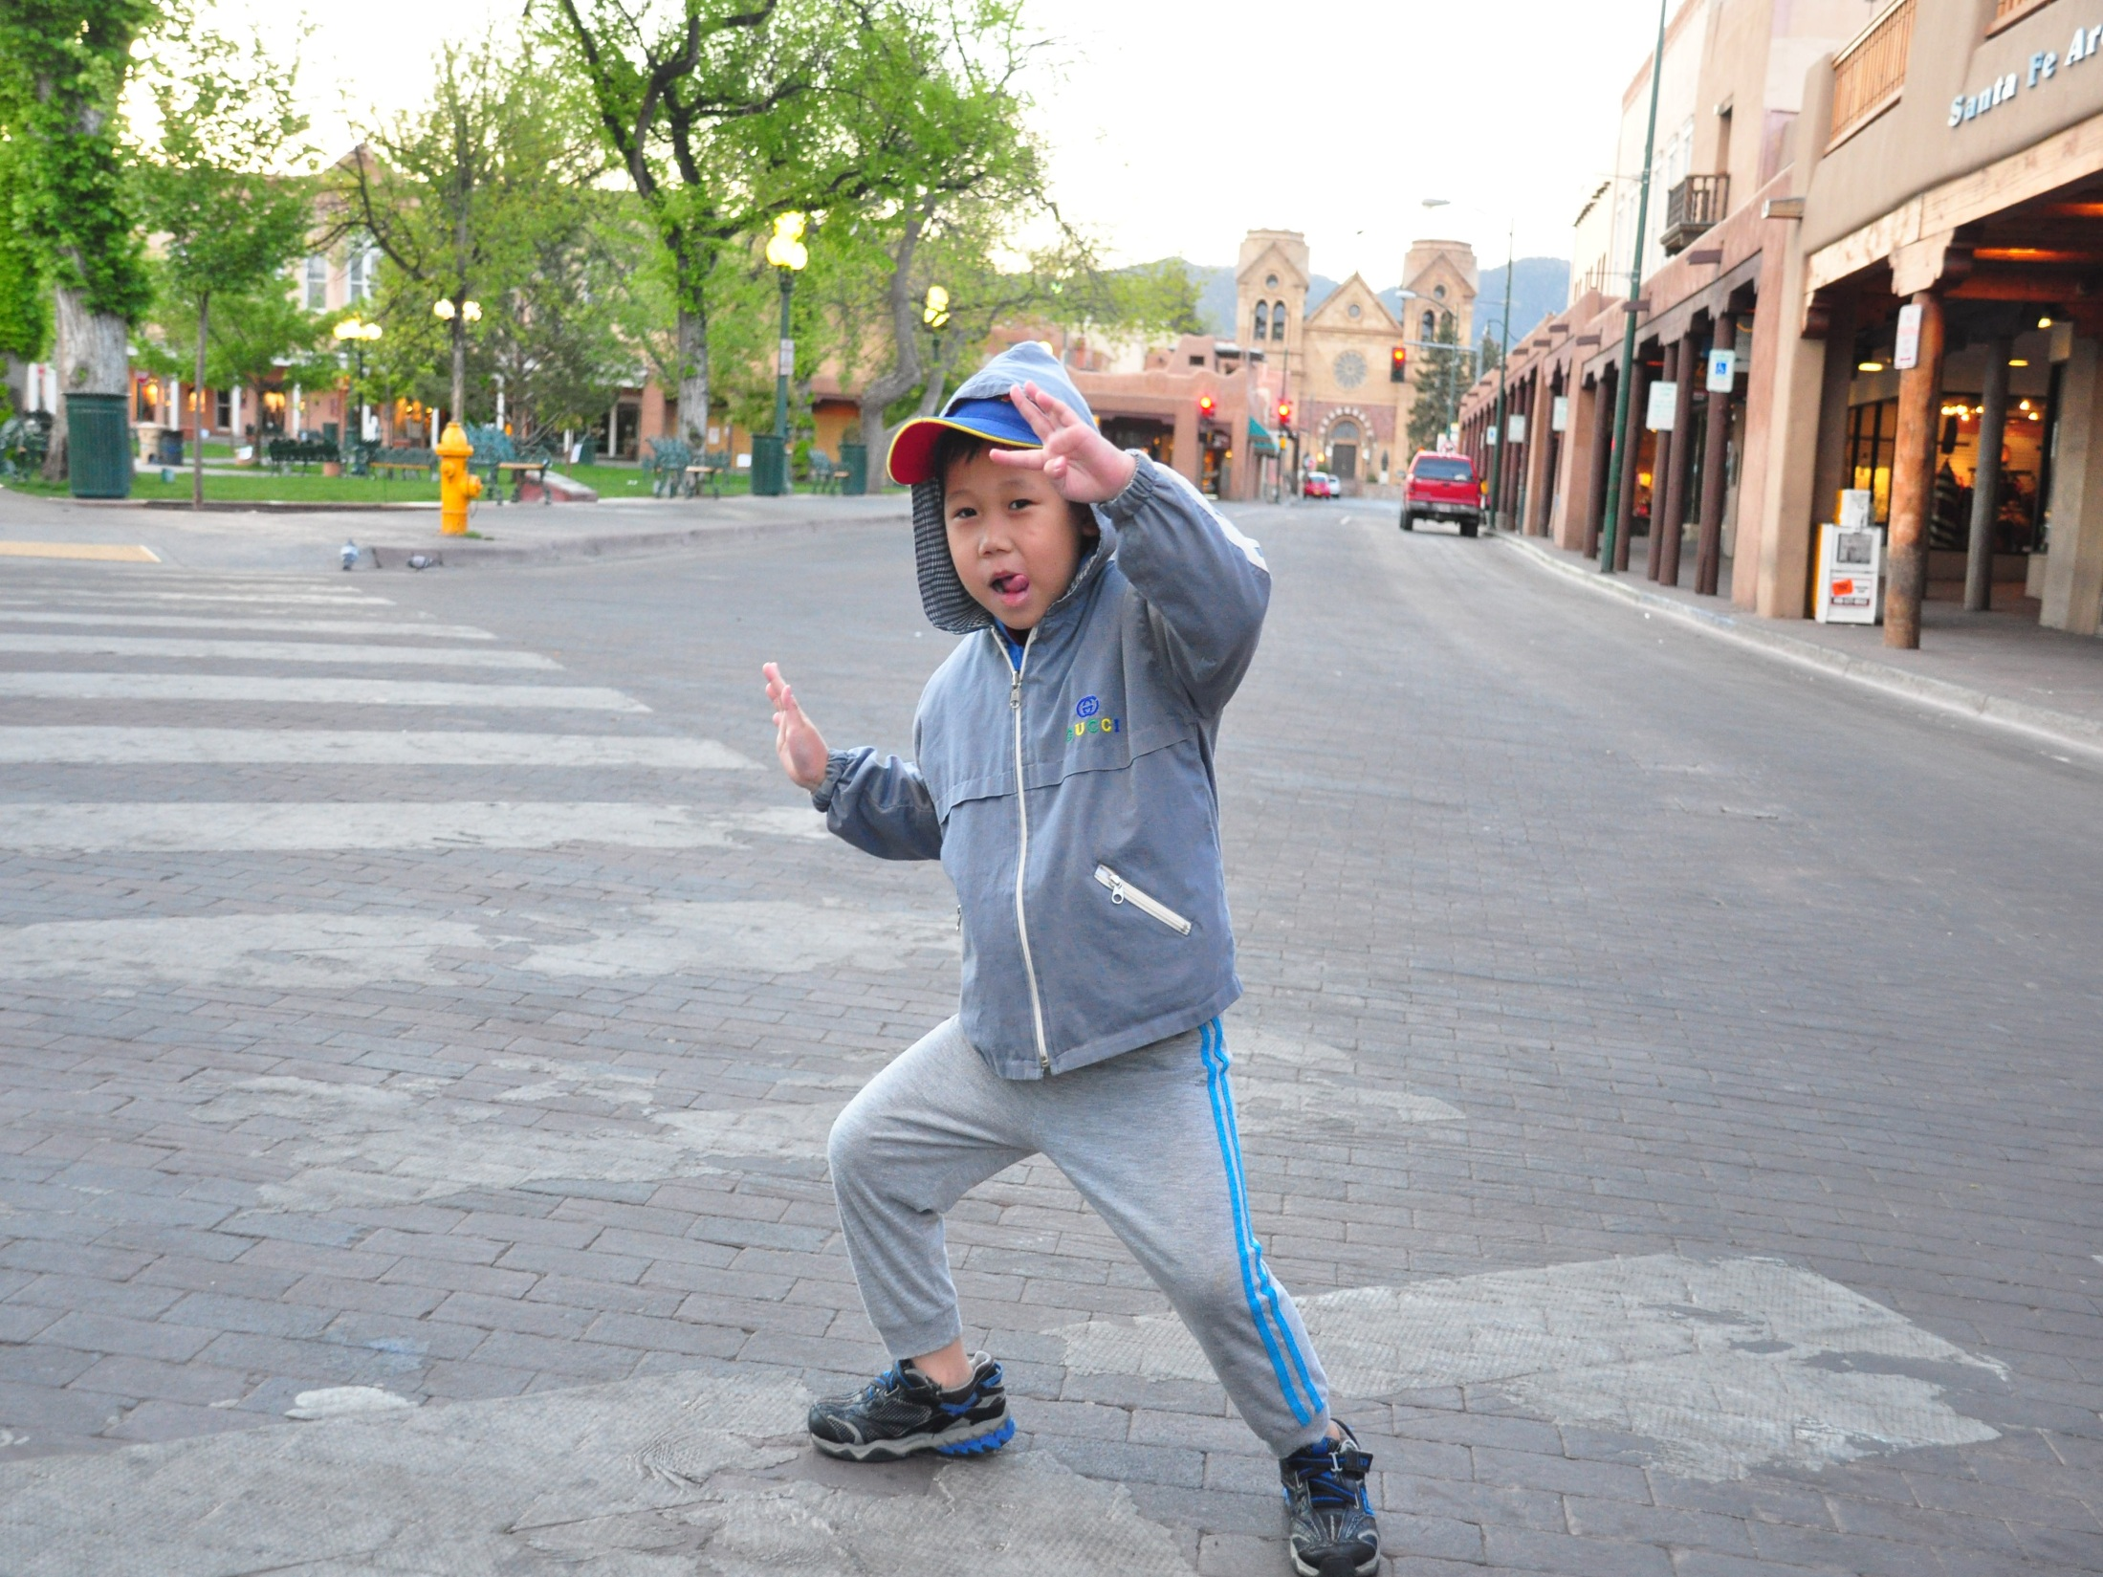
Thank
you

