Slide 1
Overview of the ITOP 2010 Measurements from the UM ASIS and EASI Buoys
Neil J Williams, Hans C Graber, William M Drennan
University of Miami’s Rosenstiel School of Marine and Atmospheric Science, Applied Marine Physics

Slide 2
Outline
Dates, locations, key typhoons, etc
Descriptions of Mooring and Buoys
Types of sensors and placement
Data overview (details: H Graber talk)
Summary
Contact information

Slide 3
2010 Typhoon Season
Tracks
Calendar
Sources: U Wisconsin, Madison and http://agora.ex.nii.ac.jp/digital-typhoon/

Slide 4
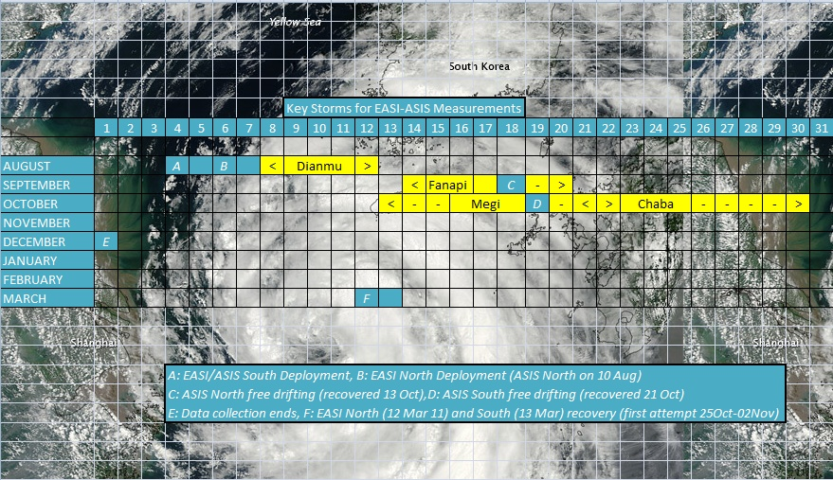
Timeline and Relevant Storms

Slide 5
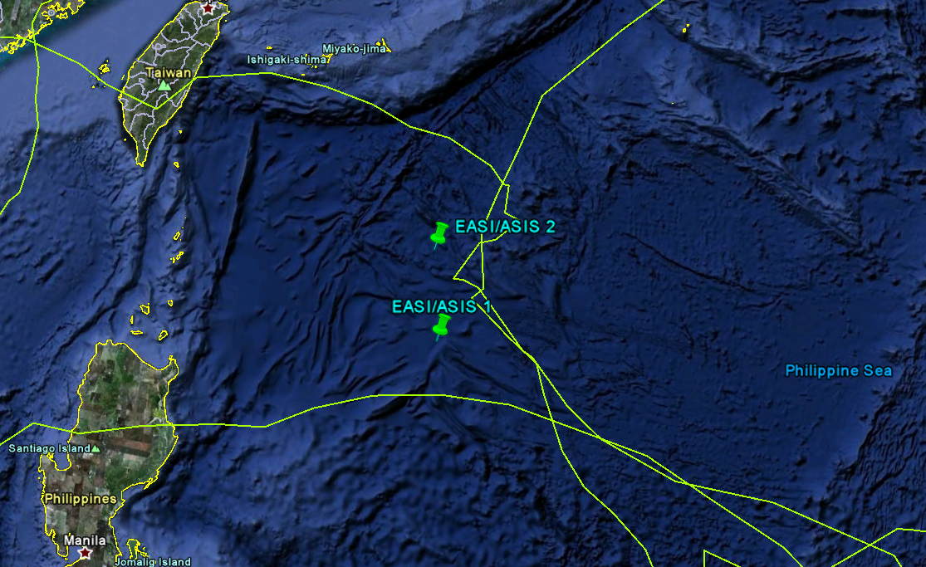
Locations and Storm Tracks
Fanapi
Chaba
21.2 N, 127.0E
19.6 N, 127.3E
Megi
Track kml’s: http://www.nrlmry.navy.mil/tc-bin/tc_home2.cgi

Slide 6
Extreme Air-Sea Interaction (EASI) Buoy
16000 lbs (7200kg) in air (18000 lbs , 8100 kg buoyant)
20 ft (6 m)x 10 ft (3 m) x 26 ft (8 m) with masts
Dual redundant data and sensor systems
Argos and Iridium telemetry (new for 2010)

Slide 7
Air-Sea Interaction Spar (ASIS)
3300 lbs (1500 kg), 40 ft (12 m) x 8 ft (2.4 m diam) approx.
For ITOP, primarily a directional wave measurement buoy, but instrumented with other sensors including wind, DO, temperature, and current

Slide 8
EASI-ASIS Moorings
5600 m water depth
EASI acts as tether buoy for ASIS
Inverse catenary mooring with 1-1/2 in chain, 2000 m wire rope (7/16”, 3/8”), 5000 m synthetic (1” nylon, 1.1” poly)
Upper 500 m instrumented

Slide 9
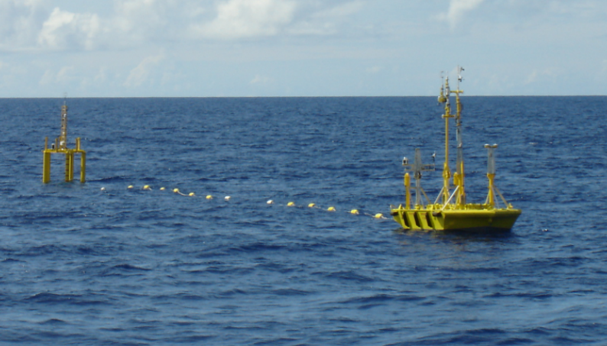
EASI-ASIS tethered

Slide 10
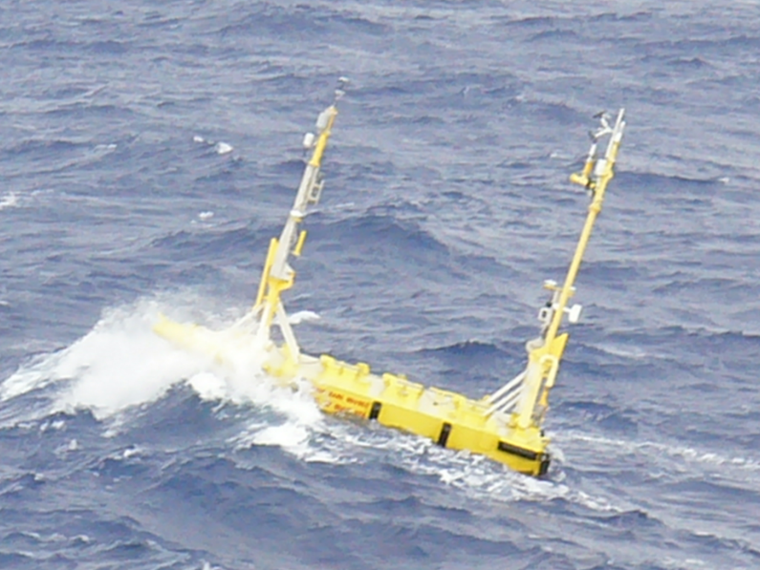
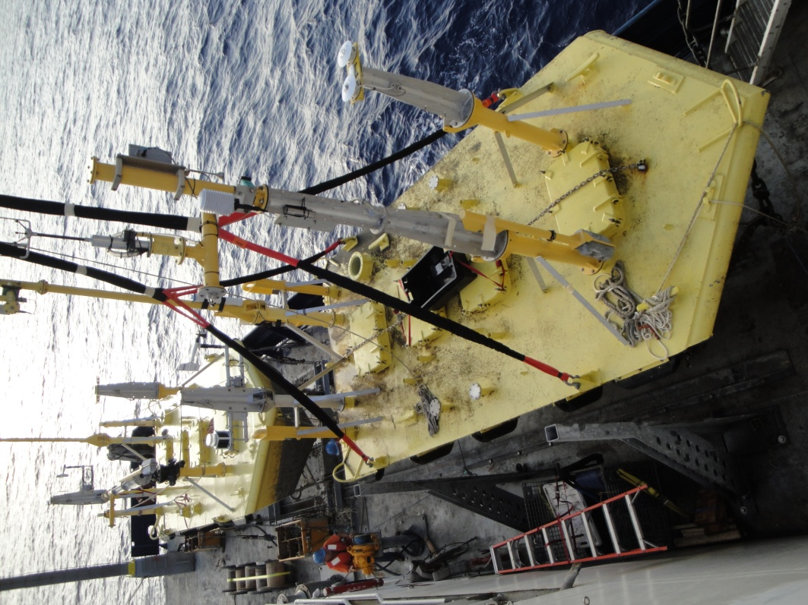
EASI Instrumentation

Slide 11
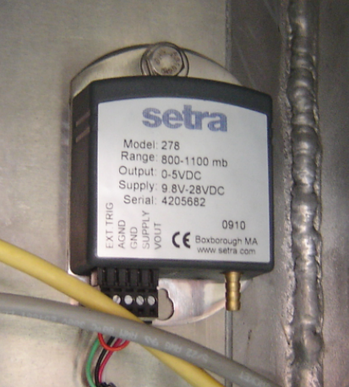
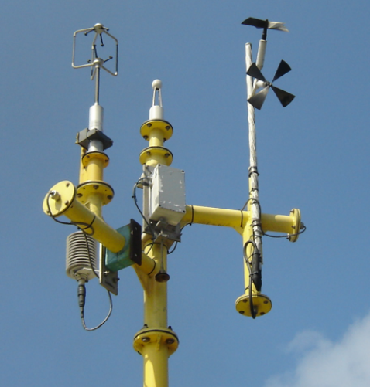
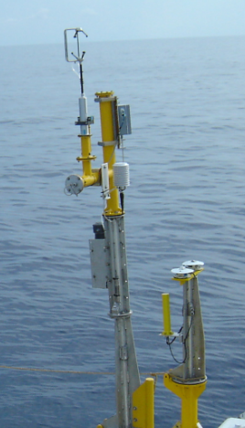
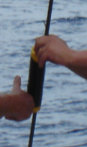
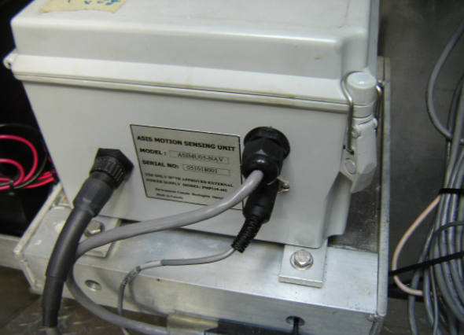
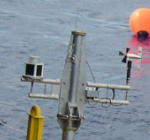
EASI Sensors

Slide 12
EASI Sensors (cont)
Atmospheric
Oceanographic
Wind Speed and Direction (Gill R2A,WP, KGill, RM Young)
CO2 and H2O concentration (Licor open and closed path)
Marine Aerosol (CLASP, sea spray)
Temperature, Relative Humidity (Rotronic)
Pressure (Setra)
Long and Short Wave Radiation (Eppley PIR, PSP)
Temperature (RBR, Brancker, Hugrun, TSKA)
Pressure
Dissolved oxygen
Depths to 500 m, most in upper 200 m
(Plus full motion pack including accelerometers and rate gyros)

Slide 13
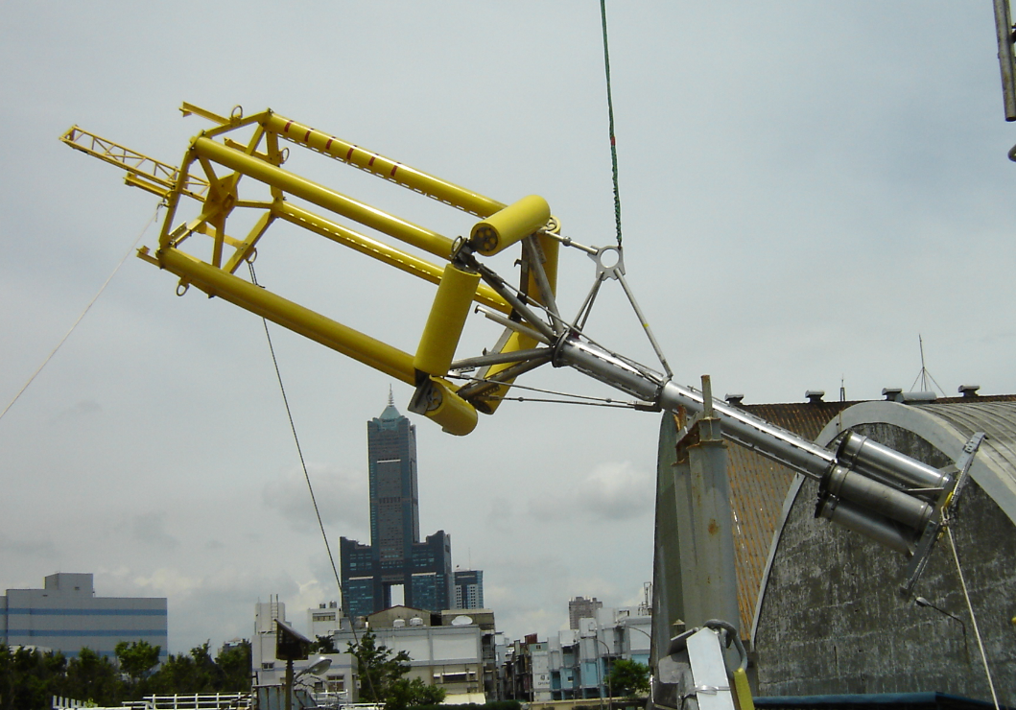
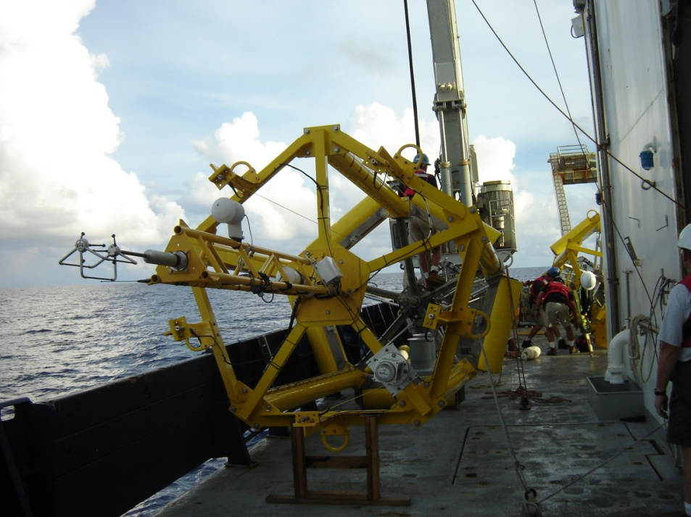
ASIS Instrumentation

Slide 14
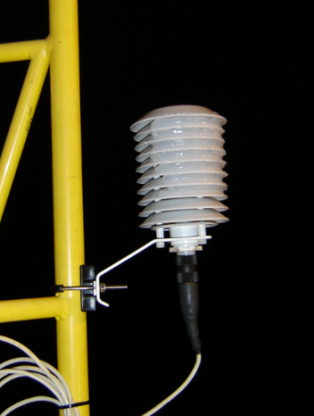
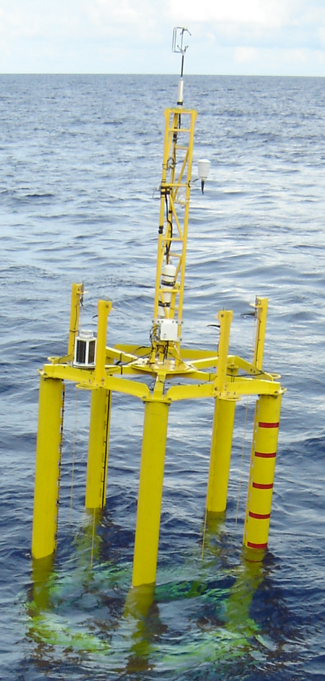
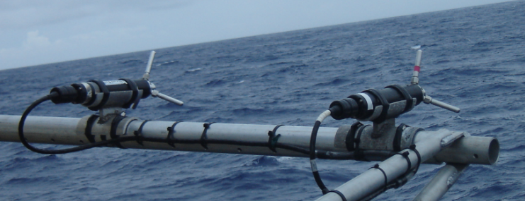
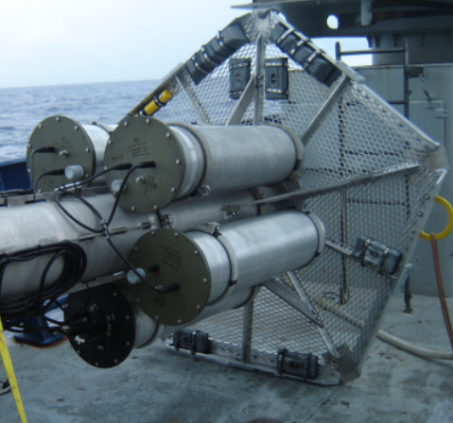
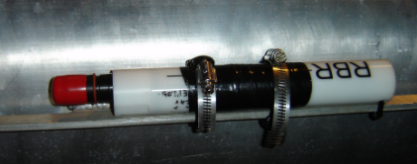
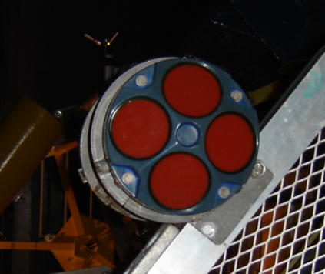
ASIS Sensors

Slide 15
ASIS Sensors (cont)
Atmospheric
Oceanographic
Wind Speed and Direction (Gill R2A)
Temperature, Relative Humidity (Rotronic)
Wave Spectrum, Capacitive Wave Wire Array (8)
Temperature (RBR, Brancker, Hugrun, TSKA)
Pressure
Dissolved oxygen
Depths 1 to 7 m
Current (both ADV and ADCP)
(Plus full motion pack including accelerometers and rate gyros)

Slide 16
Data Overview
Stand-alone
EASI/ASIS
Individual recorders sample at different rates based on storage capacity and number of channels recorded
Rates vary from 4 sec for RBR 1050 type to 20 min for ADCP
Most systems are storage limited and set for max sample rate that would last through end of Oct,2010
Test deployments of three SIO miniwaves drifting buoys
All ASIS data is sampled at 20 Hz (including ADV probes)
Redundant systems aboard EASI record at different rates (20 Hz, 5 Hz) due to storage limitations on Campbell Systems
All main system DAC’s recorded through 31 Oct
Some systems remained active through December

Slide 17
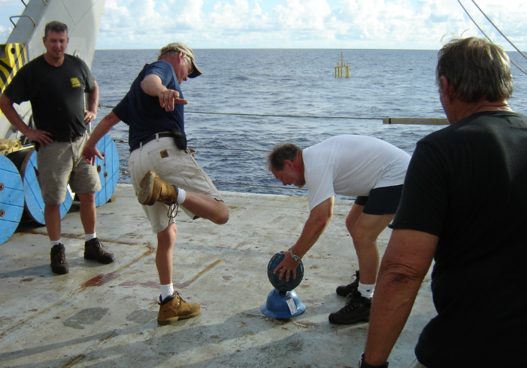
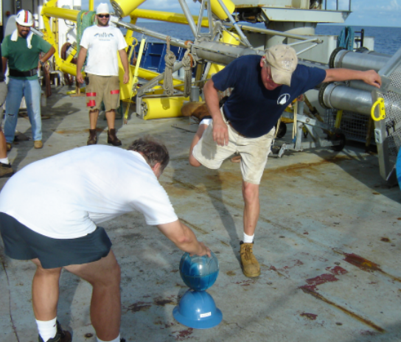
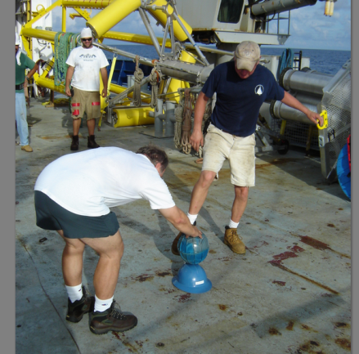
SIO Wave Buoy deployment

Slide 18
Summary
Two EASI/ASIS moorings were deployed in the Philippines Sea, collected data from early August through October 2010 and survived encounters with several major typhoons
There is a wide range of atmospheric and oceanographic data available including wind, wave, temperature and pressure
EASI/ASIS data is sampled at 5 Hz or faster and full motion correction is available
Hans Graber’s talk to follow will go into more detail on preliminary processed data

Slide 19
Many Thanks to
To ONR for sponsoring our participation
To WHOI’s mooring group for deployment/recovery assistance
To the many ITOP PI’s who helped out with equipment recovery and other assistance.
To our Taiwanese colleagues for their wonderful shore support both before and after the cruise
To the Captains and crews of the Roger Revelle for their skill and perseverance under some pretty nasty sea conditions and difficult operations

Slide 20
Contact information
University of Miami
RSMAS-AMP
4600 Rickenbacker Cswy
Miami, FL 33149
http://www.rsmas.miami.edu 305-421-xxxx
Email: xxxx@rsmas.miami.edu
Dr. Neil J Williams nwilliams@ x4656
Dr. Hans C Graber hgraber@ x4952
Dr. William M Drennan wdrennan@ x4798

