Slide 1
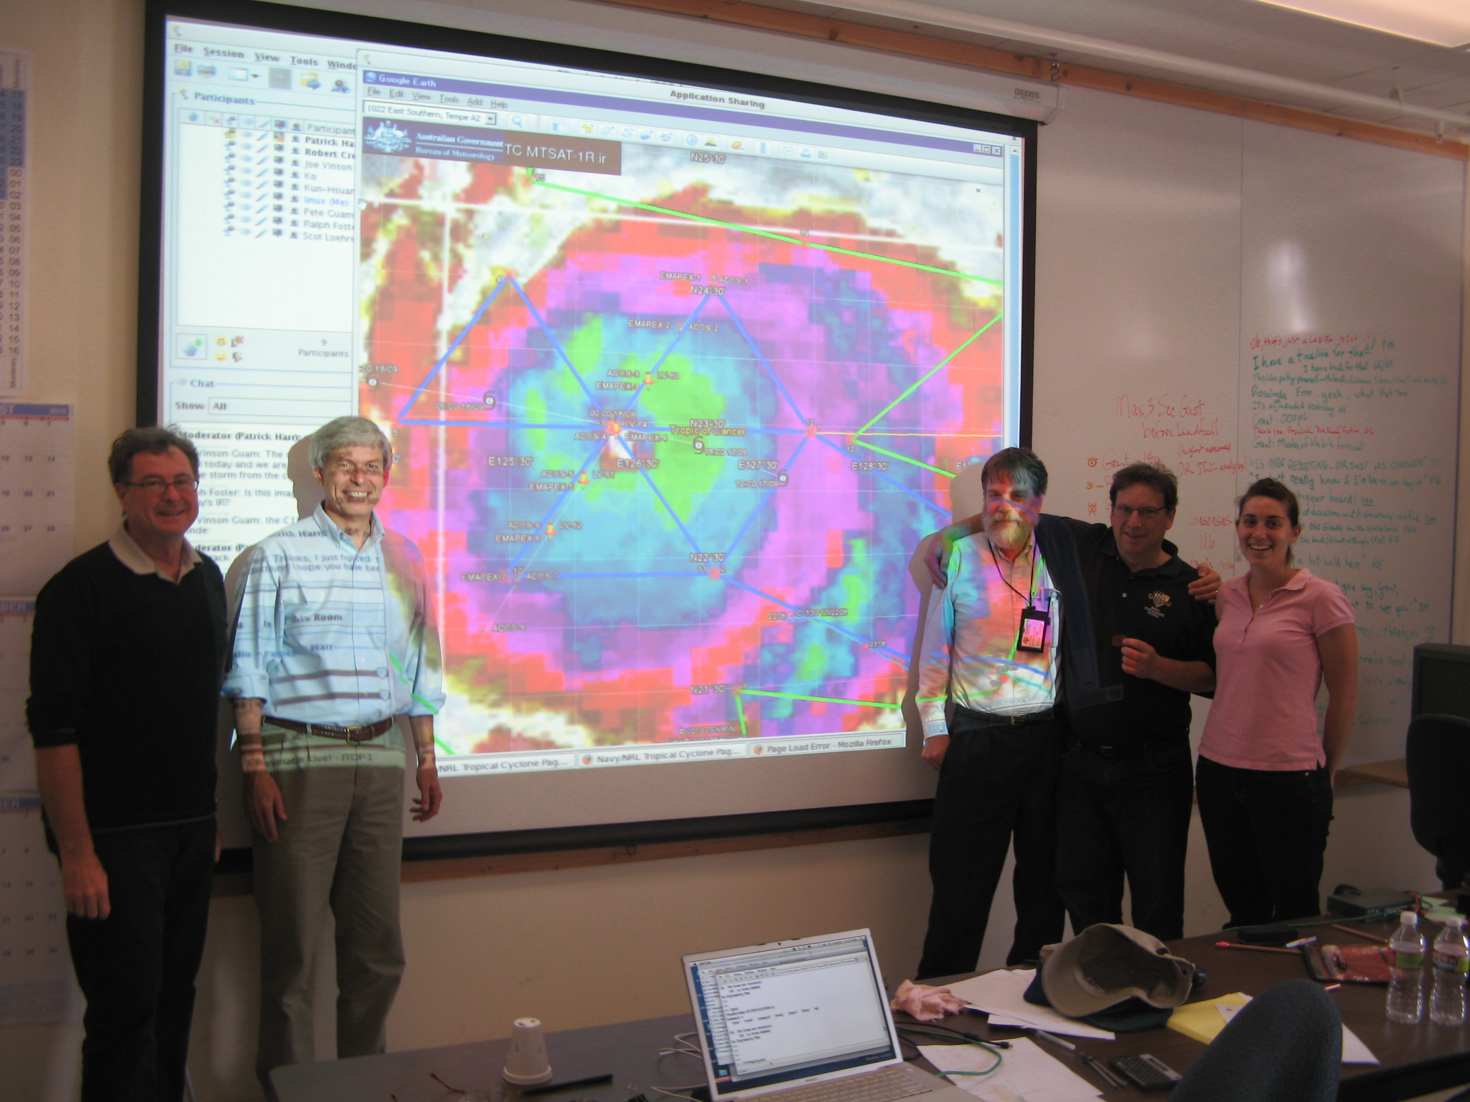
Uncovering the Wake of Typhoon Fanapi
Rosalinda Fortier, E. D’Asaro, R.-C. Lien, J. Price, L. Centurioni, J. Morzel, P. Niiler, L. Rainville, T. Sanford
17 May 2011
ITOP Meeting, Santa Fe

Slide 2
Overview
More subsurface observations were made in the cold wake of Typhoon Fanapi than ever before in a tropical cyclone
Satellite SST imagery suggests that the cold wake faded within a week of forming
However, in situ observations show a ‘subsurface’ wake persists for at least 12 days

Slide 3
Fanapi SST movie (from Jim Price)
Merged SST from JPL POET server
One-day interval Remote Sensing Systems (RSS)
MicroWave plus Infra Red (MW + IR)
Optimum Interpolation (OI)…..
20 Sep 2010, yd 263.5

Slide 4
7 Sep 2010 (yd 250 UTC)

Slide 5
8 Sep 2010 (yd 251 UTC)

Slide 6
9 Sep 2010 (yd 252 UTC)

Slide 7
10 Sep 2010 (yd 253 UTC)

Slide 8
11 Sep 2010 (yd 254 UTC)

Slide 9
12 Sep 2010 (yd 255 UTC)

Slide 10
13 Sep 2010 (yd 256 UTC)

Slide 11
14 Sep 2010 (yd 257 UTC)

Slide 12
15 Sep 2010 (yd 258 UTC)

Slide 13
16 Sep 2010 (yd 259 UTC)

Slide 14
17 Sep 2010 (yd 260 UTC)
Day 0
This is the day of the first deployment flight… call it Day 0

Slide 15
18 Sep 2010 (yd 261 UTC)
~26.5°C
Day 1

Slide 16
19 Sep 2010 (yd 262 UTC)
Day 2

Slide 17
20 Sep 2010 (yd 263 UTC)
Day 3

Slide 18
21 Sep 2010 (yd 264 UTC)
Day 4

Slide 19
22 Sep 2010 (yd 265 UTC)
Day 5

Slide 20
23 Sep 2010 (yd 266 UTC)
Day 6

Slide 21
24 Sep 2010 (yd 267 UTC)
Day 7

Slide 22
25 Sep 2010 (yd 268 UTC)
Day 8

Slide 23
26 Sep 2010 (yd 269 UTC)
Day 9

Slide 24
27 Sep 2010 (yd 270 UTC)
Day 10

Slide 25
28 Sep 2010 (yd 271 UTC)
Day 11

Slide 26
29 Sep 2010 (yd 272 UTC)
Day 12

Slide 27
30 Sep 2010 (yd 273 UTC)
Day 13

Slide 28
1 Oct 2010 (yd 274 UTC)
Day 14

Slide 29
2 Oct 2010 (yd 275 UTC)
Day 15

Slide 30
3 Oct 2010 (yd 276 UTC)
Day 16

Slide 31
4 Oct 2010 (yd 277 UTC)
Day 17
…may still be able to see the remnants of a cold wake, but take another look at Day 1…

Slide 32
18 Sep 2010 (yd 261 UTC)
Day 1

Slide 33
Remote Sensing vs. Subsurface Obs
Analysis shows the e-folding time for SST warming after Fanapi was about a week
But does the wake really disintegrate this quickly?
Subsurface observations can tell us another story of what happened to that 26.5°C water we saw on Day 1…
Notes:
Jim Price estimated that the SST on the wake warmed with an e-folding time of approximately 6 and a half days.

Slide 34
Subsurface data
Platform | Number of instruments | Timeframe
EM-APEX | 7 | 17 Sept – 27 Sept
Seagliders | 9 | 22 Sept – 13 Nov
uwCTD | 1 | 21 Sept – 10 Oct
ADOS | 14 | 17 Sept – mid Oct
SVPb | 14 | 17 Sept – mid Oct
SVPt | 19 | 17 Sept – mid Oct
Superdrifters | 3 (1) | 18 Sept – mid Oct
Lagrangian | 4 | 17 Sept – 30 Sept
AXBTs | lots | 18 Sept – mid Oct
Moorings | 7 | Aug - Nov
Notes:
So far, I have work on the first 5 of these data sets, though I will primarily focus on EM-APEX observations during this talk.

Slide 35
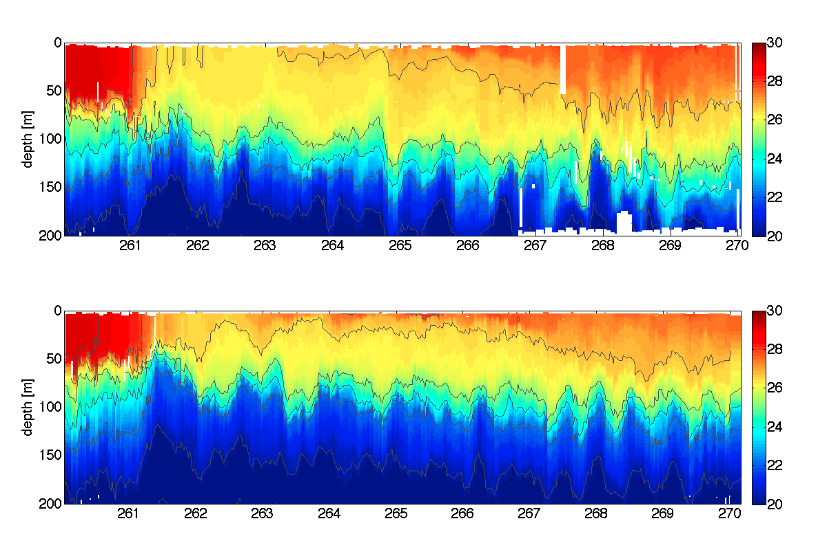
EM-APEX Time Series
Wake ~26.5°C
EM-APEX 4907
Temperature [°C]
Day: 0
1
2
3
4
5
6
7
8
9
(00Z UTC): 9/18
9/19
9/20
9/21
9/22
9/23
9/24
9/25
9/26
9/27
22.5
EM-APEX 4910
23.0
Temperature [°C]
Year Day [UTC]
Notes:
Here are the two floats that were in the strongest part of the wake. We can see that the ‘wake’ water that was formed was around 26.5 degrees and mostly contained between the 22.5 and 23 kg/m^3 potential density anomaly contours. You can see at the end of the time series, the temperature profile is still much different from what it was pre-Fanapi.

Slide 36
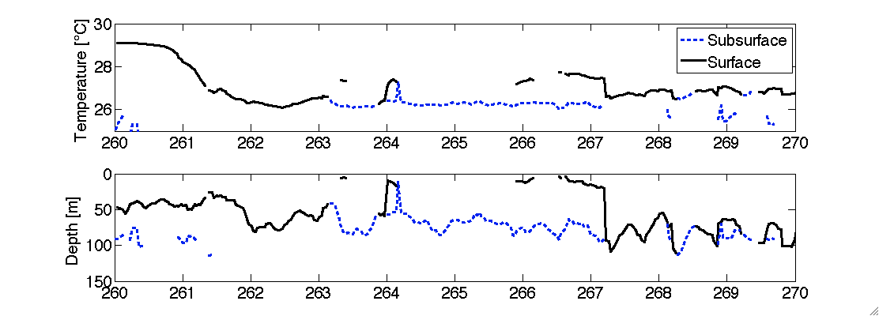
How did I define the wake?
Not just a cool surface mixed layer!
Find water with 26°C < T < 28°C
And dT/dz < 0.05°C/m – sometimes subsurface
4910 “Wake Layer” Temperature
4910 “Wake” Depth

Slide 37
The wake below the surface…
In this way, I identified and located the ‘wake’ water observed by the EM-APEX, Seagliders, ship-board CTD, and ADOS floats.
Will show map of EM-APEX wake next
Color is the temperature of the ‘wake’
Plotted on top of surface geostrophic currents

Slide 38
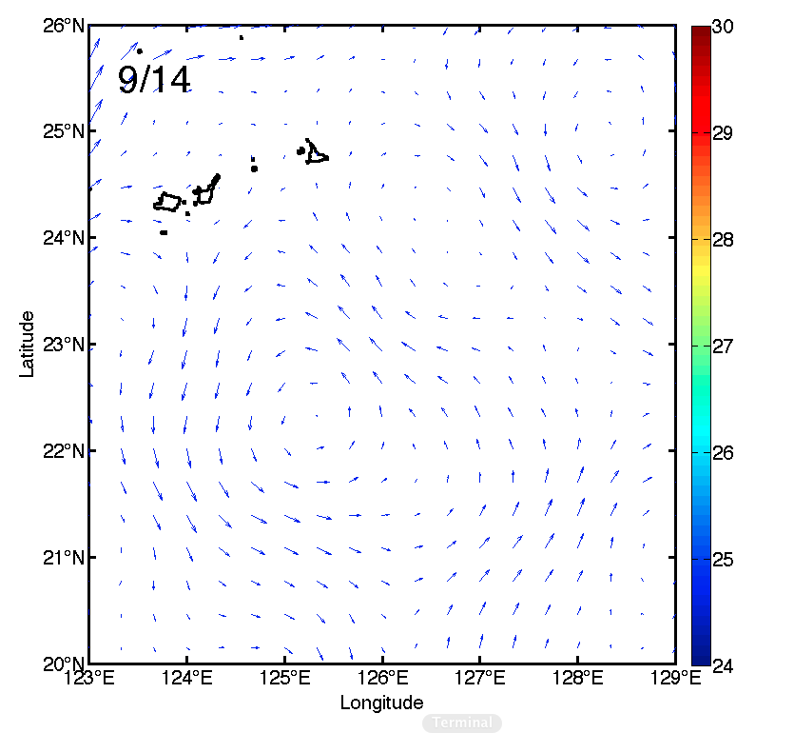
Temperature [°C]

Slide 39
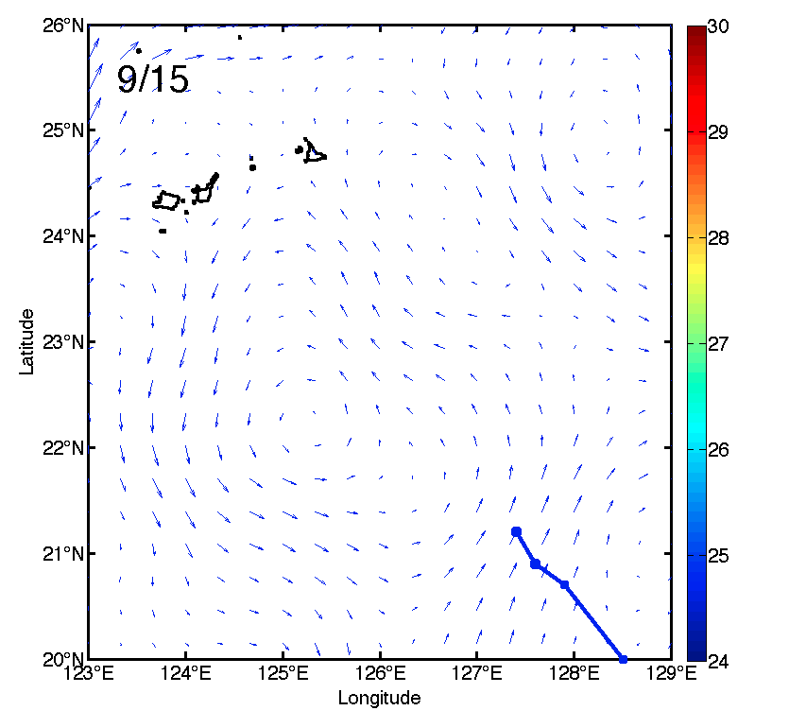
Temperature [°C]

Slide 40
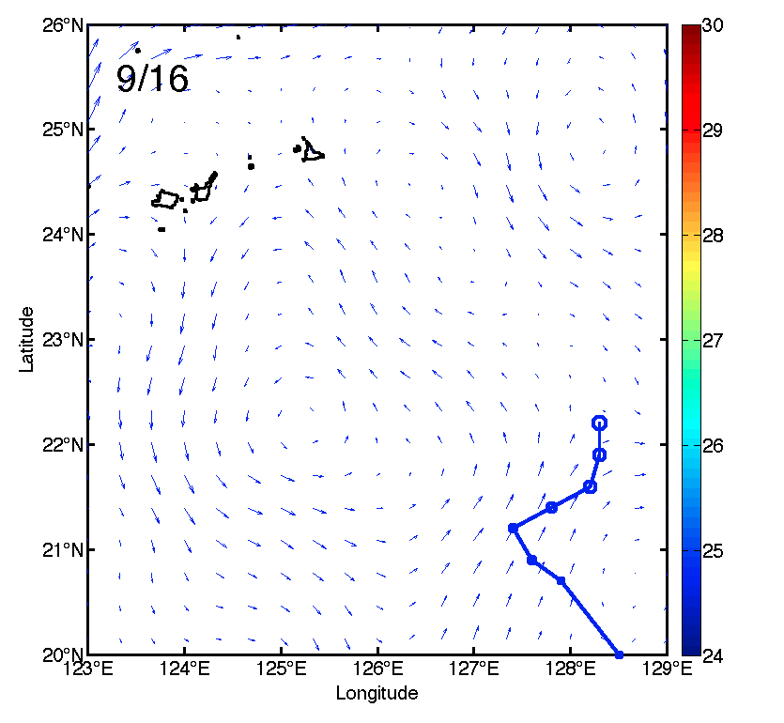
Temperature [°C]

Slide 41
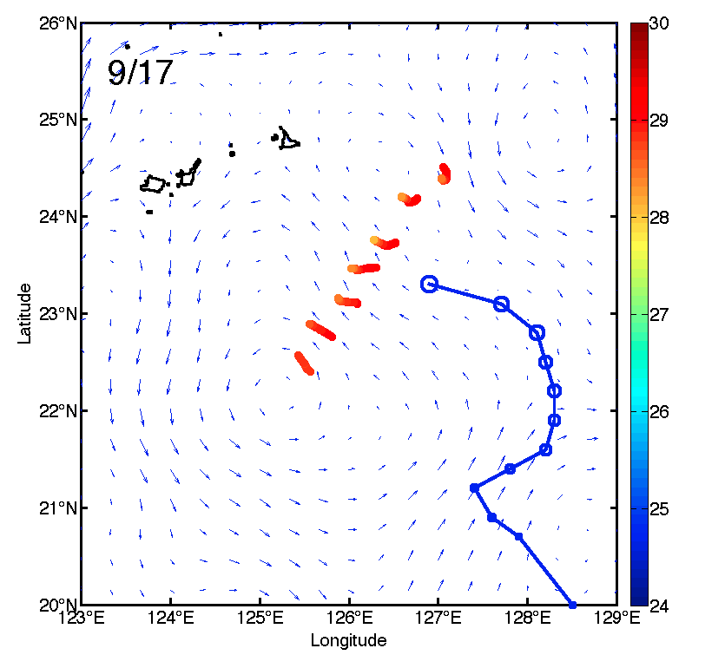
Day 0
4907
4910
Temperature [°C]

Slide 42
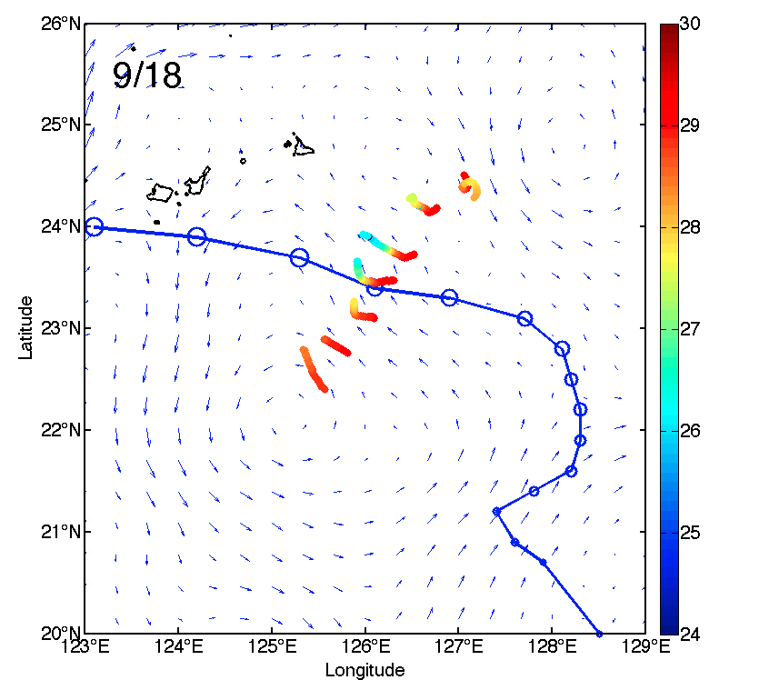
Day 1
Day 1
4907
4910
Temperature [°C]

Slide 43
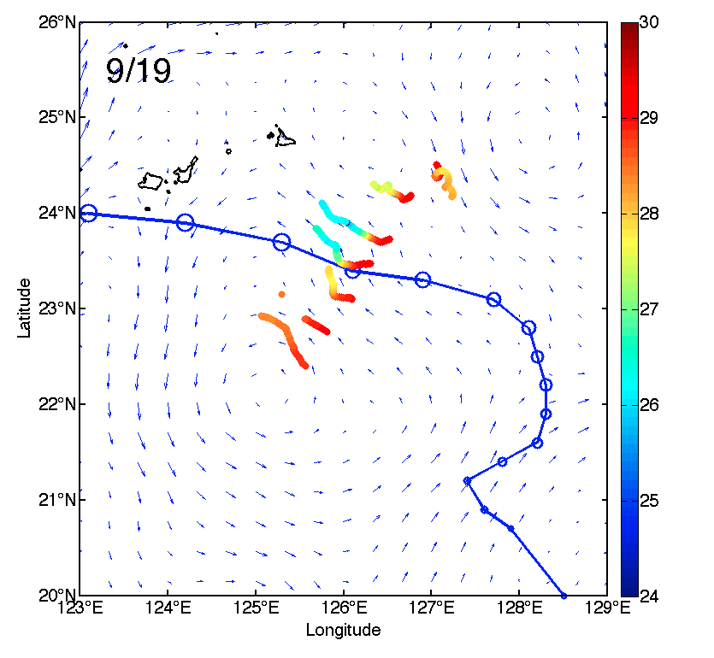
Day 2
Day 2
4907
4910
Temperature [°C]

Slide 44
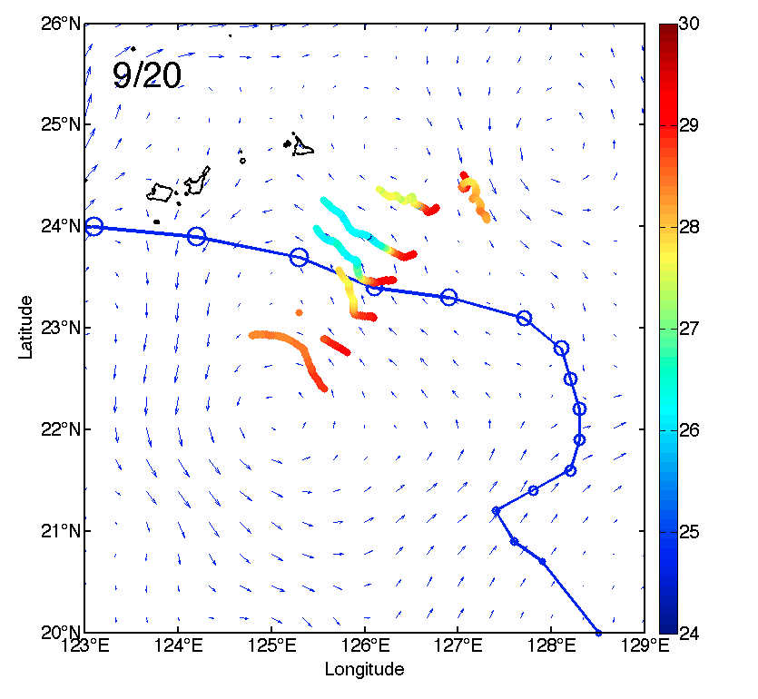
Day 3
Day 3
4907
4910
Temperature [°C]

Slide 45
Day 4
Day 4
4907
4910
Temperature [°C]

Slide 46
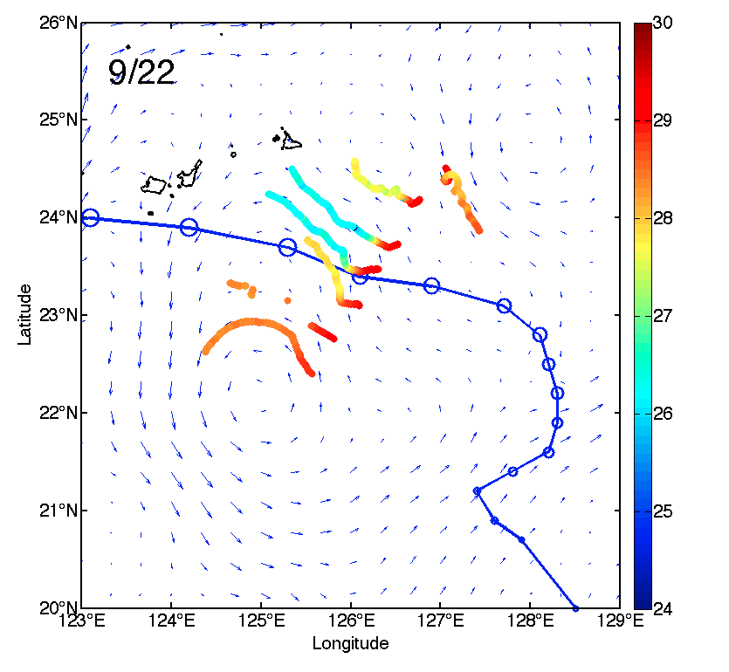
Day 5
Day 5
4907
4910
Temperature [°C]

Slide 47
Day 6
Day 6
4907
4910
Temperature [°C]

Slide 48
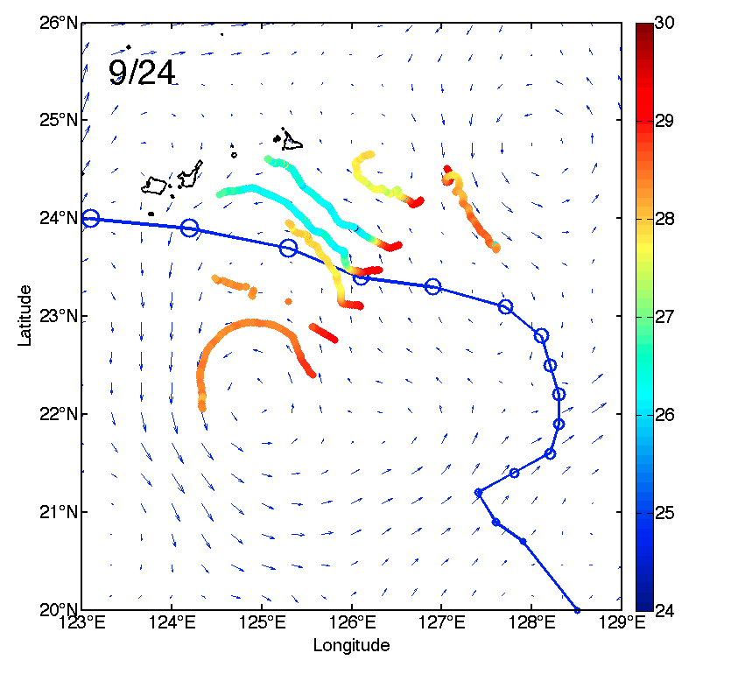
Day 7
Day 7
4907
4910
Temperature [°C]

Slide 49
Day 8
Day 8
4907
4910
Temperature [°C]

Slide 50
Day 9
Day 9
4907
4910
Temperature [°C]

Slide 51
Day 10
Day 10
end of EM-APEX record
4907
4910
Temperature [°C]

Slide 52
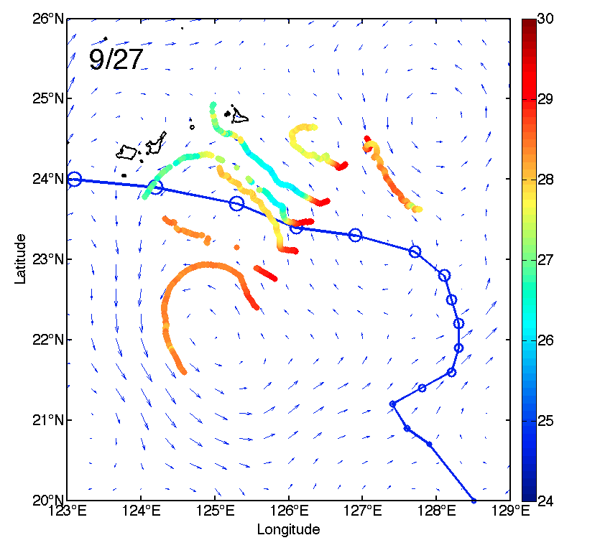
Surface Mixed Layer Temperature
4907
4910
Temperature [°C]

Slide 53
“Wake Layer”
Temperature
4907
4910

Slide 54
What happened?
Capped – isolated from the atmosphere
subsurface jet -> wake slides under warmer water
Solar radiation -> subsurface ML preserved
Ryukyu Ridge – peels in half like string cheese
Eddy – strains the wake

Slide 55
Seagliders see the ‘capped’ wake also
sg169
Can still see 26.5°C layer at day 12!
Day: 7
8
9
10
11
12
13
14
(00Z UTC):
9/25
(end EM record)
10/02
sg181
Where were these Seagliders?

Slide 56
sg181, sg169
4907
4910

Slide 57
To Summarize
Fanapi; the most well-sampled wake in history!
Wake persisted as a surface feature for a week
But survived up to 12 days ‘undercover’
Processes to preserve the wake = capping due to subsurface jet + solar insolation
Processes to destroy the wake = topography, eddy, mixing

Slide 58
Questions?

Slide 60
Warming rate as a function of cooling amplitude.
The grand-average e-folding time is about a week. This includes what appears to be significant regional variation, i.e., the persistent cool patch to the east.

Slide 61
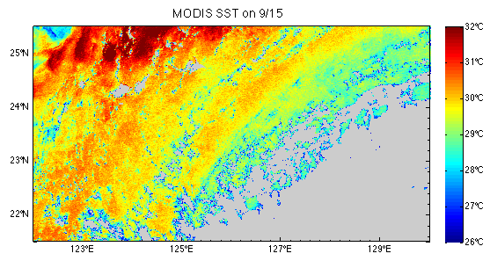
Comparing SST
9/15
MODIS
9/20
MODIS

