Slide 1
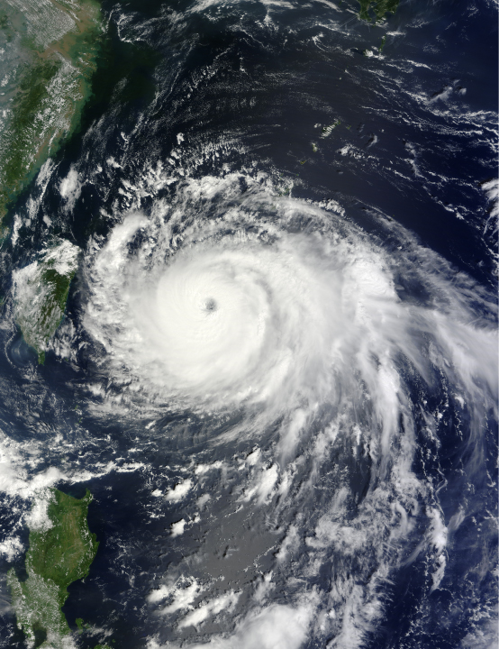
Coordinated Sampling of the Cold Wake of Typhoon Fanapi
What is the three-dimensional response of the ocean to a typhoon?
How does the cold wake of a typhoon disappear? How long does it persist?
Ships
Planes
Moorings
Gliders
Air-deployed floats
Air-deployed drifters
3-D temperature evolution
3-D inertial response
Mixing processes

Slide 2
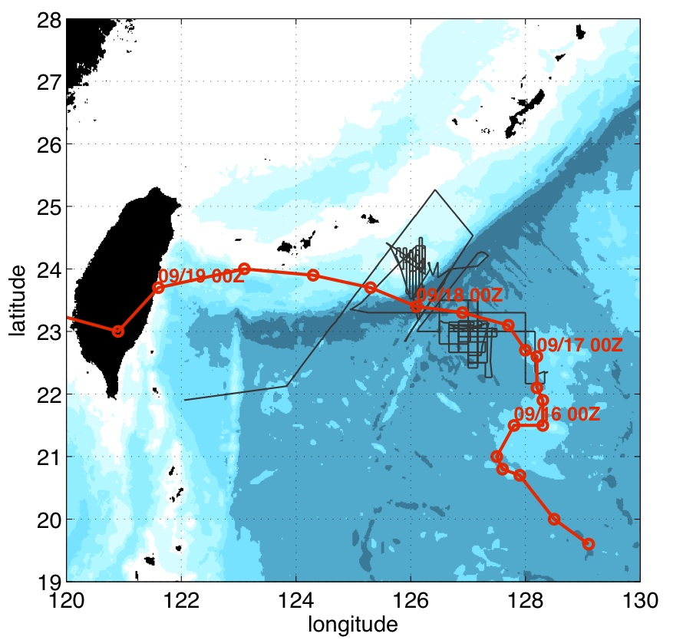
Typhoon Fanapi storm track
Typhoon Fanapi:
category 3 typhoon,
formed on 14 September,
made landfall in Taiwan on 19 September,
dissipated on 22 September over mainland China.

Slide 3
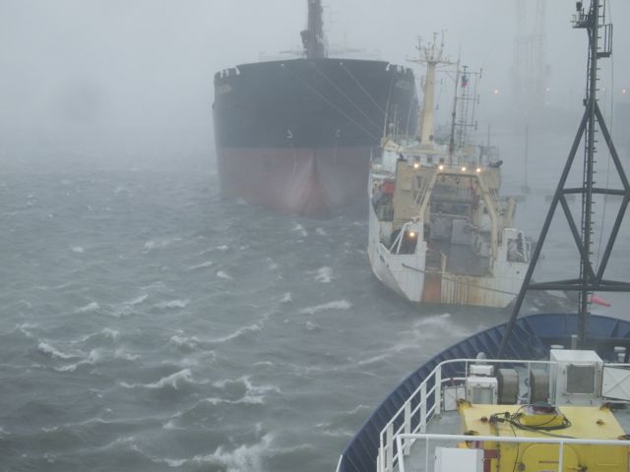
Decision made on 16 Sept 2300Z
Seattle
Woods Hole
Florida
Colorado
Keelung
Kaohsiung
arrive to Revelle ahead of Fanapi!

Slide 4
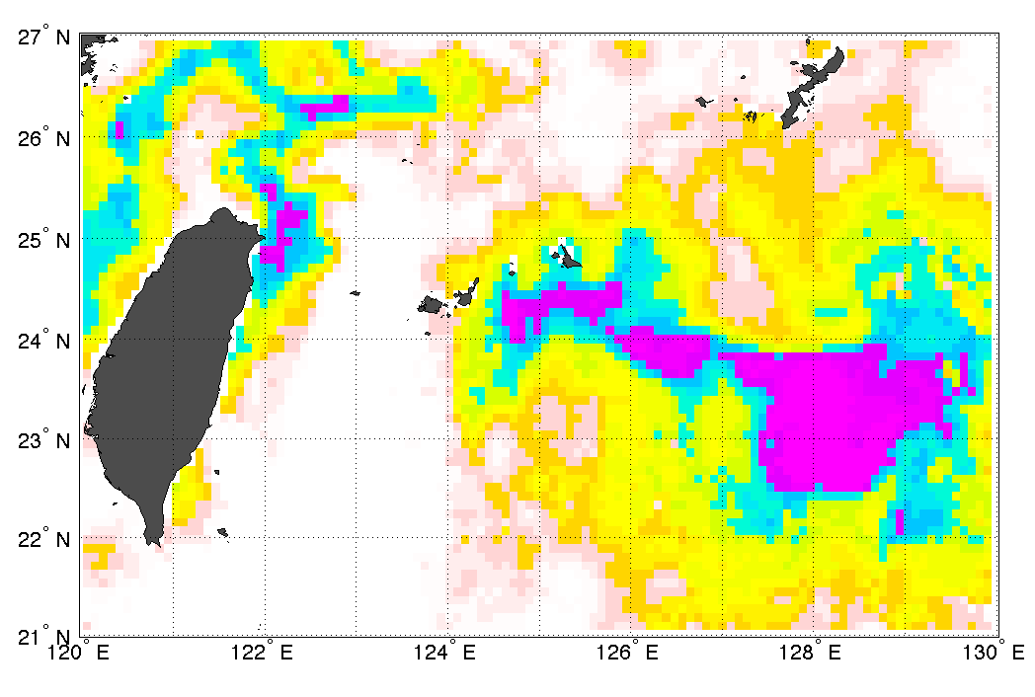
Sea-surface temperature
21 Sept. 2010
Cold wake:
Mostly due to mixing of deeper water during and after the storm.
>29°C
<27°C
NASA MW IR OI image

Slide 5
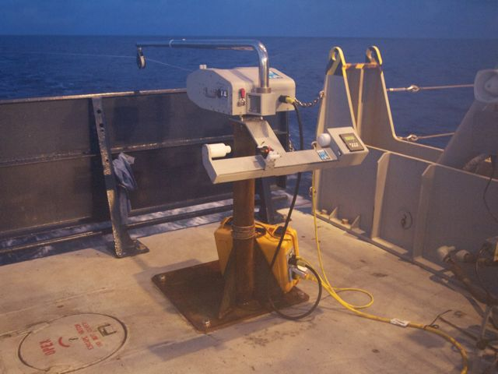
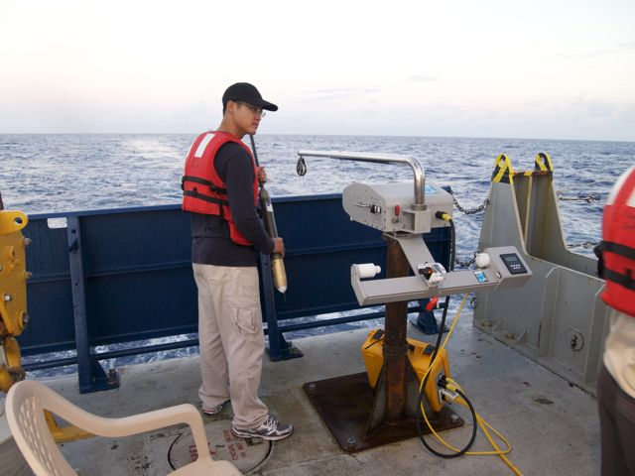
Underway CTD
2827 casts to 170 m (6 min cycles at 10 kts)
82 casts to 400 m (18 min cycles at 10 kts)
8 casts to 850 m (20 min cycles at 1 kt)

Slide 6
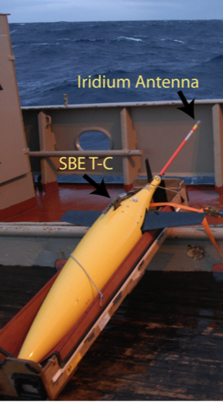
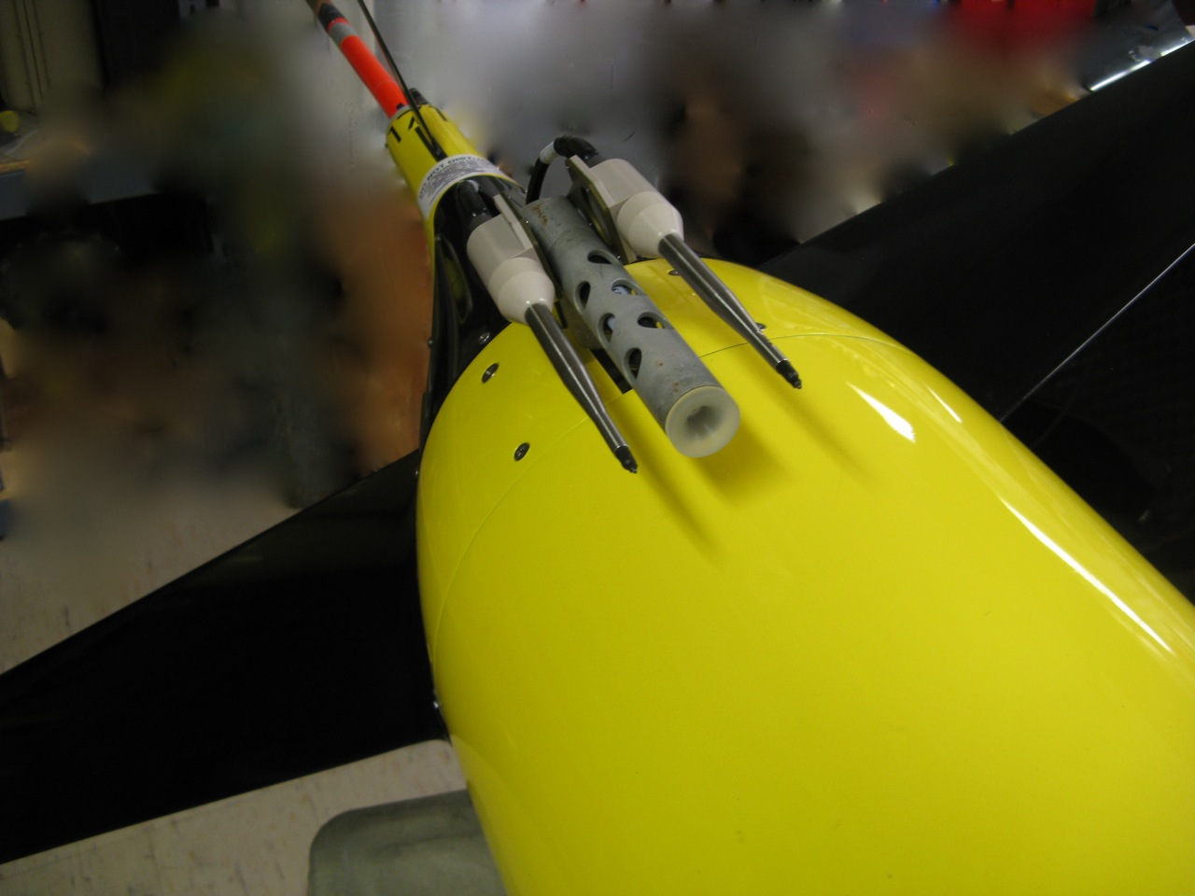
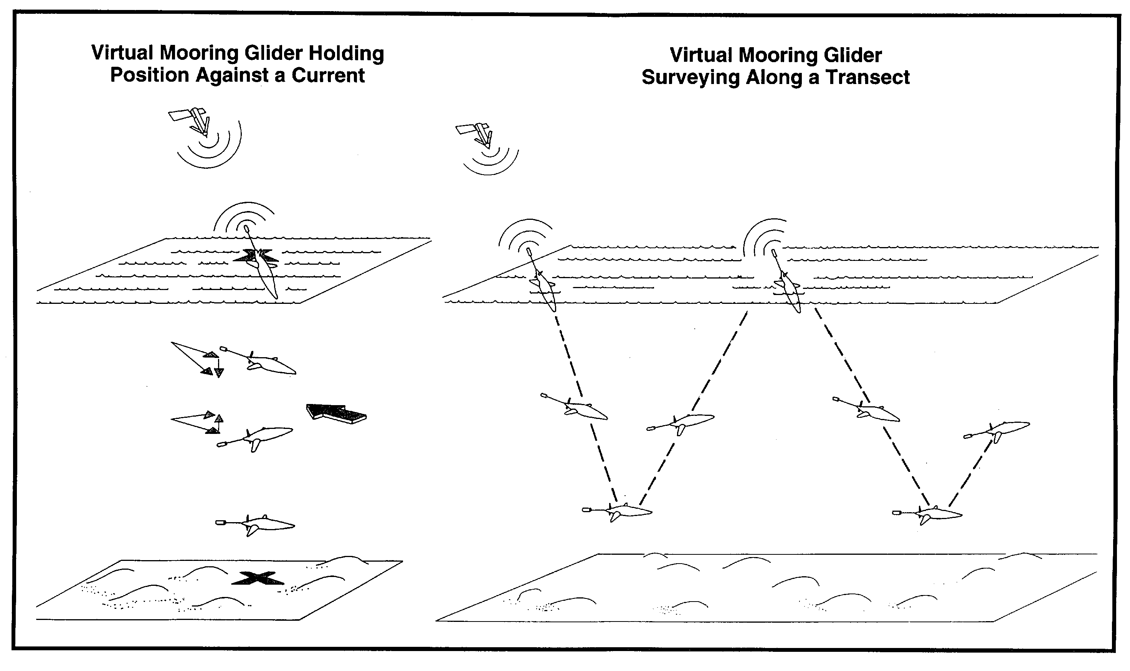
Seagliders during ITOP
Autonomous measurement platforms:
• profile to 500m about 12 times per day (vs. typically 3-4 times to 1000 m)
• T, S, oxygen, optical properties.
• real time data transmission.
• can travel 20 km / day.
• depth-averaged currents, absolute geostrophic velocity
• 6 week deployments during ITOP (vs. typically 6 months)
• 3 gliders had micro-temperature (turbulence) sensors.
• adaptive sampling

Slide 7
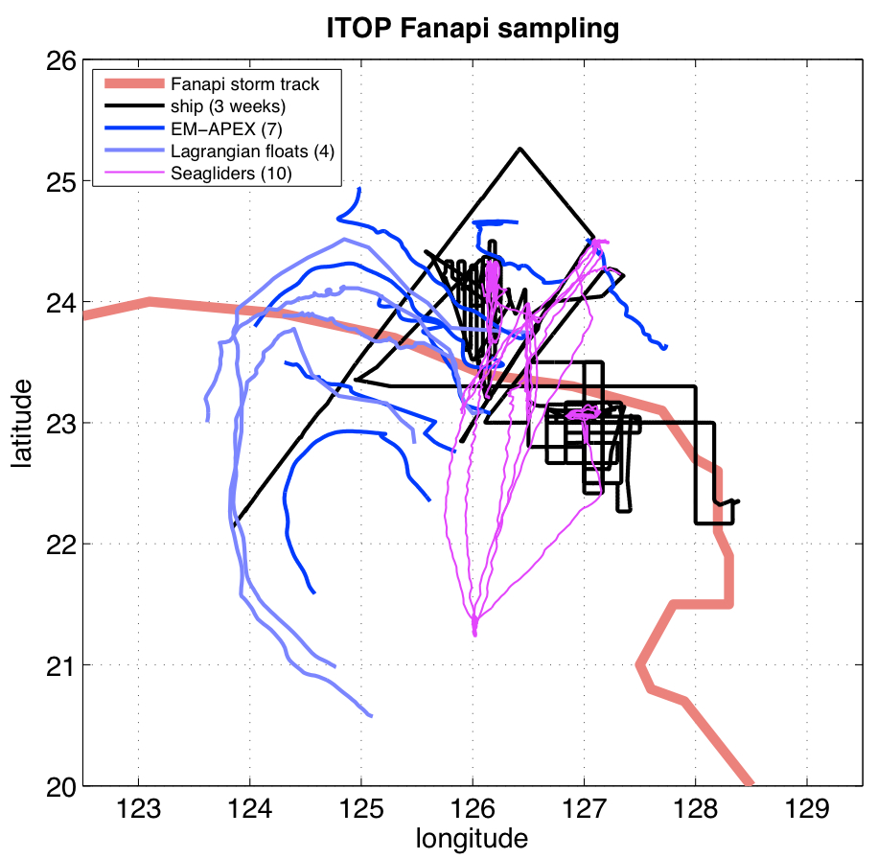
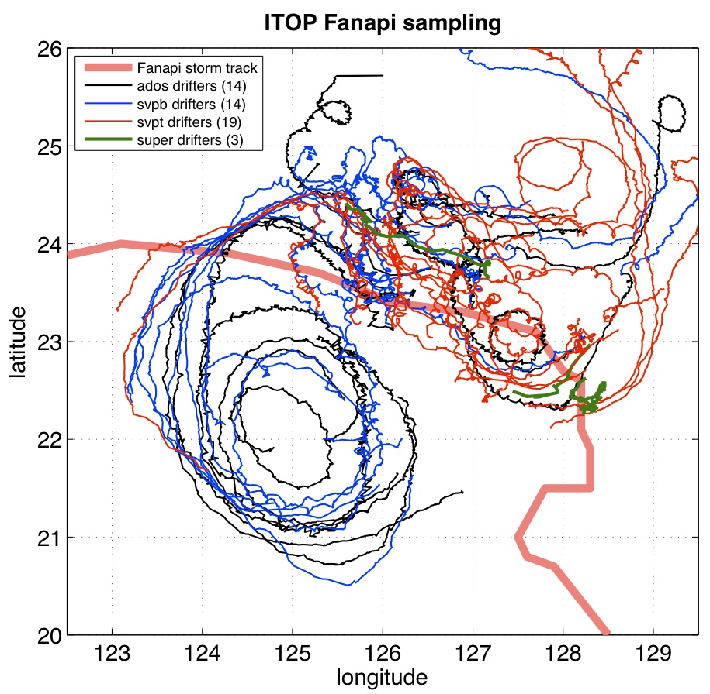
Adaptive and Integrative Sampling
10 Seagliders: 3100 dives over 1 month (including 580 χ-profiles from 3 gliders).
Underway-CTD (ship): 3162 profiles over 20 days.
172 VMP profiles (ship).
7 EM-APEX, 4 Lagrangian Floats.
28 surface drifters
19 surface drifters with T-chains
3 surface drifters with T-chains and ADCPs
+ MOORINGS and other observations

Slide 8
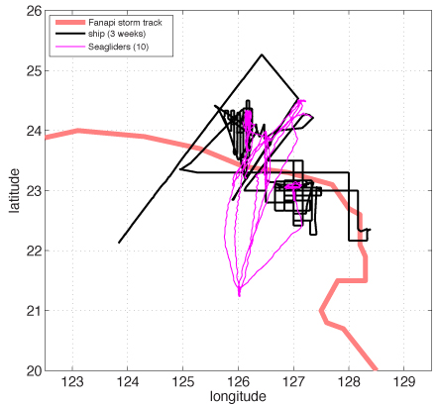
Glider and ship tracks
SITE A: narrow and strained wake.
SITE B: large persistent cold pool.
A4
Pickup site: East of Luzon, near moorings

Slide 9
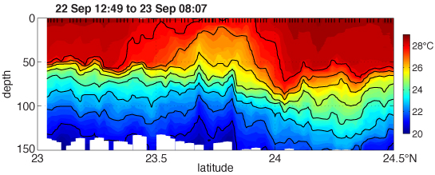
Subsurface cold wake
Rapid restratification near the surface
Sub-surface cold-wake
4 days after the storm
Fanapi Track
floats
Many gliders covering a range of latitudes in the wake.
gliders

Slide 10
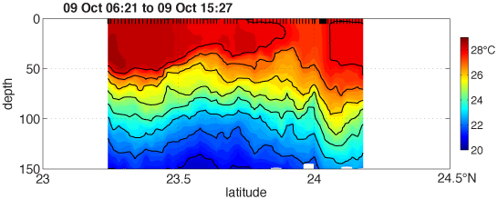
Evolution of Cold Wake
Persistent sub-surface cold-wake.
Surface signature not aligned with sub-surface signal.
4 days after the storm
Same location, 3 weeks after the storm

Slide 11
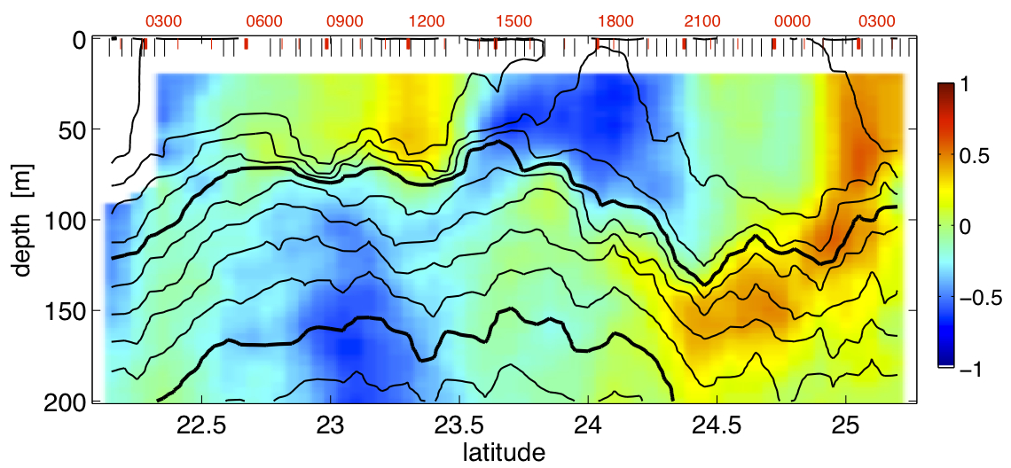
Section from A4 to the wake
Eastward velocity
Mooring A4
Fanapi track
Cold wake
Shear layers cross isopycnals
Transit time < T_{inertial}

Slide 12
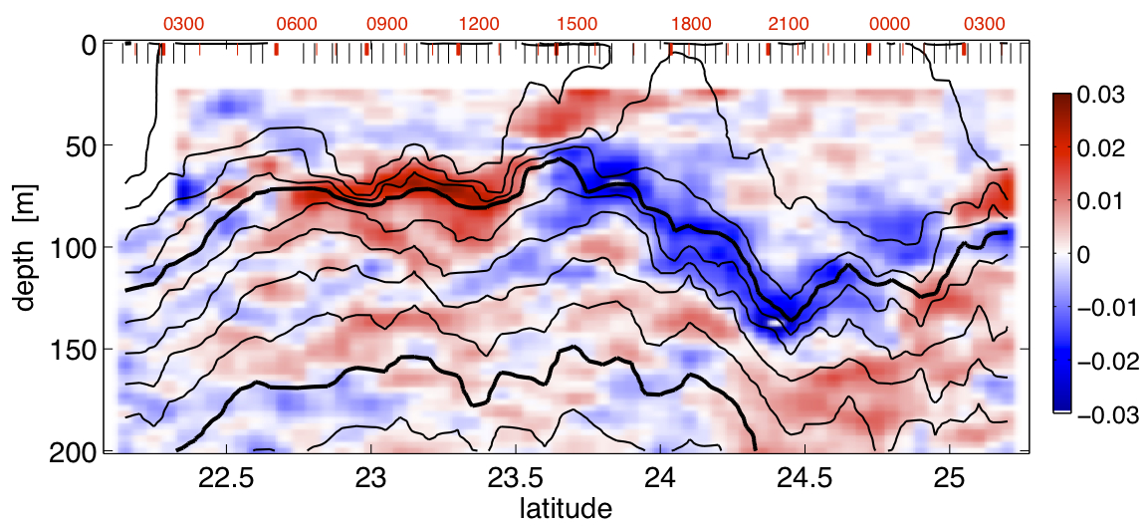
Section from A4 to the wake
Vertical velocity shear
Mooring A4
Fanapi track
Cold wake
Shear layers cross isopycnals
Transit time < T_{inertial}

Slide 13
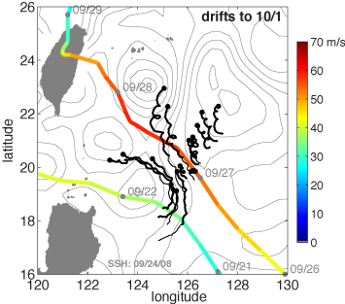
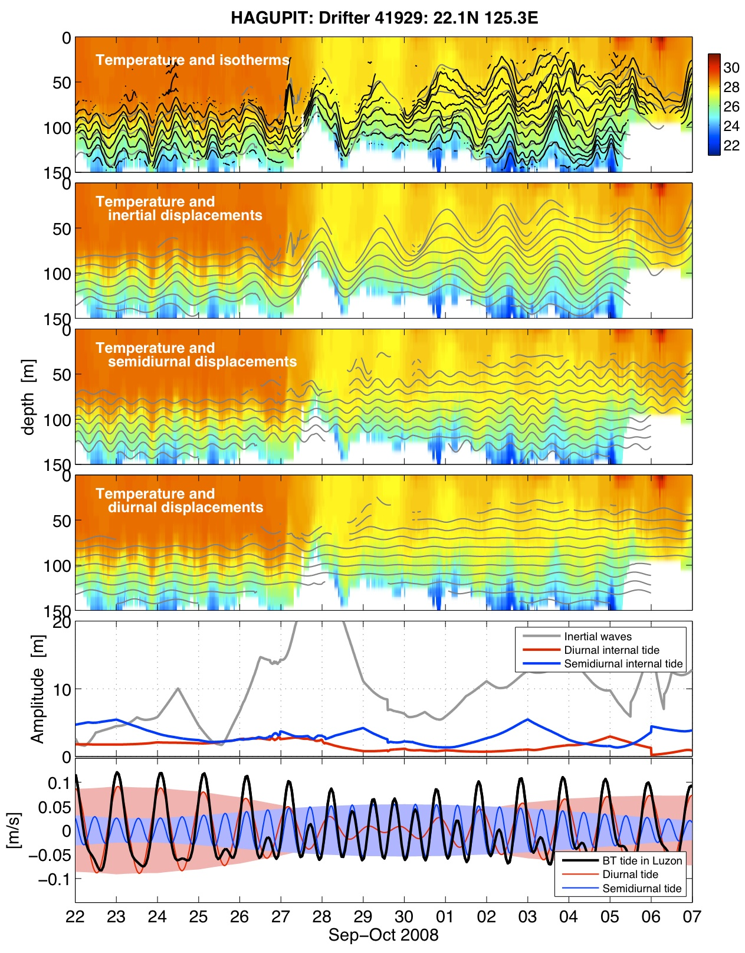
Inertial waves
Hagupit
cooling
generation of inertial waves
Data from Peter Niiler and Luca Centurioni, SIO
What is the spatial scale of the inertial waves?
What fraction dissipates locally, and how much energy propagates away?

Slide 14
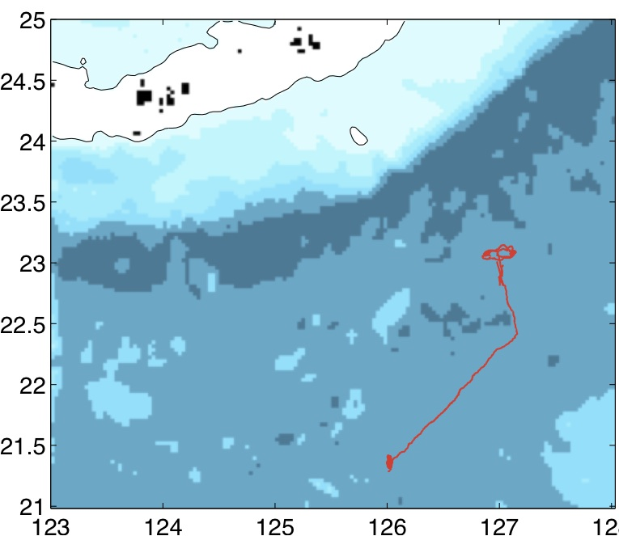
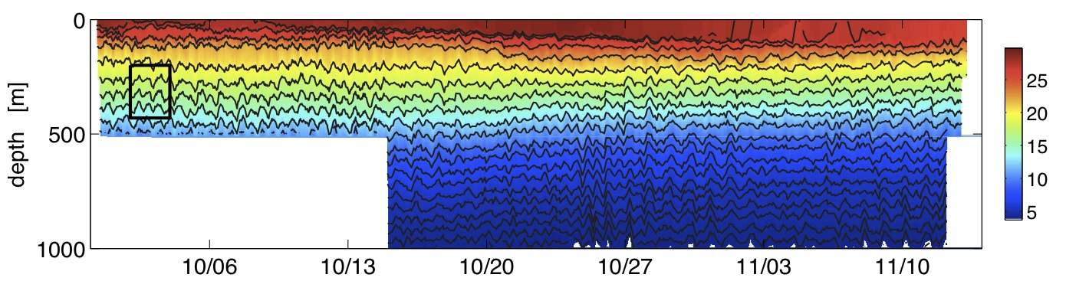
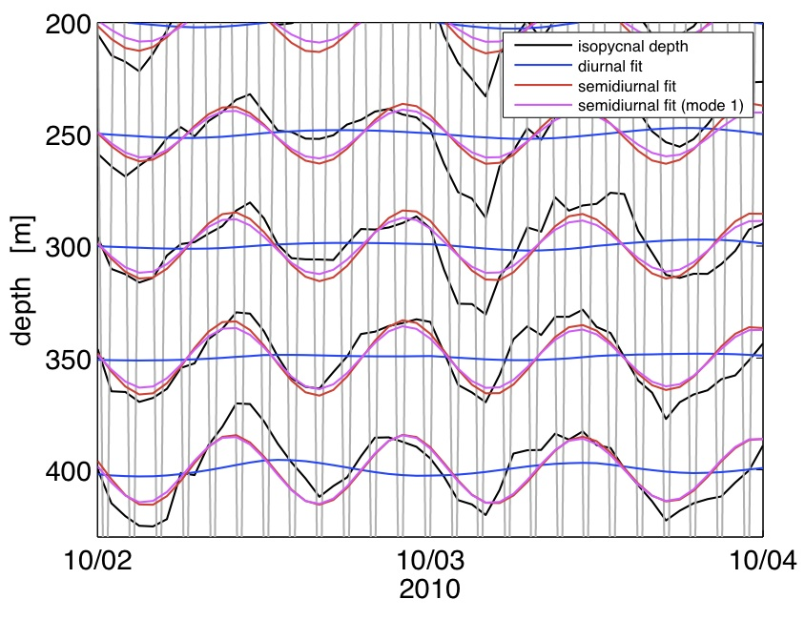
Gliders and internal waves
SG167
Measured isopycnal displacements
T
Fitting semidiurnal (12h) and diurnal (24h) and inertial (here 30h) waves to measured displacements.

Slide 15
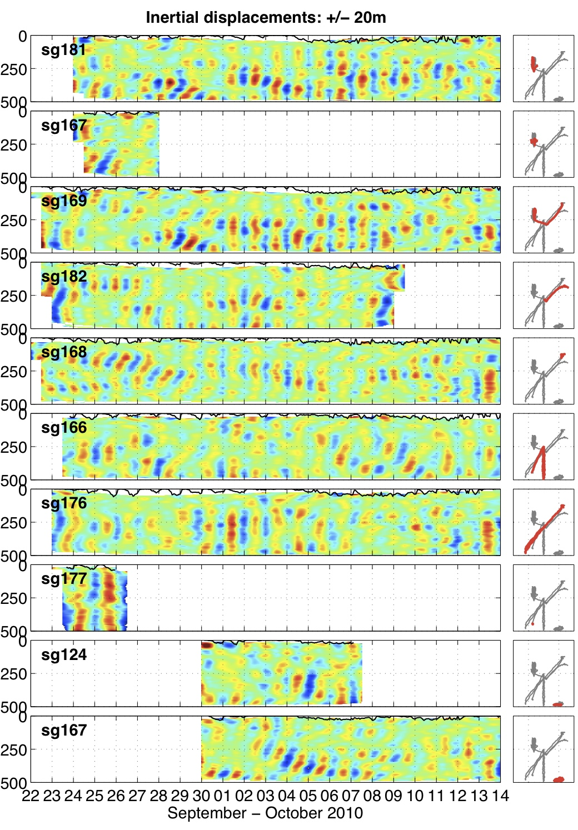
Inertial waves
10 glider deployments (6200 profiles!)
1
Inertial waves generated by the storm: vertically propagating.
Low-mode inertial waves: traveling large distances???
2
2
1

Slide 16
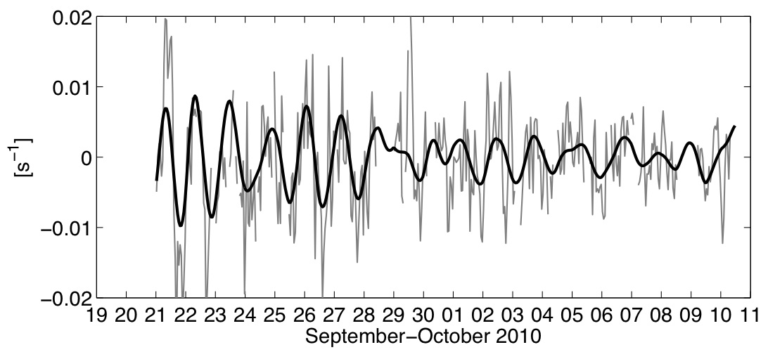
Inertial waves
1
Inertial waves generated by the storm: vertically propagating.
Low-mode inertial waves: propagating over large distances???
2
Need to look at ship data
(velocity, shear, …)
Need to look at moorings
Need to look at float and drifter data.
CW shear btw T₂₄ and T₂₆
from HDSS
2
1

Slide 17
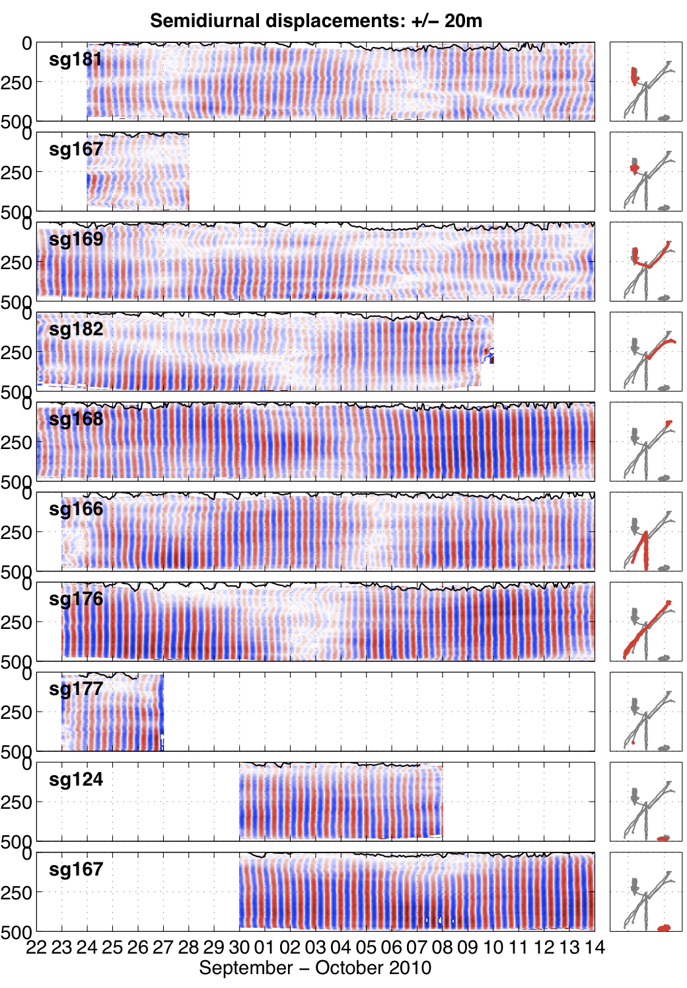
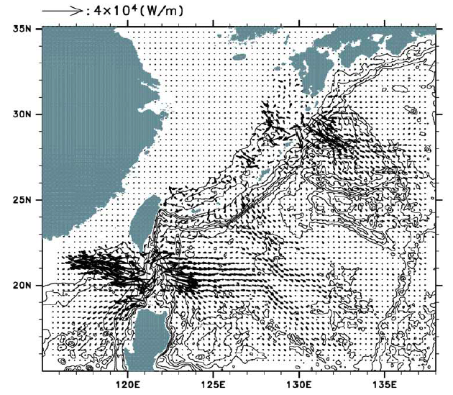
Semidiurnal tide
Need to look at float and drifter data.
Need to look at moorings

Slide 18
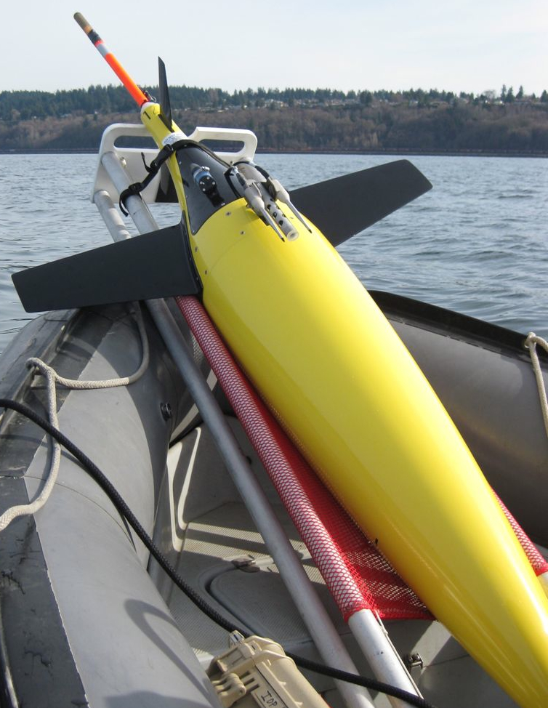
Micro-temperature Seaglider
Measure small scale (cm) fluctuations of temperature: related to turbulence and dissipation of energy.

Slide 19
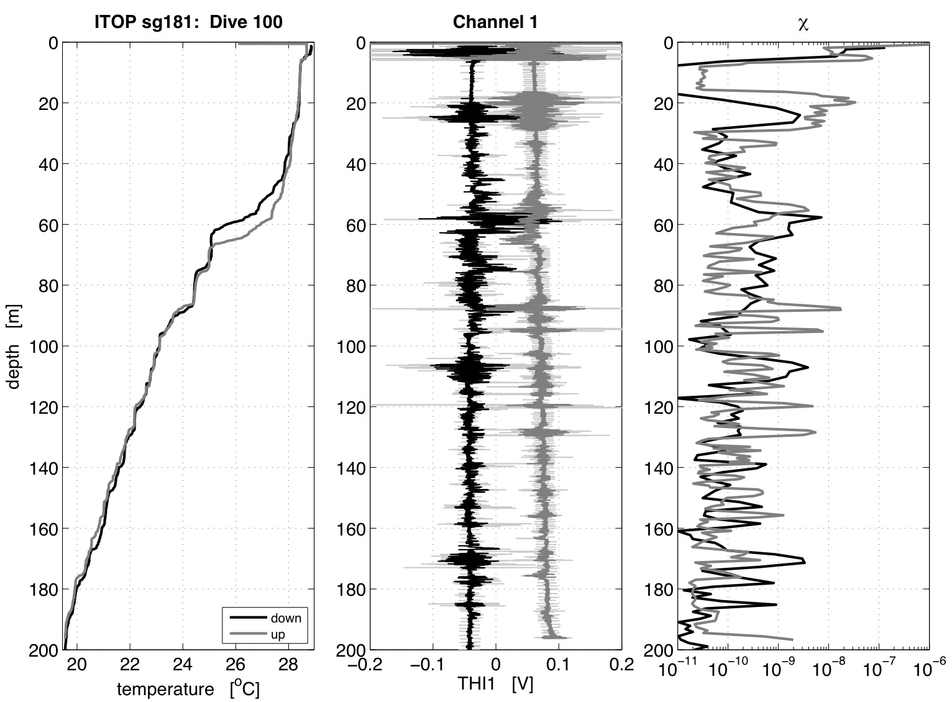
Typical χ profile at SITE A

Slide 20
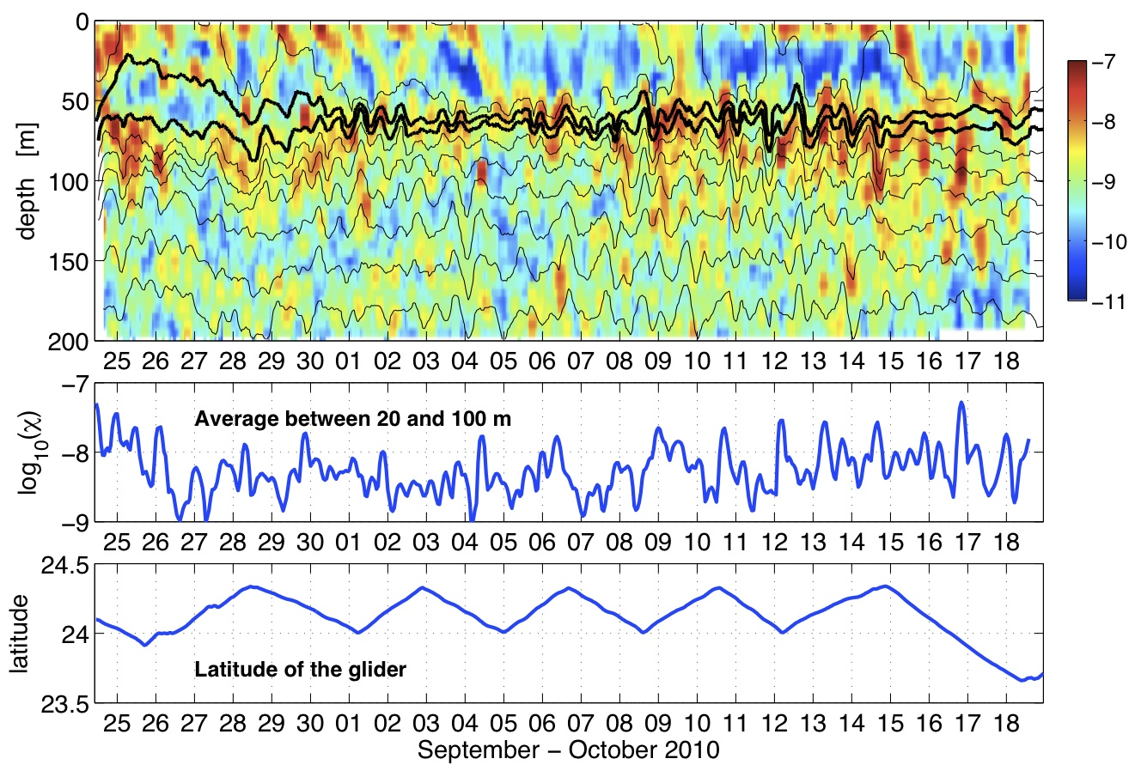
Time series of χ at SITE A
Diurnal heating
log₁₀(χ)
Elevated dissipation
269 dives over 24 days!!!

Slide 21
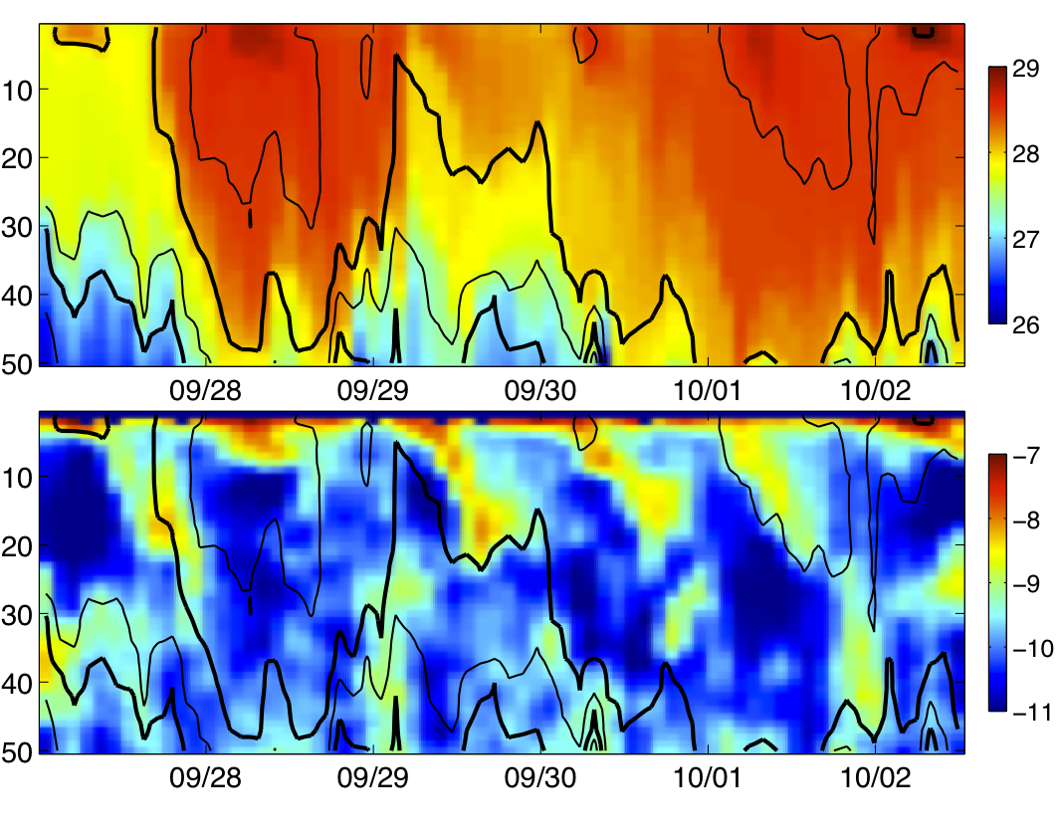
Diurnal heating
29°C
T [°C]
depth [m]
28°C
27°C
log₁₀(χ)
depth [m]

Slide 22
Summary
Together, the data resolve the three-dimensional response of the ocean to a typhoon.
The sub-surface cold wake persists for a long time!
Ships
Planes
Moorings
Gliders
Air-deployed floats
Air-deployed drifters
3-D temperature evolution
3-D inertial response
Mixing processes

