Slide 1


EM-APEX Floats Observations in Typhoon Fanapi
Ren-Chieh Lien and Thomas B. Sanford
Applied Physics Laboratory and School of Oceanography
University of Washington
14 EM-APEX Floats Successfully Deployed in Fanapi and Megi
Strong Inertial Waves, Subsurface Jet (Cyclone Induced) , Internal Tides, and Meso-scale Eddies
Rapid Inertial Energy Decay Rate (e-folding time ~2-3 Days)
Upwelling near Eye (>50 m), Strongest Surface Cooling -2.5ºC at Inertial Resonant Region
Acknowledgement: ONR support, Groups at Monterey Control Center and Guam , on Revelle and Taiwanese RVs

Slide 2
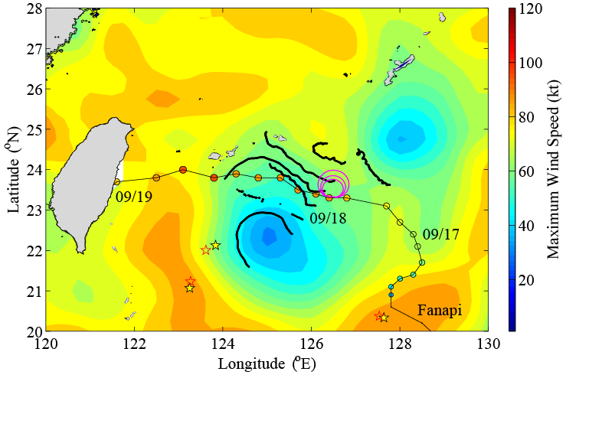
Inertial Resonance Forcing
Wind Rotation Rate
= 0.8f, 1.0 f, 1.2f
C ~13km/hr
A4
EM-APEX float 4907 at the resonant region
A2
A1
Fanapi

Slide 3

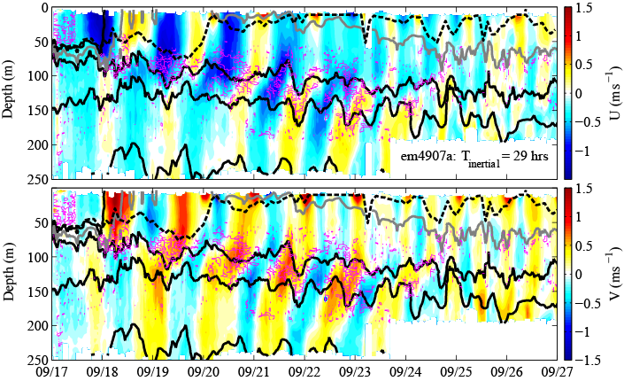
Oceanic Response at the Resonance Forcing (float 4907)
Profiling: Temperature, Salinity, Pressure, U, V
σ_{θ}= 22
MXL
22.5
23
U
24
σ_{θ}= 25
Internal Tide
V
S²-4N² >0 (Shear Instability)
Fanapi
em4907a

Slide 4
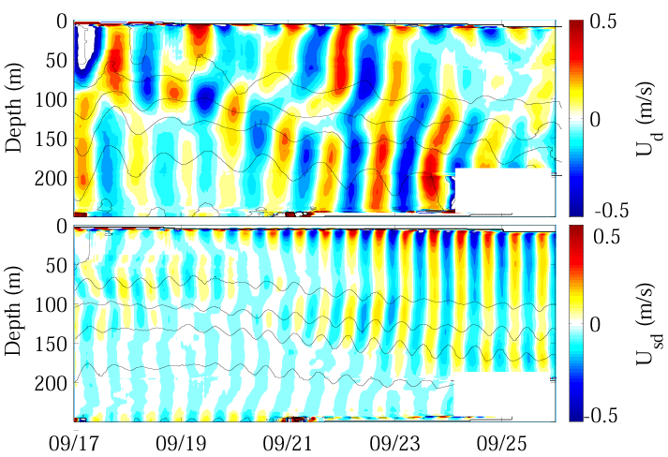
Decomposition of Velocity and Density
U = Inertial + diurnal tide + semidiurnal tide + subinertial (>36 hrs)
O(0.5m/s)
Diurnal
Semidiurnal
<0.5m/s
Fanapi
em4907a

Slide 5
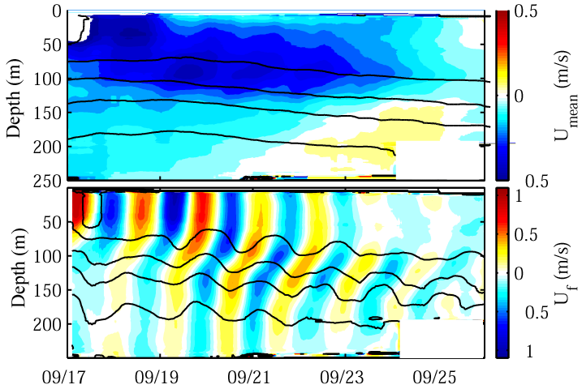
Subinertial Motion and Inertial Wave
Subsurface Jet
Cyclone Induced?
-
Inertial Wave
Upward phase propagation
Downward energy propagation
-
Fanapi
em4907a

Slide 6
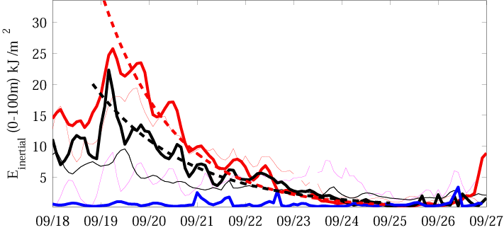
Depth Integrated Inertial Wave Energy
All floats
e-folding time scale 2-3 days for inertial wave energy
4-6 days for velocity
Resonant
Eye
Resonant: em4907a
Eye: em4910a
Far Field: em4906a
Far Field
Fanapi

Slide 7
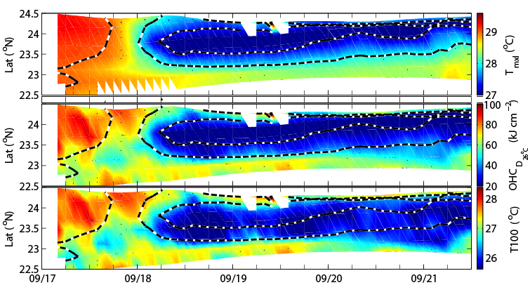
Oceanic Response to Fanapi
28ºC
29ºC
27ºC
ΔT = -2.5ºC
Eye of Fanapi
Mixed Layer Temperature
ΔOHC = 70 kJ/cm²
Eye of Fanapi
Ocean Heat Content
ΔT ₁₀₀ = -2ºC
Eye of Fanapi
T₁₀₀
Fanapi

Slide 8
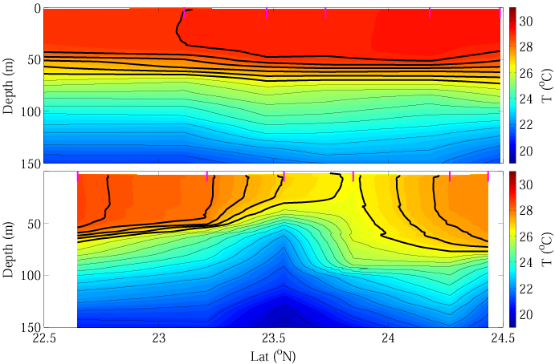
Upwelling and Mixing
Pre-storm
29ºC
26.5
6hrs after eye
26.5
27
X
Subsurface Jet
Mixing or surface cooling
Upwelling
Fanapi

Slide 9
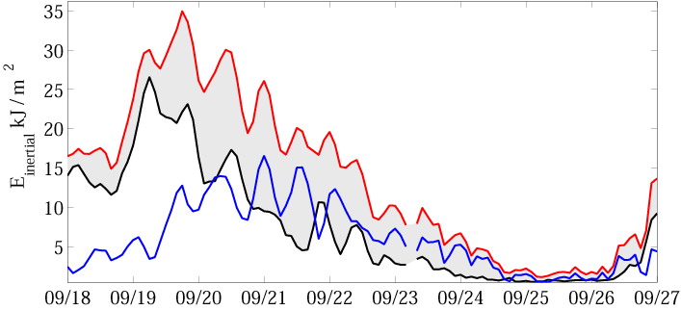
Inertial Wave Energy Vertical Propagation
Float 4907
surface - σ_{θ}= 25 (D25)
Steady deep inertial wave energy available for deep mixing
Δt < ½ day
0-D23
D23-D25
Fanapi
em4907a

Slide 10
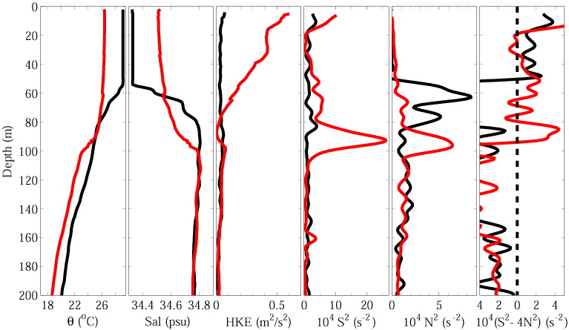
Change of Oceanic Vertical Profiles
after
before
Fanapi
em4907a

Slide 11
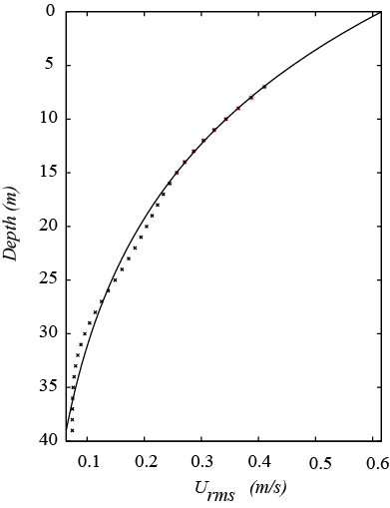
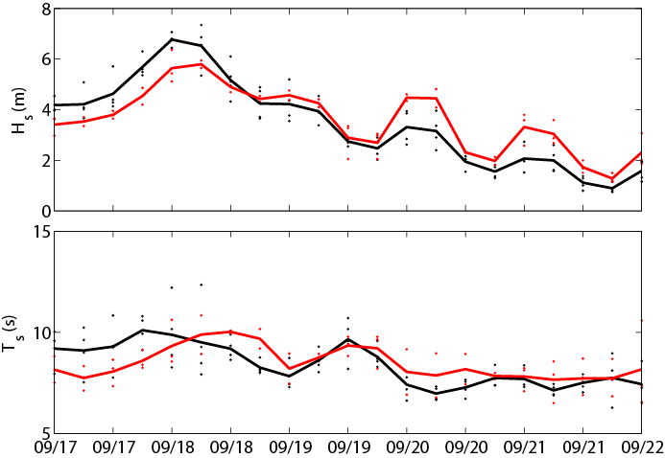
Estimates of Surface Waves from EM-APEX
Maximum Significant Wave Height ~ 7 m
Wave Period 7-10 seconds
Exponential Fit
Right of Fanapi
left of Fanapi
Significant Wave Height
Right of Fanapi
left of Fanapi
Wave Period
Fanapi

Slide 12
Summary
Fanapi forced strong inertial waves and subsurface jet (dynamics?)
Significant background internal tides and eddies
Rapid decay rate of inertial wave energy 2-3 days e-folding time
Strong upwelling > 50 m; inertial pumping 20-40 m
Maximum sea surface cooling -2.5 C;
Sea surface salinity increase 0.1 psu
Collaboration: model simulations, other oceanic observations, and estimates/measurements of surface wind, heat flux, precipitation

