Slide 1
Meso-scale structure observed by ITOP T-string moorings
I-Huan Lee, Yih Yang, Yu-Huai Wang ,David Tang
2011 5.16~21 ITOP meetings at Santa Fe

Slide 2
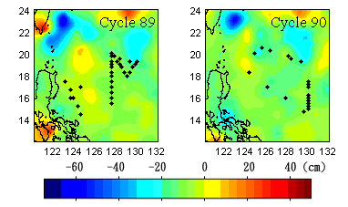
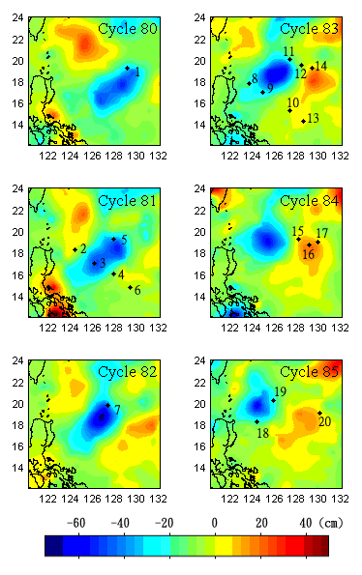
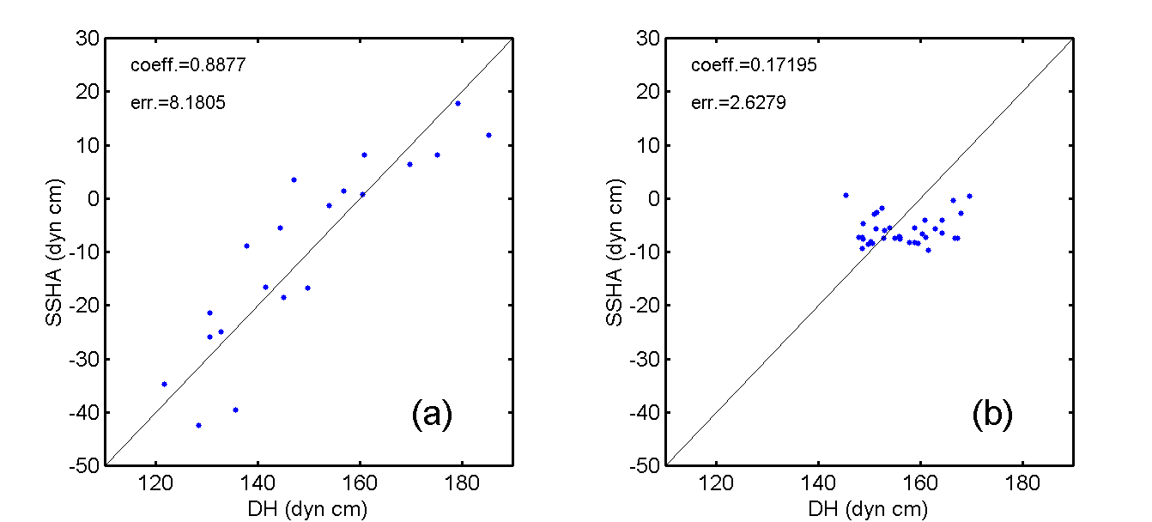
XBT stations (from NODC) :
2nd group
near 9410L
background
1st group
1st group: corr. coef.= 0.89 ; err ~ 8.2 dyn cm
2nd group: corr. coef.= 0.17 ; err ~ 2.6 dyn cm
DH500 = SSHA + 160 + O(8) dyn cm

Slide 3
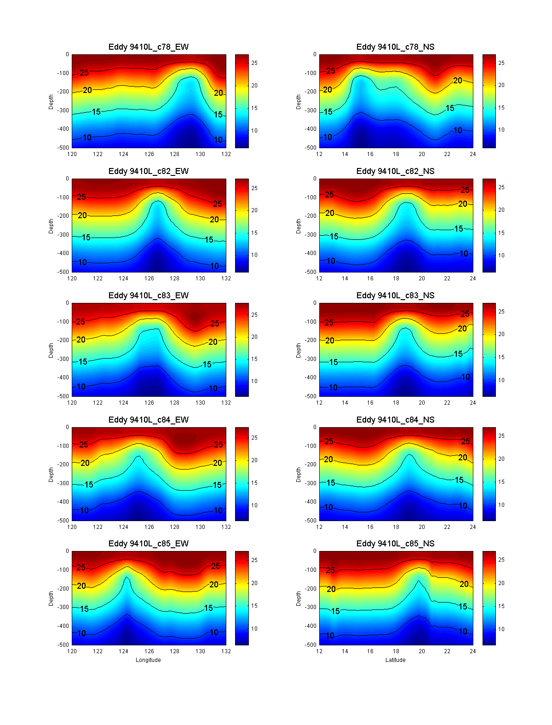
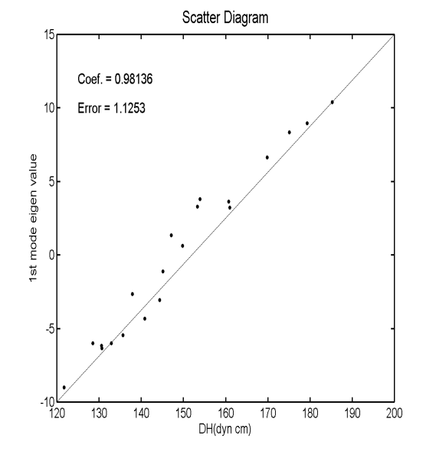
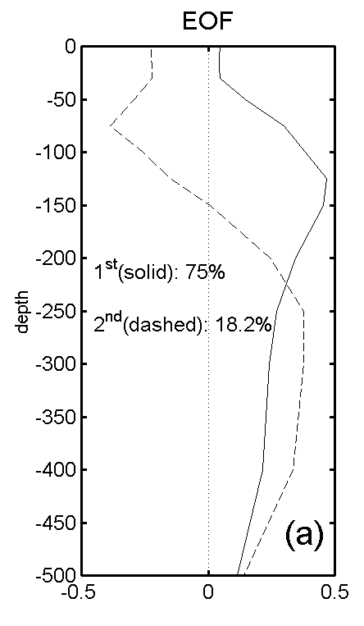
Method
apply EOF to temperature profile
PC1 = 0.3182 *DH - 47.5907
DH=SSHA+160
PC1 = 0.3182*(SSHA+160) - 47.5907
Before:
Grided altimetry SSHA and (grided) hydrographic data (ex. XBT, CTD…etc)
Now:
Along track altimetry SSHA and hydrographic data, ex. A1 A2 A3

Slide 4
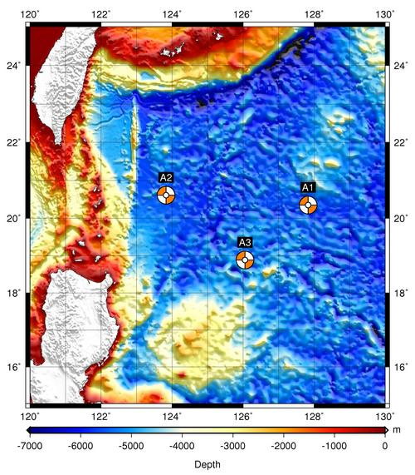
ITOP moorings A1、A2 、 A3、 A4
Ocean data observation time and sample rate:
1st deployment：
Mar., 2009 ~ Sep., 2009
A1: 2009/03/22 ~ 2009/09/22 dt= 2 min
A2: 2009/03/29 ~ 2009/09/24 dt=15min
A3: 2009/03/25 ~ 2009/09/20 dt= 2min
2nd deployment：
Sep., 2009 ~ Mar., 2010
A1: 2009/09/23 ~ 2010/03/24 dt= 2 min
A2: 2009/09/30 ~ 2009/12/28 dt= 2, 3, 15 min
A3: 2009/09/22 ~ 2010/03/27 dt= 2, 3 min
From TORI : http://mom.tori.org.tw/oppo/

Slide 5
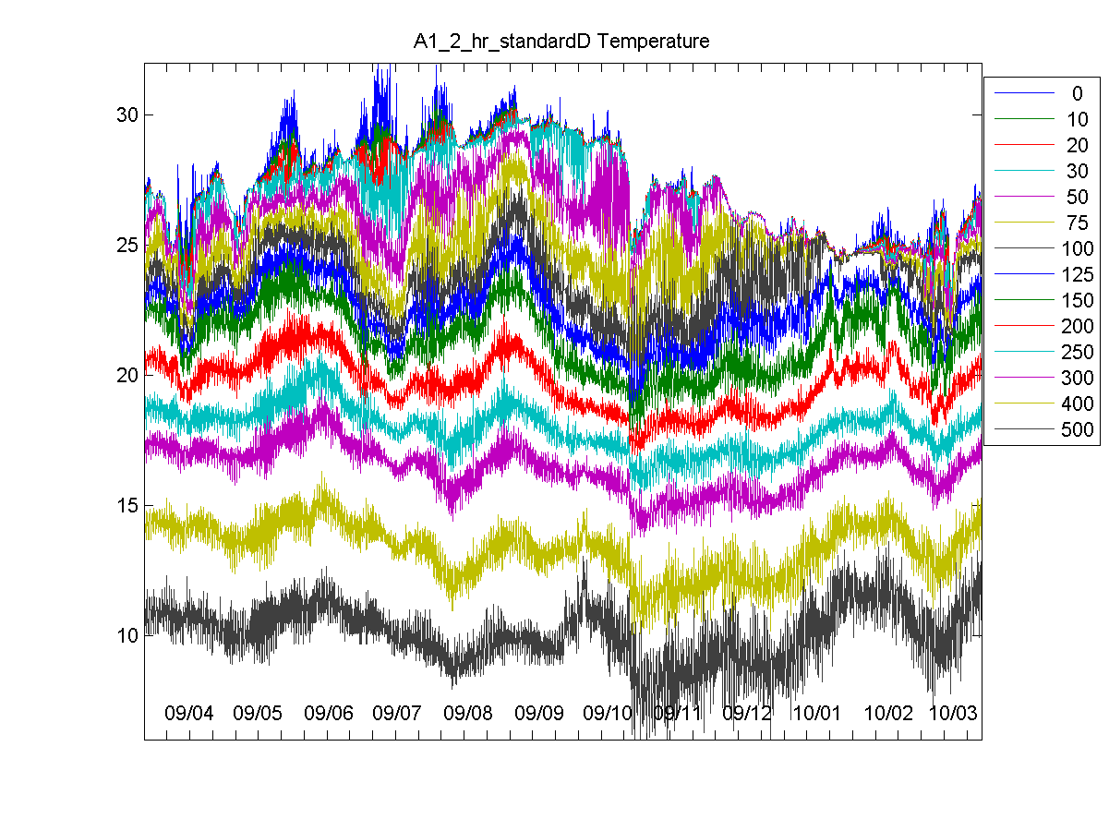
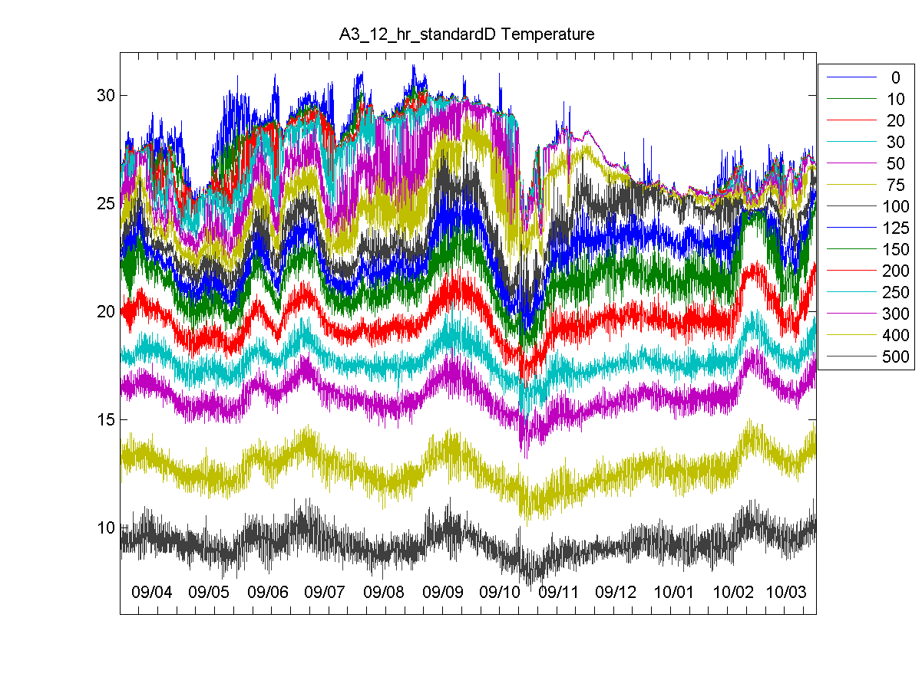
A1 and A2 _ocean
Low pass : cut off : 4 days 2. Interpolate to standard level
3. Calculate dynamic height , using climate average salinity

Slide 6
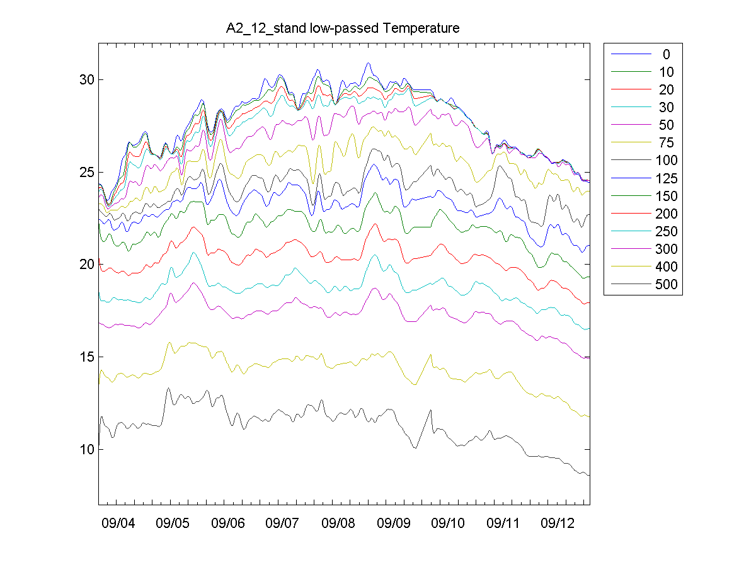
A1 and A2 _ocean
Low pass : cut off : 4 days 2. Interpolate to standard level
3. Calculate dynamic height , using climate average salinity

Slide 7
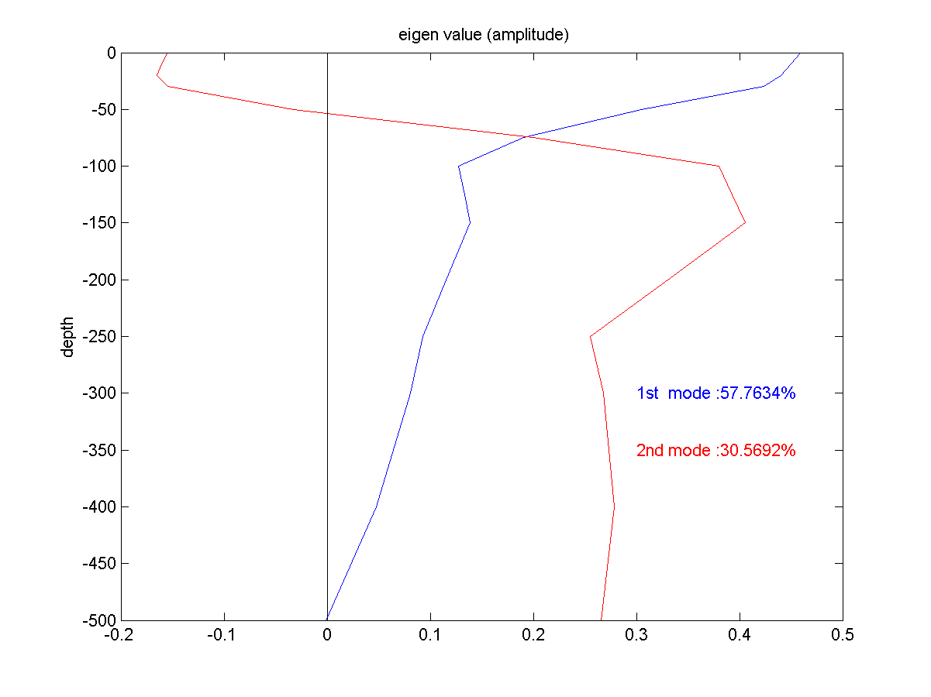
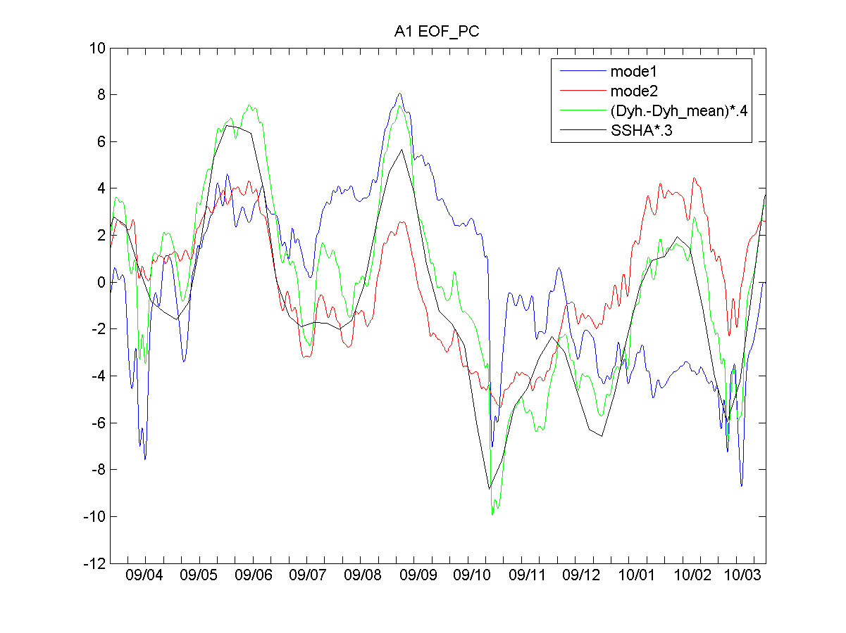
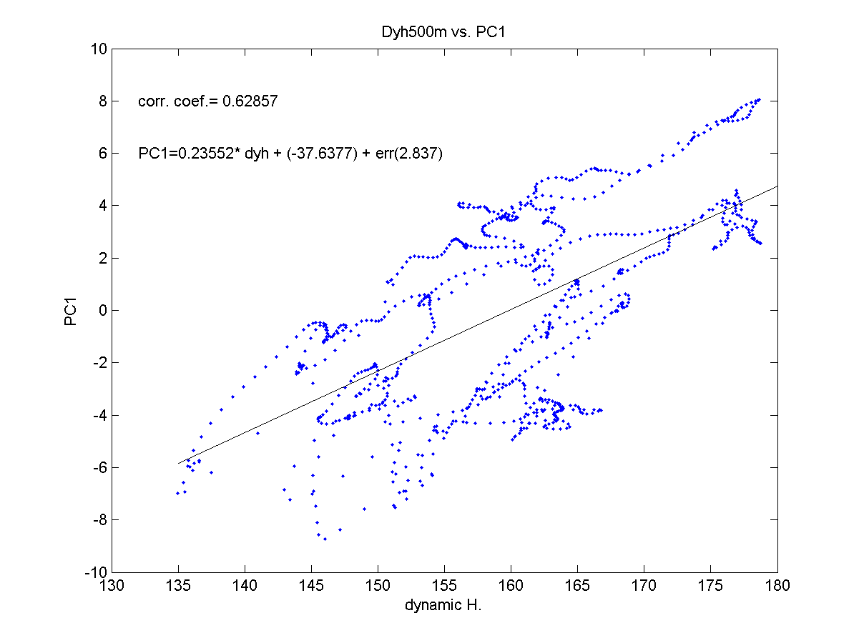
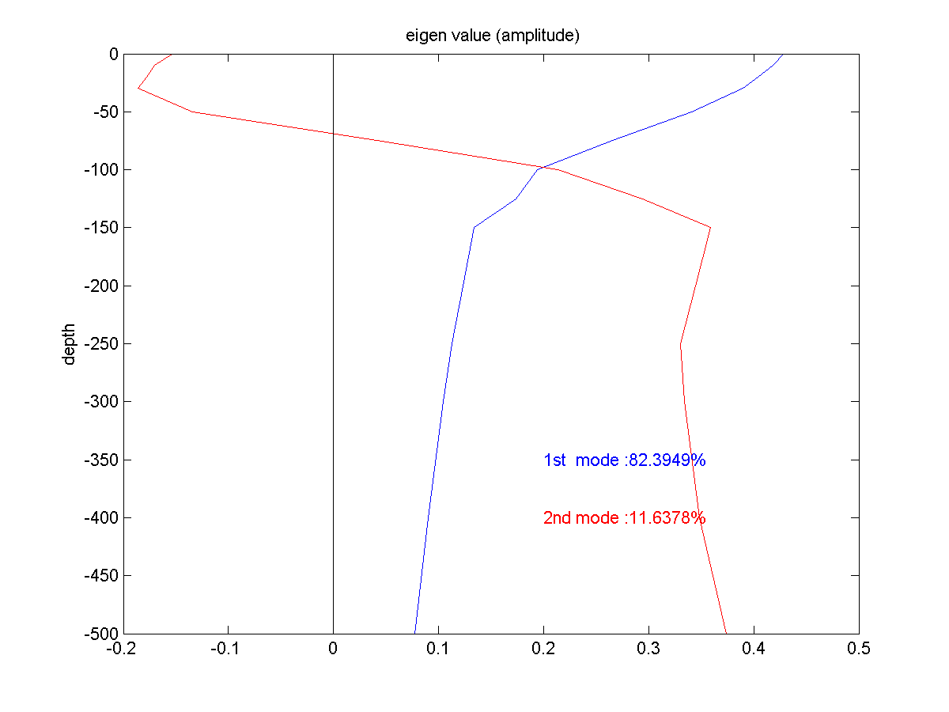
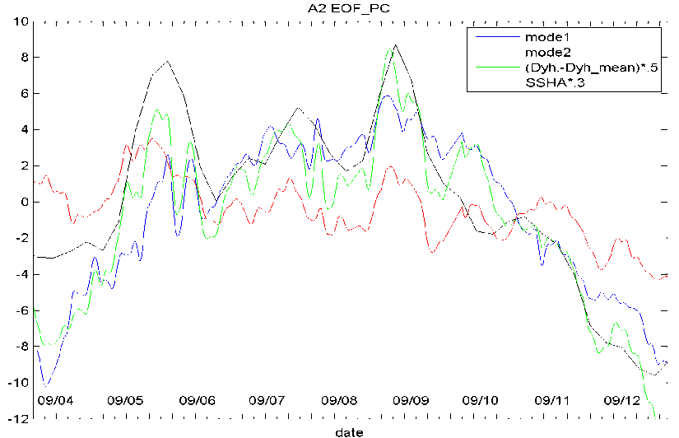
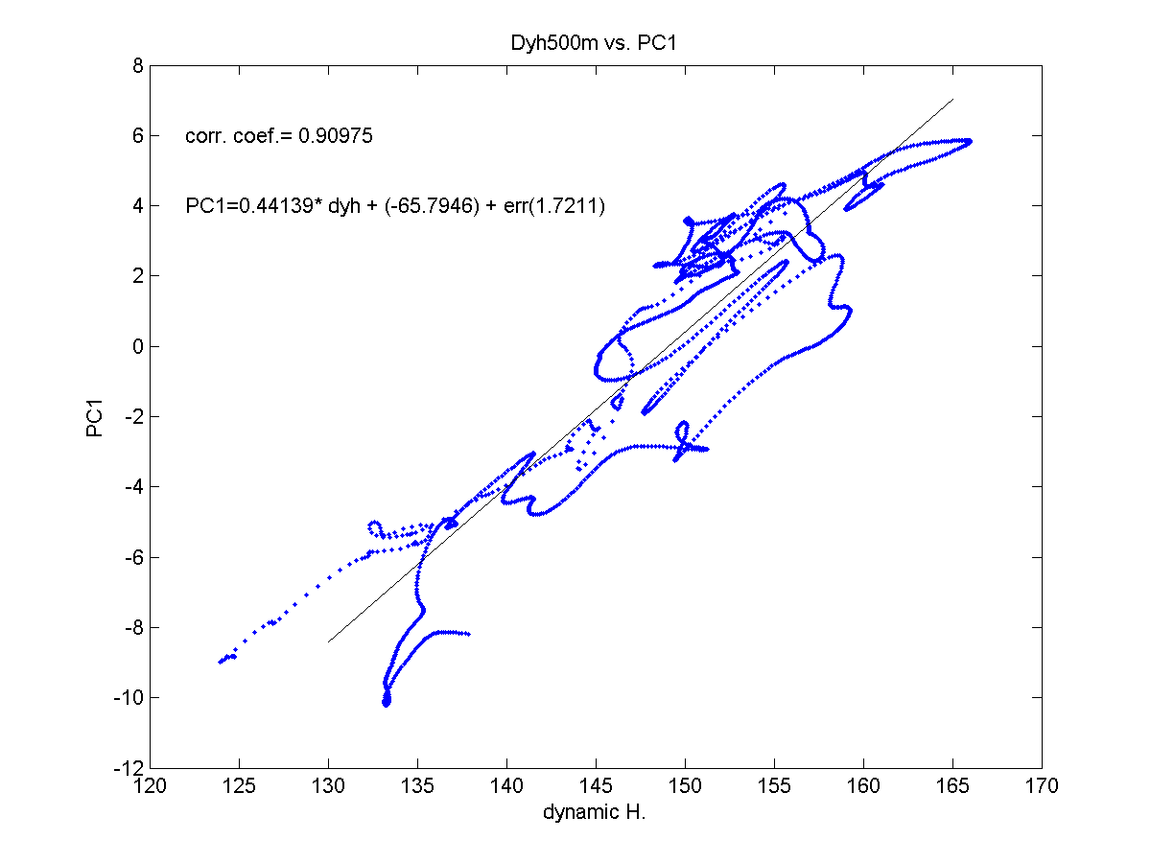
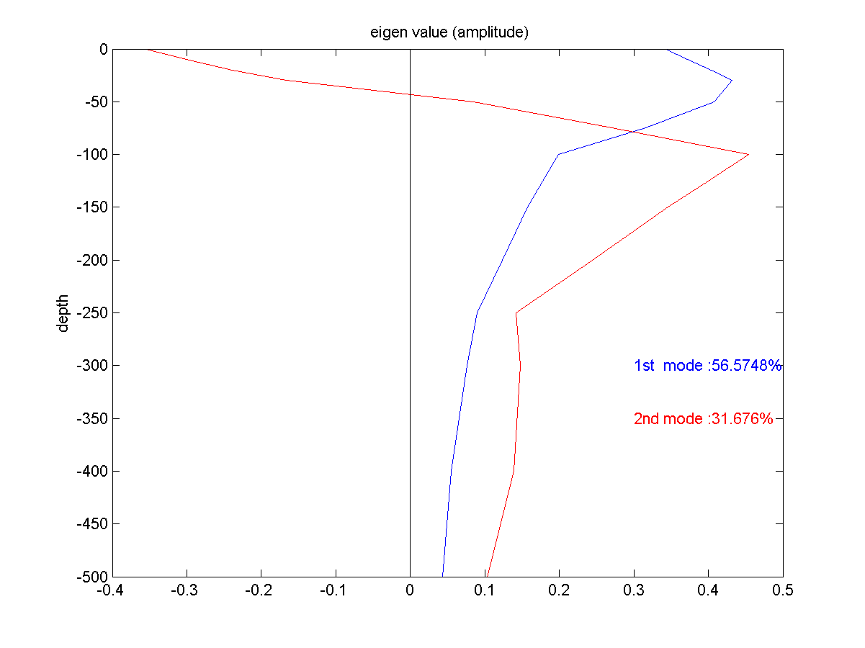
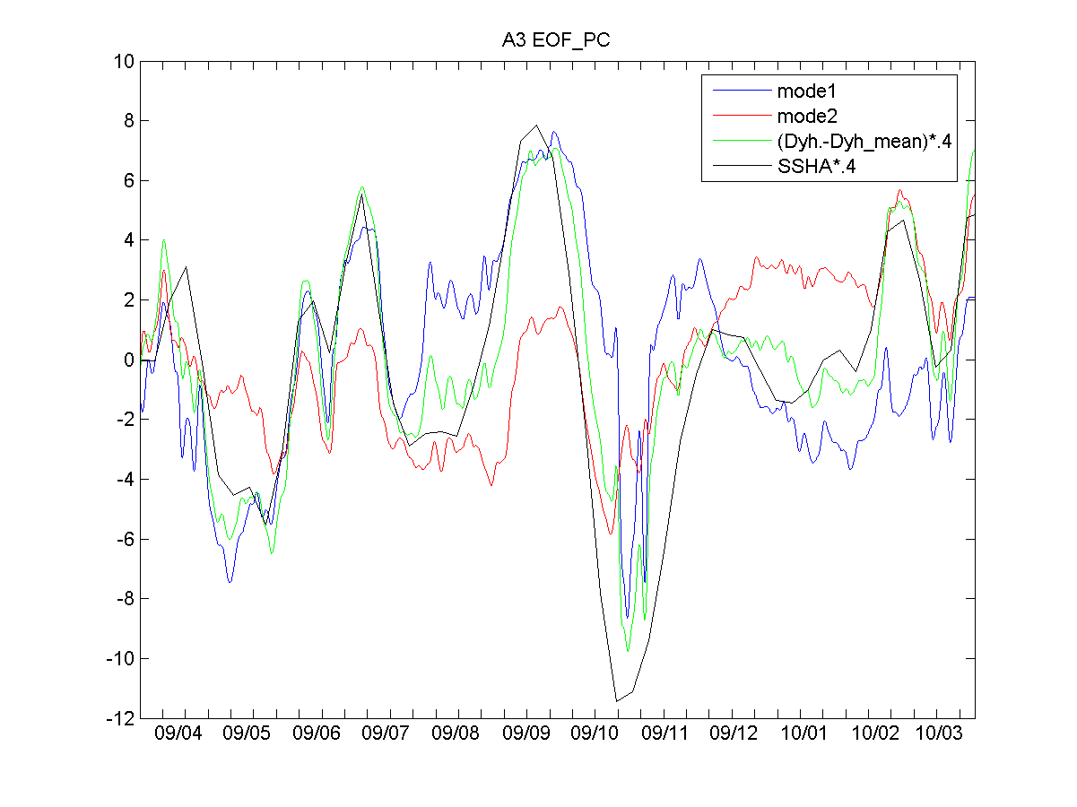
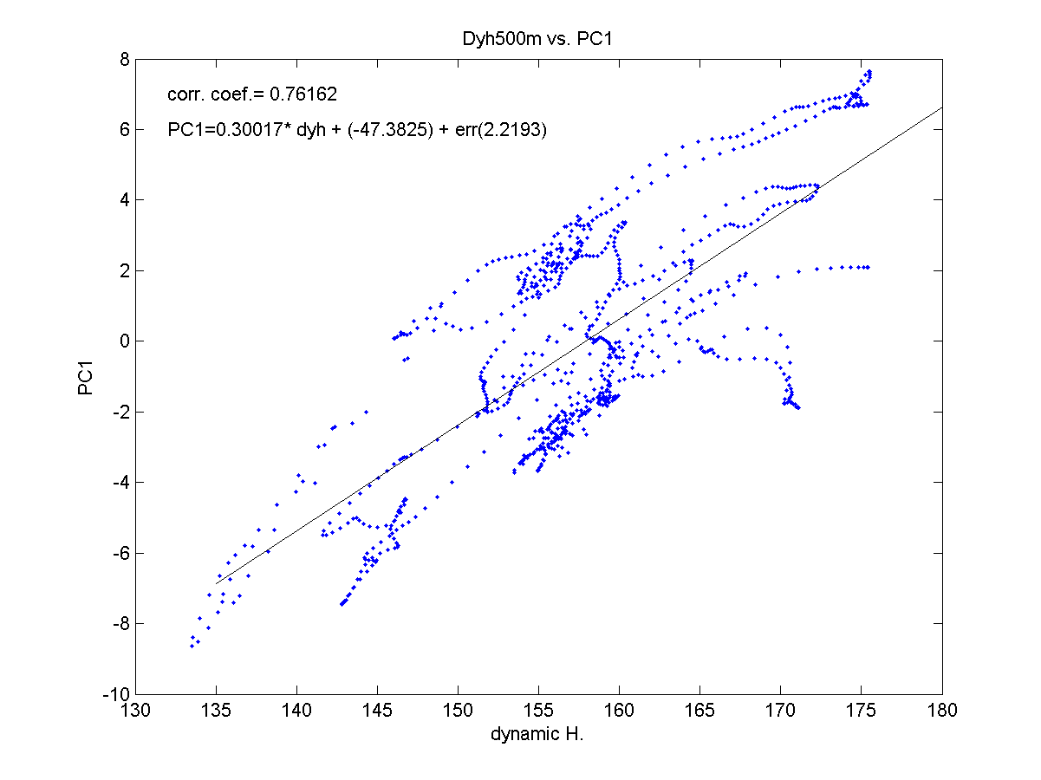
EOF analysis
A1
A1
A1
A2
A2
A2
A3
A3
A3

Slide 8
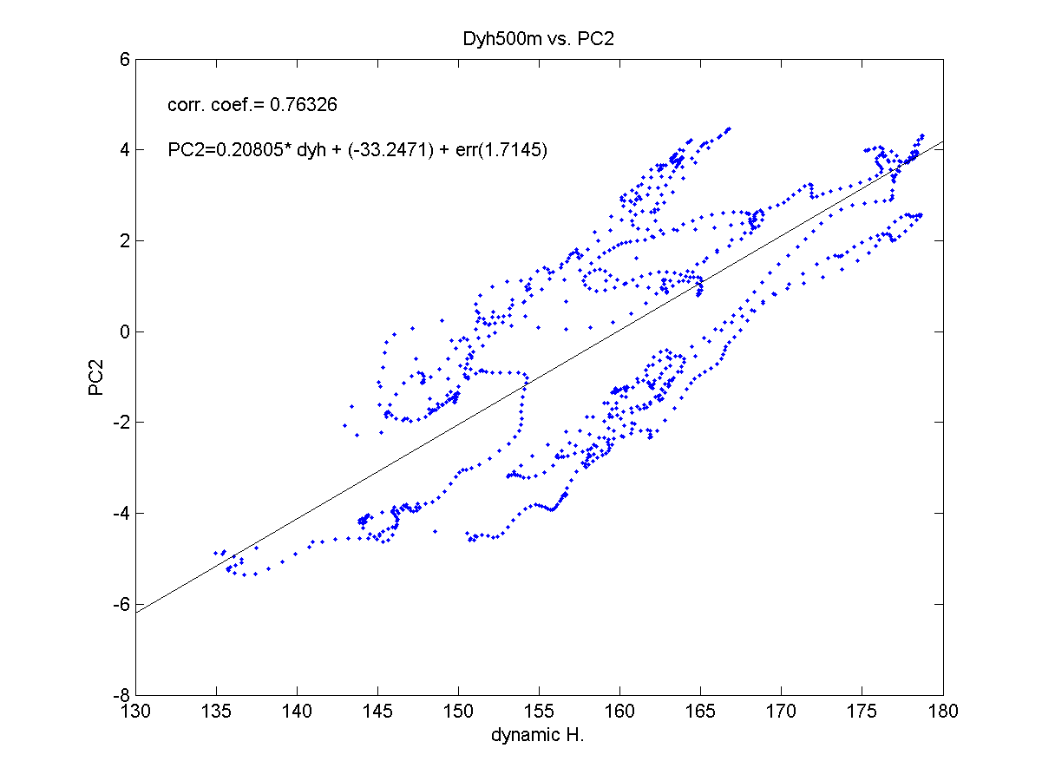
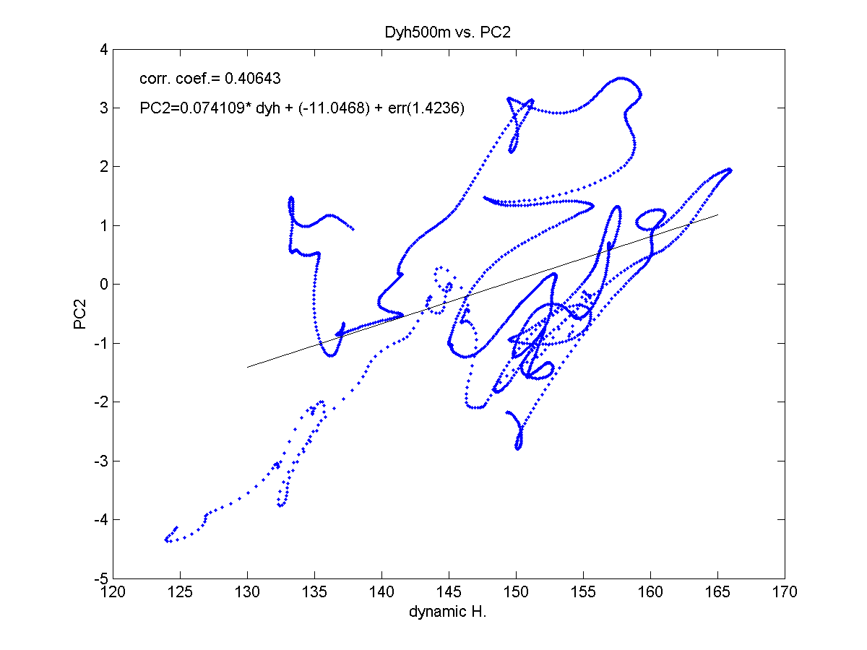
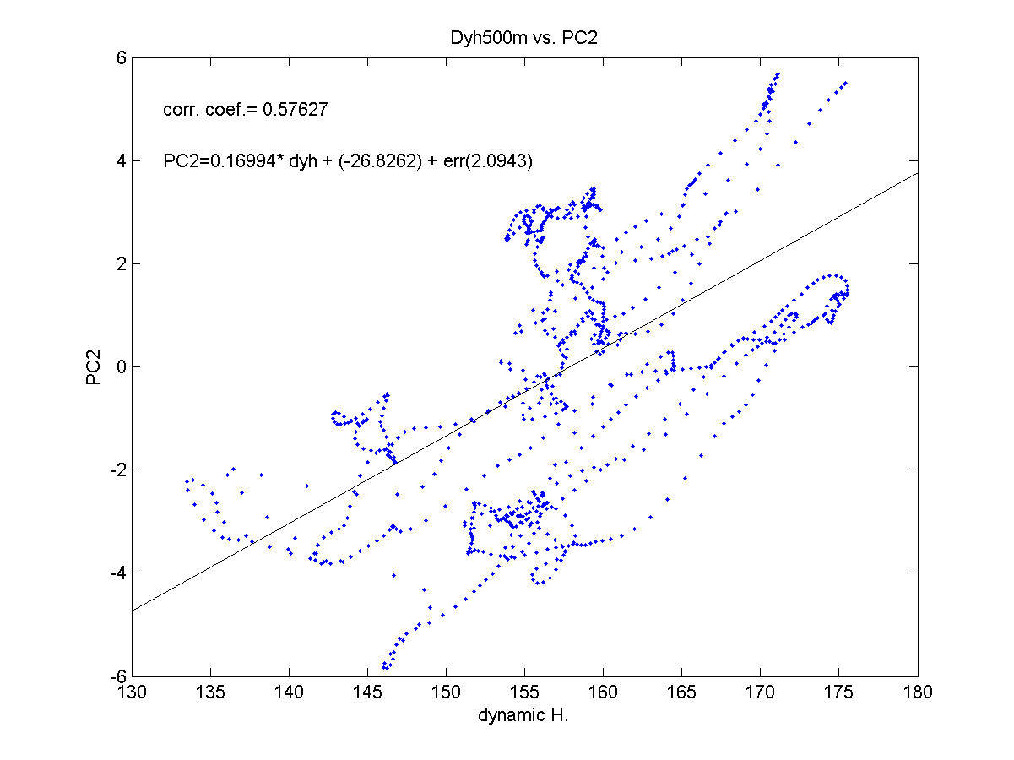
EOF analysis
A1
A1
A1
A2
A2
A2
A3
A3
A3

Slide 10
EOF analysis
A1
A2
A3
A1: PC2 corr. SSHA&DYH
r = 0.76
A2: PC1 corr. SSHA&DYH
r = 0.91
A3: PC1,2 corr. SSHA&DYH
r = 0.76 r=0.56

