Slide 1



Aircraft/Satellite comparisons from the HIPPO and GloPac campaigns
Karen Rosenlof¹ and Eric Ray²
¹NOAA ESRL CSD
²CIRES, University of Colorado
Boulder, CO

Slide 2


HIAPER Pole-to-Pole Observations (HIPPO)
What is HIPPO?
High resolutions measurements over the entire latitude range of the Pacific
Uses the NCAR Gulfstream-V
Multi-deployment experiment
Emphasis on carbon cycle and greenhouse gases
3 deployments are complete, data is finalized from HIPPO1 and nearly so for HIPPO2
There will be 2 additional deployments in 2011
This is the first comprehensive aircraft based global survey of trace gases pertinent to the carbon cycle covering the full depth of the troposphere in all seasons and multiple years

Slide 3
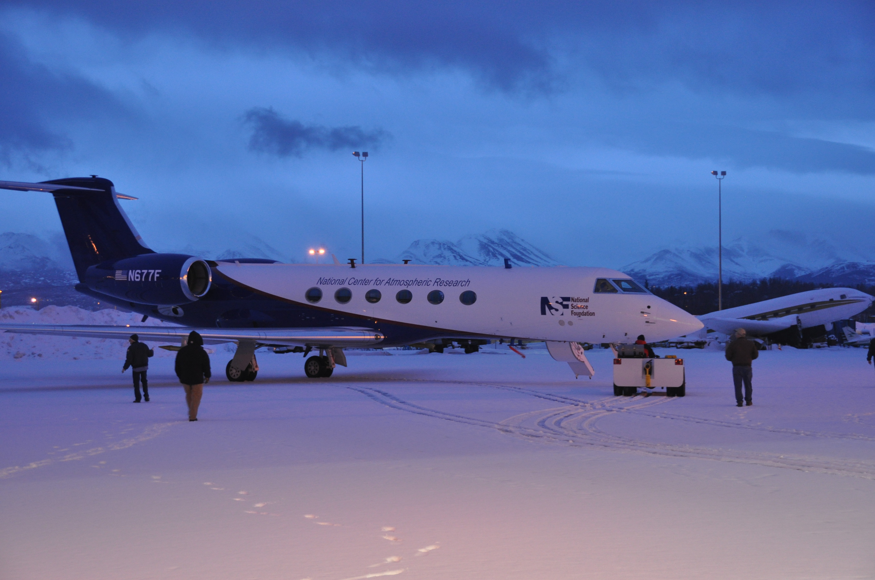
The HIPPO data set is intended to provide critical tests of global models of atmospheric gases and aerosols, helping to distinguish errors associated with sources and sinks from those due to simulated transport, model structure, etc.
The NCAR Gulfstream V has a ceiling of ~ 51kFt,
a range of 7000 miles.
payload capacity of 5600 lbs
At PANC during HIPPO I, Jan 2009

Slide 4
HIPPO Instrumentation
Multiple measurements: Red symbols ≥ 3, Blue = 2; sampling rates in ().
Notes:
QCLS...Quantum Cascade Laser Spectometer: mid IR sensor
OMS: Harvard: IR gas analyzer (long history) Daube

Slide 5
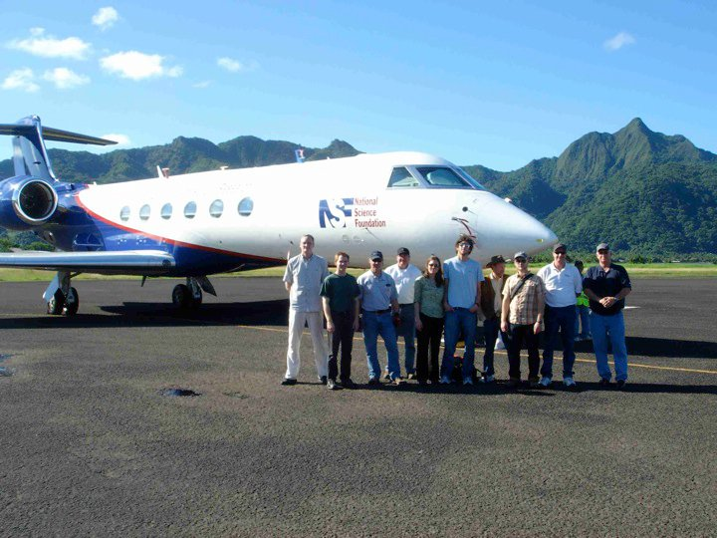
HIPPO Scientific Team:
Steve Wofsy: Principal Investigator, Harvard University
Britt Stephens: Co-PI, Airborne Oxygen instrument and MEDUSA air sampler, NCAR
Ralph Keeling: Co-PI, MEDUSA air sampler, Scripps
Bruce Daube: Mission Scientist / Instrumentation Engineer, Harvard University
Jasna Pittman, Roisin Commane, Bin Xiang, Eric Kort: QCLS and CO2 instruments,
Harvard University
Elliot Atlas: Whole Air Sampler, University of Miami
James Elkins, Steve Montzka (NOAA) Fred Moore, David Nance, Eric Hintsa (CU CIRES): PANTHER, NOAAWAS and UCATS instruments
Jonathan Bent, Steve Shertz: MEDUSA and AO2 Instruments, Scripps
David Fahey, Ru-Shan Gao: Ozone / SP2 instruments, NOAA
Christopher Picket-Heaps: chemical modeling, Harvard University
Eric Ray (CIRES), Karen Rosenlof (NOAA): flight forecasting
Shuka Schwarz, Ryan Spackman, Laurel Watts, Steve Ciciora, Anne Perring: NOAA Ozone and SP2 instruments, CU CIRES
Mark Zondlo: VCSEL instrument, Princeton University
Teresa Campos: CO instrument, NCAR
Julie Haggerty: MTP, NCAR
M.J. Mahoney: MTP, JPL
NCAR RAF: Aircraft support, project management,
data catalog management

Slide 6
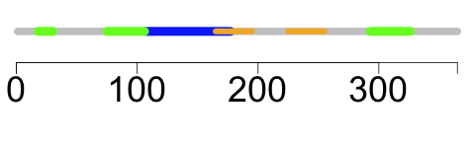
HIPPO Statistics
2009 2010 2008 2011 2011 2009
H1 H3 P-H H4 H5 H2
Day of Year
To Date: 156 days of field program, 524 profiles
National Science Foundation
National Oceanic and Atmospheric Administration
G-V "HIAPER": National Center for Atmospheric Research
HIPPO Sponsors

Slide 7
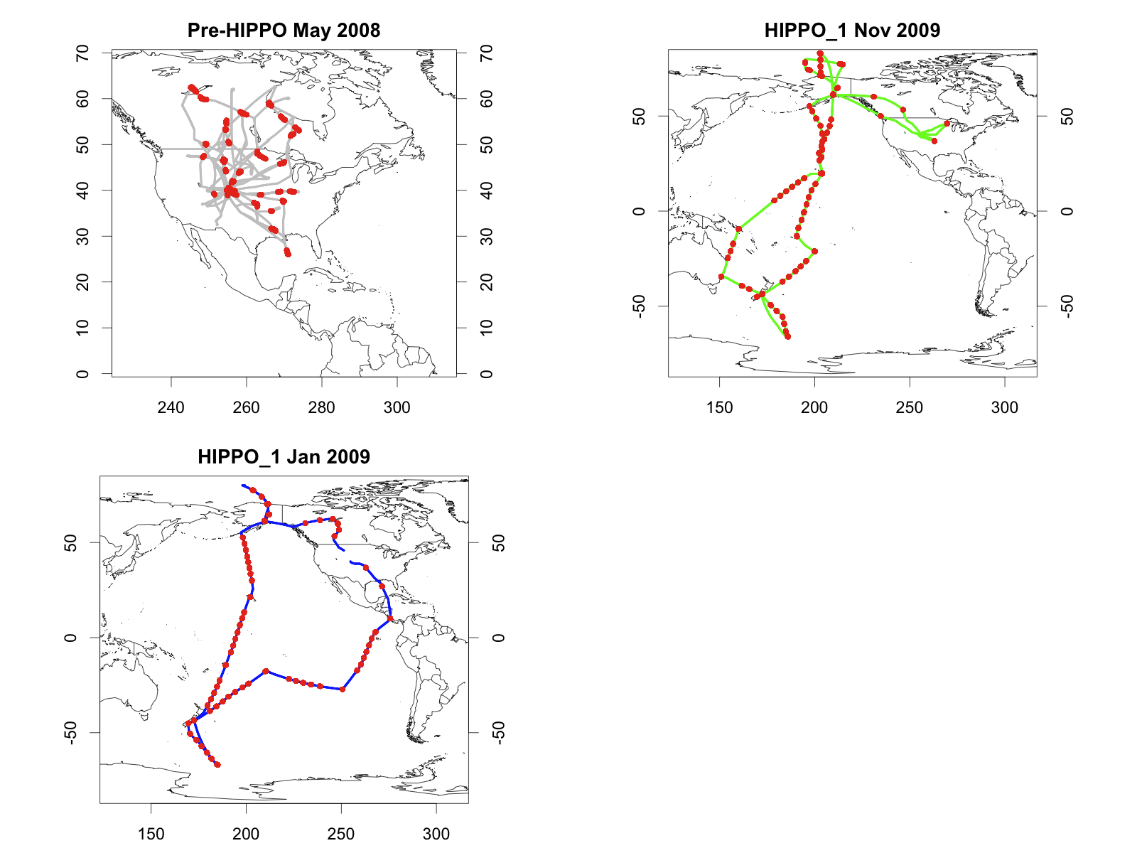
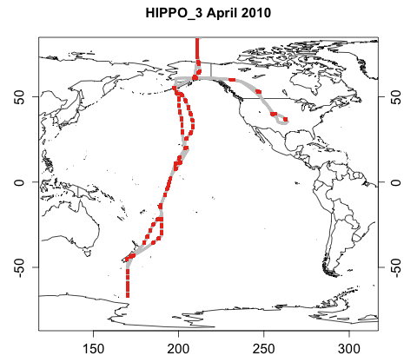
HIPPO itinerary
START08/preHIPPO Apr-Jun 2008
HIPPO_2 Nov 2009
HIPPO_1 Jan 2009
HIPPO_3 Apr 2010

Slide 8
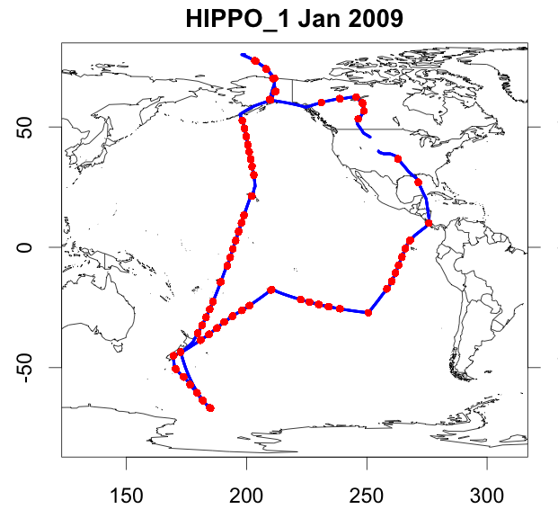
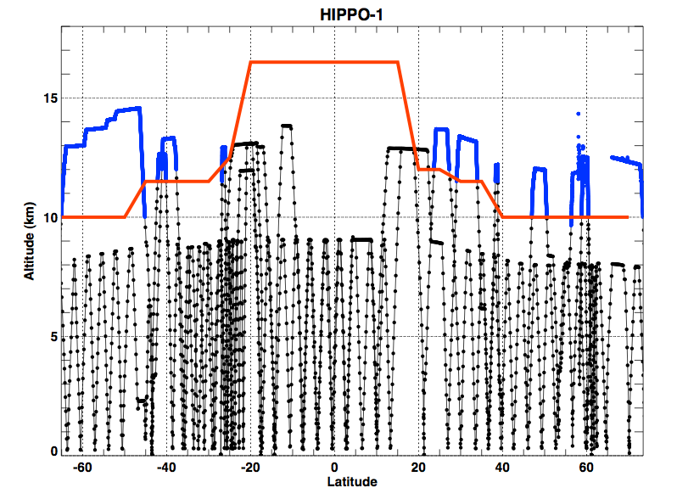
Example of vertical coverage: shows there is some coverage in the lower stratosphere (noted in blue below), so potentially useful for some MLS comparisons.

Slide 9
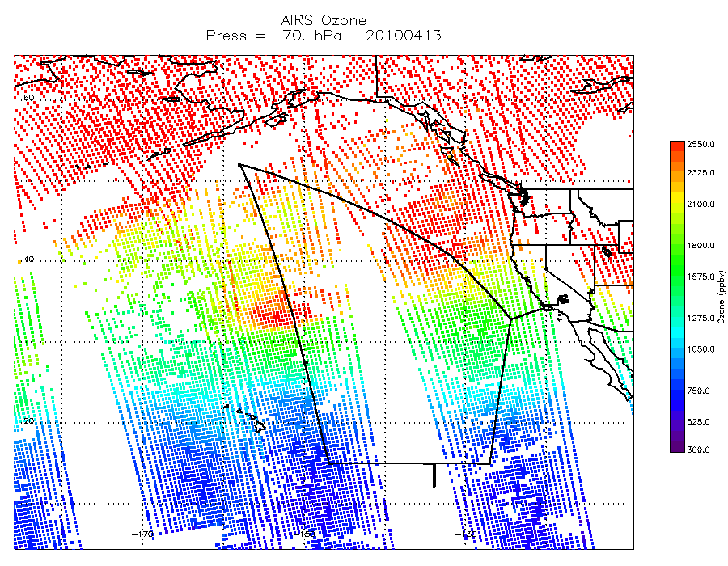
Although the main intent for use of this set of data is in regards to understanding processes and model comparisons/validations, it is also useful for satellite measurement comparisons.
HIPPO flights were not planned with satellite validation in mind. We had specific destinations predetermined, and what small deviations from great circle routes that were possible were geared to sampling specific features ascertained from chemical forecast models and current satellite observations.
However, in the case of AIRS
coverage is sufficiently dense
that coincidences on the day of
a flight were fairly common.
We did have one flight day that was
designed to be along an Aura track
and was also coincident with the
ground track of the NASA
Global-Hawk. For this case, MLS
comparisons are also possible.

Slide 10
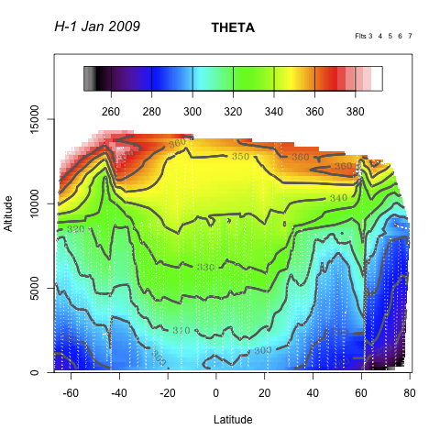
HIPPO-1 Atmospheric Structure (Pot'l T K):
January, 2009, Mid-Pacific (Dateline) Cross section
Notes:
Location of the jet steam, passing over Anchorage (and Christchurch!) during our stay there….

Slide 11
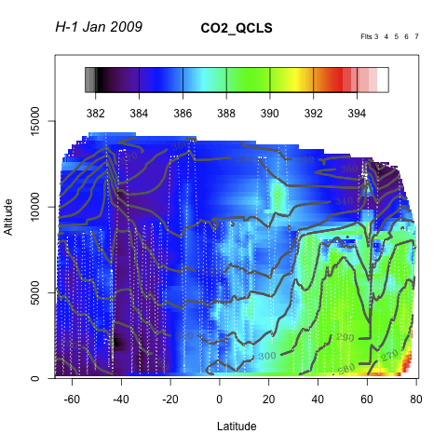
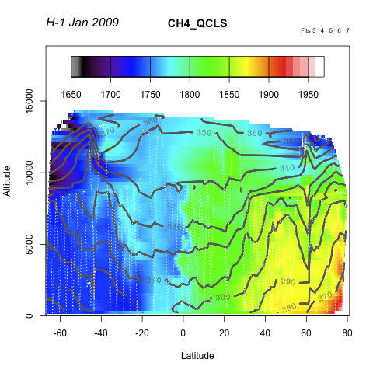
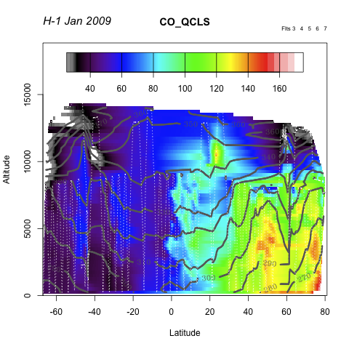
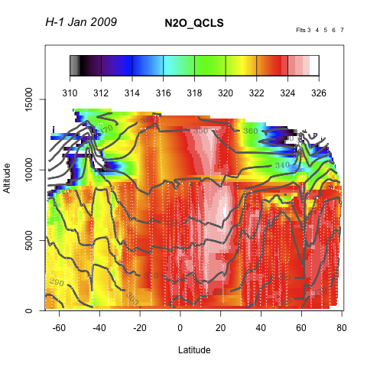
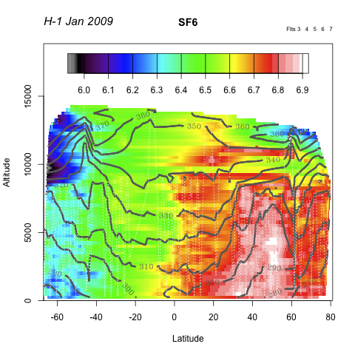
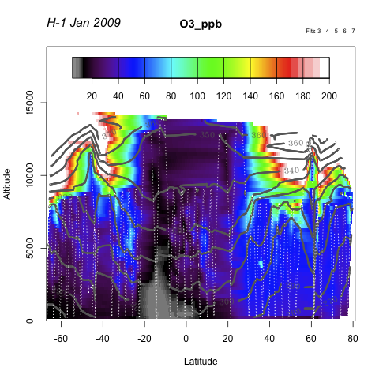
HIPPO sections, January 2009
CO₂
CH₄
CO
0 5 10 15 km
0 5 10 15 km
0 5 10 15 km
-60 -40 -20 0 20 40 60 80 -60 -40 -20 0 20 40 60 80 -60 -40 -20 0 20 40 60 80
N₂O
SF₆
O₃
0 5 10 15 km
0 5 10 15 km
0 5 10 15 km
-60 -40 -20 0 20 40 60 80 -60 -40 -20 0 20 40 60 80 -60 -40 -20 0 20 40 60 80
LATITUDE

Slide 12
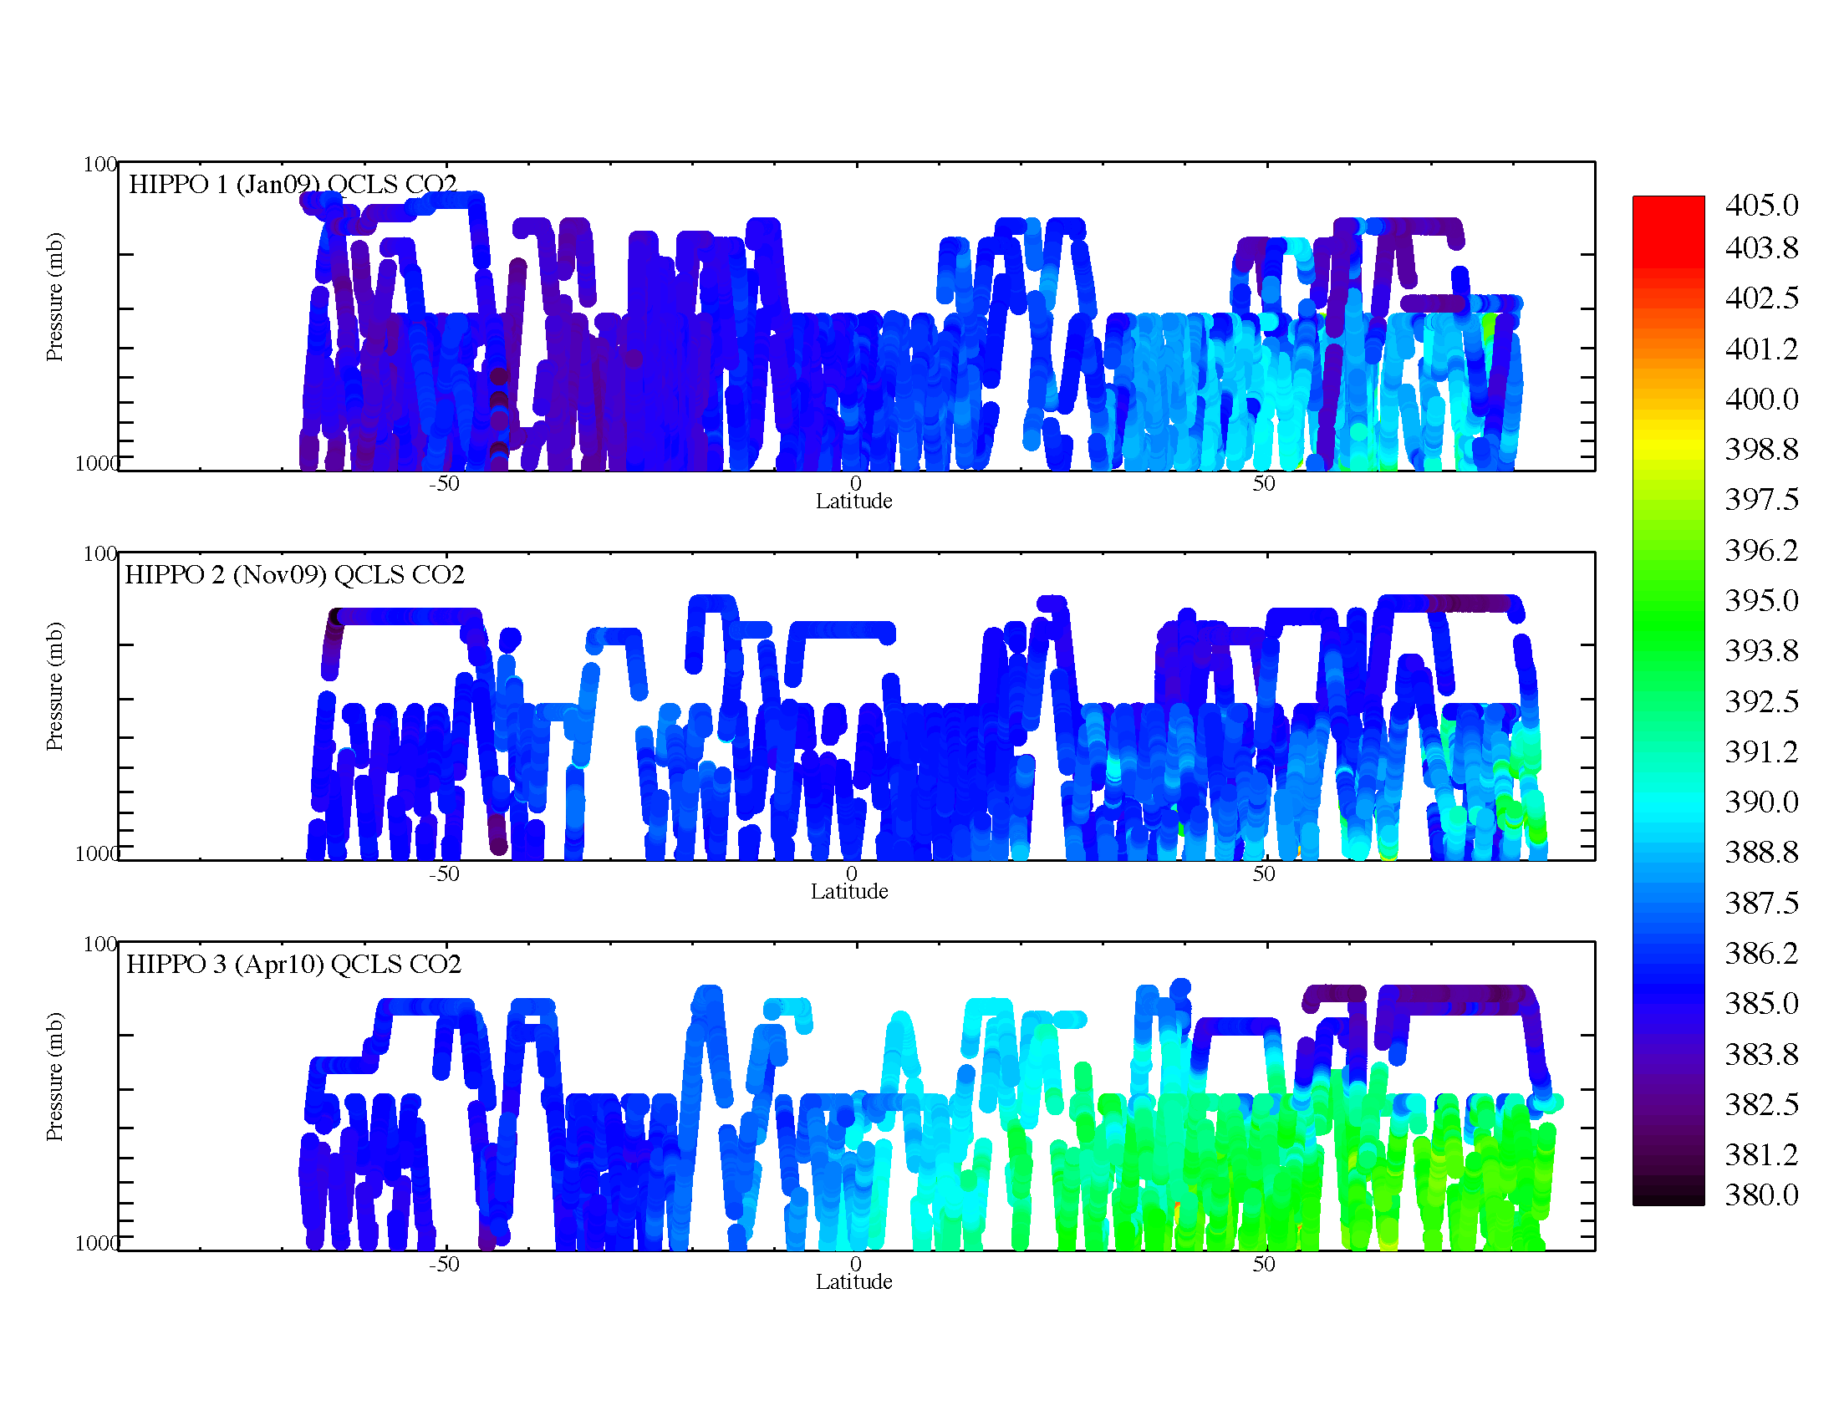

Slide 13
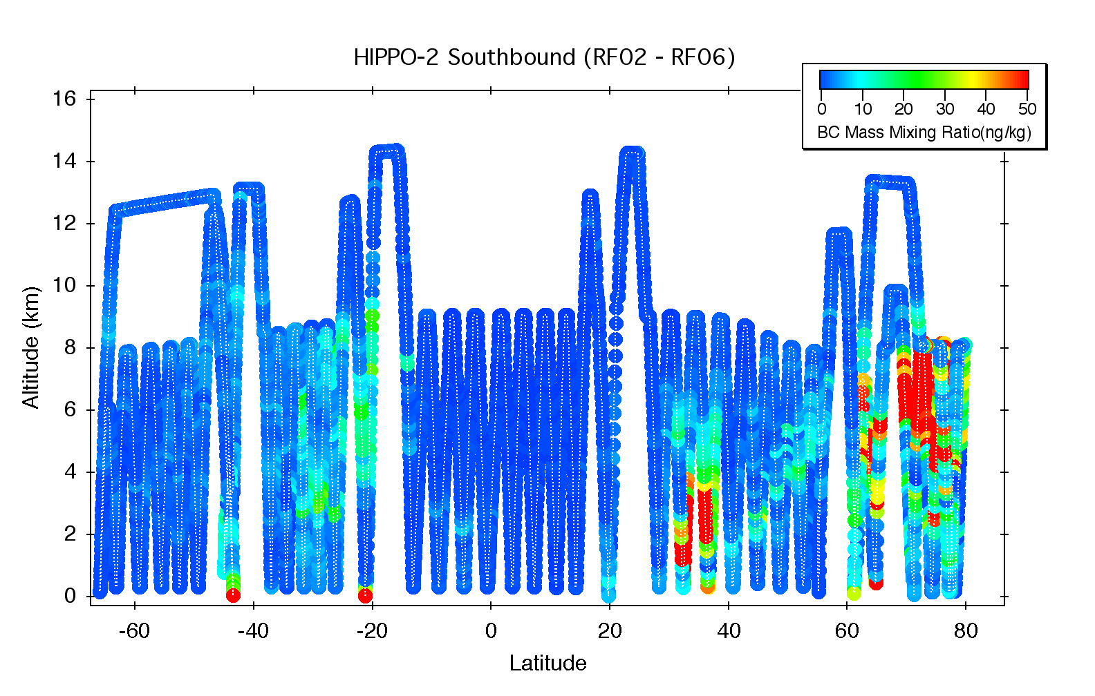
Species we have done HIPPO/AIRS comparisons with are:
O₃ H₂O CO CH₄ CO₂ Temperature
HIPPO measurements may also be useful
for satellite aerosol comparisons
(Ryan Spackman had a poster discussing
possible use of HIPPO black carbon
measurements for satellite validation.)
A unique feature about HIPPO that satellite groups may find useful:
There are many profiles in the Southern Hemisphere, covering a region that has not been heavily sampled by recent aircraft experiments. There are ~140 profiles from the surface to 8 km, and ~20 from the surface to max altitude on each deployment. (3 deployments to date, 5 in total by the end of FY11.
Although we looked exclusively at AIRS comparisons, these measurements could also be useful for TES and IASI comparisons, or any instrument measuring tropospheric ozone profiles. Could also be used for comparisons with high latitude lower stratospheric measurements.

Slide 14
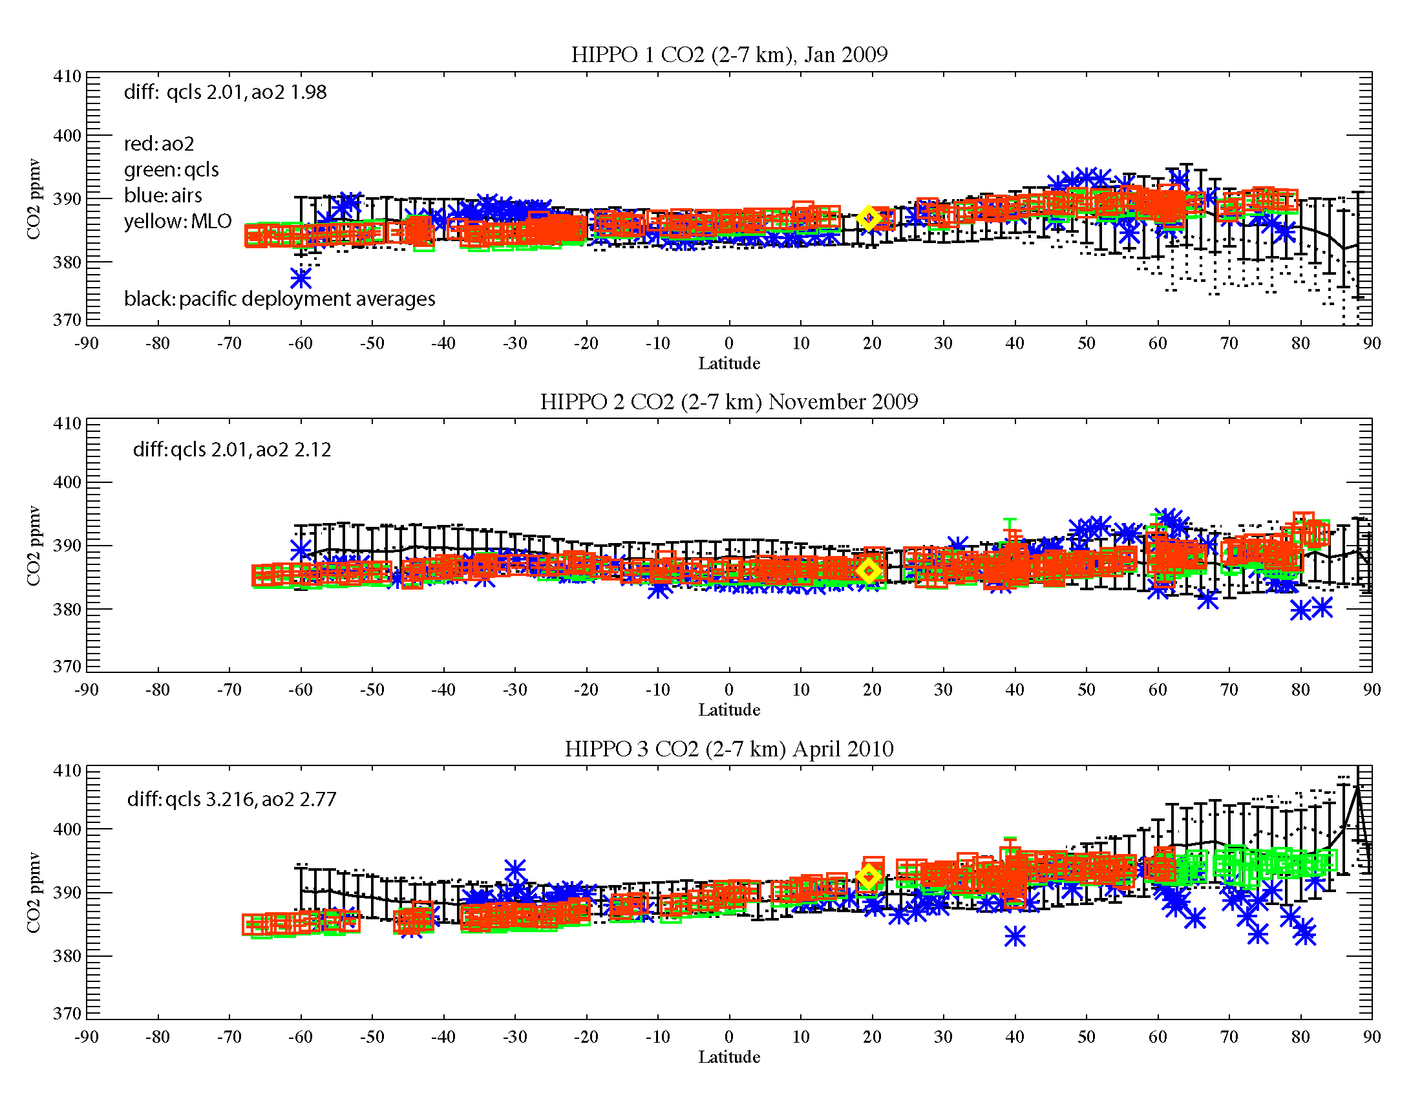

Slide 15
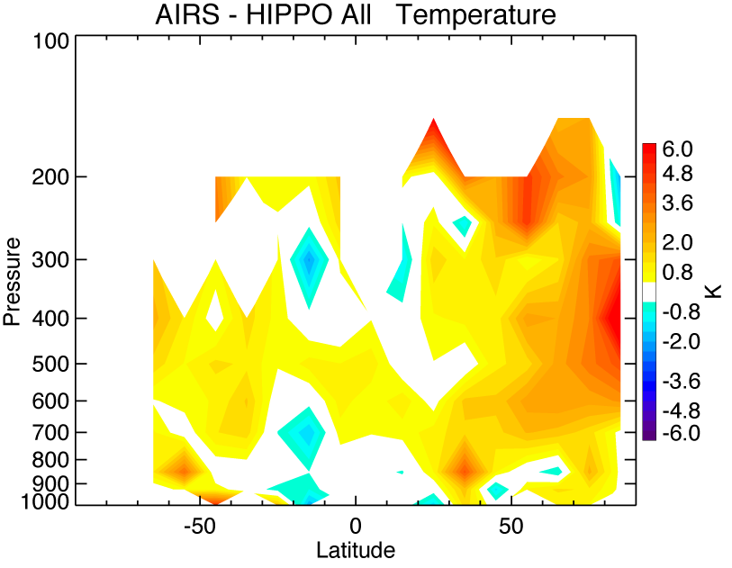
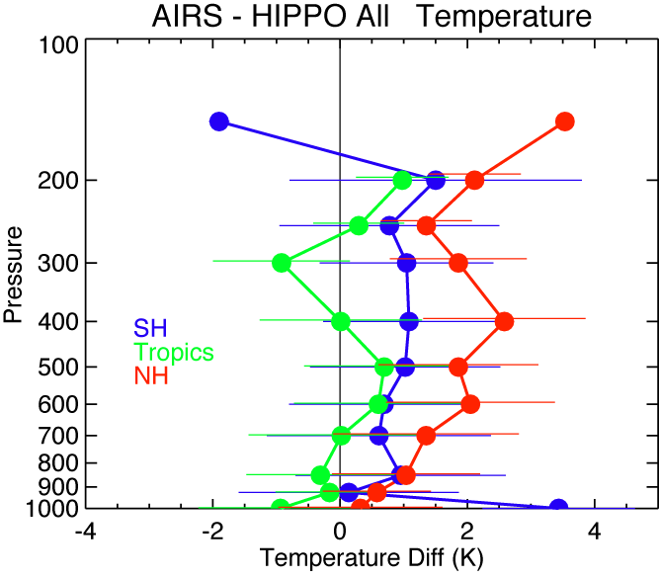
Temperature

Slide 16
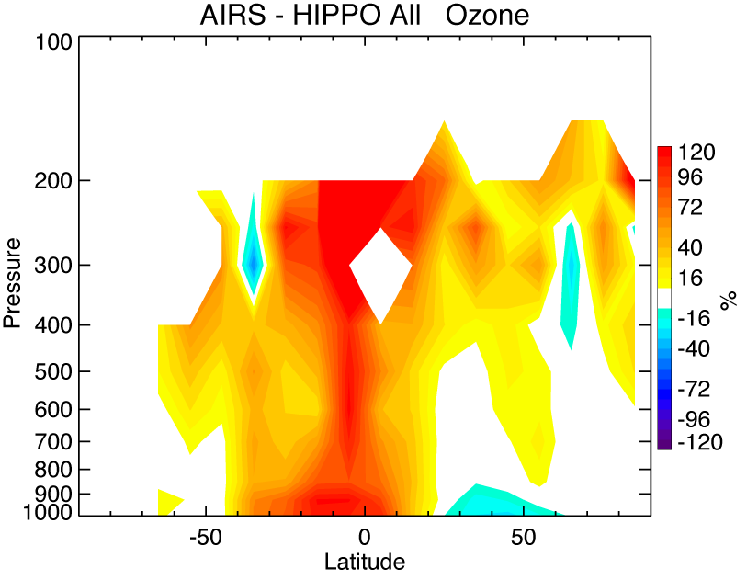
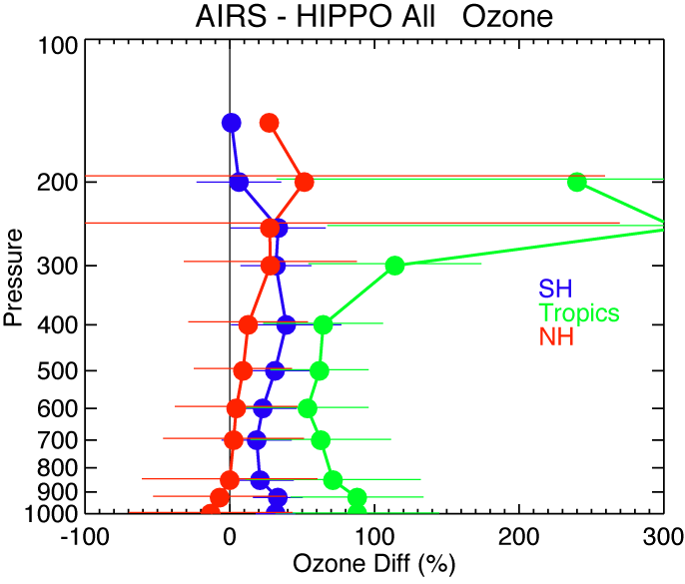
Ozone

Slide 17
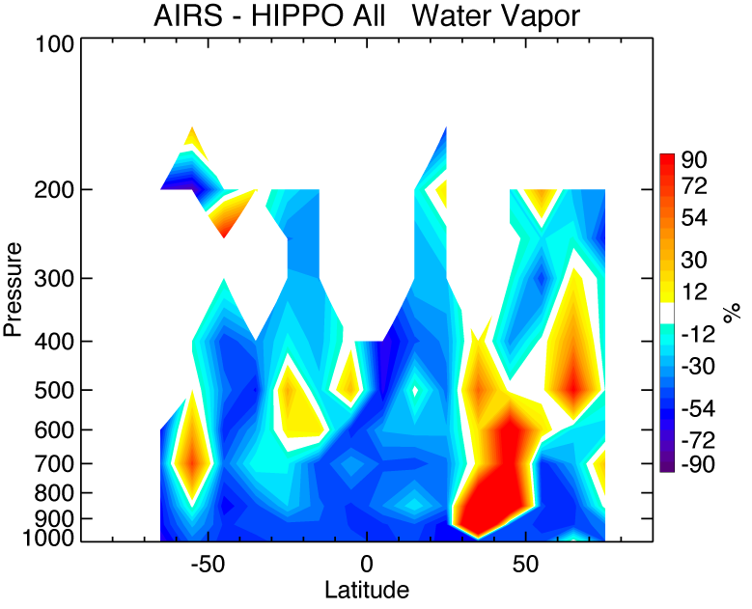
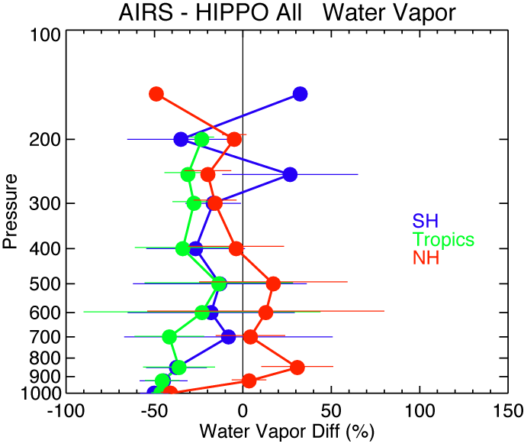
Water Vapor

Slide 18
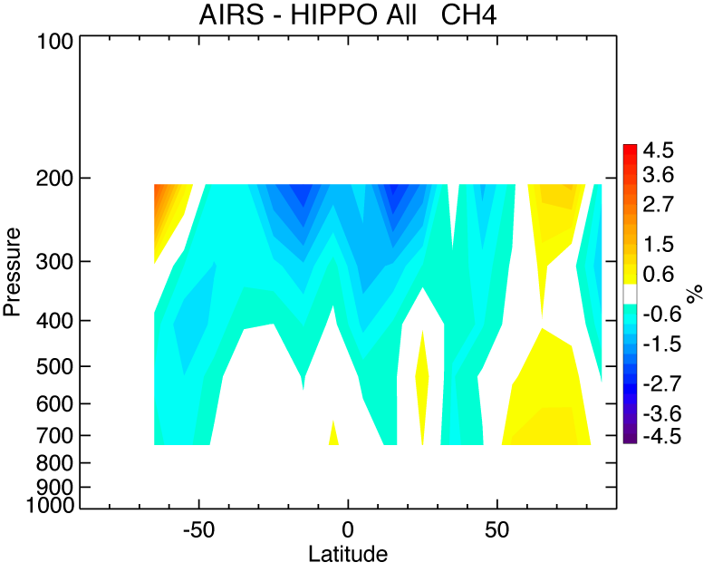
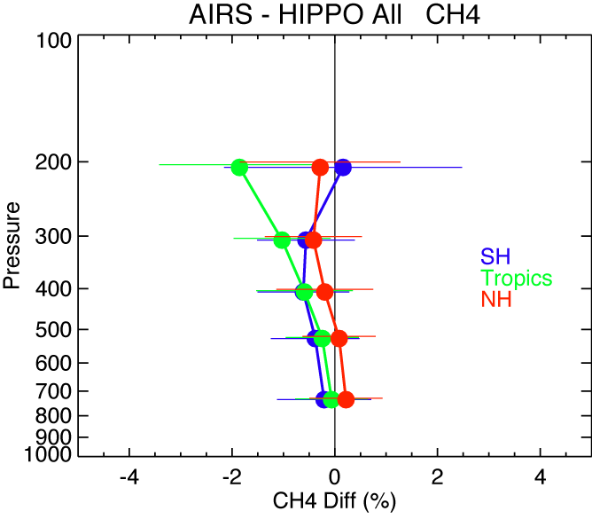
CH₄
Notes:
Differece is ~.1ppmv

Slide 19
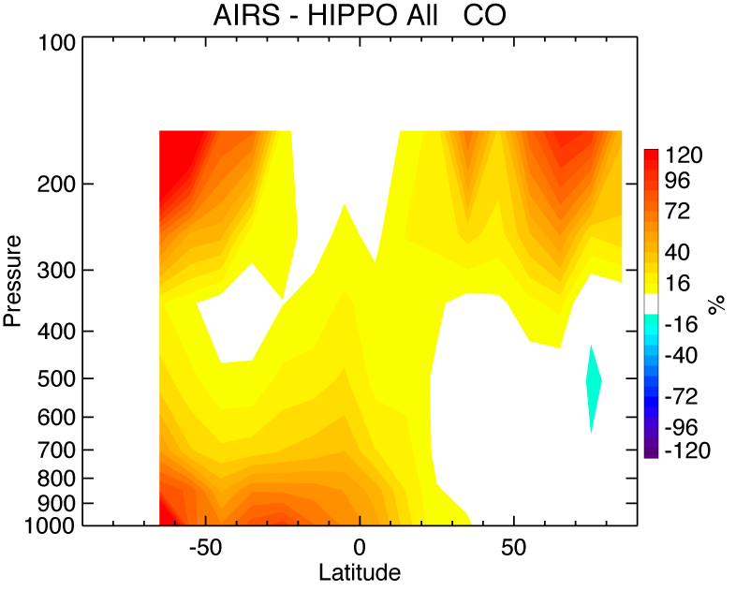
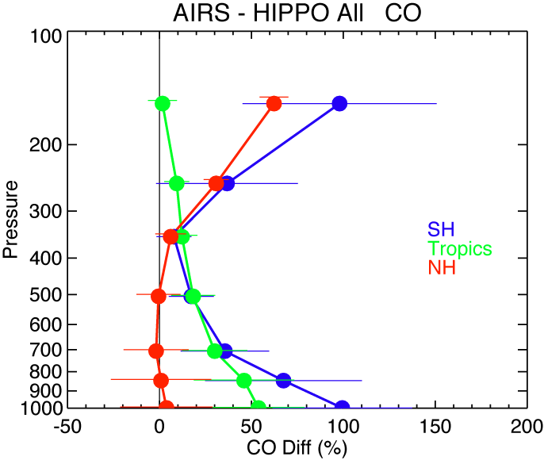
CO

Slide 20
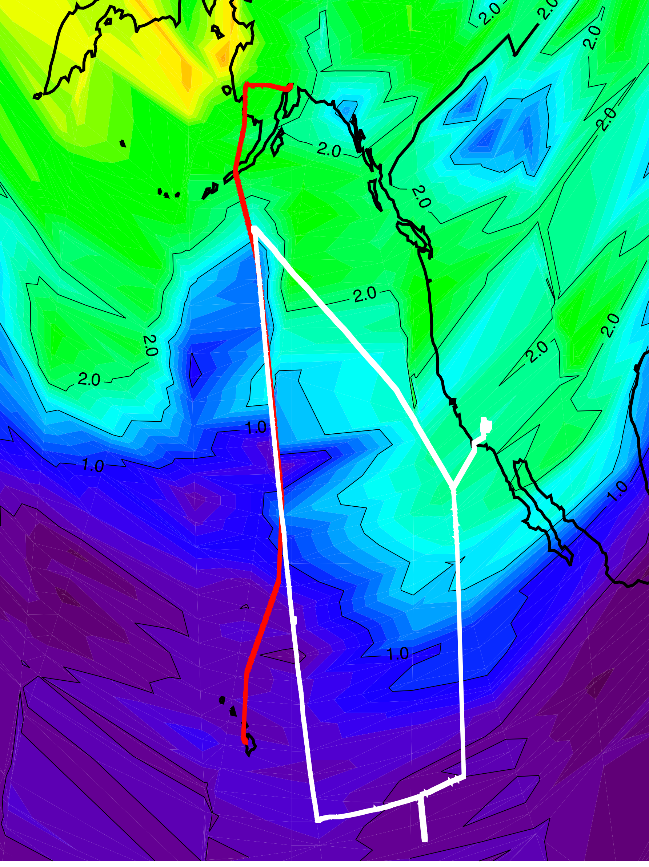

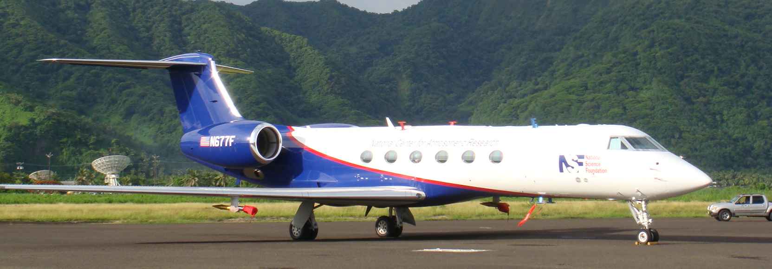
Global Hawk coordinated flights and satellite validation
Anchorage
GloPac GH track
HIPPO NSF/NCAR GV
J. Schwarz
Aura satellite track follows the western side of the GloPac flight.
70 mb
Ozone field from Aura Microwave Limb Sounder (MLS).
Hawaii
13 April 2010

Slide 21
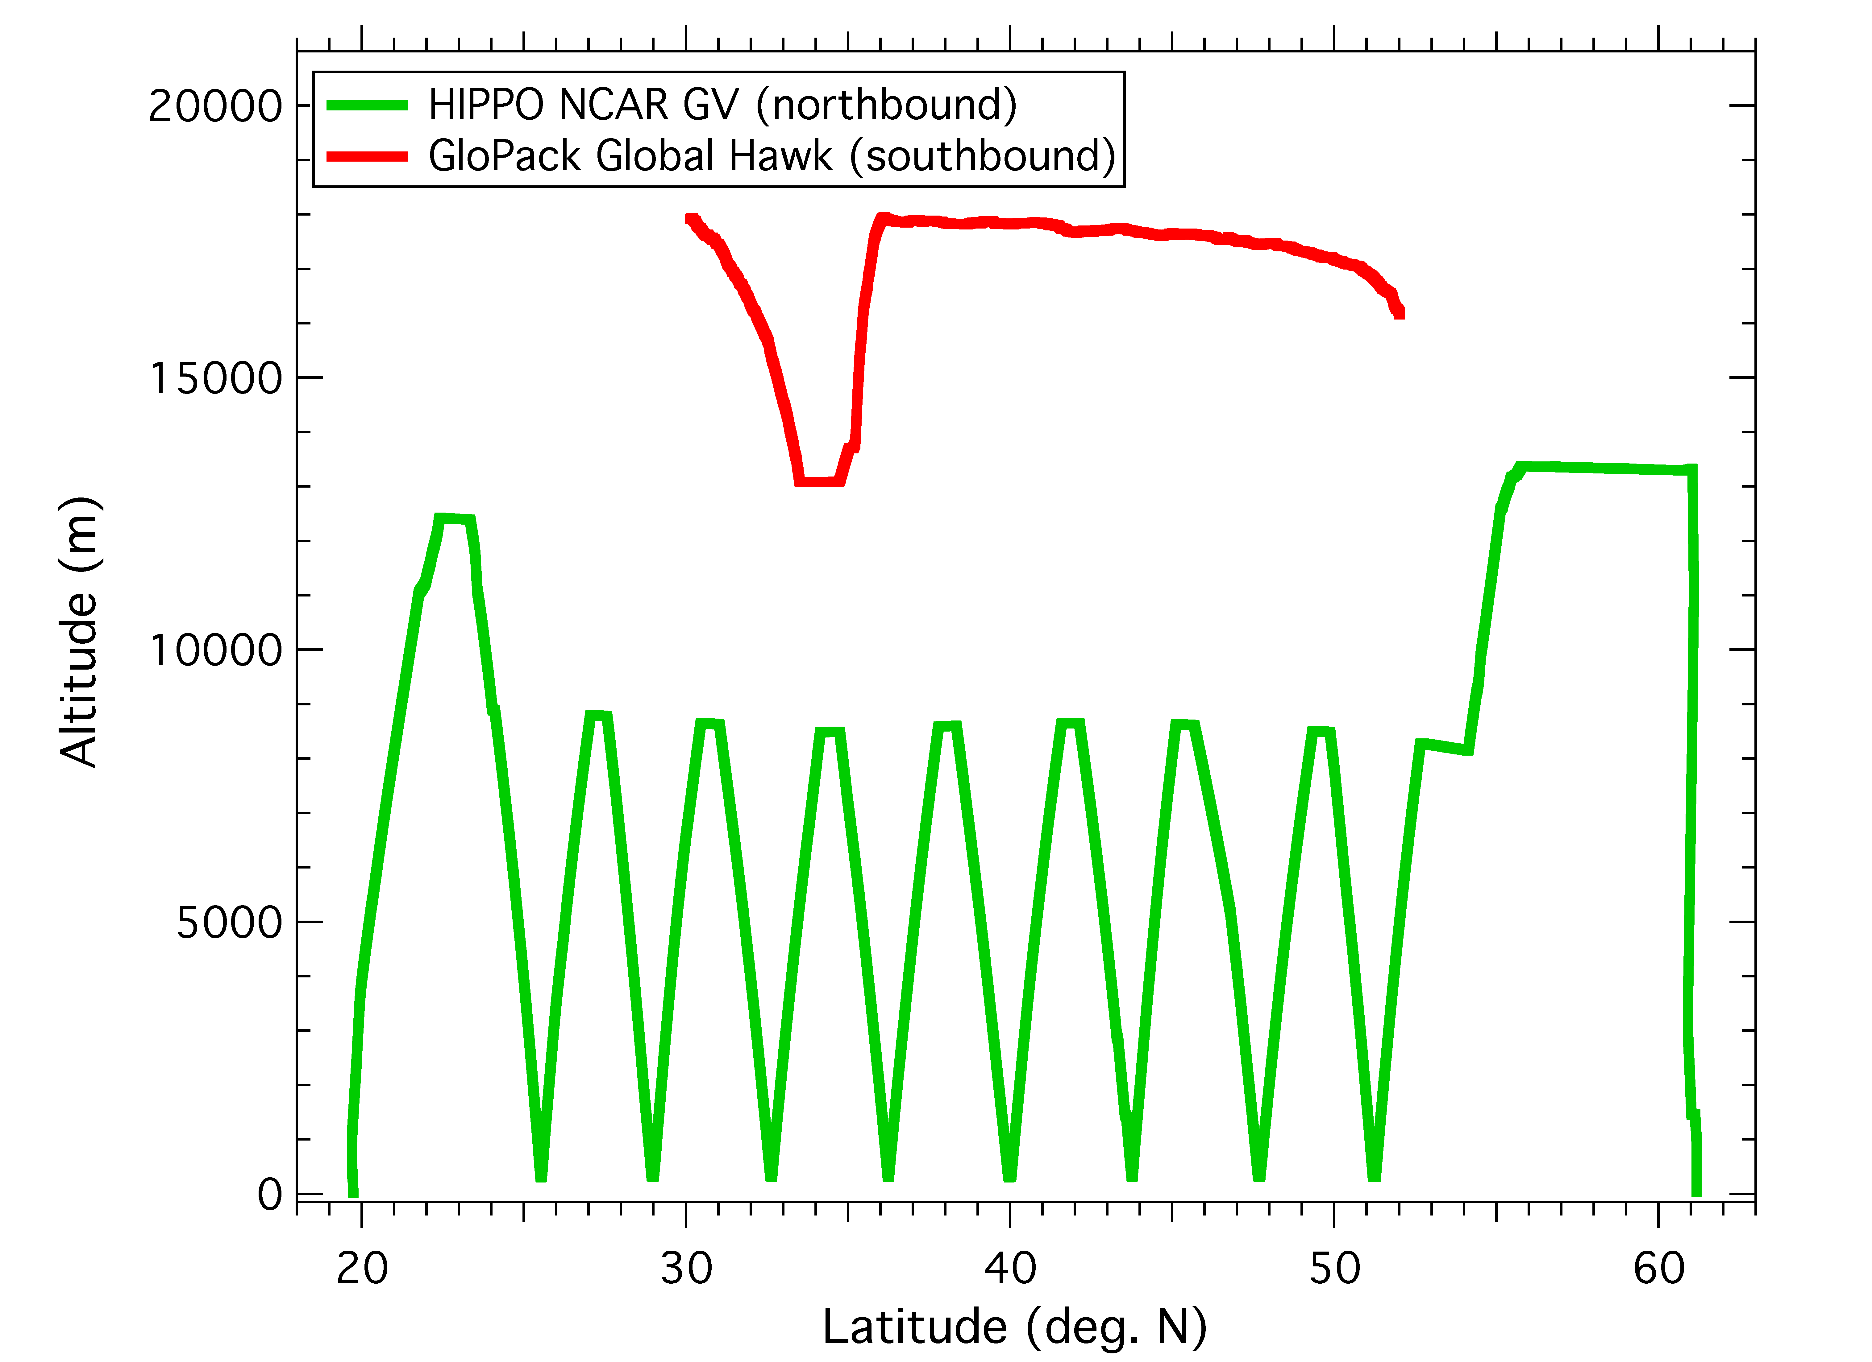
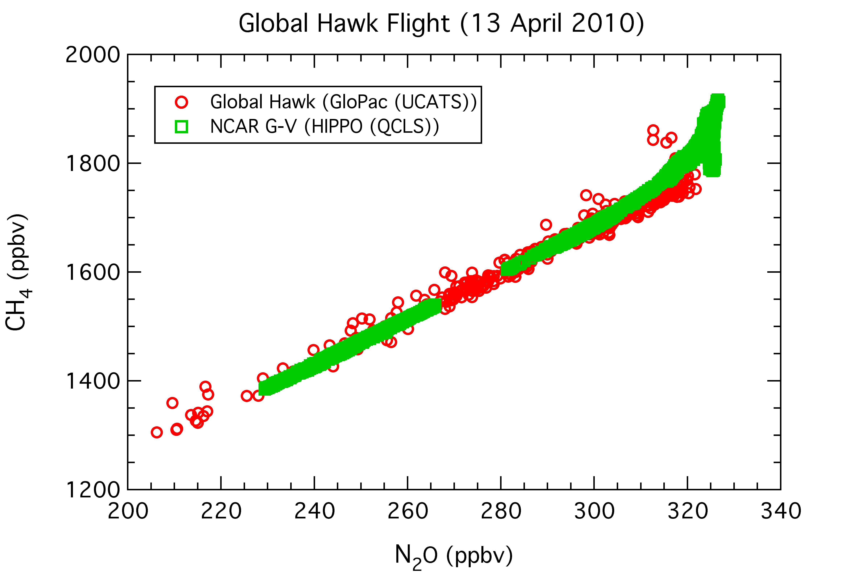
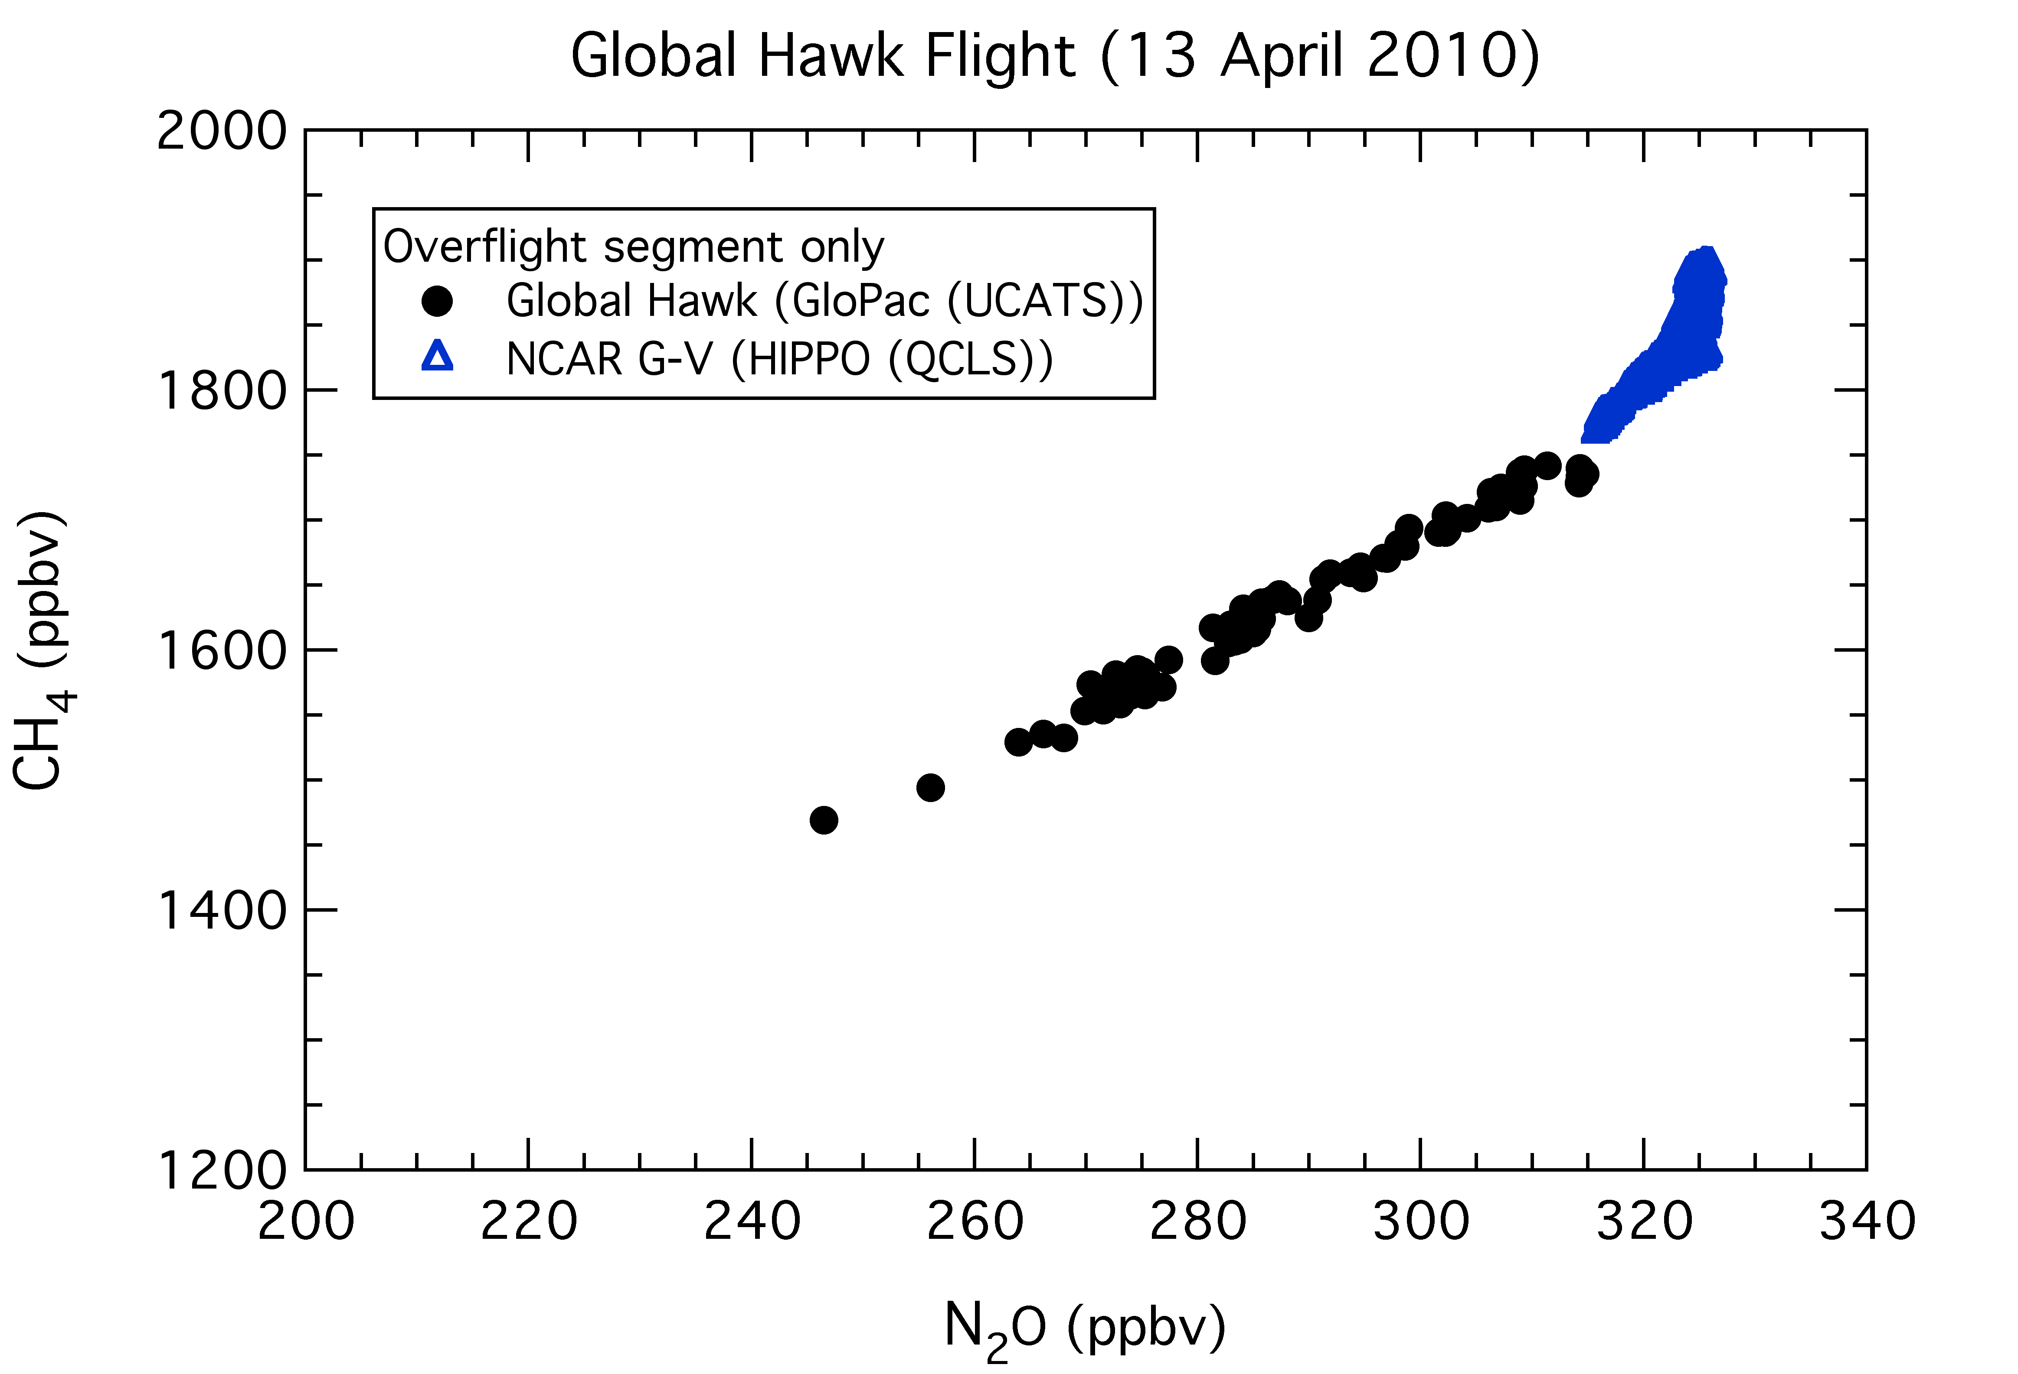
Comparison of Global Hawk and NSF/NCAR GV correlations of CH₄ with N₂O
Coordinated flights allow unique sampling of tracer space in UT/LS
Overflight segment
Tropopause range
All data
Overflight segment data only
Increasing altitude
and age-of-air
Preliminary data: QCLS, Wofsy et al.; UCATS, Hintsa et al.

Slide 22
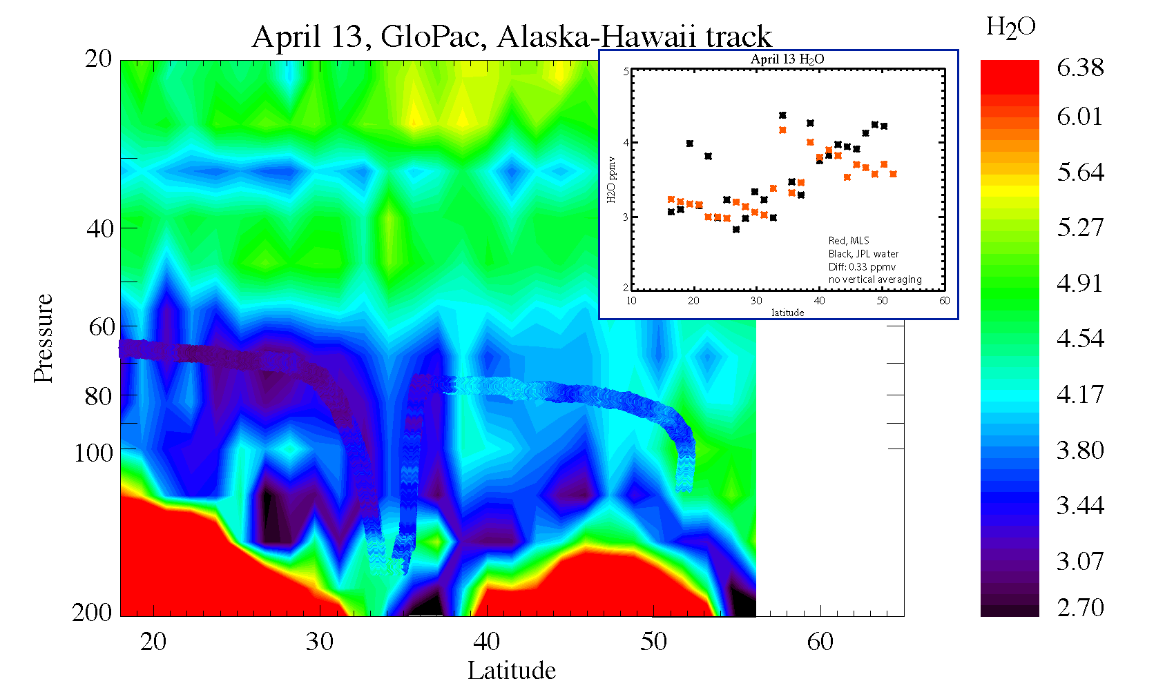
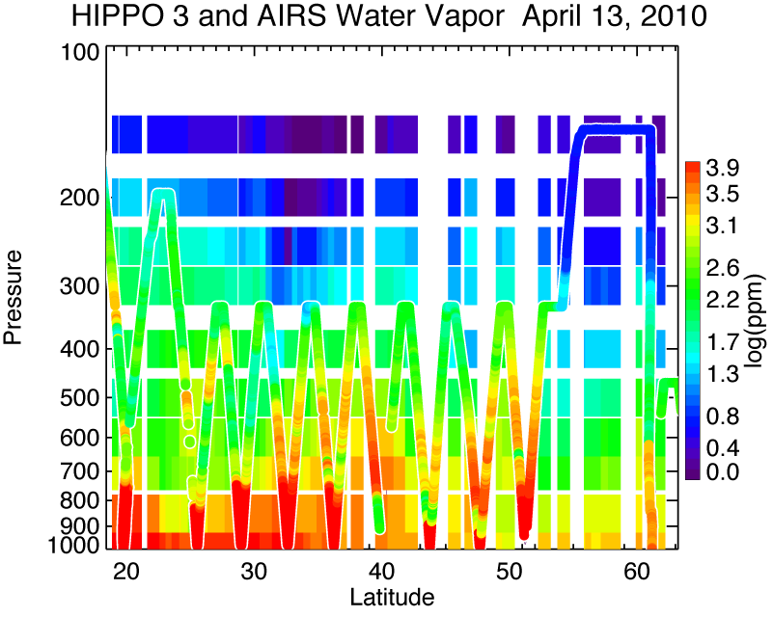
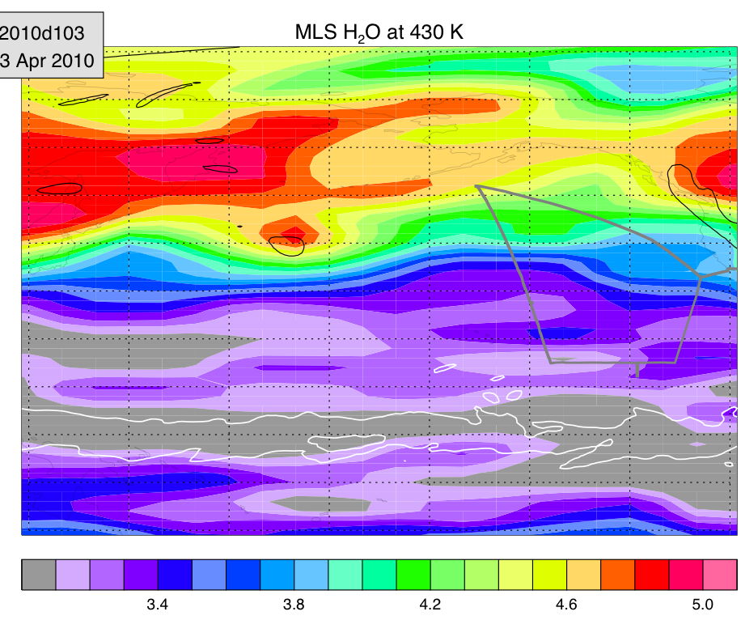
MLS water

Slide 23
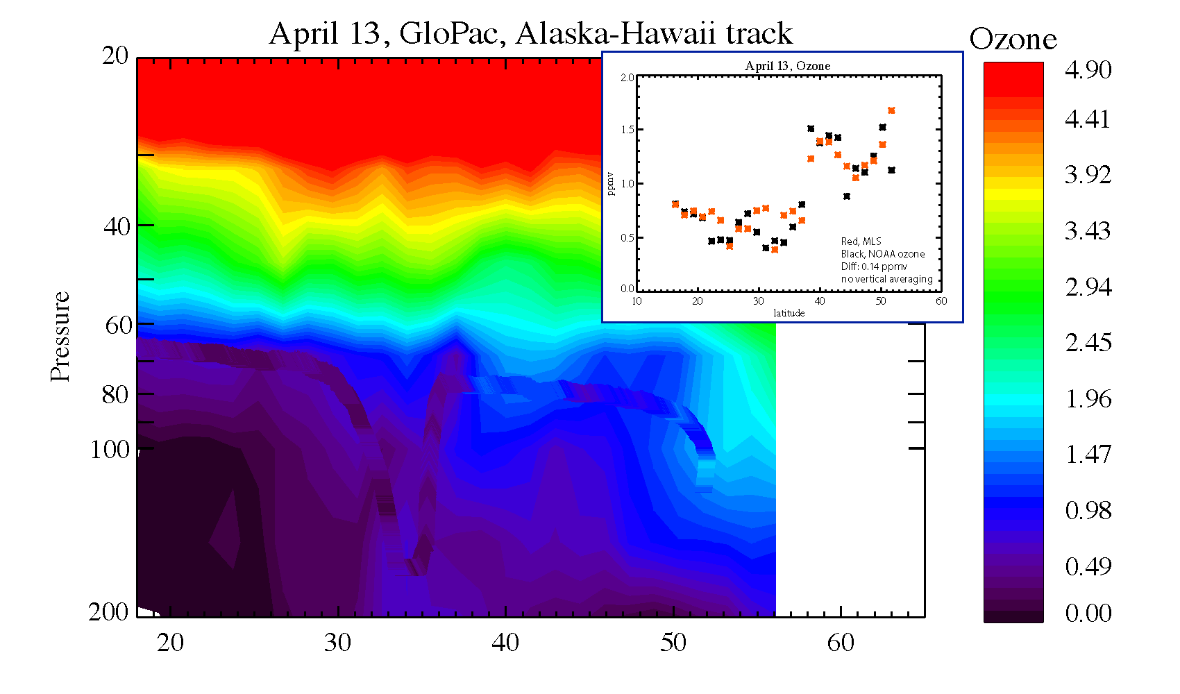
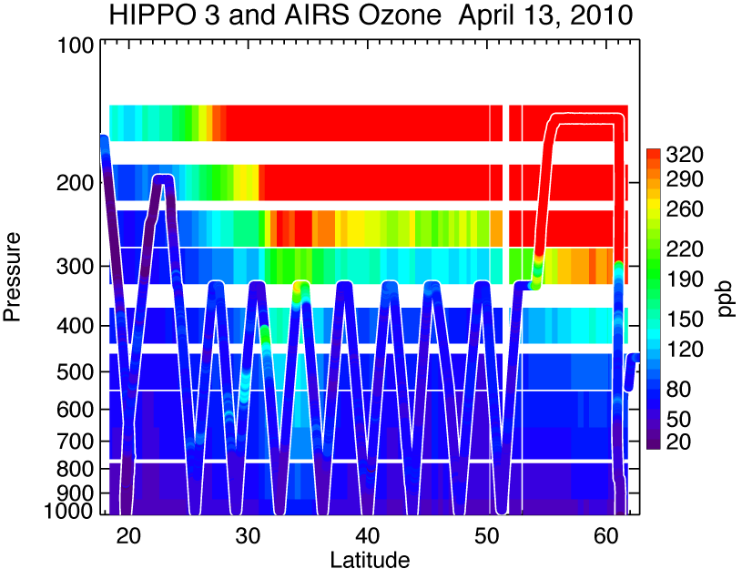

Slide 24
What could be possible with these two platforms?
Coordinated flights allow unique sampling of tracer space in UT/LS
Tropopause range
If appropriately coordinated, between the two platforms can get vertical profiles through the UTLS at all latitudes, then would be able to apply satellite weighting functions.
With the G-Hawk based in California with a 30 hour duration, and the G-V flying between multiple bases, it would be possible to cover a large portion of the NH Pacific.

Slide 25
Final Notes:
HIPPO provides fine resolution data covering the latitudinal extent of the Pacific for a number of species. There are approximately 140 profiles per deployment, with 3 deployments completed, and 2 more planned.
HIPPO 1 data is finalized, should be publically available soon.
An initial publication (Wofsy et al.) will appear in the near future (Royal Society proceedings)
Official data archive will be at the CDIAC (ornl.gov); data is currently at an NCAR mission data catalog site.

Slide 26
extras

Slide 27
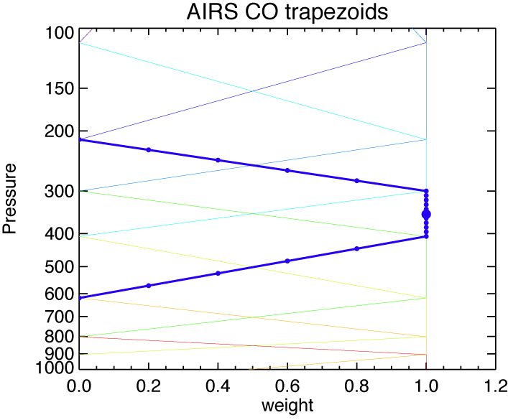
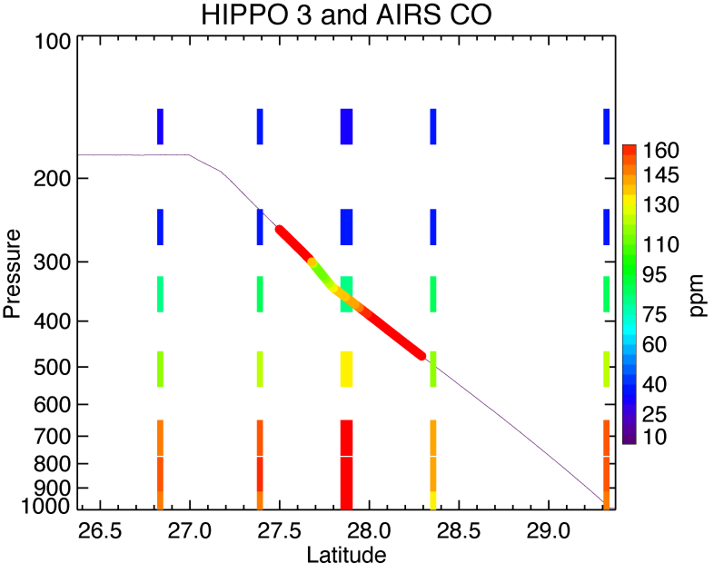
AIRS-HIPPO Comparison Method
Small circles represent fine layers in example trapezoid
HIPPO data within 50 km of example AIRS profile
Identify nearest AIRS profiles to HIPPO flight tracks (≈2500 for 3 missions).
For each AIRS profile find HIPPO measurements within 50 km and 6 hours.
For AIRS layer quantities we divide the layer into 10-20 finer layers and the layer difference is:
where z is the fine layer where HIPPO data is available and W is the layer weighting function.
For CO₂, we simply took a 2-8 km profile average, and found the AIRS profile closest in space on a given flight day.

Slide 28
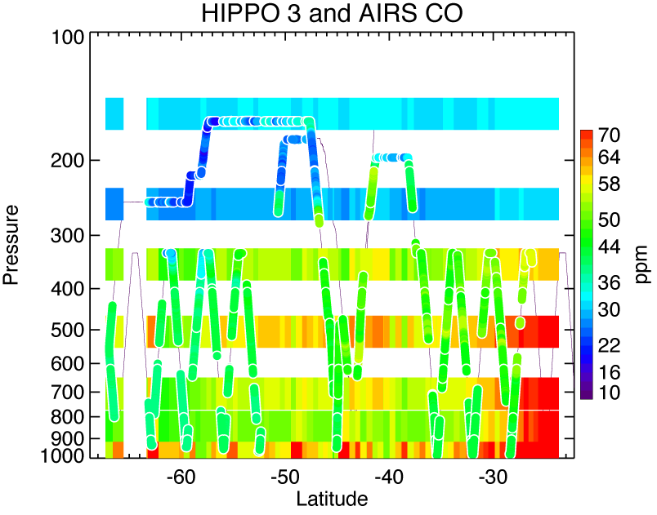
Southern Hemisphere CO during HIPPO3 (April 3-10, 2010)

