Slide 1
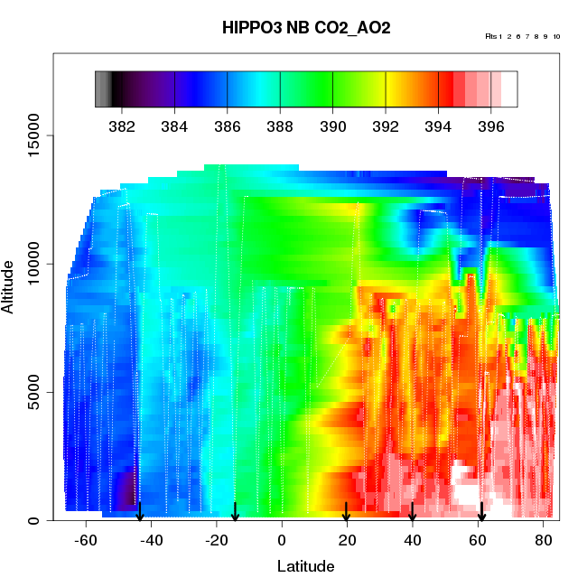
HIPPO1-3 Large-Scale CO₂ Gradients
(“scientific Issue #1“ in original HIPPO proposal )

Slide 2
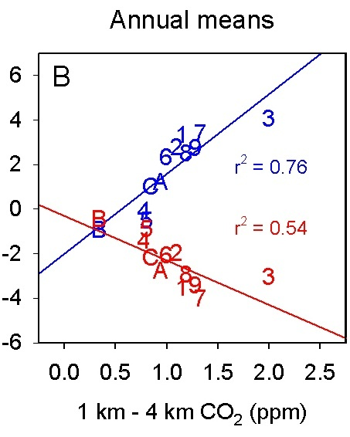
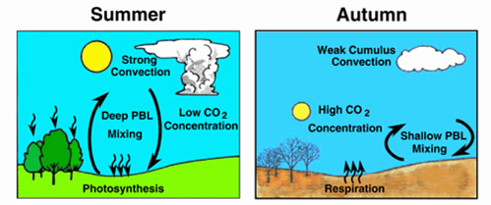
Tropical and Northern Land Fluxes
The 12 TransCom3 models disagree by up to 5 PgCyr⁻¹ on the distribution of global carbon fluxes and the transport of CO₂ through the atmosphere, owing to biases in atmospheric CO₂ transport
[Stephens et al., 2007]
[figure courtesy of Scott Denning]

Slide 3
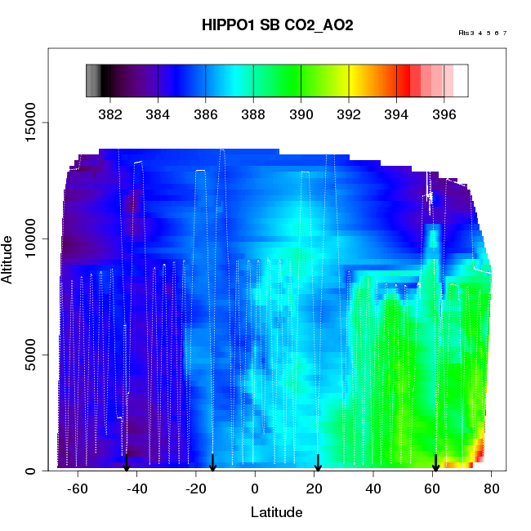
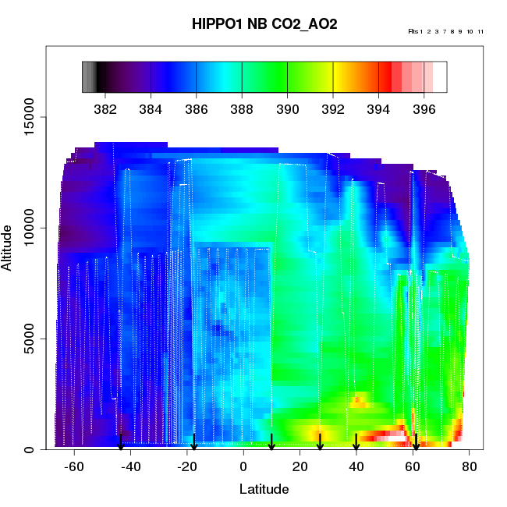
HIPPO1 CO₂ Slices, 2009
Early January (southbound)
Late January (northbound)

Slide 4
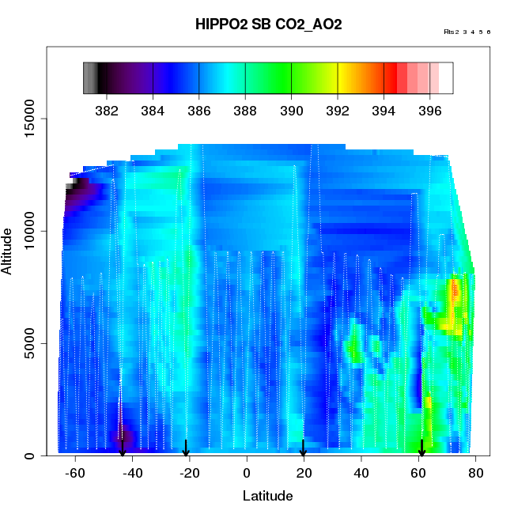
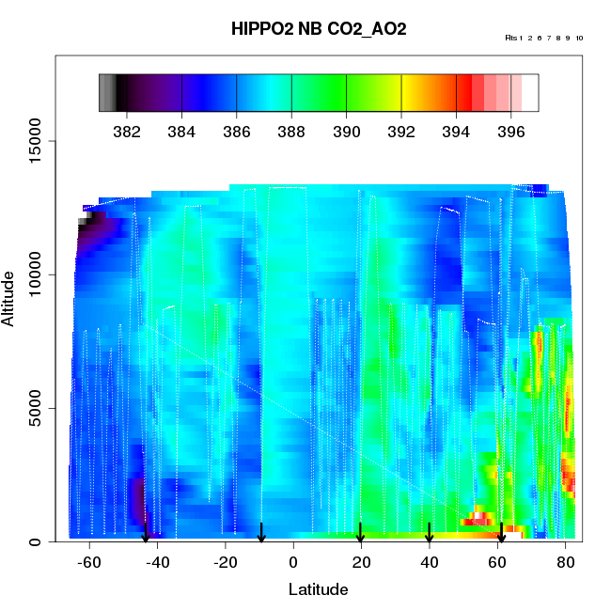
HIPPO2 CO₂ Slices, 2009
Early November (southbound)
Late November (northbound)

Slide 5
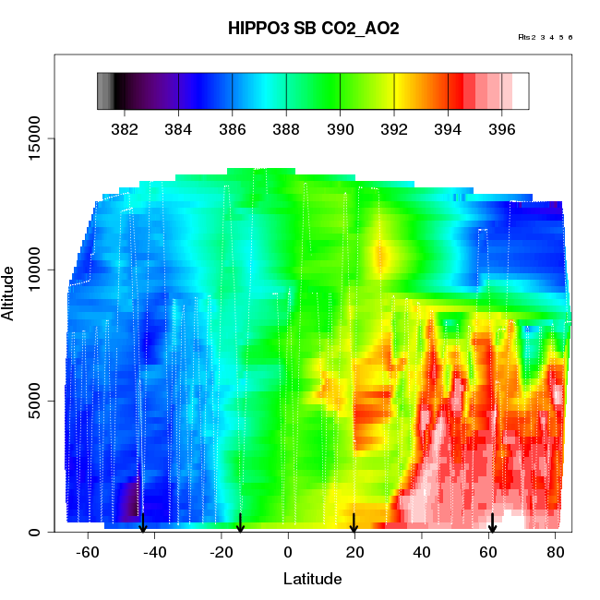
HIPPO3 CO₂ Slices, 2010
Late March (southbound)
Early April (northbound)

Slide 6
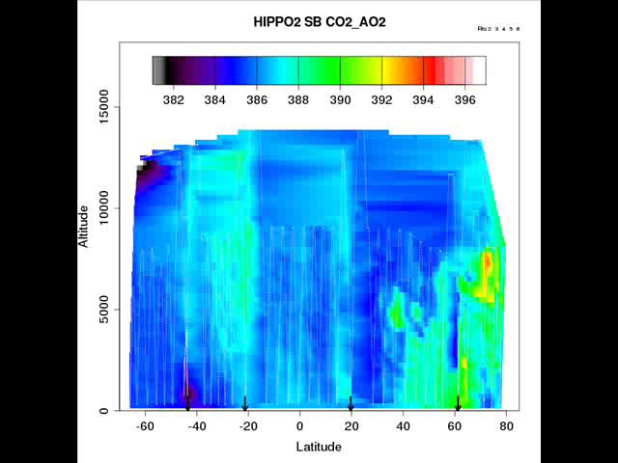
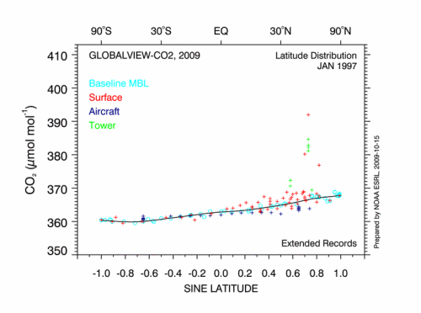
Slices in seasonal order (November – April)

Slide 7
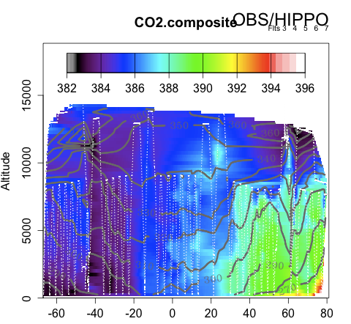
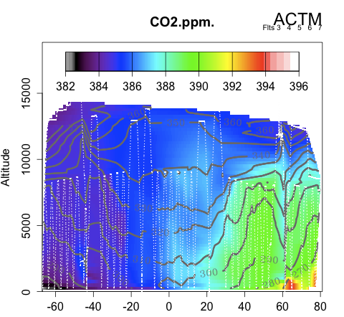
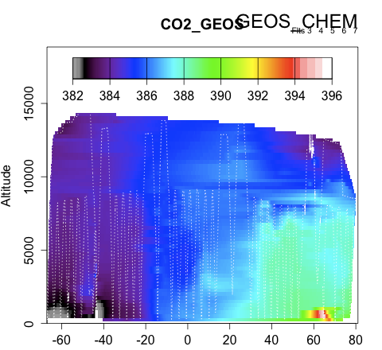
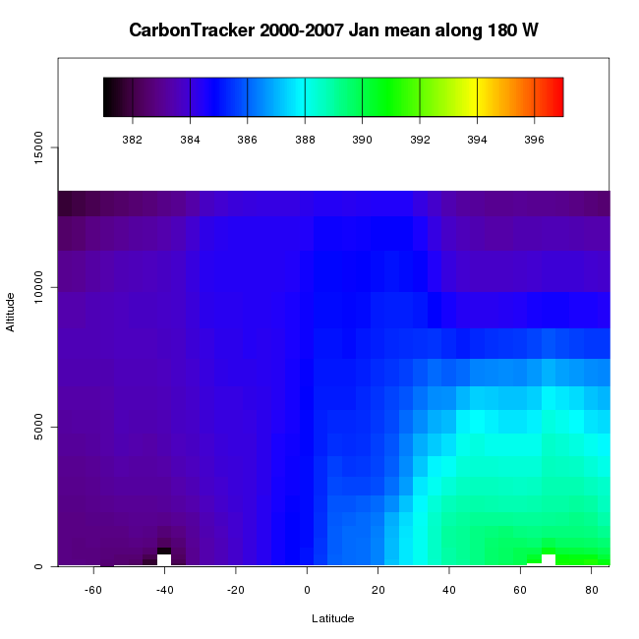
Preliminary CO₂ model comparisons for HIPPO1

Slide 8
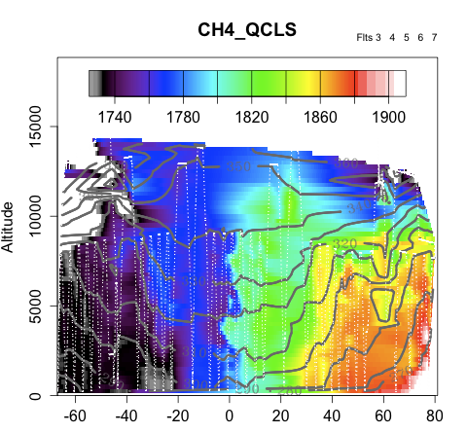
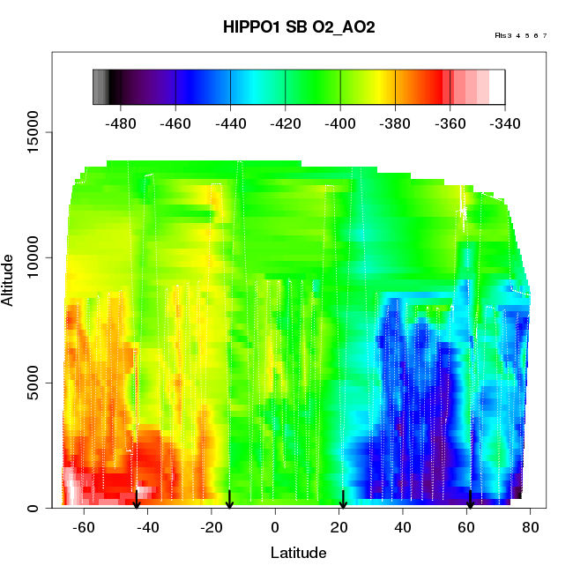
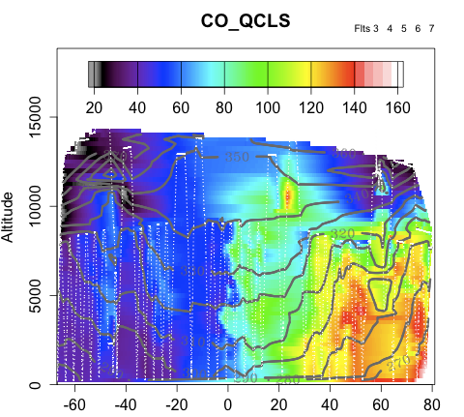
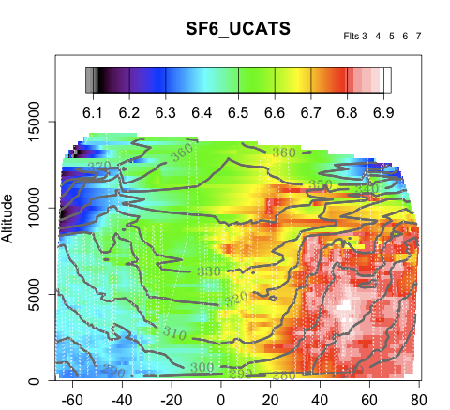
Other species provide key complementary information
Notes:
isentropes….differences and similarities in structure

Slide 9
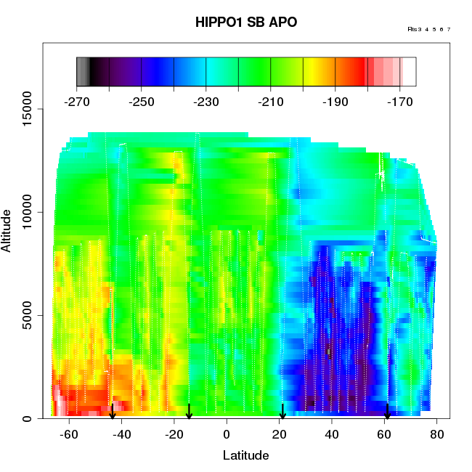
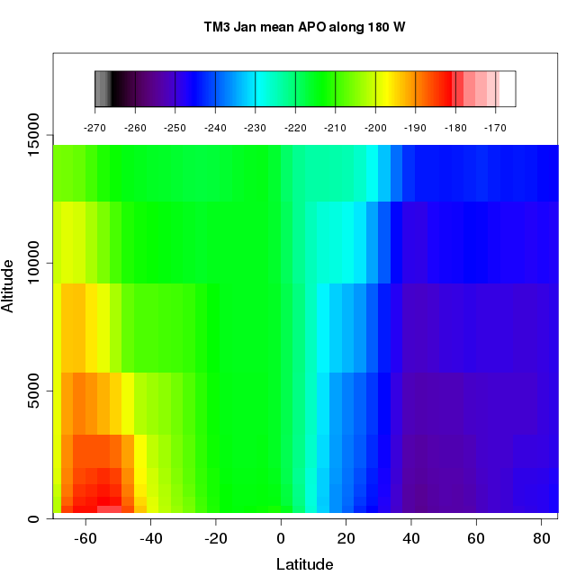
Preliminary APO model comparisons for HIPPO1
January Mean APO from Climatological fluxes in TM3
HIPPO1 APO Observations
per meg
Atmospheric Potential Oxygen:
APO = O₂ + 1.1*CO₂
Fluxes:
Mean ocean O₂: Gruber et al., 2001
Seasonal ocean O₂ and N₂: Garcia and Keeling, 2001
Mean ocean N₂: Gloor et al., 2001
Seasonal + mean ocean CO₂: Takahashi et al., 2009
Fossil-fuel CO₂ and O₂: CDIAC

Slide 10
Conclusions
HIPPO campaigns are defining large-scale gradients in CO₂ and other species, and their progression through the seasons with unprecedented resolution
These observations have the potential to resolve on the order of 5 billion of tons of carbon flux uncertainty (20 billion tons CO₂)
HIPPO4 and HIPPO5 campaigns in NH summer are crucial for constraining annual mean fluxes

Slide 12
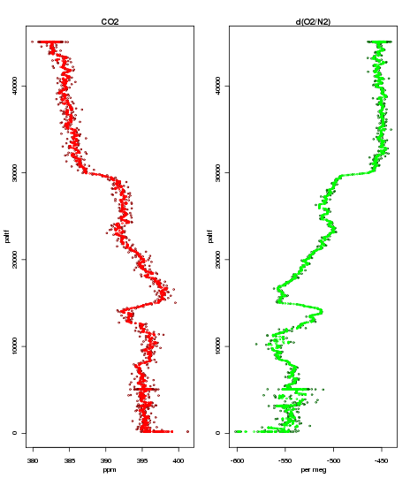
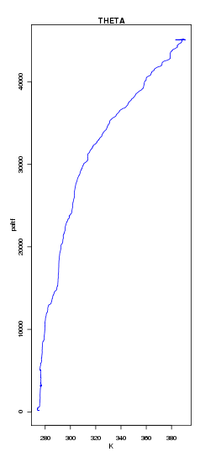
HIPPO 3 AO2 Profiles at 65 N

Slide 13
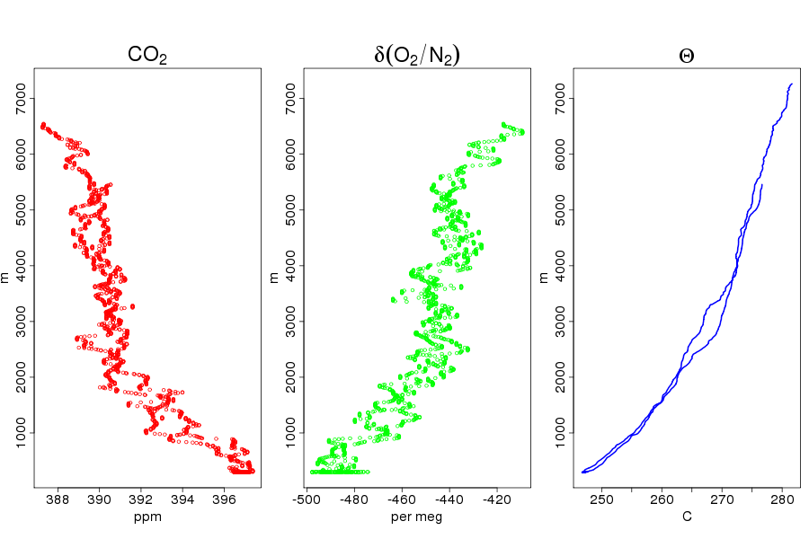
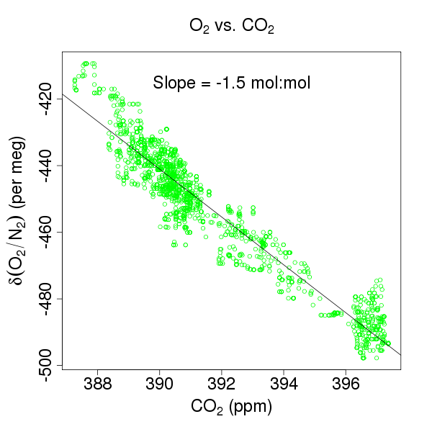
HIPPO1 AO2 Profiles at 80 N
January 12, 2009

Slide 14
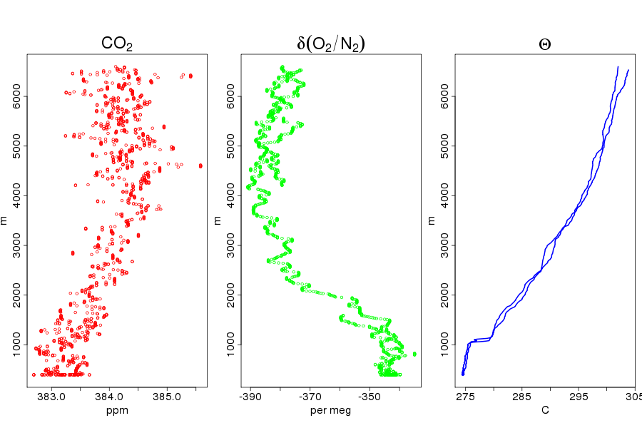
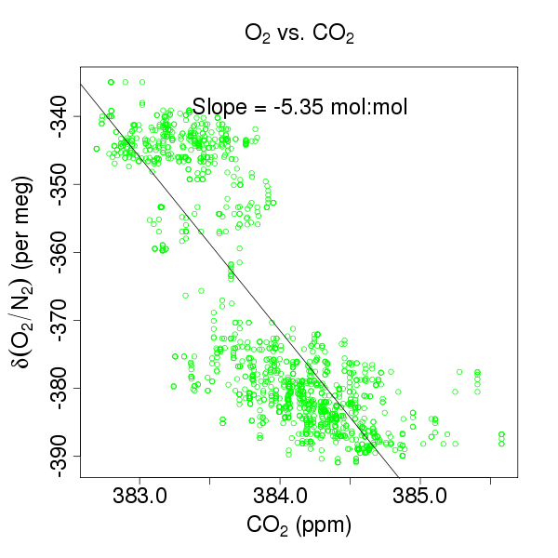
HIPPO1 AO2 Profiles at 65 S
Southern Ocean O₂ outgassing
January 20, 2009

